Slide 1

Neural Networks
Unlocking the Power of Deep Learning

Slide 2



Problem Statement
1) Generate 100 more random samples around each of the existing two classes and then run one of the two NNs with two hidden layers and evaluate the performance.
2) Implement a simple feed-forward neural network model for the loan dataset and then evaluate the performance on a 80/20 split. Exclude irrelevant columns and perform one-hot encoding and normalization of each column, if needed.

Slide 3

Types of Neural Networks
Feedforward Neural Networks
Convolutional Neural Networks (CNNs)
Recurrent Neural Networks (RNNs)
Long Short-Term Memory (LSTM) Networks:

Slide 4
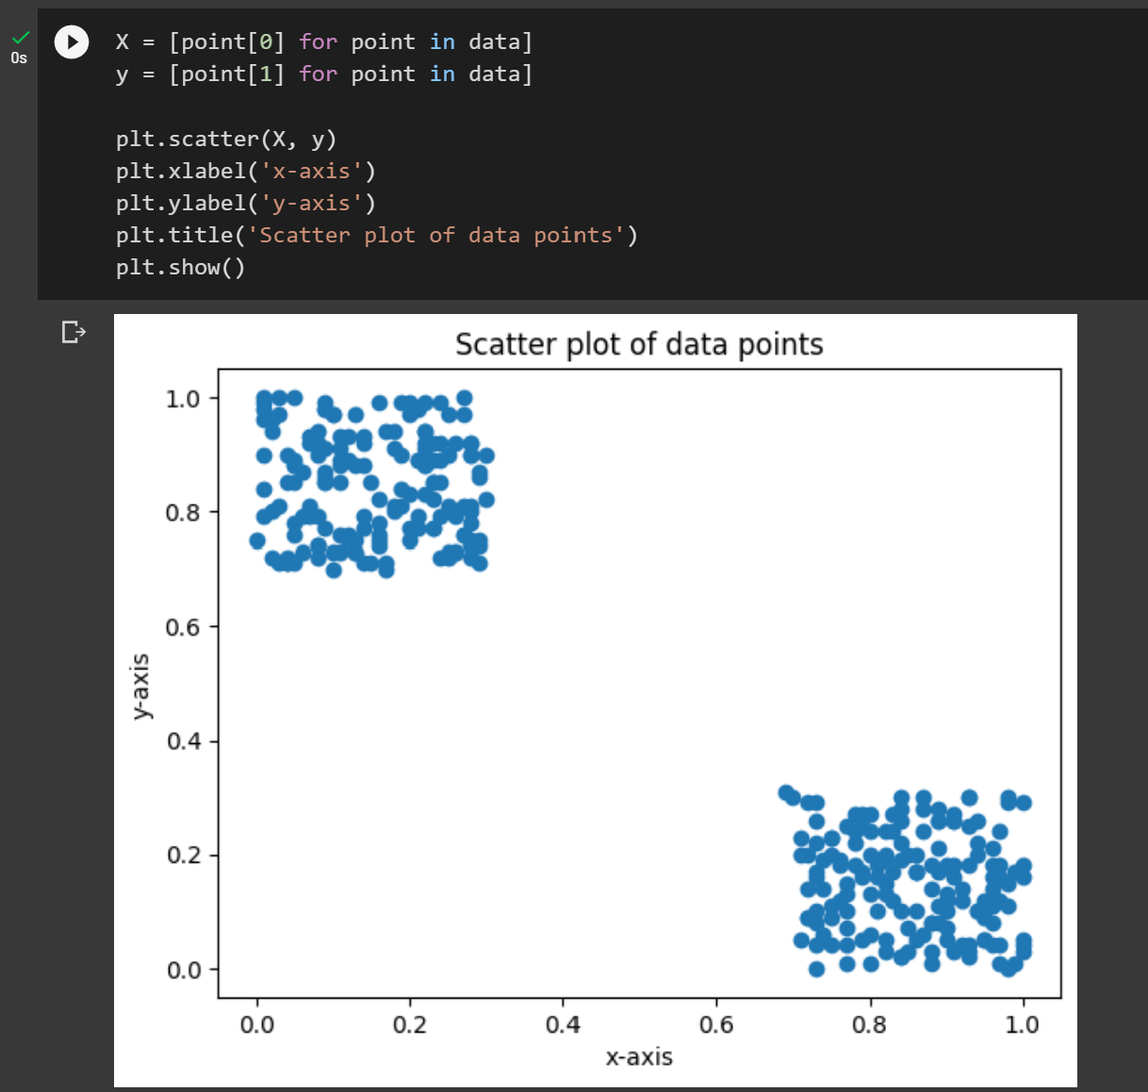
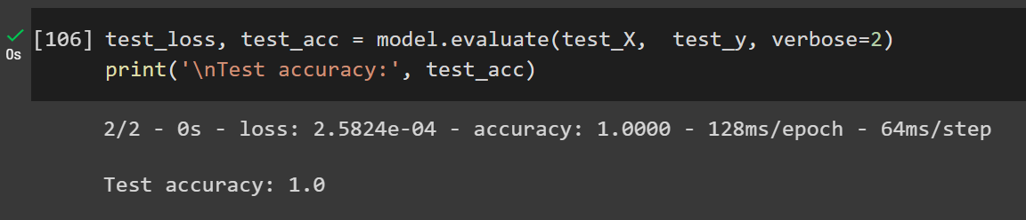
Part A
Generate 100 more samples

Slide 5


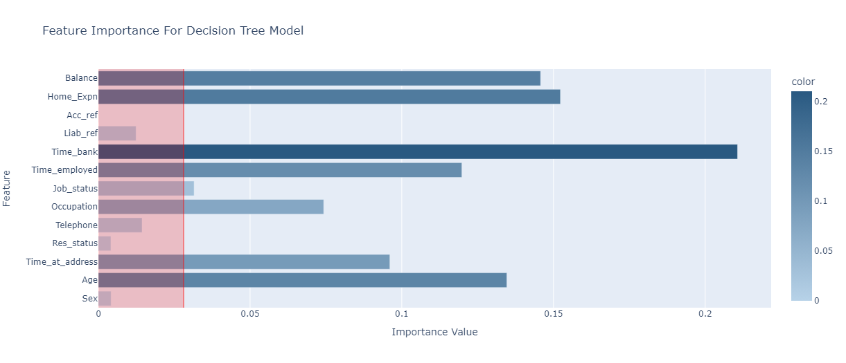
Part B (Loan Dataset)

Slide 6
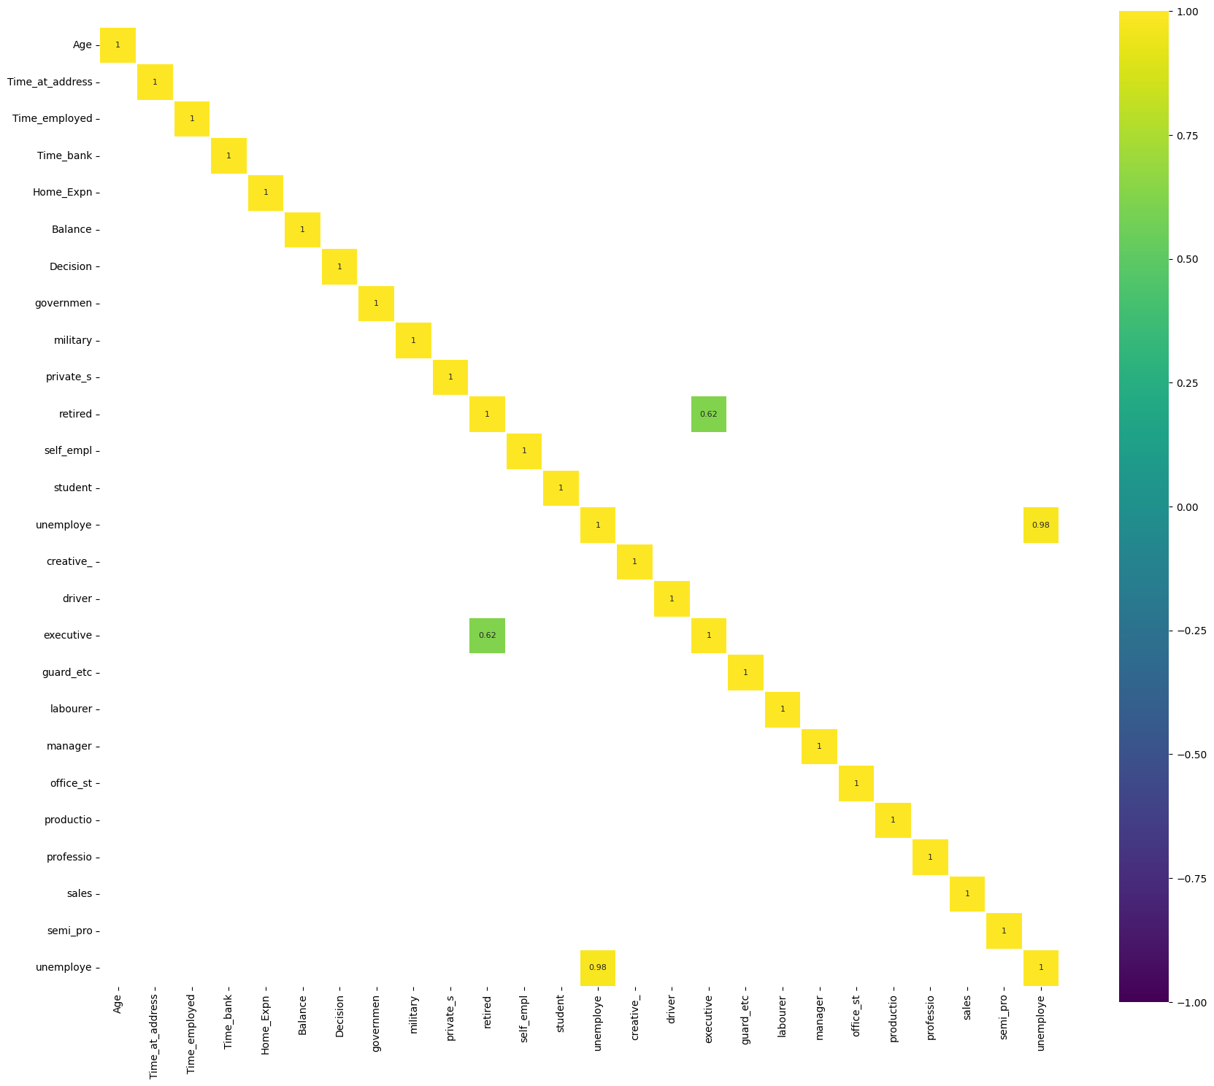
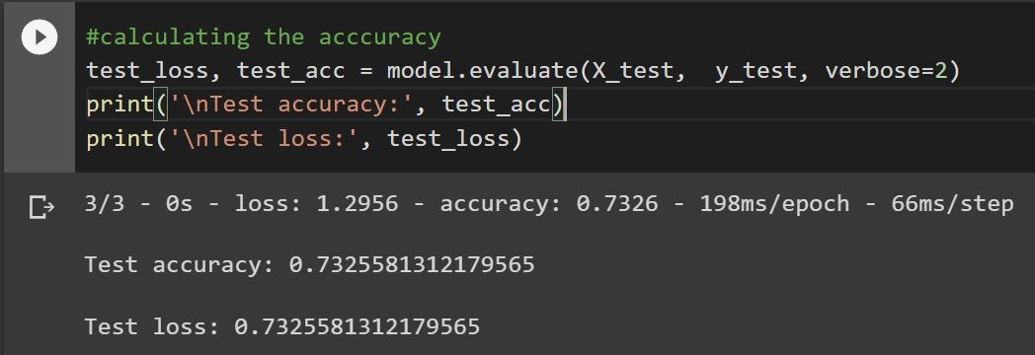
Part B (Loan Dataset)

Slide 7
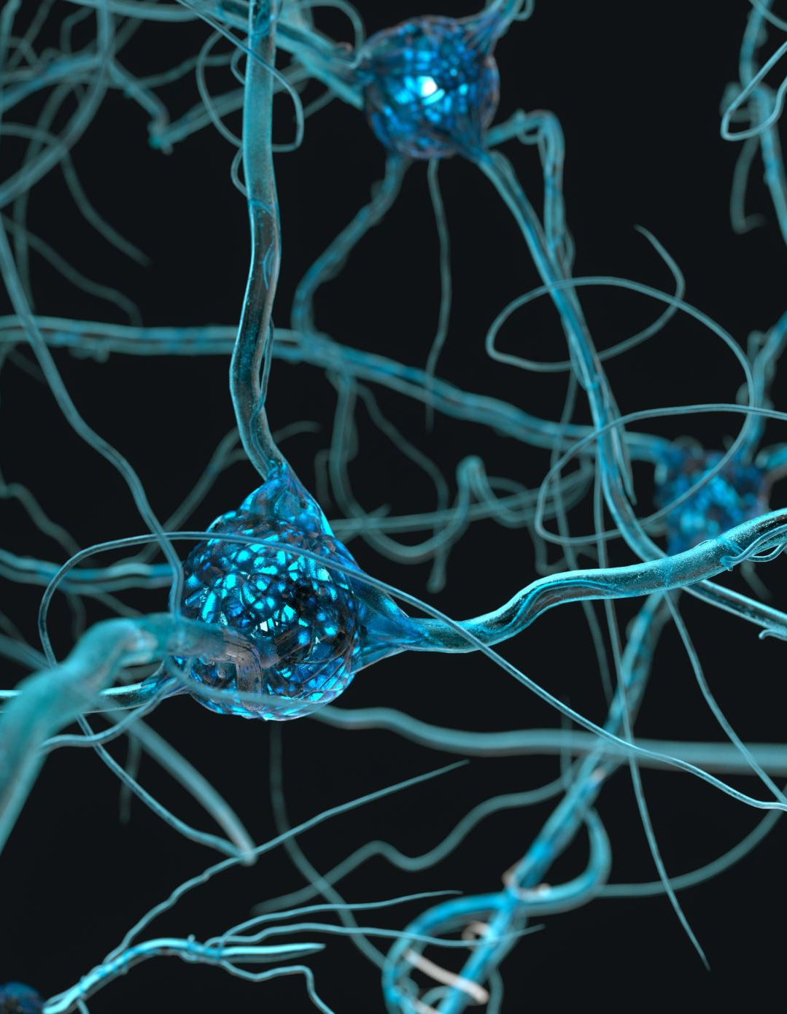
Conclusion
FFNNs are a type of artificial neural network where information flows only in one direction, from input to output layers, without any feedback loops.
FFNNs consist of one or more hidden layers in addition to the input and output layers. Each layer contains a set of neurons that perform computations on the input data.
The neurons in an FFNN are connected by weighted edges, which are updated during training to minimize the difference between predicted and actual outputs.
FFNNs are commonly used for supervised learning tasks, such as classification and regression, where the input-output mapping is known.

