Slide 1
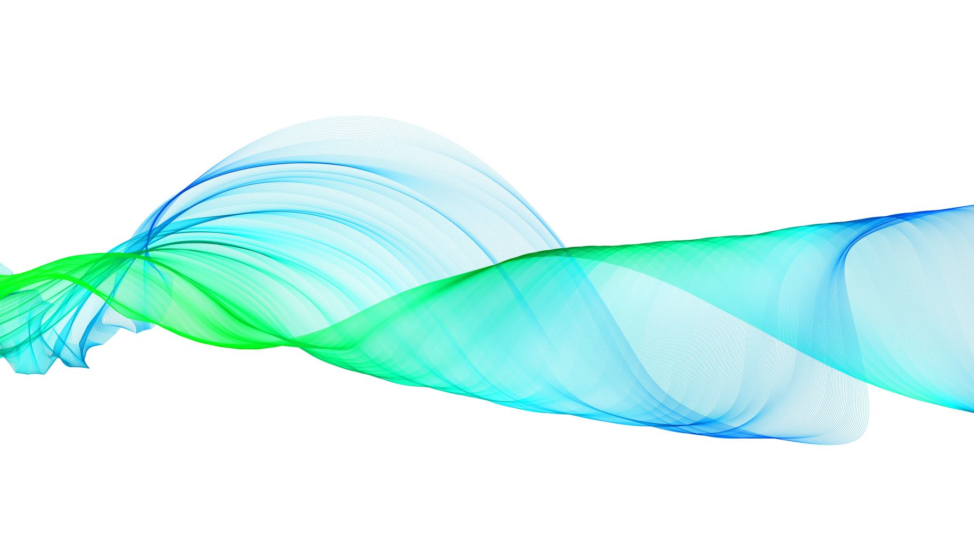
Convolutional Neural Network (CNN)
Turning Images into Insights

Slide 2

Problem Statement
Implement CNN modeling from scratch (using Keras/TF/PyTorch) for classifying CIFAR-10 images.
Evaluate the performance with a 90/10 split.

Slide 3
Convolutional Neural Network
CNNs learn a hierarchy of feature representations from the raw pixel values of an image.
The network consists of convolutional layers, pooling layers, and fully connected layers.
During training, the network adjusts its weights to minimize a loss function that measures the difference between the predicted output and the true output.
CNNs have achieved state-of-the-art performance on many computer vision tasks, such as image recognition, and have potential applications in fields like self-driving cars and personalized medicine.

Slide 4
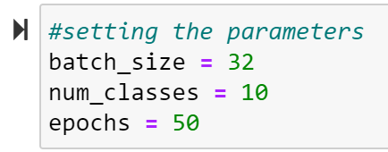
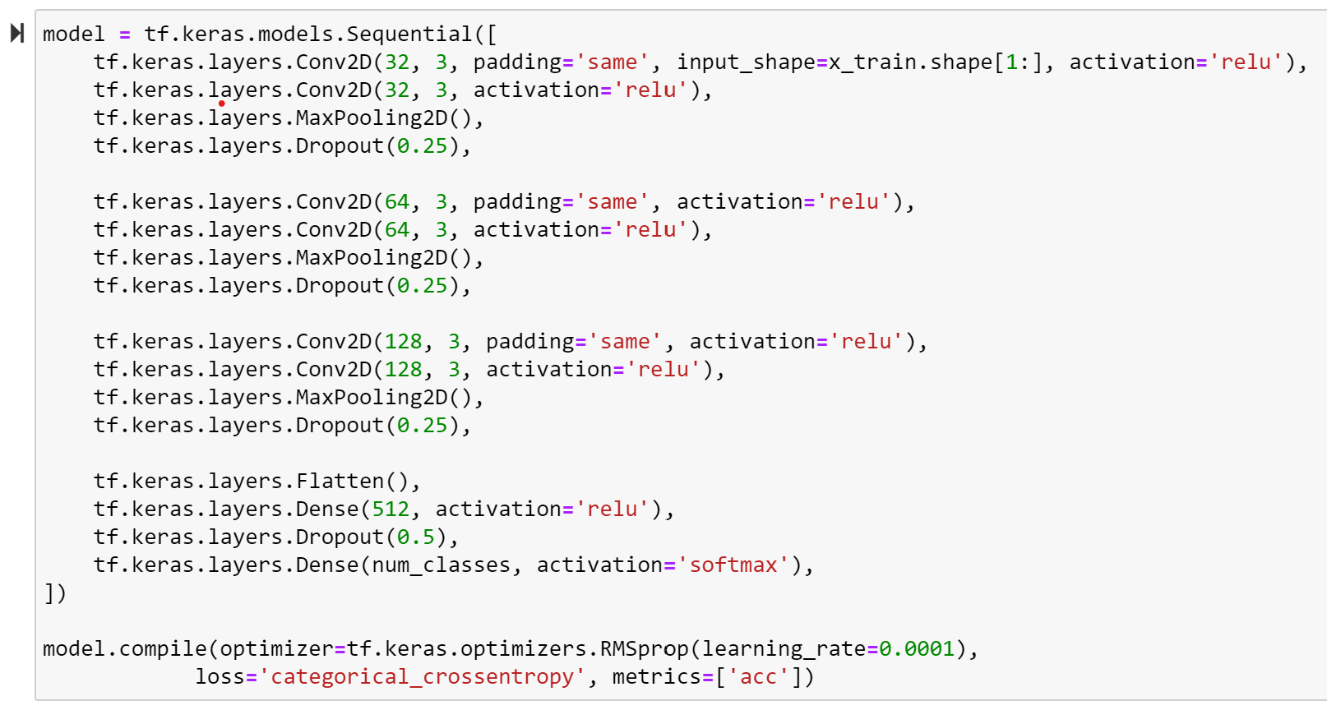
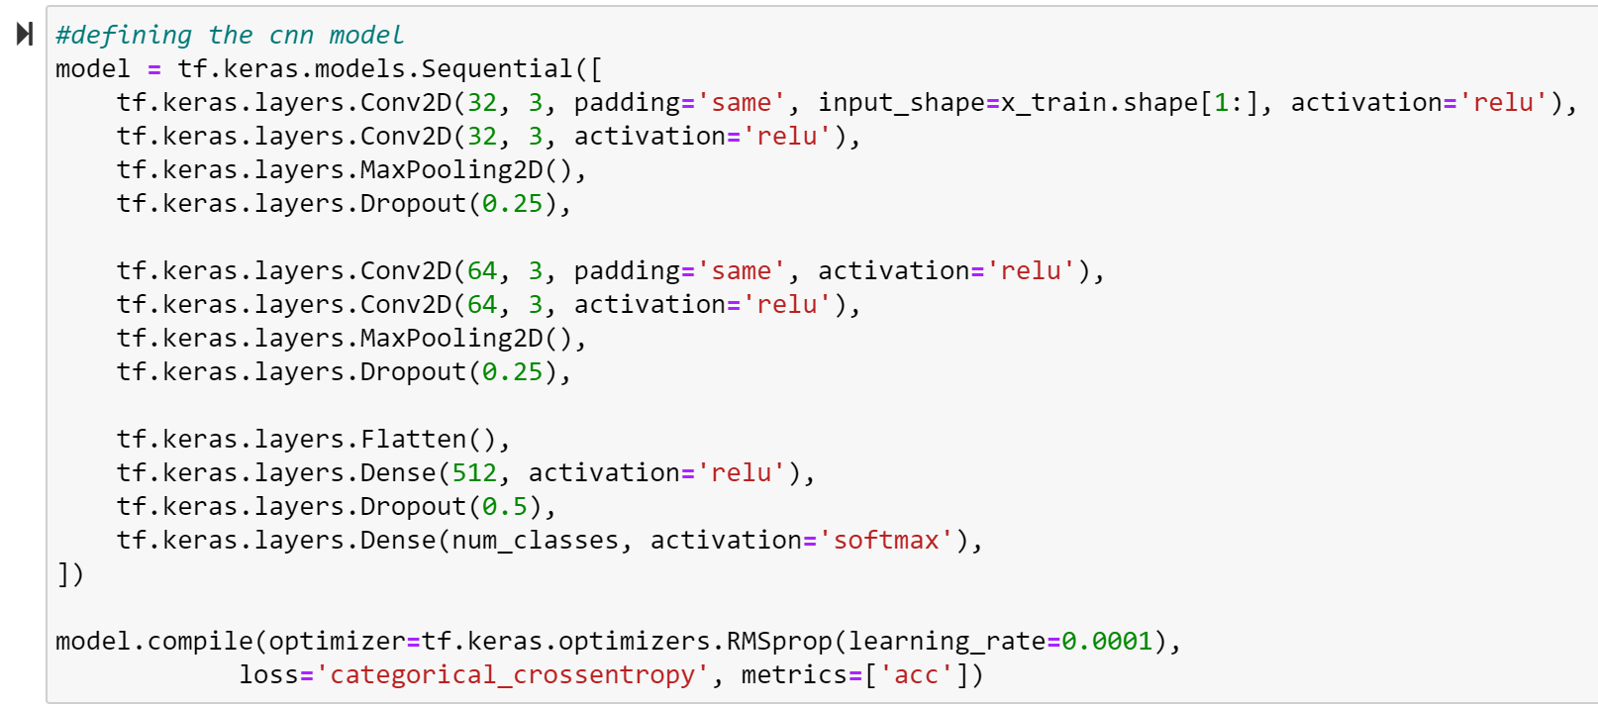
Parameters:
For 2 Layers
For 3 Layers

Slide 5
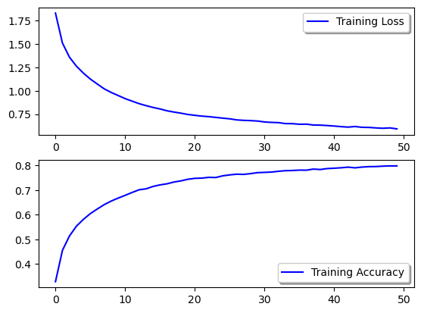
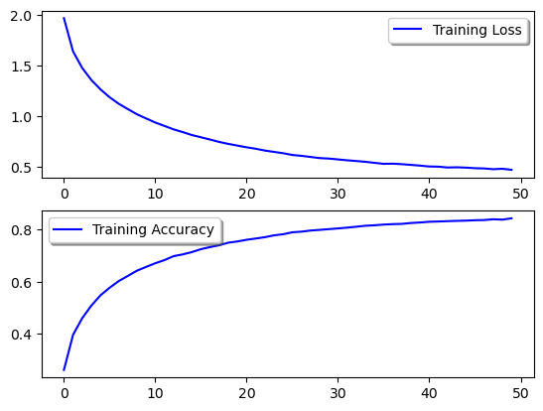
Outcomes
With 2 layers:
Training Accuracy: 0.7879
Training Loss: 0.6192
With 3 layers:
Training Accuracy: 0.8167
Training Loss: 0.5529

Slide 6

Conclusion
CNNs revolutionized computer vision by enabling accurate object recognition and image classification.
CNNs learn features and patterns in images through convolutional and pooling layers.
Pre-trained CNN models can be used as powerful feature extractors and transfer learning models.
Visualization techniques can help us understand how a CNN model is learning and making predictions.

