Slide 1

Naïve Bayes
The Secret Sauce Behind Accurate Text Classification

Slide 2
Problem Statement
Scrape
01
Scrape about 10,000 reviews on any product of your choice
Label
02
Label review as negative if its rating is 1 or 2, positive if its rating is 4 or 5
Build
03
Build an NBC classifier and Evaluate the performance with 80/20 split
Apply
04
Apply tokenization and stemming for preparing the textual reviews

Slide 3

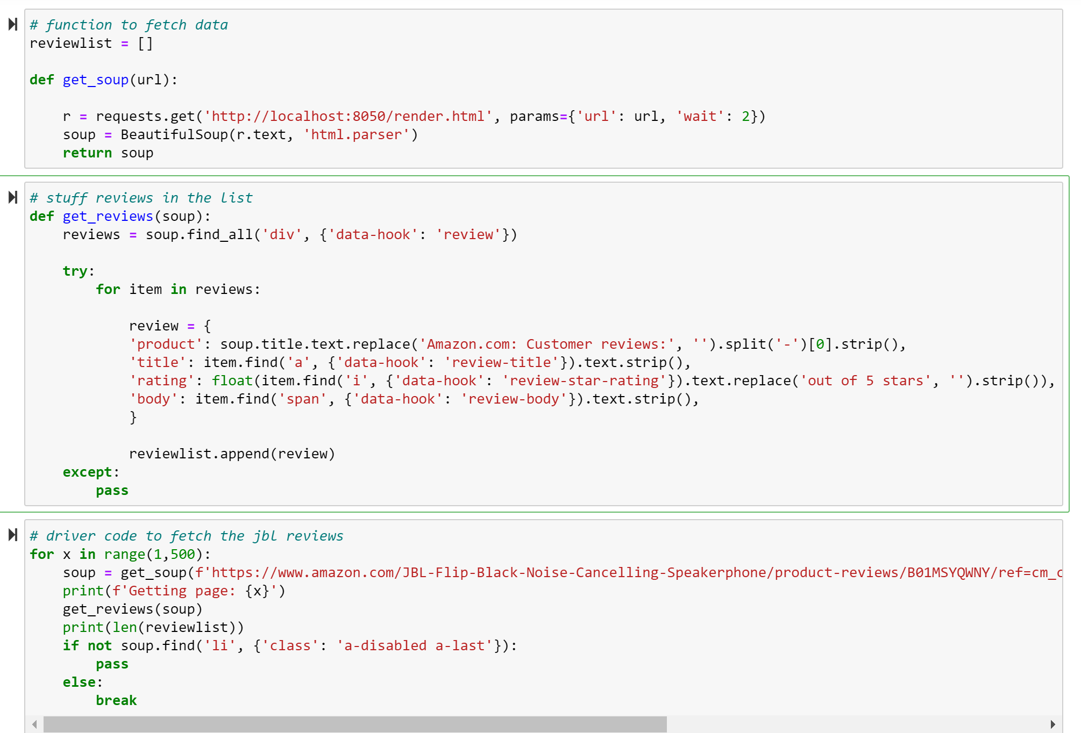
Web Scraping
Web scraping is the process of extracting data from websites using automated software or tools.
We have used Beautiful Soup to scrape about 5k reviews on JBL-Flip-Black-Noise-Cancelling-Speakerphone

Slide 4

Naïve Bayes Classifier
Probabilistic machine learning algorithm used for classification tasks, such as text classification, spam filtering, and sentiment analysis.
The NBC works by calculating the probability of each class (e.g., positive or negative sentiment) given the features

Slide 5
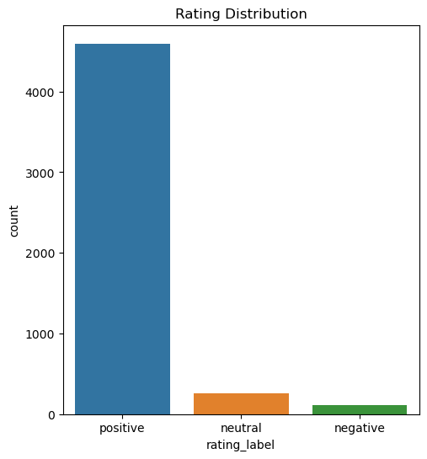
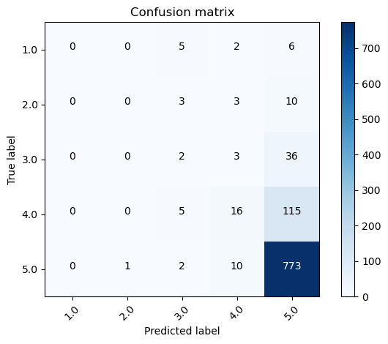
Results
Accuracy: 79.74 %
Precision: 72.1 %
Recall: 79.74 %
F1-score: 73.84 %

Slide 6

Conclusion
Naive Bayes is an efficient machine learning algorithm for text data.
Web scraping extracts data from websites for research, monitoring, and feedback.
Naive Bayes and web scraping combine for valuable insights, like classifying customer reviews.
Ethical considerations and proper cleaning are essential for web scraping and Naive Bayes analysis

