Slide 1

DA 204o: Data Science in Practice Course Project Presentation Credit Card Fraud Detection
Rahul Varna, IISc., rahulvarna@iisc.ac.in
Vikash Kumar, IISc., vikashkumar3@iisc.ac.in
Aditya Prasad, IISc., adityaprasa1@iisc.ac.in

Slide 2
Data Science Canvas |  |  | Project: | Credit Card Fraud Detection
 |  |  | Team: | Aditya Prasad, Rahul Varna, Vikash Kumar
Problem Statement |  |  |  | Execution & Evaluation |  | Data Collection & Preparation
Business Case & Value Added Which business case should be analyzed and what added value does it generate? Credit Card Fraud Detection It adds the value that the financial loss of the consumer and the company can be minimized | Model Selection Which analysis methods can be considered on the basis of the specific data landscape and the business case? - Logistic Regression - Decision Trees - Random Forest - Gradient Boost | Model Requirements Which model requirements must be complied with in order to obtain a valid model? - Extensive Data Analysis must be performed to remove outliners & covariance among features - Based on the quantum of the data model parameters needs to be estimated for model to not overfit or underfit - Model needs to be trained for higher epochs & accuracy must be checked on validation dataset after few epochs. | Skills What skills are needed to provide the data and model development? - Data Science hands on learning with some examples | Model Evaluation Which indicators require quality control and validation and how should they be interpreted? Is real-time monitoring necessary? - Training and testing accuracy percentage, Precision, Recall, F1 score, Accuracy matrices Confusion Matrix - If training accuracy is low, then it is underfitting - If training accuracy is too good but testing accuracy is low, then it is overfitting - Interpretation of Precision Recall and F1 Scores are as per their definitions - Real time monitoring can be done. But the data we have has been split into training and testing part and then the validation has been done which does not do real time analysis. | Data Storytelling What requirements does the target group have for the presentation of the results and how do I effectively communicate this data? - The target group would be the consumers and the Credit Card Company - For consumer, the only info he/she is needed is “Should the current transaction be treated to be legitimate and be allowed to be processed?” This data can be presented in textual manner and response can be gathered in YES/NO. - For Credit Card Company, they need 1) If the current data is classified as fraudulent? 2) The Monthly report for such data in a visual manner. To effectively communicate it, different charts and graphs can be used to show the % and trend of such transactions. | Data Selection & Cleansing Which of the available data is relevant? Do the data have to be cleaned up? - The available dataset from Kaggle website is relevant. It need to be cleaned up little. | Data Collection How and with which methods should additionally required data be collected? What properties has this data to fulfil? - No additional Data is needed
Data Landscape Which data is required for this and which is already available? Which additional data has to be collected? - Credit Card Transaction details are needed and it is already available on the Kaggle website. - No additional data need to be collected. |  | Software & Libraries Which software should be used? Is there already a standard solution? Which libraries are used? - Python, pandas, sklearn, matplotlib, seaborn, dataprep, imbalanced-laern - Solution is available on the Kaggle itself, but we plan not to get biased with that. |  |  |  | Data Integration In which system should the data from different sources be migrated? - Google Drive as Colab need to be used because of high memory requirement. | Explorative Data Analysis Are there outliers or structures to be considered? Creation of descriptive key figures for the first assessment of the data. - There are no outliers. The EDA is present in the .ipynb file
Adopted from: https://github.com/tomalytics/datasciencecanvas

Slide 3
Problem Definition
Objectives of the project
Credit Card Fraud Detection on the Kaggle Dataset.
Why is it important?
Because fraudulent transactions are big financial risk for the Consumers as well as Credit Card Companies itself.
It is in best interest for the consumer and company to identify such transaction in timely and accurate manners.
Data source: https://www.kaggle.com/datasets/priyamchoksi/credit-card-transactions-dataset
Description of the data (features, 337 MB, Tabular)
Features:
['Unnamed: 0', 'trans_date_trans_time', 'cc_num', 'merchant', 'category’, 'amt', 'first', 'last', 'gender', 'street', 'city', 'state', 'zip', 'lat', 'long', 'city_pop', 'job', 'dob', 'trans_num', 'unix_time', 'merch_lat', 'merch_long', 'is_fraud', 'merch_zipcode’]
The following python libraries are used for the project
pandas
seaborn
Dataprep
imbalanced-learn
matplotlib
sklearn
The project was originally developed and executed on Google Colab owing to higher memory requirement and later the necessary.ipynb files were uploaded the github link adityaprasa1/credit_card_fraud_detection for the repository management.

Slide 4
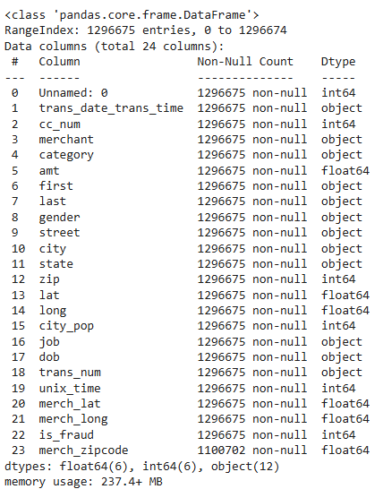
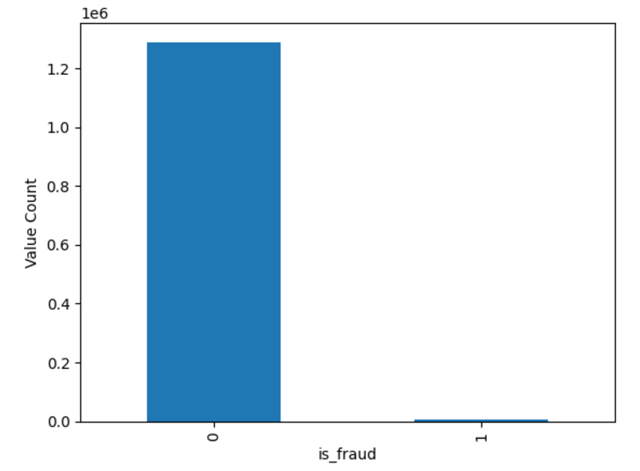
Data Exploration
EDA - General & Uni-variate Analysis
For the EDA, it was done in 4 parts:
General Analysis
Uni-variate Analysis
Bi-Variate Analysis
Multi-variate Analysis
General Analysis
How many features are there in the dataset - 24
What are the types of each feature -> See table right
Statistical description of the data in the dataframe
How many entries are there -1296675
How many null values are there and in which features – 195973 in merch_zipcode
If there are duplicated values in a feature or not - No
Univariate Analysis
How many total fraudulent transactions are in the dataframe – 7506 count
Also, what % of data of this of the entire dataframe is fraudulent transactions – 0.578%
Is the class imbalanced - Yes
Count of Fraud Transaction

Slide 5
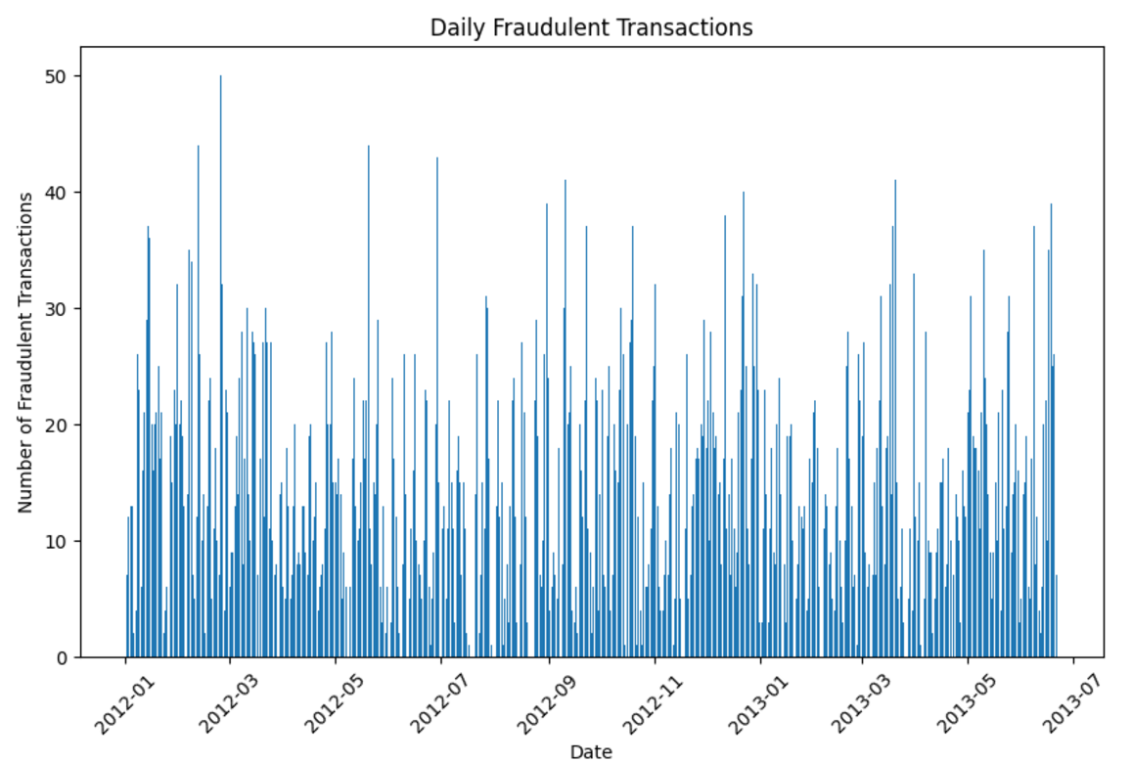
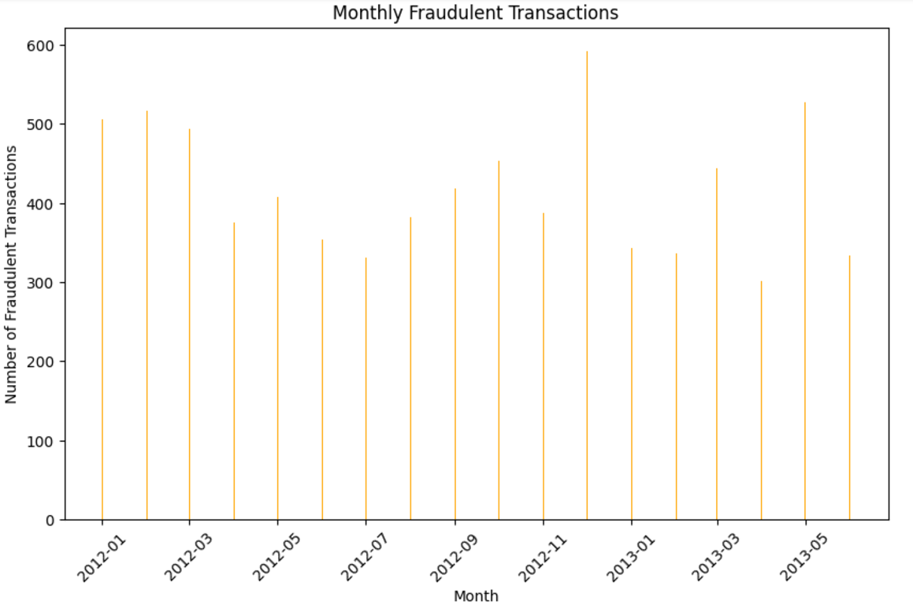
EDA - Bi-variate Analysis
Daily fraudulent transaction analysis -- to see if the there is any particular timeframe which affects such transactions - There is no relation observed between day and fraud transactions.
Monthly fraudulent transaction analysis – We have 18 months transaction data and there is no relation observed for fraud transaction happening each month

Slide 6
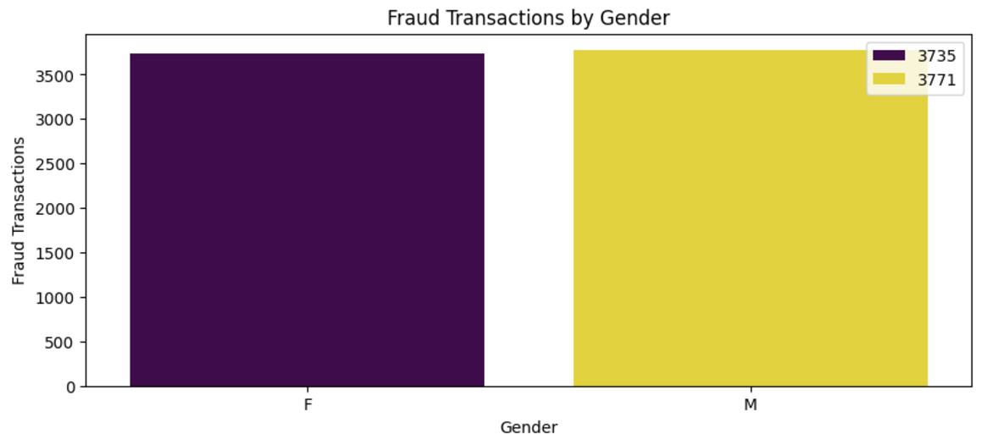
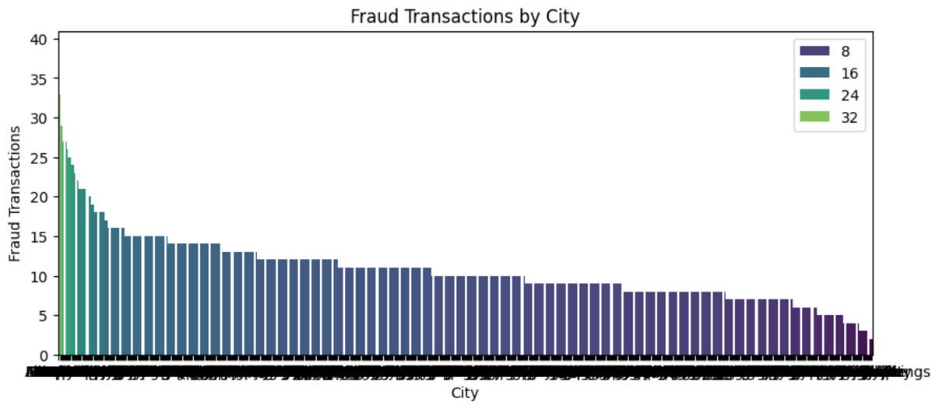
EDA - Bi-variate Analysis (contd…)
Fraud transactions based on the customer details – We do not observe such transactions dependent on customer gender
Fraud transactions based on the city – Some cities have more such transactions than other

Slide 7
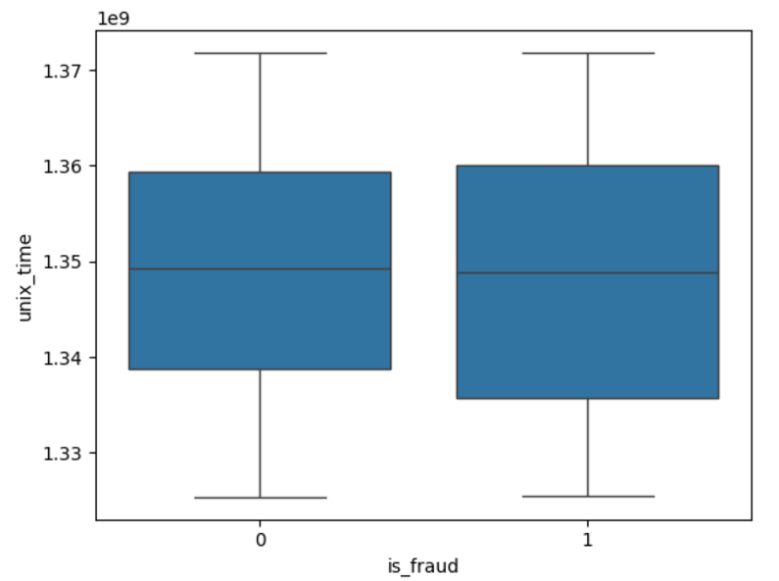
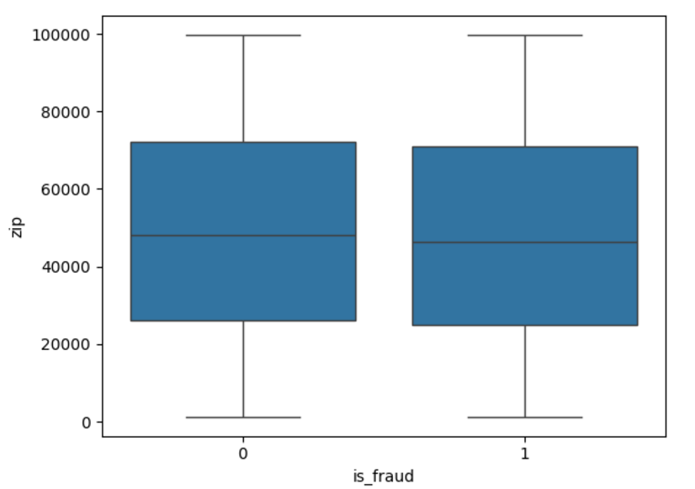
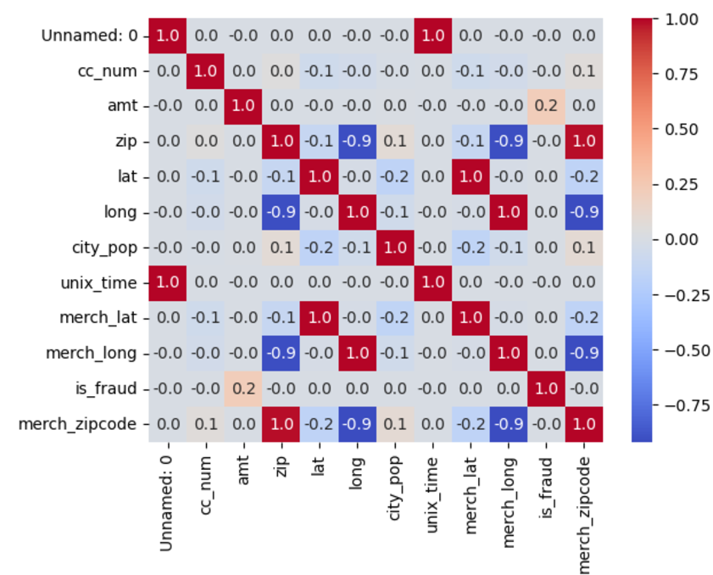
Data Exploration
EDA - Bi-variate Analysis (contd…)
If there is any outlier - No
Correlations between attributes – Some of the attributes are correlated
Box-plot for Fraud Transactions with unix_time
Box-plot for Fraud Transactions with zip code

Slide 8
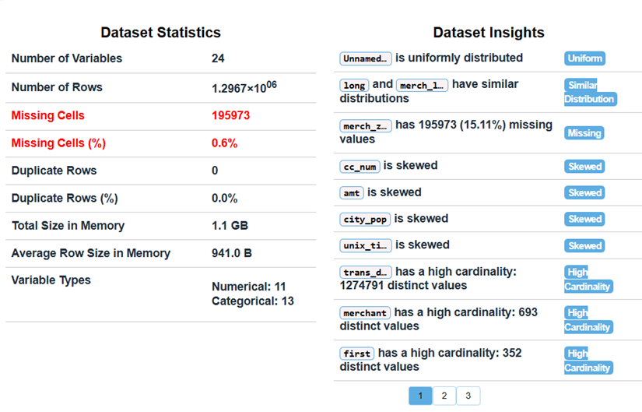
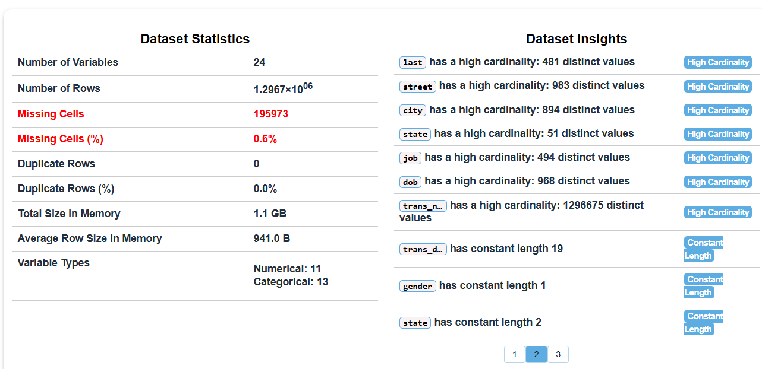
Data Exploration
EDA - Multi-variate Analysis
It was done using the dataprep python library.
It generated lot more data to be analyzed but only overview from that is captured in this presentation.

Slide 9
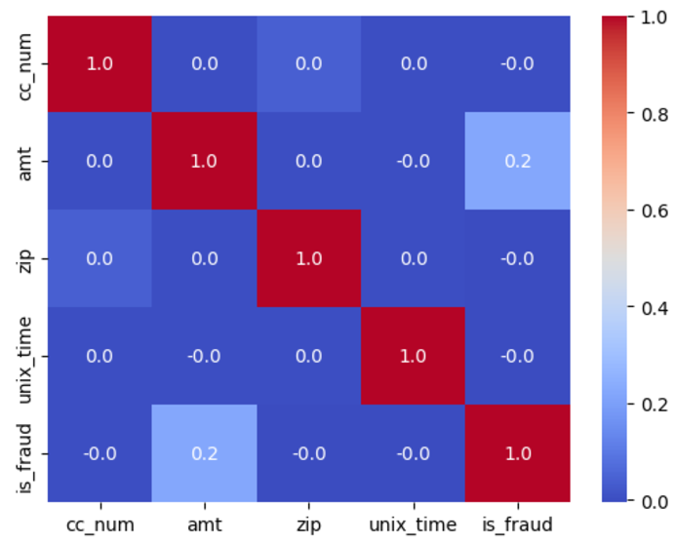
Data Modelling
Data Pre-processing
After EDA, all the columns which were not affecting the data modelling, were dropped.
The remaining columns were: 'cc_num', 'merchant', 'category', 'amt', 'zip', 'unix_time', 'is_fraud'
And now this is the new correlation matrix with almost no correlation value

Slide 10
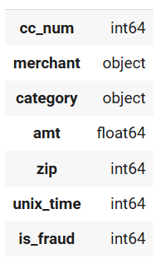
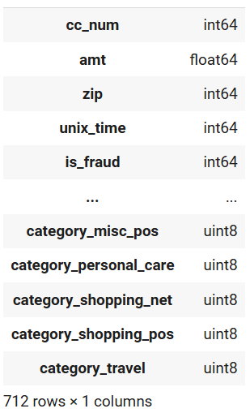
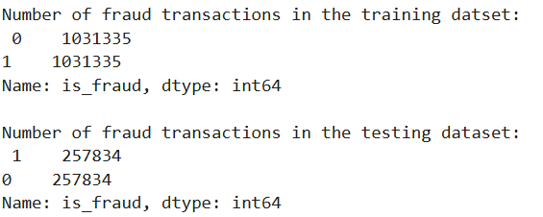
Data Modelling
Data Pre-processing (contd…)
All the categorical data types were also converted into numerical values using one-hot encoding
And since, the classes were imbalanced, SMOTE was used to make the class balanced.
One-hot Encoding
SMOTE

Slide 11
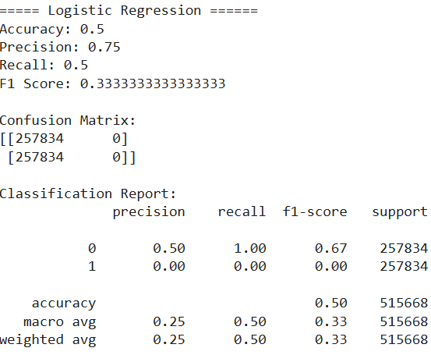
Data Modelling + Inference Phase
Data Modelling
The data modelling was done using below algorithms independently and the Accuracy, Precision, Recall and F1 scores were obtained along with Confusion Matrix:
Logistic Regression
Random Forest Classifier
Random Forest Classifier with PCA
Decision Tree Classifier
Gradient Boost Classifier
K-fold Cross Validation with Random Forest Classification Model
Logistic Regression:
We can see that Logistic Regression is not a good choice for this exercise.
We had also tried Logistic Regression with Kernel PCA. But the issue we faced is the available amount of RAM since KPCA memory requirement grows quadratic of the data points available in the dataset. In our case we have around 1.3M rows and hence it is difficult to work with KPCA

Slide 12
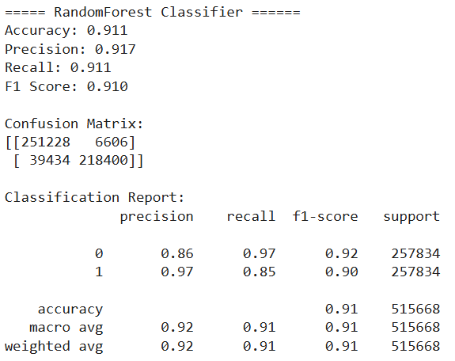
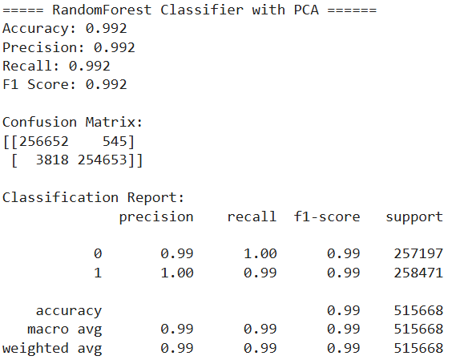
Data Modelling
Random Forest Classifier:
The Type-I and Type-II error with RandomForestClassifier is more with n_estimators=20.
Also, the Precision, Recall, and f-1 scores are okay but not that good.
So RandomForest is somewhat okay
Random Forest Classifier with PCA:
We can see that with same n_estimators=20 and max_depth=20, the RandomForestClassifier with PCA is giving better result compared to standalone RandomForestClassifier.
Type-I error is less
Type-II error is very less

Slide 13
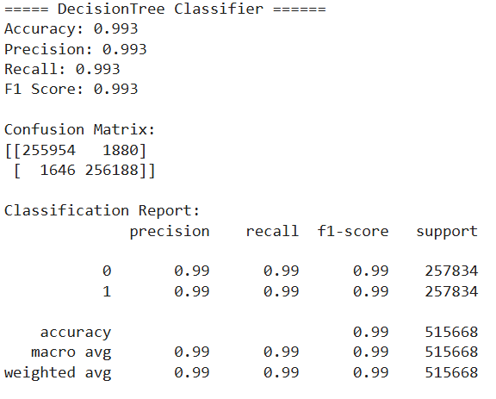
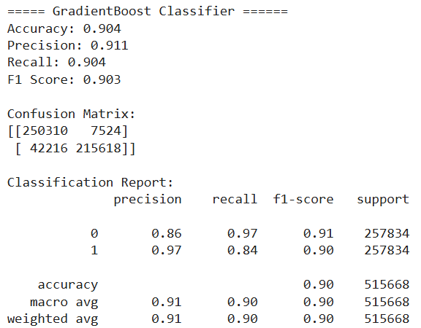
Data Modelling
Decision Tree Classifier:
The type-I and Type-II error with DecisonTreeClassifier is very less (~ 1%).
Type-I error (FP) is less than RandomForestClassifier with PCA
Type-II error (FN) is more than RandomForestClassifier with PCA
Also, the Precision, Recall, and f-1 scores are very good.
Gradient Boost Classifier:
Type-I error (FP) and Type-II error (FN) are more
Also, the Precision, Recall, and f-1 scores are okay but not that good.
K-fold Cross Validation with Random Forest Classification Model:
Cross Validation Accuracy: 0.896 (+/-0.006)

Slide 14
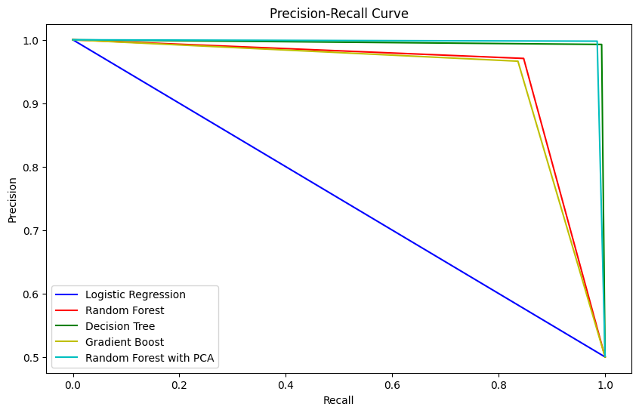
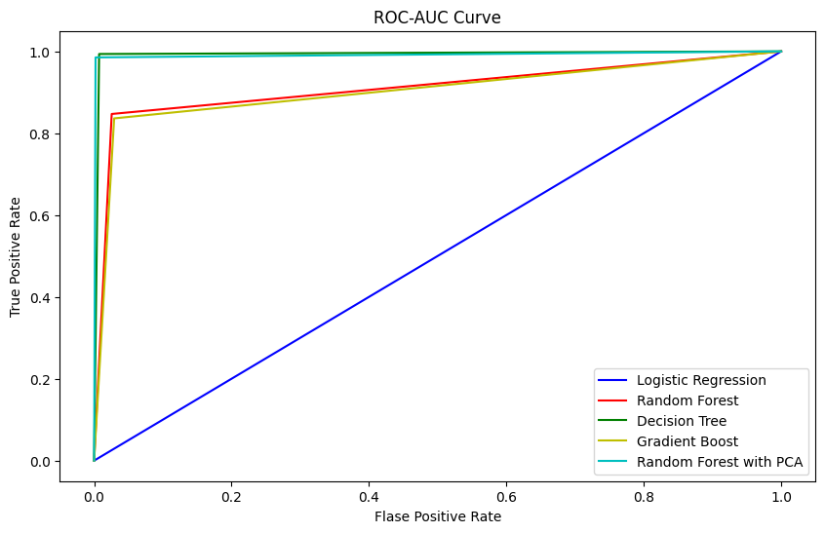
Result Visualization & Conclusion
From these graphs, it can be observed that:
DecisionTree Classifier and RandomForestClassifier with PCA, both are giving best results
RandomForest & GradientBoost are giving similar results
Logistic Regression is not a good choice for this problem as the data may not be linearly separable.

Slide 15
Demo (followed by Q&A)

