Slide 1

HR ANALYTICS PESENTATION
PRESENTED BY
ADITYA NARAYAN PUROHIT
TEAM ID
PTID-CDA-JUNE-26-11174

Slide 2
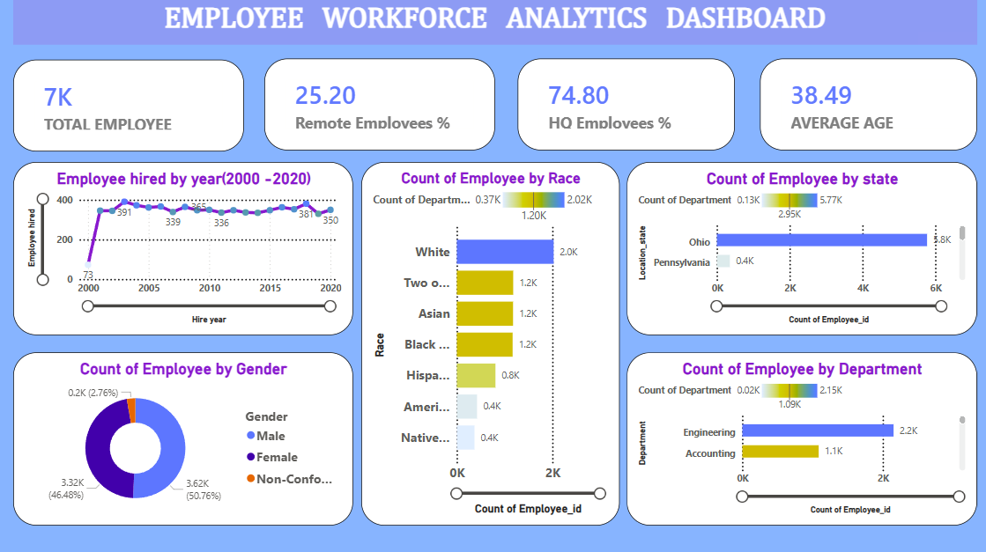

Slide 3
WHAT IS HR ANALYTICS ?
HR Analytics is the process of collecting, organizing, and analyzing employee data to understand workforce trends and improve HR decision-making. It helps organizations track key metrics such as employee count, hiring trends, workforce distribution, diversity, and employee demographics. By transforming raw HR data into meaningful insights, companies can make informed decisions related to recruitment, workforce planning, employee engagement, and overall organizational performance.

Slide 4
HR ANALYTICS BENIFIT
Improved Hiring Decisions
Identify hiring trends
Support data-driven recruitment
Improve talent acquisition strategy
Enhanced Employee Retention
Monitor workforce patterns
Improve employee engagement
Reduce employee turnover
Strategic Workforce Planning
Optimize staffing levels
Improve organizational efficiency

Slide 5
OBJECTIVE OF KPI
Key Performance Indicators (KPIs) are measurable values used to evaluate performance, track progress toward goals, and support data-driven decision-making. They help organizations monitor important activities and identify areas that need improvement.

Slide 6
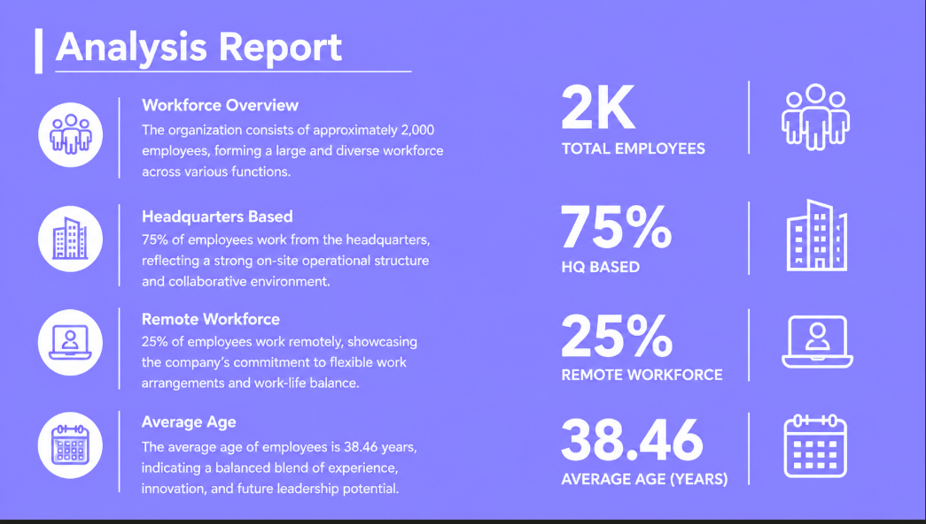

Slide 7
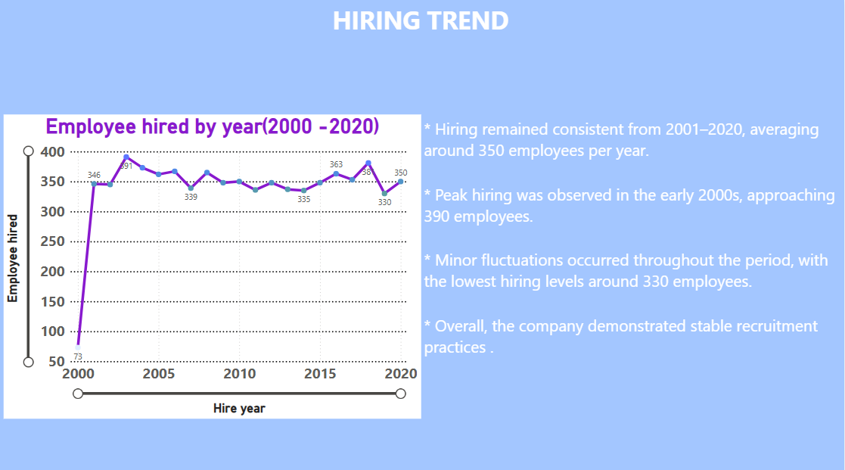

Slide 8
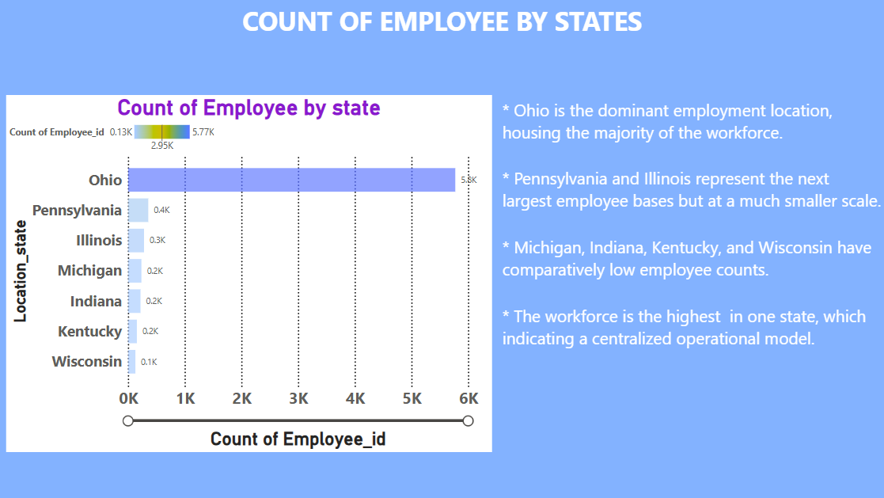

Slide 9
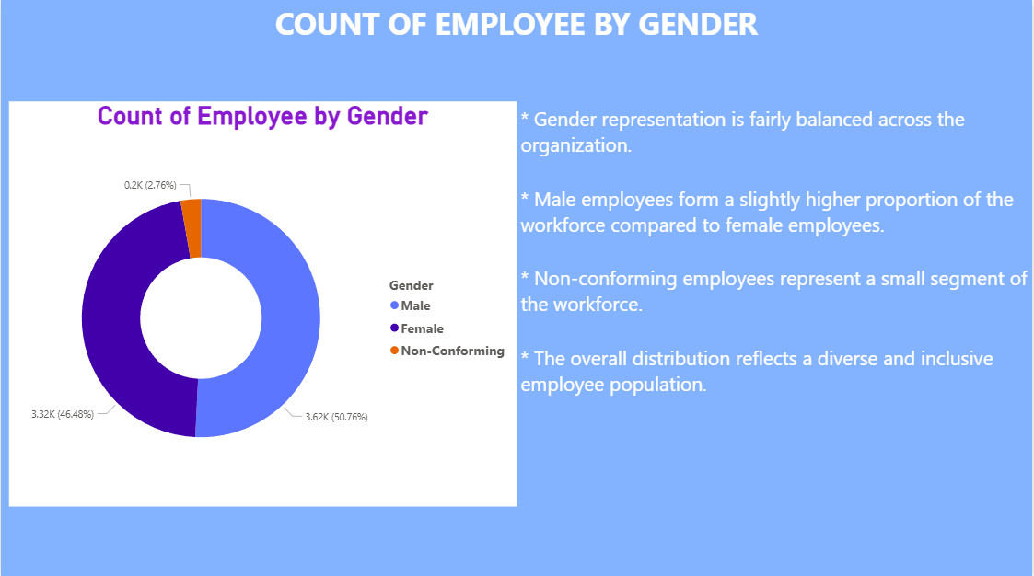

Slide 10
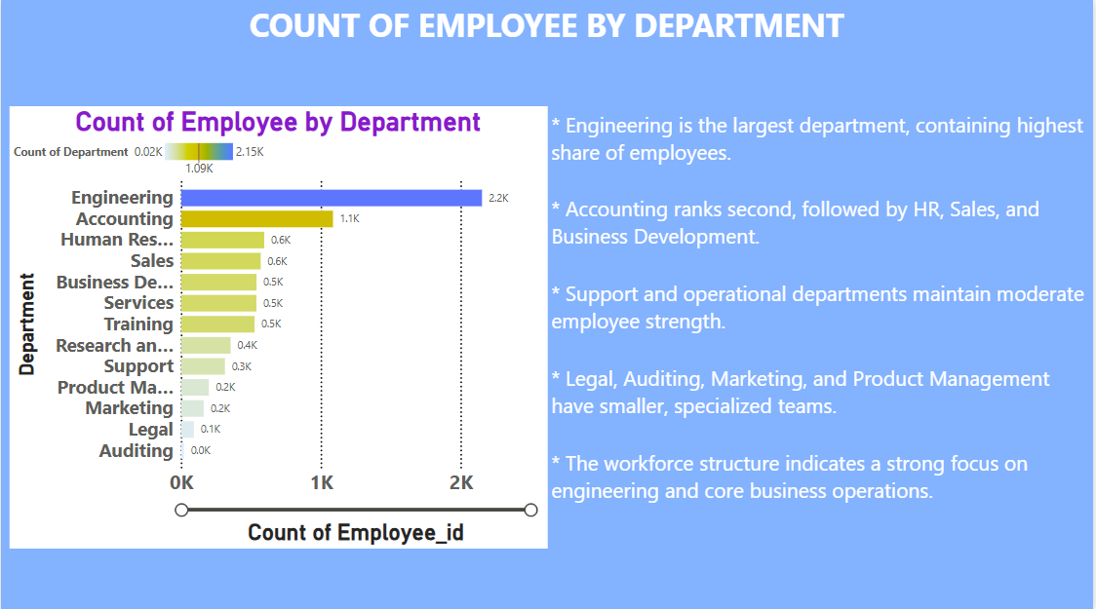

Slide 11
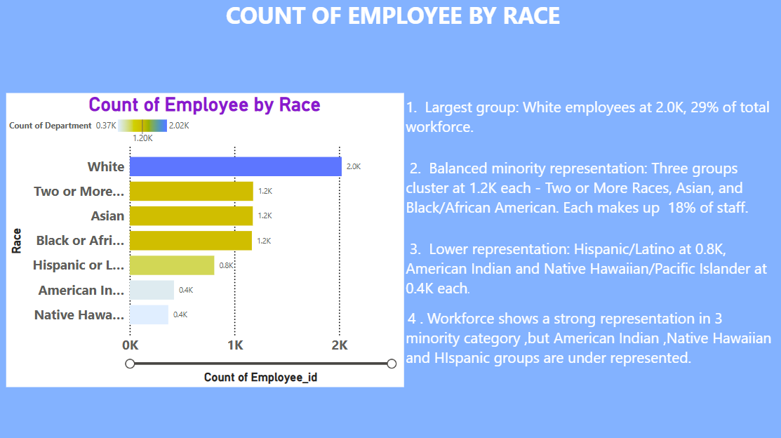

Slide 12
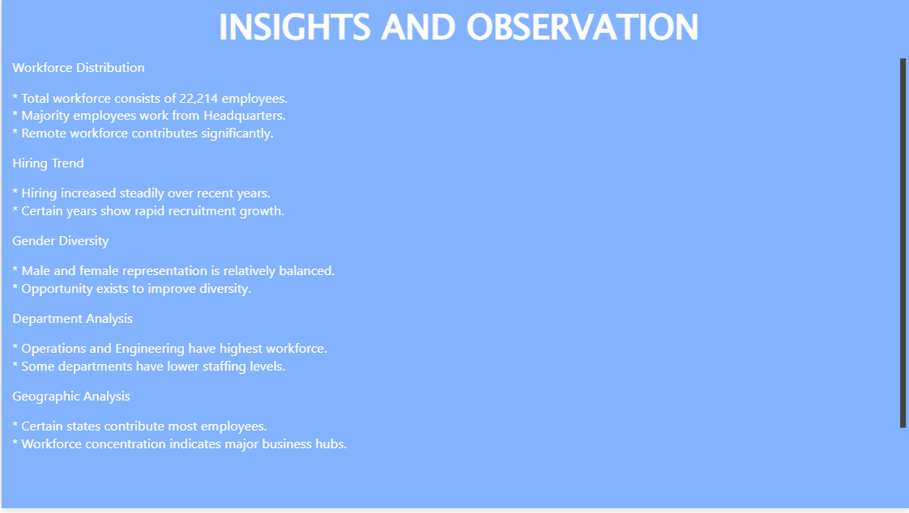

Slide 13
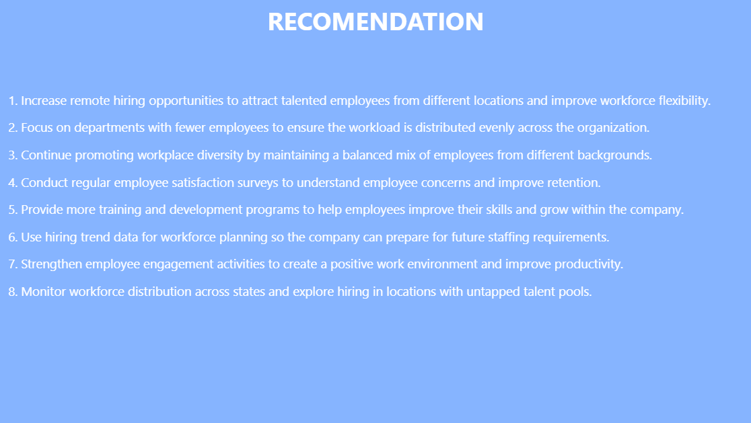

Slide 14
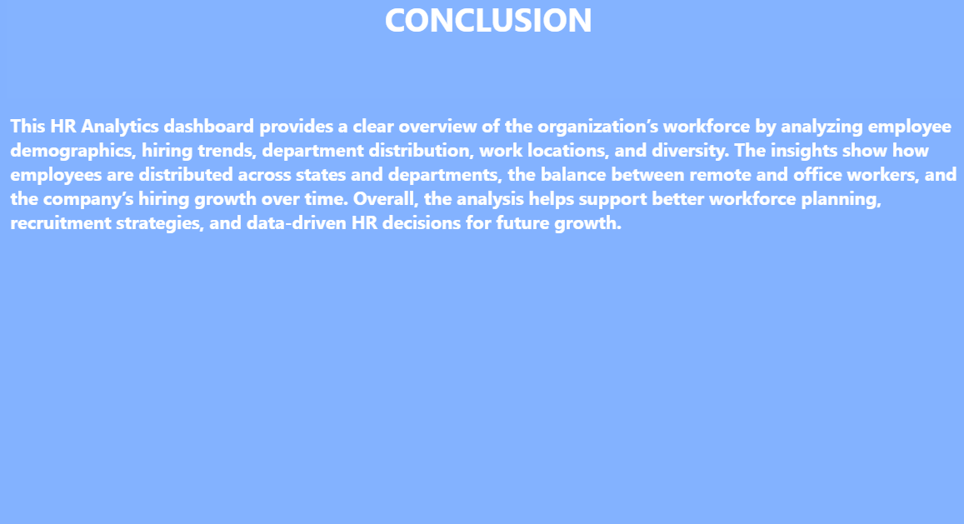

Slide 15

THANK YOU

