Slide 1
Network Security Project Review
Designing an Encryption Technique using Genetic Algorithms
Team Members:
Justine Jacob – 16BLC1061
Sandeep B – 16BLC1073
Aditya P Varma – 16BLC1107

Slide 2
Abstract
Genetic Algorithms are adaptive heuristic search algorithms that are based on the ideas of natural selection and genetics
Commonly used to generate high quality solutions for optimization problems
Implementing the same principles of GA such as Crossovers and mutations into encryption would make the cipher text even harder to decipher

Slide 3
Modules
Altered Conway’s Game of Life as base for evolution
Key Generation Block
Encryption Block
Mutations
Crossovers
Selection
Decryption Block
Will be using Python3

Slide 4
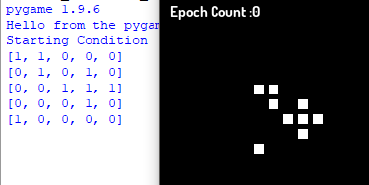
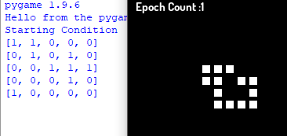
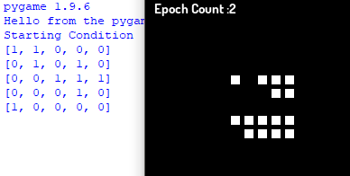
Conway’s GoL – Basic Stage

Slide 5
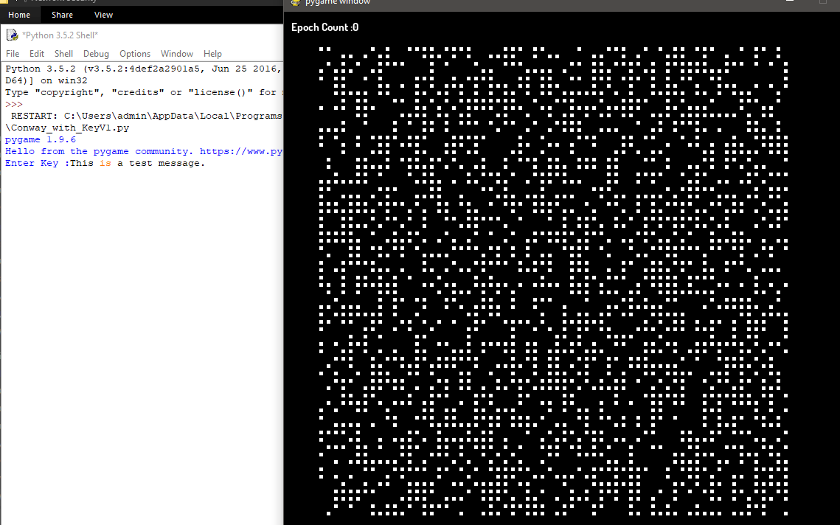
Conways With Custom Key (Hashed)

Slide 6
Character Matrix
ASCII 33 – 97
6 bit
Includes Capital letters, Numbers and Special characters.

Slide 7
Algorithm
Get custom key from the User (Format : <Key>-<iter_no>)
Use SHA512 to hash the input and keep rehashing till the desired length of hashed output is obtained (64*64)
Pass it to the Conways matrix to populate and set the initial condition of the same.

Slide 8
Version 1
Run the GoL upto iter_no of times.
PLAINTEXT
KEYKEYKEY
=> Cipher Text : [P-K][L-E][A-Y]…[T-Y]
(Acts like Vignere Table)

Slide 9
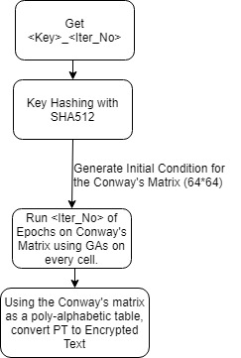
Version 1 – Flowchart

Slide 10
Version 2
Run GoL upto iter_no of times.
PLA | INTEXT
KEY |
Cipher Text = [P-K][L-E][A-I]
Repeat 1
PLA | INT | EXT
|KEY |
Cipher Text = [I-K][N-E][T-Y]
Repeat till the entire plaintext is traversed

Slide 11
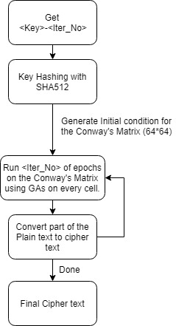
Version 2 - Flowchart

Slide 12
Modified Conway Rules
No of Neighbours – 0
0 – 0 (Nothing)
1 – 1 (Nothing)
No of Neighbours – 1
0 – 0 (Nothing)
1 - 1 (Replicate + Mutate)
No of Neighbours – 2
0 – 1 (Crossover) (2x1)
1 – 1 ( Crossover) (2x1)
No of Neighbours – 3
0 – 1 (Crossover) (3x1)
1 – 1 (Crossover) (3x1)
No of Neighbours – 4
0 – 0 (Nothing)
1 – 0 (Dead)
No of Neighbours – 5,6
0 – 0 (Nothing)
1 – 0 (Nothing)

Slide 13
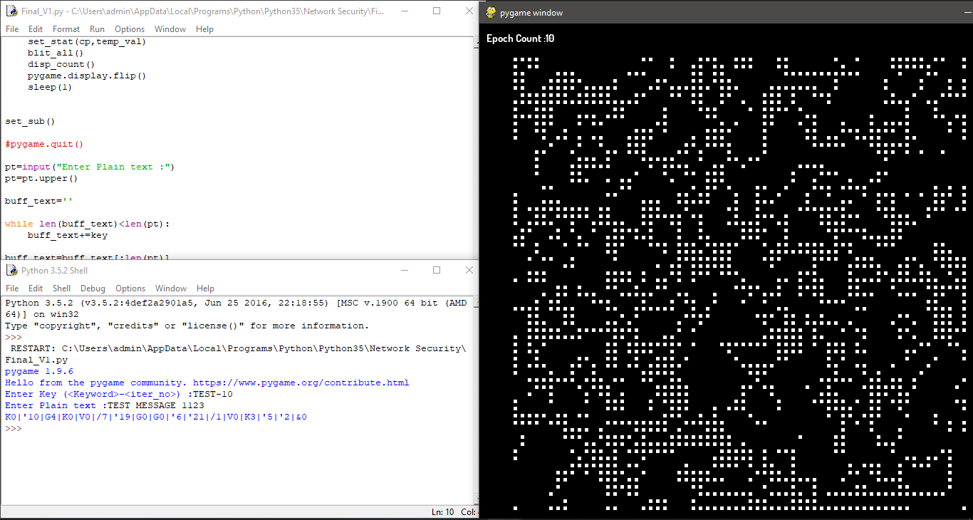
Version 1 - Encoder

Slide 14
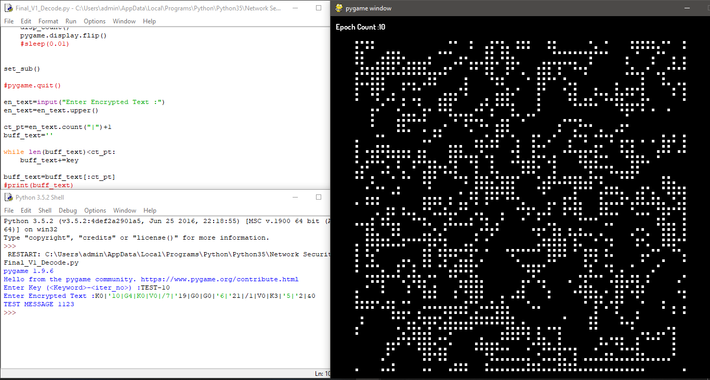
Version 1 - Decoder

Slide 15
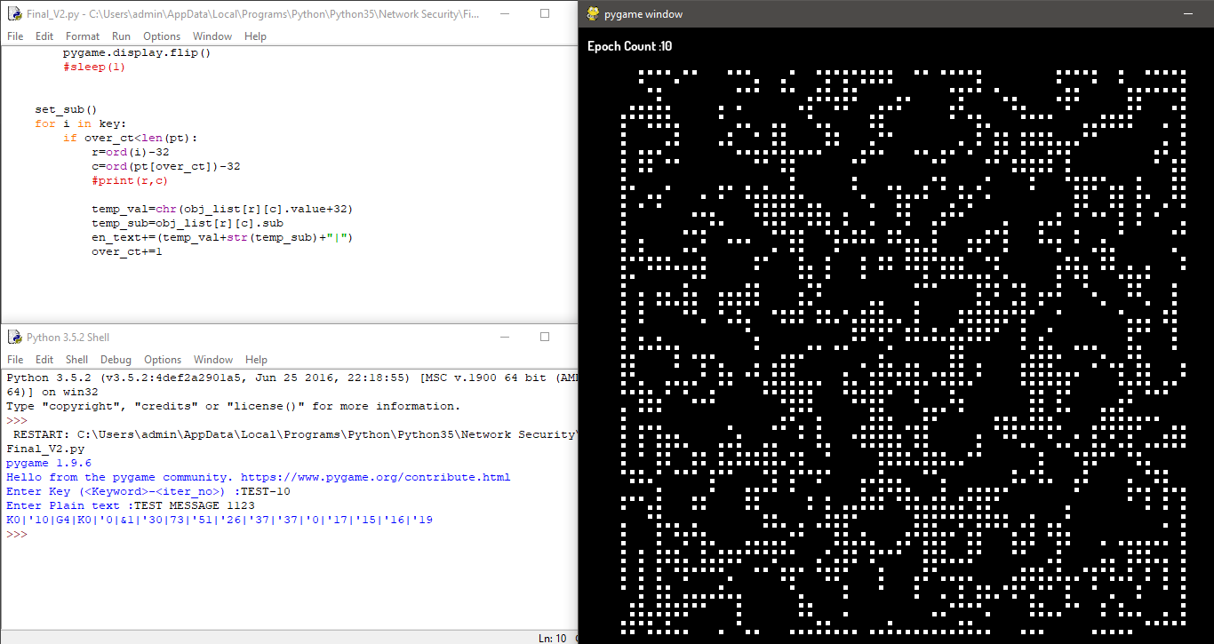
Version 2 - Encoder

Slide 16
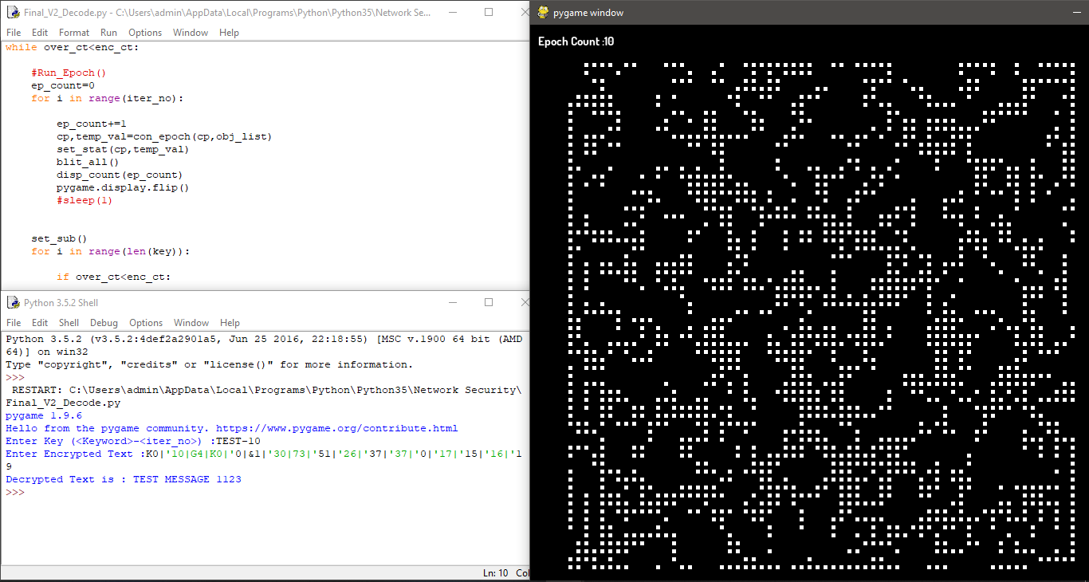
Version 2 - Decoder

Slide 17
Extensive Testing Results
Version 1
Sl. No | Key Text | Iter_No | Plain Text | Duration 1 | Duration 2 | Status
1 | 1 | 10 | 1 | 2.03125 | 2.15625 | Match
2 | 1 | 20 | 1 | 4.015625 | 4 | Match
3 | 2 | 10 | 1 | 2.015625 | 2.015625 | Match
4 | 2 | 20 | 1 | 4.171875 | 4.171875 | Match
5 | 1 | 10 | 2 | 2.390625 | 2.1875 | Match
6 | 1 | 20 | 2 | 3.953125 | 4.3125 | Match
7 | 2 | 10 | 2 | 2.03125 | 2.21875 | Match
8 | 2 | 20 | 2 | 4.640625 | 4.40625 | Match

Slide 18
Extensive Testing Results
Version 2
Sl. No | Key Text | Iter_No | Plain Text | Duration 1 | Duration 2 | Status
1 | 1 | 10 | 1 | 5.96875 | 6.078125 | Match
2 | 1 | 20 | 1 | 12.78125 | 11.890625 | Match
3 | 2 | 10 | 1 | 2.078125 | 2.640625 | Match
4 | 2 | 20 | 1 | 4.125 | 4.03125 | Match
5 | 1 | 10 | 2 | 74.78125 | 75.046875 | Match
6 | 1 | 20 | 2 | 151.625 | 149.25 | Match
7 | 2 | 10 | 2 | 30.421875 | 31.5 | Match
8 | 2 | 20 | 2 | 61.03125 | 61.375 | Match

Slide 19
Inference
V1:
Fast
Can be used for time sensitive application
Time taken almost independent of the size of Plain Text or Cipher Text.
V2:
Reliable
Highly Secure
Time consuming
Time taken highly dependent on the size of Plain Text or Cipher Text

