Slide 1
Banker’s Algorithm
Aditya Raghavan

Slide 2
Background
Process is program in execution
Process requests/uses resources
Resources – Memory, Printer, CPU etc.
Deadlock – State from which system cannot proceed or recover
Set of conditions must hold true for deadlock to occur

Slide 3
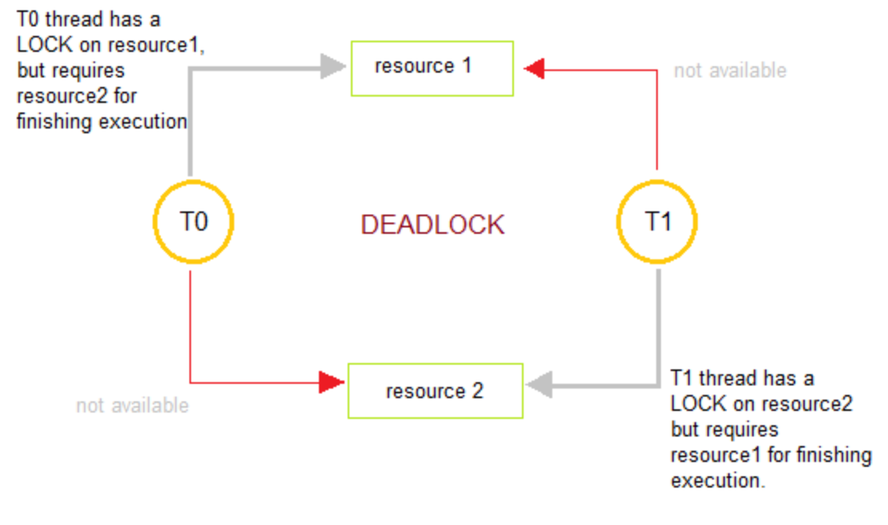
Deadlock
Set of processes each holding a resource waiting to acquire resource held by another
Necessary conditions for deadlock:
Mutual Exclusion
Hold and Wait
Circular Wait
No Preemption

Slide 4
Prevention vs Avoidance
Prevention
Ensuring at least one of the necessary conditions never hold true
Under commit resources and request all at once
For e.g. Serializing tokens, Dijkstra’s Algorithm
Avoidance
Do not let the system enter an unsafe state
Modify the resource allocation strategy
For e.g. Banker’s Algorithm

Slide 5
Banker’s Algorithm
Deadlock avoidance algorithm
Ensures the system always remains in safe state
Process requests for resources
Banker’s algo verifies if system remains in safe state
Requested resources not allocated if unsafe state possible

Slide 6
Input for algorithm
Maximum amount of required resources for each process
Amount of resources held by each process currently
Maximum available resources in the system
Conditional check
Request made by process < Max. required for process
Request made by process < Available resource in system

Slide 7
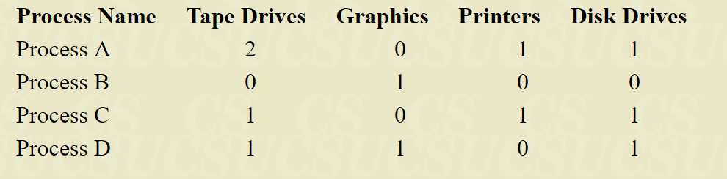
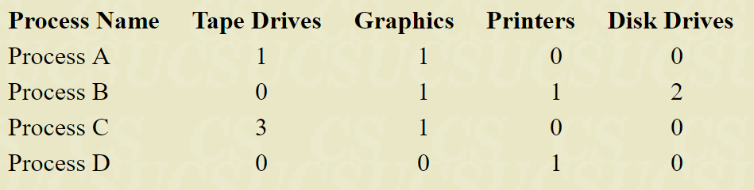
Example: 5 drives, 2 displays, 4 printers, 3 disks
Total = (5, 2, 4, 3)
Initial distribution: Allocated = (4, 2, 2, 3)
Resources available: Available = (1, 0, 2, 0)

Slide 8
Iteration 1 – Process D requires less than available
Allocated = (1, 1, 0, 1)
Updated Available = (2, 1, 2, 1)
Iteration 2 – Process A requires less than available
Allocated = (2, 0, 1, 1)
Updated Available = (4, 1, 3, 2)
Iteration 3 – Process B requires less than available
Allocated = (0, 1, 0, 0)
Updated Available = (4, 2, 3, 2)
Iteration 4 – Process C requires less than available
Allocated = (1, 0, 1, 1)
Updated Available = (5, 2, 4, 3)

Slide 9
References
http://www.geeksforgeeks.org/deadlock-prevention/
https://stackoverflow.com/questions/2485608/what-the-difference-between-deadlock-avoidance-and-deadlock-prevention
http://www.cs.colostate.edu/~cs551/CourseNotes/Bankers.html
http://www.geeksforgeeks.org/operating-system-bankers-algorithm/

