Slide 1
Bitcoin Blockchain and Byzantine
Aditya Raghavan

Slide 2
Background
Bitcoin is a cryptocurrency founded in 2009
Decentralized banking system with no server or central authority
Digital currency that assures anonymity and integrity of transactions
Current trading value 1Bitcoin ≈ USD 17k
Users help maintain and validate transaction records

Slide 3
Blockchain
Blockchain – Shared public ledger containing all transaction information
Confirmed transactions included to this blockchain
Integrity and sequence of the block chain guaranteed using encryption
Blockchains mined by users to convert them into a hash value
Generated hash appended at the end of the blockchain and shared publicly

Slide 4
Bitcoin is a Peer to Peer electronic cash system
Distributed infrastructure has various issues with consensus
Byzantine generals problem one such approach to resolve consensus
Each block in the Bitcoin blockchain comprises of a hash signature of previous block
This creates a secure chain of blocks, hence the term ‘Blockchain’
Important to tolerate byzantine failures to maintain integrity of blockchains

Slide 5
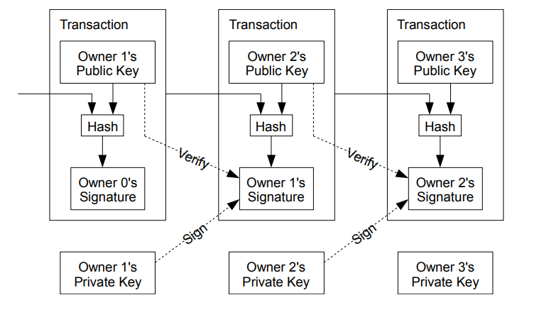
Structure of a block in a Blockchain

Slide 6
Byzantine Generals Problem
Illustrates the difficulty in reaching consensus in a distributed system
Army surrounding a city with various camps
Messages to be communicated to agree upon strategy
Unknown traitor might corrupt the message
Loss of consensus due to corrupt message exchange

Slide 7
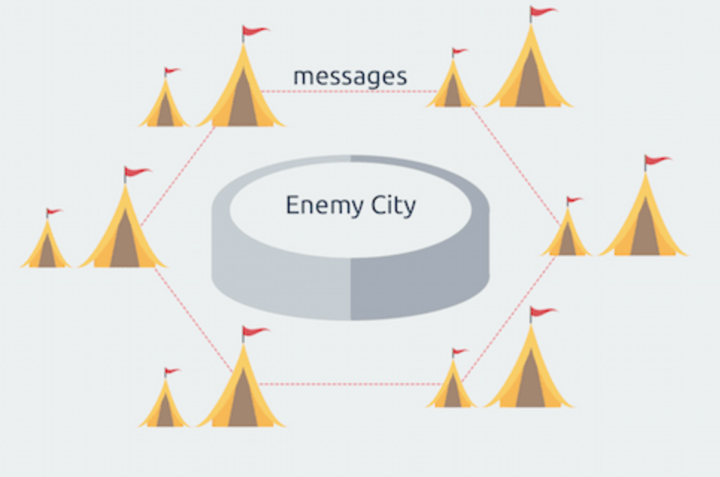
Byzantine Fault – Any fault presenting different symptoms to different observers
Byzantine Failure – Loss of system service due to Byzantine fault

Slide 8
Byzantine Fault Tolerance
Reduce BGP to Commander and Lieutenants problem
Solution can be found only if T > 3F where T – total number of nodes, F – number of failures
Application of BFT found in Bitcoin blockchain
Blockchain should overcome Byzantine failures to reach a coherent global view of the entire system

Slide 9
Bitcoin relies on node votes and majority consensus to remove faults
Very difficult for malicious actor to undermine a consensus and exert a meaningful influence on blockchain
On a large blockchain, Proof of Work (PoW) requirement provides BFT
PoW – Performing work intensive task in order to add to the blockchain
Prevents byzantine faults that might lead to inaccurate information

Slide 10
References
https://bitcoin.org/bitcoin.pdf
http://www.nasdaq.com/article/byzantine-fault-tolerance-the-key-for-blockchains-cm810058
https://www.weusecoins.com/bitcoin-byzantine-generals-problem/
https://medium.com/@DebrajG/how-the-byzantine-general-sacked-the-castle-a-look-into-blockchain-370fe637502c
http://www.akitaonrails.com/2017/11/01/how-does-bitcoin-force-consensus-among-byzantine-generals

