Slide 1
Distributed Deadlocks
Aditya Raghavan

Slide 2
Background
Process is program in execution
Process requests/uses resources
Resources – Memory, Printer, CPU etc.
Deadlock – State from which system cannot proceed or recover
Set of conditions must hold true for deadlock to occur

Slide 3
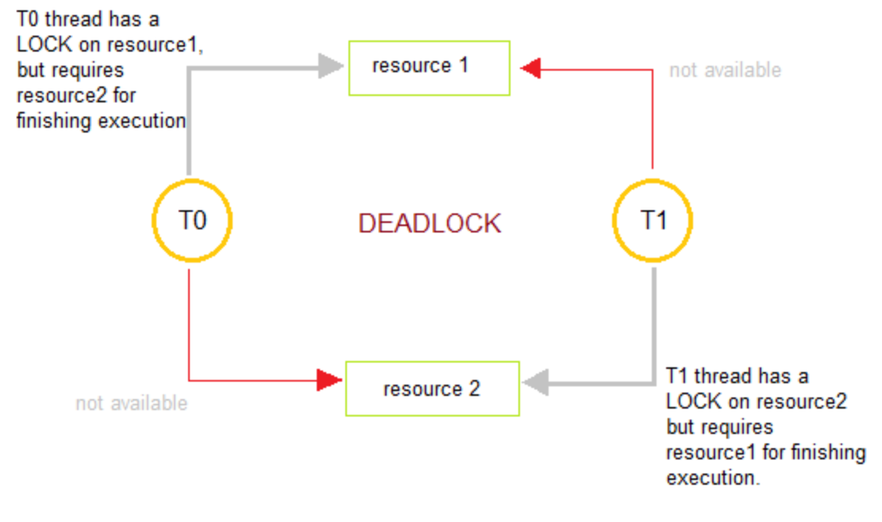
Deadlock
Set of processes each holding a resource waiting to acquire resource held by another
Necessary conditions for deadlock:
Mutual Exclusion
Hold and Wait
Circular Wait
No Preemption

Slide 4
Distributed Deadlocks
Deadlocks in distributed environment similar to monolithic systems
Harder to predict, prevent and detect
Types of Distributed Deadlock
Communication Deadlock – Processes trying to send and receive messages waiting for one another
Resource Deadlock – Processes trying to get exclusive access to different types of resources

Slide 5
Handling Distributed Deadlocks
No one centralized system overseeing all allocation of resources
Tracking all resource allocation much more complex
Strategies for handling Distributed Deadlocks
Ignore
Detect
Prevent
Avoid

Slide 6
Ignore
No system wide deadlock mechanism
No algorithm implemented to handle deadlock
Individual nodes within the distributed infrastructure may implement their own solution
Detect
Deadlocks allowed to occur on distributed infrastructure
Wait for graphs created
Existence of a cycle in the graph indicates deadlock

Slide 7
Algorithms use timers and each transaction associated with a timer
Timers indicate a deadlock if transaction not completed within specified time
Types of Deadlock Detector
Centralized
One node designated as deadlock detector
Hierarchical
Multiple detectors arranged in a heirarchy
Distributed
All nodes participate in deadlock detection

Slide 8
Prevention
Ensuring at least one of the necessary conditions never hold true
Under commit resources and request all at once
for e.g. Wait-die and Wound-wait algorithm
Avoidance
Do not let the system enter an unsafe state
Modify the resource allocation strategy
for e.g. Banker’s algorithm

Slide 9
Wait-die approach
If an old process wants a resource held by younger process, the old process waits
If a young process wants a resource held by older process, the younger process is killed
Younger process might keep getting killed till the older process releases the resource
Wound-wait approach
If an old process wants a resource held by younger process
Old process pre-empts the young process
Younger process wounded, killed, restarts and waits
If a young process wants a resource held by older process, the younger process waits

Slide 10
Locks implemented to avoid deadlocks
Locks associated with transactions
Types of locks
Write lock
Acquires lock for an object before modifying
Blocks intended write/read by another transaction
Read lock
Acquires lock for an object before reading
Blocks only write by another transaction

Slide 11
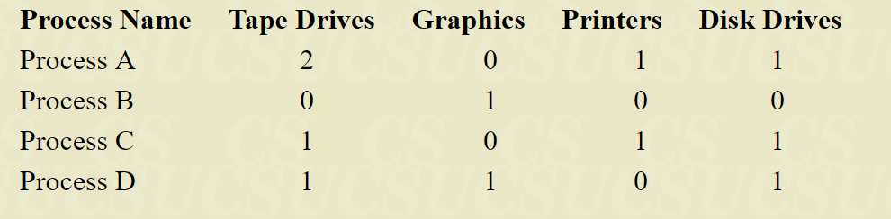
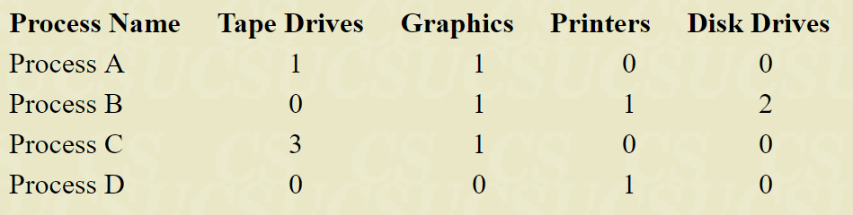
Example: Distributed system with 5 drives, 2 displays, 4 printers, 3 disks
Using Banker’s Algorithm, Total = (5, 2, 4, 3)
Initial distribution: Allocated = (4, 2, 2, 3)
Resources available: Available = (1, 0, 2, 0)

Slide 12
Iteration 1 – Process D requires less than available
Allocated = (1, 1, 0, 1)
Updated Available = (2, 1, 2, 1)
Iteration 2 – Process A requires less than available
Allocated = (2, 0, 1, 1)
Updated Available = (4, 1, 3, 2)
Iteration 3 – Process B requires less than available
Allocated = (0, 1, 0, 0)
Updated Available = (4, 2, 3, 2)
Iteration 4 – Process C requires less than available
Allocated = (1, 0, 1, 1)
Updated Available = (5, 2, 4, 3)

Slide 13
References
http://www.geeksforgeeks.org/deadlock-prevention/
https://stackoverflow.com/questions/2485608/what-the-difference-between-deadlock-avoidance-and-deadlock-prevention
ftp://cosm.sfasu.edu/cs/dcook/CSC563/Lecture%2010%20-%20Deadlocks.pdf
http://www.nptel.ac.in/courses/106106107/Module-5--DistributedDeadlocks.pdf
https://www.tutorialspoint.com/distributed_dbms/distributed_dbms_deadlock_handling.htm
https://www.cs.rutgers.edu/~pxk/417/notes/deadlock.html

