Slide 1
Microservices

Slide 2
Service Oriented Architecture (SOA)
Software architecture pattern used by various applications.
Components provide services via communication protocol over network.
Communication involves data exchange or two or more services coordinating with each other [1].
Architecture follows producer/consumer model with services exposed as interfaces.
Services autonomous, share contract and schema with compatibility based on service policy [2].

Slide 3
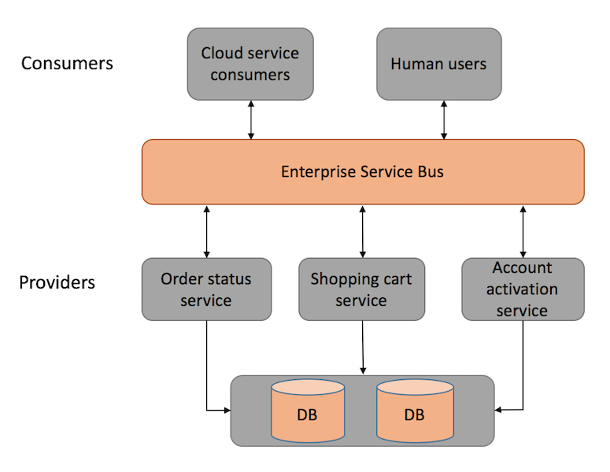
Service Oriented Architecture (SOA)

Slide 4
SOA Monolith Drawbacks
Monolith architecture runs on single application layer and bundles all functionalities together [3].
Traditional SOA architecture has many inter dependencies and uses Enterprise Service Bus for communication which has large overhead.
Scaling applications with monolith architectures difficult.
Tight coupling requires huge effort for a small change in the system.
Maintaining and evolution of applications with large monolith systems very complex.

Slide 5
Microservices Architecture
Structures an application as collection of loosely coupled services which implement business capabilities.
Application components follow their own development and deployment lifecycle.
Decentralized data management and standards [5].
Automated infrastructure management to reduce complexity while deploying independent components [5].
Evolutionary design enables replacing and upgrading without affecting its collaborator.

Slide 6
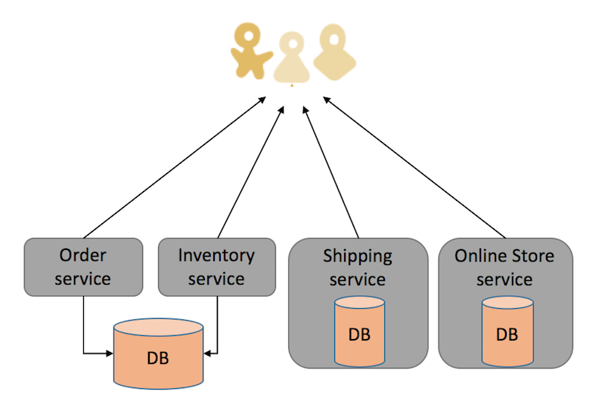
Microservices Architecture

Slide 7
Communication in Microservices
Lightweight protocols such as HTTP/REST and AMQP used for communication.
Types of communication [4]:
Synchronous Protocol for e.g. HTTP/HTTPS
Asynchronous Protocol for e.g. AMQP
Synchronous – Client code/ message sender waits for a response.
Asynchronous – Client code/ message sender does not wait for a response.

Slide 8
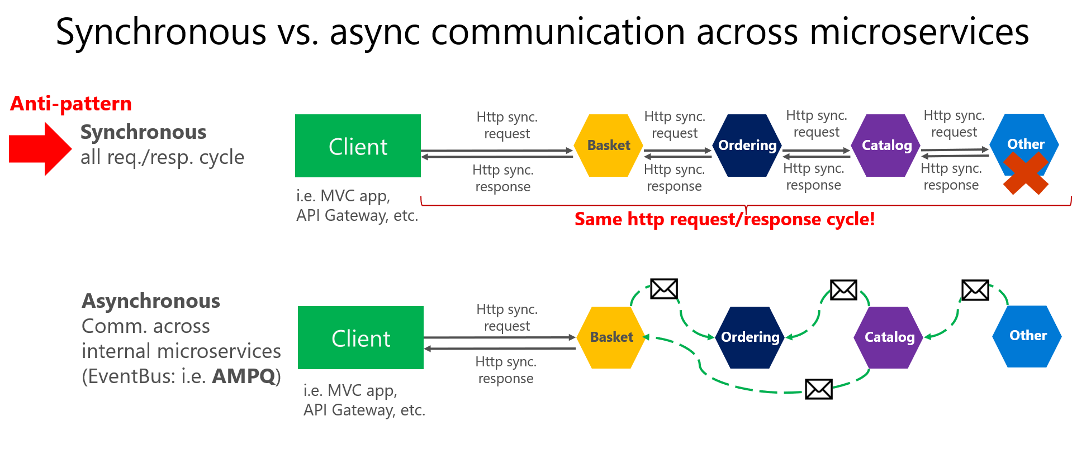

Slide 9
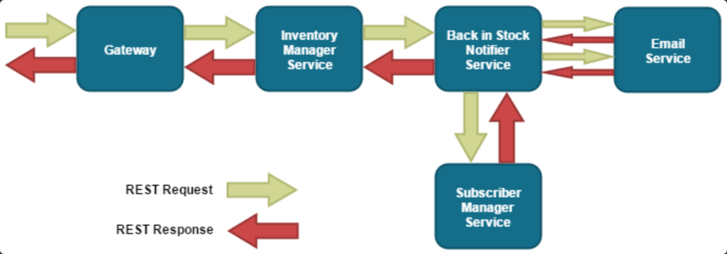
A system that notifies customers when a particular item is back in stock.
Synchronous Messaging

Slide 10
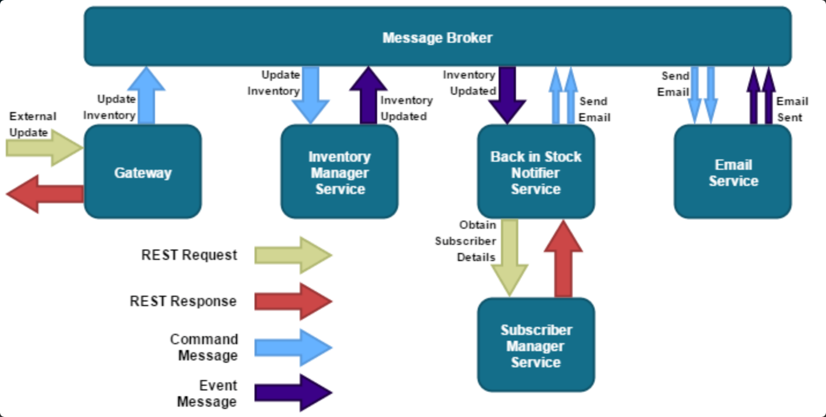
Asynchronous Messaging

Slide 11
Scaling in Microservices
Two aspects to knowing the growth scale of a microservice [6]:
Qualitative growth scale
Quantitative growth scale
Growth scale measured in terms of requests per second (RPS) or queries per second (QPS).
A well-defined, measurable, and quantitative understanding of how much traffic a microservice can handle.

Slide 12
The Scale Cube
X-axis scaling consists of running multiple copies of an application behind a load balancer.
Y-axis axis scaling splits the application into multiple, different services.
In Z-axis scaling, each server runs an identical copy of the code, but each server is responsible for only a subset of the data.
The microservice architecture is an application of Y-axis scaling.

Slide 13
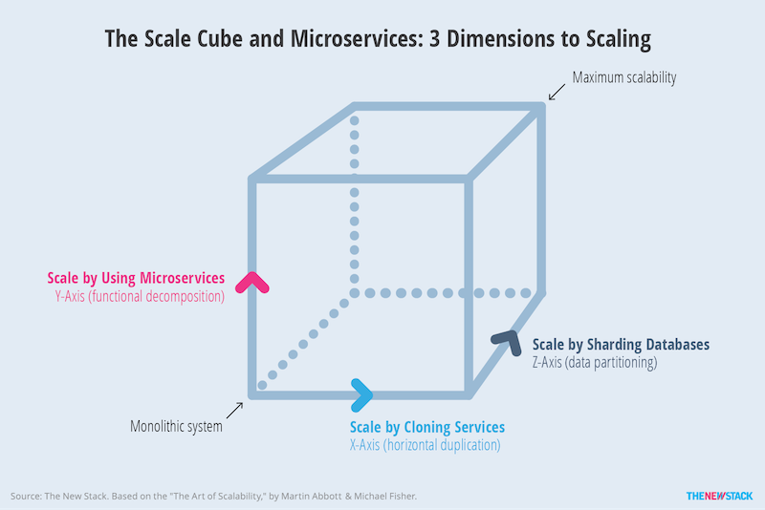

Slide 14
References
[1]https://dzone.com/articles/microservices-vs-soa-2
[2]https://en.wikipedia.org/wiki/Service-orientation
[3]http://odino.org/on-monoliths-service-oriented-architectures-and-microservices/
[4]https://docs.microsoft.com/en-us/dotnet/standard/microservices-architecture/architect-microservice-container-applications/communication-in-microservice-architecture
[5]https://dzone.com/articles/microservices-architecture-what-when-how
[6]https://www.safaribooksonline.com/library/view/production-ready-microservices/9781491965962/ch04.html

