Slide 1
Avoiding the Curveball: Detecting Missing Rail Grease with Mobile Lasers
Aditya Rahalkar, S. Morteza Mirzaei, Dr. Yang Chen, Carvel Holton, Dr. Mehdi Ahmadian

Slide 2
Outline
Introduction
Background
Study Motivation and Objective
Design and Functionality of Railway Technologies Laboratory’s (RTL) Laser-Based Grease Detection System
Technical Approach Toward System Design
Mobile Rail Cart Configuration for RTL System
Performance Evaluation of the System Through Dynamic Laboratory Tests
Test Setup
Results
Low-Speed Field Tests
Field Test Setup
Field Test Session 1 (Christiansburg, VA)
Field Test Session 2 (Roanoke, VA)
Results
Conclusions

Slide 3
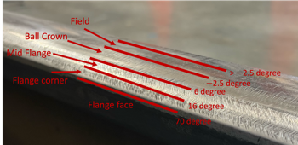
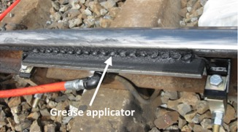
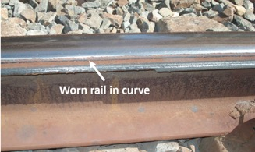
Keeping Trains on Track: The Role of Flange Lubrication in Safety and Maintenance
Flange-face lubrication is critical for
Reducing wheel and rail wear
Preventing wheel-climb derailment
Decreasing wheel squeal
Reducing fuel consumption
Grease is applied via wayside applicators near curves
When grease applicators fail, the consequences multiply
25% of grease applicators were found dysfunctional in Australian rail inspections [Ref 2]
Over $2 billion/year is lost in the U.S. due to improper flange lubrication [Ref 3]
In 2004 alone, track repairs from poor lubrication cost over $10 billion [Ref 4]
Unlubricated rails = high flange forces = higher derailment risk
Ref 1
Ref 1. Chattopadhyay G, Desai A, Sroba P, et al. Best practice in rail curve lubrication and remote performance monitoring in heavy haul lines, AusRail Conference and Exhibition. Australia; 2010, p.1-7.
Ref 2. Kramer J. Rail lubrication--a solid future? Railway track and structures. 1994; 90(11): 31-33.
Ref 3. Sid D, Wolf E. Tracglide top-of-rail lubrication system, Report from Department of Energy, USA. 2006.
Ref 4. Daniels LE. Track maintenance costs on rail transit properties. 2009. (TCRP Project J-7).
Ref 1

Slide 4
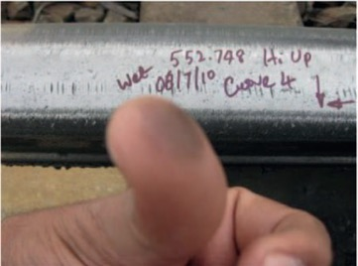
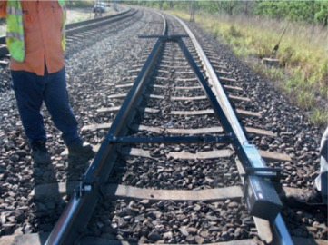
Track Smarter: A Call for Scalable, Non-Contact Lubrication Assessment
Finger test
Limitations of existing lubricity assessment methods
Visual inspection rely on detecting sheen or rubbing grease with a finger
Time consuming, subjective and limited to short sections of track
Tribometers provide friction data but not direct grease condition
Not ideal for long distances or mobile use
Results vary due to operator dependency and inconsistent readings
Tribometer test

Slide 5
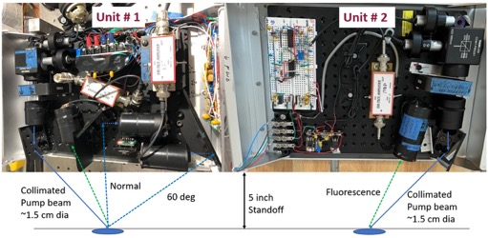
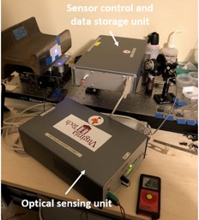
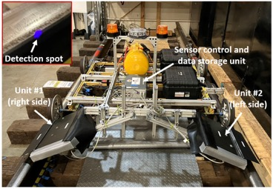
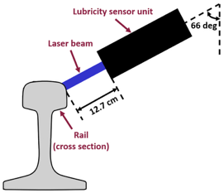
Solution? RTL’s Non-Contact Optical Grease Detection System
Develop a mobile laser-based system to detect the presence and absence of flange grease
Designed for Hyrail trucks and robotic platforms to assess lubrication levels at track speeds
Supports predictive maintenance by identifying dry curves early

Slide 6
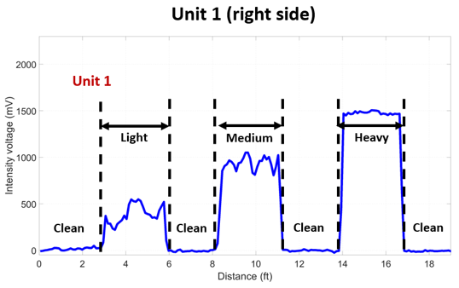
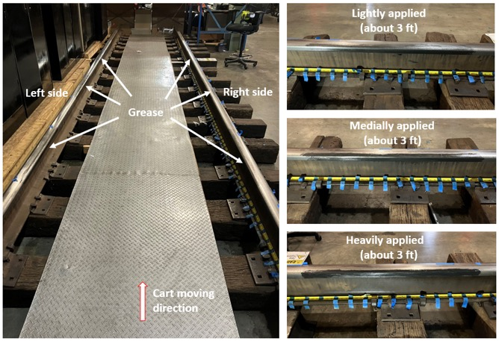
The RTL system has been tested dynamically in the lab to assess its grease detection performance in the field
Lab dynamic test results
Clear distinction in fluorescence intensity voltage was observed across lightly, moderately and heavily lubricated sections

Slide 7
Field Testing the RTL System: Real Rails, Real Conditions

Slide 8
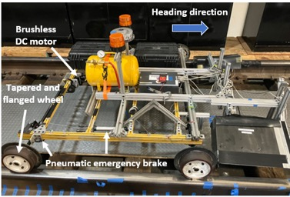
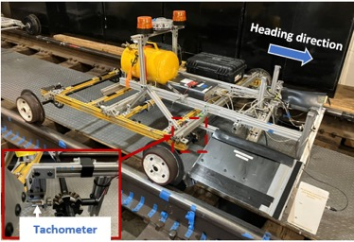
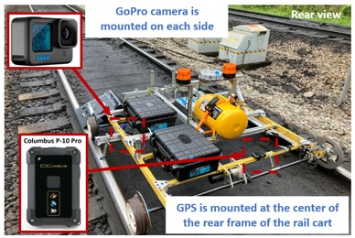
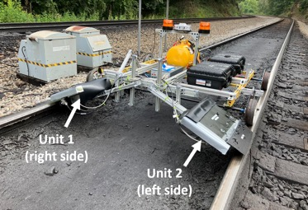
Test Setup: We mounted the RTL system on a robotic rail cart to conduct the field tests on revenue service tracks
Components mounted on the Rail cart
Unit 1 (Right side) and Unit 2 (Left side)
Tachometer
Global Navigation Satellite System (GNSS)
GoPro Cameras
Maximum speed of the rail cart: 5 mph

Slide 9
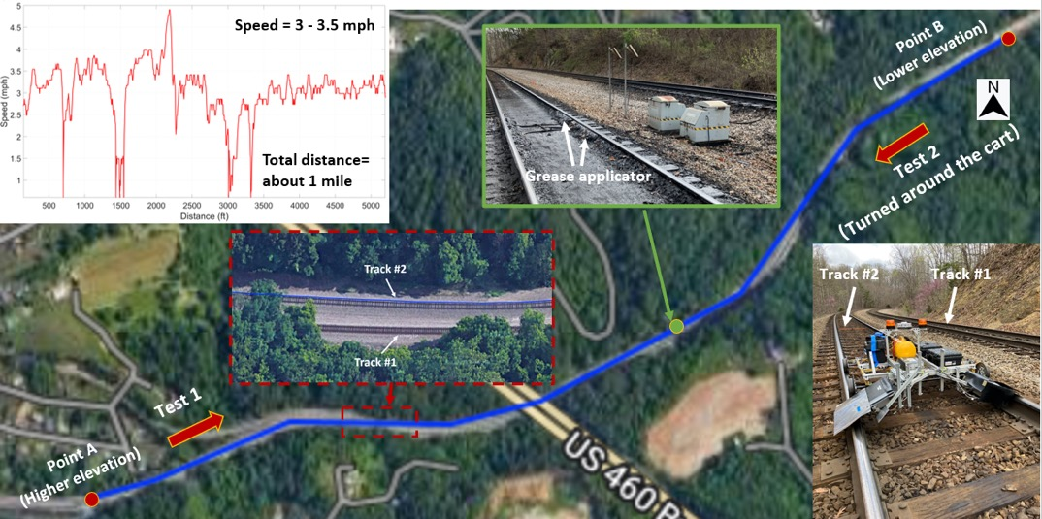
Field Test Session 1: We conducted the first round of low-speed field test on a revenue service track in Christiansburg, VA

Slide 10
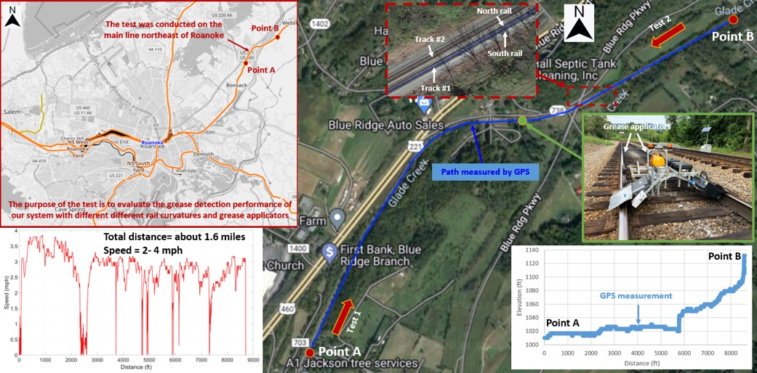
Field Test Session 2: We conducted the second round of low-speed field test on a different grease formulation in Roanoke, VA

Slide 11
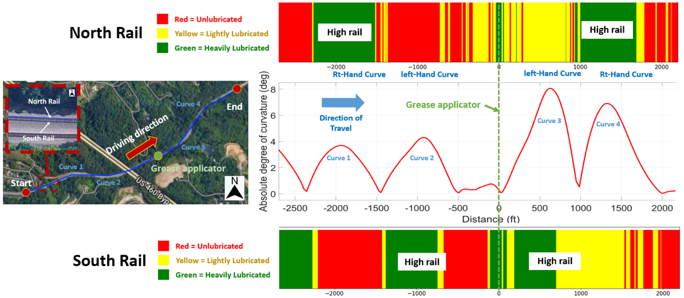
Results-Session 1: We developed tricolor charts to represent the lubrication levels on the north and the south rail of the track in Christiansburg, VA

Slide 12
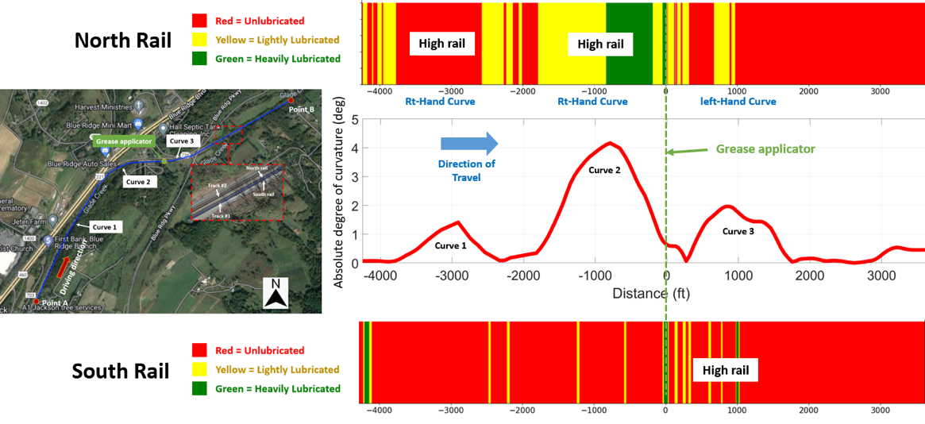
Results-Session 2: A very limited amount of grease was observed on the south rail of the track in Roanoke, VA

Slide 13
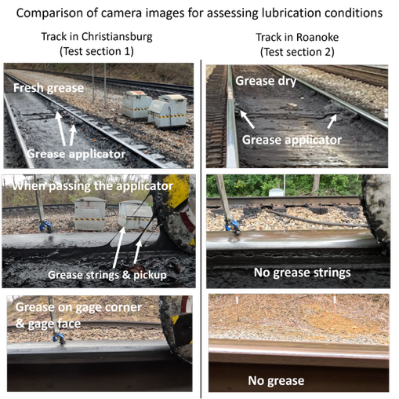
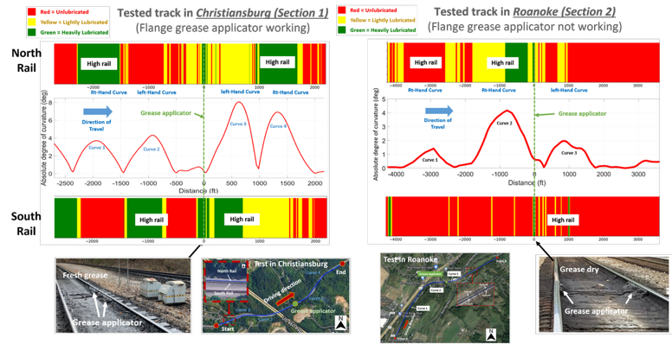
Comparison of the lubricity detection results between the tests in Roanoke and Christiansburg

Slide 14
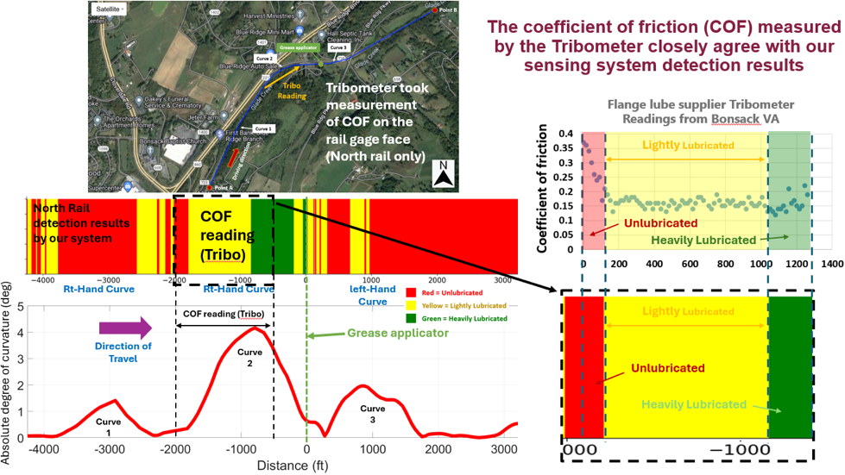
The system performance was validated with the measurements collected from a push tribometer

Slide 15
Conclusions
A laser-based optical sensing system was developed by RTL for flange grease detection.
The system offers a reliable, scalable alternative to traditional methods like visual inspection and tribometers.
Lab tests confirmed sensitivity to grease thickness with clear separation between light, moderate, and heavy lubrication levels.
Low-speed field tests conducted with a Class I railroad showed effective detection in real-world rail environments.
GoPro® visual validation confirmed strong alignment with system’s fluorescence-based detections.
Tribometer COF measurements supported the system’s reliability in identifying lubrication levels.
The RTL system is a viable onboard solution for continuous grease monitoring in revenue service, overcoming the limitations of intermittent tribometer testing.
Future Scope:
Evaluate the performance of the system at higher speeds of up to 30 mph by mounting the system on Hyrail vehicles

Slide 16
Thank you!
The funding provided by the Federal Railroad Administration (FRA) is greatly acknowledged.
We are grateful to our program managers, Ms. Alexandra D'Andrea and Dr. Abe Meddah, for their strong support and many technical discussions.
Many aspects of the project would have not been possible without tremendous support of Norfolk Southern (NS) in conducting revenue service track tests.

