Slide 1

ML-Based Traffic Management System with Emergency Priority System

Slide 2

Traffic Congestion Crisis :
The Challenge
Traffic congestion creates critical delays for emergency vehicles, directly impacting response times and human lives. Traditional traffic signals operate on fixed timing cycles, unable to adapt to real-time emergency situations.
Average emergency vehicle delay: 3-5 minutes per intersection
Response time critical for cardiac arrest cases
Fixed signal timing ignores priority vehicle needs

Slide 3
Project Objective :
Smart Automation
Priority Clearance
Faster Response
Replace fixed-timing signals with intelligent, adaptive control systems
Automatic green signal for authenticated emergency vehicles
Reduce emergency vehicle delay to under 2 seconds per intersection

Slide 4




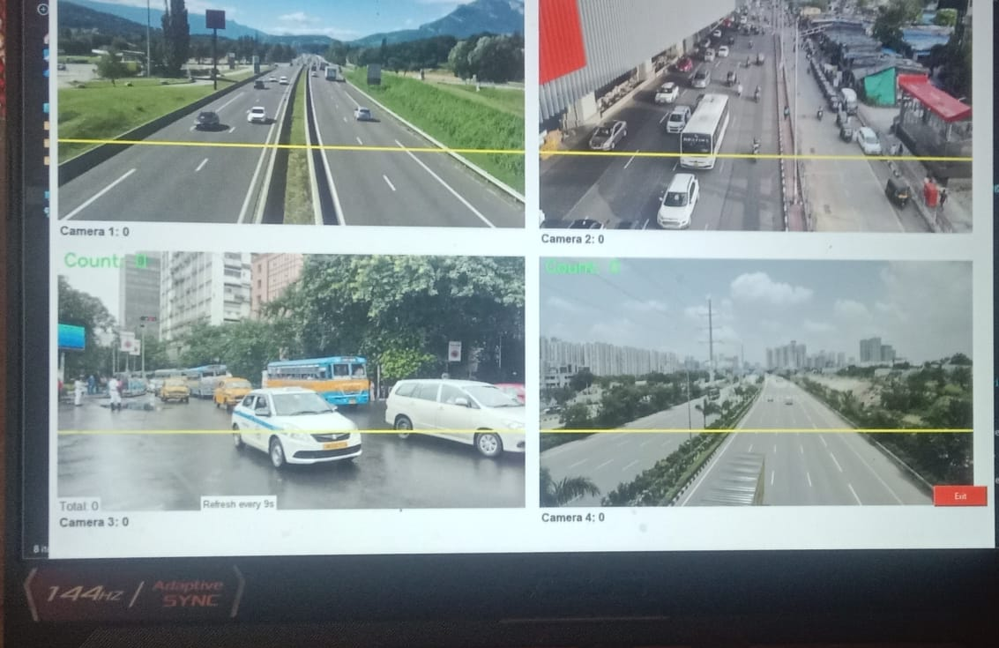
Proposed Solution :
Hybrid System Architecture
Audio Detection
RFID Authentication
TinyML-based siren recognition
Hardware verification
Decision Engine
Signal Control
Dual verification logic
Automatic green priority
Powered by Arduino Nano 33 BLE Sense with integrated machine learning capabilities

Slide 5
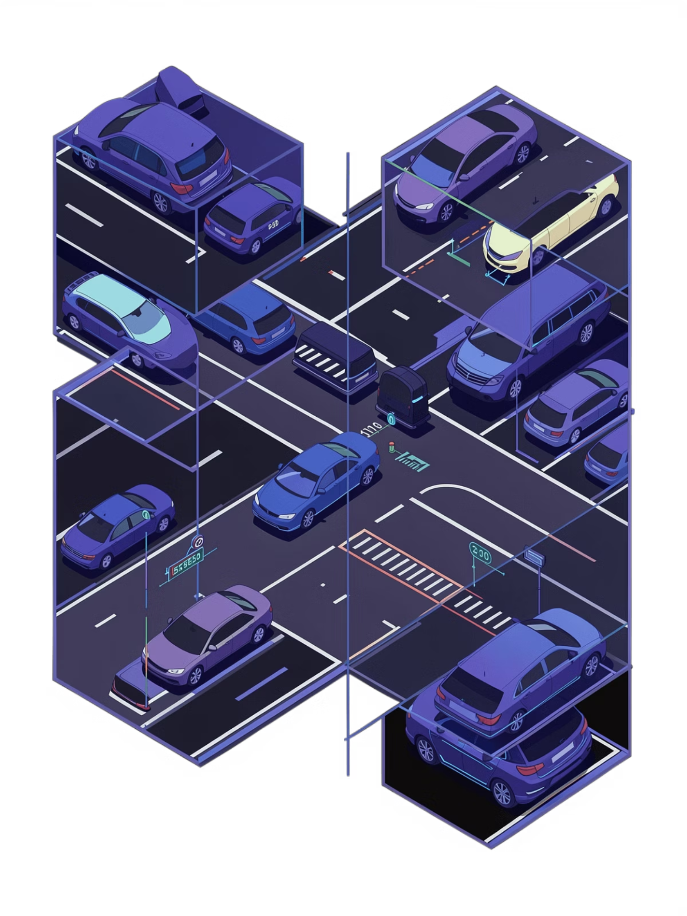
System Workflow :
Multi-Camera Traffic Monitoring & Vehicle Detection System | Prototype Implementation
01
Continuous Audio Monitoring
Real-time siren detection using microphone sensor
02
ML-Based Classification
TinyML processes audio patterns instantly
03
RFID Validation
Secondary authentication prevents false triggers
04
Smart Signal Switching
Automatic green light activation for priority vehicles

Slide 6
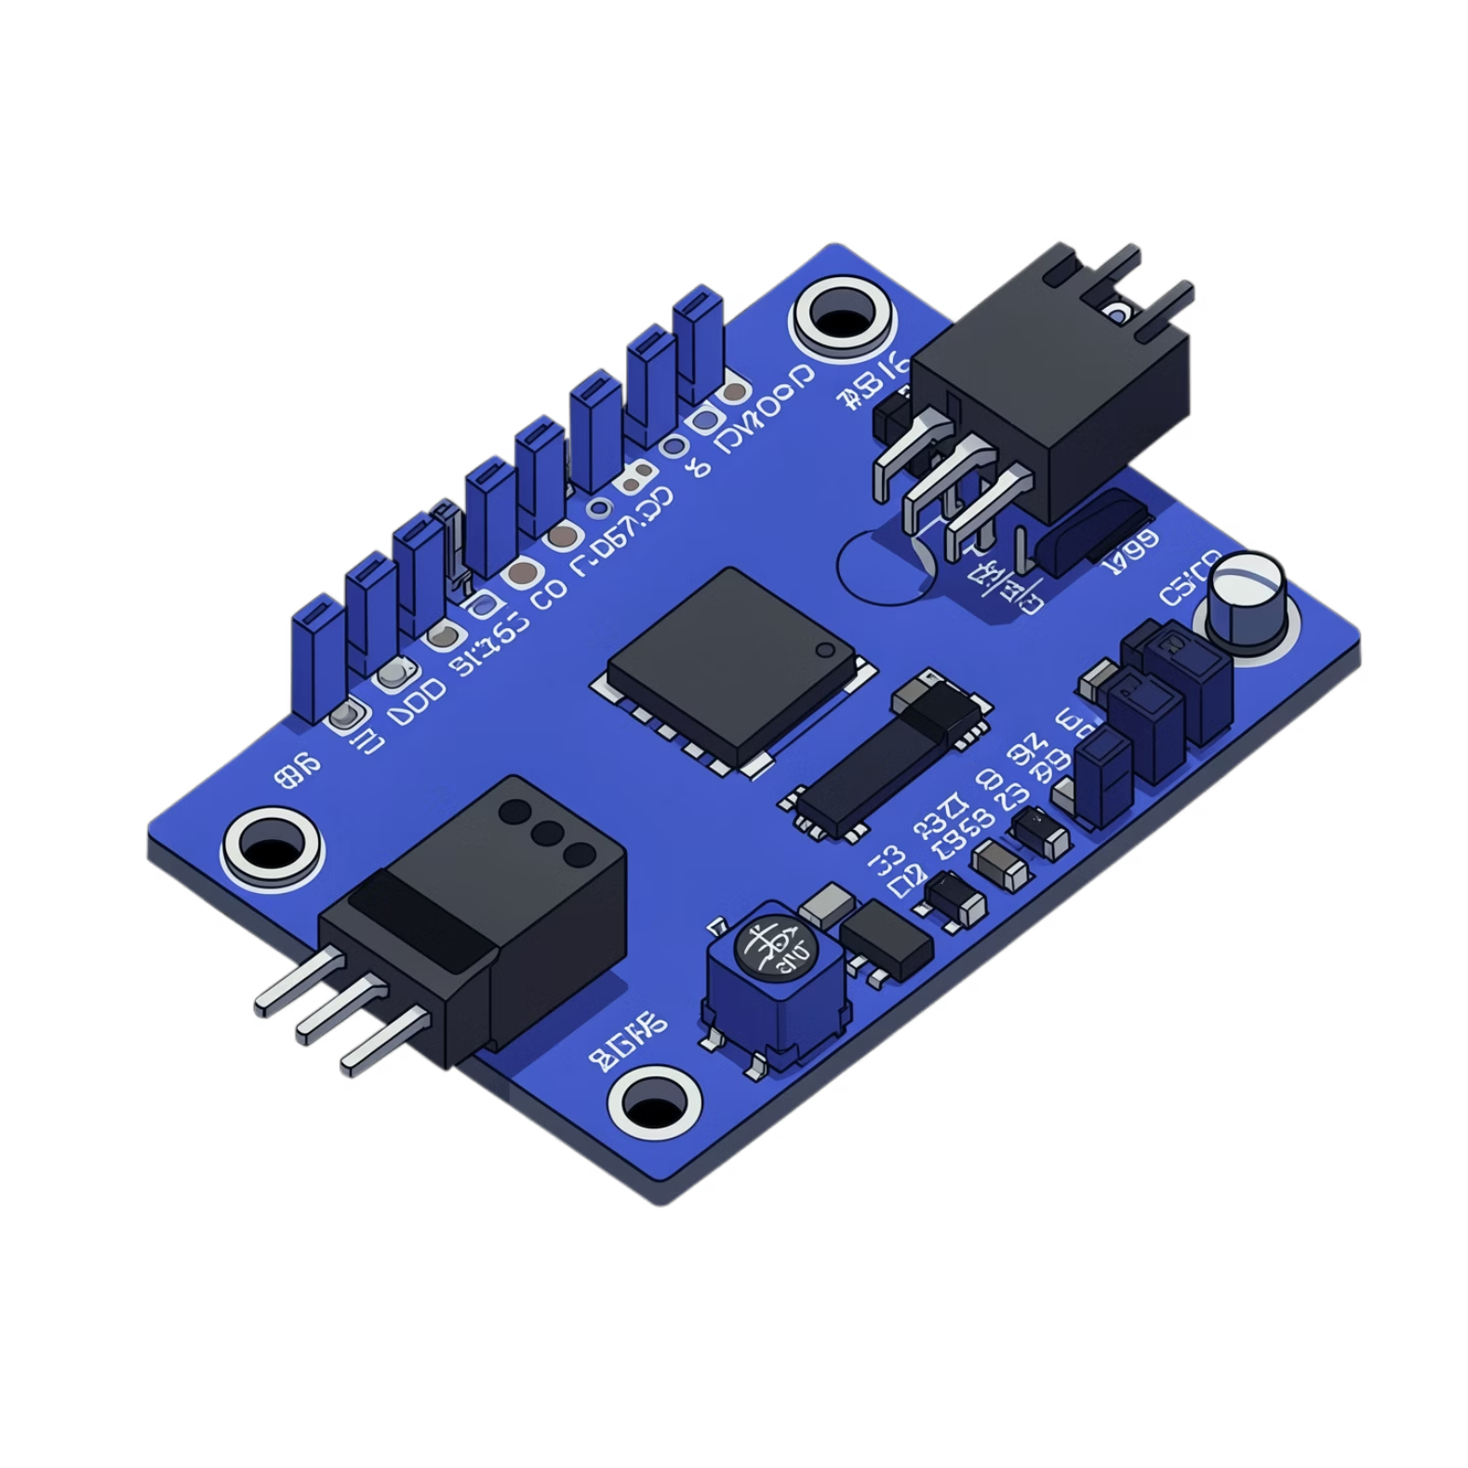
Hardware Implementation :
Core Components
Arduino Nano 33 BLE Sense
RFID Module
Authentication system for emergency vehicle verification
Main controller with built-in microphone and BLE connectivity
Microphone Sensor
Traffic LEDs
Audio input for siren detection and sound classification
Signal control outputs for red, yellow, and green lights

Slide 7
Software Stack & Methodology :
TinyML Framework
Embedded C/Python
Continuous Monitoring
Lightweight machine learning for embedded audio classification
Real-time signal processing and control algorithms
24/7 audio stream analysis with instant response capability

Slide 8

Performance Results :
92%
100%
<2s
Siren Detection Accuracy
RFID Success Rate
Response Time
Correct classification of emergency vehicle sirens across varied conditions
Reliable hardware authentication without failures
Average delay from detection to signal change
Key Achievement: Dual verification system significantly reduces false triggers compared to audio-only detection methods

Slide 9
Applications & Future Enhancements :
Current Applications
Smart Cities
Emergency Services
Traffic Control
Integrated traffic management infrastructure
Ambulance and fire vehicle priority
Adaptive signal optimization
Future Enhancements
Cloud-Based Control
GPS Tracking
Centralized monitoring and city-wide coordination
AI Camera Integration
Route prediction and pre-emptive signal control
Visual verification and multi-camera coordination

Slide 10

Conclusion :
Improves Emergency Response
Reduces critical delays for life-saving vehicles through intelligent priority clearance
Intelligent & Efficient System
Hybrid approach combines machine learning with hardware authentication for reliability
Supports Smart City Vision
Scalable, low-cost implementation ready for urban infrastructure integration
Thank You | Questions & Discussion Welcome

