Slide 1
Weather Prediction
Rain prediction based on:
Principal Component Analysis and
Decision Trees

Slide 2
Overview
Problem statement
Background
Input data analysis
Evaluation

Slide 3
Problem statement

Slide 4
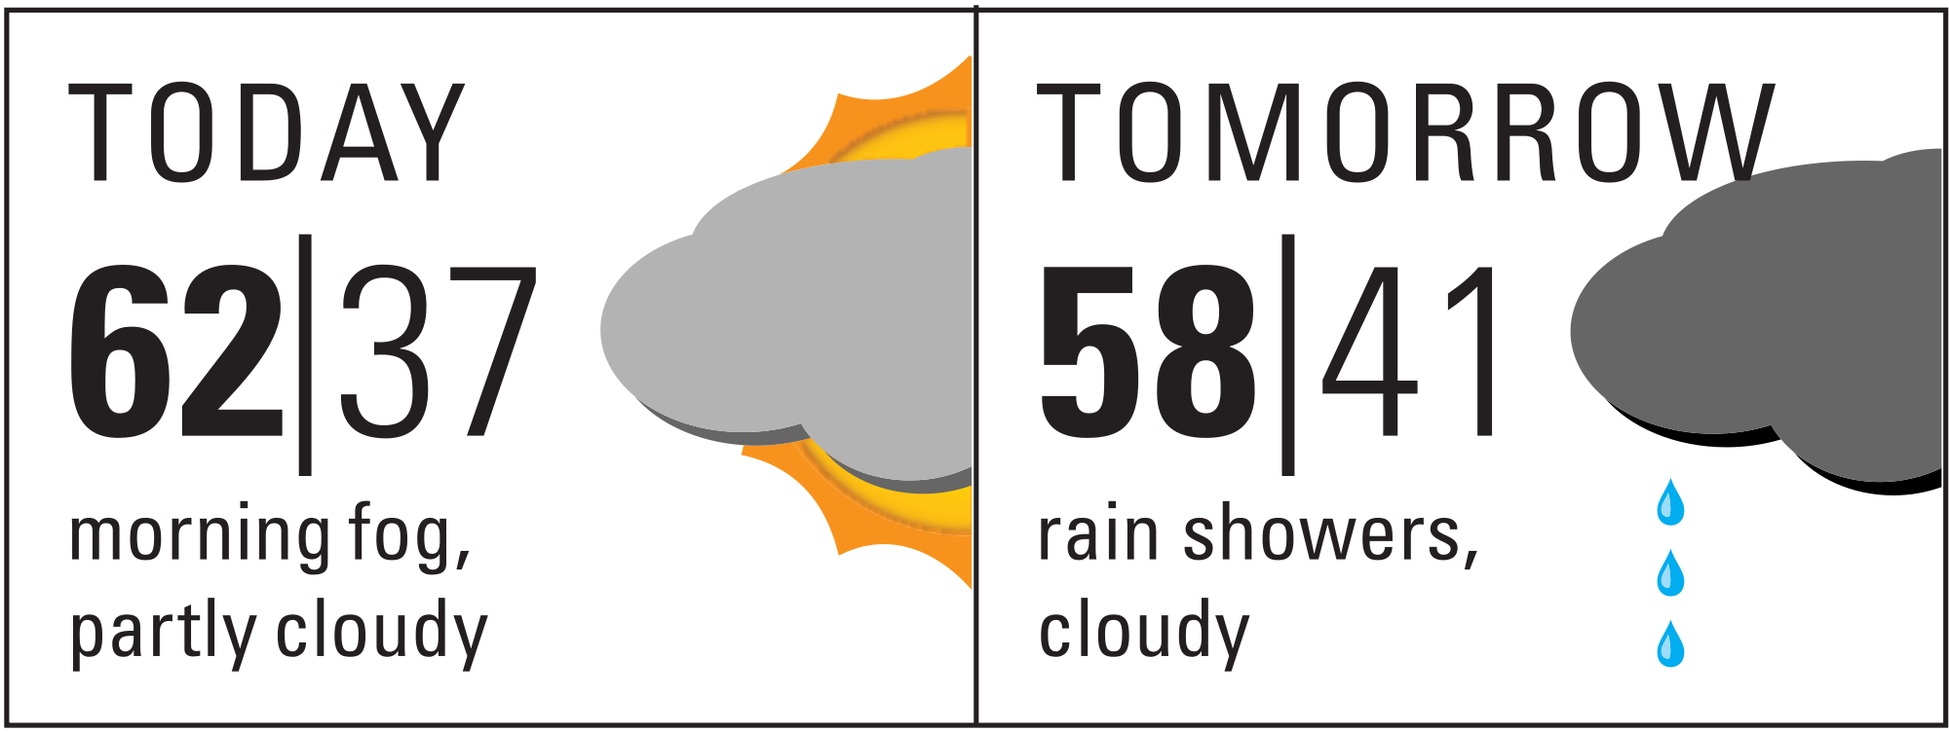



What’s tomorrow?
1010101010101010101010010010
Hey! It’s me…
Need weather advice
Hi
Sure! How is it since 10 years?

Slide 5
Background

Slide 6
Tools
Linear
Logistic
OLSR
PCA
QDA
LDA
Deep learning
Regression
Dimensionality reduction
Random Forest
Gradient based machines
Boosting
GBRT
Bagging
Machine Learning
Naive bayes
Gausian naive bayes
Bayesian network
Machine learning
Ensemble
Bayesian
Neural
networks
Clustering
Decision tree
K-Means
K-Medians
EM
Hierarchial clustering
Notes:
Classify a given set of people into male and female depending on the their genetic data.
So the classification problem groups data into clumps of internally related data groups.

Slide 7


Principal Component Analysis: Algebraic View
PC1
Feature 2
$$M(x_{1},x_{2})$$
PC2
$$θ$$
Feature 1
Notes:
Computer

Slide 8
Decision Trees and CART
Recursive partitioning of the training set
to obtain pure subsets
Subset selected by going through all possible splits for each feature
Selection based on chosen splitting criterion.
E.g. Gini index: leads to a 0 impurity when all records belong to the same class

Slide 9
Input Analysis

Slide 10
Input structure
10948 Observations
About:
Cateogrical:Location, RainToday, RainTomorrow
Numerical:temp, rainfall, evaporation, pressure, humidity, windSpeed, cloud, longitude, latitude

Slide 11
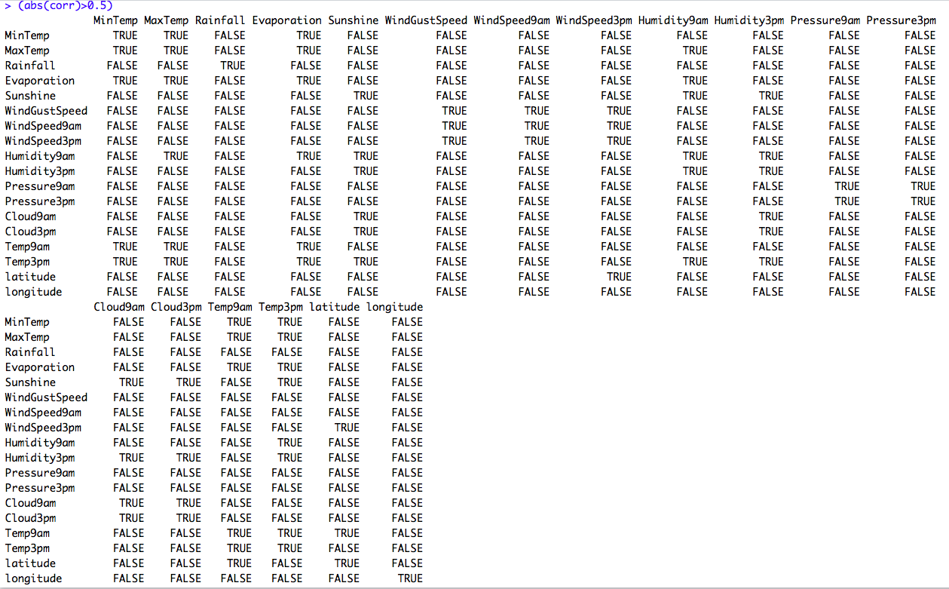
Input structure
cor > 0.5
False | True
248 | 76

Slide 12
Process Model
Dividing observations into
75% training data and
25% test data
Principal Component Analysis on the train data
Rpart Model using PC for test data
Evaluation of test data

Slide 13
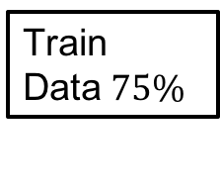
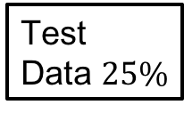
Numbers to patterns
Climate
Information
PCA
Decision
Tree
Validate
Temperature
Pressure
Wind
Location…
Train
Data$75\%$
Test
Data $25\%$
Notes:
Computer

Slide 14
Principal Component Analysis
"sdev”: Standard deviation on principal components
"rotation”: Rotation axes
"center" : Center at (0,0)
"scale" : Normalise data
"x”: Transformed training points

Slide 15
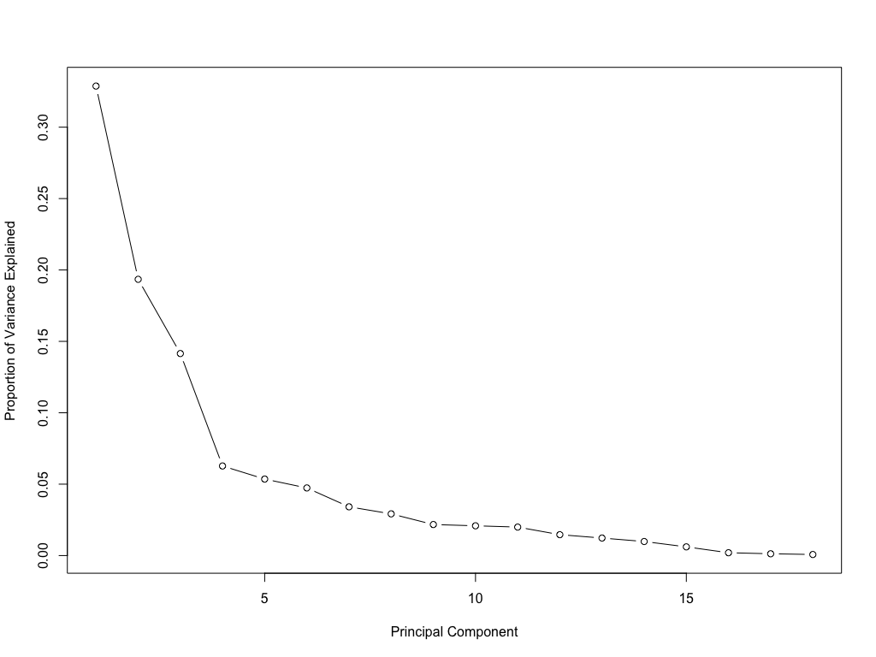
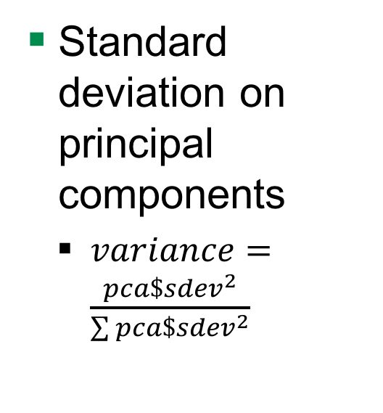
Principal Component Analysis: sdev
Standard deviation on principal components
$variance=\frac{{pca\$sdev}^{2}}{\sum{{pca\$sdev}^{2}}}$
Proportion of Variance
Principle Components

Slide 16
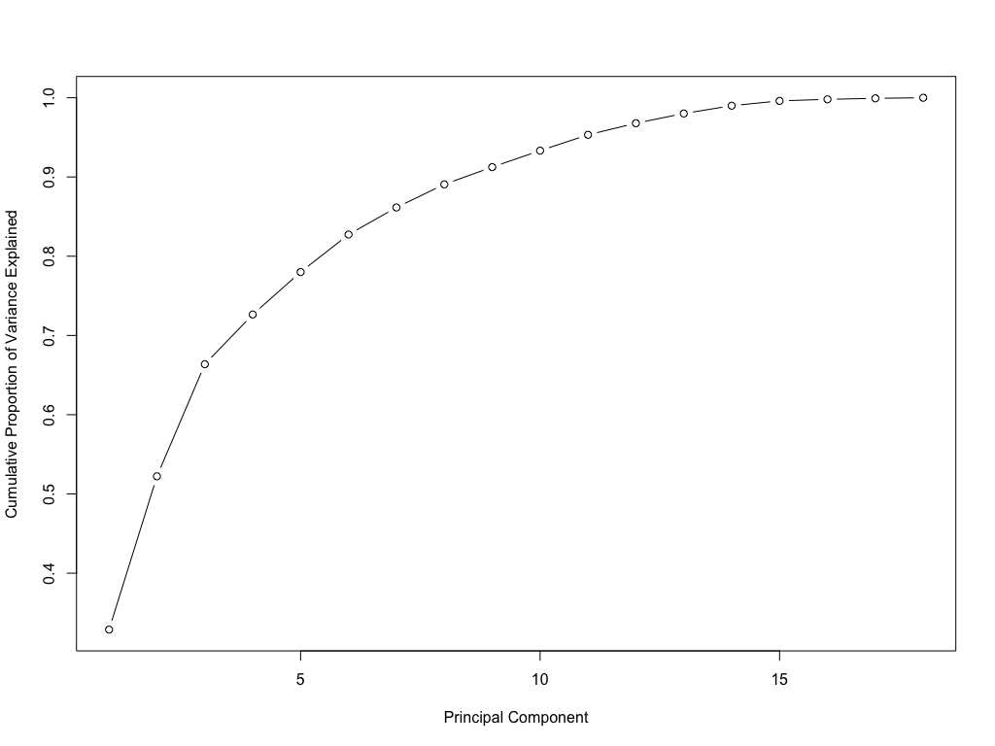
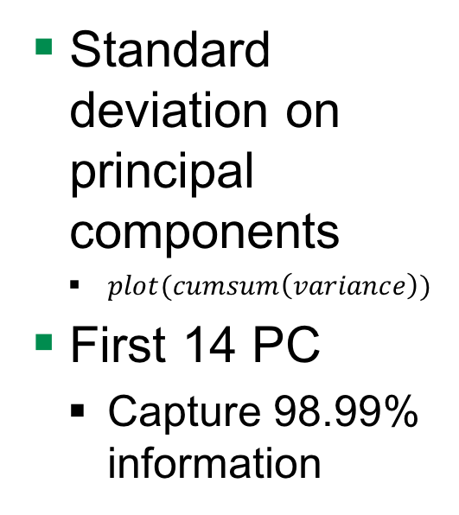
Principal Component Analysis: sdev
Standard deviation on principal components
$plot(cumsum\left(variance\right))$
First 14 PC
Capture 98.99% information
Cumulative Proportion of Variance
Principle Components

Slide 17

Rpart Prediction
Run a decision tree
Transform test data into PCA
Using $predict$ function
Select the first $14$ PC
Make prediction on test data
Using $predict$ function

Slide 18
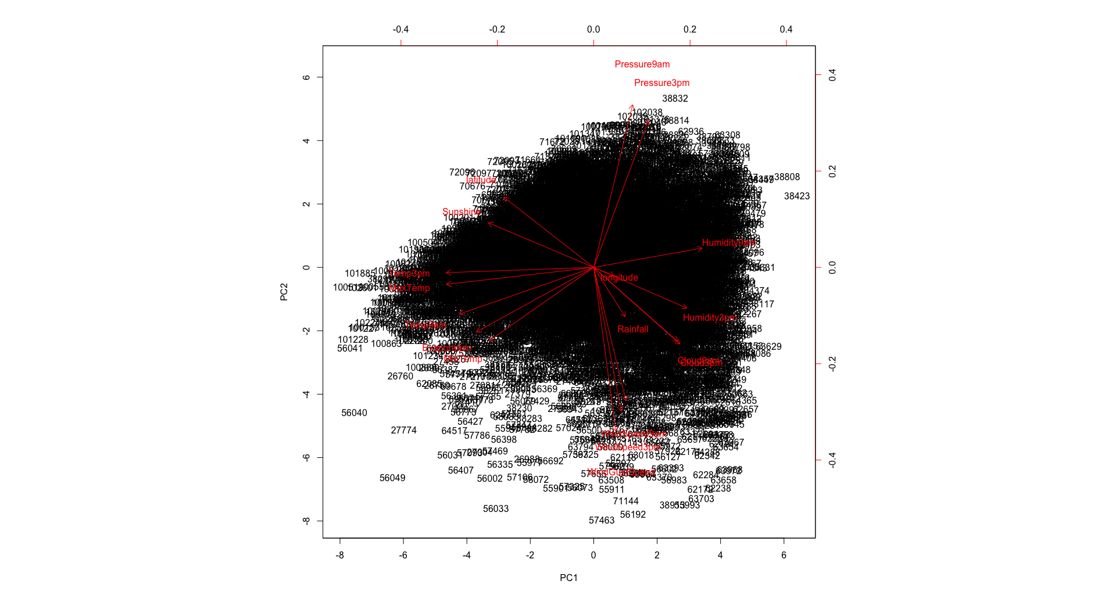
Principal Components
biplot(pca)
PC1 vs PC2

Slide 19
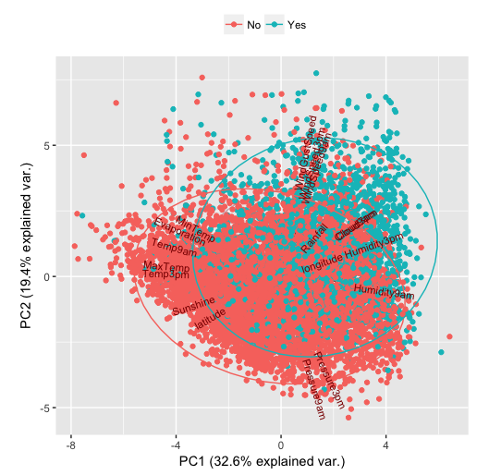
Principal Components
ggbiplot(pca)
PC1 vs PC2

Slide 20
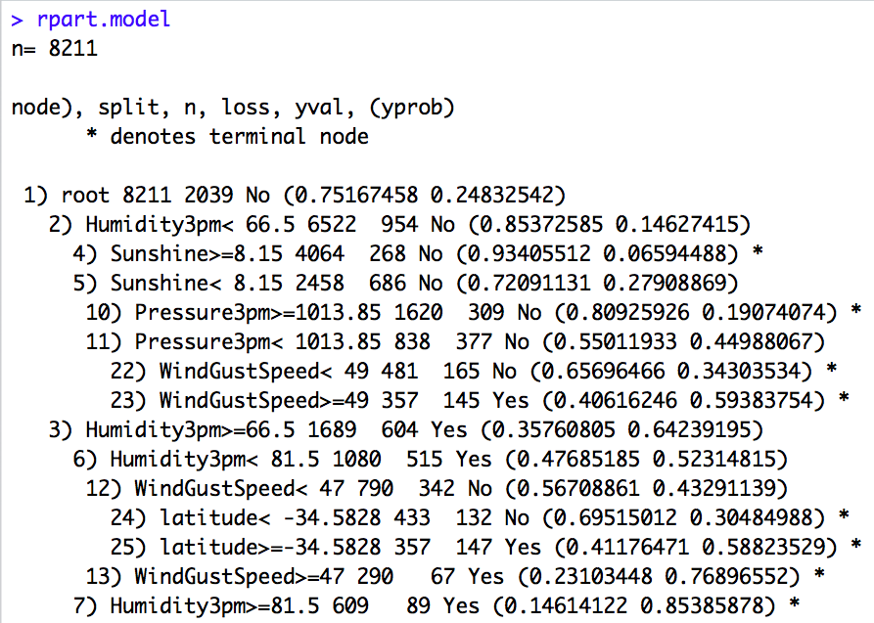
Evaluation results: Decision Tree
Notes:
Every data point is scored based on its outlierness in an increasing scale of figure.
Normal data to noise to anomalies.
However, there only seems a semantic boundary between these points.
Interests of the analysts distinguish weak outliers from strong ones
One way is to get feedback from previously known outlier points called supervised classification of outlier points.
For this we need labels for both normal and abnormal data
Outliers are different from the noise data
Noise is random error or variance in a measured variable
Noise should be removed before outlier detection
Outliers are interesting: It violates the mechanism that generates the normal data

Slide 21
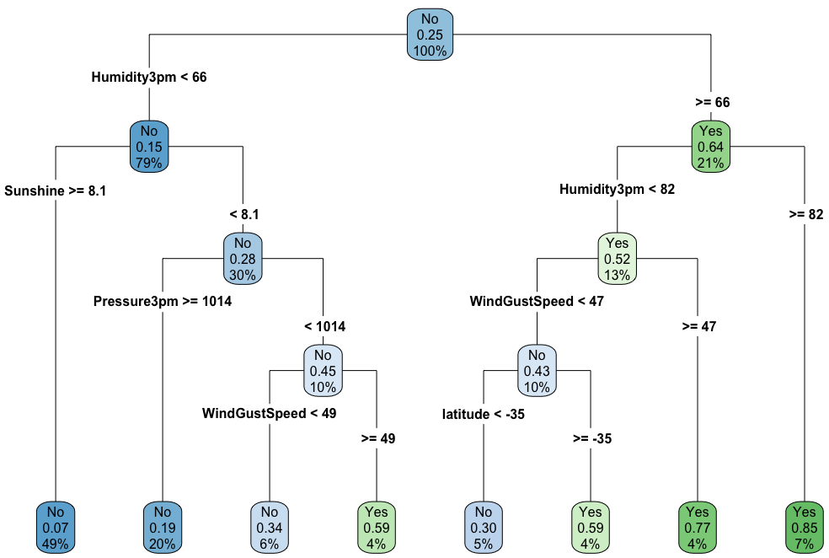
Evaluation results: Decision Tree
Notes:
Every data point is scored based on its outlierness in an increasing scale of figure.
Normal data to noise to anomalies.
However, there only seems a semantic boundary between these points.
Interests of the analysts distinguish weak outliers from strong ones
One way is to get feedback from previously known outlier points called supervised classification of outlier points.
For this we need labels for both normal and abnormal data
Outliers are different from the noise data
Noise is random error or variance in a measured variable
Noise should be removed before outlier detection
Outliers are interesting: It violates the mechanism that generates the normal data

Slide 22

Evaluation results: Test Data
Accuracy
$\frac{1878+372}{1878+155+332+372}=82\%$
 | No | Yes
No | 1878 | 155
Yes | 332 | 372
Notes:
Every data point is scored based on its outlierness in an increasing scale of figure.
Normal data to noise to anomalies.
However, there only seems a semantic boundary between these points.
Interests of the analysts distinguish weak outliers from strong ones
One way is to get feedback from previously known outlier points called supervised classification of outlier points.
For this we need labels for both normal and abnormal data
Outliers are different from the noise data
Noise is random error or variance in a measured variable
Noise should be removed before outlier detection
Outliers are interesting: It violates the mechanism that generates the normal data

