Slide 1
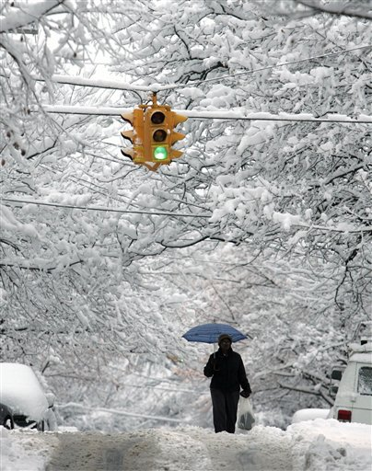
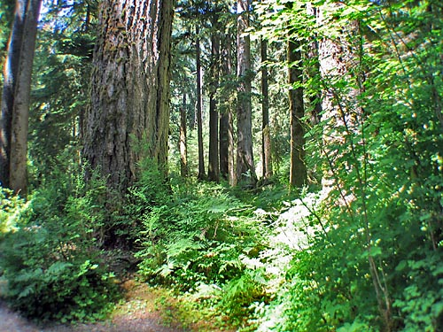
Climate

Slide 2
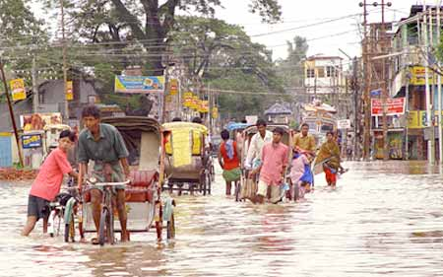
Climate is…
An area’s long-term pattern of weather.
It includes characteristics such as how hot summers are, how cold winters are, and how much precipitation falls at different times of year.
2 main characteristics:
Temperature &
Precipitation

Slide 3
Climate Controls
Climate depends on a set of conditions called climate controls. These include:
  Latitude: how much solar radiation a location receives.
  Proximity to water
  Altitude/Elevation
  Proximity to mountains
  Ocean currents
  Prevailing Winds

Slide 4
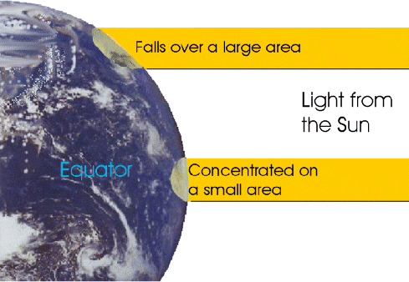
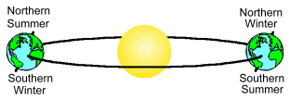
1. Latitude
A location’s position relative to the equator determines how much solar radiation it receives, and therefore affects its temperature.
*Remember as Earth revolves around the Sun, the tilt influences how much solar radiation a location receives & seasons change.

Slide 5
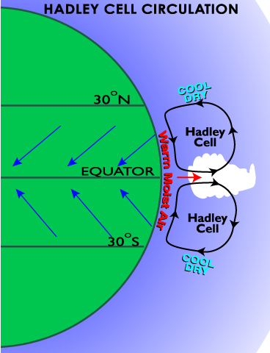
1. Latitude
Also, the latitude relative to convection cells in our troposphere affects precipitation.
Dry at 30 N & S
Moist at equator

Slide 6
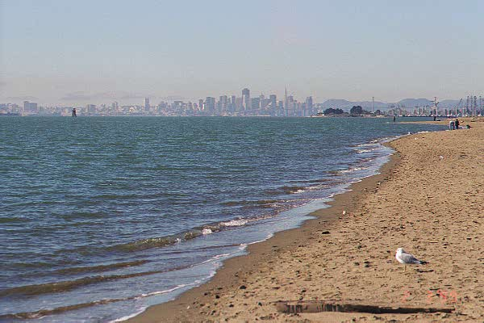
2. Proximity to Water
Because water heats and cools slowly, it has a low temperature range. Therefore land masses beside large bodies of water usually have mild climates.
Large bodies of water add water vapor to the air, so precipitation is more likely downwind of water
Ever heard of “lake effect” snow?

Slide 7
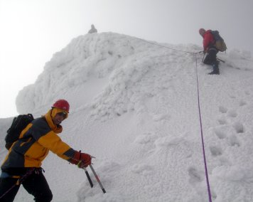
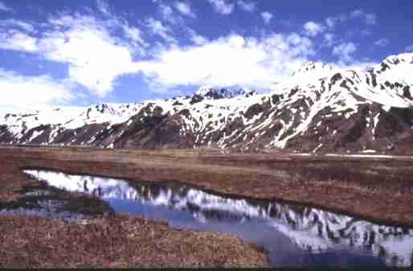
3. Altitude/Elevation
As you go up in the Troposphere (bottom layer of the atmosphere) temperature decreases.
Therefore, the higher the elevation of the land, the colder it is, generally.

Slide 8
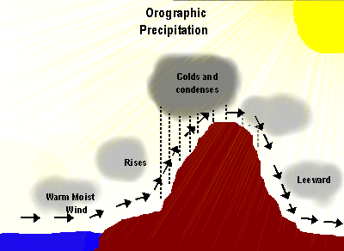
4. Proximity to Mountains
Mountains can affect precipitation by making a Rain Shadow.
On the windward side of the mountain, air is forced to rise. As it rises, it cools. As it cools, it loses its ability to hold water, and precipitation occurs on the windward side. As the air travels to the leeward side, it no longer contains moisture, the air is arid, or dry. This is why there are deserts on the east side of our Rocky Mountains

Slide 9
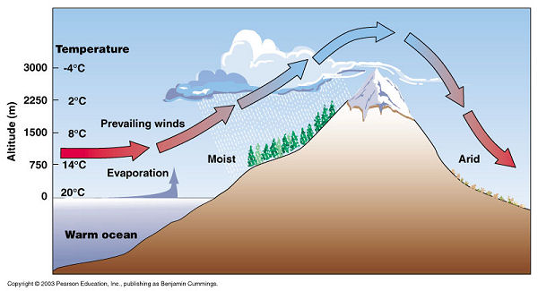
Result of Rain Shadow

Slide 10
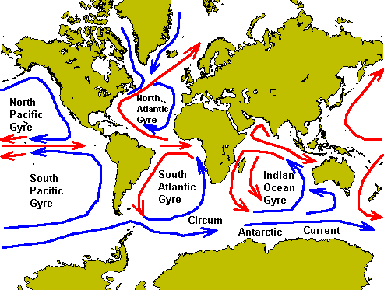
5. Ocean Currents
Global circulation of heat in the oceans moves heat energy around the world.
Use this map to help you answer the questions in your notes.

Slide 11
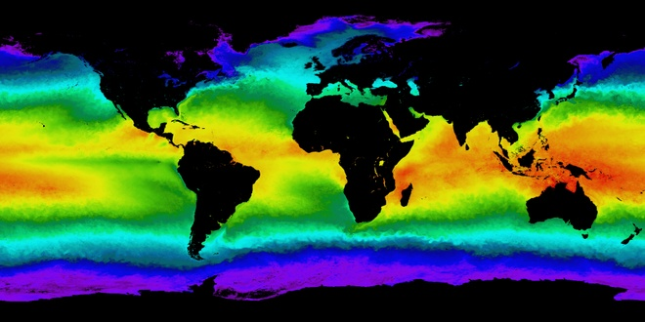
Warm Ocean Currents
Where is the water the warmest ? Why?

Slide 12
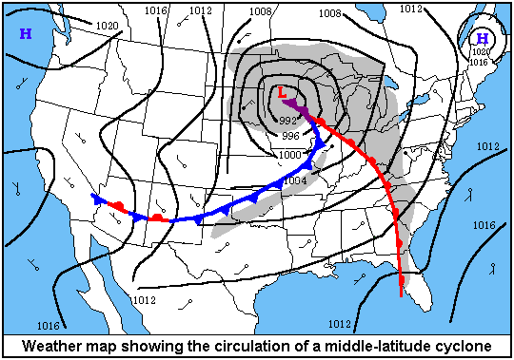
6. Prevailing Winds
Global Wind Patterns cause there to be a predominant wind direction in some areas. This influences the type of weather that approaches you.
Prevailing Westerlies cause weather patterns to move from west to east across the United States.
Answer the weather map review questions in your notes

Slide 13
Questions
Which factors affect our climate in Harrisonburg?
England has the same latitude as Canada. The climate of England is similar to our climate here. Why isn’t it cold and snowy like Canada?
Why is Nevada a desert?
Why does Buffalo, NY get so much snow?

Slide 14
Questions
Which factors affect our climate in Harrisonburg?Latitude, Altitude, Proximity to mountains, Prevailing winds
England has the same latitude as Canada. The climate of England is similar to our climate here. Why isn’t it cold and snowy like Canada? Proximity to water (Ocean), and prevailing winds (Westerlies)
Why is Nevada a desert? Due to the Rain Shadow, and it’s 30º North latitude
Why does Buffalo, NY get so much snow? Proximity to water (Evaporation from the Great Lakes), and prevailing Westerlies, and Altitude

