Slide 1
A Convolutional Neural Network for Image Classification of Cats and Dogs
Status update

Slide 2
Structure
Neural Nets (NN)
Convolution NN (CNN)
Hyperparameters
Problem
Evaluation

Slide 3
Neural Nets

Slide 4
Introduction – Neural Nets
W₁₁
W’₁₁
W₁₂
W’₁₂
…
…
W_{1n}
W’_{1n}
Input
Hidden
Hidden
Output
Quelle: http://cs231n.github.io/convolutional-networks/
Notes:
Based on pretty basic ideas
Image is a 2-D array of images
Looking at it CNN decides if Pictures is X or O.

Slide 5
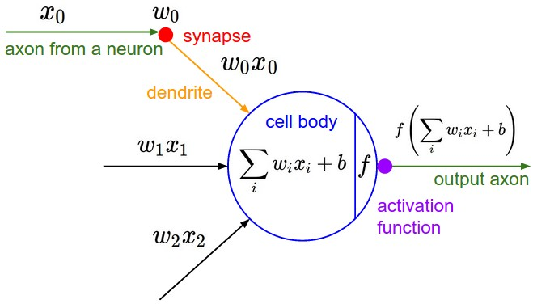
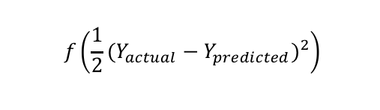
Neuron Model
Cost function
$$f\left(\frac{1}{2}{(Y_{actual}−Y_{predicted})}^{2}\right)$$

Slide 6





Mathematical view
Actual output, weights
Compute Sigmoid (activation function)
Measure how much we missed (cost function)
Multiply error by the Sigmoid slope
Update weights (backpropagation)
$l_{0}=X_{i}$, W = rand()
$l_{1}=Sig\left(X_{i} . W\right)$
Err = $l_{0}−l_{1}$
${∆l}_{1}$ = Err*$∆\left(Sig\left(Err\right)\right)$
W = W+$α$($l_{0}.{∆l}_{1}$)

Slide 7
Activation Functions
Non-Linear
Sigmoid, tanh
Continuous but not everywhere differentiable function
Relu
Notes:
elu, softplus, and softsign
relu6, crelu and relu_x

Slide 8
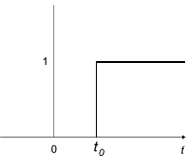
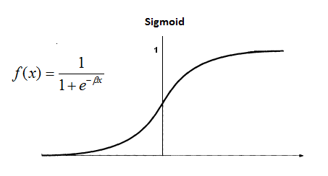
Activation functions - Sigmoid
Motivation
Not telling in which direction should we move in.
Non-differentiability at certain points

Slide 9
Motivation for CNN
Number of parameters
x₁
x₂
x₃
x₄
x₅
x₆
x₇
x₈
x₉
x₁ | x₂ | x₃
x₄ | x₅ | x₆
x₇ | x₈ | x₉
Input
Transformed input

Slide 10
Motivation for CNN
NN
High number of params
CNN
Lower number of params
x₁
x₂
x₃
x₄
x₅
x₆
x₇
x₈
x₉
x₁ | x₂ | x₃
x₄ | x₅ | x₆
x₇ | x₈ | x₉
x₁
x₂
x₃
x₄
x₅
x₆
x₇
x₈
x₉
…
Number of weights: 36
Number of weights: 4

Slide 11
Convolutional NN

Slide 12


Slide 13

TensorFlow
Developed by Google Brain team
Use cases
Handwritten patterns, image recognition, Word2Vec
Input data
Audio, image, text
Used techniques
Linear classifiers, NN, CNN
Notes:
Google Brain Team is a deep learning research project at Google
Linear classifier for Linear relation

Slide 14
Structure of the CNN we used
input
conv
pool
norm
conv
norm
pool
local
local
Softmax linear
Notes:
NN with multiple hidden layers, because it is passed to several non-linearity functions -> Deep learning
Over time the original image is reduced in size more and more
Deep stacking is increasing the training time
Relatively simple structure to keep training time low

Slide 15
Input layer
Image cropping
Distortions
Randomly flipping
Randomly changing brightness
Randomly changing contrast
input
conv
pool
norm
conv
norm
pool
local
local
Softmax linear
Notes:
NN with multiple hidden layers, because it is passed to several non-linearity functions -> Deep learning

Slide 16
Convolutional layer - Filter
Input
Filter
Output
0 | 0 | 0 | 0 | 0 | 0 | 0
0 | 2 | 1 | 0 | 0 | 2 | 0
0 | 2 | 2 | 2 | 0 | 2 | 0
0 | 1 | 2 | 0 | 2 | 0 | 0
0 | 2 | 1 | 2 | 1 | 2 | 0
0 | 1 | 2 | 1 | 0 | 0 | 0
0 | 0 | 0 | 0 | 0 | 0 | 0
0 | 0 | 0
0 | 2 | 1
0 | 2 | 2
1
1*0 + 2*0 + 0*0 +
0*0 + 0*2 + 0*1 +
0*0 + 0*2 + 0*2 +
1 = 1
Bias
1
http://cs231n.github.io/convolutional-networks/
input
conv
pool
norm
conv
norm
pool
local
local
Softmax linear
Notes:
NN with multiple hidden layers, because it is passed to several non-linearity functions -> Deep learning
Dot-product

Slide 17
Convolutional layer - Parameters
Input volume size
Number of filters
Filter size
Step size
Zero padding
Input
Filter
0 | 0 | 0 | 0 | 0 | 0 | 0
0 | 2 | 1 | 0 | 0 | 2 | 0
0 | 2 | 2 | 2 | 0 | 2 | 0
0 | 1 | 2 | 0 | 2 | 0 | 0
0 | 2 | 1 | 2 | 1 | 2 | 0
0 | 1 | 2 | 1 | 0 | 0 | 0
0 | 0 | 0 | 0 | 0 | 0 | 0
0 | 0 | 0
0 | 2 | 1
0 | 2 | 2
input
conv
pool
norm
conv
norm
pool
local
local
Softmax linear
Notes:
NN with multiple hidden layers, because it is passed to several non-linearity functions -> Deep learning
Volume size is width x heigth x depth
Input volume size – resized image
Number of filters – number of features we tryin to extract
- feature (fur of cat)
Filter size
- Small, to keep number of params low
- If too large size data is lost
- Smaller would be to detailed
Step size
- Increase params get lower
- Decrease params get higher and prediction better
Zero padding
- To keep spatial dimensions

Slide 18
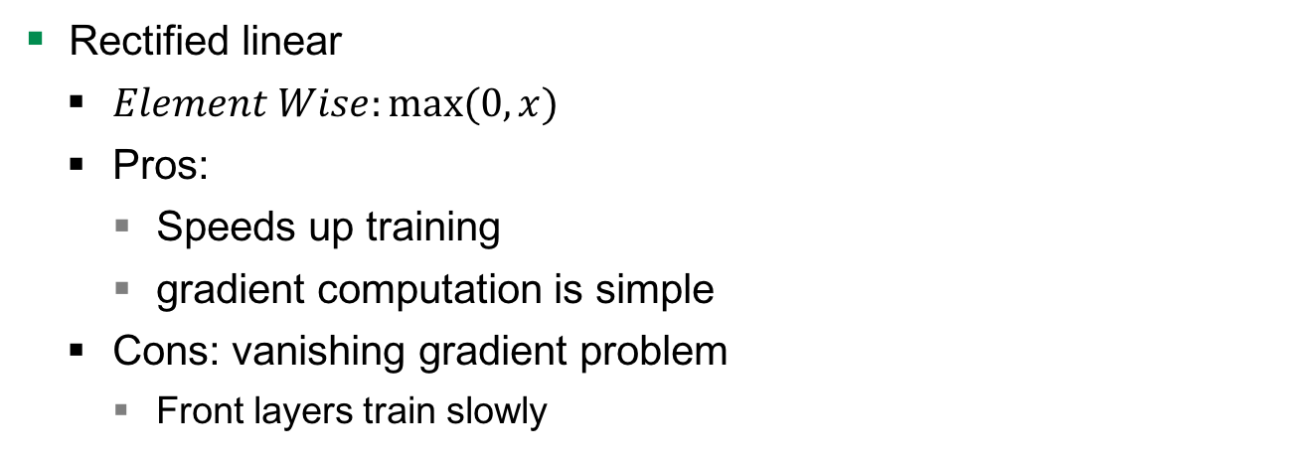
Convolutional layer – Activation function
Rectified linear
$Element Wise:max⁡(0, x)$
Pros:
Speeds up training
gradient computation is simple
Cons: vanishing gradient problem
Front layers train slowly
input
conv
pool
norm
conv
norm
pool
local
local
Softmax linear
Notes:
NN with multiple hidden layers, because it is passed to several non-linearity functions -> Deep learning
Volume size is width x heigth x depth

Slide 19
Pool layer – Max pooling
Reduce the spatial dimension of an image
1 | 1 | 2 | 4
5 | 6 | 7 | 8
3 | 2 | 1 | 0
1 | 2 | 3 | 4
6 | 8
3 | 4
http://cs231n.github.io/convolutional-networks/
input
conv
pool
norm
conv
norm
pool
local
local
Softmax linear
Notes:
Get rid of large amount of data and make computation less intensive

Slide 20
Norm layer
a₁
a₂
4D-array
3D-array of 1D-vector
Normalize each element of this1D-vector
a₃
…
a₁ | a₂ | a₃ | …
input
conv
pool
norm
conv
norm
pool
local
local
Softmax linear
Notes:
NN with multiple hidden layers, because it is passed to several non-linearity functions -> Deep learning
Weights cannot exceed any limit
Update weights is easier

Slide 21

Norm layer
RGB
RGB
RGB
Normalize each element of this1D-vector
a₁
a₂
a₃
…
a₁ $=\left(\left(\frac{R}{\sqrt{R^{2}+G^{2}+B^{2}}}\right),\left(\frac{G}{\sqrt{R^{2}+G^{2}+B^{2}}}\right)\text{, }\left(\frac{B}{\sqrt{R^{2}+G^{2}+B^{2}}}\right)\right)$
a₁ | a₂ | a₃ | …
input
conv
pool
norm
conv
norm
pool
local
local
Softmax linear
Notes:
NN with multiple hidden layers, because it is passed to several non-linearity functions -> Deep learning
Weights cannot exceed any limit
Update weights is easier

Slide 22
Local layer
Fully connected
x₁
x₂
x₃
x₄
x₅
x₆
x₇
x₈
x₉
x₁ | x₂ | x₃
x₄ | x₅ | x₆
x₇ | x₈ | x₉
…
input
conv
pool
norm
conv
norm
pool
local
local
Softmax linear
Notes:
NN with multiple hidden layers, because it is passed to several non-linearity functions -> Deep learning

Slide 23
Softmax-linear layer
Softmax output function
Cost measure for softmax
input
conv
pool
norm
conv
norm
pool
local
local
Softmax linear
Notes:
NN with multiple hidden layers, because it is passed to several non-linearity functions -> Deep learning

Slide 24




Softmax output function
Soft continuous version of Max Function
Forces$\sum{(Output of NN) }=1$.
$$Y_{i}= \frac{e^{Z_{i}^{ }}}{\sum_{j ∈group}^{ }{e^{Z_{j}}}}$$
$$Z_{i}$$
$$Y_{i}$$
input
conv
pool
norm
conv
norm
pool
local
local
Softmax linear
Notes:
NN with multiple hidden layers, because it is passed to several non-linearity functions -> Deep learning

Slide 25
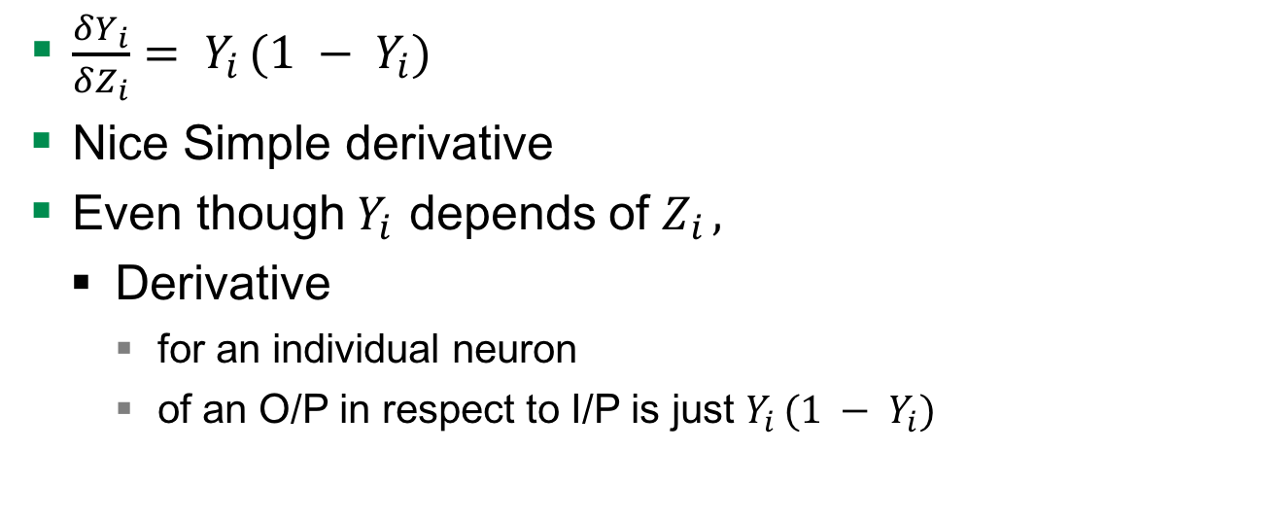


Softmax output function
$\frac{δY_{i}}{δZ_{i}}= Y_{i }(1 − Y_{i})$
Nice Simple derivative
Even though$Y_{i }$depends of $Z_{i },$
Derivative
for an individual neuron
of an O/P in respect to I/P is just $Y_{i }(1 − Y_{i})$
$$Z_{i}$$
$$Y_{i}$$
input
conv
pool
norm
conv
norm
pool
local
local
Softmax linear
Notes:
NN with multiple hidden layers, because it is passed to several non-linearity functions -> Deep learning

Slide 26
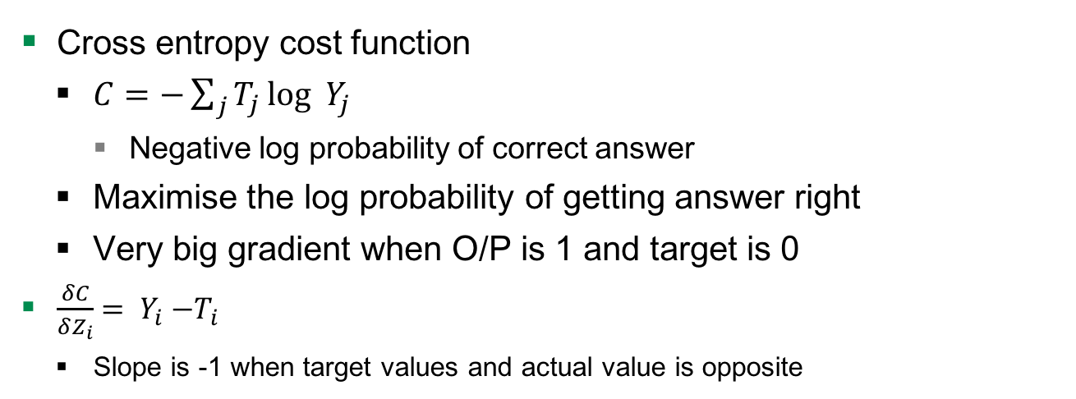
Cost measure for softmax
Cross entropy cost function
$C=−\sum_{j}^{ }{T_{j}}\log_{ }{Y_{j }}$
Negative log probability of correct answer
Maximise the log probability of getting answer right
Very big gradient when O/P is 1 and target is 0
$\frac{δC}{δZ_{i}}= Y_{i}{ −T}_{i}$
Slope is -1 when target values and actual value is opposite
input
conv
pool
norm
conv
norm
pool
local
local
Softmax linear
Notes:
If you are using softmax o/p then what is the right cost function

Slide 27
Hyperparameters

Slide 28
Learning Rate
How fast the network trains
High learning rate
Convergence or global minimum finding is problem
Low learning rate
High training times

Slide 29
Learning Rate decay
Learning rate decay means the learning rate decreases over time
higher learning rate is well suited to get close to the global minimum
small learning rate is better at fine tuning the global minimum
Several way
Exponential decay, reduction by factor of n
Function to decrease the learning rate by 4%

Slide 30
Overfitting or Underfitting

Slide 31
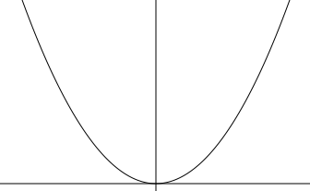

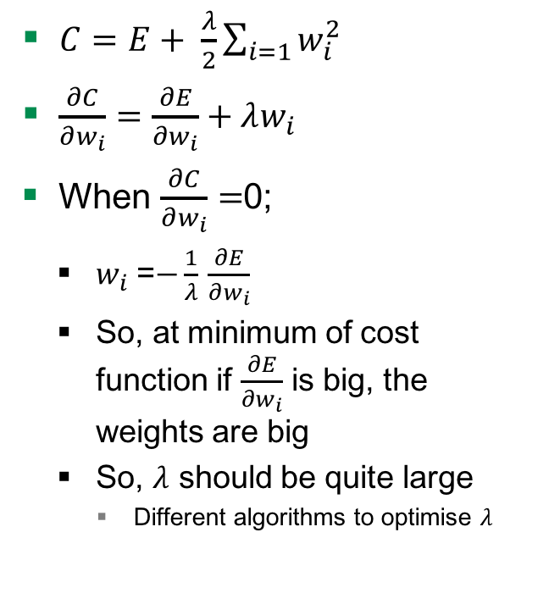
Weight Penalty
$C=E+ \frac{λ}{2}\sum_{i=1}{w_{i}^{2}}$
$\frac{∂C}{∂w_{i}}=\frac{∂E}{∂w_{i}}+λw_{i}$
When $\frac{∂C}{∂w_{i}}=$0;
$w_{i}$ =$−\frac{1}{λ}$ $\frac{∂E}{∂w_{i}}$
So, at minimum of cost function if $\frac{∂E}{∂w_{i}}$ is big, the weights are big
So, $λ$ should be quite large
Different algorithms to optimise $λ$
Adding $λ$to penalise
Keeps weight small
Big error derivatives
C
W
Notes:
Derivative of penalty is the force pulling down to zero

Slide 32


Weight Penalty - Advantages
Preventing network from the weights it does not need
Don’t have a lot of weights not doing anything
So output changes more slowly as input changes.
Putting half the weight on each and not on one
W
0
$$\frac{w}{2}$$
$$\frac{w}{2}$$

Slide 33
Structure of the CNN we used
24 x 24 x 3
128 x 24 x 24 x 3
128 x 24 x 24 x 64
128 x 12 x 12 x 64
128 x 12 x 12 x 64
128 x 12 x 12 x 64
128 x 12 x 12 x 64
128 x 6 x 6 x 64
128 x 384
128 x 192
Output: 128 x 2
input
conv
pool
norm
conv
norm
pool
local
local
Softmax linear
Notes:
NN with multiple hidden layers, because it is passed to several non-linearity functions -> Deep learning
Over time the original image is reduced in size more and more

Slide 34
Problem

Slide 35
The data
Images of cats and dogs
File format is *.jpg
Color space is RGB

Slide 36
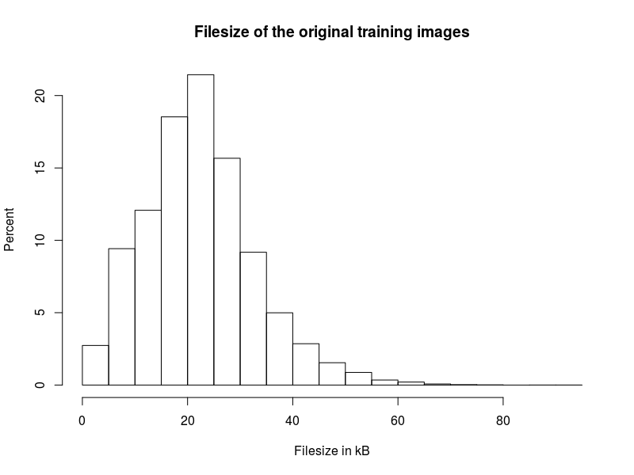
Data
25,000 images
12,500 of dogs
12,500 of cats
Avg. file size
22.34 kB

Slide 37
Train and test data
Split data
Train data
20,000 images (80 percent)
Divided into 5 batches containing 4,000 each
Test data
5,000 images (20 percent)

Slide 38
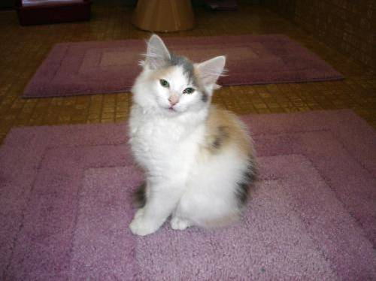
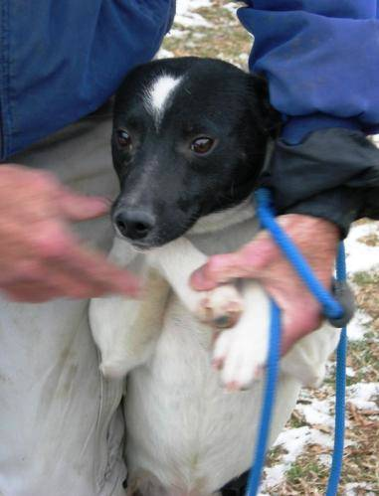
Process images
Resize to 32 * 32 * 3 = 3,072
Convert to array
25,000 * 3,073
cat10.jpg
dog1.jpg

Slide 39


Process images
Resize to 32 * 32 * 3
Convert to array
25,000 * 3,073
Example
1; 22; 11; 123; …
0; 256; 255; 0; …
cat10.jpg
dog1.jpg
Notes:
Thats what the computer sees

Slide 40
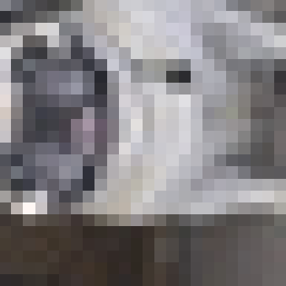


Random distorsion

Slide 41
Evaluation

Slide 42
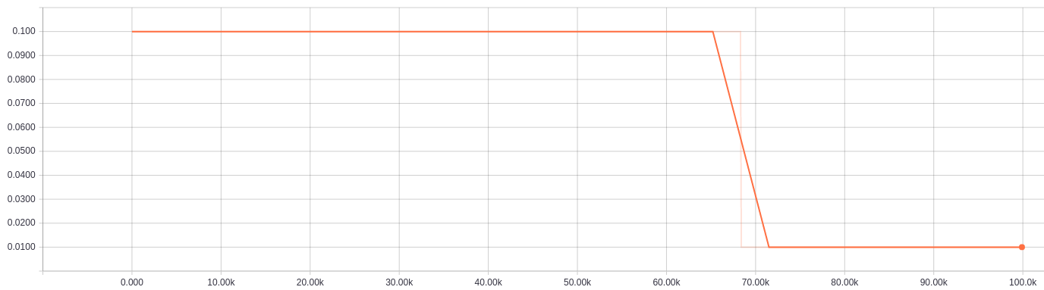
Learning rate

Slide 43
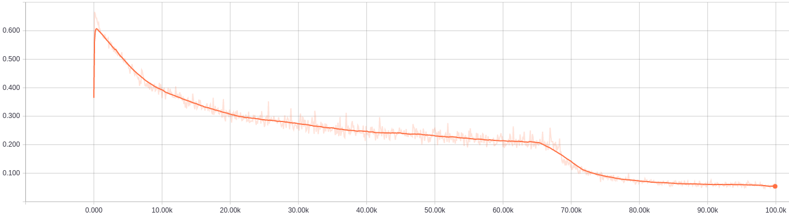
Cross-entropy

Slide 44
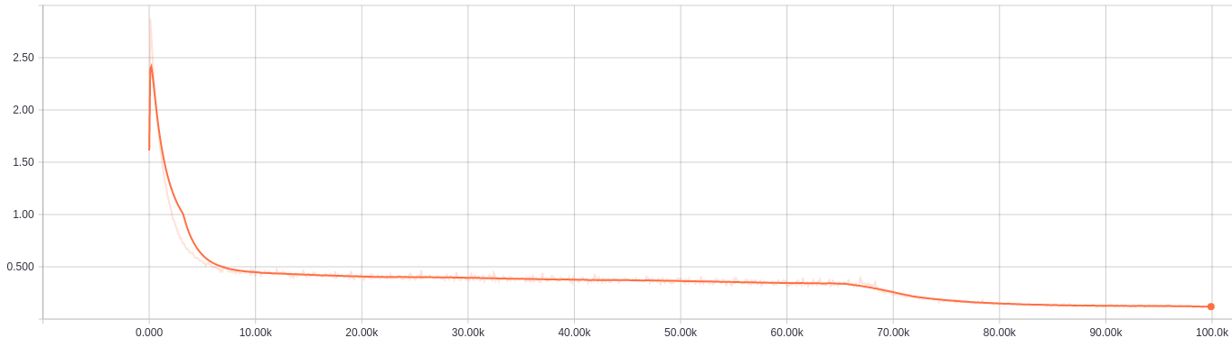
Total loss
Total loss after 100k steps roughly above 0.1

Slide 45
Summarize
Understood a CNN
Trained it
Total loss is decreasing over time
Precision just above 0.1

Slide 46
Questions

Slide 47
Quellen
http://cs231n.github.io/convolutional-networks/
https://www.tensorflow.org/tutorials/deep_cnn/
Maas, Andrew L., Awni Y. Hannun, and Andrew Y. Ng. "Rectifier nonlinearities improve neural network acoustic models." Proc. ICML. Vol. 30. No. 1. 2013.

