Slide 1
Convolutional NN for Image Classification
Dogs Vs Cats Classification Problem

Slide 2
Today‘s Talk
Problem Statement
Introduction to Deep Learning
Layers In Deep Learning
TensorFlow (TF)
Data-Structure for TensorFlow
Implementation in TF
Inputs
Prediction
Training
Evaluation
Results
Future Works

Slide 3
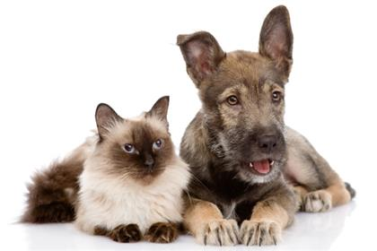
Problem Statement
I am DOG
...No No...
I am CAT

Slide 4
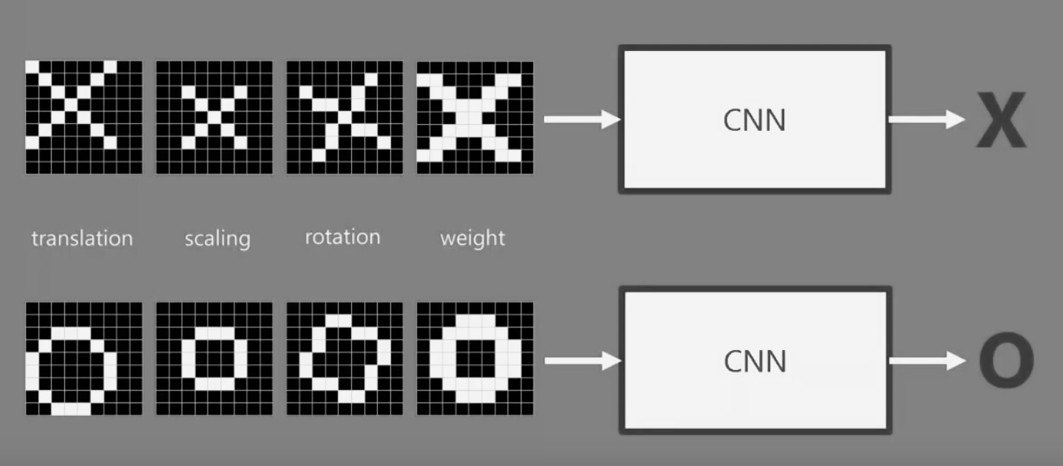
Problem Statement - Explained
Neural Net
NN
Neural Net

Slide 5
Introduction – Neural Nets
W₁₁
W’₁₁
W₁₂
W’₁₂
W_{1n}
W’_{1n}
Input
Hidden
Hidden
Output
Quelle: http://cs231n.github.io/convolutional-networks/
Notes:
Based on pretty basic ideas
Image is a 2-D array of images
Looking at it CNN decides if Pictures is X or O.

Slide 6
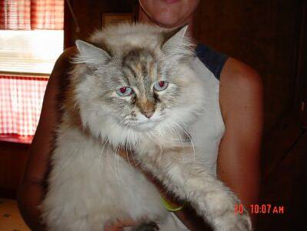
Why not just Neural Nets?
I/P 32*32*3 = 3072
Weights 3072 * N
Biases N
So,
Full connectivity is wasteful
Huge number of parameters

Slide 7
Convolutional Neural Network (CNN)
CNN
CNN
Notes:
What Computers See
When using If and else, we can not say that if it is X or O
If the pixels do not match for a given X and rotated X then it can either do or not do.

Slide 8
CNN Layers
INPUT
CONV
RELU
POOL
FC

Slide 9


CNN – Conv Layer
1
.11
-1 | 1 | -1
1 | 1 | 1
-1 | 1 | -1
1 | 1 | 1
1 | 1 | 1
1 | 1 | 1
$$1/9$$
Feature 1

Slide 10
Input
Filter
Output
0 | 0 | 0 | 0 | 0 | 0 | 0
0 | 2 | 1 | 0 | 0 | 2 | 0
0 | 2 | 2 | 2 | 0 | 2 | 0
0 | 1 | 2 | 0 | 2 | 0 | 0
0 | 2 | 1 | 2 | 1 | 2 | 0
0 | 1 | 2 | 1 | 0 | 0 | 0
0 | 0 | 0 | 0 | 0 | 0 | 0
0 | 0 | 0
0 | 2 | 1
0 | 2 | 2
1
1*0 + 2*0 + 0*0 +
0*0 + 0*2 + 0*1 +
0*0 + 0*2 + 0*2 +
1 = 1
Bias
1
Notes:
Numbers are irrelevant
If the filter can be applied

Slide 11
Result= Stack of Filtered images
Stack of Images
Features
Input Image
Notes:
Higher Probabilities appear in the feature shown

Slide 12
CNN – POOL
.55 | .77
.33 | .99
.99
 | .77
 |  | .55
 |  |  | .77

Slide 13

CNN – RELU
$$Element Wise:max⁡(0, x)$$
 | .77
.33 | .99
 | .77
.33 | .99
-0.99
0

Slide 14
TensorFlow
Wird von Google genutzt und entwickelt
Anleitungen:
Handschrift erkennen, Bilderkennung, Deep Neural Network Classifier, Word2Vec
Input
Audio, Bilder, Text
Techniken
Lineare Modelle, Regression, Neuronale Netze

Slide 15
The data
Images …
.jpg ...
Cats
Dogs

Slide 16
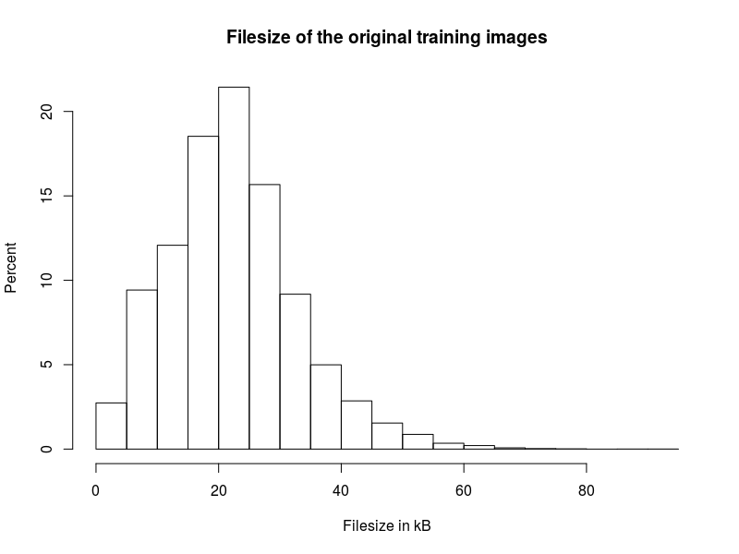
Training data
25 000 images
12 500 of dogs
12 500 of cats
Avg. file size
22.34 kB

Slide 17
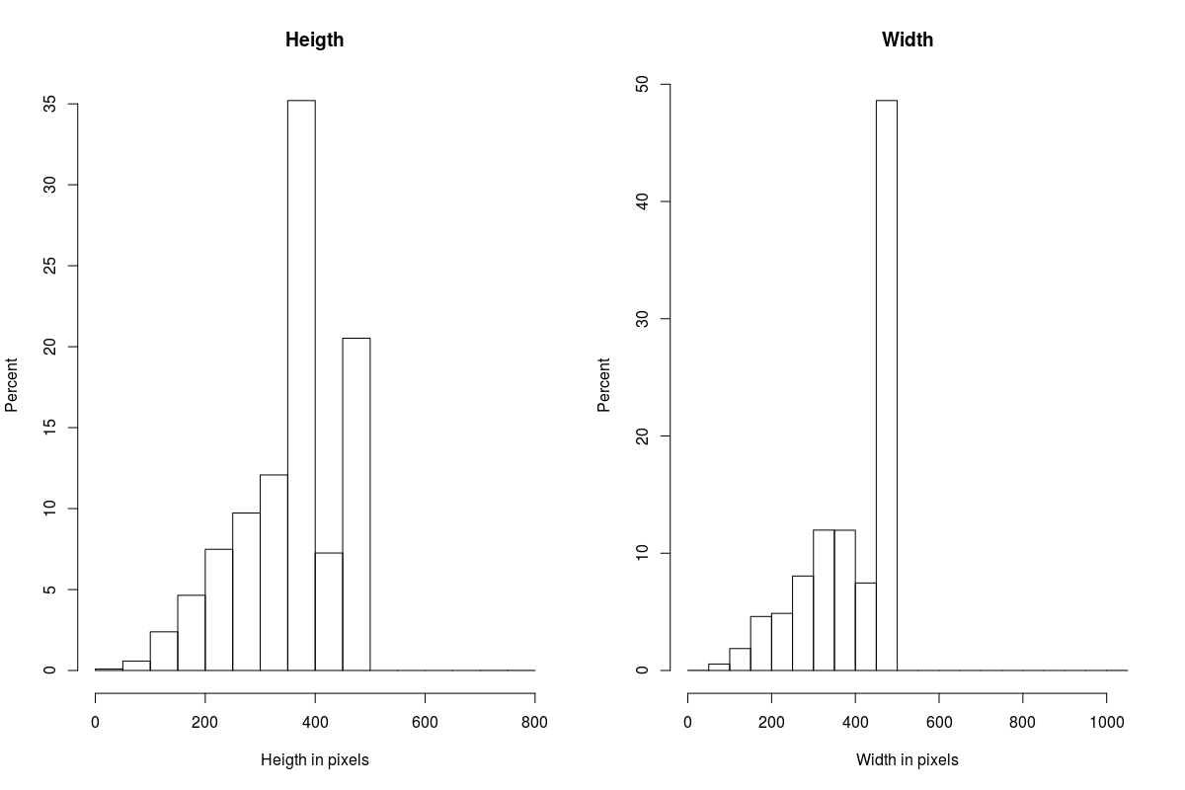
Ratio

Slide 18
Test data
12 500 images

Slide 19
Process images
Resize to 32 * 32 * 3

Slide 20
Limitations
150 images viewed
1 duplicate
1 wrong content
Training lasts long
Reduced image size

Slide 21
Structure of the CNN used

Slide 22
TF Implementation: Prediction
Cifar10.Inference()
Conv1: convolution and rectified linear activation.
Pool1: max pooling.
Norm1: local response normalization.
Local3: fully connected layer with rectified linear activation.
Local4: fully connected layer with rectified linear activation.
Softmax_linear: Linear transformation to produce logits.

Slide 23
Cost Functions
Squared Error Measure
Softmax Cross-entropy Function

Slide 24
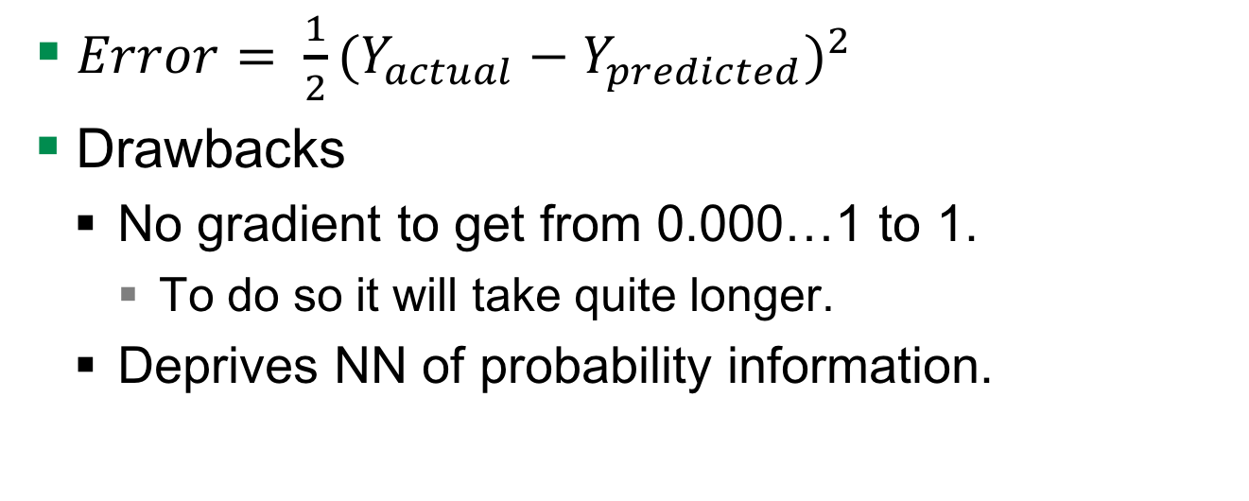
Squared Error Measure Function
$Error= \frac{1}{2}{(Y_{actual}−Y_{predicted})}^{2}$
Drawbacks
No gradient to get from 0.000…1 to 1.
To do so it will take quite longer.
Deprives NN of probability information.

Slide 25
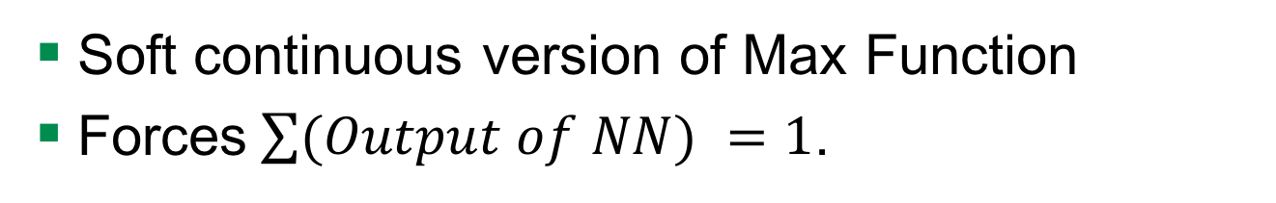
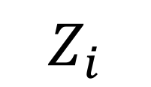

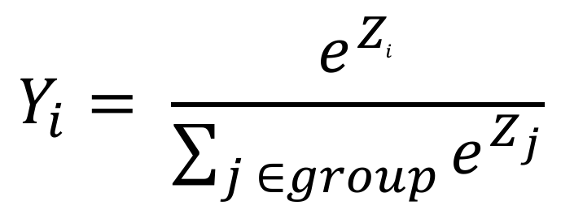
Softmax Output Function
Soft continuous version of Max Function
Forces$\sum{(Output of NN) }=1$.
$$Y_{i}$$
$$Y_{i}= \frac{e^{Z_{i}^{ }}}{\sum_{j ∈group}^{ }{e^{Z_{j}}}}$$
$$Z_{i}$$
Notes:
So Y lies between 0 to 1…..

Slide 26
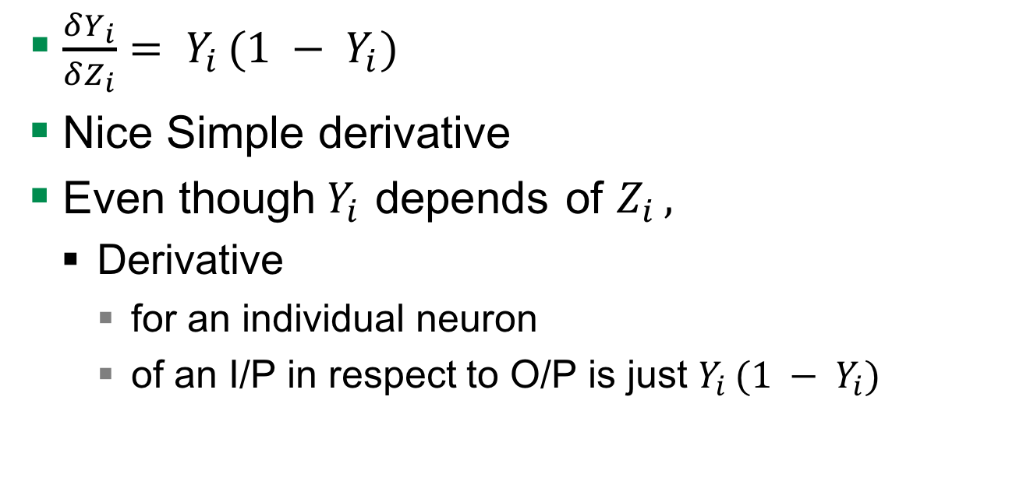
Derivative Softmax
$\frac{δY_{i}}{δZ_{i}}= Y_{i }(1 − Y_{i})$
Nice Simple derivative
Even though$Y_{i }$depends of $Z_{i },$
Derivative
for an individual neuron
of an I/P in respect to O/P is just $Y_{i }(1 − Y_{i})$

Slide 27
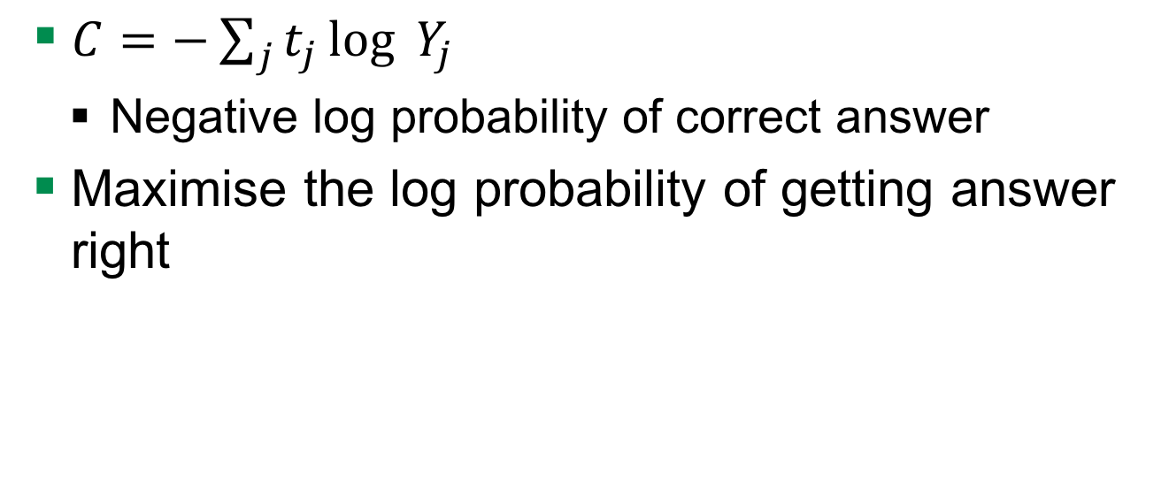
Cost Measure for Softmax Output Function
$C=−\sum_{j}^{ }{t_{j}}\log_{ }{Y_{j }}$
Negative log probability of correct answer
Maximise the log probability of getting answer right

Slide 28
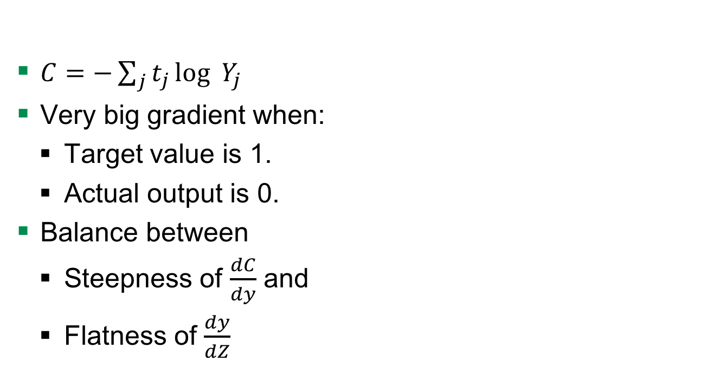
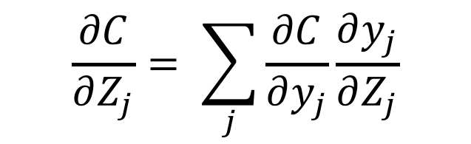
Advantages to Squared Error Measure
$C=−\sum_{j}^{ }{t_{j}}\log_{ }{Y_{j }}$
Very big gradient when:
Target value is 1.
Actual output is 0.
Balance between
Steepness of $\frac{dC}{dy}$ and
Flatness of $\frac{dy}{dZ}$
$$\frac{∂C}{∂Z_{j}}= \sum_{j}{\frac{∂C}{∂y_{j}}\frac{∂y_{j}}{∂Z_{j}}}$$

Slide 29
Results
Precision 0.83
Notes:
Graphics have to be added

Slide 30
Quellen
http://cs231n.github.io/convolutional-networks/

