Slide 1
A Convolutional Neural Network for Image Classification of Cats and Dogs
Final presentation

Slide 2
Introduction

Slide 3
Structure
1. Introduction
1
2
3
4
5
6
7
8

Slide 4
Structure
Introduction
Neural Networks (NN)
Math behind NN
Convolutional NN (CNN)
Problem
Design
Evaluation
Summary

Slide 5
Neural NetWorks

Slide 6
Structure
2. Neural Networks
Overview
Concept of Neurons
1
2
3
4
5
6
7
8

Slide 7
Overview
Input
Hidden
Hidden
Output
http://cs231n.github.io/convolutional-networks/

Slide 8
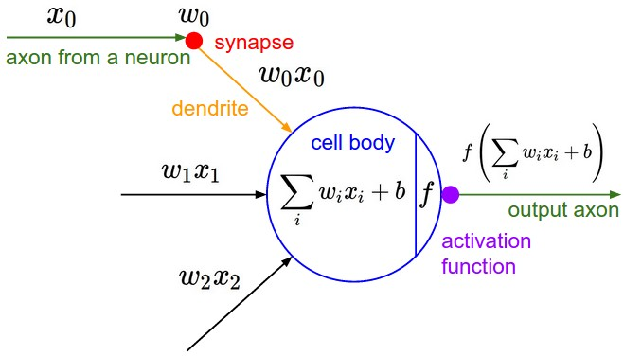
Concept of Neurons
http://cs231n.github.io/convolutional-networks/

Slide 9
Math Behind neural nets

Slide 10
Structure
3. Math behind NN
Introduction
Activation Function
Backpropagation
Loss Function
Summarize
1
2
3
4
5
6
7
8

Slide 11
Introduction
Actual output, weights
Activation function
Measure how much we missed (cost function)
Multiply error by the activation function slope
Update weights (backpropagation)

Slide 12
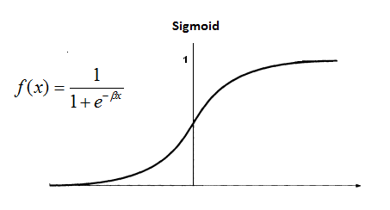
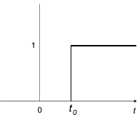

Activation Functions
Non-Linear
Ex: Sigmoid, tanh
Continuous but not everywhere differentiable function
Cons: descent gradient cannot be obtained
Ex: Relu
$$f\left(x\right)= \frac{1}{1+ e^{−βx}}$$
http://cs231n.github.io/convolutional-networks/
Notes:
elu, softplus, and softsign
relu6, crelu and relu_x

Slide 13



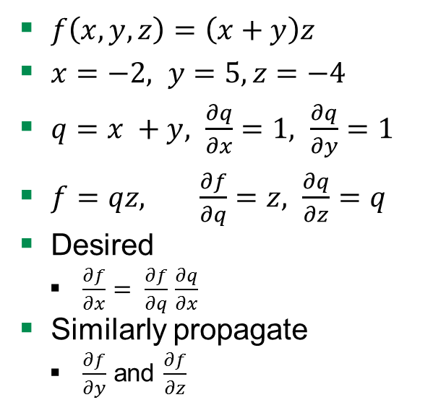







Back Propagation
$f\left(x,y,z\right)=\left(x+y\right)z$
$x=−2, y=5, z=−4$
$q=x +y, \frac{∂q}{∂x}=1, \frac{∂q}{∂y}=1$
$f=qz, \frac{∂f}{∂q}=z, \frac{∂q}{∂z}=q$
Desired
$\frac{∂f}{∂x}= \frac{∂f}{∂q}$ $\frac{∂q}{∂x}$
Similarly propagate
$\frac{∂f}{∂y}$ and $\frac{∂f}{∂z}$
$$−2$$
x
$$−4$$
q
$$3$$
$$−4$$
$$5$$
f
y
$$−12$$
$$−4$$
$$1$$
$$−4$$
z
$$3$$
$$\frac{∂f}{∂x}$$
http://cs231n.github.io/convolutional-networks/

Slide 14
Loss Function
Squared Error Measure
SoftMax

Slide 15
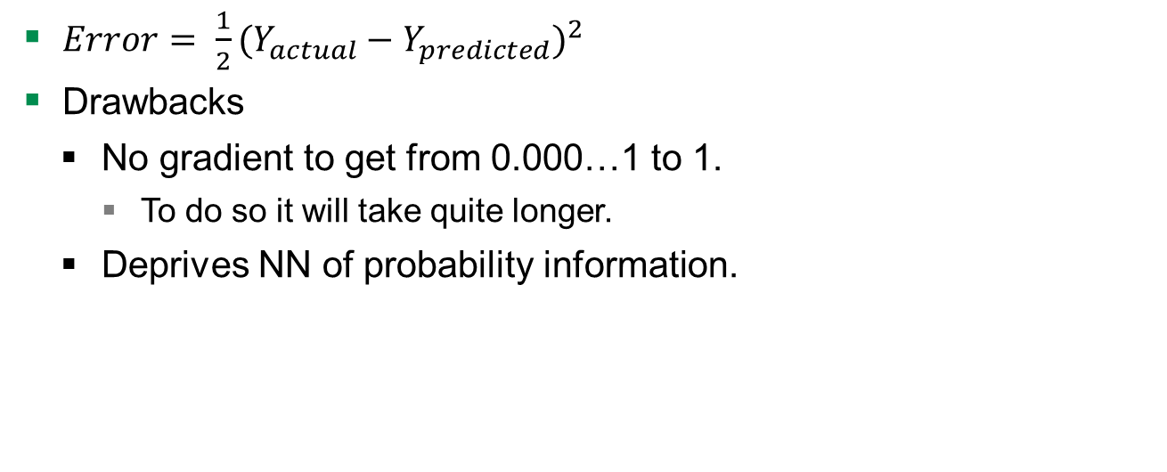
Loss Function - Squared Error Measure
$Error= \frac{1}{2}{(Y_{actual}−Y_{predicted})}^{2}$
Drawbacks
No gradient to get from 0.000…1 to 1.
To do so it will take quite longer.
Deprives NN of probability information.

Slide 16

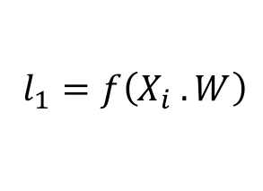

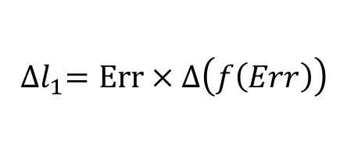

Summarize
Actual output, weights
Activation function
Measure how much we missed (cost function)
Multiply error by the activation function slope
Update weights (backpropagation)
$$l_{0}=Y_{actual}, W=rand()$$
$l_{1}=f\left(X_{i} . W\right)$
$${Err=f(l}_{0}, l_{1})$$
${∆l}_{1}=Err × ∆\left(f\left(Err\right)\right)$
$$W=W+α(l_{0}.{∆l}_{1})$$

Slide 17
Convolutional NN

Slide 18
Structure
4. Convolutional NN
Motivation
Description of Layers
Hyperparameters
1
2
3
4
5
6
7
8

Slide 19
Motivation
Number of parameters
x₁
x₂
x₃
x₄
x₅
x₆
x₇
x₈
x₉
x₁ | x₂ | x₃
x₄ | x₅ | x₆
x₇ | x₈ | x₉
Input
Transformed input

Slide 20
Motivation
NN
High number of params
CNN
Lower number of params
x₁
x₂
x₃
x₄
x₅
x₆
x₇
x₈
x₉
x₁ | x₂ | x₃
x₄ | x₅ | x₆
x₇ | x₈ | x₉
x₁
x₂
x₃
x₄
x₅
x₆
x₇
x₈
x₉
…
Number of weights: 36
Number of weights: 4

Slide 21
Description of Layers
input
conv
pool
norm
conv
norm
pool
local
local
Softmax linear
Notes:
NN with multiple hidden layers, because it is passed to several non-linearity functions -> Deep learning
Over time the original image is reduced in size more and more
Deep stacking is increasing the training time
Relatively simple structure to keep training time low

Slide 22
Input Layer
Image cropping
Distortions
Randomly flipping
Randomly changing brightness
Randomly changing contrast
input
conv
pool
norm
conv
norm
pool
local
local
Softmax linear
Notes:
NN with multiple hidden layers, because it is passed to several non-linearity functions -> Deep learning

Slide 23
Convolutional Layer - Filter
Input
Filter
Output
0 | 0 | 0 | 0 | 0 | 0 | 0
0 | 2 | 1 | 0 | 0 | 2 | 0
0 | 2 | 2 | 2 | 0 | 2 | 0
0 | 1 | 2 | 0 | 2 | 0 | 0
0 | 2 | 1 | 2 | 1 | 2 | 0
0 | 1 | 2 | 1 | 0 | 0 | 0
0 | 0 | 0 | 0 | 0 | 0 | 0
0 | 0 | 0
0 | 2 | 1
0 | 2 | 2
1
1*0 + 2*0 + 0*0 +
0*0 + 0*2 + 0*1 +
0*0 + 0*2 + 0*2 +
1 = 1
Bias
1
http://cs231n.github.io/convolutional-networks/
input
conv
pool
norm
conv
norm
pool
local
local
Softmax linear
Notes:
NN with multiple hidden layers, because it is passed to several non-linearity functions -> Deep learning
Dot-product

Slide 24
Convolutional Layer - Parameters
Input volume size
Number of filters
Filter size
Step size
Zero padding
Input
Filter
0 | 0 | 0 | 0 | 0 | 0 | 0
0 | 2 | 1 | 0 | 0 | 2 | 0
0 | 2 | 2 | 2 | 0 | 2 | 0
0 | 1 | 2 | 0 | 2 | 0 | 0
0 | 2 | 1 | 2 | 1 | 2 | 0
0 | 1 | 2 | 1 | 0 | 0 | 0
0 | 0 | 0 | 0 | 0 | 0 | 0
0 | 0 | 0
0 | 2 | 1
0 | 2 | 2
input
conv
pool
norm
conv
norm
pool
local
local
Softmax linear
Notes:
NN with multiple hidden layers, because it is passed to several non-linearity functions -> Deep learning
Volume size is width x heigth x depth
Input volume size – resized image
Number of filters – number of features we tryin to extract
- feature (fur of cat)
Filter size
- Small, to keep number of params low
- If too large size data is lost
- Smaller would be to detailed
Step size
- Increase params get lower
- Decrease params get higher and prediction better
Zero padding
- To keep spatial dimensions

Slide 25
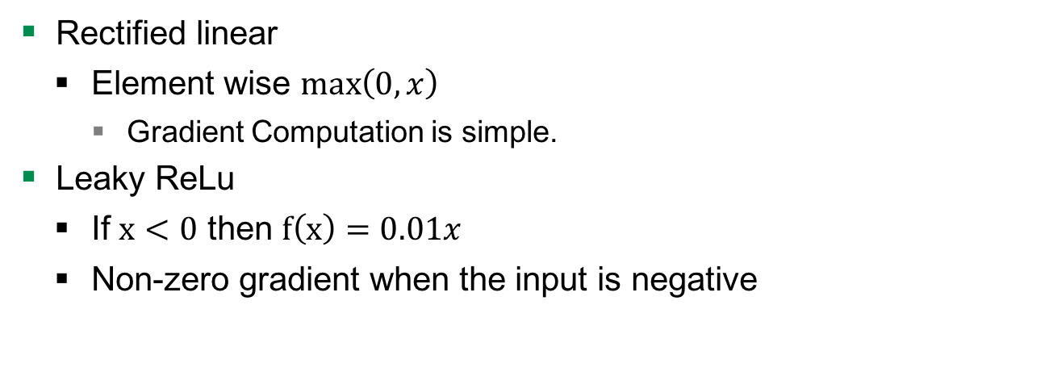
Convolutional Layer – Activation function
Rectified linear
Element wise $\max\left(0, x\right)$
Gradient Computation is simple.
Leaky ReLu
If $x<0$ then $f\left(x\right)=0.01x$
Non-zero gradient when the input is negative
input
conv
pool
norm
conv
norm
pool
local
local
Softmax linear
Notes:
NN with multiple hidden layers, because it is passed to several non-linearity functions -> Deep learning
Volume size is width x heigth x depth

Slide 26
Pool Layer – Max Pooling
Reduce the spatial dimension of an image
Input
1 | 1 | 2 | 4
5 | 6 | 7 | 8
3 | 2 | 1 | 0
1 | 2 | 3 | 4
Output
6 | 8
3 | 4
http://cs231n.github.io/convolutional-networks/
input
conv
pool
norm
conv
norm
pool
local
local
Softmax linear
Notes:
Get rid of large amount of data and make computation less intensive

Slide 27
Norm Layer
4D-array
Normalize each element of this array
To reduce data size
To move towards classification
a₁
a₂
a₃
…
a₁ | a₂ | a₃ | …
input
conv
pool
norm
conv
norm
pool
local
local
Softmax linear
Notes:
NN with multiple hidden layers, because it is passed to several non-linearity functions -> Deep learning
Weights cannot exceed any limit
Update weights is easier

Slide 28

Norm Layer
RGB
RGB
RGB
a₁
a₂
Normalize each
element of this array
$a_{1}=\left(\left(\frac{R}{\sqrt{R^{2}+G^{2}+B^{2}}}\right),\left(\frac{G}{\sqrt{R^{2}+G^{2}+B^{2}}}\right)\text{, }\left(\frac{B}{\sqrt{R^{2}+G^{2}+B^{2}}}\right)\right)$
a₃
…
a₁ | a₂ | a₃ | …
input
conv
pool
norm
conv
norm
pool
local
local
Softmax linear
Notes:
NN with multiple hidden layers, because it is passed to several non-linearity functions -> Deep learning
Weights cannot exceed any limit
Update weights is easier

Slide 29
Local Layer
Input
Also named fully connected layer
x₁
x₂
x₃
x₄
x₅
x₆
x₇
x₈
x₉
Input
x₁ | x₂ | x₃
x₄ | x₅ | x₆
x₇ | x₈ | x₉
…
input
conv
pool
norm
conv
norm
pool
local
local
Softmax linear
Notes:
NN with multiple hidden layers, because it is passed to several non-linearity functions -> Deep learning

Slide 30
Softmax-Linear Layer
Softmax output function
Cost measure for softmax
input
conv
pool
norm
conv
norm
pool
local
local
Softmax linear
Notes:
NN with multiple hidden layers, because it is passed to several non-linearity functions -> Deep learning

Slide 31
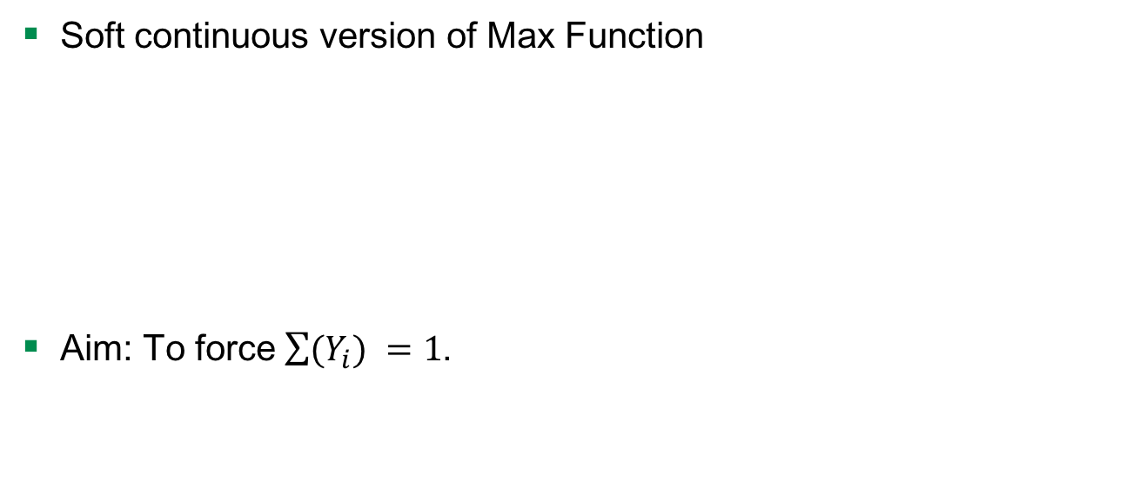



Softmax Output Function
Soft continuous version of Max Function
Aim: To force$\sum{(Y_{i}) }=1$.
logits
$$z_{j}$$
$$Y_{i}$$
$$Y_{i}= \frac{e^{z_{i}^{ }}}{\sum_{j}^{ }{e^{z_{j}}}}$$
input
conv
pool
norm
conv
norm
pool
local
local
Softmax linear
Notes:
NN with multiple hidden layers, because it is passed to several non-linearity functions -> Deep learning

Slide 32
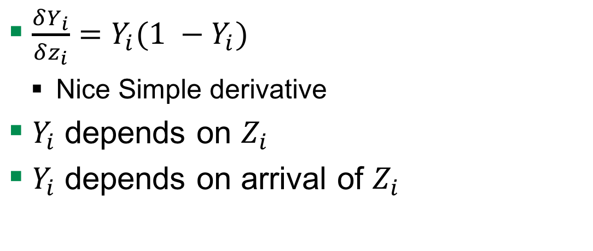


Softmax Output Function
$\frac{δY_{i}}{δz_{i}}=Y_{i}(1 −Y_{i})$
Nice Simple derivative
$Y_{i}$ depends on $Z_{i }$
$Y_{i}$ depends on arrival of $Z_{i }$
$$z_{i}$$
$$Y_{i}$$
input
conv
pool
norm
conv
norm
pool
local
local
Softmax linear
Notes:
NN with multiple hidden layers, because it is passed to several non-linearity functions -> Deep learning

Slide 33
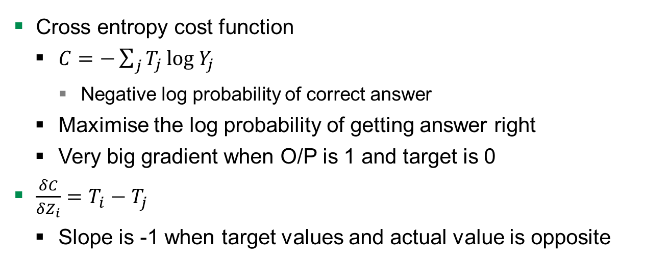
Cost Measure for Softmax
Cross entropy cost function
$C=−\sum_{j}^{ }{T_{j}}{log{ Y}_{j}}_{ }{ }$
Negative log probability of correct answer
Maximise the log probability of getting answer right
Very big gradient when O/P is 1 and target is 0
$\frac{δC}{δZ_{i}}=T_{i}−T_{j}$
Slope is -1 when target values and actual value is opposite
input
conv
pool
norm
conv
norm
pool
local
local
Softmax linear
Notes:
If you are using softmax o/p then what is the right cost function

Slide 34
Hyperparameters - Learning Rate
How fast the network trains
High learning rate
Convergence or global minimum finding is problem
Low learning rate
High training times

Slide 35
Hyperparameters - Learning Rate Decay
Learning rate decay means the learning rate decreases over time
higher learning rate is well suited to get close to the global minimum
small learning rate is better at fine tuning the global minimum
Several way
Exponential decay, reduction by factor of n
Function to decrease the learning rate by 4%

Slide 36
Hyperparameters - Overfitting or Underfitting
Underfitting
Overfitting

Slide 37
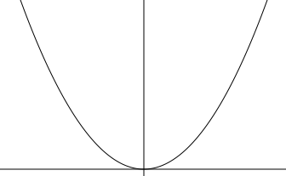

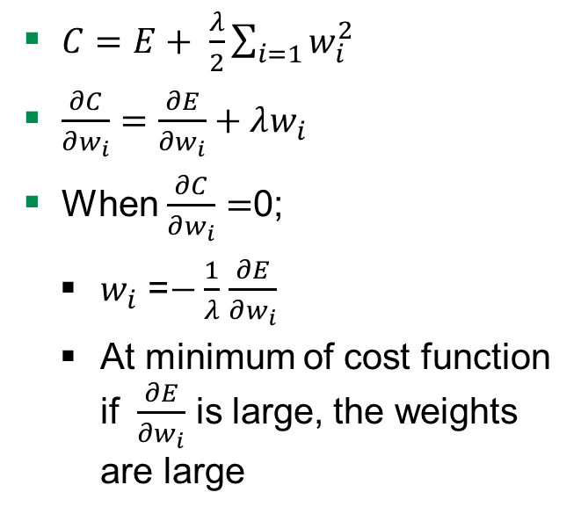
Hyperparameters - Weight Penalty
Adding $λ$to penalise
Keeps weight small
Big error derivatives
$C=E+ \frac{λ}{2}\sum_{i=1}{w_{i}^{2}}$
$\frac{∂C}{∂w_{i}}=\frac{∂E}{∂w_{i}}+λw_{i}$
When $\frac{∂C}{∂w_{i}}=$0;
$w_{i}$ =$−\frac{1}{λ}$ $\frac{∂E}{∂w_{i}}$
At minimum of cost function if $\frac{∂E}{∂w_{i}}$ is large, the weights are large
C
W
Notes:
Derivative of penalty is the force pulling down to zero

Slide 38


Hyperparameters - Weight Penalty
Preventing network from the weights it does not need
Don’t have a lot of weights not doing anything
So output changes more slowly as input changes.
Putting half the weight on each and not on one
W
0
$$\frac{w}{2}$$
$$\frac{w}{2}$$

Slide 39
Problem

Slide 40
Structure
5. Problem
Introduction
Data
1
2
3
4
5
6
7
8

Slide 41
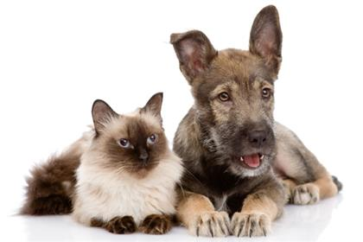
Introduction

Slide 42
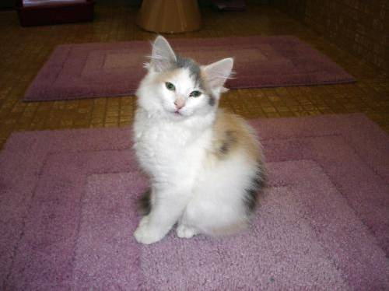
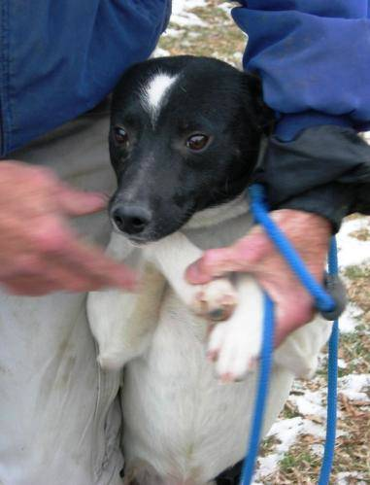
Data
Images of cats and dogs
File format is *.jpg
Color space is RGB
cat10.jpg
dog1.jpg

Slide 43
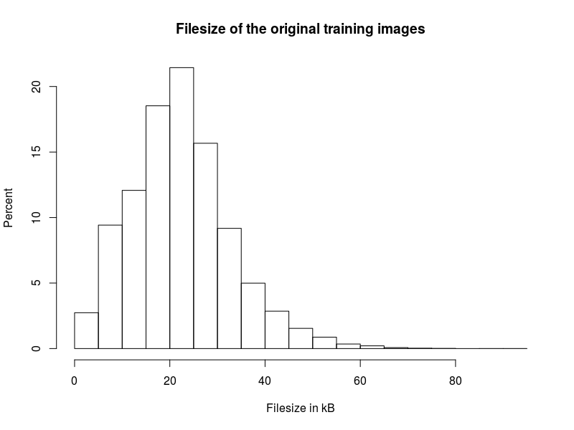
Data
25,000 images
12,500 of dogs
12,500 of cats
Avg. file size
22.34 kB

Slide 44
Design

Slide 45
Structure
6. Design
Implementation of CNN architecture
System model
Implemented architectures
1
2
3
4
5
6
7
8

Slide 46
Implementation of CNN Architecture
input
conv
pool
norm
conv
norm
pool
local
local
Softmax linear

Slide 47

Implementation of CNN Architecture
TensorFlow was developed by Google Brain team
Version 1.0
Use cases
Handwritten patterns, image recognition, Word2Vec
Input data
Audio, image, text
Used techniques
Linear classifiers, NN, CNN
Notes:
Google Brain Team is a deep learning research project at Google
Linear classifier for Linear relation

Slide 48
Implementation of CNN Architecture
Input: Raw model
Graph
Architecture of nodes and edges (like NN structure)
Session is placed on device
Initialise variables randomly
Run
Let tensors pass through the graph
Output: Trained model

Slide 49
System Model
TensorFlow
Input
Output

Slide 50
System Model -Train vs. Test Data
Split data
Train data
20,000 images (80 percent)
Divide into 5 batches containing 4,000 each
Test data
5,000 images (20 percent)

Slide 51
Process images
Resize to 32 * 32 * 3 = 3,072
Convert to array
25,000 * 3,073
cat10.jpg
dog1.jpg

Slide 52


Process images
Resize to 32 * 32 * 3
Convert to array
25,000 * 3,073
Example
1; 22; 11; 123; …
0; 256; 255; 0; …
cat10.jpg
dog1.jpg
Notes:
Thats what the computer sees

Slide 53
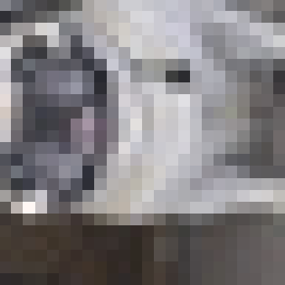
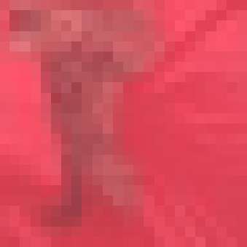
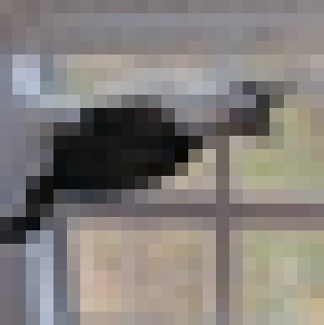
System Model - Random distorsion

Slide 54
System Model - Structure of CNN
24 x 24 x 3
128 x 24 x 24 x 3
128 x 24 x 24 x 64
128 x 12 x 12 x 64
128 x 12 x 12 x 64
128 x 12 x 12 x 64
128 x 12 x 12 x 64
128 x 6 x 6 x 64
128 x 384
128 x 192
Output: 128 x 2
input
conv
pool
norm
conv
norm
pool
local
local
Softmax linear
Notes:
NN with multiple hidden layers, because it is passed to several non-linearity functions -> Deep learning
Over time the original image is reduced in size more and more

Slide 55
Implemented Architectures – Added Conv Layer
Input: 128 x 24 x 24 x 3
Output: 128 x 24 x 24 x 3
conv
input
conv
pool
norm
conv
norm
pool
local
local
Softmax linear
Notes:
NN with multiple hidden layers, because it is passed to several non-linearity functions -> Deep learning
Over time the original image is reduced in size more and more

Slide 56
Implemented Architectures – Increased size
28 x 28 x 3
Original input: 24 x 24 x 3
New input: 28 x 28 x 3
input
conv
pool
norm
conv
norm
pool
local
local
Softmax linear
Notes:
NN with multiple hidden layers, because it is passed to several non-linearity functions -> Deep learning
Over time the original image is reduced in size more and more

Slide 57
Evaluation

Slide 58
Structure
7. Evaluation
Automated verification
Manual verification
1
2
3
4
5
6
7
8

Slide 59
Automated Verification
 | Number of steps | Total loss | Time | Machine
Standard 100k | 99,900 | 0.1132 | 6h 15m 50s | Windows
Standard 40k | 40,600 | 0.3316 | 8h 26m 58s | Linux
Additional ConvLayer | 13,500 | 0.3128 | 9h 19m 34s | Linux
Increased size | 30,100 | 0.3446 | 8h 37m 30s | Linux

Slide 60
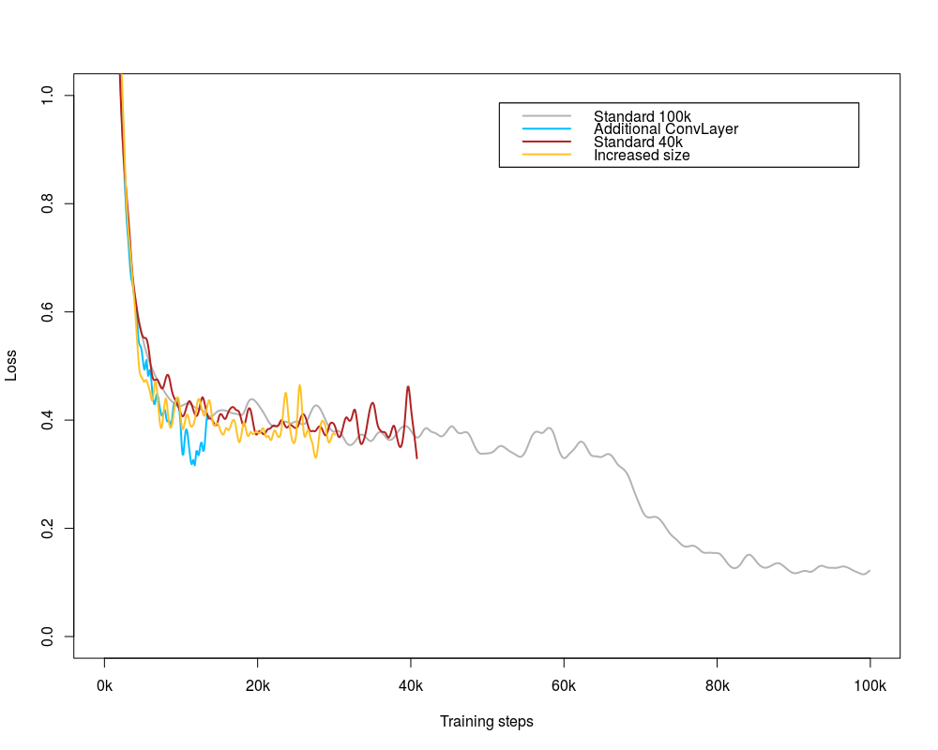
Automated Verification
Accuracy of 85 percent

Slide 61
Manual Verification
For 2008 images accuracy of 97 percent
Manually verified 100 images
Seven were predicted wrong
93 were predicted correctly

Slide 62
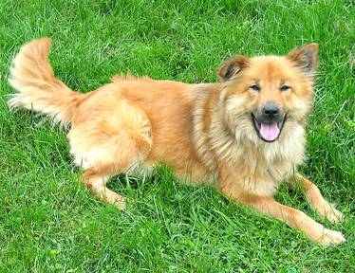
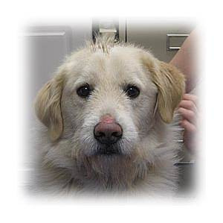
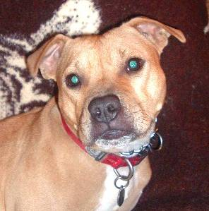
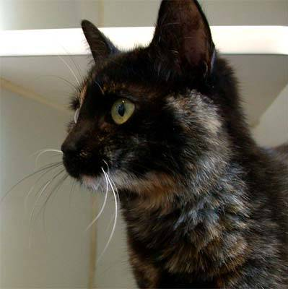
Manual Verification – Correctly Predicted

Slide 63
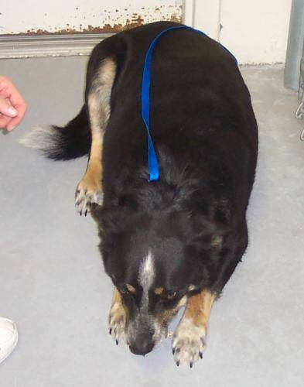
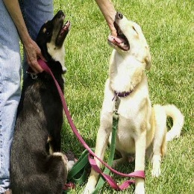
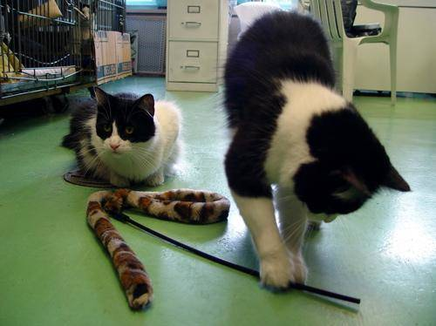
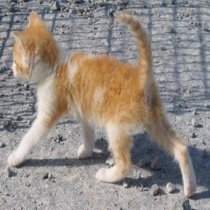
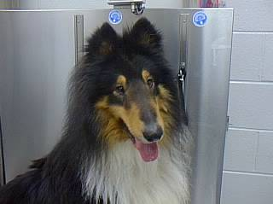
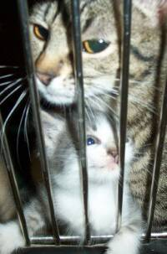
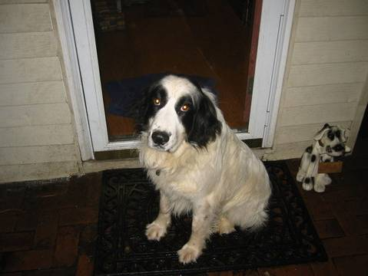
Manual Verification – Wrongly Predicted

Slide 64
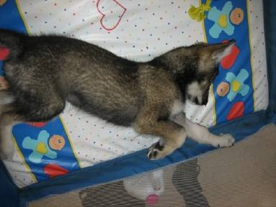
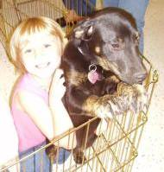
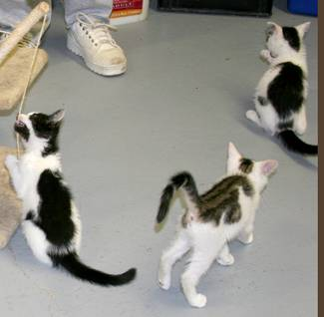
Manual Verification – Confusing Images

Slide 65
Summary

Slide 66
Structure
8. Summary
1
2
3
4
5
6
7
8

Slide 67
Summary
Introduction
Neural Networks (NN)
Math behind NN
Convolutional NN (CNN)
Problem
Design
Evaluation
Summary

Slide 68
Questions

Slide 69
Quellen
http://cs231n.github.io/convolutional-networks/
https://www.tensorflow.org/tutorials/deep_cnn/
Maas, Andrew L., Awni Y. Hannun, and Andrew Y. Ng. "Rectifier nonlinearities improve neural network acoustic models." Proc. ICML. Vol. 30. No. 1. 2013.

Slide 71
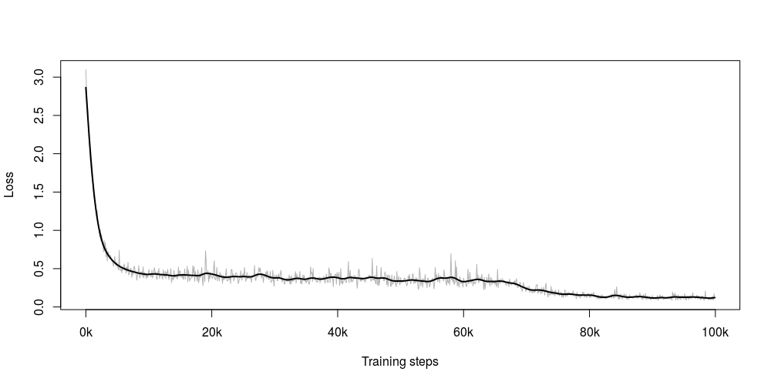
Standard 100k

Slide 72
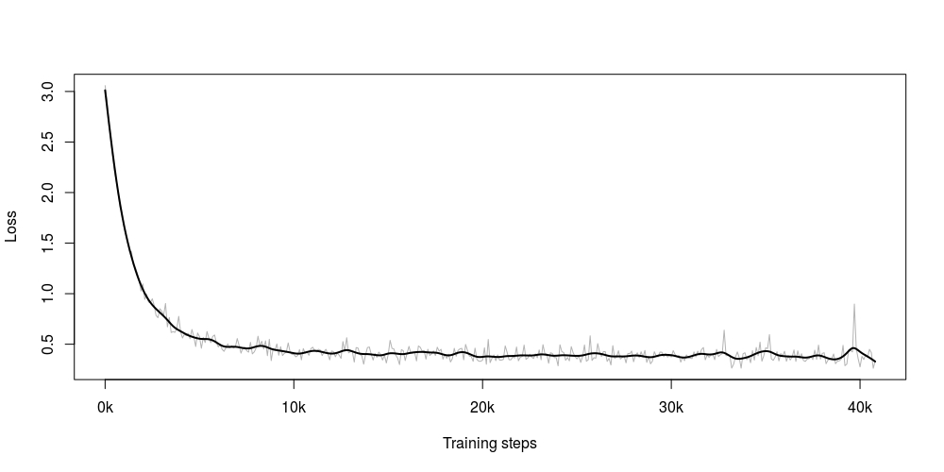
Standard 40k

Slide 73
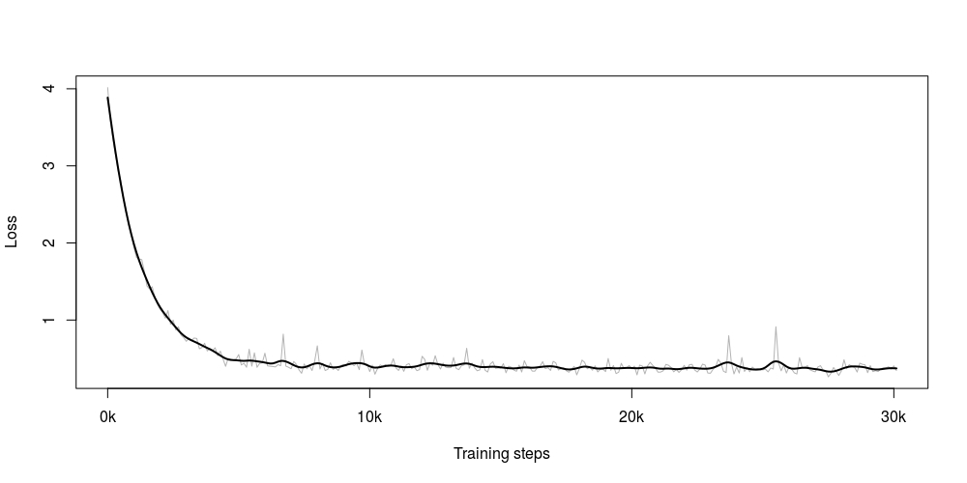
Increased Image Size

Slide 74
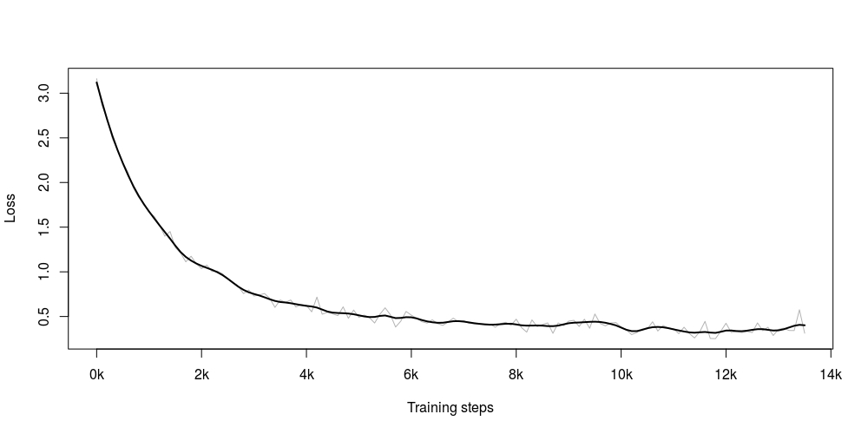
Added Convolutional Layer

Slide 75
Structure of the CNN we used
24 x 24 x 3
128 x 24 x 24 x 3
128 x 24 x 24 x 64
128 x 12 x 12 x 64
128 x 12 x 12 x 64
128 x 12 x 12 x 64
128 x 12 x 12 x 64
128 x 6 x 6 x 64
128 x 384
128 x 192
Output: 128 x 2
input
conv
pool
norm
conv
norm
pool
local
local
Softmax linear
Notes:
NN with multiple hidden layers, because it is passed to several non-linearity functions -> Deep learning
Over time the original image is reduced in size more and more

Slide 76
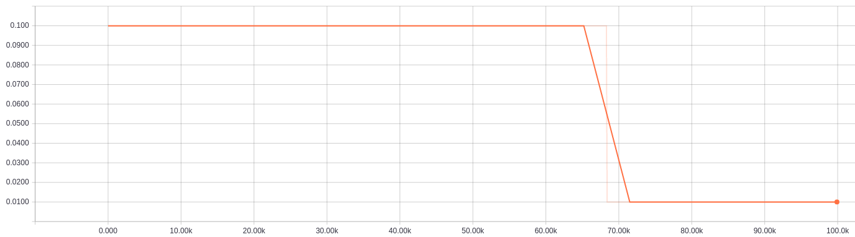
Learning rate

Slide 77
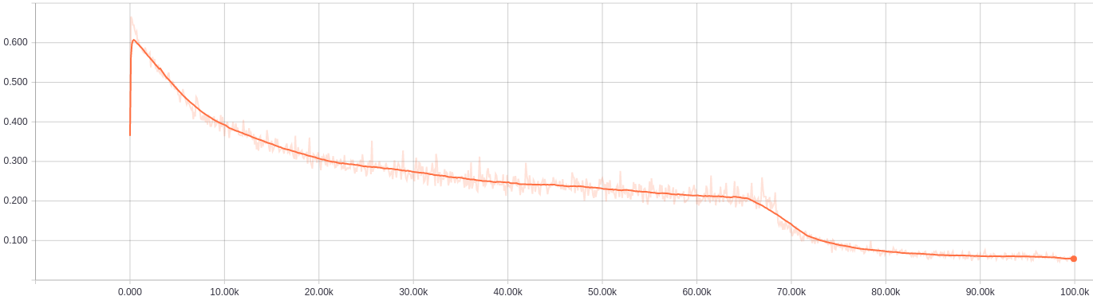
Cross-entropy

Slide 78
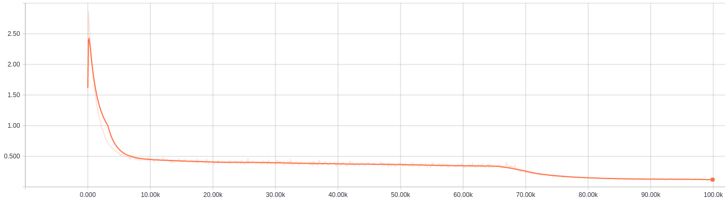
Total loss
Total loss after 100k steps roughly above 0.1

