Slide 1
Convolutional NN for Image Classification
Dogs Vs Cats Classification Problem

Slide 2
Today‘s Talk
Problem Statement
Introduction to Deep Learning
Layers In Deep Learning
TensorFlow (TF)
Data-Structure for TensorFlow
Implementation in TF
Cifar10 Lifecycle
TensorFlow CNN vs General Deep Learning
Mathematical Formulation of Deep Learning algorithms
Results
Future Works

Slide 3
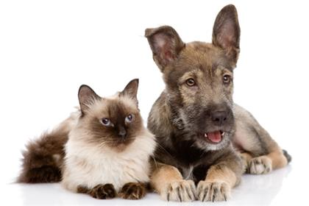
Problem Statement
I am DOG
...No No...
I am CAT

Slide 4
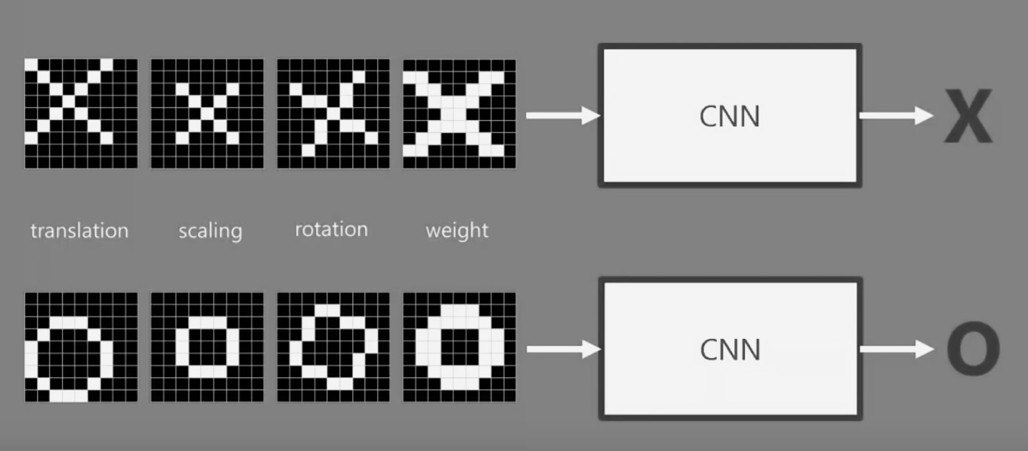
Problem Statement - Explained
NN
NN
NN

Slide 5
Datenanalyse
Computer
Science
Machine
Learning
Math and
Statistics
…
Unicorn
Traditional
Software
Traditional
Research
Subject Matter
Expertise
blog.cloudera.com

Slide 6
Introduction – NeuralNets
W₁₁
W’₁₁
W₁₂
W’₁₂
W_{1n}
W’_{1n}
Input
Hidden
Hidden
Output
Quelle: http://cs231n.github.io/convolutional-networks/
Notes:
Based on pretty basic ideas
Image is a 2-D array of images
Looking at it CNN decides if Pictures is X or O.

Slide 7
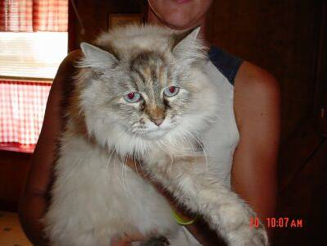
Why not Just NeuralNets?
I/P = 32 * 32 * 3 = 3072
Num_Weights = 3072 * N
Num_Biases = N
So,
Full connectivity is wasteful
Huge number of parameters

Slide 8
Convolutional NN
CNN
CNN
Notes:
What Computers See
When using If and else, we can not say that if it is X or O
If the pixels do not match for a given X and rotated X then it can either do or not do.

Slide 9


Convolutional NN – Conv Layer
1
.11
-1 | 1 | -1
1 | 1 | 1
-1 | 1 | -1
1 | 1 | 1
1 | 1 | 1
1 | 1 | 1
$$1/9$$
Feature 1

Slide 10
Result= Stack of Filtered images
Stack of Images
Features
Input Image
Notes:
Higher Probabilities appear in the feature shown

Slide 11
Convolutional NN – MaxPooling
.55 | .77
.33 | .99
.99
 | .77
 |  | .55
 |  |  | .77

Slide 12

Convolutional NN – Relu
$$Element Wise:max⁡(0, x)$$
 | .77
.33 | .99
 | .77
.33 | .99
-0.99
0

Slide 13
Convolutional NN – RELU Layer
Wird von Google genutzt und entwickelt
Anleitungen:
Handschrift erkennen, Bilderkennung, Deep Neural Network Classifier, Word2Vec
Input
Audio, Bilder, Text
Techniken
Lineare Modelle, Regression, Neuronale Netze

Slide 14
Convolutional NN – POOL Layer
Input
Hidden
CONV, RELU, POOL, FC
Output
FC
Input
Hidden
Hidden
Output
Quelle: http://cs231n.github.io/convolutional-networks/

Slide 15
Convolutional NN – FC Layer
Input
Hidden
CONV, RELU, POOL, FC
Output
FC
Input
Hidden
Hidden
Output
Quelle: http://cs231n.github.io/convolutional-networks/

Slide 16
Convolutional NN – FC Layer
Input
Hidden
CONV, RELU, POOL, FC
Output
FC
Input
Hidden
Hidden
Output
Quelle: http://cs231n.github.io/convolutional-networks/

Slide 17
Input
Hidden
Hidden
Output
Quelle: http://cs231n.github.io/convolutional-networks/

Slide 18
Bisher verwendet
Random Forest
PCA
Textanalyse
Clustern
Multiple lineare Regression
TensorFlow
Python 3
Neuronale Netze
Tools
ConvNet
R Project
Jupyter Notebook
Java

Slide 19
Ideen für Projekte
Automatisierte Zuordnung der VPMCs zu Klassen
…

Slide 20
Quellen
http://blog.cloudera.com/blog/2015/12/common-probability-distributions-the-data-scientists-crib-sheet/
http://cs231n.github.io/convolutional-networks/

