Slide 1
A Convolutional Neural Network for Image Classification of Cats and Dogs
Status update

Slide 2
Structure
Neural Nets (NN)
Convolution NN (CNN)
Problem
Evaluation
Aims

Slide 3
Neural Nets

Slide 4
Introduction – Neural Nets
W₁₁
W’₁₁
W₁₂
W’₁₂
…
…
W_{1n}
W’_{1n}
Input
Hidden
Hidden
Output
Quelle: http://cs231n.github.io/convolutional-networks/
Notes:
Based on pretty basic ideas
Image is a 2-D array of images
Looking at it CNN decides if Pictures is X or O.

Slide 5
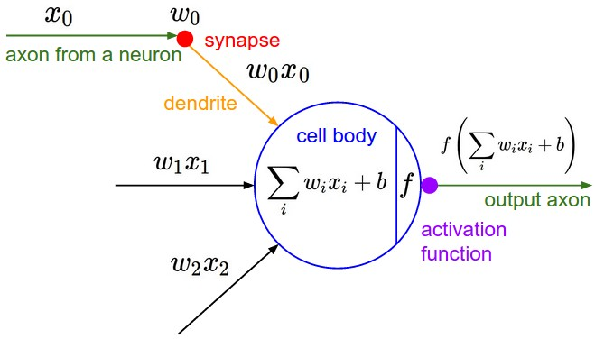
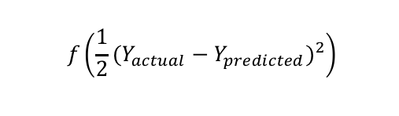
Neuron Model
Cost Function
$$f\left(\frac{1}{2}{(Y_{actual}−Y_{predicted})}^{2}\right)$$

Slide 6

Mathematical view
Input, Weights
Compute Sigmoid (Activation Function)
Measure how much we missed (Cost Function)
Multiply Err by the Sigmoid slope
Update Weights
$l_{0}=X_{i}$, W = rand()
$l_{1}=Sig\left(X_{i} . W\right)$
Err = $l_{0}−l_{1}$
${∆l}_{1}$ = Err*$∆\left(Sig\left(Err\right)\right)$
W = W+($l_{0}.{∆l}_{1}$)

Slide 7
Activation Functions
Non-Linear
sigmoid, tanh, elu, softplus, and softsign
continuous but not everywhere differentiable functions
relu, relu6, crelu and relu_x

Slide 8
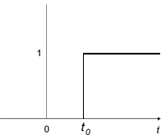
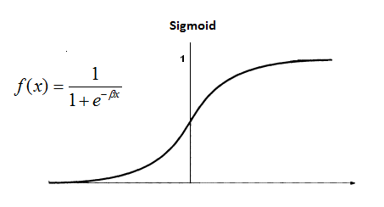
Activation functions
Why Sigmoid?
Not telling in which direction should we move in.
Non-differentiability at certain points

Slide 9
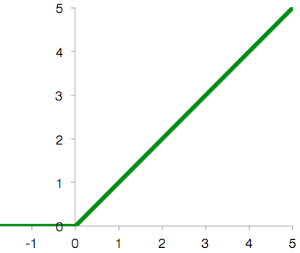
Activation functions
Why Relu?
Accelerates the convergence rate
Simply implementation

Slide 10
Cost Functions
Squared Error Measure
Softmax Cross-entropy Function

Slide 11
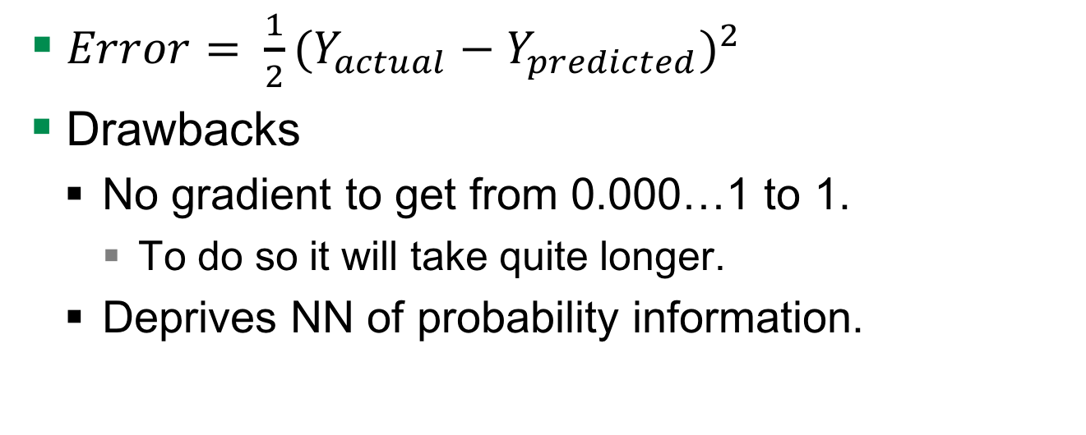
Squared Error Measure Function
$Error= \frac{1}{2}{(Y_{actual}−Y_{predicted})}^{2}$
Drawbacks
No gradient to get from 0.000…1 to 1.
To do so it will take quite longer.
Deprives NN of probability information.

Slide 12
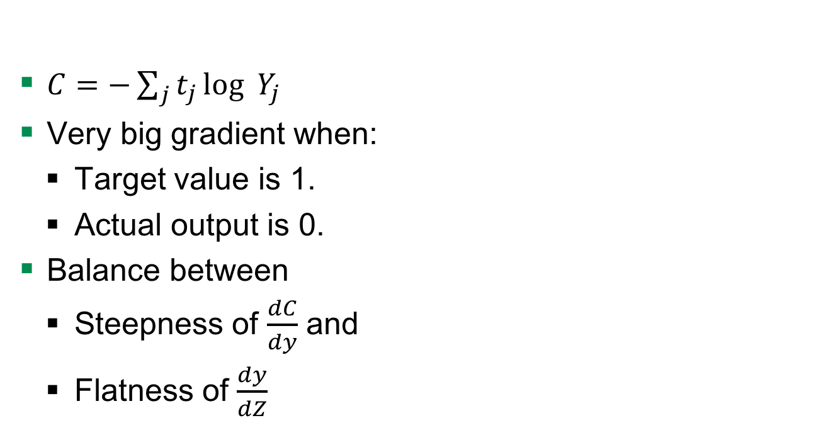
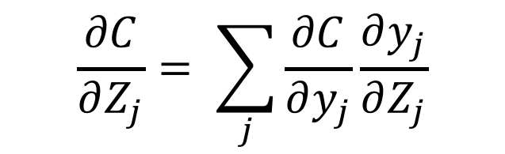
Advantages to Squared Error Measure
$C=−\sum_{j}^{ }{t_{j}}\log_{ }{Y_{j }}$
Very big gradient when:
Target value is 1.
Actual output is 0.
Balance between
Steepness of $\frac{dC}{dy}$ and
Flatness of $\frac{dy}{dZ}$
$$\frac{∂C}{∂Z_{j}}= \sum_{j}{\frac{∂C}{∂y_{j}}\frac{∂y_{j}}{∂Z_{j}}}$$

Slide 13
Convolutional NN

Slide 14
Neural Nets to CNN
W₁₁
W’₁₁
W₁₂
W’₁₂
…
…
W_{1n}
W’_{1n}
Input
Hidden
Hidden
Output
Quelle: http://cs231n.github.io/convolutional-networks/
Notes:
Based on pretty basic ideas
Image is a 2-D array of images
Looking at it CNN decides if Pictures is X or O.

Slide 15
Introduction – Neural Nets
W₁₁
W’₁₁
Bias
W₁₂
W’₁₂
W₁₃
Stride
W₁₁
…
W₁₂
W’_{1n}
W₁₃
Input
Feature Map
Fully Connected
Layer
Output
Quelle: http://cs231n.github.io/convolutional-networks/
Notes:
Based on pretty basic ideas
Image is a 2-D array of images
Looking at it CNN decides if Pictures is X or O.

Slide 16

TensorFlow
Developed by Google Brain Team
Use cases
Handwritten patterns, image recognition, Word2Vec
Input data
Audio, image, text
Used techniques
Linear classifiers, NN
Notes:
Google Brain Team is a deep learning research project at Google

Slide 17
Structure of the CNN we used
input
conv
pool
norm
conv
norm
pool
local
local
Softmax linear
Notes:
NN with multiple hidden layers, because it is passed to several non-linearity functions -> Deep learning
Over time the original image is reduced in size more and more

Slide 18
Input layer
input
conv
pool
norm
conv
norm
pool
local
local
Softmax linear
Notes:
NN with multiple hidden layers, because it is passed to several non-linearity functions -> Deep learning

Slide 19
Convolutional layer - Filter
Input
Filter
Output
0 | 0 | 0 | 0 | 0 | 0 | 0
0 | 2 | 1 | 0 | 0 | 2 | 0
0 | 2 | 2 | 2 | 0 | 2 | 0
0 | 1 | 2 | 0 | 2 | 0 | 0
0 | 2 | 1 | 2 | 1 | 2 | 0
0 | 1 | 2 | 1 | 0 | 0 | 0
0 | 0 | 0 | 0 | 0 | 0 | 0
0 | 0 | 0
0 | 2 | 1
0 | 2 | 2
1
1*0 + 2*0 + 0*0 +
0*0 + 0*2 + 0*1 +
0*0 + 0*2 + 0*2 +
1 = 1
Bias
1
http://cs231n.github.io/convolutional-networks/
input
conv
pool
norm
conv
norm
pool
local
local
Softmax linear
Notes:
NN with multiple hidden layers, because it is passed to several non-linearity functions -> Deep learning

Slide 20
Convolutional layer - Parameters
Input volume size
Number of filters
Filter size
Zero padding
Input
Filter
0 | 0 | 0 | 0 | 0 | 0 | 0
0 | 2 | 1 | 0 | 0 | 2 | 0
0 | 2 | 2 | 2 | 0 | 2 | 0
0 | 1 | 2 | 0 | 2 | 0 | 0
0 | 2 | 1 | 2 | 1 | 2 | 0
0 | 1 | 2 | 1 | 0 | 0 | 0
0 | 0 | 0 | 0 | 0 | 0 | 0
0 | 0 | 0
0 | 2 | 1
0 | 2 | 2
input
conv
pool
norm
conv
norm
pool
local
local
Softmax linear
Notes:
NN with multiple hidden layers, because it is passed to several non-linearity functions -> Deep learning
Volume size is width x heigth x depth

Slide 21
Convolutional layer – Activation function
Sigmoid
Not telling in which direction should we move in.
Non-differentiability at certain points
input
conv
pool
norm
conv
norm
pool
local
local
Softmax linear
Notes:
NN with multiple hidden layers, because it is passed to several non-linearity functions -> Deep learning
Volume size is width x heigth x depth

Slide 22
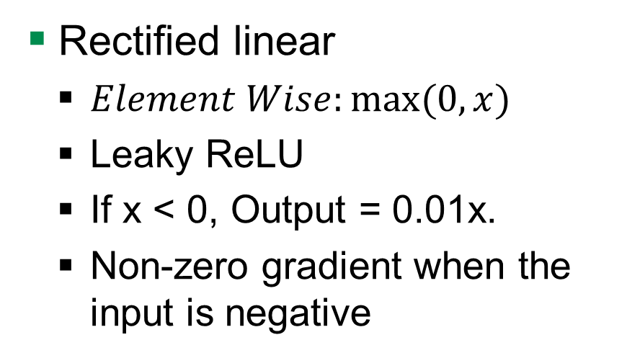
Convolutional layer – Activation function
Rectified linear
$Element Wise:max⁡(0, x)$
Leaky ReLU
If x < 0, Output = 0.01x.
Non-zero gradient when the input is negative
input
conv
pool
norm
conv
norm
pool
local
local
Softmax linear
Notes:
NN with multiple hidden layers, because it is passed to several non-linearity functions -> Deep learning
Volume size is width x heigth x depth

Slide 23
Pool layer
input
conv
pool
norm
conv
norm
pool
local
local
Softmax linear
Notes:
NN with multiple hidden layers, because it is passed to several non-linearity functions -> Deep learning

Slide 24
Pool layer – Max pooling
Reduce the spatial dimension of an image
1 | 1 | 2 | 4
5 | 6 | 7 | 8
3 | 2 | 1 | 0
1 | 2 | 3 | 4
6 | 8
3 | 4
http://cs231n.github.io/convolutional-networks/
input
conv
pool
norm
conv
norm
pool
local
local
Softmax linear
Notes:
NN with multiple hidden layers, because it is passed to several non-linearity functions -> Deep learning
Max pool with 2x2 filters and stride 2

Slide 25
Norm layer
input
conv
pool
norm
conv
norm
pool
local
local
Softmax linear
Notes:
NN with multiple hidden layers, because it is passed to several non-linearity functions -> Deep learning

Slide 26
Local layer
input
conv
pool
norm
conv
norm
pool
local
local
Softmax linear
Notes:
NN with multiple hidden layers, because it is passed to several non-linearity functions -> Deep learning

Slide 27
Softmax-linear layer
input
conv
pool
norm
conv
norm
pool
local
local
Softmax linear
Notes:
NN with multiple hidden layers, because it is passed to several non-linearity functions -> Deep learning

Slide 28
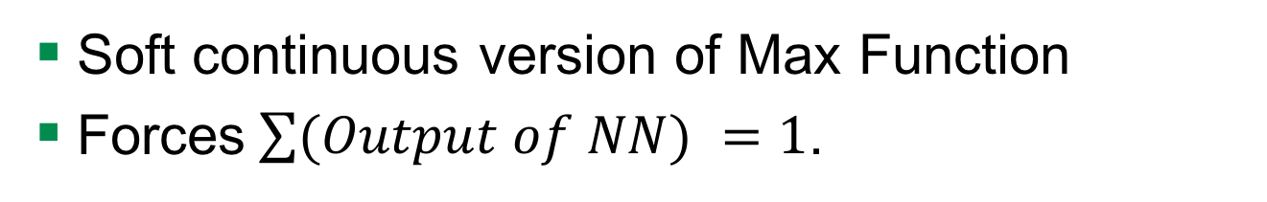
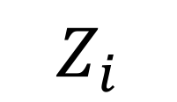

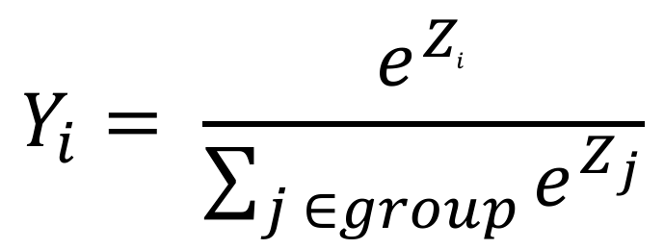
Softmax Output Function
Soft continuous version of Max Function
Forces$\sum{(Output of NN) }=1$.
$$Y_{i}$$
$$Y_{i}= \frac{e^{Z_{i}^{ }}}{\sum_{j ∈group}^{ }{e^{Z_{j}}}}$$
$$Z_{i}$$
Notes:
So Y lies between 0 to 1…..

Slide 29
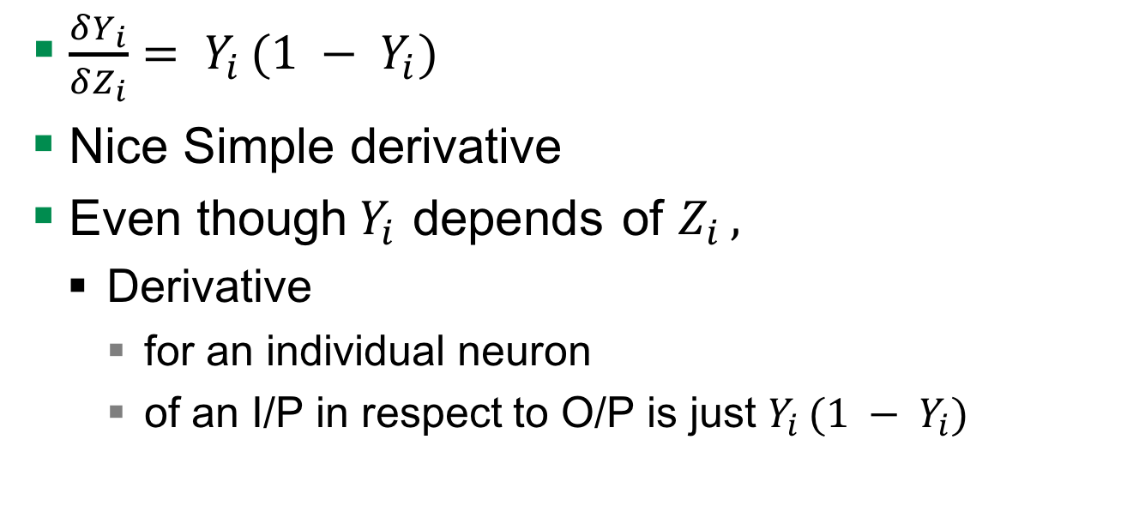
Derivative Softmax
$\frac{δY_{i}}{δZ_{i}}= Y_{i }(1 − Y_{i})$
Nice Simple derivative
Even though$Y_{i }$depends of $Z_{i },$
Derivative
for an individual neuron
of an I/P in respect to O/P is just $Y_{i }(1 − Y_{i})$

Slide 30
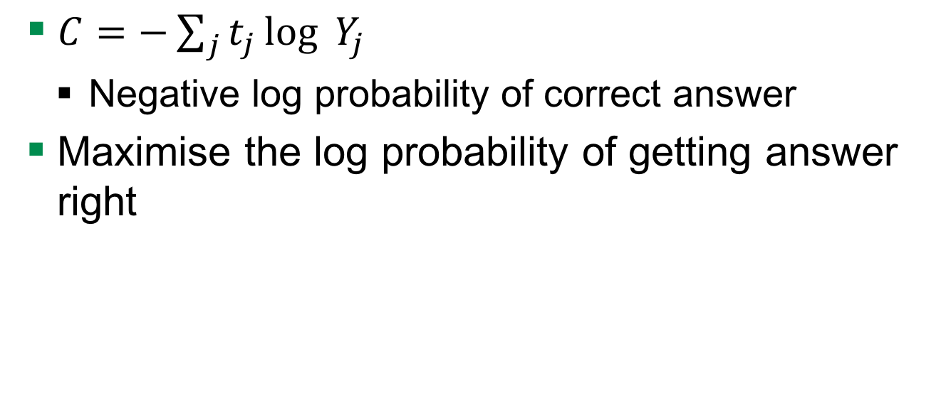
Cost Measure for Softmax Output Function
$C=−\sum_{j}^{ }{t_{j}}\log_{ }{Y_{j }}$
Negative log probability of correct answer
Maximise the log probability of getting answer right

Slide 31
Hyperparameters

Slide 32
Learning Rate
how fast the network trains
High learning rate
Convergence or global minimum finding is problem
Low learning rate
High training times

Slide 33
Learning Rate decay
Learning rate decay means the learning rate decreases over time
higher learning rate is well suited to get close to the global minimum
small learning rate is better at fine tuning the global minimum
Several ways to do it:
Exponential decay, reduction by factor of n
GoogLeNet: function to decrease the learning rate by 4%

Slide 34
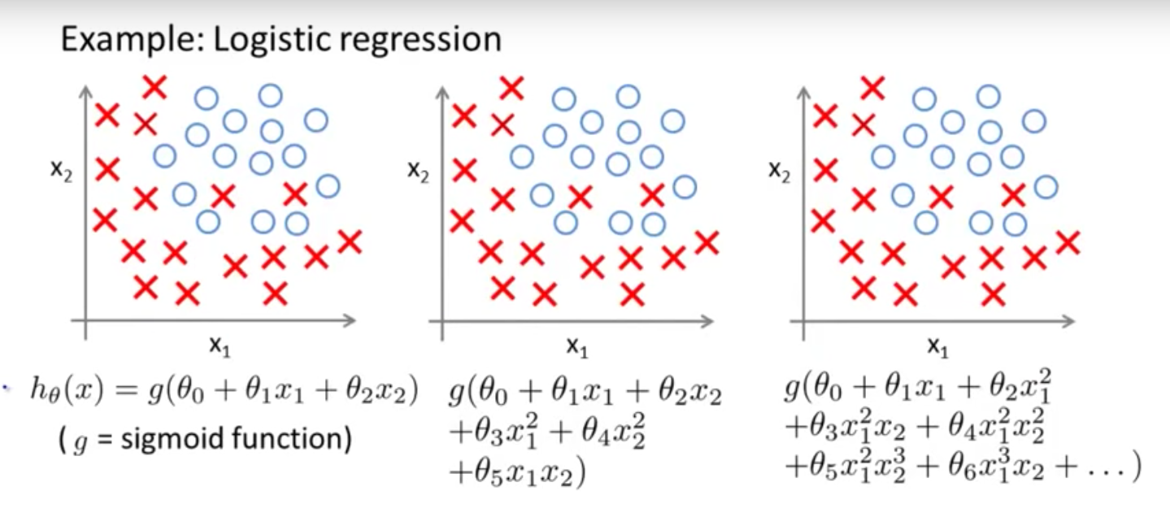
Overfitting or Underfitting

Slide 35
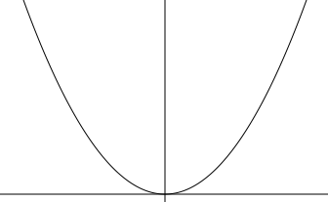

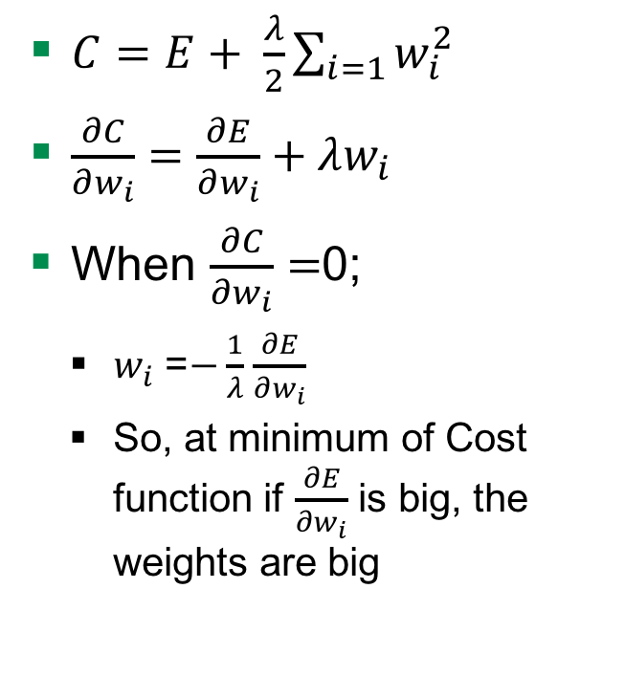
Weight Penalty
$C=E+ \frac{λ}{2}\sum_{i=1}{w_{i}^{2}}$
$\frac{∂C}{∂w_{i}}=\frac{∂E}{∂w_{i}}+λw_{i}$
When $\frac{∂C}{∂w_{i}}=$0;
$w_{i}$ =$−\frac{1}{λ}$ $\frac{∂E}{∂w_{i}}$
So, at minimum of Cost function if $\frac{∂E}{∂w_{i}}$ is big, the weights are big
Adding $λ$to penalise
Keeps weight small
Big error derivatives
C
W
Notes:
Derivative of penalty is the force pulling down to zero

Slide 36


Weight Penalty - Advantages
Preventing network from the weights it does not need
Don’t have a lot of weights not doing anything
So output changes more slowly as input changes.
Putting half the weight on each and not on one
W
0
$$\frac{w}{2}$$
$$\frac{w}{2}$$

Slide 37
Problem

Slide 38
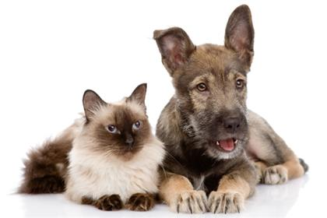
The data
Images of cats and dogs
File format is *.jpg
Color space is RGB

Slide 39
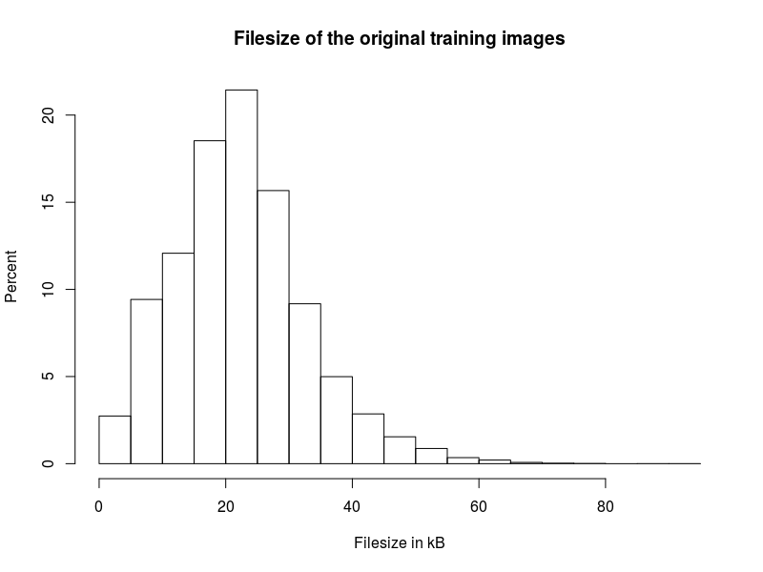
Training data
25,000 images
12,500 of dogs
12,500 of cats
Avg. file size
22.34 kB

Slide 40
Test data
12,500 images
x of dogs
y of cats
x + y = 12,500

Slide 41
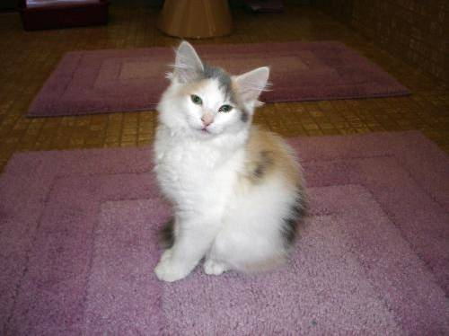
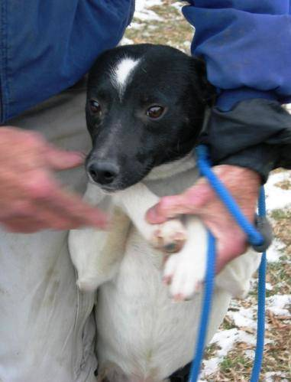
Process images
Resize to 32 * 32 * 3
Convert to array
25,000 * 3,073
cat10.jpg
dog1.jpg

Slide 42


Process images
Resize to 32 * 32 * 3
Convert to array
25,000 * 3,073
cat10.jpg
dog1.jpg

Slide 43
Evaluation

Slide 44
AIMS

Slide 45
Aims
Removing normalization layer
Notes:
No advantage in normalization

Slide 46
Questions

Slide 47
Quellen
http://cs231n.github.io/convolutional-networks/
https://www.tensorflow.org/tutorials/deep_cnn/
Maas, Andrew L., Awni Y. Hannun, and Andrew Y. Ng. "Rectifier nonlinearities improve neural network acoustic models." Proc. ICML. Vol. 30. No. 1. 2013.

