Slide 1
Sorting Visualizer (Java – DSA Project)
By Aditya Raj
A step-by-step sorting visualization console project

Slide 2
Project Overview
This project visualizes how sorting algorithms work internally.
Users input numbers and choose from six sorting algorithms.
The console prints step-by-step sorting actions.

Slide 3
Sorting Algorithms Included
Bubble Sort
Selection Sort
Insertion Sort
Merge Sort
Quick Sort
Heap Sort

Slide 4
How It Works
The program:
Takes input from the user
Creates a copy of the array
Runs the selected sorting algorithm
Prints each step on the console
Loops until user exits

Slide 5
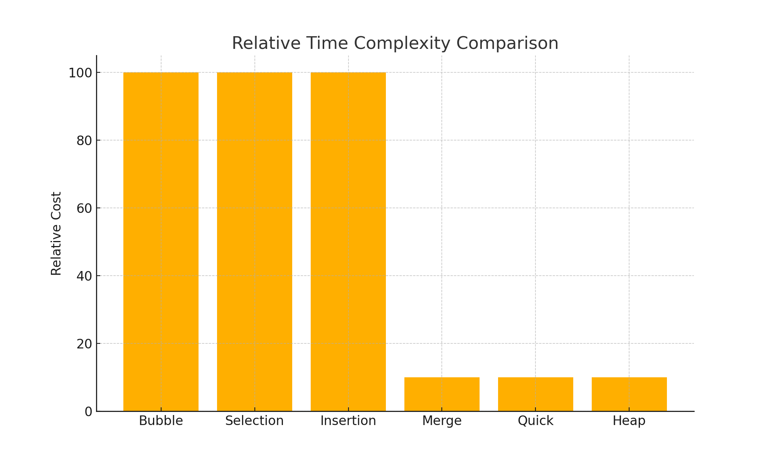
Algorithm Time Complexity Comparison

Slide 6
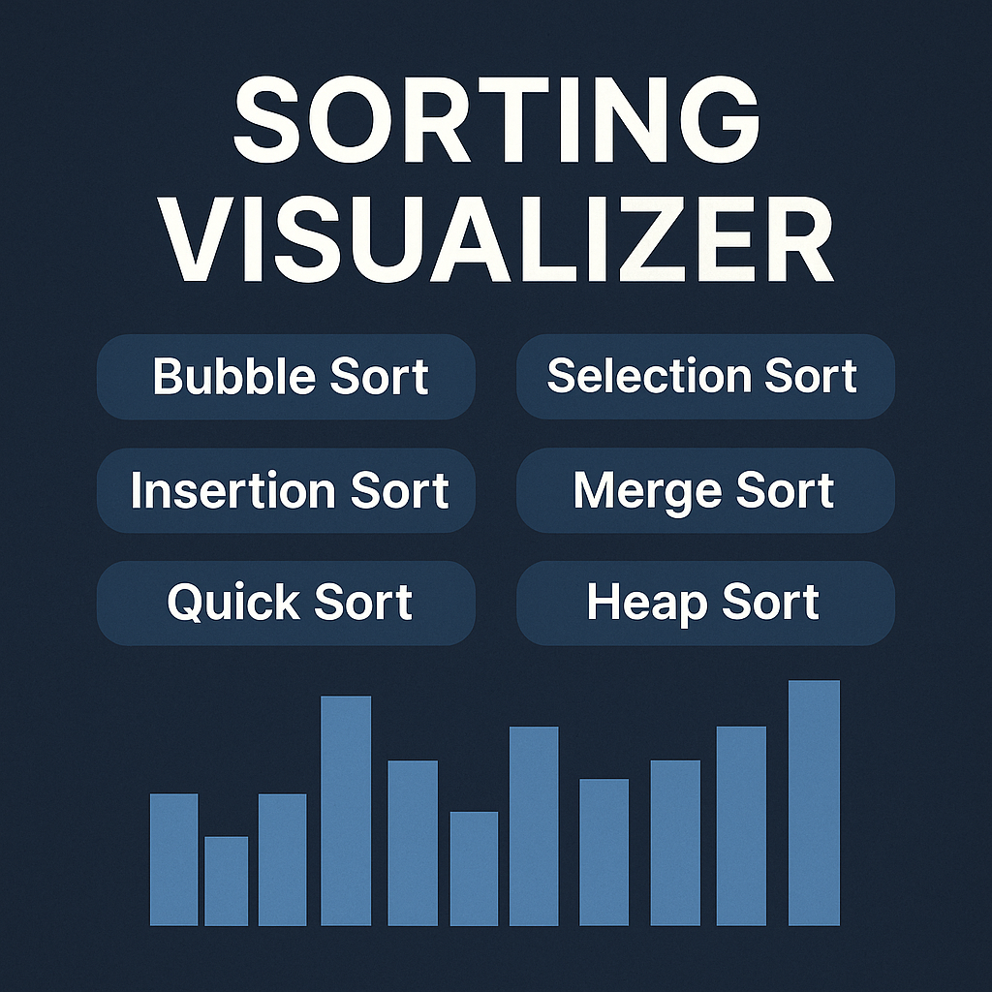
Project Thumbnail (Console Output)

Slide 7
Key Learnings
Through this project, the following concepts were strengthened:
Sorting Algorithm Logic
Time Complexity Understanding
Recursion (Merge/Quick Sort)
Divide-and-Conquer Strategy
Heap Data Structure & Heapify

Slide 8
Sample Output
Users see algorithm steps printed like:
[3, 4, 5, 7, 8]
Pass 1: ...
Pivot: 7 ...
Merged arrays...

Slide 9
Conclusion
This sorting visualizer is great for learning DSA concepts.
It demonstrates algorithm flow clearly and helps beginners understand sorting internal steps.

