Slide 1
Bluestock Mutual Fund Analytics
Capstone
End-to-End Data Engineering, Risk Modeling, & BI Dashboarding
Aditya Raj
Data Analytics ntern | Bluestoc k Fintech

Slide 2

The Data Fragmentation Problem
The mutual fund industry generates massive data streams, but they are rarely unified.
Daily NAVs: Sit in isolated pricing feeds.
Monthly AUMs: Locked in distinct compliance disclosures.
Transactions: Buried in granular investor ledgers.
”Without a central key connecting behavior to performance, AMCs miss critical signals like at-risk capital and hidden concentration risks.”

Slide 3




Core Project Objectives
Data Engineering
Design a robust ETL pipeline in Python to ingest, clean, and centralize raw CSV feeds into a unified SQLite star-schema database.
Quantitative Performance
Compute standardized financial metrics (Alpha, Beta, CAGR, and Sharpe Ratio) to build an objective Top 40 Fund Scorecard.
Advanced Risk Analytics
Move beyond basic volatility by modeling extreme tail risk (Historical VaR), portfolio concentration (HHI), and investor SIP continuity.

Slide 4
ETL & Analytics Architecture
1. Ingestion & Cleaning
Pandas/Num Py utilized to forward-fill missing NAVs, enforce ISO date formats, and cap severe transaction outliers
2. Centralized Storage
Data structured into a relational SQ Lite database (b tue sI oc k rrf . db) using a star-schema (Facts linked to
Dim Fund).
3. Analytics Engine
Python modules execute CAPM formulas and historical simulations, outputting the master
fund scorecard . csv.
4. BI Visualization
Power BI connects to the processed datasets to deliver a 4-page interactive dashboard for non-technical stakeholders.

Slide 5
Data Processing Scale (2022-2025)
Rigorous programmatic cleaning ensured high relational integrity before analytics commenced.

Slide 6
Fund Scorecard: Top vs Bottom Performers
Analysis of the Top 40 funds revealed that Large Cap funds offered the most stable risk-adjusted returns.
AM FI CO DE | CATEGO RY | ALP HA (EXC ESS) | B ETA (VO L.) | CAG R | S HAR PE RATIO
118632 | Large Cap | 0.04 | 0.85 | 18.2%
119092 | Multi Cap | 0.02 | 0.92 | 15.4%
120503 | Mid Cap | 0.01 | 1.05 | 14.1% | 1.20
119551 | Small Cap | -0.01 | 1.18 | 12.8% | 0.80
120841 | Sectoral | -0.03 | 1.25 | 9.5% | 0.60 (Laggard)

Slide 7
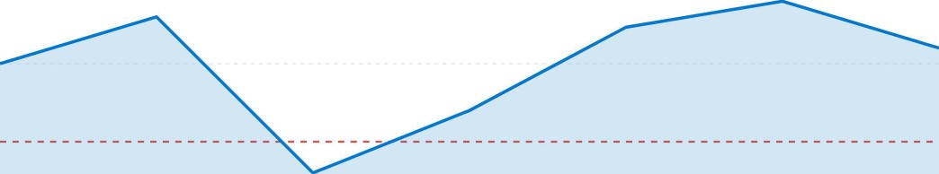
Dynamic Volatility: 90-Day Rolling Sharpe
Point-in-time metrics are deceptive. Rolling analytics prove that risk-adjusted returns plunge below zero during macroeconomic shocks (e.g., rate hikes) before aggressively recovering.
2.0
1.0
0.0
-1.0
Q1'23
Q3 '23(Macro Shock)
Q124
Q4'24

Slide 8

Extreme Tail Risk: 95% Historical VaR
Val ue at Risk (Va R) estimates the maximum expected 1-day loss. Analysis shows that the highest-risk funds failed to deliver proportional returns, suffering from severe volatility drag.
Fundll86]2
Fundll9O92 Fundl2OSO3 Fundl2O84l
•A 95% Ve P o I -2. 15% implies o 5% historical probobiliy of losing more rban 2. 15% o I capital in o single trading day.

Slide 9
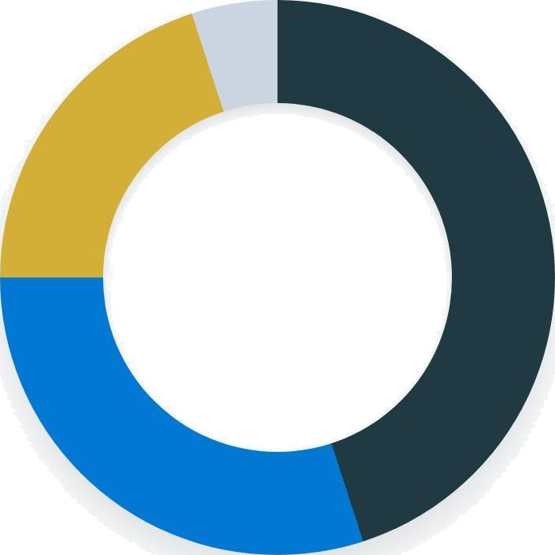
Covert Concentration Risk (HHI)
Applying the Herfindahl-Hirschman Index (HHI) to sector weights revealed that several "Diversified" funds hold covert overweight positions, scoring near 2,500 (highly concentrated).
Financial Services (45^A)
Information Technology (3096)
Energy & Auto (2096)
All Other Sectors (5°â)

Slide 10
Investor Behavior: SIP Continuity
SlPs form the backbone of AMC revenue, but continuity analysis isolated a critical vulnerability.
SIP Dominance: Systematic Investment Plans account for
83.59« of all tracked transaction volume.
The Vulnerability: 1 0-15% of seasoned investors (6+ previous SIPs) fall into the "at-risk" category.
The Metric: "At-risk" is defined by exhibiting a gap of more than 35 days between investments.
The Cause: Often correlates with minor macro-corrections or failed bank auto-debit setups.
I•?Dashboard data visualization showing transaction trends

Slide 11
Strategic Recommendations for AMCs
Deploy automated trigger workflows (SMS/Email) specifically targeting the "at-risk" investor cohort flagged by the 35-day
continuity algorithm to recover failed auto-debits.
Shift away from static risk labels (Low/Med/High). Utilize rolling-risk metrics like the 90-Day Rolling Sharpe and Historical
VaR to better manage investor expectations during shocks.
Integrate internal HHI scoring alerts to ensure funds marketed and sold as "Diversified Equity" do not silently breach
safe concentration thresholds in IT and Financials.

Slide 12
Thank you for your time.
Aditya Raj
github.com/adityaraj9798/Mutual-Fund-Analytics

Slide 13

Image Sources
https://static.vecteezy.com/system/resources/previews/075/683/084/non 2x/abstract-financial-growth-background-with-glowing-purple-data-chart-and-rising-trend-line-mode rn-business-analytics-concept-design-with-copy-space-for-presentation-report-or-marketing-use-vector.jpg
Source: www.vecteezy.com
“Chumbnail
www.kIipfoIio
SI//images.kIipfoIio.com/website/public/bf9c6fbb-06bf-4f1d-88a7-d02b70902bd1/data-dashboard.png
e: www.klipfolio.com

