Slide 1

SMART INDIA HACKATHON 2026
TITLE PAGE
Problem Statement ID – SIH26208
Problem Statement Title- Student Innovation-Challenge your creative mind to conceptualize and develop unique toys and games based on our civilization, history, and culture etc.
Theme- Toys & Games
PS Category- Software
Team ID- 469
Team Name Beyonders

Slide 2
BharatVerse
Beyonders
PROBLEM
WHY DIFFERENT?
OUR SOLUTION
Others digitise heritage — we make it playable. Every app shows monuments and facts; BharatVerse is the only one where a child fixes the Indus drains, builds the ancient city and plays Kho-Kho — you can't forget what you've done yourself.
Heritage is taught passively → textbooks and rote memorisation give children no way to experience history.
BharatVerse → a browser 2D game that turns India's heritage into a playable map of 5 worlds — Indus Valley, Magadha, folk arts, traditions & sports.
The first AI guide a parent can trust. Smriti Didi speaks to children in their own language — but she is engineered to say only pre-verified heritage facts, with safety filters at every step. AI for children, with zero risk of AI mistakes.
History feels distant → ancient cities, crafts and traditions seem disconnected from a child's daily life.
Learn by doing → children fix Indus drains, build an ancient city, make Rangoli, light diyas & race Kho-Kho — 6 working mini-games, zero rote learning.
Traditional games, crafts and festivals are fading → children rarely engage with living heritage like kho-kho, rangoli or diyas.
KEY VALUE PROPOSITION
Memory Restoration → every game restores the map's lost memories — visible progress that pulls children back to learn more.
Children don't study heritage — they play it. Every lesson is a game they do, so it stays with them for life.
Digital content is static and one-way → no exploration, no progress, no motivation to return and learn deeper.
A safe AI friend in their own language. Smriti Didi speaks Hinglish and says only verified facts — learning feels like talking to an elder sister, not reading a textbook.

Slide 3
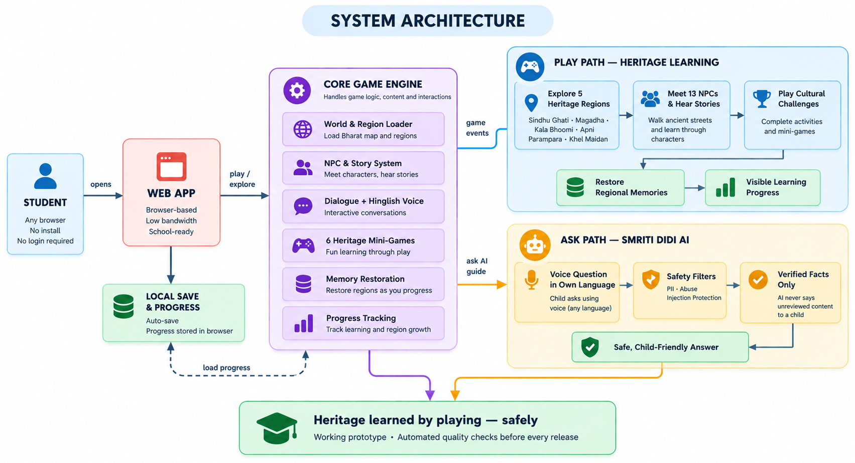
TECHNICAL APPROACH
Beyonders
TECH STACK USED :
React.js
TypeScript
HTML5 Canvas
CSS3
React Router
Web Speech API
Phaser

Slide 4
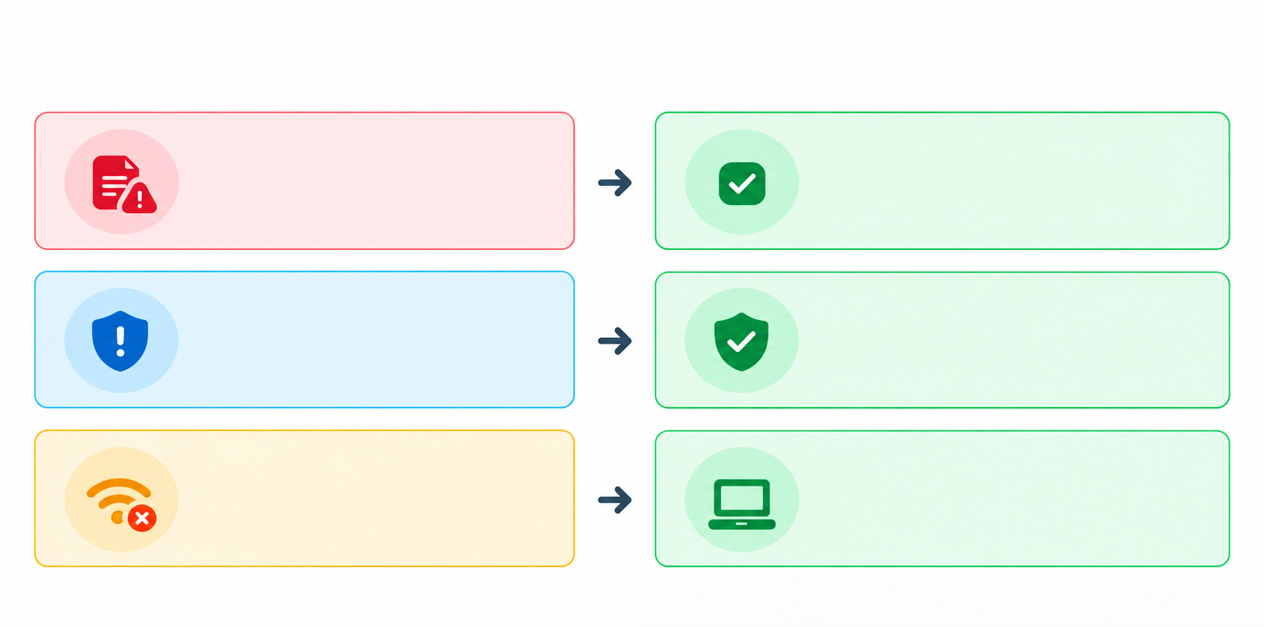
FEASIBILITY AND VIABILITY
Beyonders
Risk Assessment and Mitigation
PROBLEM
Inaccurate Heritage Information
SOLUTION
Reviewed Content +
Verified Facts Only
Prevents misleading cultural learning
TECHNICAL FEASIBILITY
Working Web Prototype: Developed using React, TypeScript, Vite and a custom HTML5 Canvas game engine.
School-Ready Deployment: Browser-based, no installation, touch/keyboard support and local progress saving.
Safe AI Assistance: Multilingual interaction with verified facts and multi-layer child-safety filters.
Quality Assurance: Automated type checks, world-data validation, gameplay-solvability checks and UI testing.
PROBLEM
Child Safety &
Privacy Risks
SOLUTION
Multi-Layer Safety Filters
+ No Login Required
Blocks PII, unsafe content and prompt injection
PROBLEM
Low Connectivity &
Basic School Devices
SOLUTION
Lightweight Browser Game
+ Local Progress Saving
No installation; designed for school computers
RESOURCE REQUIREMENTS
ECONOMIC APPROACH
Browser-enabled computer, laptop, tablet or smartphone
Open-source technologies: React, TypeScript, Vite and HTML5 Canvas
No specialized hardware or commercial game engine required, making it affordable for schools
Browser-based deployment eliminates installation and maintenance expenses
Reusable game architecture enables new heritage regions to be added at a lower incremental cost
Phased rollout through schools, CSR and government partnerships supports sustainable nationwide scaling
Static web hosting and lightweight Node.js server
Stable internet connection for multilingual AI and voice assistance
Verified heritage content, 2D game assets and narration audio
Modern web browser; no specialized GPU or commercial game engine required

Slide 5
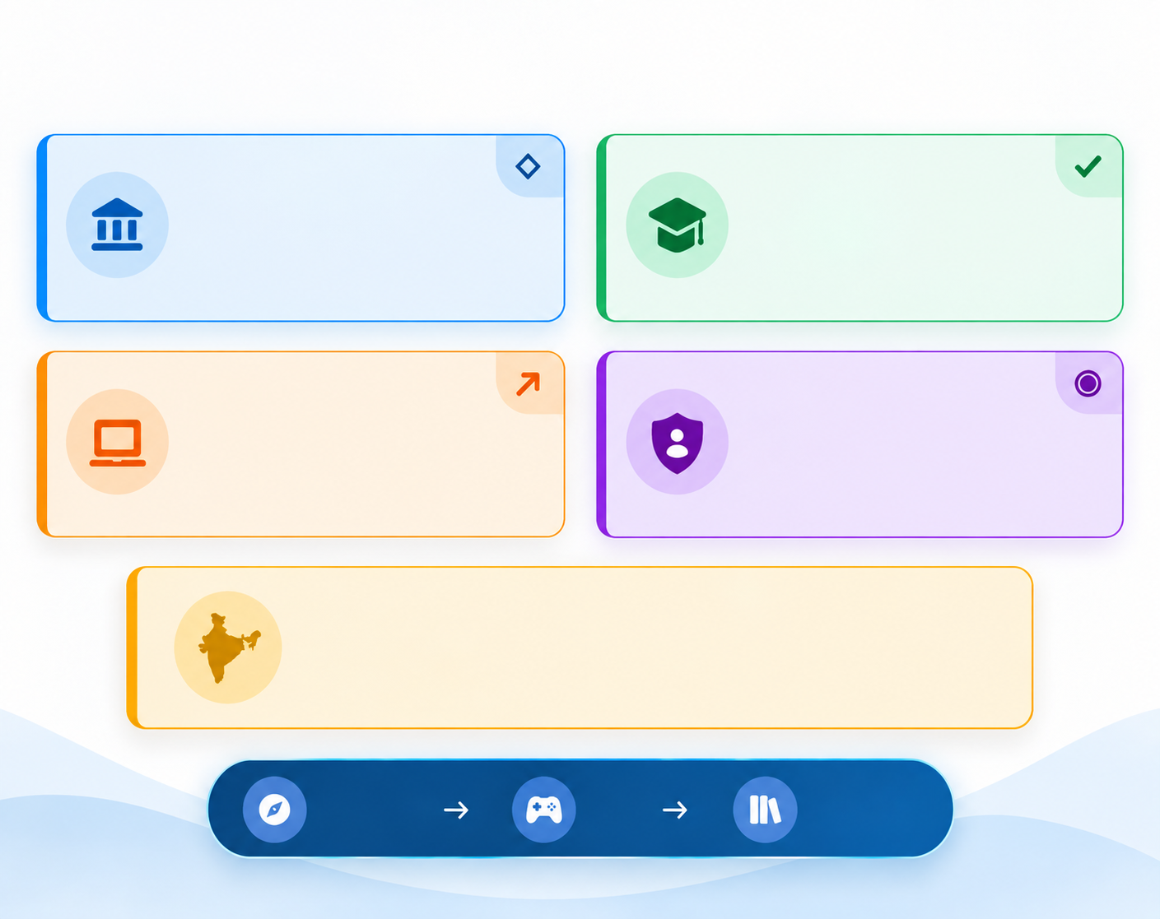
IMPACT AND BENEFITS
Beyonders
FUTURE PROSPECTS
IMPACT
Expand Across India: Add more states, monuments, folk traditions, festivals, freedom movements and indigenous games as playable heritage worlds.
Government-School Integration: With government support, BharatVerse can be aligned with the school curriculum and introduced as a recommended or structured heritage-learning activity in government schools.
Partnerships with NGOs: Collaborate with education and cultural NGOs to provide heritage learning in rural, tribal and underserved communities.
Multilingual Learning: Introduce regional languages, voice narration and locally relevant stories so children can experience heritage in their mother tongue.
Teacher and Classroom Tools: Develop lesson plans, classroom activities, teacher dashboards and progress reports for effective school adoption.
AR and Virtual Heritage Tours: Enable students to experience monuments, historical environments and cultural practices through immersive AR-based learning.
Community-Contributed Heritage: Allow historians, teachers, museums and local communities to contribute verified regional stories and cultural knowledge.
Cultural Impact
Educational Impact
Brings regional stories, traditions and
indigenous games to life for the next
generation.
Transforms passive memorisation into
activity-based learning through stories
and challenges.
Accessibility Impact
Safe Digital Impact
Browser-based, no-install learning
designed for school computers, tablets
and low-bandwidth access.
Provides child-focused guidance using
reviewed facts, privacy protection and
multi-layer safety filters.
National Impact
A reusable platform where new regions and cultural experiences can be
added—building a scalable digital heritage learning network for India.
DISCOVER
PLAY
RESTORE

Slide 6
RESEARCH AND REFERENCES
Beyonders
SUPPORTING RESEARCH PAPERS
DATA SOURCES
NCERT Textbooks — Indian history and age-appropriate educational content
https://ncert.nic.in/textbook.php
UNESCO World Heritage Centre — Mohenjo-daro and Nalanda Mahavihara
https://whc.unesco.org/
Archaeological Survey of India — Archaeological and monument information
https://asi.nic.in/
Ministry of Culture — Indian art, traditions and intangible heritage
https://www.indiaculture.gov.in/
Kholo India & Sports Authority of India — Indigenous sports and traditional games
https://kheloindia.gov.in/
UNICEF & UNESCO — Child-safe and responsible AI guidance
https://www.unicef.org/innocenti/reports/policy-guidance-ai-children
Clark, D. B., Tanner-Smith, E. E., & Killingsworth, S. S. (2016). Digital Games, Design, and Learning: A Systematic Review and Meta-Analysis. Review of Educational Research.
Mortara, M., Catalano, C. E., Bellotti, F., et al. (2014). Learning Cultural Heritage by Serious Games. Journal of Cultural Heritage.
UNICEF. Policy Guidance on AI for Children.
UNESCO. (2023). Guidance for Generative AI in Education and Research.
Government of India. (2020). National Education Policy 2020.
MARKET RESEARCH
TECHNICAL DOCUMENTATION
Large Target Audience: India has a vast school-going population, creating strong demand for engaging and curriculum-relevant digital learning tools.
Clear Market Gap: Most heritage platforms provide static text, images or videos; very few offer story-driven exploration, cultural mini-games and multilingual interaction together.
Growing Institutional Demand: NEP 2020 encourages experiential learning, Indian Knowledge Systems, regional languages and technology-enabled education.
Scalable Adoption Opportunity: BharatVerse can reach private and government schools through partnerships with education departments, NGOs, museums and CSR programmes.
System Architecture: React and TypeScript frontend with a custom HTML5 Canvas game engine and modular heritage-world structure.
Data Management: Structured JSON/TypeScript files store regions, NPCs and stories; LocalStorage automatically saves player progress.
AI and Voice Module: Smriti Didi supports multilingual voice interaction with verified facts and child-safety filters.
Testing and Deployment: Type checking, gameplay-solvability validation and automated UI tests ensure a reliable browser-based release.

