Slide 1
DETERMINING INTRUDER AIRCRAFT POSITION USING SERIES OF STEREOSCOPIC 2-D IMAGES
Aditya Ramani
Thesis Supervisor: Dr. Atilla Dogan

Slide 2
Outline
Introduction
Part 1: Camera Image Generation (incl. Simulation Results)
Part 2: Relative Position Calculation (incl. Simulation Results)
Conclusion and Future Work

Slide 3
Introduction
Introduction of UAV (Unmanned Aerial Vehicles) into the NAS (National Air Space) requires the detect-and-avoid capability.
An aircraft should be able to detect other aircraft flying in the same airspace volume and make evasive maneuvers if there is potential conflict.
One potential method for intruder aircraft detection is processing digital images taken by onboard cameras
Avoidance algorithms could benefit from relative position information determined through image processing

Slide 4
Introduction
Focus of thesis research is to compute the position of an intruder aircraft relative to an observer aircraft with onboard stereo cameras.
First phase of research effort was to generate camera images given the relative position information
This process uses a simple pinhole camera methods where cameras are characterized by focal length, angle of view and resolution.
The second phase of the research developed two methods to estimate the relative position based on the generated camera images. Both methods employ epipolar geometry of stereo vision based on two cameras placed on the aircraft with lateral separation.
Various cases were designed and run in MATLAB-Simulink environment to evaluate relative position estimation methods with different aircraft trajectories, different camera separation, and different image resolution

Slide 5
Part 1: Camera Image Generation

Slide 6
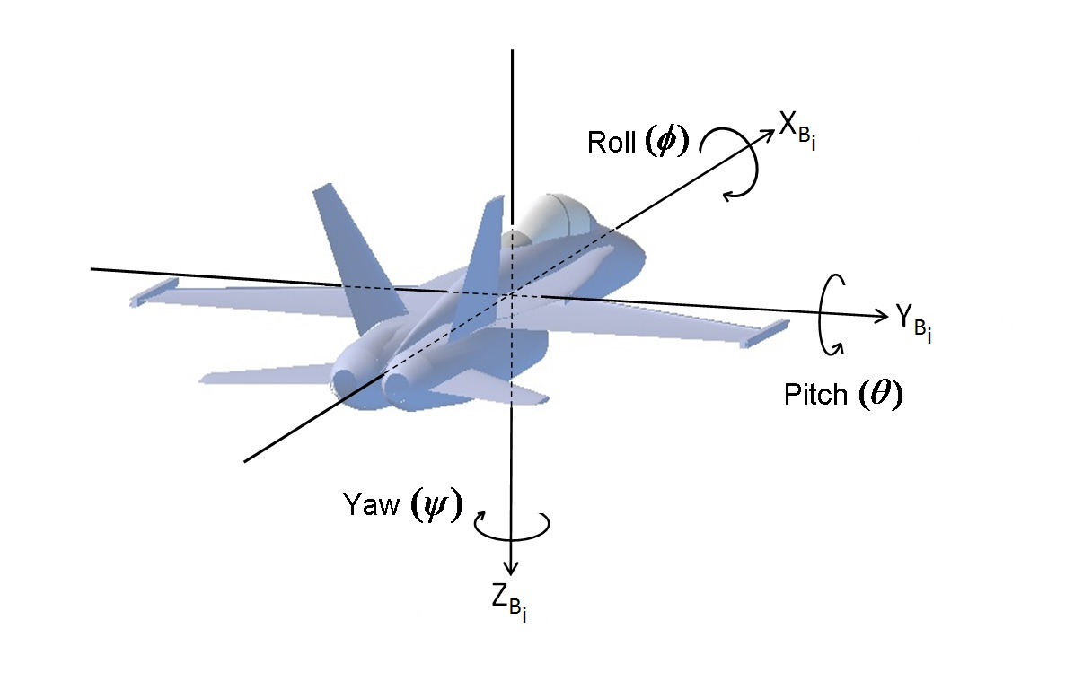
Reference Frames
Inertial Frame is defined to be located at geometrically-fixed point in space and its x, y, and z axes pointing local north, local east, and local down respectively (North-East-Down); referred to as I-frame
Body Frame of Aircraft-i defined to have origin at aircraft Center of Gravity, having axes definition as shown on diagram on the left; referred to as B_{i}-frame
Wind frame defined to have same origin point as B_{i}-frame and characterized by angle of attack α and side-slip angle β; referred to as W_{i}-frame

Slide 7
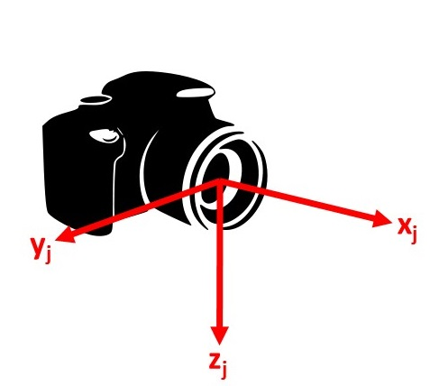
Camera Frame
The camera-j frame is defined to have its origin at the center of the camera lens, and x-axis pointing along the normal line of view
Referred to as C_{j}-frame

Slide 8
Rotation Matrices and Vectrix Formulation
Rotation matrices used to rotate from one frame to another.
R_{CjBi}: rotation matrix used to rotate from the C_{j}-frame to the B_{i}-frame
R_{BiI}: rotation matrix used to rotate from the I-frame to the B_{i}-frame
R_{BiWi}: rotation matrix used to rotate from the W_{i}-frame to the B_{i}-frame
Vectrix notation used to write vector in terms of components in specified frame
Allows one to use the rotation matrix to transform vector representation to another frame

Slide 9
Determining 3-D Position of Intruder Aircraft
First, the representation of velocity of each aircraft in inertial frame is written in terms of airspeed V , using the translational kinematics equation
The rotational kinematics equations are also used, expressed in terms of angles ψ, θ and Φ and pitch, roll, and yaw rates p, q, and r
These equations are implemented in Simulink

Slide 10
Determining 3-D Position of Intruder Aircraft (cont.’d)
Using vector relations, the resulting equation that gives the representation of Aircraft 2 position relative to Aircraft 1 in B₁-frame in terms of representations of Aircraft 1 and 2 in I-frame as:

Slide 11
Transferring Relative Position to Images
Next step is to formulate Aircraft 2 relative to each camera at specified location and orientation relative to B₁-frame
Using vector relations and rotation matrix from B₁-frame to C_{j}-frame, the resulting equation is

Slide 12
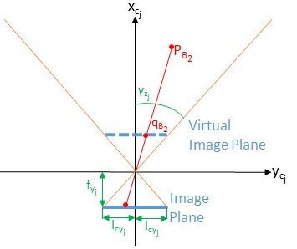
Transferring Relative Position to Images (cont.’d)
The next step is to formulate projection of intruder aircraft position in camera image plane
Ideal pinhole camera model used (see diagram on the right)
Camera aperture considered as a point, and no lenses used to focus light
Result is 2D matrix M (of size N_{zj} X N_{yj}, both of which are odd numbers) representing processed image file from digital camera
2 important camera parameters considered: focal length f_{cj} and view angle γ_{zj} and γ_{yj}

Slide 13
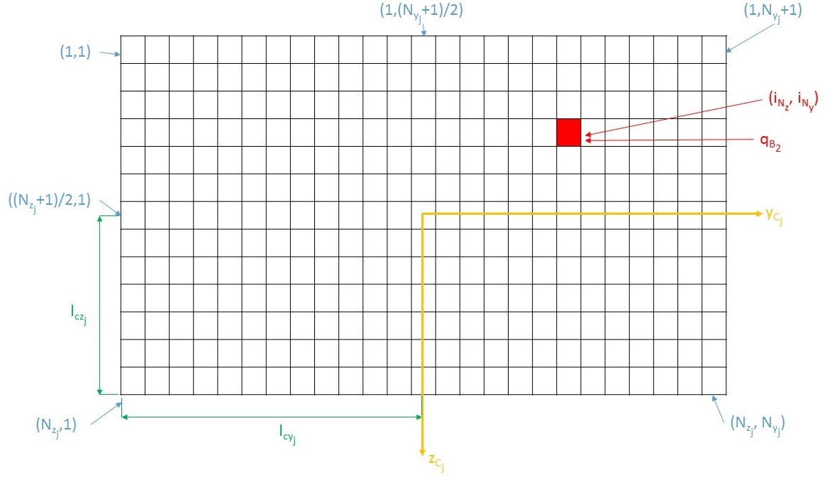
Transferring Relative Position to Images (cont.’d)
Position of point p_{B2} in C_{j}-plane is defined as

Slide 14
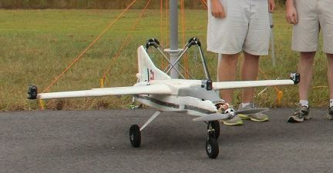
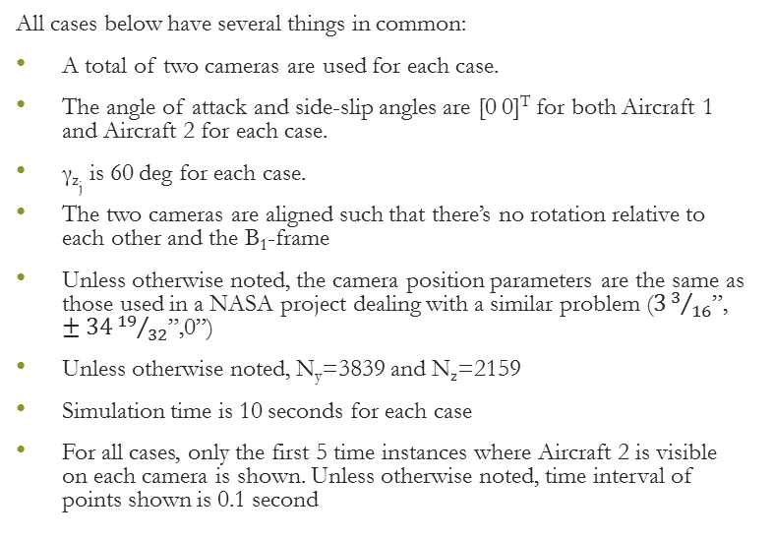
Simulation Cases and Results
All cases below have several things in common:
A total of two cameras are used for each case.
The angle of attack and side-slip angles are [0 0]^{T} for both Aircraft 1 and Aircraft 2 for each case.
γ_{zj} is 60 deg for each case.
The two cameras are aligned such that there’s no rotation relative to each other and the B₁-frame
Unless otherwise noted, the camera position parameters are the same as those used in a NASA project dealing with a similar problem ($33/{16}$”, $±34{19}/{32}$”,0”)
Unless otherwise noted, N_{y}=3839 and N_{z}=2159
Simulation time is 10 seconds for each case
For all cases, only the first 5 time instances where Aircraft 2 is visible on each camera is shown. Unless otherwise noted, time interval of points shown is 0.1 second

Slide 15
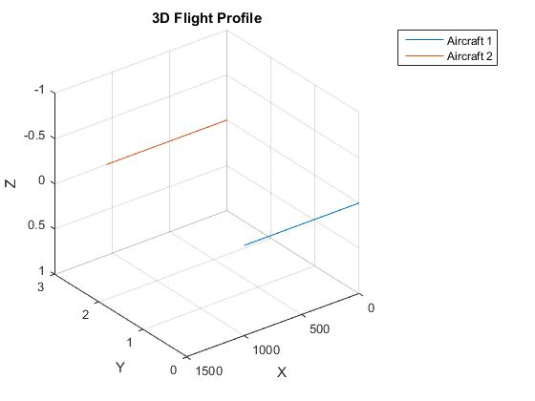
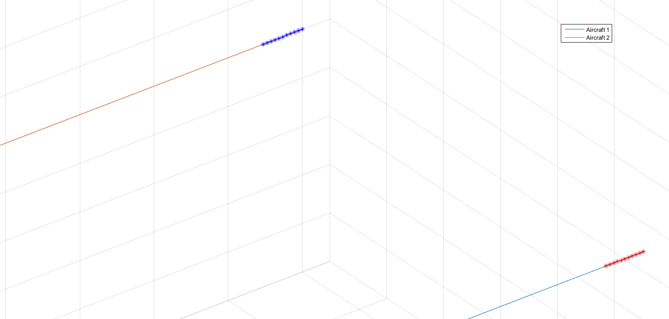
Case 1
Starting Point
A simple case
Aircraft 1 and 2 are located at [0 0 0]^{T} and [0 3 0]^{T} respectively, and travel at speeds of 100 m/s and 105 m/s respectively
Both travel along a straight path, with Euler angles all set to 0 deg.

Slide 16
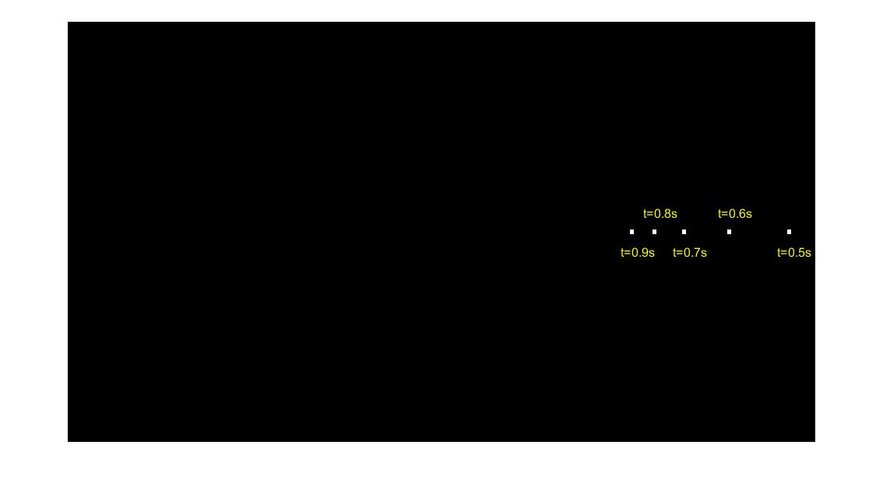
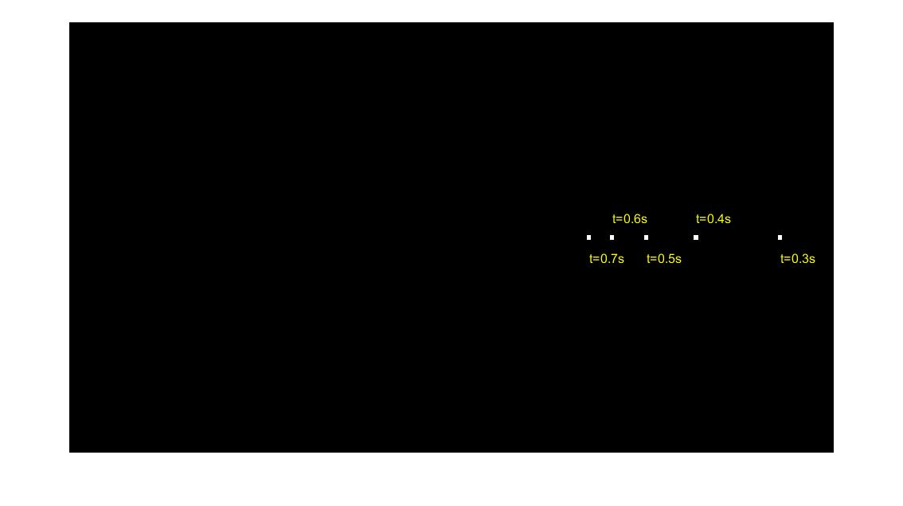
Case 1 Image Results

Slide 17
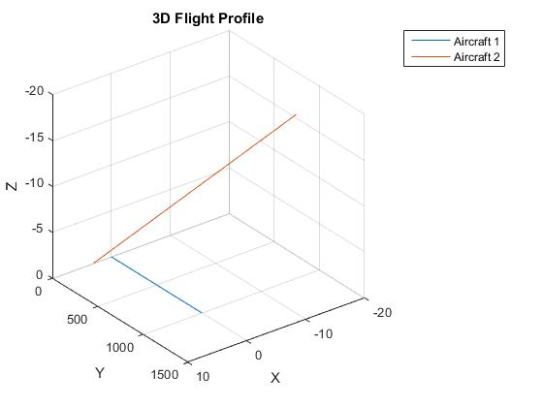
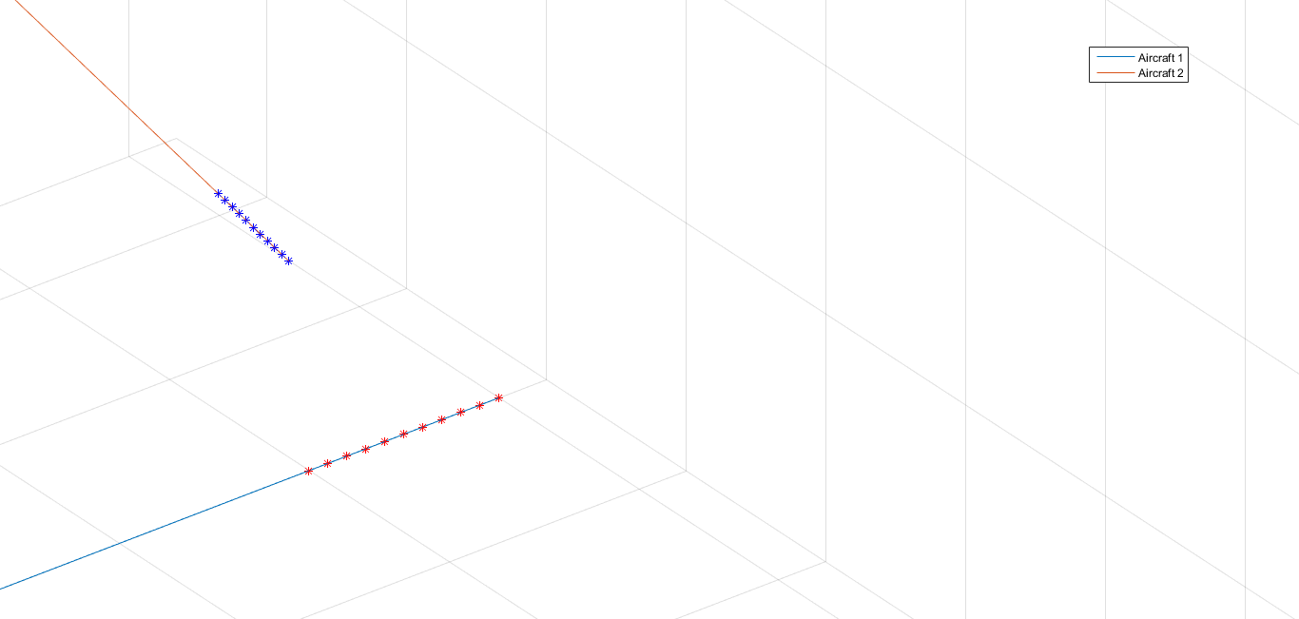
Case 2
Starting Point
This case has the same initial positions and speeds as case 1, but with yaw and pitch angles set to -1 and 1 deg respectively

Slide 18
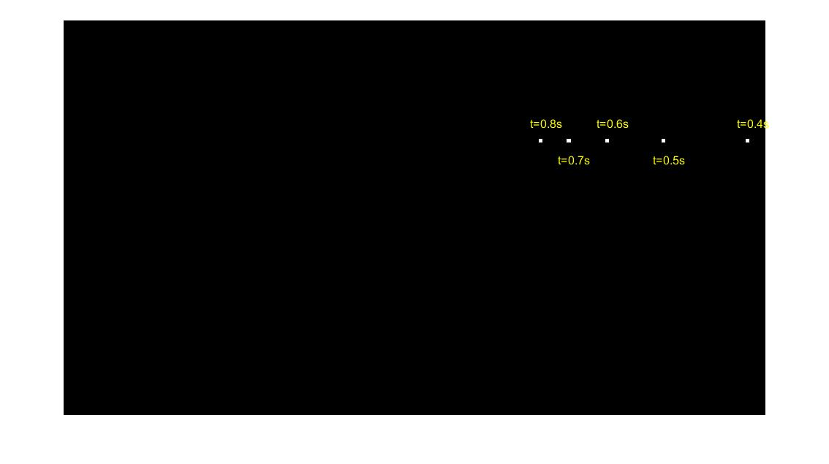
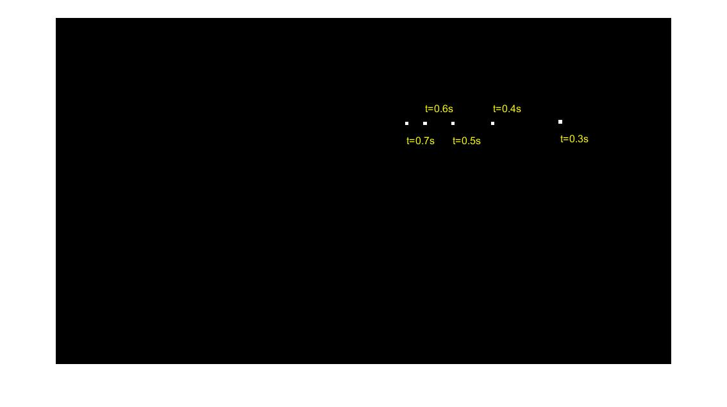
Case 2 Image Results

Slide 19
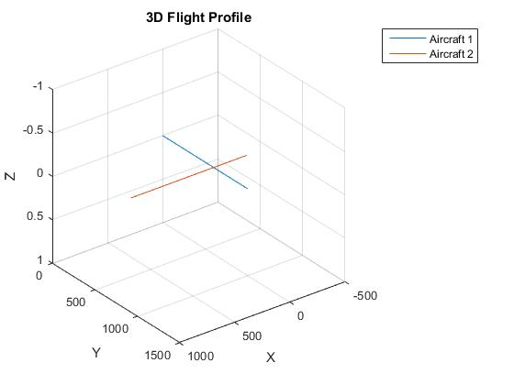
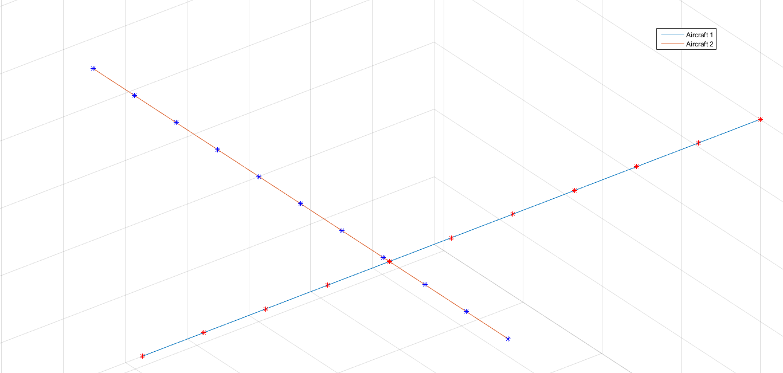
Case 3
Starting Point
Both aircraft fly at same speeds as previous 2 cases (i.e., 100 m/s for Aircraft 1 and 105 m/s for Aircraft 2), but with Aircraft 2 flying both perpendicular to Aircraft 1 ant having its origin point at [600 -300 0]^{T}

Slide 20
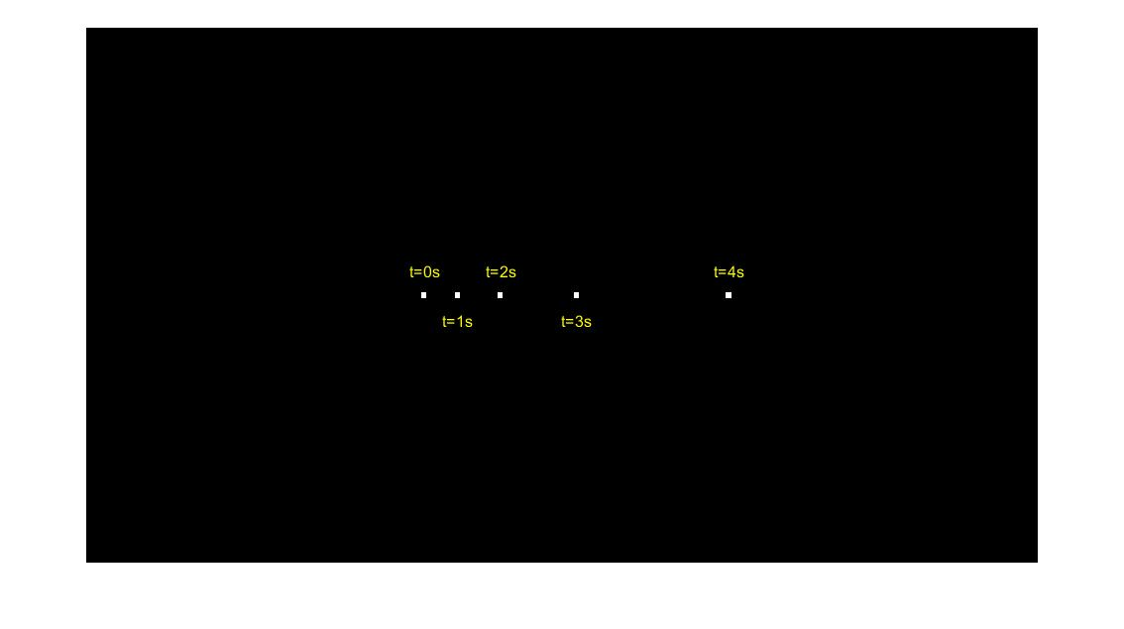

Case 3 Image Results

Slide 21
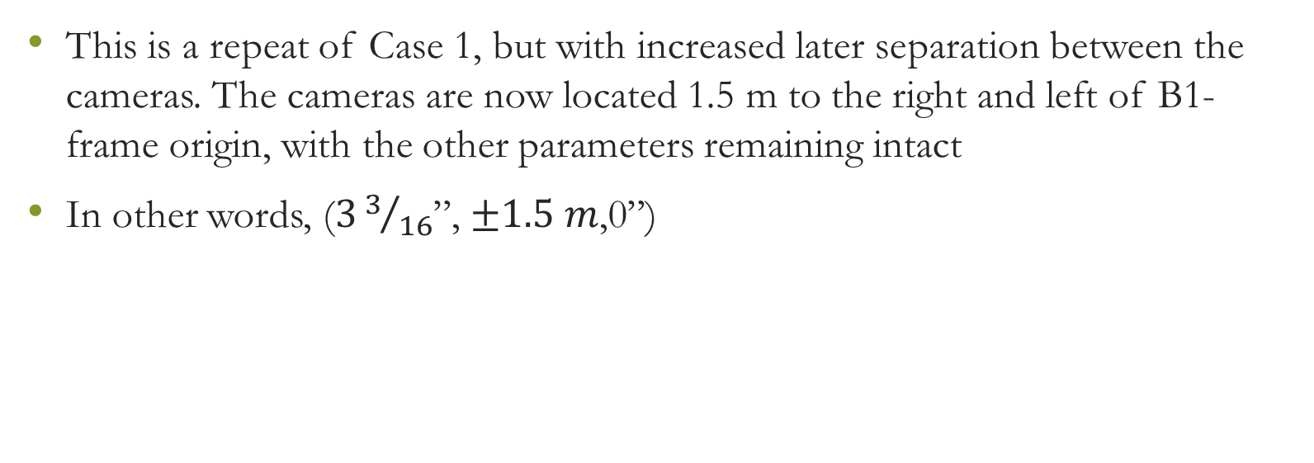
Case 4
This is a repeat of Case 1, but with increased later separation between the cameras. The cameras are now located 1.5 m to the right and left of B1-frame origin, with the other parameters remaining intact
In other words, ($33/{16}$”, $±1.5 m$,0”)

Slide 22
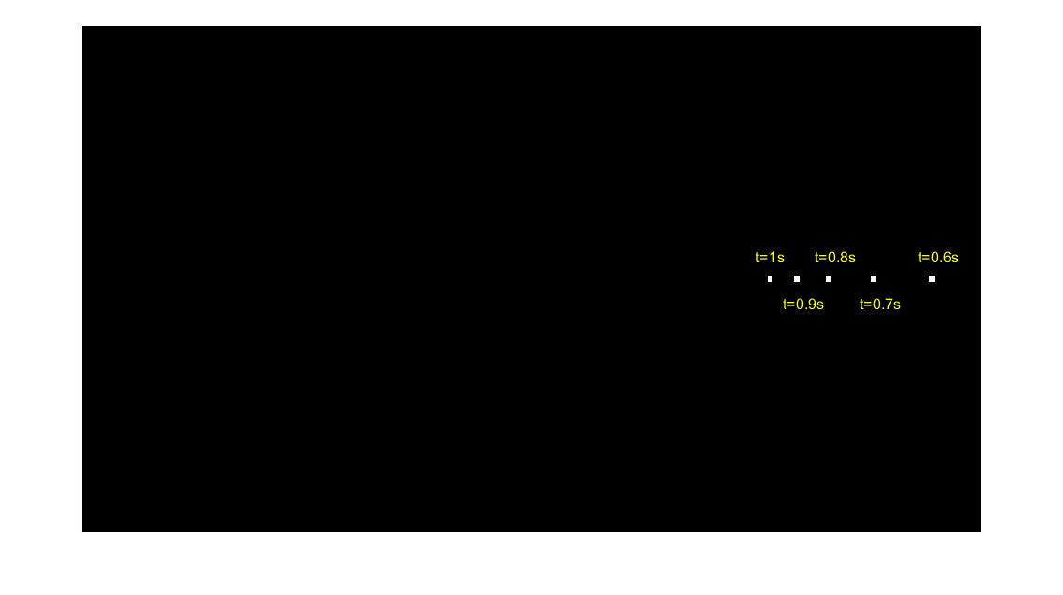
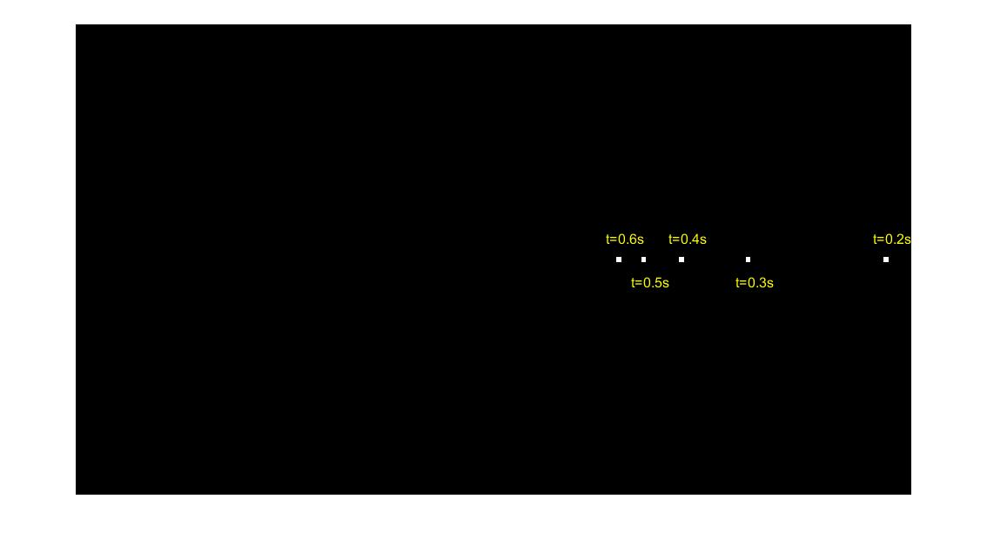
Case 4 Image Results

Slide 23
Case 5
This is a repeat of Case 2, but with modified image resolution
For this case, N_{y}=2001 and N_{z}=1001

Slide 24
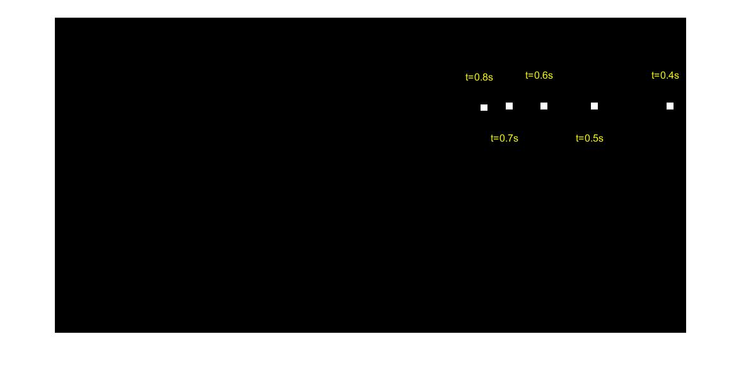
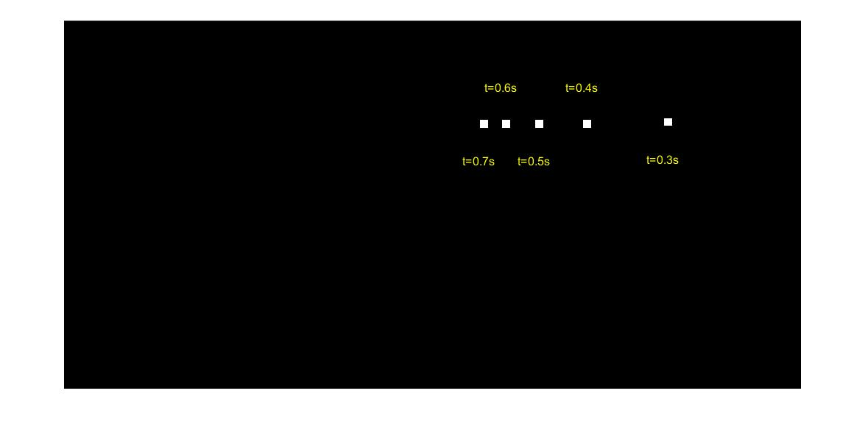
Case 5 Image Results

Slide 25
Part 2: Relative Position Calculation

Slide 26
Relative Position Calculation
Try to ‘reverse-engineer’ focuses on whether one could find the relative position of the intruder aircraft relative to the observer aircraft, assuming all that are given are the camera position(s) and orientation(s) relative to B₁-frame and the images taken by at least two cameras at the same times
Show two methods to finding position, both of which use epipolar geometry of stereo vision, where two cameras view a single 3D scene from different positions

Slide 27
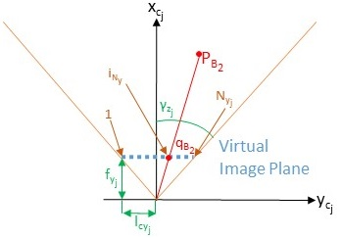


Method 1: Triangular Angles
Use right-angled triangles and trigonometry to solve for intruder aircraft position relative to left camera (Camera 2) frame before using vector addition to solve for position relative to B₁-frame
First solve for line of sight angle from camera-j to intruder aircraft using relationship between (i_{Ny}, i_{Nz}) and (γ_{zj}, γ_{yj}) using equations:

Slide 28
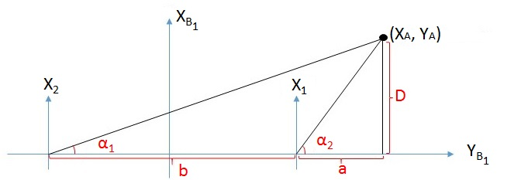

Case A: Г_{Bz2}>0 and Г_{Bz1}>0
Aircraft located to the right of both cameras

Slide 29

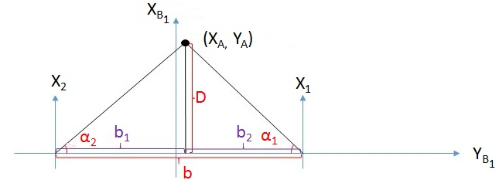
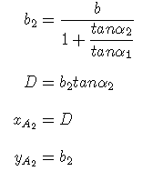

Case B: Г_{Bz2}>0 and Г_{Bz1}<0
Aircraft located somewhere in between the two cameras

Slide 30

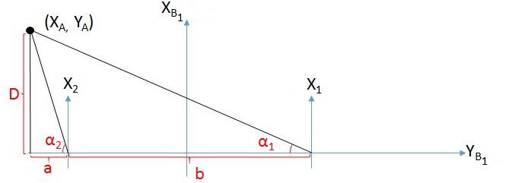
Case C: Г_{Bz2}<0 and Г_{Bz1}<0
Aircraft located to the left of both cameras

Slide 31

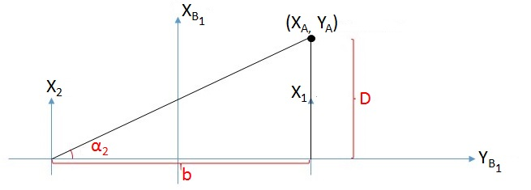
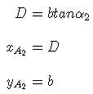

Case D: Г_{Bz2}>0 and Г_{Bz1}=0
Aircraft located at center of camera 1 and to the right of camera 2

Slide 32
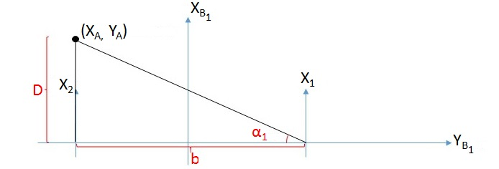
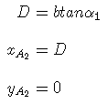
Case E: Г_{Bz2}=0 and Г_{Bz1}<0
Aircraft located at center of camera 2 and to the left of camera 1

Slide 33
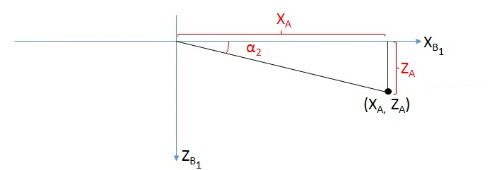
Solving for z_{A}

Slide 34
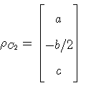
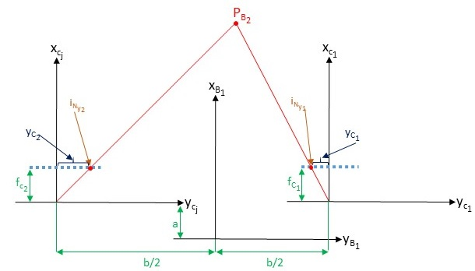
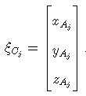
Method 2: Virtual Image Frame Utilization
Given
Expressing in camera frame

Slide 35
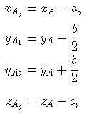

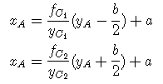
Method 2: Virtual Image Frame Utilization (cont.’d)
Since cameras are aligned with B1-frame, this means that:
Using similar triangles, one can deduce that:
This leads to: Finally, this gives

Slide 36
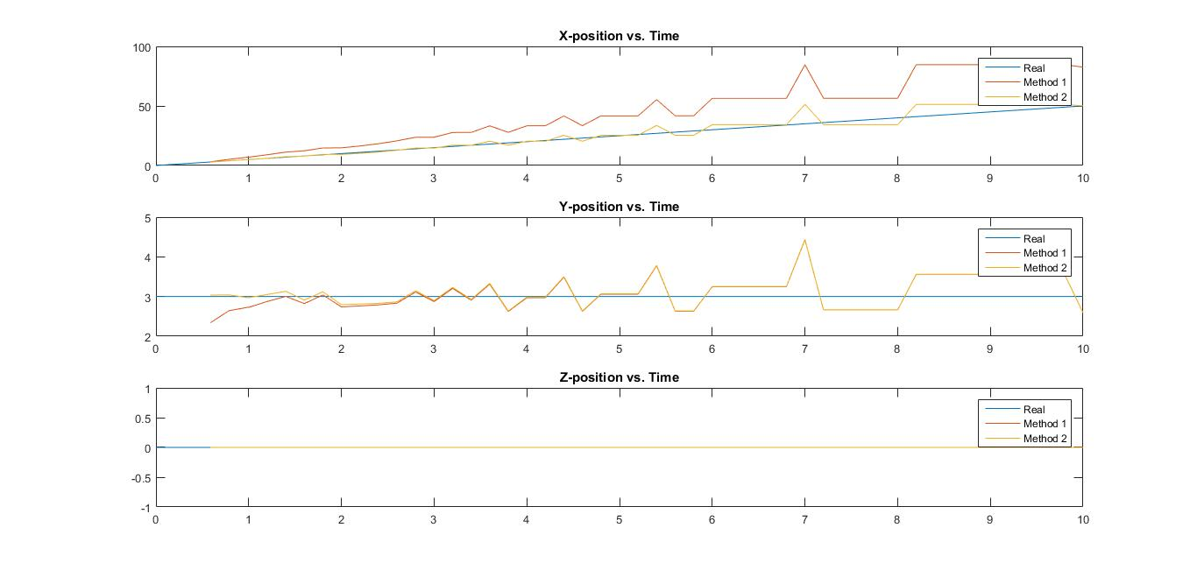
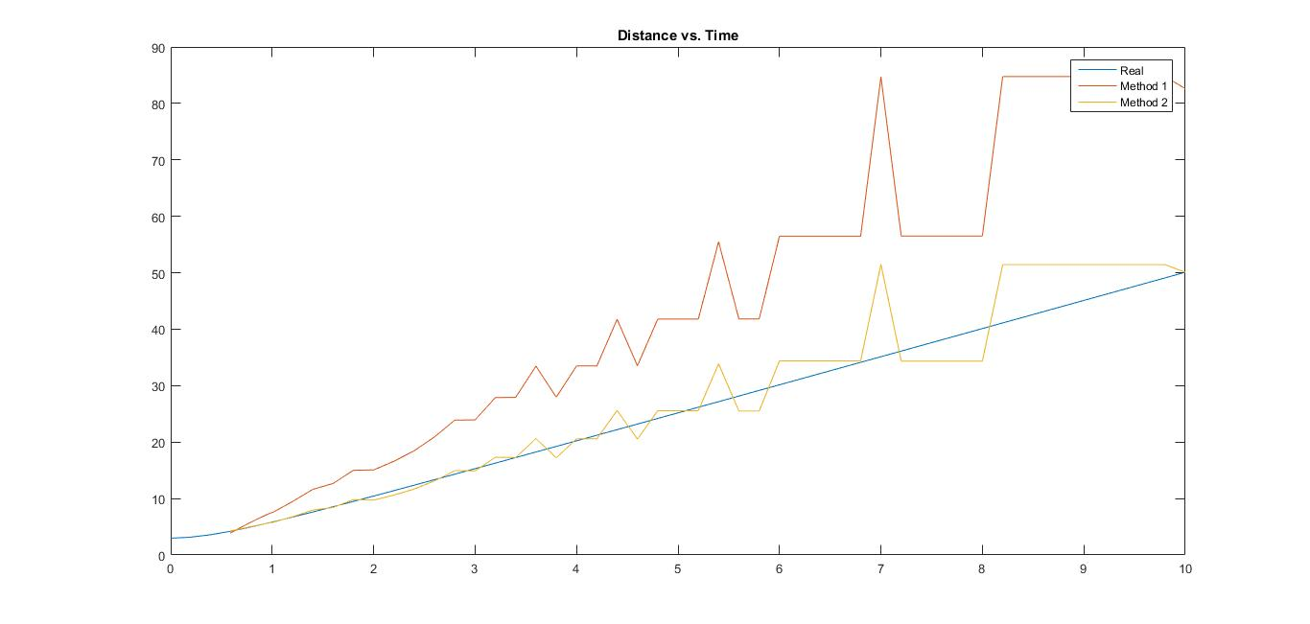
Case 1

Slide 37
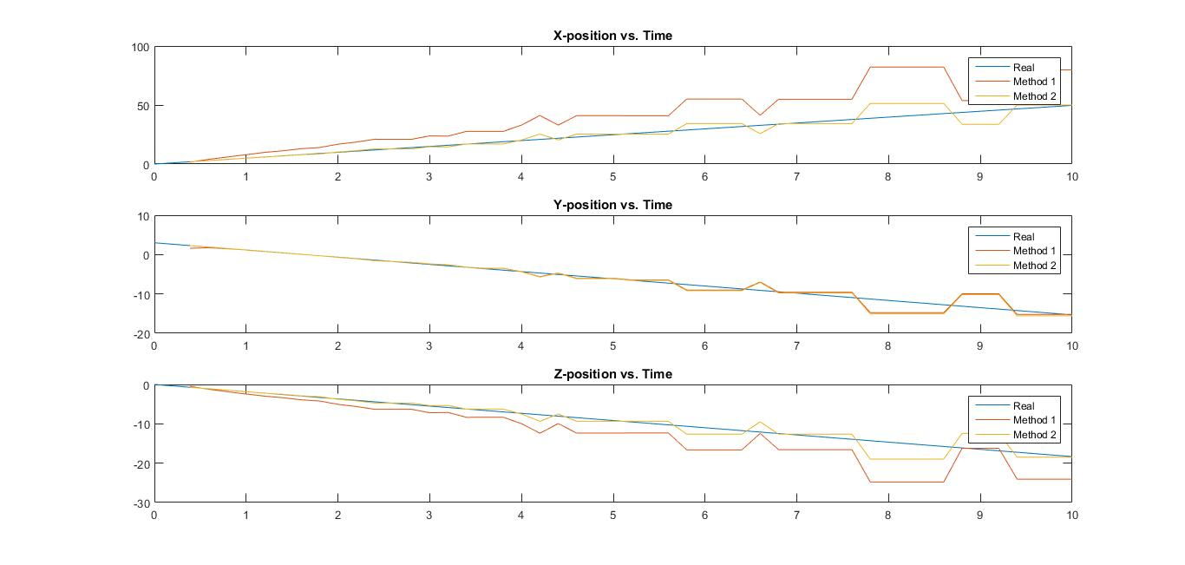
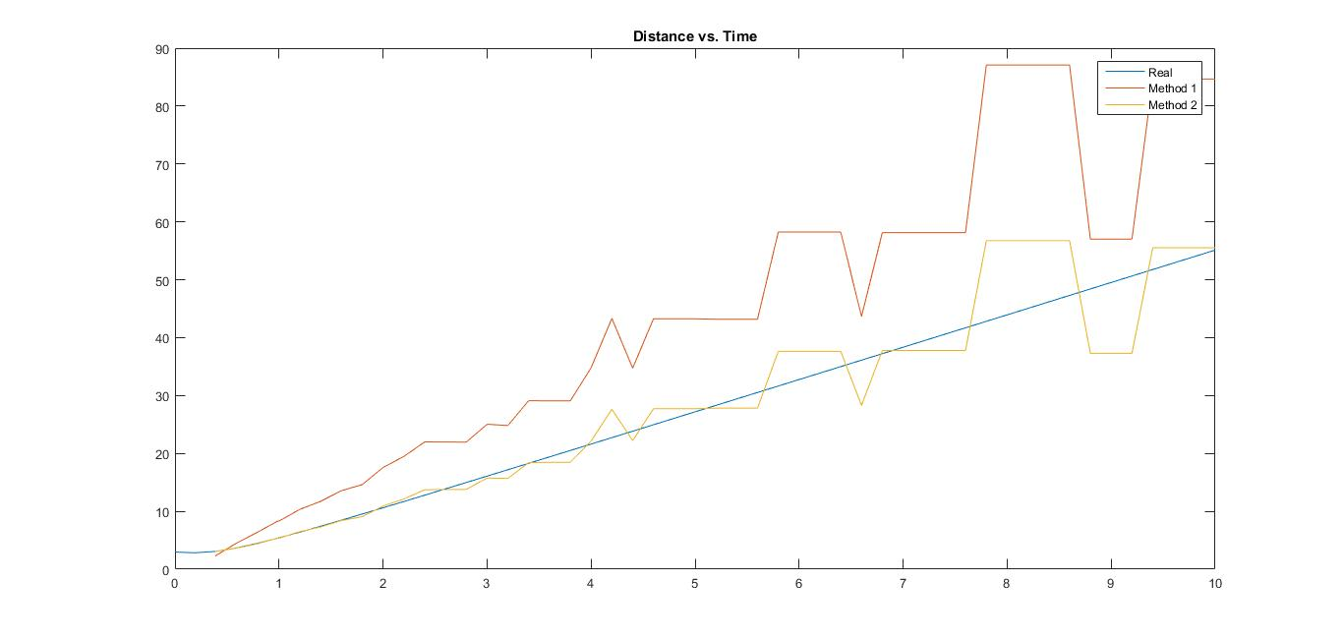
Case 2

Slide 38
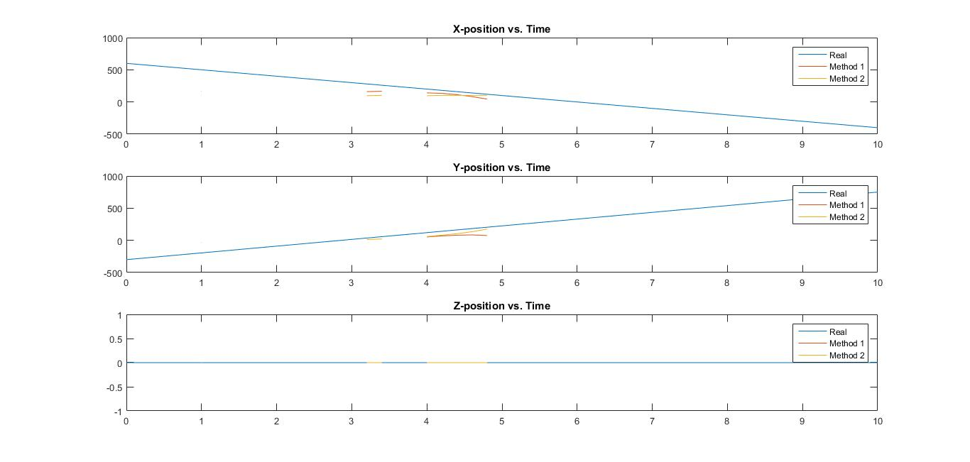
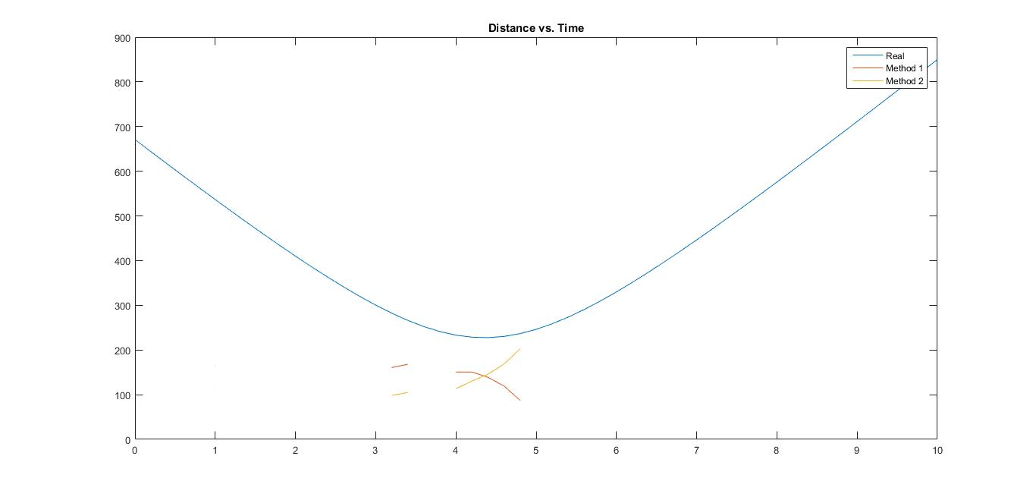
Case 3

Slide 39
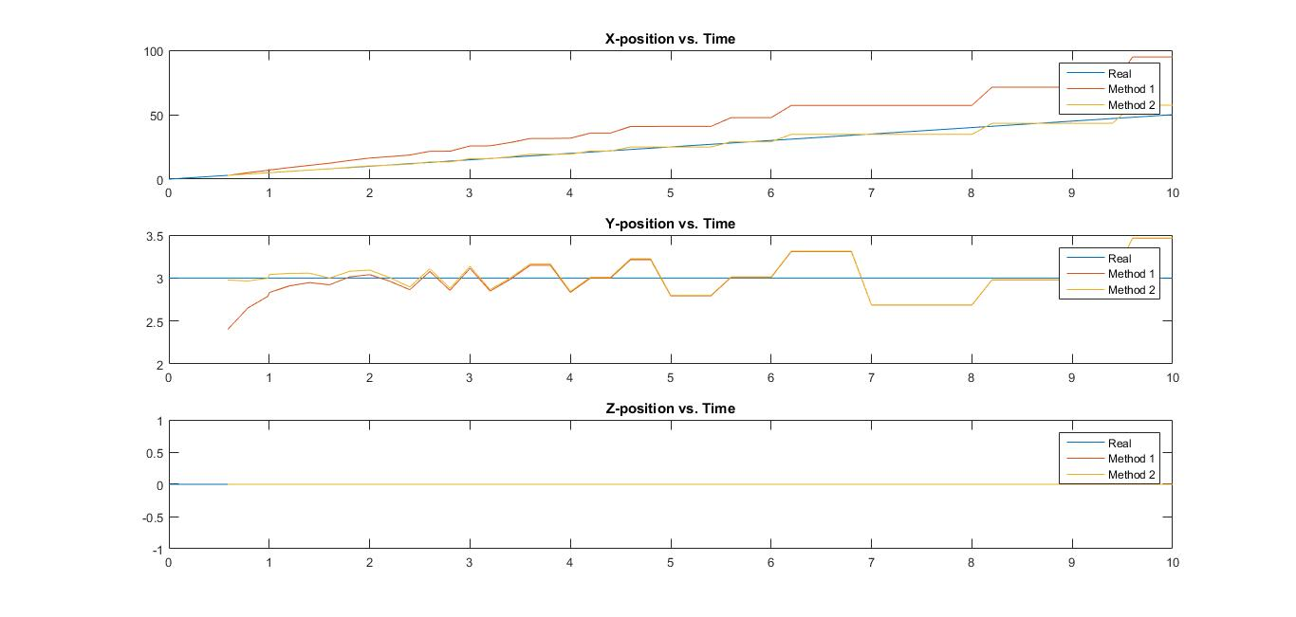
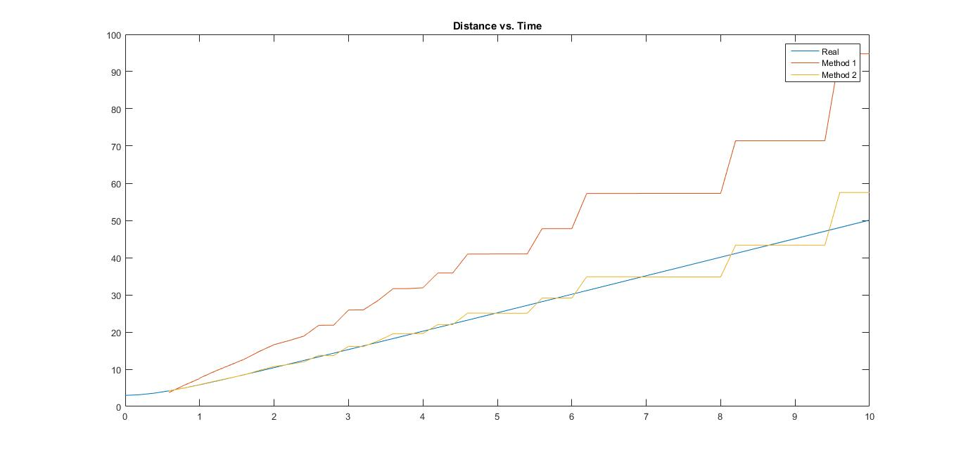
Case 4

Slide 40
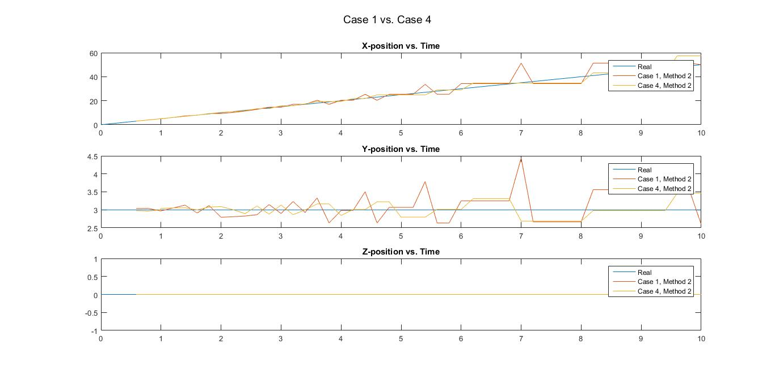
Case 4 (Cont.’d)

Slide 41
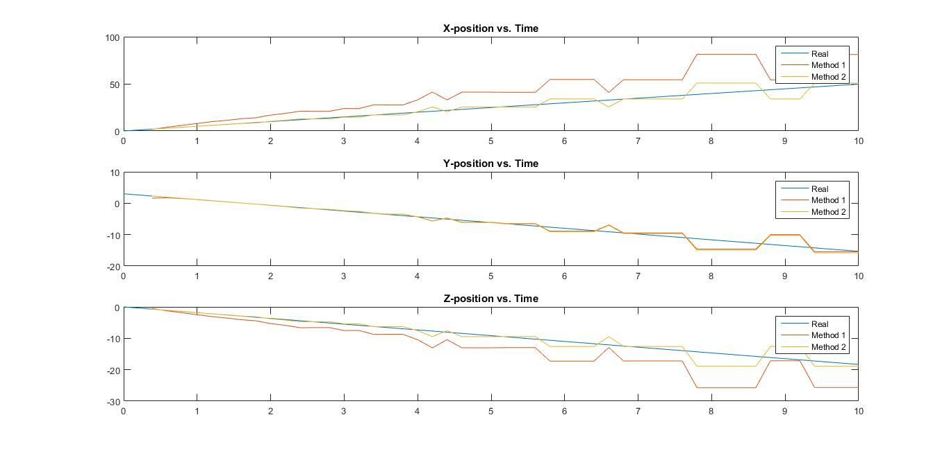
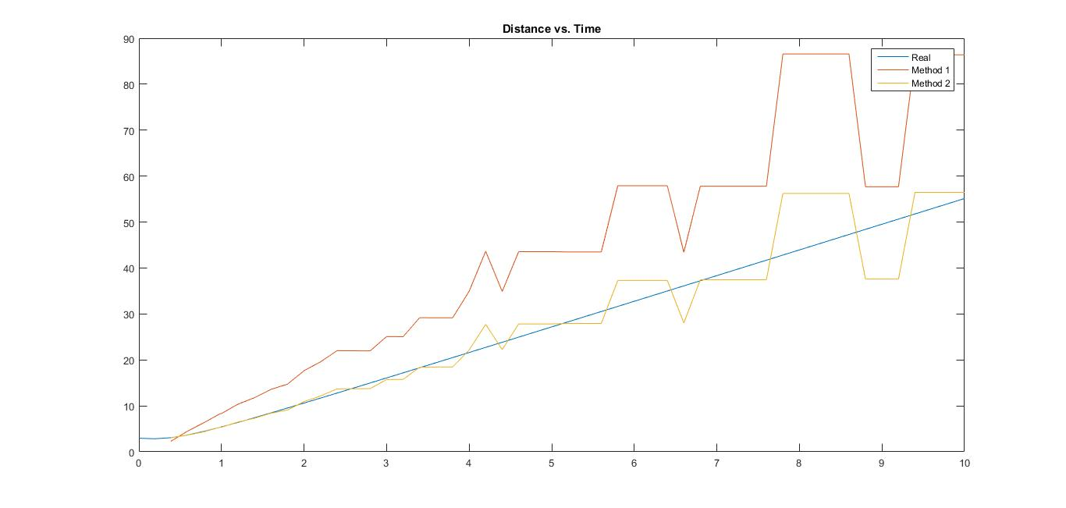
Case 5

Slide 42
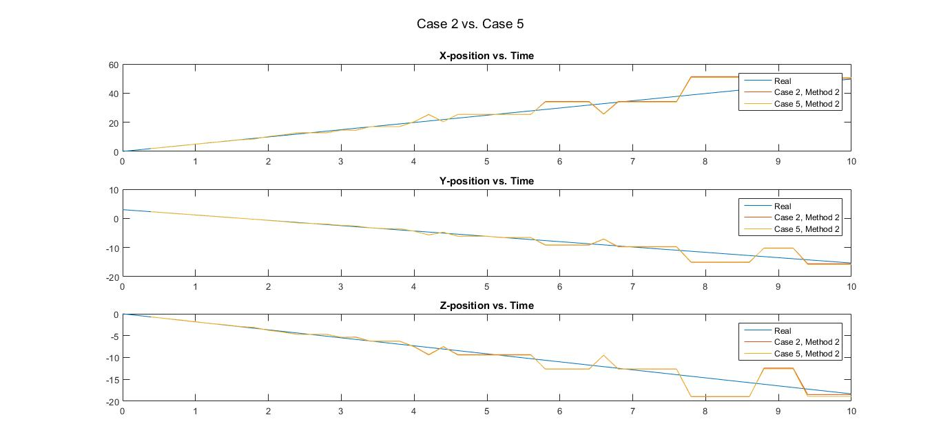
Case 5 (cont.’d)

Slide 43
Conclusion
Both of the methods above give similar results, although the focal length method (Method 2) is more accurate as the plot 'follows' the real simulated values, while the values obtained on Method 1 veer away from the real simulated values with increasing distance.
As the distance between the 2 aircraft increase, the accuracy of the results obtained decrease. The accuracy is virtually non-existent if they are too far, as demonstrated in Case 3.
The accuracy of the result is also dependent on the baseline length (lateral separation). The larger the lateral separation, the more accurate the calculation.
The image resolution has negligible impact on the accuracy of the results obtained.
When distance increases, there are occurrences where the estimated position stay constant while the actual position increases.
As the aircraft travels farther and farther away, the disparity between image points decrease; this is the root cause for drop in accuracy with increasing distance.

Slide 44
Future Work
In all, it can be seen that it is indeed possible to obtain useful position estimation results given that the intruder aircraft was visible on both cameras at once and was reasonably close to observer aircraft
Future methods that could improve results include
Use actual images rather then creating binary ones
Use stereo camera setup with cameras at various orientations and positions
Increase complexity of simulation cases

