Slide 1
RoadTrip Assistant
Aditya Ranjan Behera-12325948
Shorya Pratap Singh-12311257

Slide 2
Introduction
Project Idea: A smart travel assistant web app to plan road trips in India. It provides distance, travel time, gas stations, and tourist attractions between locations.
Problem Statement: Travelers often struggle to plan routes with relevant stopovers, attractions, and fuel points. This project solves that by offering an all-in-one planning tool.

Slide 3
Technology Used
Languages: Python, HTML/CSS, JavaScript
Frameworks: Flask (initial), Streamlit (final GUI)
APIs: OpenStreetMap, OSRM, Overpass API
Platform: Localhost / Streamlit Web App

Slide 4
Features & Benefits
🛣️ Route planning between cities (distance & duration)
🏞️ Tourist attractions between or in cities
⛽ Nearest gas station on the way
📍 Clean UI for natural language input
💡 Helps travelers plan better with accurate open-source data

Slide 5
Challenges Faced & Solutions
Challenge: Slow response or timeout from Overpass API
Solution: Added retry logic, reduced radius, and limited results
Challenge: Integrating Streamlit with backend logic
Solution: Modularized the backend and used stateful session management

Slide 6
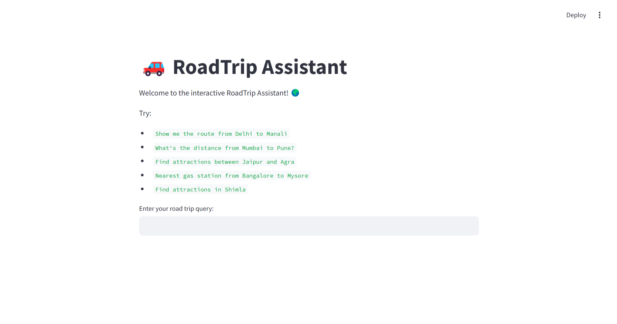
Screenshots

Slide 7
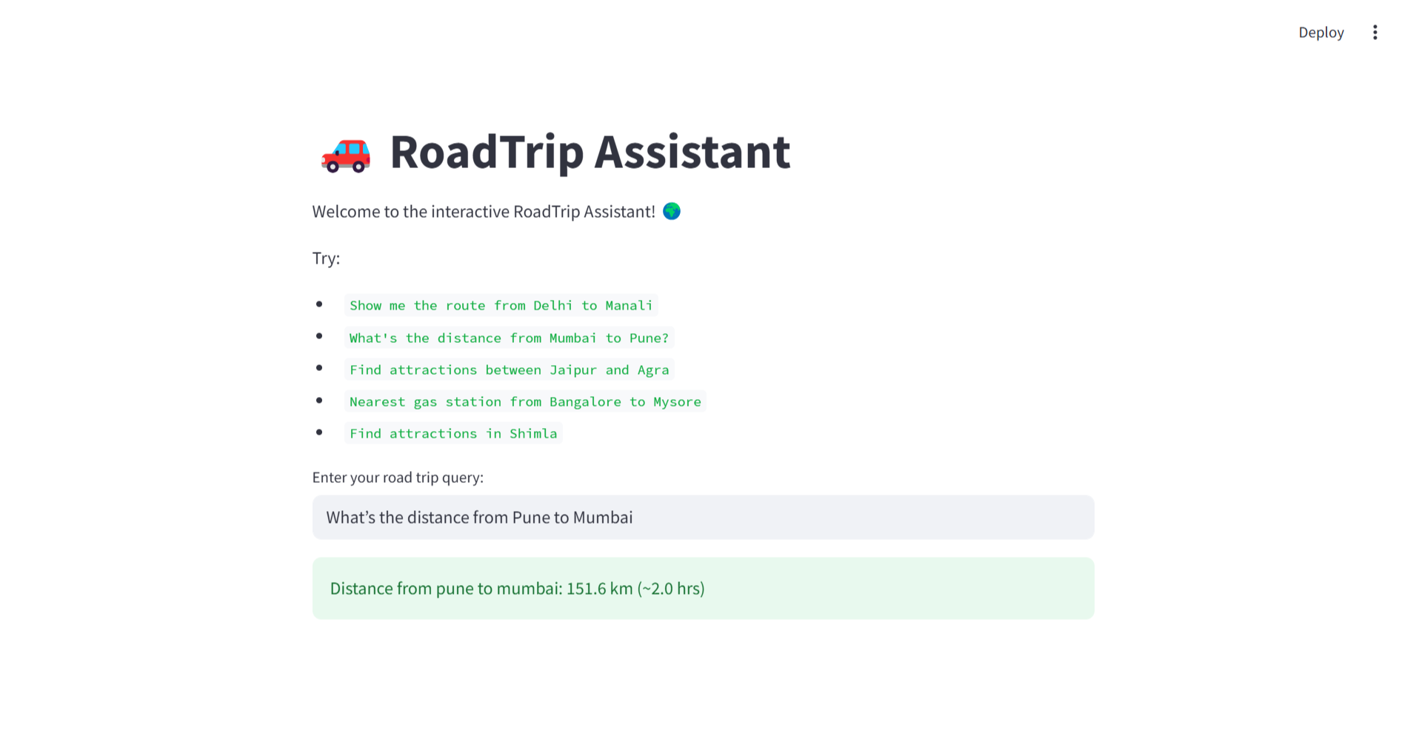

Slide 8
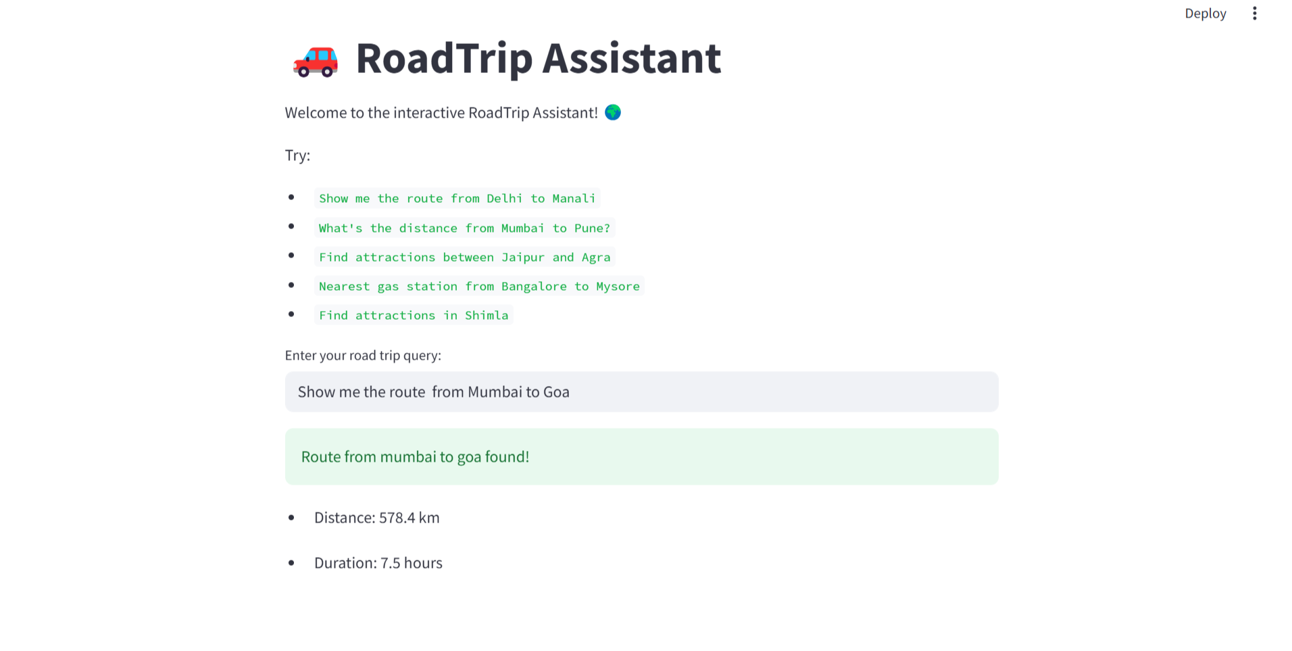

Slide 9
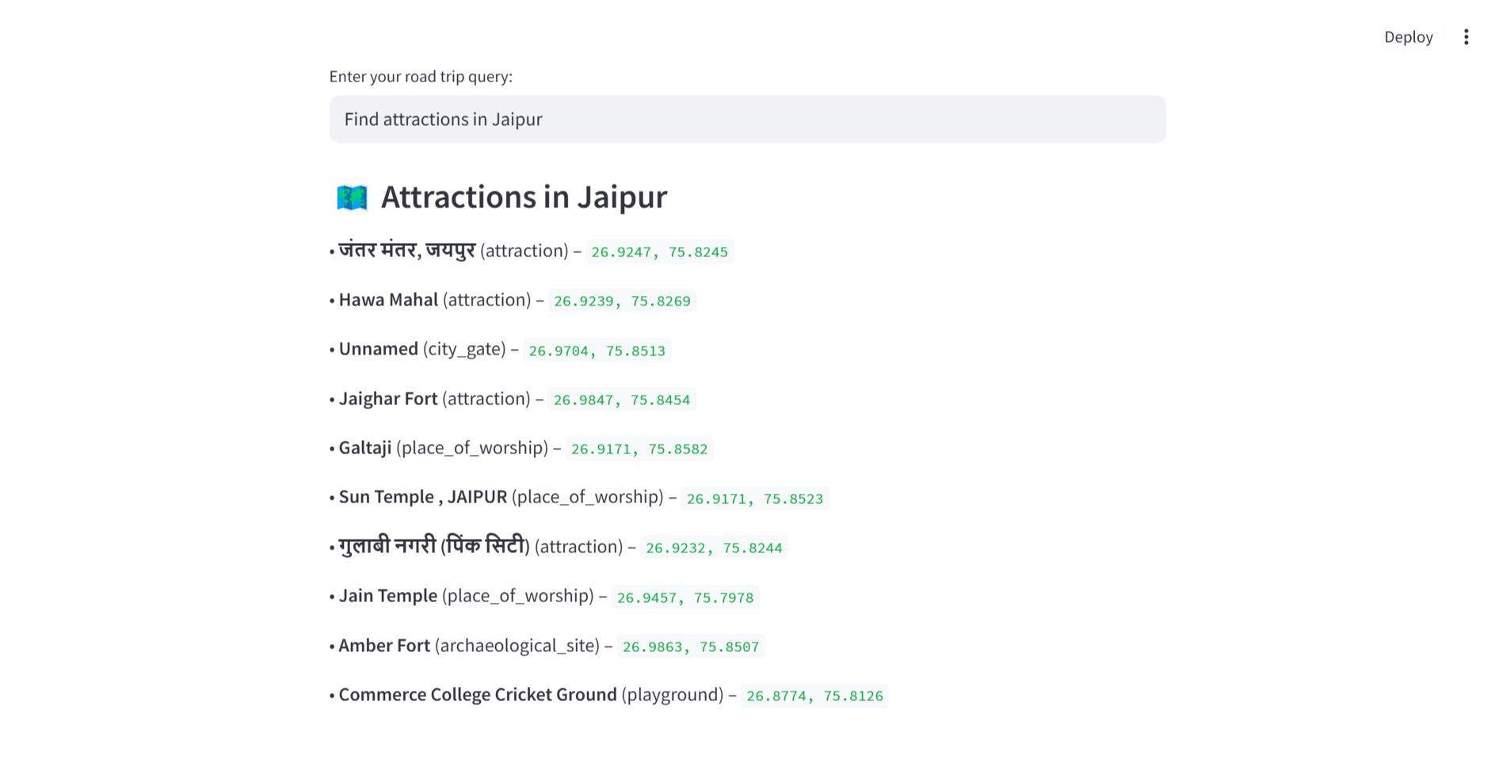

Slide 10
GitHub Link
✅ Code hosted at: https://github.com/adityaranjan23/roadtrip-assistant
- Full source code
- README.md with setup instructions
- Sample screenshots

Slide 11
Future Scope
🌐 Integration with Google Maps or Mapbox for interactive maps
🏨 Show hotels/restaurants along the route
🗣️ Add voice input
📱 Mobile-friendly version

Slide 12
Conclusion
Developed a functional web app to simplify road trip planning
Utilized real-time geospatial data from open APIs
Learned about web frameworks, API integration, and UI design

Slide 13
Role of Each Member
Aditya: UI/UX, Streamlit integration, logic implementation, OSRM routing, API handling
Shorya : Testing, presentation, deployment setup

