Slide 1
MICROSOFT SQL SERVER
ARCHITECTURE
(DATE:27/07/2021)

Slide 2
WHAT IS AN ARCHITECTURE?
The Internal process of working of an component/element is known as its architecture.
SOFTWARE ARCHITECTURE:
Software Architecture refers to the fundamental structures of a software system and the discipline of creating such structures and systems.
Each structure comprises software elements, relations among them and properties of both elements and relations.

Slide 3
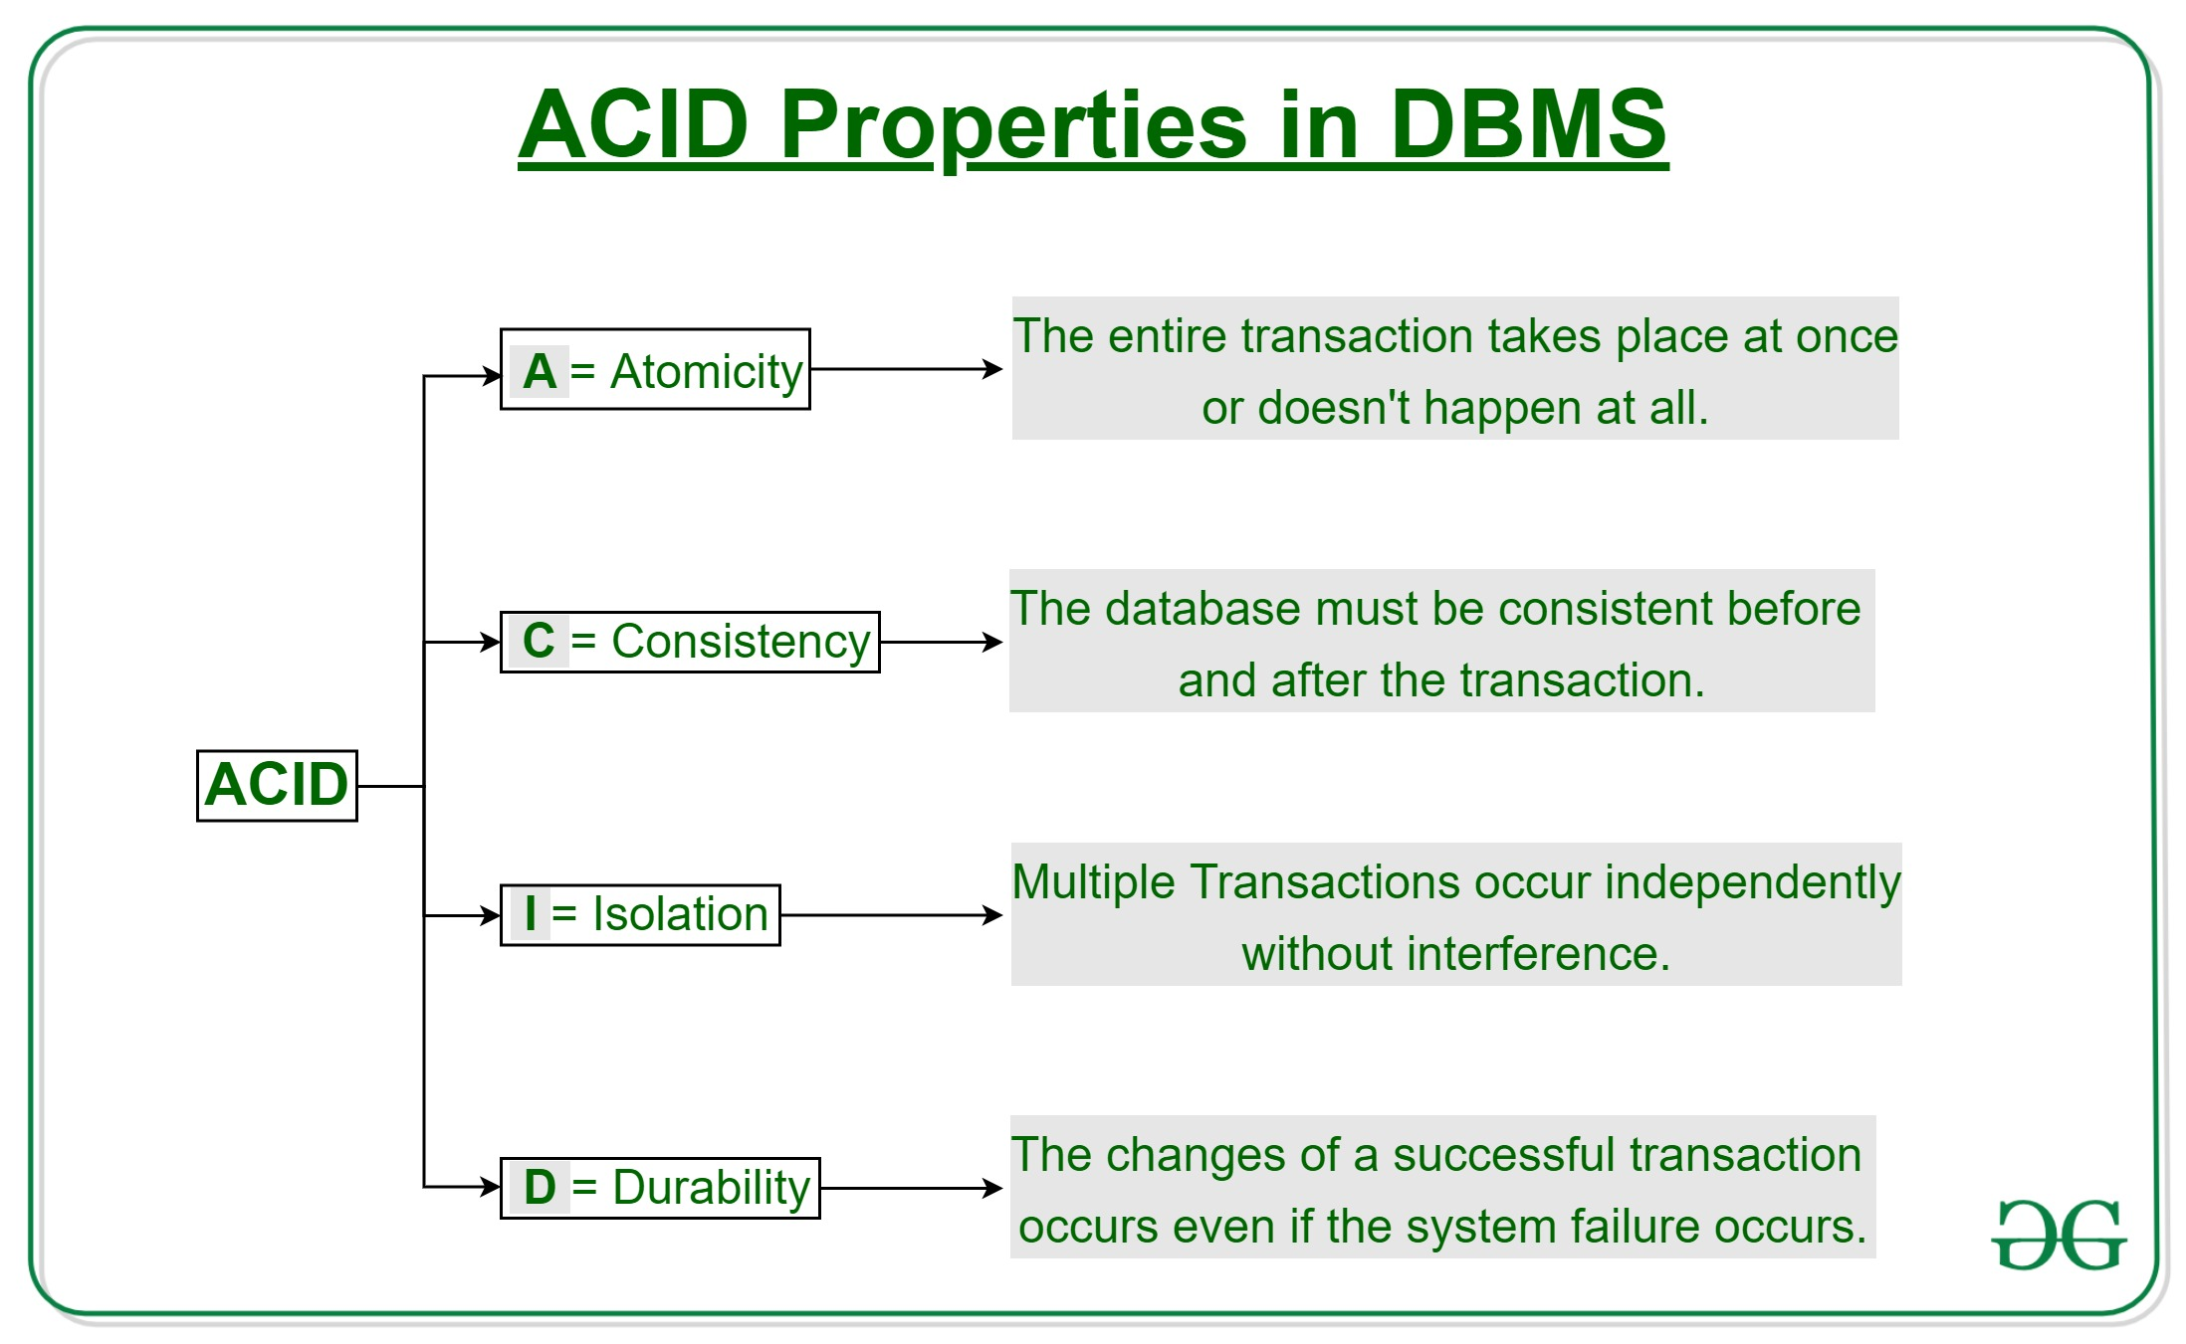

Slide 4
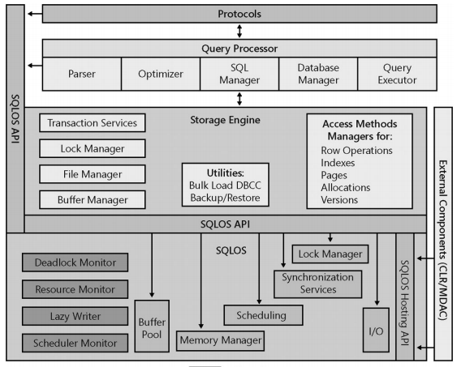
SQL SERVER ARCHITECTURE

Slide 5
Mainly SQL Server Architecture comprises of 4 major components:
1. Protocols
2. Relational Engine/ Query Processor
3. Storage Engine
4. SQLOS

Slide 6
Protocols
Shared Memory
Named Pipes
Transmission Control
Protocol /
Internet Protocol
(TCP/IP)
Virtual Interface
Adapter
(VIA)
When Client and SQL Server on same local machine
When Client and SQL Server on same LAN / Work group environment
When Client and SQL Server are on different physical locations they
connect through internet.
Note: Default port for SQL Server is 1433.
It is a protocol used for high performance communication between
two connected systems, with the help of specialized hardware on
both ends. Deprecated by Microsoft and will be removed in future.
Supports SQL Server 2008/2008R2/2012/2014

Slide 7
Relational Engine or Query Processor
Relational Engine is responsible for the execution of user queries by requesting data from the storage engine and processing the results that are returned.
There are three major components in Relational Engine:
> CMD Parser
> Optimizer
> Query Executor
It also contains SQL Manager and Database Manager.

Slide 8
Relational Engine or Query Processor
CMD Parser
Optimizer
SQL Manager
Database Manager
Query Executor
CMD Parser will check for syntax and semantic errors and
generates the query tree
Optimizer creates an optimum i.e., cheapest, not the best,
It is a cost-effective execution plan for the user's query by
considering I/O , CPU Usage.
SQL Manager will manage stored procedures.
Database manager will provide connectivity and also provides
required metadata to execute the query.
The query executor runs the execution plan that the optimizer
produced, acting as a dispatcher for all the commands in the
execution plan. Most of the commands require interaction with
the storage engine to modify or retrieve data and to manage
transactions and locking.

Slide 9
Storage Engine
The work of the Storage Engine is to store data in a storage system like Disk or SAN and retrieve the data when needed.
The storage engine consists of access methods, locking and transaction services, and utility commands.
Communication between relational engine and storage engine happens in terms of OLE DB row sets (result set).
OLEDB(Object Linking and Embedding) is a API by Microsoft. It allows accessing of data from a variety of sources in uniform manner.

Slide 10
Pages and Extents
Page is a fundamental unit of data storage in SQL Server.
The disc space allocated to a data file (.mdf or .ndf) in a database is logically divided into pages numbered contiguously from 0 to n.
In SQL Server the page size is 8KB.
All pages are stored in Extents (1Extent=8Pages).
Extents are a collection of eight physically contiguous pages and are used to efficiently manage the pages.
The size of each extent is 64KB.
Log files do not contain pages.

Slide 11
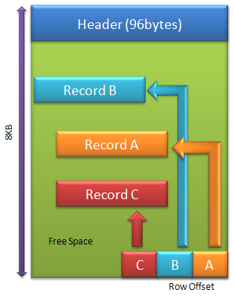
Page Structure
Each page begins with 96-byte header.
Page header stores the information about page number, page type, the amount of used and free space on the page and the allocation unit ID of the object that owns the page.
Data rows are put on the page serially, starting immediately after the header.
A row offset table starts at the end of the page, and each row offset table contains one entry for each row on the page in the reverse order.
Each entry records how far the first byte of the row is from start of the page.
Rows cannot span pages, however portions of the row may be moved off the row's page so that the row can actually be very large. Maximum row size is 8KB.

Slide 12
Types of Pages
There are 14 types of pages in SQL Server
Data Page
Index Page
Text Mixed Page
Text Page
Sort Page
GAM Page ( Global Allocation Map)
SGAM Page (Shared Global Allocation Map)
IAM Page (Index Allocation Map)
PFS Page (Page Free Space)
Boot Page
Server Configuration Page (Not official)
File Header Page
Differential Change Map (DCM)
Bulk Change Map (BCM)

Slide 13
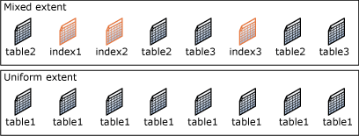
Types of Extent
There are two types of Extents in SQL Server based on space allocations.
Uniform Extent: Uniform extents are owned by a single object: all eight pages in the extent can only be used by the owing object.
Mixed Extent: Mixed Extents are shared by up to eight objects: Each of the eight pages can be owned by different objects.

Slide 14
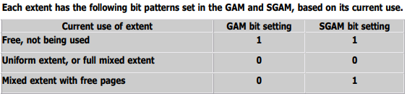
Managing Extent Allocations
SQL Server uses two types of allocation maps to record the allocation of extents:
Global Allocation Map (GAM) :
GAM pages record what extents have been allocated. The GAM has one bit for each extent in the interval it covers. If the bit is 1, the extent is free. If the bit is 0, the extent is allocated.
Shared Global Allocation Map (SGAM) :
SGAM pages record which extents are currently being used as mixed extents and also have at least one unused page. The SGAM has one bit for each extent in the interval it covers. If the bit is 1, the extent is being used as a mixed extent and has a free page. If the bit is 0, the extent is not used as a mixed extent, or it is a mixed extent and all its pages are being used.
Note: Both GAM and SGAM covers 64000 extents or 4GB data approx.

Slide 15
Locks
Locks are designed to allow SQL Server to work seamlessly in a multi-user environment.
Locks are very important to maintain data consistency and transaction concurrency.
Essentially, locks are in-memory structures which have owners, types, and the hash of the resource that it should protect.
A lock as an in-memory structure is 96 bytes in size.
Locking is designed to ensure the integrity of the data in the database, as it forces every SQL Server transaction to pass the ACID test.

Slide 16
Lock Modes
Shared Lock (S) :
Shared lock type , when imposed, will reserve a page or row to be available only for reading.
When the lock is active, it prevents the modification of locked record.
Shared lock can be imposed by several transactions at the same time over the same page or row as the reading process doesn't affect any data.
A shared lock will allow write operations, but no DDL changes will be allowed.
Exclusive Lock (X):
This lock type will ensure that a page or row will be reserved exclusively for the transaction that imposed exclusive lock.
Exclusive locks will be imposed by the transaction when it wants to carryout DML statements like delete, update and insert.
Only one exclusive lock can be imposed to a page or row and once imposed no other lock can be imposed on locked resources.

Slide 17
Lock Modes
Update Lock (U) :
An update lock can be imposed on a record that already has a shared lock.
In such a case, the update lock will impose another shared lock on the target row. Once the transaction that holds the update lock is ready to change the data, the update lock (U) will be transformed to an exclusive lock (X).
Update lock can be imposed on a record that has the shared lock, but not vice-versa.
Intent Lock (I):
This lock is a means used by a transaction to inform another transaction about its intention to acquire a lock. The purpose of such lock is to ensure data modification to be executed properly by preventing another transaction to acquire a lock on the next in hierarchy object.
There are three regular intent locks and three so-called conversion locks:
Regular Intent Locks: Intent Share (IS), Intent Exclusive (IE), Intent Update (IU).
Conversion locks: Shared with intent exclusive (SIX), Shared with intent update (SIU), Update with intent exclusive (UIX).
Note: There are also Schema Locks (Sch) and Bulk Update Locks (BU).

Slide 18
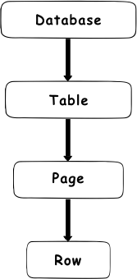
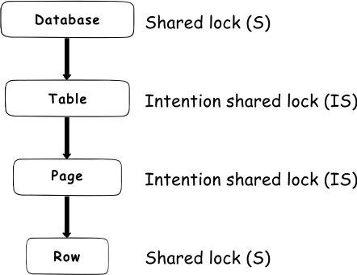
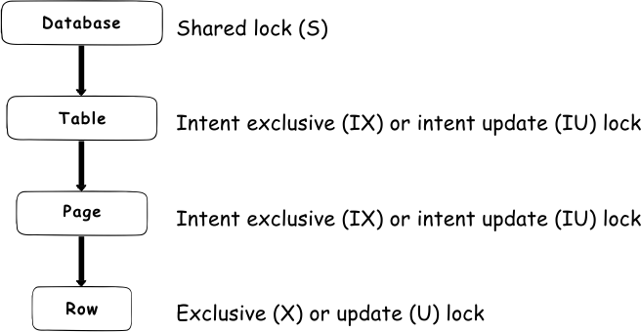
Locking Hierarchy
The lock hierarchy starts with the database at the highest hierarchy level and down via table and page to the row at the lowest level.
Locking Hierarchy
Locking Hierarchy for Select Query
Locking Hierarchy for Insert, Update, Delete

Slide 19
Files and File groups
SQL Server maps a database over a set of operating-system files.
A File is a collection of related data or program records stored as a unit with a single name. Files are the basic units that a computer uses to save data.
Data and log information are never mixed on the same file and individual files are used only by one database.
File groups are named collection of files and are used to help with data replacement and administrative tasks such as backup and restore options.

Slide 20
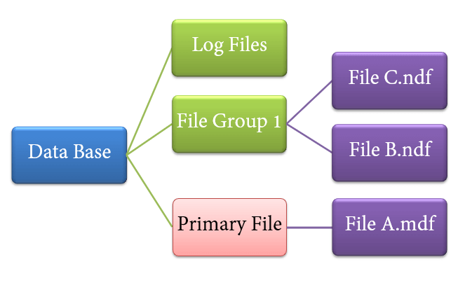
Database Files
SQL Server database has 3 types of files:
Primary Data File : Every database contains one primary file which stores all important data related to tables, views, triggers etc. Filename extension is .mdf
Secondary Data File : Database may or may not contain secondary data files. One database can have multiple secondary data files. Filename extension is .ndf
Log Files : Log files (WAL:Write Ahead Logs) hold all the log information that is used to recover the database from any unwanted instances. Perform important task of Rollback to uncommitted transactions. There should be at least one log file for each database, although there can be more than one. The recommended file name extension is .ldf

Slide 21
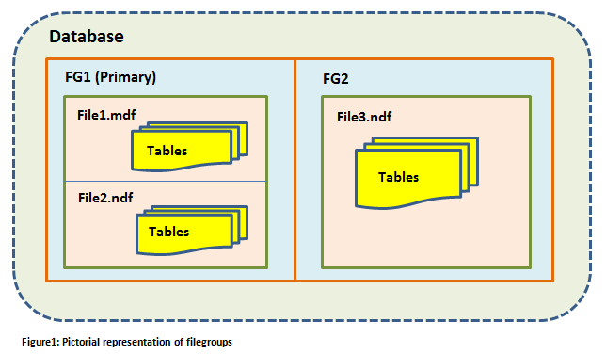
Database File Groups
Database objects and files can be grouped together in file groups for allocation and administration purposes. There are two types of file groups:
Primary : Primary file group contains the primary data file and any other files not specifically assigned to another file group. All pages for the system tables are allocated in the primary file group.
User-Defined : User-defined file groups are any file groups that are specified by using the FILEGROUP keyword in a Create Database or Alter Database statement.
Note: Log Files are never part of the file groups.

Slide 22
Databases
System Databases
User Databases
Master
Model
MSDB
TempDB
ResourceDB
It contains all the server configuration settings like logins, linked servers, server level information etc.
It serves as a template that is used when user databases are created.
It contains information related to database backups, replication, SSIS packages and all the configuration information for any SQL Server jobs that exist on the server.
It stores any temporary objects that are required by the system.
Resource DB introduced in 2005. It is a read-only and hidden db. It contains the definitions of all the system procedures, views and functions.

Slide 23
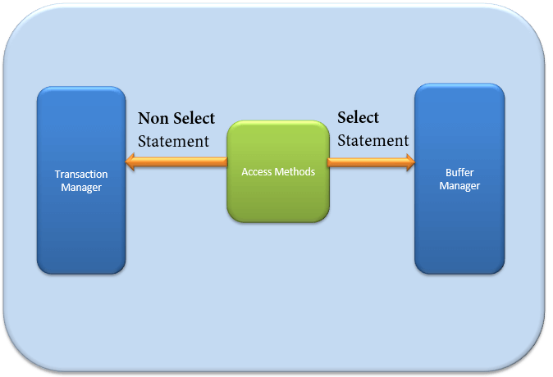

Access Methods
It acts as an interface between query executor and Buffer Manager/Transaction Logs.
Access Method itself does not do any execution.
The first action is to determine whether the query is:
Select Statement (DDL)
Non- Select Statement (DDL & DML)
Depending upon the result, the Access Method takes the following steps:
If the query is DDL, SELECT statement, the query is pass to the Buffer Manager for further processing.
And if query if DDL, NON-SELECT statement, the query is pass to Transaction Manager. This mostly includes the UPDATE statement.

Slide 24
Buffer Manager
Buffer manager manages core functions for modules below:
Plan Cache
Data Parsing: Buffer cache & Data storage
Dirty Page
Plan Cache :
Existing Query plan: The buffer manager checks if the execution plan is there in the stored Plan Cache. If Yes, then query plan cache and its associated data cache is used.
First time Cache plan: Where does existing Plan cache come from?
If the first-time query execution plan is being run and is complex, it makes sense to store it in in the Plan cache. This will ensure faster availability when the next time SQL server gets the same query. So, it's nothing else but the query itself which Plan execution is being stored if it is being run for the first time.

Slide 25
Data Parsing
Buffer manager provides access to the data required. Below two approaches are possible depending upon whether data exist in the data cache or not:
Buffer Cache - Soft Parsing:
Buffer Manager looks for Data in Buffer in Data cache. If present, then this Data is used by Query Executor. This improves the performance as the number of I/O operation is reduced when fetching data from the cache as compared to fetching data from Data storage.
Data Storage - Hard Parsing:
If data is not present in Buffer Manager than required Data is searched in Data Storage. It also stores data in the data cache for future use.
Data exists
Data doesn't exist

Slide 26
Transaction Manager
Transaction Manager is invoked when access method determines that Query is a Non-Select statement.
Log Manager :
Log Manager keeps a track of all updates done in the system via logs in T-Logs.
Logs have Log Sequence Number(LSN) with the Transaction ID and Data Modification Record.
LSN is used for keeping track of Transaction Committed and Transaction Rollback.
Lock Manager :
During Transaction, the associated data in Data Storage is in the Lock state. This process is handled by Lock Manager.
This process ensures data consistency and isolation. Also known as ACID properties.

Slide 27
Terminologies
Clean Page : The page that is pulled from the data storage to buffer cache is called clean page. Clean page is unmodified.
Dirty Page : The modified pages of the query execution are called dirty pages.
Write Ahead Logging : Whenever a modification happens, it generates log records containing the details of modification. SQL Server writes this log record to the disk in the transaction log before the associated dirty page is flushed to the disk (data files) from the buffer cache. This process is known as write-ahead logging.
Checkpoint : A Checkpoint process writes all dirty pages (available in the buffer cache) and transaction log records to the disk. It also logs checkpoint information in the transaction log. Usually it happens for every 1 minute.
Lazy Writer : It uses LRU- Least Recently Used algorithm to flush out the dirty pages. It also removes clean pages based on the huge load on buffer memory.
Eager Writer : SQL Server performs certain activities as non-logged operations. Ex: Select Into, Bulk Insert, WriteText and UpdateText.The Eager Writer process handles both the page creation and page writing in parallel so that queries do not wait to complete the entire bulk process before writing all pages to the disk.

Slide 28
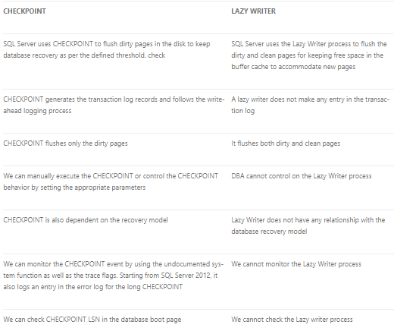
Check Point vs Lazy Writer

Slide 29
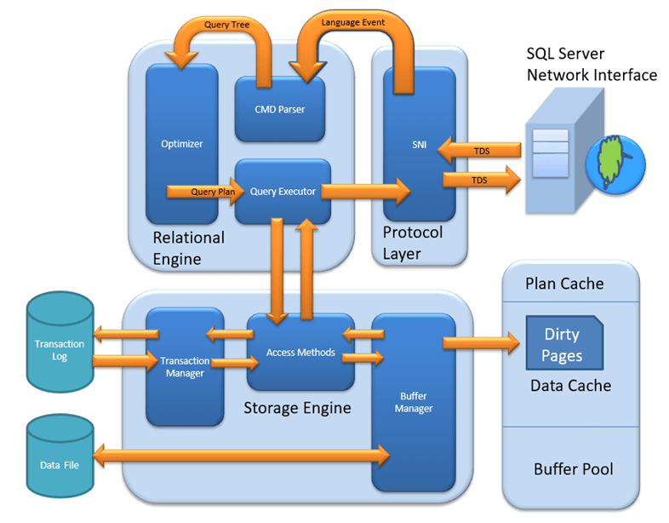
SQL Server Architecture Flow
Checkpoint

Slide 30
External References
ACID Properties :
  https://www.geeksforgeeks.org/acid-properties-in-dbms/
Locks :
  https://www.sqlshack.com/locking-sql-server/
Page Types :
  http://www.sqlnotes.info/2011/10/31/page-type/
SQL Server Architecture Flow :
  https://www.guru99.com/sql-server-architecture.html
Checkpoint :
  https://sqlbak.com/academy/checkpoint

Slide 31
THANK YOU

