Slide 1


CMR TECHNICAL CAMPUS UGC (Autonomous) Kandlakoya, Medchal Road, Hyd-501 401 Department of Computer Science & Engineering Real Time Project Review TITLE OF THE PROJECT : RFID & BLUETOOTH BASED TOURIST SERVICE PROTOTYPE
BATCH NO : 19
Project Guide : ROLL NUMBERS :
NAME :Mr. R. SAI KRISHNA 227R1A0503 - ADITYA RAO
Designation : ASSOCIATE PROFESSOR 227R1A0522 - G.MADHURI
227R1A0557 - T.DHANUSH
Project Coordinator :
NAME :Mr.V.SRINU
Designation : ASSISSTANT PROFESSOR

Slide 2
CONTENTS
ABSTRACT
INTRODUCTION
LITERATURE SURVEY
PROPOSED METHODOLOGY
IMPLEMENTATION & ARCHITECTURE
RESULTS & DISCUSSIONS
CONCLUSION & FUTURE SCOPE
REFRENCES

Slide 3
ABSTRACT
In the contemporary tourism industry, enhancing the visitor experience through advanced technological solutions is a key objective. This project introduces an innovative tourist service prototype that leverages RFID (Radio Frequency Identification) and Bluetooth technologies to provide a seamless, informative, and interactive experience for tourists. The system is meticulously designed to offer personalized services, real-time information dissemination, and enhanced navigation within tourist attractions such as museums, historical sites, and theme parks.
The hardware architecture of the prototype includes RFID tags, RFID readers, Bluetooth beacons, and a central processing unit. Tourists are provided with RFID-enabled smart cards, which they can use to interact with RFID readers positioned at various points of interest. These interactions trigger the system to provide tailored information and recommendations based on the tourist's preferences and previous interactions. Bluetooth beacons strategically placed throughout the site communicate with tourists' smartphones, providing real-time notifications, location-based services, and navigational assistance

Slide 4
INTRODUCTION
Today, technology is changing how we travel and explore new places. Two key technologies, RFID and Bluetooth, are playing a big role in making tourism easier and more enjoyable.
RFID uses small tags that send out radio signals. These tags can be put on tickets, maps, or even wearable devices. They help automatically identify things and get information quickly. For tourists, this means they can get details about attractions or events just by waving their device near a reader.
Bluetooth lets devices like smartphones connect and share information wirelessly over short distances. This technology is great for sending updates, maps, or even virtual guides straight to your phone when you're near a tourist spot.

Slide 5
LITERATURE SURVEY
S.No. | Name of Author | Title of the paper | International journal/conference | Volume No. | Issue | ISBN/ ISSN | Indexing
1. | Prashant J. Mahajan; Kalyani V. Pagare | PIR Based Automatic Fever Testing | International Journal of Electronics Engineering Research.(IRJET) | 07 | 04 | Apr 2020 | e-ISSN: 2395-0056 p-ISSN: 2395-0072 | 1345-1347
2. | Akshay Sharma A S | Review on Automatic Sanitizer Dispensing Machine | International Journal of Electronics Engineering Research.(IRJET) | 09 | 07, July-2020 | ISSN: 2278-0181 | 725-726
3. | Pooja Ajmera | Infrared Sensor | International Journal of Electronics Engineering Research.(IRJET) | 05 | 05,May-2019 | e-ISSN: 2581-0181 p-ISSN: 1559-1577

Slide 6
PROPOSED METHODOLOGY
To develop a prototype tourist service utilizing Bluetooth and RFID technology, the system will include RFID tags and readers, Bluetooth beacons and receivers, a mobile application, and a central server. RFID tags will be placed at various points of interest (POIs) and key locations. Tourists will carry RFID readers, which can be handheld or integrated into their mobile devices, to scan these tags. Bluetooth beacons will be installed at strategic locations to interact with tourists' smartphones via a custom mobile app. When a tourist approaches a POI, the RFID reader scans the tag, sending the tag ID to the server. The server retrieves the relevant information and sends it back to the mobile app, displaying details about the POI. Similarly, Bluetooth beacons will transmit signals to nearby smartphones, enabling location-based notifications and navigation assistance. The mobile app will serve as the user interface, offering information, navigation, and additional services, while the server will manage data processing and storage. This integrated approach aims to enhance the tourist experience by providing real-time, location-specific information and services.

Slide 7
IMPLEMENTATION & ARCHITECTURE
The Bluetooth and RFID-based tourist service prototype integrates RFID tags, Bluetooth beacons, a mobile application, and a central server. RFID tags placed at points of interest (POIs) are scanned by tourists' smartphones, sending tag IDs to the server, which retrieves and returns relevant information to the app. Bluetooth beacons broadcast signals to nearby smartphones for location-based notifications and navigation assistance. The mobile app serves as the user interface, providing POI information and navigation, while the central server manages data processing and communication, ensuring seamless interaction between all components and enhancing the tourist experience with real-time, location-specific information.

Slide 8
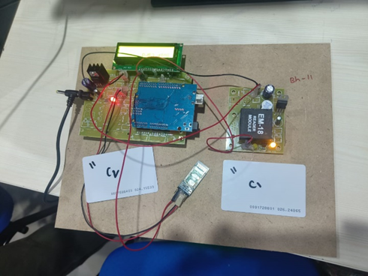
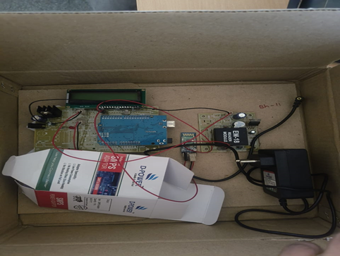
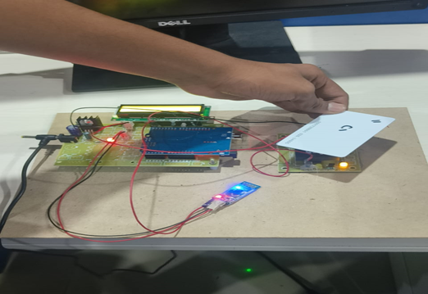
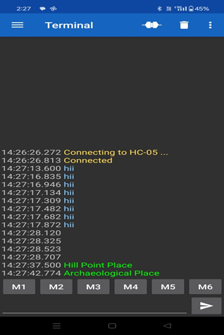
RESULTS & DISCUSSION

Slide 9
CONCLUSION AND FUTURE SCOPE
In conclusion, the integration of RFID technology into our tourist service prototype revolutionizes the visitor experience, ensuring seamless, personalized, and secure interactions at every touchpoint. By leveraging RFID, we not only enhance operational efficiency but also provide tourists with a memorable and hassle-free journey, fostering increased satisfaction and loyalty. This innovative approach sets a new standard in the tourism industry, paving the way for smarter, more connected travel experiences.

Slide 10
REFERENCES
Prashant J. Mahajan; Kalyani V. Pagare, “PIR based automatic fever testing”, International Research Journal of Engineering and Technology(IRJET),vol-07,issue no-04,pp.1345-1347,2020.
Pooja Ajmera, “INFRARED SENSOR” , International Research Journal of Engineering and Technology(IRJET), ISSN: 2278-0181 vol-05,issue no-23,1559-1557.
Hanzhong, “DESIGN OFA NON-CONTACT INFRARED THERMOMETER”, International Research Journal of Engineering and Technology(IRJET),ISSN: 2581-0181 vol-08,issue no-13,1859-183
Rohit Ramagade , Uday Thak, Harshad pidurkar, Lokesh Kathale; ”INNOVATIVE TECHNOLOGIES FOR TEMPERATURE MEASUREMENT OF AERO ENGINE COMPONENT”, International Research Journal of Engineering and Technology(IRJET), ISSN: 2395-0056 vol-05,issue no-23, 2395-0072
Akshay Sharma A S, “ Review on Automatic Sanitizer Dispensing Machine”, International Research Journal of Engineering and Technology(IRJET),vol-09,issue no-07,pp.725-726,2020.

Slide 11
Q&A

Slide 12
THANK YOU

