Slide 1


Restaurant Management System
Mobile application
DEVELOPMENT LABORATORY
(18CSMP68)
ADITYA RASTOGI (1JS18CS008)
AMIT(1CS18CS015)
SECTION CSE ‘A’
FACULTY:
Swetha Kaddi

Slide 2
ABSTRACT :
DineOut is an Android based Restaurant Management System that aims to digitalize the process of various restaurant operations including ordering, billing kitchen, hall and inventory management.

Slide 3
CONTENTS:
INTRODUCTION
Software Development Kit (SDK)
Java Development Kit (JDK)
XML
Android Studio
Objectives
Summary
Requirement Specifications User Characteristics
● System Design and Implementation
Introduction
ER Diagram
Schema Diagram
Screenshots
Future Enhancement

Slide 4

Introduction:
Android is a mobile operating system based on a modified version of the Linux kernel and other open source software, designed primarily for touchscreen mobile devices such as smartphones and tablets. Android is developed by a consortium of developers known as the Open Handset Alliance and commercially sponsored by Google. It was unveiled in November 2007, with the first commercial Android device, the HTC Dream, being launched in September 2008.
Software Development Kit (SDK): According to the principles of database systems, the data is stored in such a way that it acquires lot less space as the redundant data (duplicate data) has been removed before storage. Let’s take a layman example to understand this: In a banking system, suppose a customer is having two accounts, one is saving account and another is salary account.

Slide 5
Java Development Kit (JDK) :
The Java Development Kit (JDK) is an implementation of either one of the Java Platform, Standard Edition, Java Platform, Enterprise Edition, or Java Platform, Micro Edition platforms released by Oracle Corporation in the form of a binary product aimed at Java developers on Solaris, Linux, macOS or Windows.
Extensible Markup Language (XML) is a markup language that defines a set of rules for encoding documents in a format that is both human-readable and machine-readable. The World Wide Web Consortium's XML 1.0 Specification of 1998 and several other related specifications all of them free open standards—define XML.
XML:

Slide 6
Android Studio
Android Studio is the official integrated development environment (IDE) for Google's Android operating system, built on JetBrains' IntelliJ IDEA software and designed specifically for Android development.
It is available for download on Windows, macOS and Linux based operating systems or as a subscription-based service in 2020 It is a replacement for the Eclipse Android Development Tools (E-ADT) as the primary IDE for native Android application development.

Slide 7
Objectives:
Android based Restaurant Management System that aims to digitalize the process of various restaurant operations including ordering, billing kitchen, hall and inventory management. The main purpose is to improve the performance of the restaurant by eradicating the daily paperwork. With this system the tasks would be performed in less amount of time and more efficiently.

Slide 8
Summary :
The chapter discussed before is an overview about the android application and android studio used for app development. The scope of study and objectives of the project are mentioned clearly. The organization of the report is been pictured to increase the readability. Further, coming up chapters depicts the use of various queries to implement various changes like insert, update, delete and also triggers to perform various functions.

Slide 9

· Windows Vista (32-bit or 64-bit)
· Windows 7 (32-bit or 64-bit)
· Windows 8 / Windows 8.1 or later
· Mac OS X 10.8.5 or later (Intel based systems only)
· Linux systems with version 2.15 or later of GNU C Library (glibc)
· Minimum of 2GB of RAM (4GB is preferred)
· Approximately 4.5GB of available disk space
REQUIREMENT SPECIFICATION

Slide 10
System Design and Implementation:
Introduction
Systems design is the process or art of defining the architecture, components, modules, interfaces, and data for a system to satisfy specified requirements. One could see it as the application of systems theory to product development.
ER Diagram
An entity–relationship model or the ER Diagram describes inter-related things of interest in a specific domain of knowledge. An ER model is composed of entity types and specifies relationships that can exist between instances of those entity types.

Slide 11
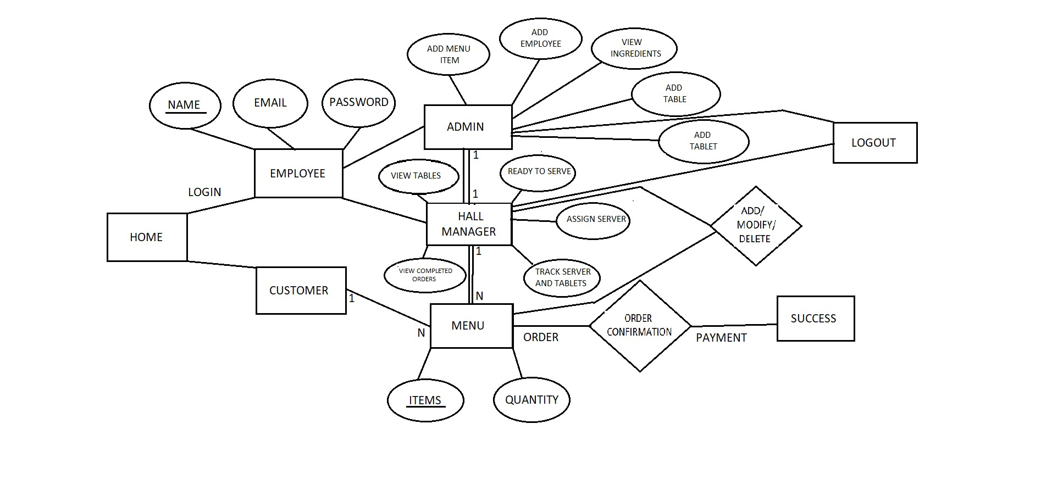
E R Diagram

Slide 12
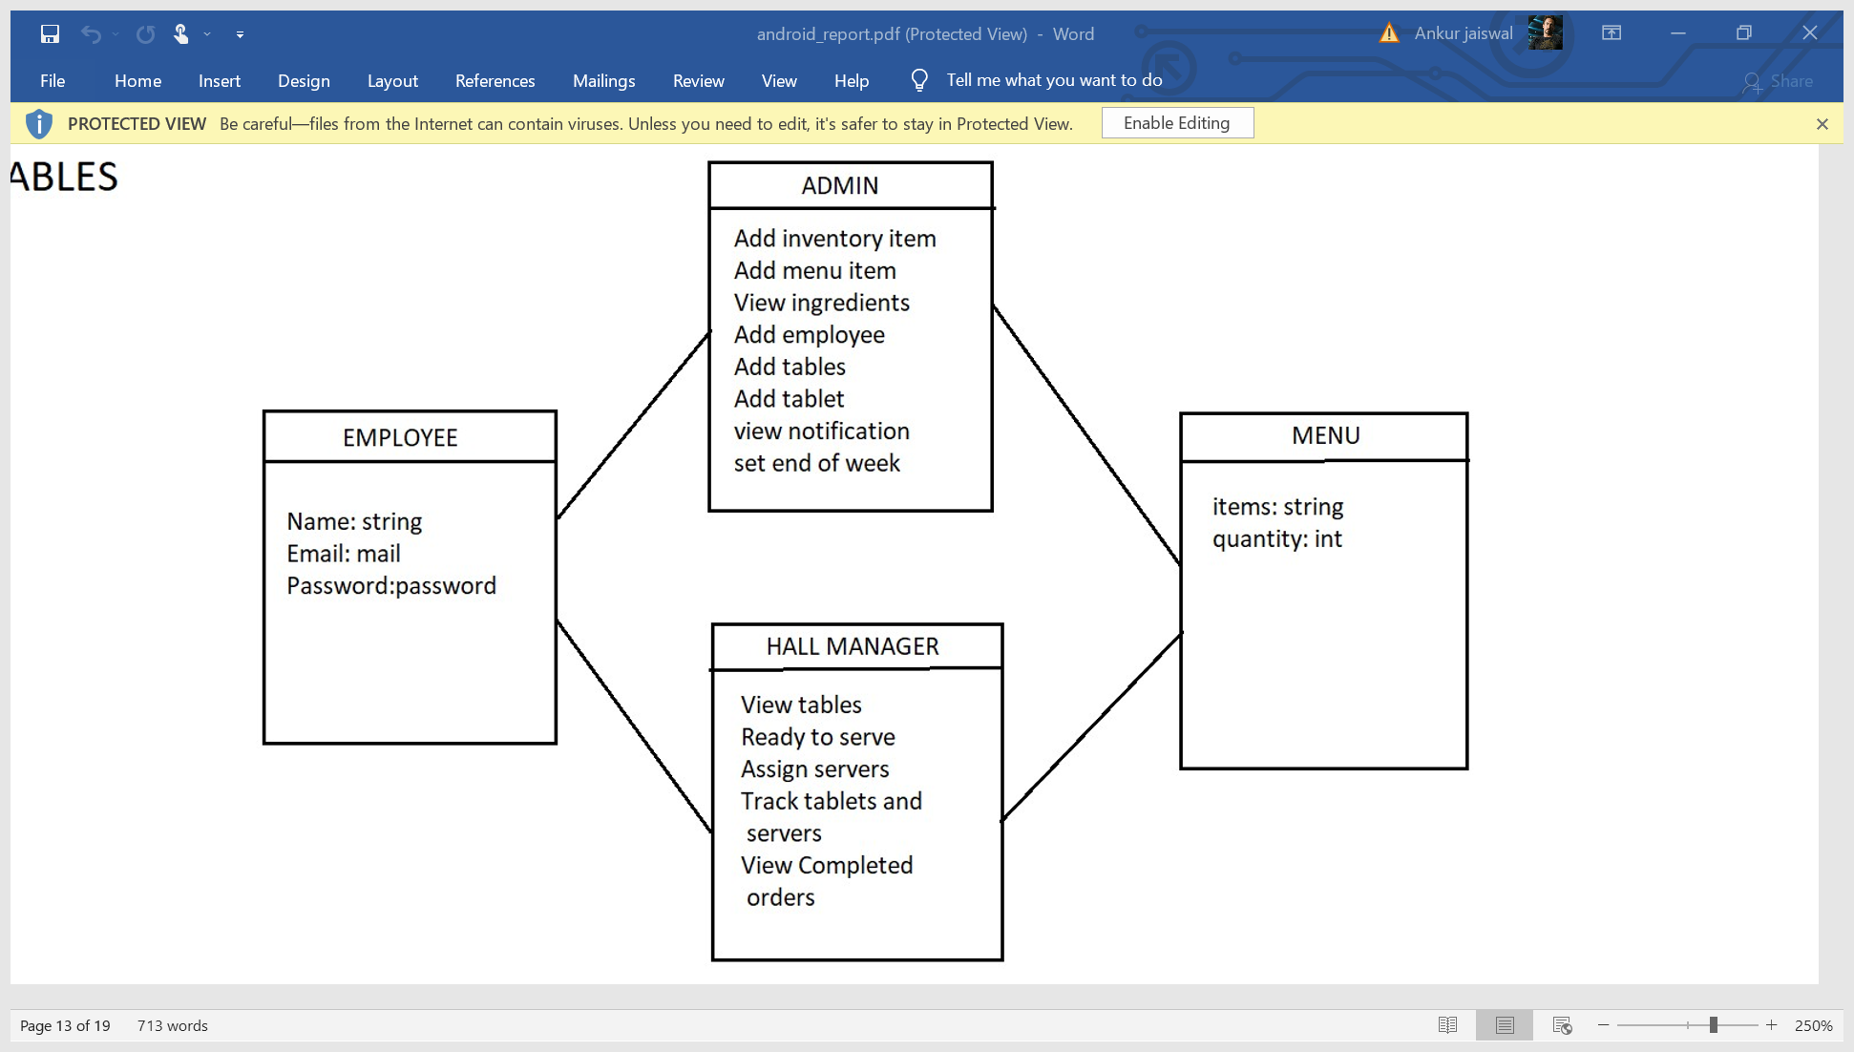
Schema Diagram
The schema diagram of a database system is its structure described in a formal language supported by the database management system (DBMS). The formal definition of a database schema is a set of formulas called integrity constraints imposed on a database. The term "schema" refers to the organization of data as a blueprint of how the database is constructed .

Slide 13
Future Enhancement :
The future scope of our project is vast and can be used in extensive ways: As discussed the limitation of this system, we can implement this as a client/ server system. So all the data will be stored in the single machine, and for any purpose all the data will be retrieved from this central database. So there will be no human work required for the employee. There will be only one person required who will maintain this central database .

Slide 14
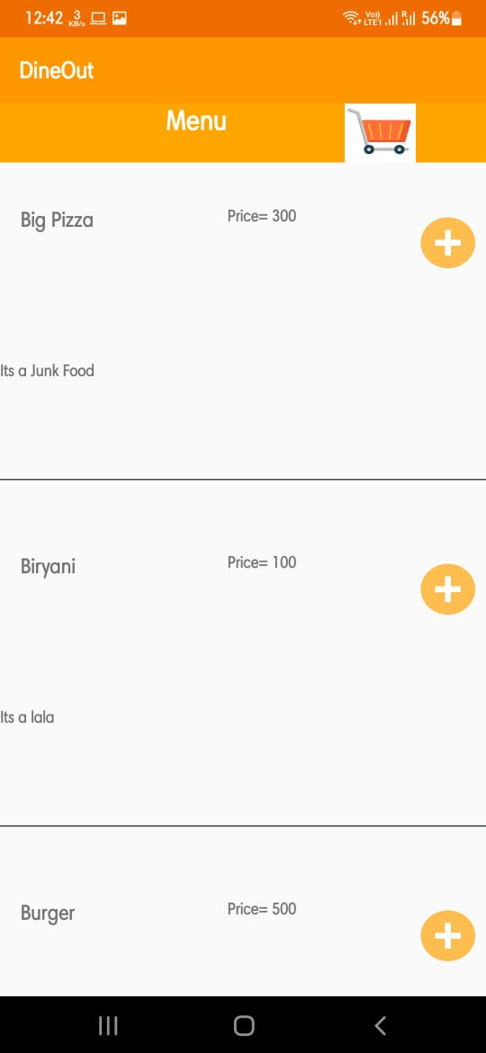
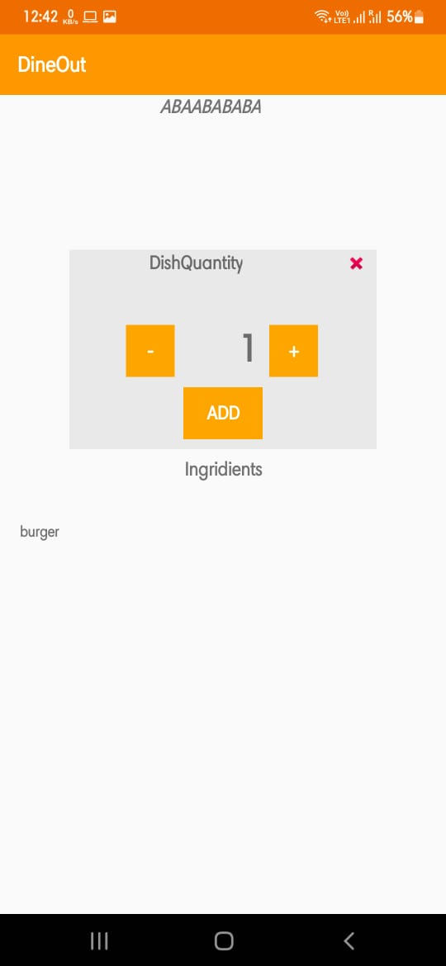
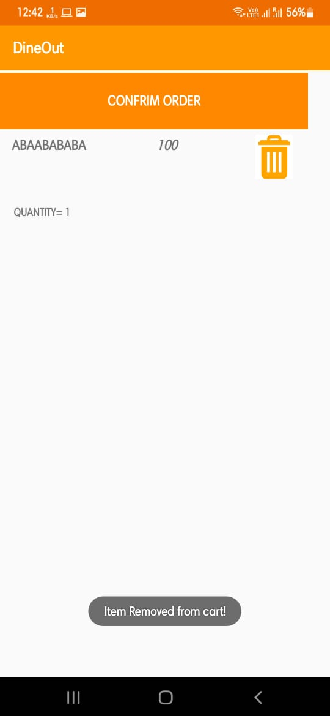
SCREENSHOTS:

Slide 15
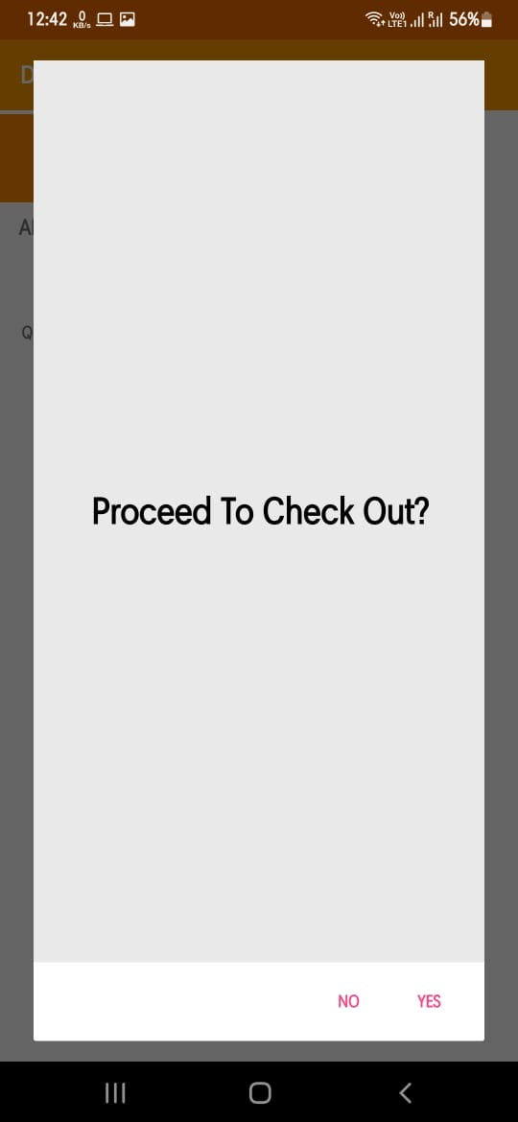
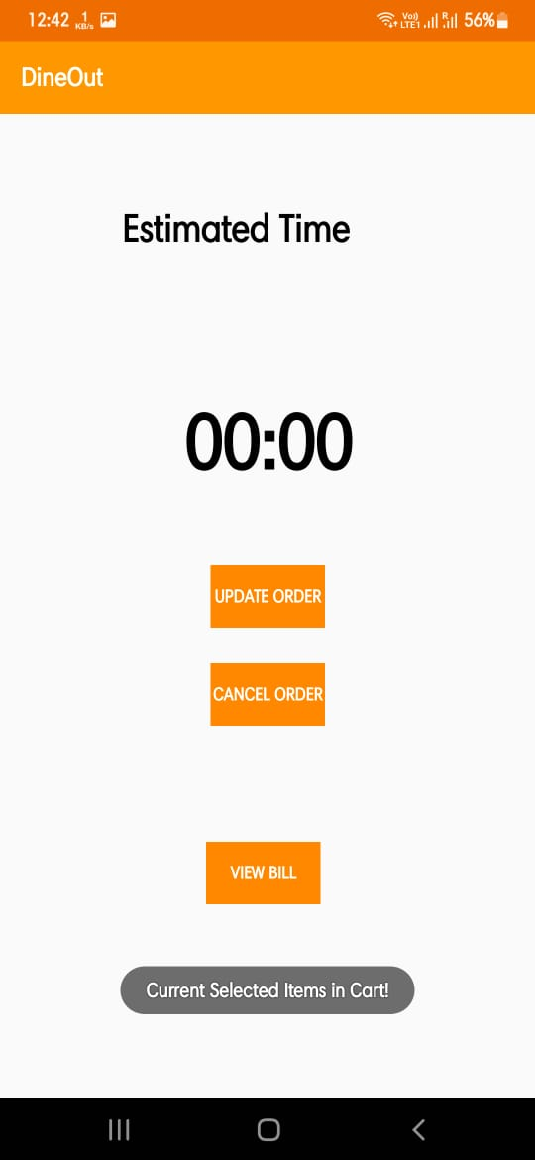
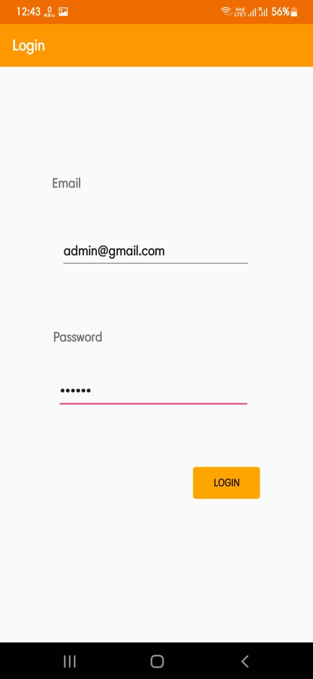

Slide 16
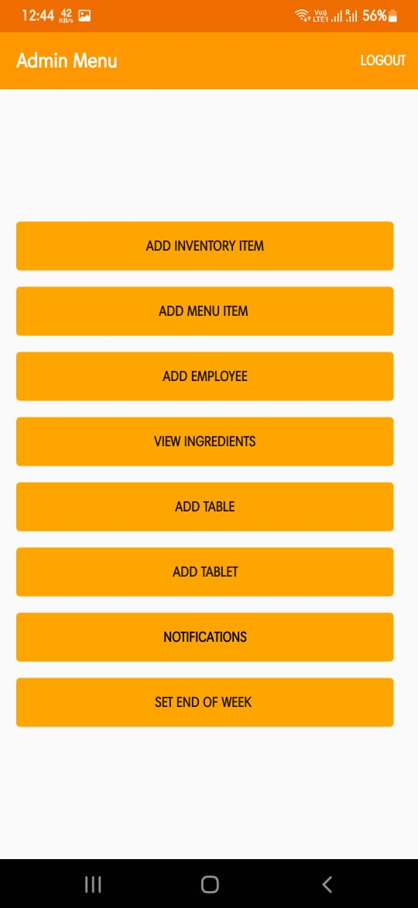
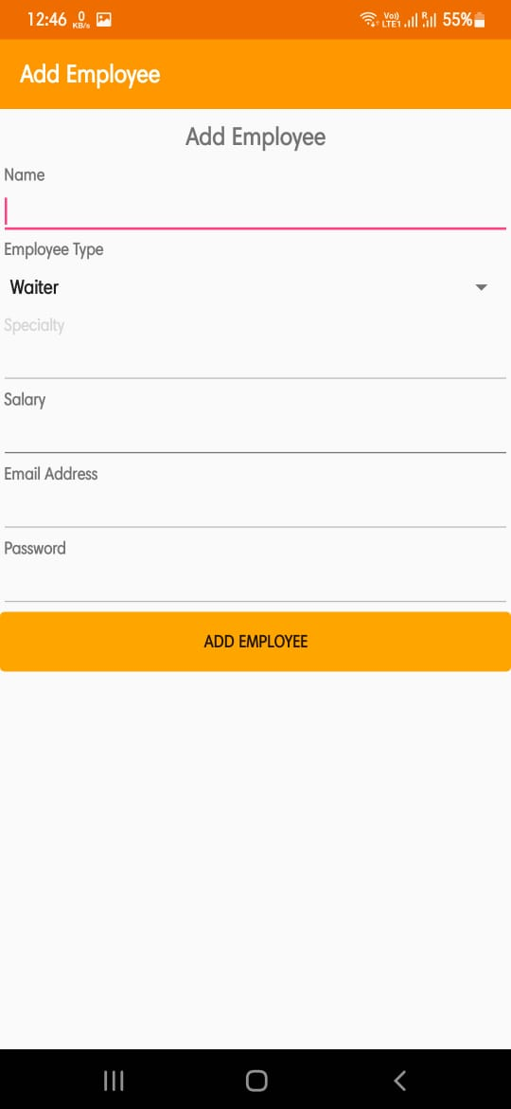
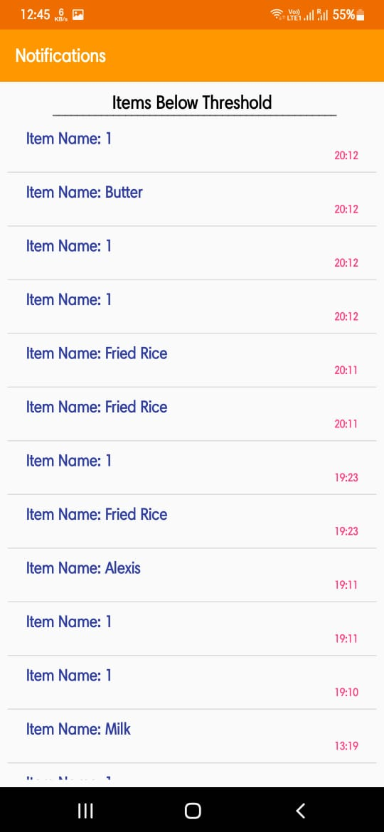

Slide 17
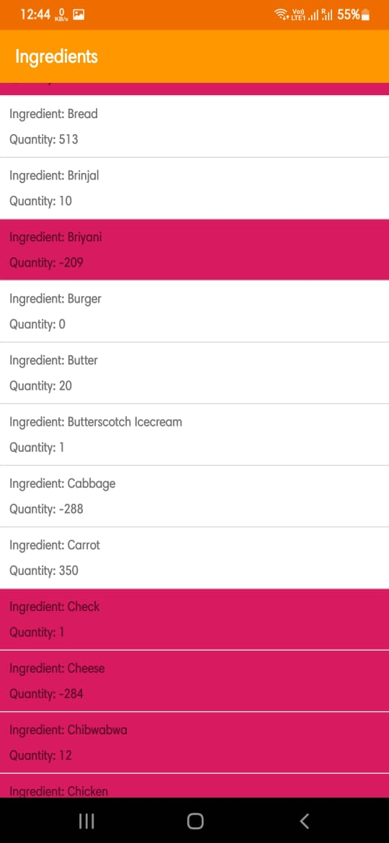
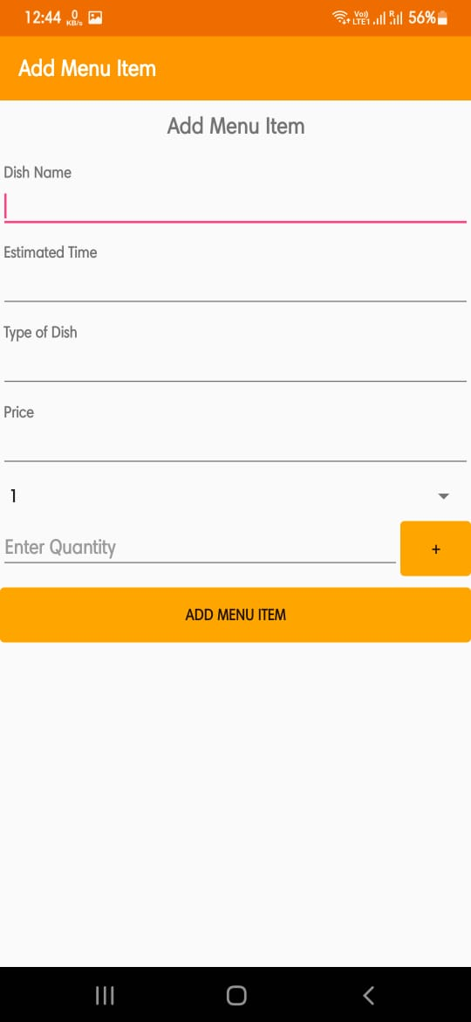
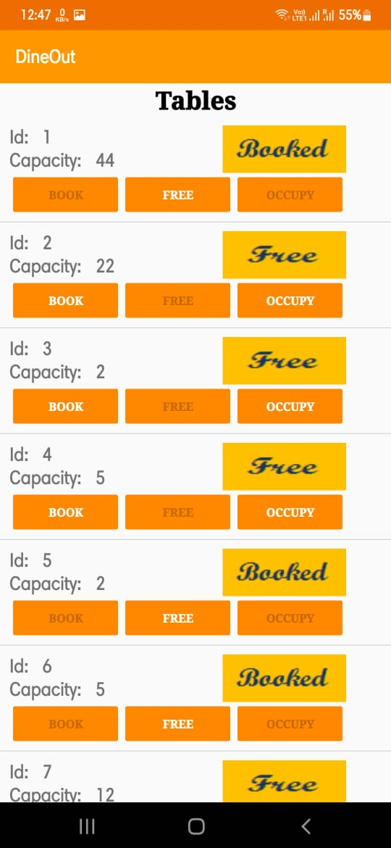

Slide 18
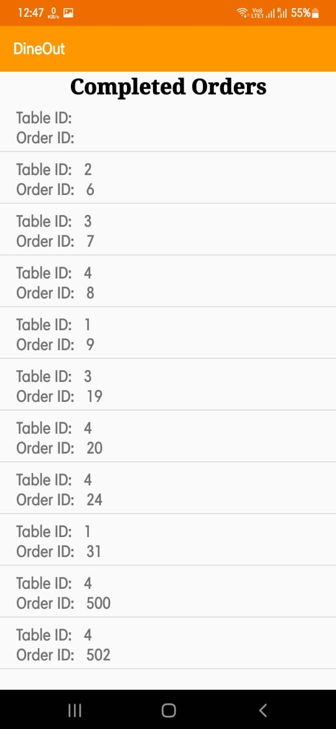
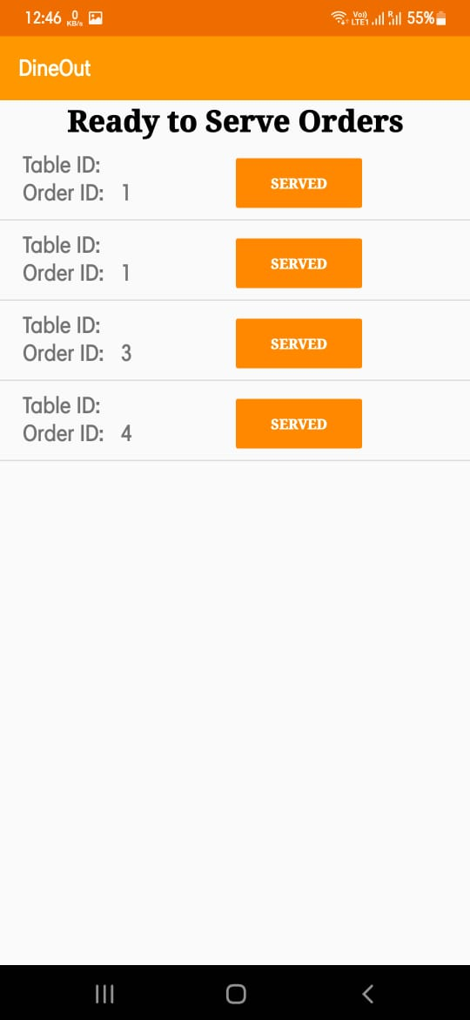
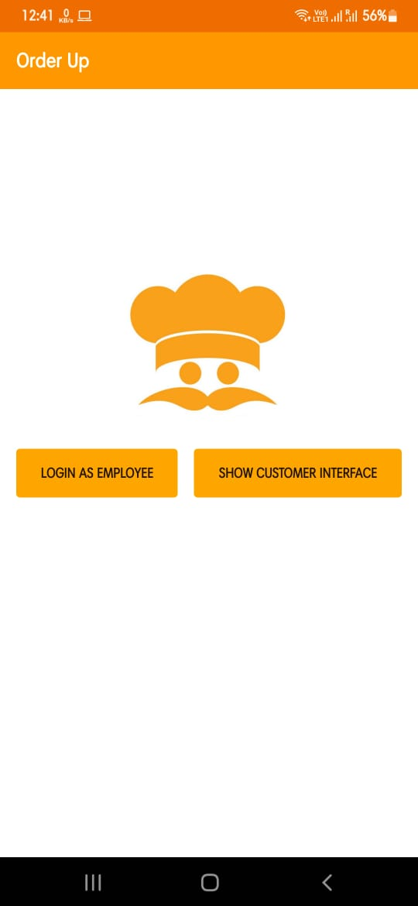

Slide 19
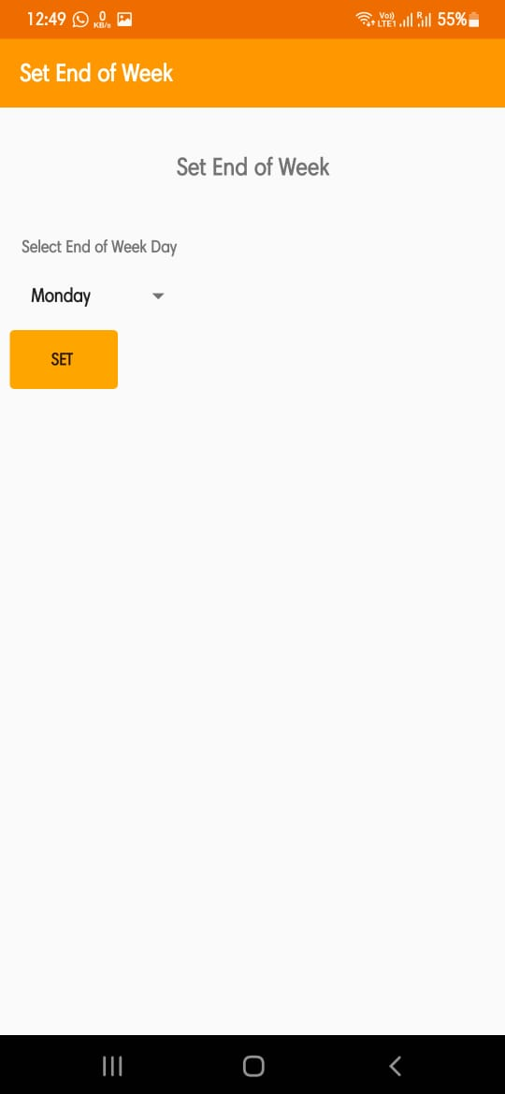
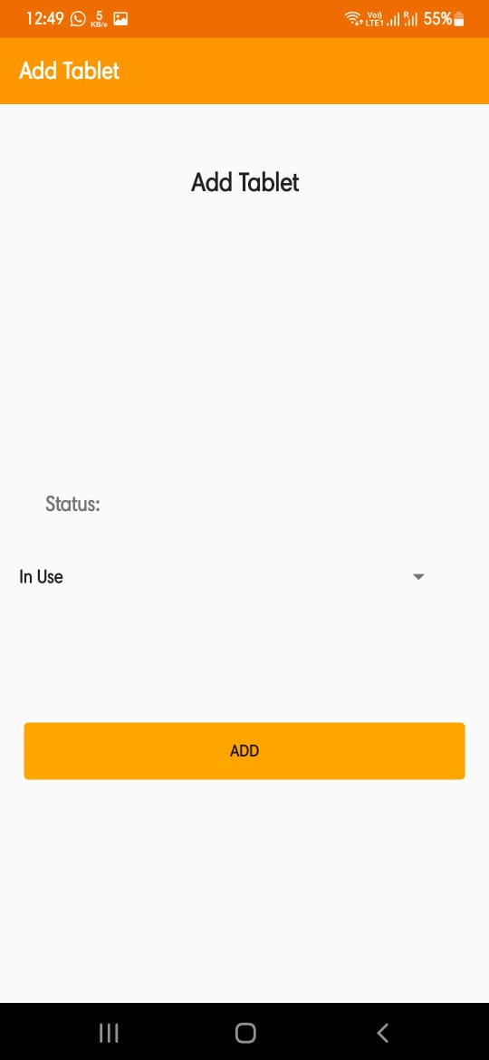
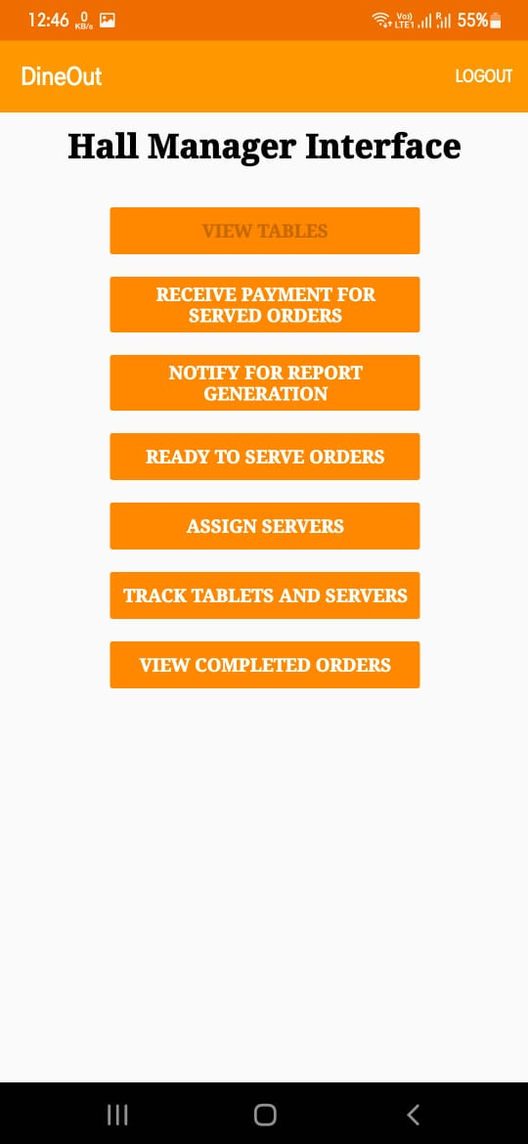

Slide 20
THANK
YOU

