Slide 1
Computer Networks And Security
Model Question Paper-1(Ques no. - 10)
By:-
Abhinav Aditya
1JS18IS002

Slide 2
INDEX
1.Netflix(history)
2.architecture of the Netflix video-streaming platform
functions taking place in the Amazon cloud
interaction between the client and the various servers

Slide 3
(a). Write a short notes on (i) Netflix video streaming platform (ii) VoIP with Skype
Netflix
Generating almost 30 percent of the downstream U.S. Internet traffic in 2011, Netflix has become the leading service provider for online movies and TV shows in the United States. In order to rapidly deploy its large-scale service, Netflix has made extensive use of third-party cloud services and CDNs. Indeed, Netflix is an intresting example of a company deploying a large-scale online service by renting servers, bandwidth, storage, and database services from third parties while using hardly any infrastructure of its own. The following discussion is adapted from a very readable measurement study of the Netflix architecture [Adhikari 2012]. As we’ll see, Netflix employs many of the techniques covered earlier in this section, including video distribution using a CDN (actually multiple CDNs) and adaptive streaming over HTTP.

Slide 4
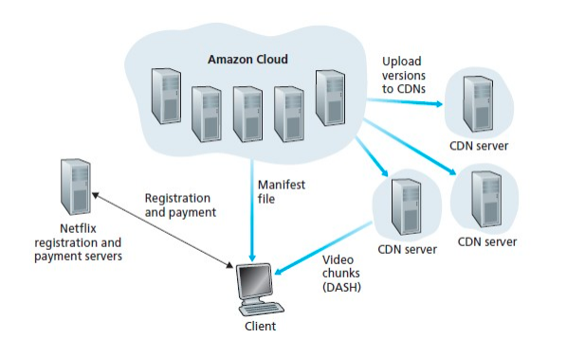
Basic Architecture :

Slide 5
Architecture of the Netflix video-stream has four major components: the registration and payment servers, the Amazon cloud, multiple CDN providers, and clients. In its own hardware infrastructure, Netflix maintains registration and payment servers, which handle registration of new accounts and capture credit-card payment information. Except for these basic functions, Netflix runs its online service by employing machines (or virtual machines) in the Amazon cloud.

Slide 6
*Some of the functions taking place in the Amazon cloud include:
Content ingestion. Before Netflix can distribute a movie to its customers, it must first ingest and process the movie. Netflix receives studio master versions of movies and uploads them to hosts in the Amazon cloud.
Content processing. The machines in the Amazon cloud create many differentformats for each movie, suitable for a diverse array of client video players run_x0002_ning on desktop computers, smartphones, and game consoles connected to televisions. A different version is created for each of these formats and at multiple bit rates, allowing for adaptive streaming over HTTP using DASH.
Uploading versions to the CDNs. Once all of the versions of a movie have been created, the hosts in the Amazon cloud upload the versions to the CDNs.

Slide 7
* Interaction between the client and the various servers
The Web pages for browsing the Netflix video library are served from servers in the Amazon cloud. When the user selects a movie to “Play Now,” the user’s client obtains a manifest file, also from servers in the Amazon cloud. The manifest file includes a variety of information, including a ranked list of CDNs and the URLs for the different versions of the movie, which are used for DASH playback. The ranking of the CDNs is determined by Netflix, and may change from one streaming session to the next. • Typically the client will select the CDN that is ranked highest in the manifest file. • After the client selects a CDN, the CDN leverages DNS to redirect the client to a specific CDN server. The client and that CDN server then interact using DASH

Slide 8
Case Study: VoIP with Skype
Skype is an immensely popular VoIP application with over 50 million accounts active on a daily basis. In addition to providing host-to-host VoIP service, Skype offers host-to-phone services, phone-to-host services, and multi-party host-to-host video conferencing services. Because the Skype protocol is proprietary, and because all Skype’s control and media packets are encrypted, it is difficult to precisely determine how Skype operates. Skype sends audio and video packets over UDP. However, control packets are sent over TCP, and media packets are also sent over TCP when firewalls block UDP streams. Skype uses FEC for loss recovery for both voice and video streams sent over UDP.

Slide 9
Cont...
Skype uses P2P techniques in a number of innovative ways, nicely illustrating how P2P can be used in applications that go beyond content distribution and file sharing. As with instant messaging, host-to-host Internet telephony is inherently P2P since, at the heart of the application, pairs of users (that is, peers) communicate with each other in real time. But Skype also employs P2P techniques for two other important functions, namely, for user location and for NAT traversal.

Slide 10
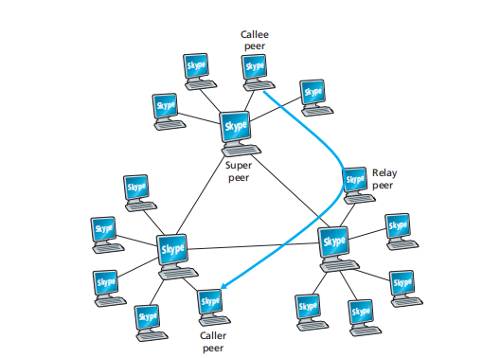
Skype peers:

Slide 11
As shown in Figure the peers (hosts) in Skype are organized into a hierar_x0002_chical overlay network, with each peer classified as a super peer or an ordinary peer. Skype maintains an index that maps Skype usernames to current IP addresses (and port numbers). This index is distributed over the super peers. When Alice wants to call Bob, her Skype client searches the distributed index to determine Bob’s current IP address. Because the Skype protocol is proprietary, it is currently not known how the index mappings are organized across the super peers, although some form of DHT organization is very possible.

