Slide 1
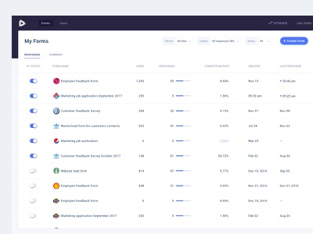
DASHBOARD
End User can view all the surveys that has been pending for him/her to complete and historic surveys attempted
SPOC user can view all the forms that have been created by them and the status of it.
Views, Responses, Completion Rate, Created by, Avg Response time
Can enable/disable the surveys
Email notification to be rolled out for all the stakeholders
Query & sorting of surveys.
Creation of Surveys – SPOC User only

Slide 2
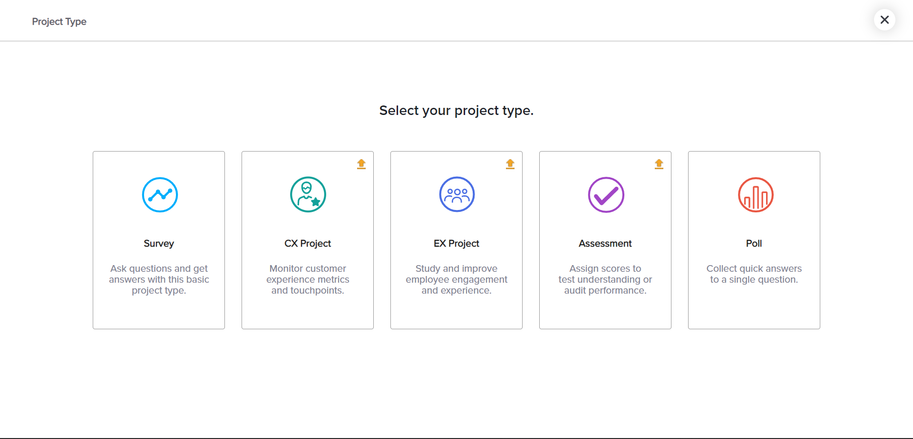
Creation - Type of Engagement (Survey, Poll, Rating, Feedback, Assessment)

Slide 3
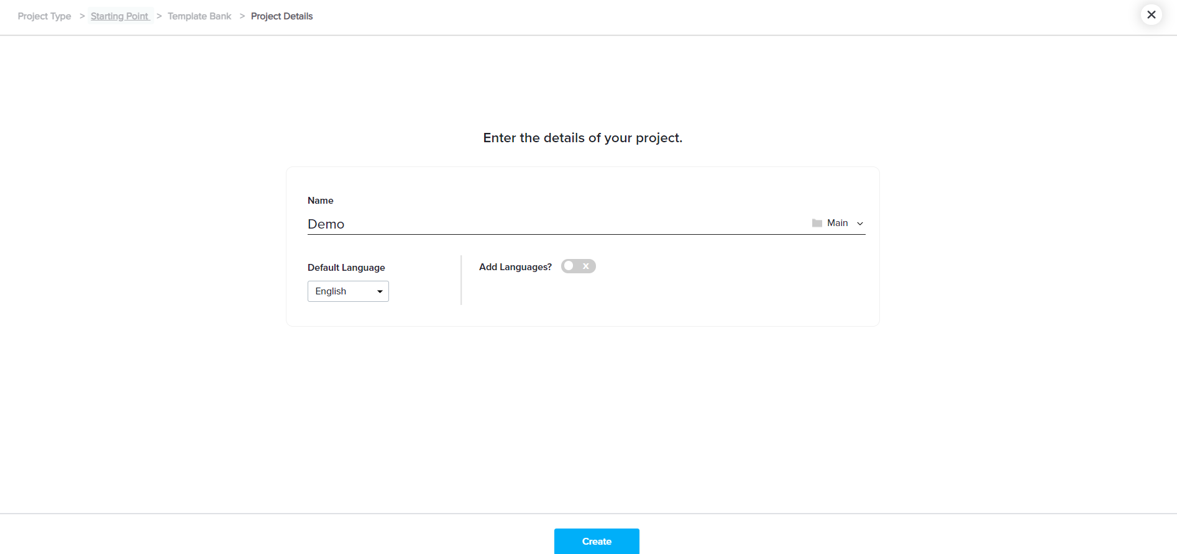
Creating Engagement Quiz
Engagement Title
Tags – Group tags, dept tags, general tags

Slide 4
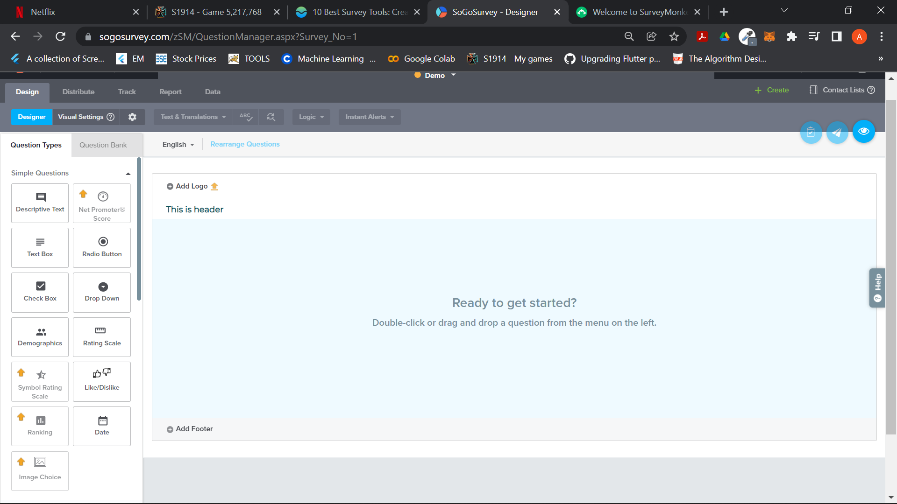
Designing Engagement - Questions
Add questions button / Drag and drop elements
Rearrange questions
Drop questions from the global/personal question bank
Preview on the go
Choose header/footer from pre built templates
Test run (user can configure the test run team members)
Submit

Slide 5
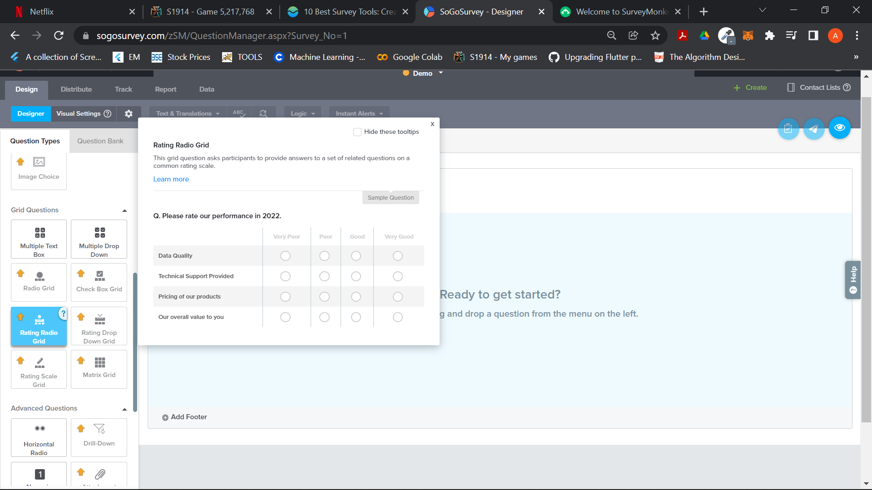
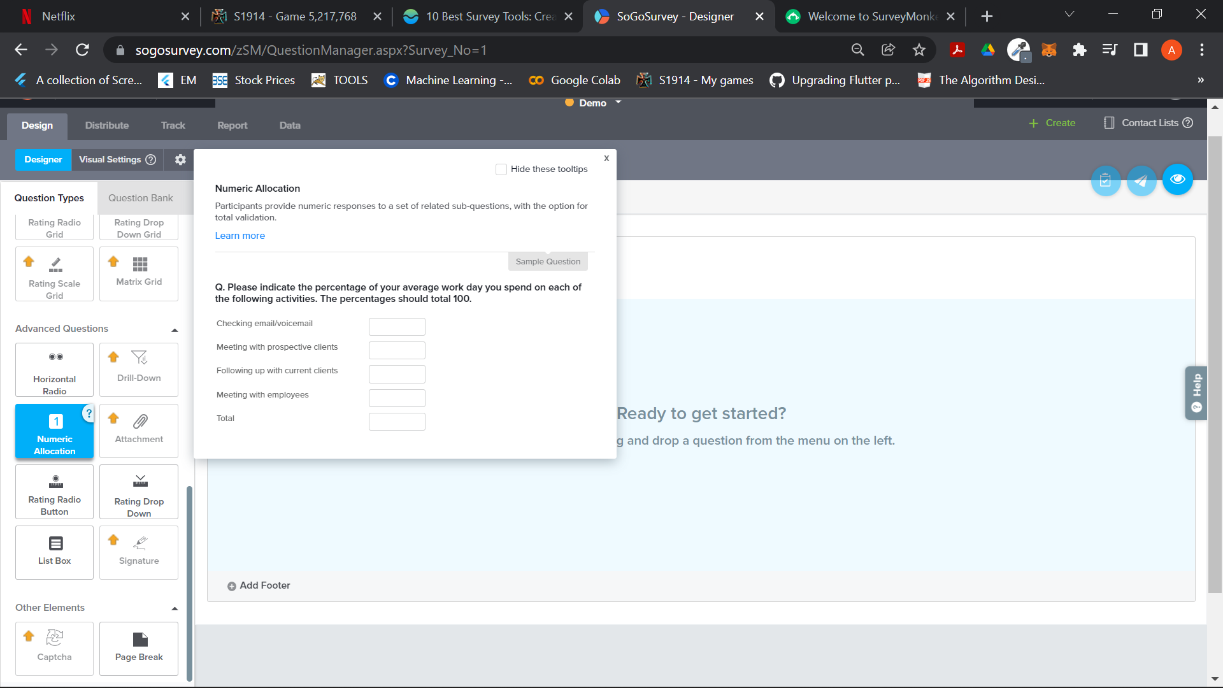
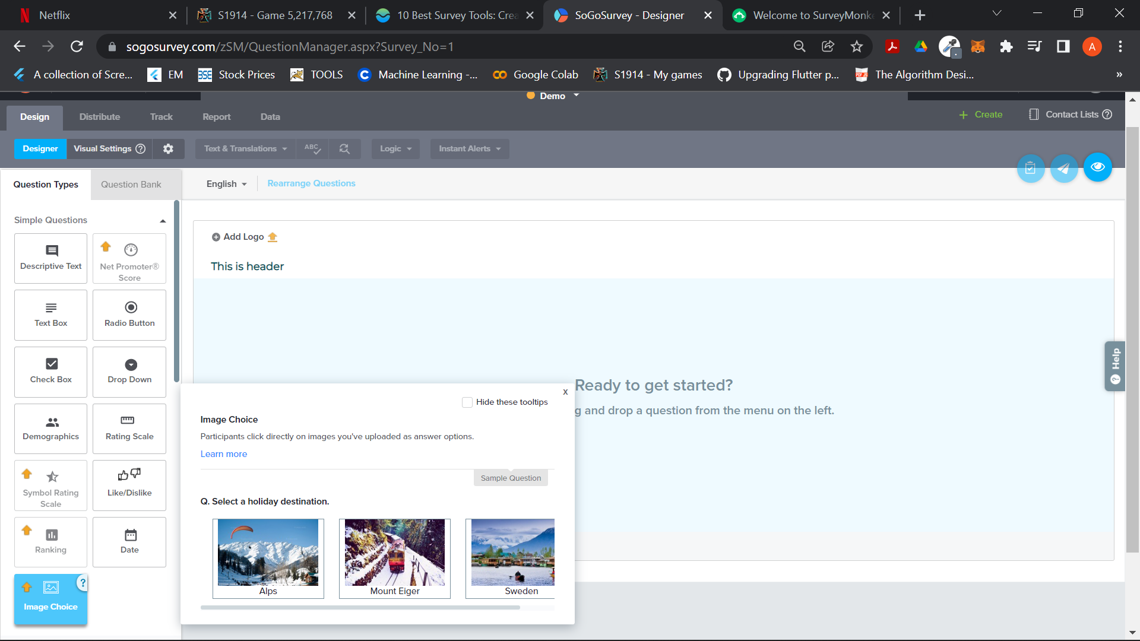
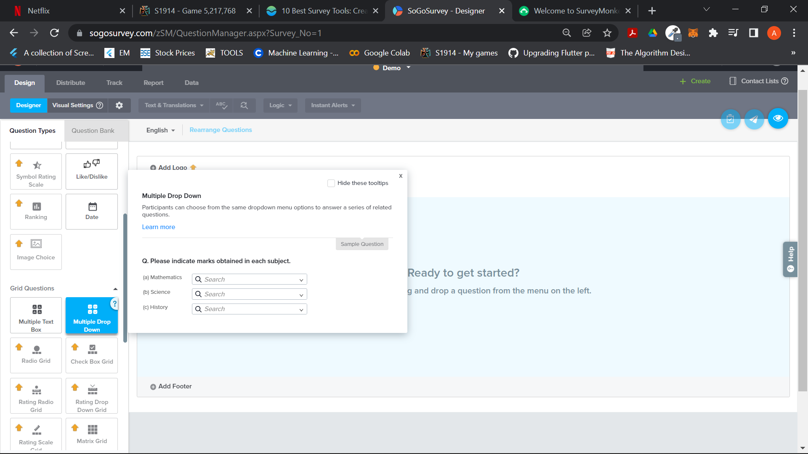

Slide 6
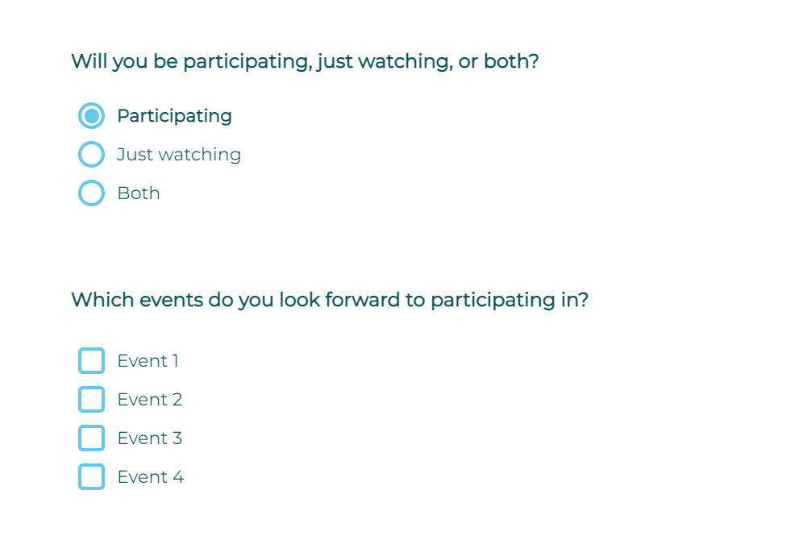
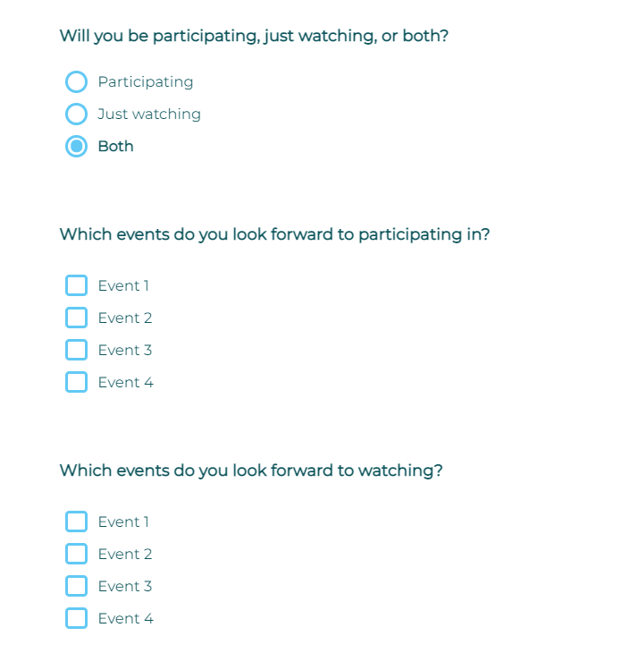
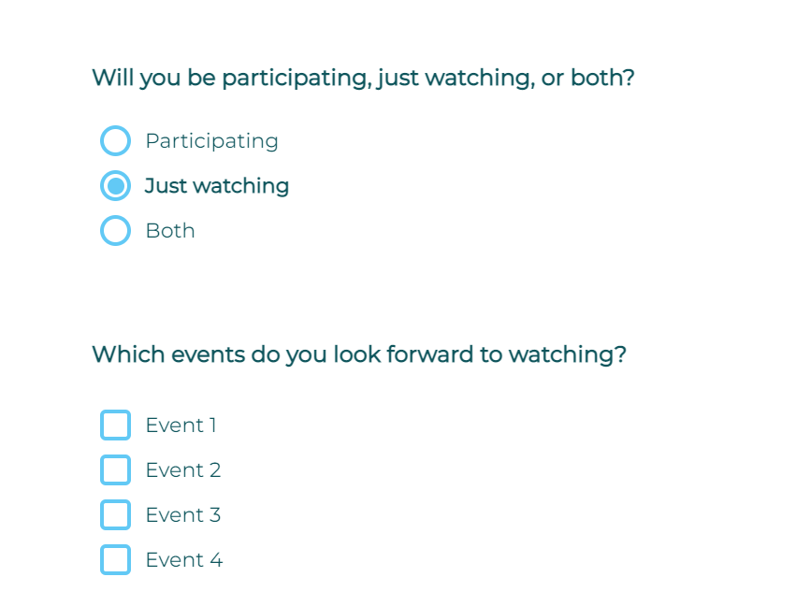
Displaying Questions according to user input of prev question

Slide 7
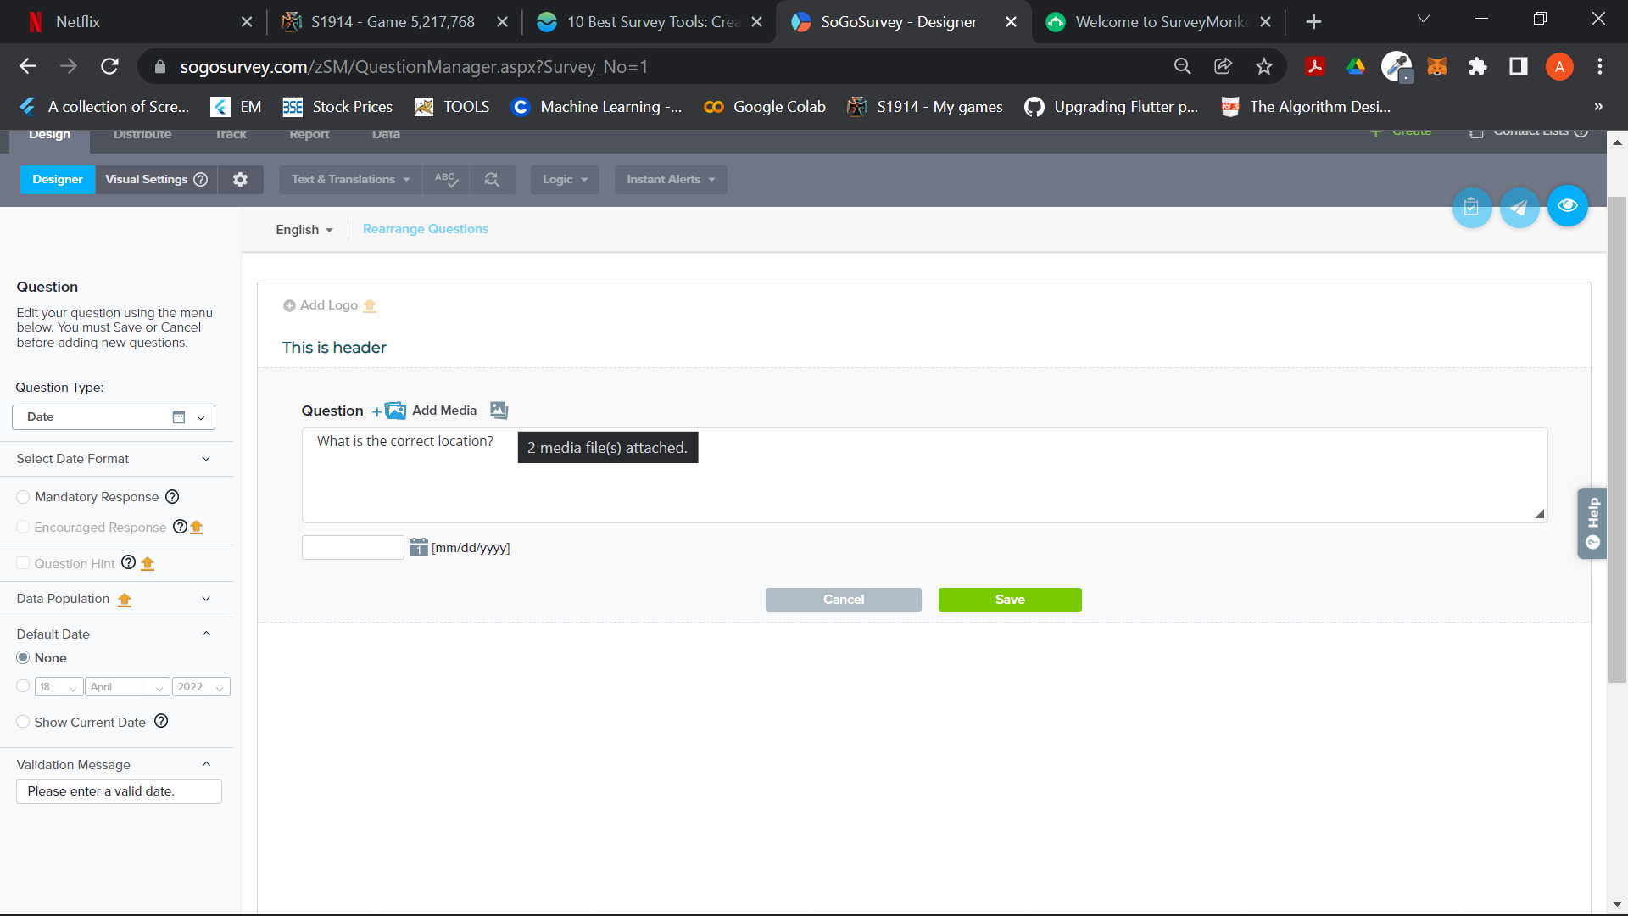
Edit - Engagement Questions
User can edit the question text
By default all questions will be mandatory
Can be edited to non mandatory
Any input validation (in case of textual input type of questions)

Slide 8
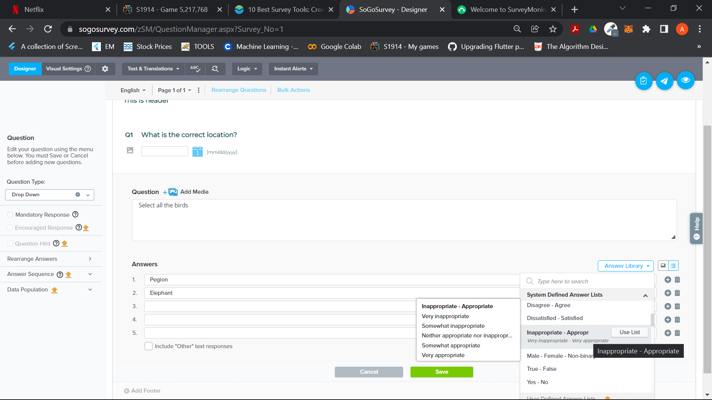
Answer Library
User can add custom input
User can select from generic answer library
User can weight the answer or can provide the right and wrong answers
Can change the sequence/
Ask for randomization

Slide 9
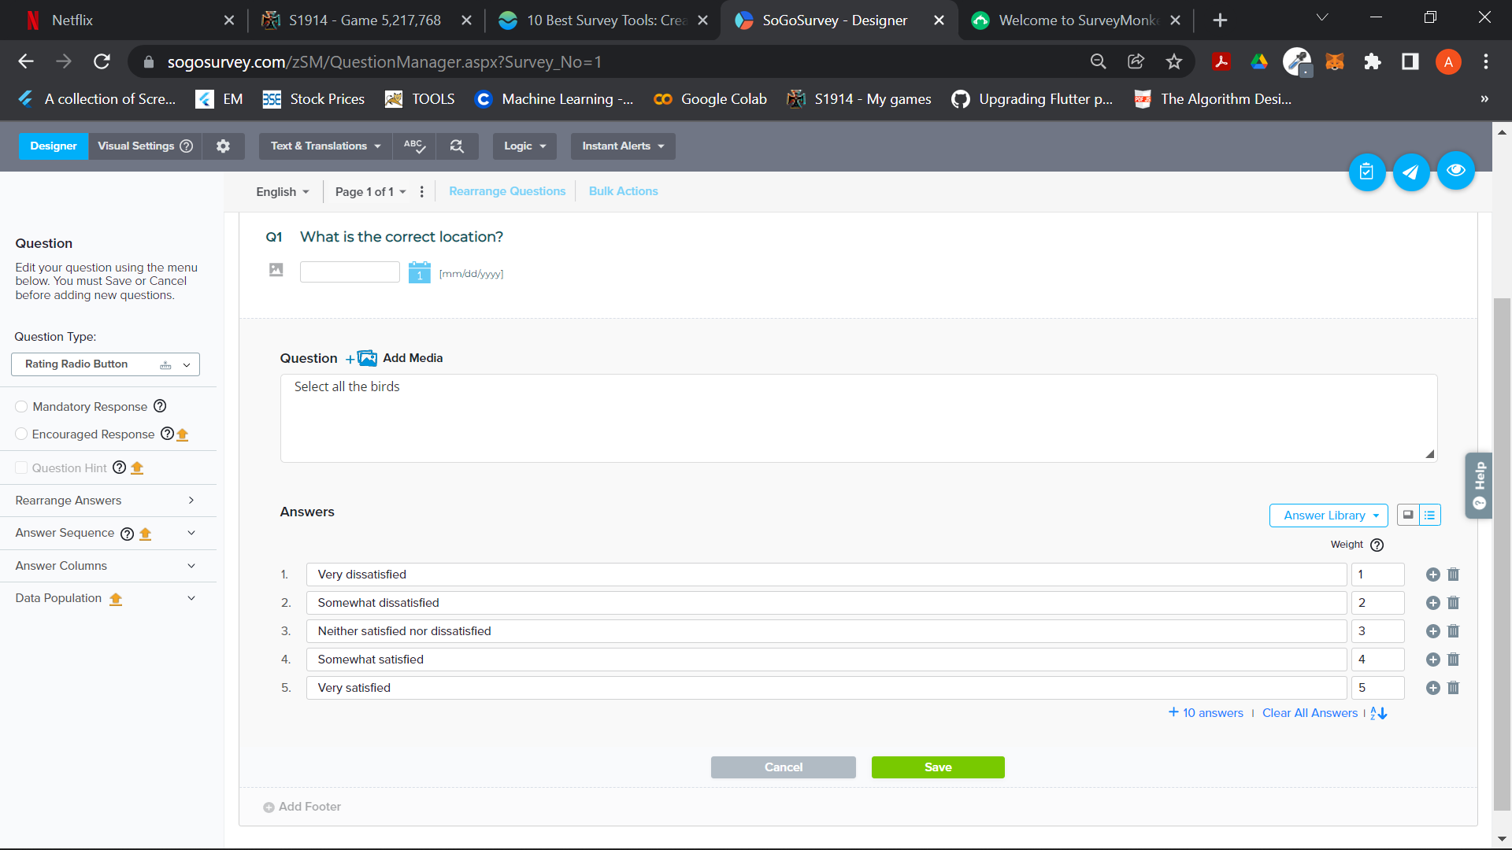
Answer Edit UI -

Slide 10
Others
User should be able to save questions individually and use it in any of the survey
Public Question bank
Private Question bank
Should be able to save the complete survey
Scheduling of surveys (one time/regular intervals)
Test invites for the survey
Preview of the survey
Adding the group or individual members in the survey
Rearrange questions
Customizing header and footers (with limited templates)
Question randomization (Any 10 out of a set of 30)

