Slide 1
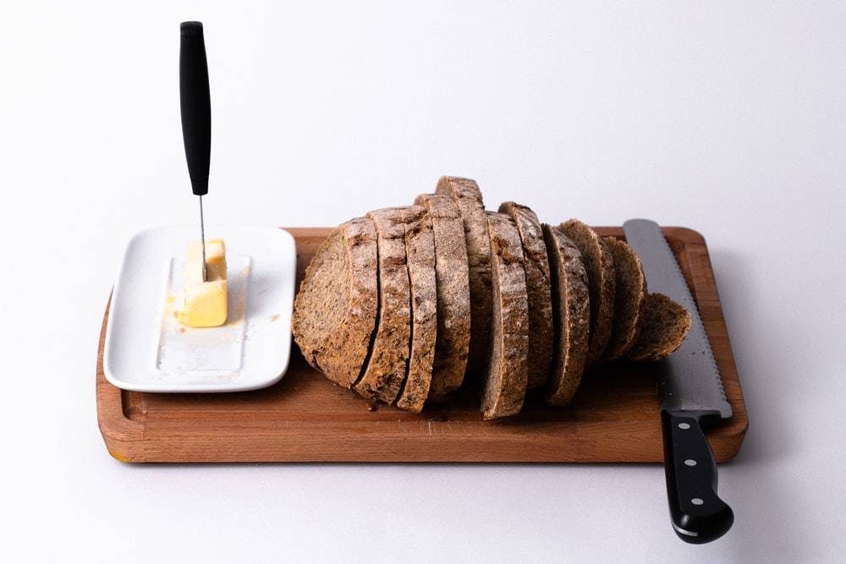


Unlocking future growth potential for Conagra in Margarine Spreads
Analysis and Tactics for Conagra by Region by Brand
POS Data Analysis (2018-2023)
BUAN 6337.005
Group 28
May, 2023

Slide 2
Group 28
Harshitha Nandikonda - hxn210040
Suraj Rayudu Bichinepally - sxb210239
Indrajeet Thakare - ist220000
Aditya Anasane - aka220002
Hakan Genc - hxg210012

Slide 3
POS Dataset Analysis 2018-2023*
*: 2023 is partial data

Slide 4
POS Dataset Formation & Tools
We used KNIME (https://www.knime.com) as initial data preparation tool. KNIME is an open source platform data analytics.
For modeling purposes we used R statistics language.
For visualization our main preference is Tableau Software
We believe we don’t have enough information related other sub-categories than Margarine with this POS dataset. We need more product attributes like taste, ingredients, health index and customer choice survey within this POS dataset by geography.
Conagra is strong number 2 in Margarine/Spreads with one third of revenue of number one Upfield. That’s why we decided to focus only on Margarine/Spreads sub-category from POS dataset.
Therefore as we suggested in our previous delivery we focus only on POS Dataset and Margarine sub-category. We provided the detailed reasons on our choice of selection of Margarine in our previous delivery (Appendix II).

Slide 5
Model before Regional Split
What to do for a better sales strategy:
By Brand, By Geography

Slide 6




Grouping Conagra Brands Data Prep for Models: Brand choices for Conagra
Our Team’s Brand choices for Conagra is based on Table Spreads Share by Brand Presentation by Conagra with 5 brands as below:
Blue Bonnet, Smart Balance, Earth Balance, Parkay and Conagra Other Brands
We grouped brands for Upfield as “Upfield Brands”
All the remaining is called “Other Manufacturer Brands”
Tablespreads (Butter/Butter Blends + Margarine/Spreads)
$5.4 B Sales; + 18.8% vs. YA
+ 6.3% 3 Year CAGR
Source: IRI POS, Total US MULO+C, 52Wks Data Ending 02.28.21

Slide 7
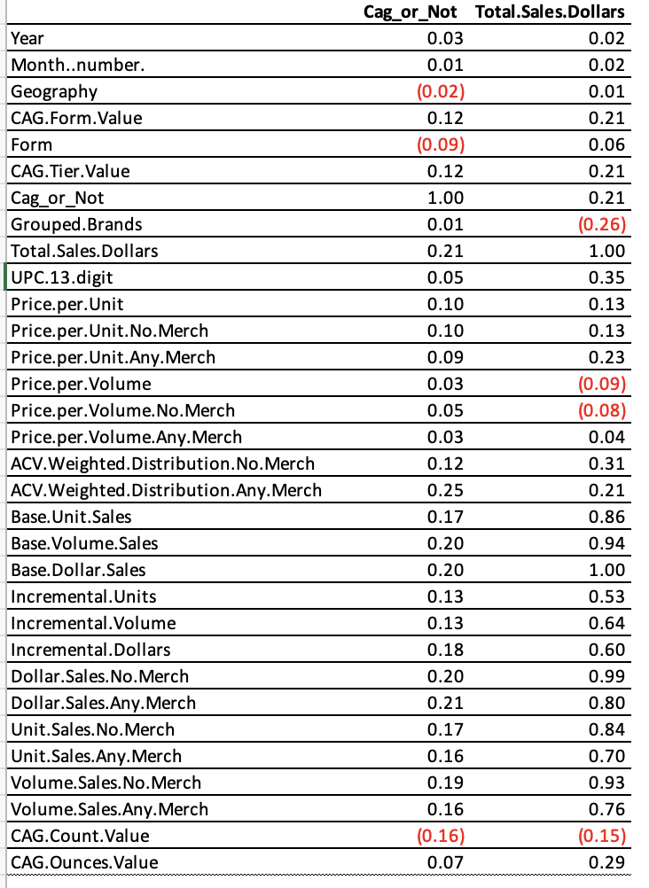
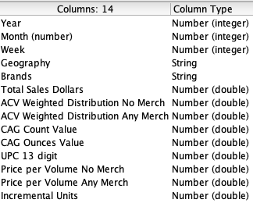
Initial Feature Selection with obvious Collinearity
Features with high correlation are more linearly dependent and hence have almost the same effect on the dependent variable. So, when two features have high correlation, we can drop one of the two features.
Based on our analysis with correlation matrix, we have eliminated:
Pricing: Price per unit together with No Merch and Any Merch
Price per volume only
All Unit, Volume and Dollar sales columns except Total Sales Dollars which represent our dependent variable for models.
We kept and pivoted the following fields for models by brand:

Slide 8
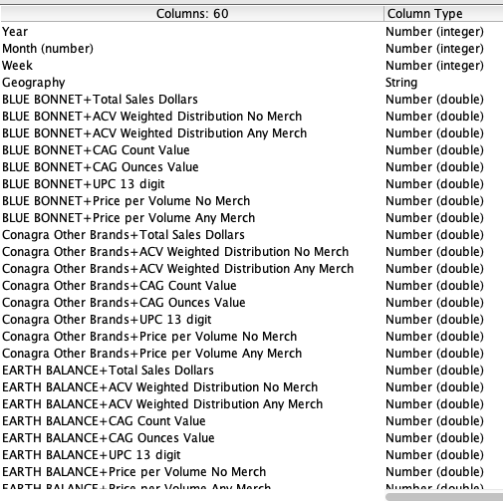
Preparing Model Dataset: Pivoting by Brand
We pivot the columns for each brand and ended up 60 columns per model, one is which becomes independent variable “Total Sales Dollars” as remaining are subject to model feature selection and our choice of algorithm “Linear Regression”.
Since our initial analysis revealed that regions have totally separate chracteristics, we run this set as 8 individual and separate regional models
Pivot

Slide 9
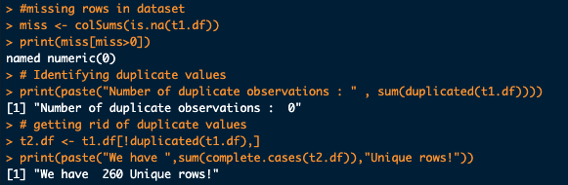
Dataset for each model Data Prep for Models: Columns
We run this set as 8 individual and separate regional models
We have no missing or duplicate rows in our model datasets.
Before studying by region by brand:
Our model datasets are composed of 260 rows and 60 columns separately for each 8 region.
We split data into training (90%) and test (10%) and look at the test performances by R2.
Not too much difference in R2
Since we have too less of rows, we decided to get insight with the whole model by analyzing predictors of variables, rather trying to forecast next sales for Conagra.
We cleaned up data from duplicates and missing rows
We used R for modelling purposes and KNIME for data preparations

Slide 10
Part III – Does Conagra cannibalize its own brands?
Linear Regression for
Total Sales Dollars

Slide 11
Executive Summary Regional Market/Brand Analysis
Data-driven marketing, merchandising with a strong proposal for Conagra
PARKAY: PARKAY is never even a number two brand other than South Central but seems having both serious positive and negative varying impacts on number one brand dollar sales in regional markets. (We gave details by region in upcoming slides)
We seriously need to consider studying in detail what to do with PARKAY by region.
Depending on PARKAY’s profitability, decisions on PARKAY brand activities can be a good candidate selling more number one and/or number two brand sales in markets or eating more and more shares of these brands of ours.
Merchandising: There seems a need a more tailored and analyzed merchandising, pricing efforts sensitivity analysis for brands by region. When we analyze number one brands we saw that time to time we are cannibalizing our own brands dollar sales with our other brands merchandising efforts.
Count, Ounce and UPC Offerings: A certain need for a harmonized tailored offerings of our brands for each region are needed. The impact of each of these items are changing by region. We have provided detailed recommendations for number one brands for each region.
Consumers behave towards our brands very diversely by region. Therefore consumers respond to merchandising efforts differently by region by brand, in which we analyzed in our models (40 combinations with our groupings).

Slide 12
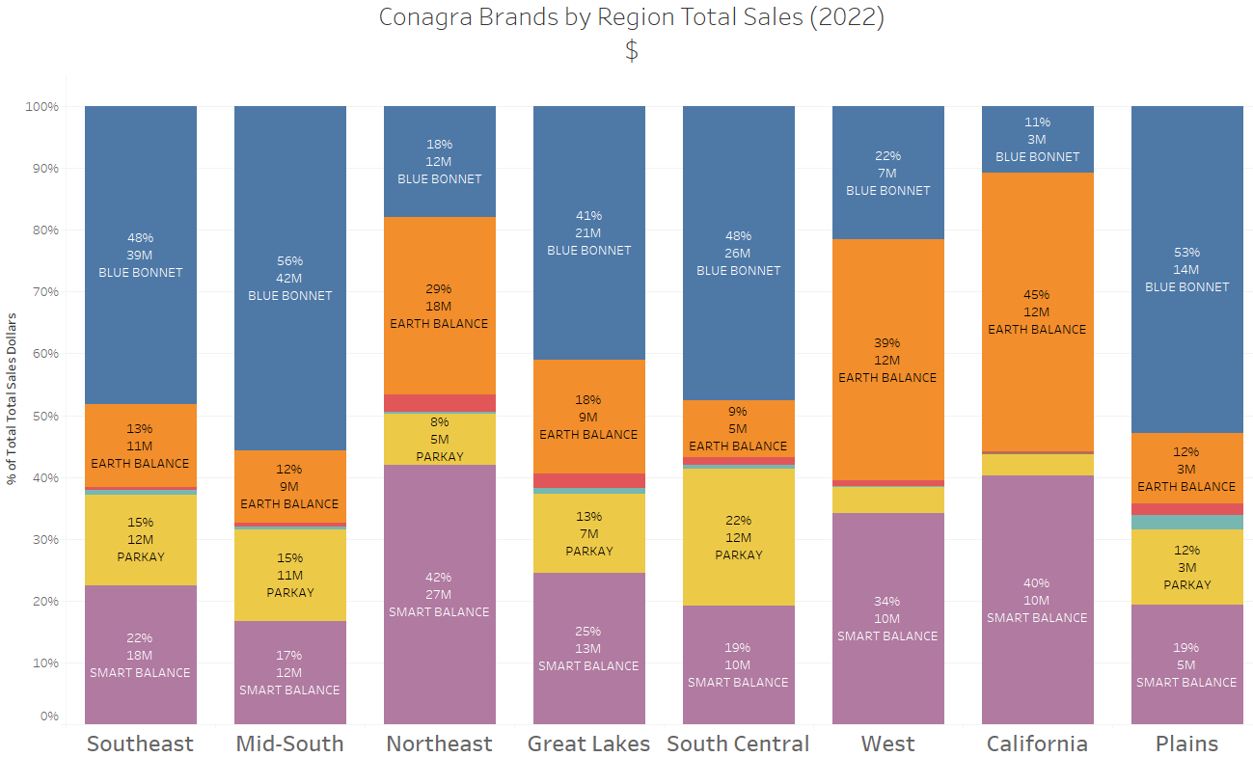
Top Conagra Brand per Region
Southeast: Blue Bonnet
Mid-south: Blue Bonnet
Northeast: Smart Balance
Great Lakes: Blue Bonnet
South Central: Blue Bonnet
West: Earth Balance
California: Earth Balance
Plains: Blue Bonnet
We have run 40 different models by region by product
Even we have modeled 40 combinations of grouped brands and regions, for representative analysis we focused on number 1 Conagra Brand for each region.:

Slide 13
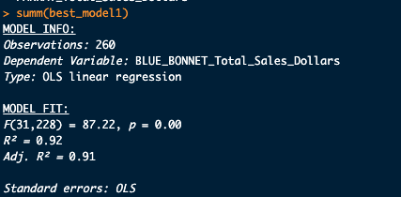
Southeast with Blue Bonnet
We used Stepwise methodology to predict the best linear regression model
Tactics and Analytics for Increasing Blue Bonnet Total Sales Dollars :
Merchandising is helping Blue Bonnet in Southeast, with all kind of promotions.
Smaller brands of Conagra eating Blue Bonnet sales in big stores, with increasing number of offerings
PARKAY’s increasing counts are one the biggest internal cannabilizer for Blue Bonnet in Southeast
If Upfield changes packaging with bigger counts with more ounces it helps Blue Bonnet in Southeast
Smart Balance is positioned just like Upfield in terms of counts for Blue Bonnet in Southeast
Smart Balance promotions and even sales are helping Blue Bonnet sales in bigger groceries.

Slide 14
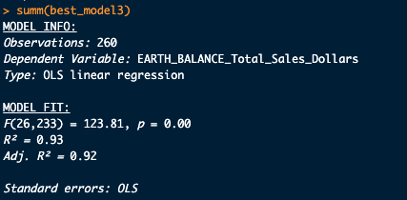
California with Earth Balance
We used Stepwise methodology to predict the best linear regression model
Tactics and Analytics for Increasing Conagra Earth Balance Sales Dollars:
If Blue Bonnet increases variety of offerings, this impacts negatively
Other Conagra Brand campaigns impacts negatively
Certainly more offerings (UPCs) needed
Again PARKAY’s merchandising’s pricing impacts are taking our Earth Balance dollar sales share
Upfield, Smart Balance and PARKAY campaigns with pricing impacts in almost same direction, negatively to Earth Balance sales in California

Slide 15

Mid-south with Blue Bonnet Brand Total Sales Dollars
We used Stepwise methodology to predict the best linear regression model
Tactics and Analytics for Increasing Blue Bonnet Dollar Sales:
Smaller brands of Conagra, Earth Balance counts offerings does not help Blue Bonnet sales
PARKAY is cannibalizing Blue Bonet without Merchandising and in big grocery stores
Smart Balance price increases help Blue Bonnet sales
Blue Bonnet is sensitive to Upfield regular pricing. Offer lower pricing then Upfield
Earth Balance Count value increase seems having a big negative impact on Blue Bonnet sales.
PARKAY is a serious competitor for Blue Bonnet in Mid-south

Slide 16
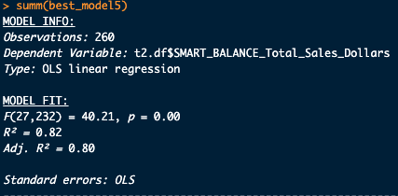
Northeast with Smart Balance Brand Total Sales Dollars
We used Stepwise methodology to predict the best linear regression model
Tactics and Analytics for Increasing Smart Balance Dollar Sales:
Count values for Smaller brands of Conagra and Earth Balance are really a threat tho Smart Balance sales in Northeast
PARKAY and Other Competitor Brands campaigns are cannibalizing Blue Bonet with Merchandising
Campaigning in big groceries with Smart Balance seems a strong tool to increase Smart Balance sales in Northeast
Interestingly Upfield does not seem a threat in Northeast for Smart Balance at all

Slide 17
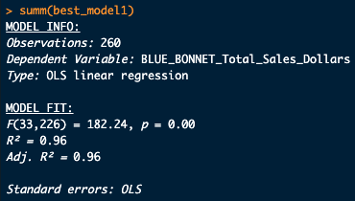
Great Lakes with Blue Bonnet Brand Total Sales Dollars
We used Stepwise methodology to predict the best linear regression model
Tactics and Analytics for Increasing Blue Bonnet:
Campaigning and being presence in big groceries with Blue Bonnet seems a strong tool to increase Smart Balance sales in Great Lakes
Smaller brands of Conagra count values and number of offerings are a threat to Blue Bonnet sales
Real competitor(s) for Blue Bonnet seems within other manufacturing brands in big grocery stores
Interestingly Upfield’s campaigns are helping BlueBonnet Sales in Great Lakes
PARKAY seems a very strong facilitator to sell more Blue Bonnet in Great Lakes
If Upfield offerings increases Blue Bonnet sales seem decreasing in Great Lakes.

Slide 18
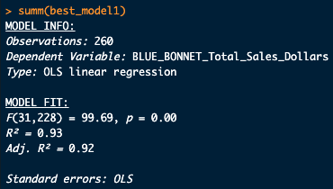
South Central with Blue Bonnet Brand Total Sales Dollars
We used Stepwise methodology to predict the best linear regression model
Tactics and Analytics for Increasing Blue Bonnet:
Smaller brands of Conagra seriously cannibalizes Blue Bonnet sales
Blue Bonnet shall increase count values
Again PARKAY count value is even more of a threat to Blue Bonnet sales
If PARKAY increases price and offerings this seems helping very much Blue Bonnet Sales in South Central
Upfield existence with no campaign in big groceries looks like having a negative impact on Blue Bonnet Sales in South Central

Slide 19
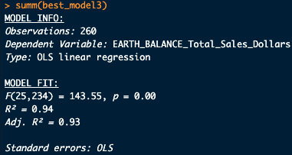
West with Earth Balance Brand Total Sales Dollars
We used Stepwise methodology to predict the best linear regression model
Tactics and Analytics for Increasing Earth Balance Sales Dollars:
We shall decrease ounces value offerings in West to sell more Earth Balance
Looks like Smart Balance pricing in merchandising eats up Earth Balance sales dollar market shares
Seems like in this region Earth Balance has competitor(s) other than Upfield
PARKAY’s merchandising pricing impacts Earth Balance sales negatively in this region.

Slide 20
Appendix A: Part II (HW 2)
Unlocking future growth potential for Conagra in Tablespreads
POS Data Analysis (2018-2023)
BUAN 6337.005
Group 28
April, 2023

Slide 21
POS Dataset Analysis 2018-2023*
*: 2023 is partial data

Slide 22
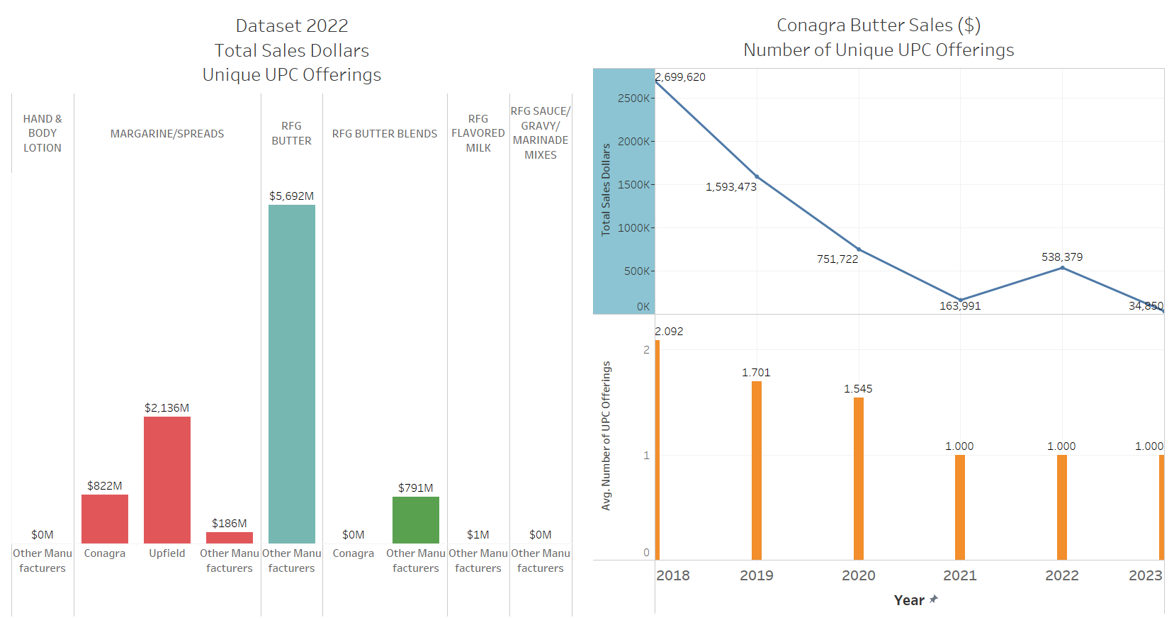
All POS combined
This is a 1.3m row dataset with 34% only margarine sub category related which Conagra operates
Rfg Butter by far the biggest portion of the data in terms of USD sales with 2x more than margarine subcategory and no Conagra share in it.
Conagra seems experimented RFG Butter Blends but seems pulling off over 5 years from $2.7m revenue in 2018 down to $538K revenue in 2022 with down to one UPC offering.
Why Conagra failed in RFG Butter Blends?
Why Conagra does not operate in RFG Butter sub-category? Can Conagra operate in other sub-categories too?
We believe we don’t have enough information related above questions with this POS dataset. We need more product attributes like taste, ingredients, health index and customer choice survey within this POS dataset by geography.
Conagra is strong number 2 in Margarine/Spreads with one third of revenue of number one Upfield. That’s why we decided to focus only on Margarine/Spreads sub-category from POS dataset.

Slide 23
POS Margarine/Spreads Dataset Analysis 2018-2023*
*: 2023 is partial data

Slide 24
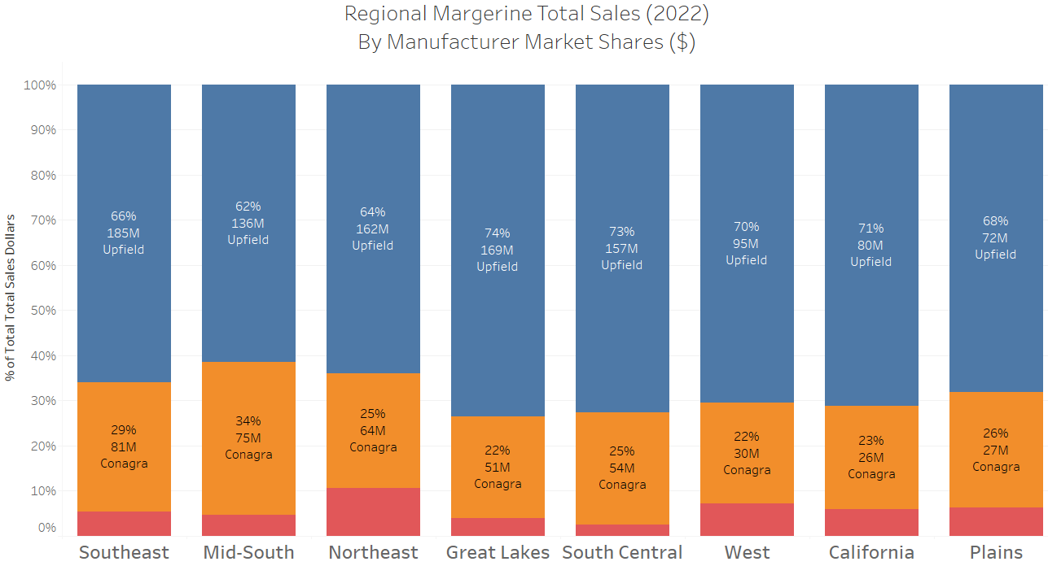
Competitive Margarine Market Share by Geography
Upfield and Conagra together around 95% of the market.
We decided to group rest of the manufacturers and their brands as “Other Manufacturers” and “Other Manufacturer Brands” for future data analysis.
By Conagra Revenue we classified markets as:Southeast, Mid-South and Northeast are big markets (>$64m) , Great Lakes and South Central mid-markets (>$50m) and West, California and Plains are small markets (<$50m)
Let’s look at Conagra’s brands by geography

Slide 25
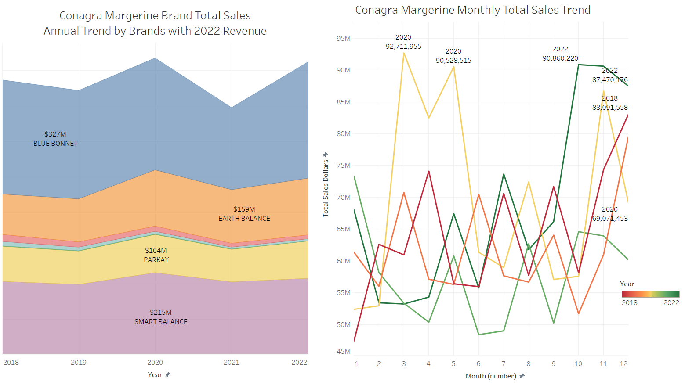
Conagra Brands
We can see the impact of Covid19 era (2020 April-May) when we assume people hoarded long lasting margarines.
2022 revenues are seriously picking up for Conagra especially with a jump on October 2022.
Blue Bonnet has by far the biggest revenue with Smart Balance second and Earth Balance third in 2022 revenues.
Fleischmanns and Move Over Butter have very small market shares.
Let’s look at how brands vary by region?

Slide 26
Conagra Brands Geography
Conagra Brands brand value varies very different by geography regardless of total market size of Conagra for that region in USD Sales.
Even though Blue Bonnet is the biggest in total sales dollars, we can see that Smart Balance and Earth Balance are dominating in some regions.
We will analyze Conagra by Brand and by region separately.

Slide 27
POS Margarine/Spreads Dataset Analysis 2018-2023* Pricing
*: 2023 is partial data

Slide 28
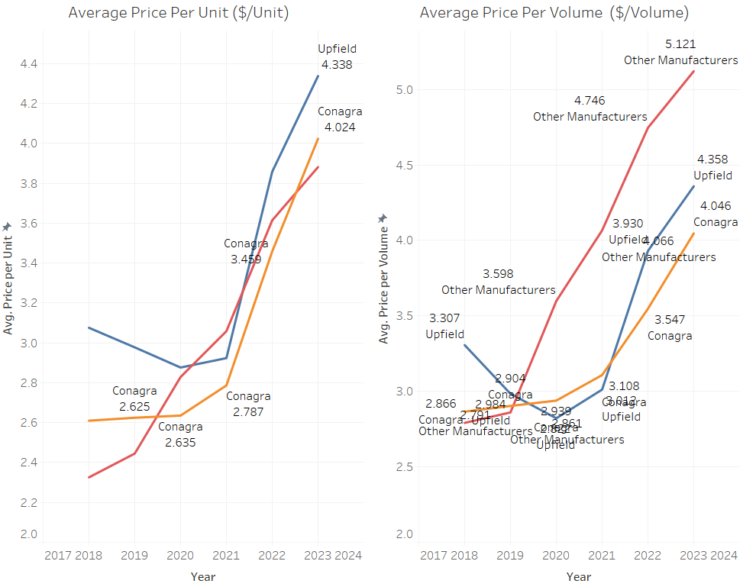
Competitive Margarine Market Pricing
We can see that consumers in Margarine care about the value per volume.
Upfield started using its market share power to justify per volume price increases.
At the same time Conagra kept its price per volume lower than Upfield after 2021.
Other manufacturers seem not having enough playground to play price per volume game at all.
Conagra and Upfield have almost same price per unit and price per volume which indicates focused on offering 16oz based product offerings.
Competition seems on the price volume/unit game as compared to Conagra and Upfield.
We will look at the details of correlation of different forms of competitive pricing in total sales dollars within this dataset.
Let’s look at Conagra’s brands

Slide 29
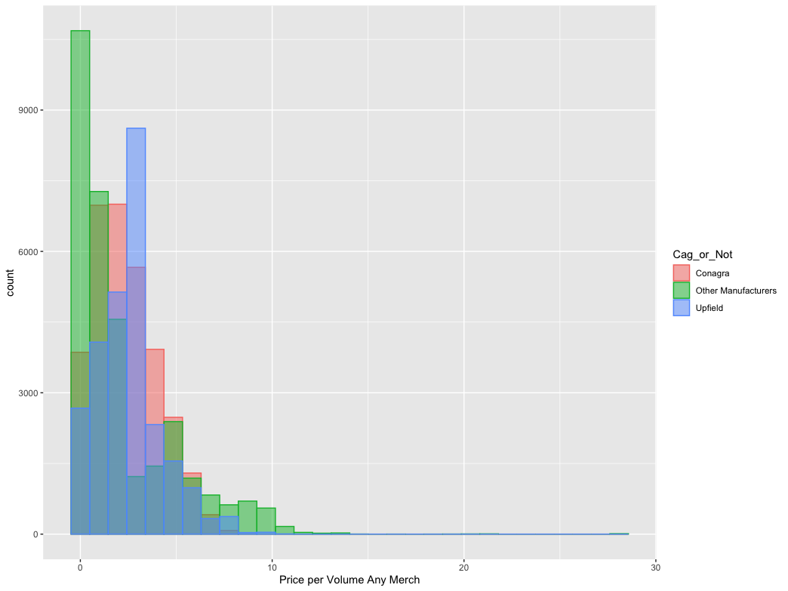
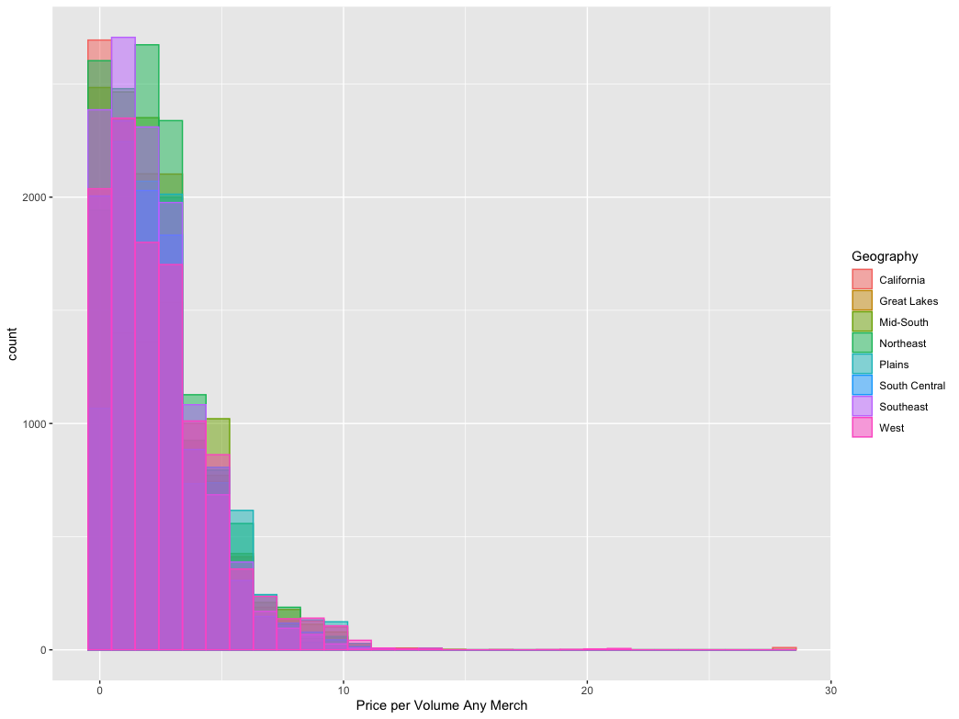
Competitive Margarine Market Pricing 2
Conagra seems using pricing in merchandising more than Upfield. We will analyze how much it helps or not to Conagra on improving the existing market share if it helps further ?
We can see that in merchandising pricing per volume is a very strong tool regionally in margarine sub category.
We will analyze the impact of pricing further by region, by brand

Slide 30
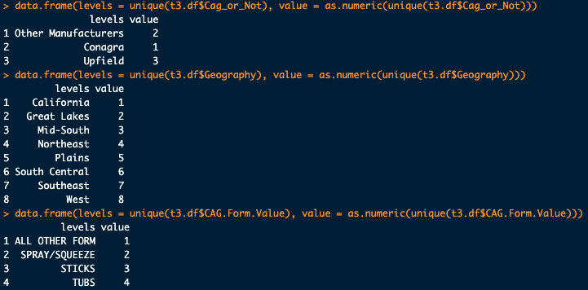
Margarine Correlation Matrix
“Price per volume no merch” moves in opposite direction of total sales dollars, whereas promotional price per volume increases goes slightly (almost indifferent) in the same direction of total sales.
Again ACV No Merch has more movement together with Total Sales Dollars than promotion equivalent.
Count value in offerings in opposite direction vs ounces almost two time more in the same direction with sales dollars.
Brand might be important variables for further analysis
Some more insight Analysis (Hypothesis) we will test in the next step:
No merchandising: seems like spending marketing money on pricing activities a better idea?
Price sensitivity especially no merchandising pricing increases?
ACV by Manufacturer, Geography, Brands: Search for local groceries, and be strong more on lower size groceries or big groceries?

Slide 31
Appendix B: Part I (HW 1)
Panel Buyer Distribution and HH Distribution and Buying Index Analysis
BUAN 6337.005
Group 28
March, 2023

Slide 32
Executive Summary Buyers/Buying Market Analysis
Our initial strategy proposal for Conagra
We investigated who really buys categories, among them who not to prioritize and which competitors are strong among buying behaviors.
Based on our analysis from the provided datasets we recommend:
A certain entry to butter and/or butter blends categories.
A cost effective marketing/merchandising strategy building for high sales volume brands with a diminishing HH buying interest (Smart Balance).
A Demographic / Geographic focus analytics for:
Non-Hispanic/white
Married home owner living in a county size A Top 25 Mkts
Have no children or no children under 18 years of age
Pet owner but no dogs or cats.
Based on our analysis from the provided datasets who do not seem really our target buyers for Tablespreads:
Gen Z or 18-24 years of age
Farm owners
Have children 0 to 5 and 12 to 17 years of age
Warning: Smart Balance has a lot more sales volume than Parkay and Earth Balance, nevertheless with a decreasing HH% buying interest. An important brand with lesser strong interest from buyers. A special focus is needed for Smart Balance (Cash Cow?, evolving the brand?) .
Action: For Parkay and Earth Balance we seem good at attracting buyers, but more efforts are needed on an increasing interest for later purchases. We seem losing acceleration with 2nd + HH buying interest.
Butter/Butter Blends Market Entry Advantage for Conagra: One interesting fact that in this category of Tablespreads having Nobrand among top 5 brands indicate that in this category brand loyalty is not that strong. This will be an indication of a lesser entry barrier for Conagra into the butter and/or butter blends market.
Next phase:
We want to develop data-driven marketing, merchandising with a strong guidance for Conagra brands with the next phase of pricing, demography and geography attribute.
We have seen, as a start, strong competition in tablespreads market in terms of buying distribution and buying index. From this analysis, we will think, perform data mining for product attributes: Which product attributes would be more attractive to these buyers?

Slide 33
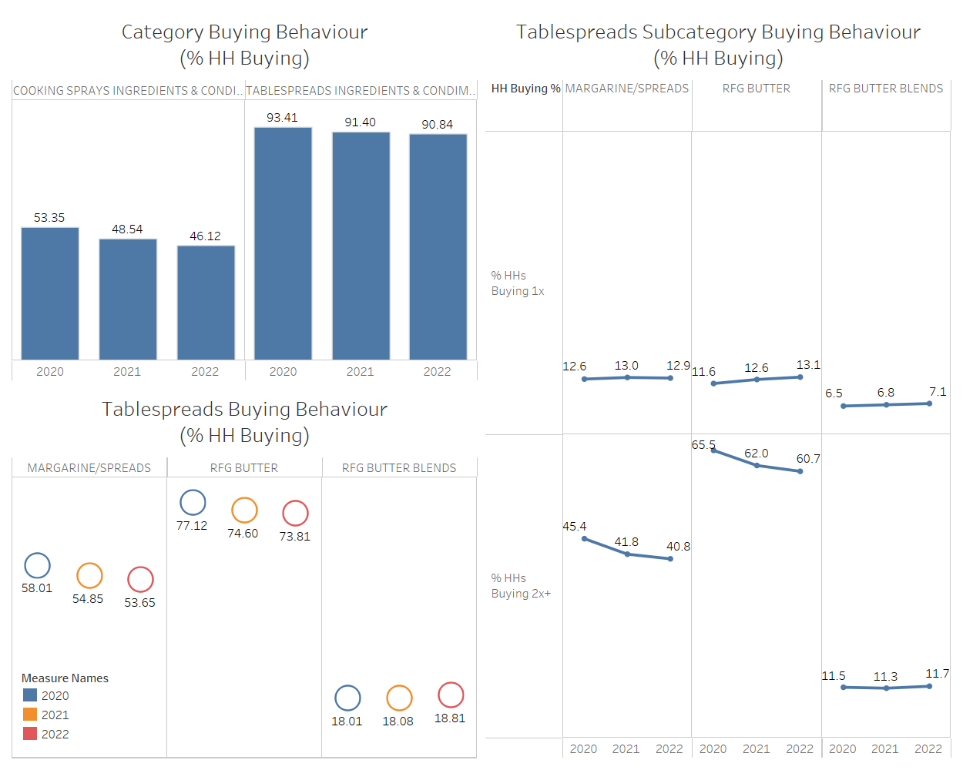
Household buying behavior Market
Category
Cooking Sprays have significant decrease between 2020-2022
Tablespreads Category
Tablespreads has some decrease but not as much as Cooking Sprays
Within Tablespreads Margarine/Spreads have significant downward trend in total HH % trend.
1st time buyers we see an increase between 2020 and 2022. HH are showing interest to Tablespreads.
2nd time buyers have different behaviors
Margarine/Spreads and Butter shows a significant decrease whereas Butter Blends shows even a slightly increase.
Why?

Slide 34
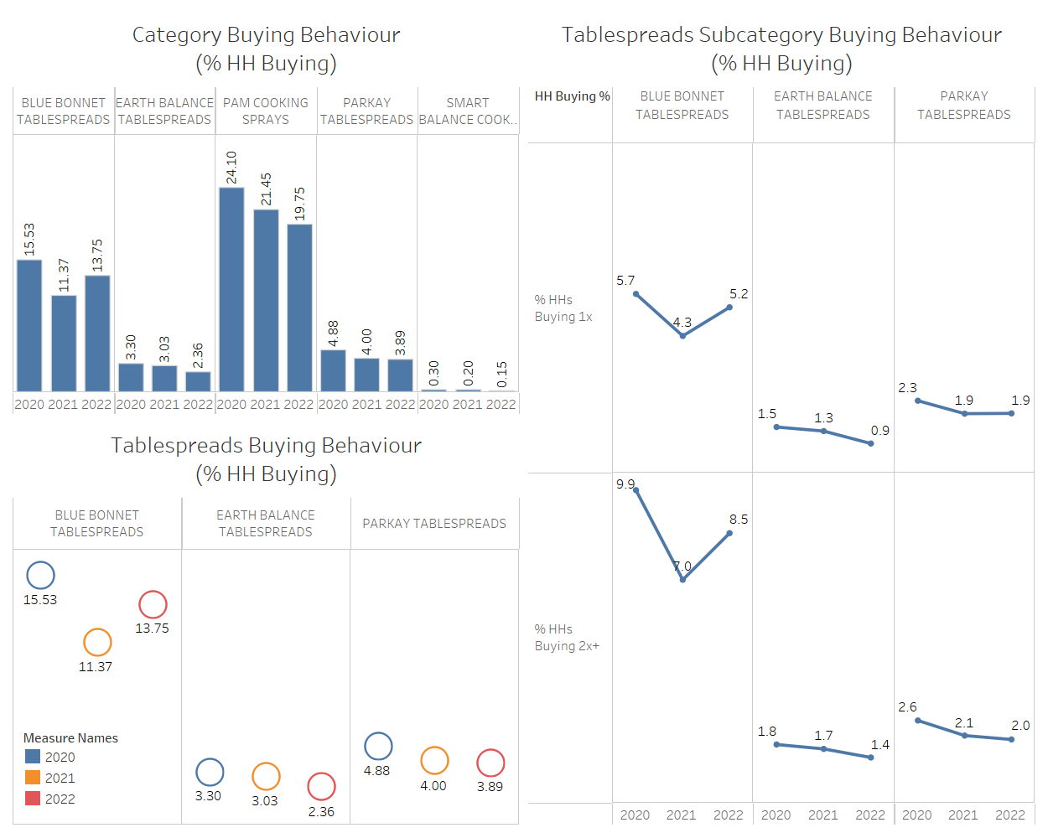
Household buying behavior Conagra Brands
Category
On Cooking Sprays; PAM decreased lower than the category which can be said as success.
Smart Balance is way too small to compare in terms of HH choice. This can be a warning for Smart Balane with Total Sales slide of Conagra presentation in which Smart Balance a lot more sales volume than Parkay and Earth Balance.
Tablespreads Subcategory
Blue Bonnet distinguishes itself from both buying behaviour as well as size.
1st time buyers show interest to Blue Bonnet. Parkay shows a promise as compared to its size.
2nd time buyers have different behaviors
Blue Bonnet has an increase in last year vs both Earth Balance and Parkay are in decrease.
Note: All Conagra brands are either margarine or spreads.
Shall Conagra join Butter market where HH shows much bigger interest? If not why?

Slide 35
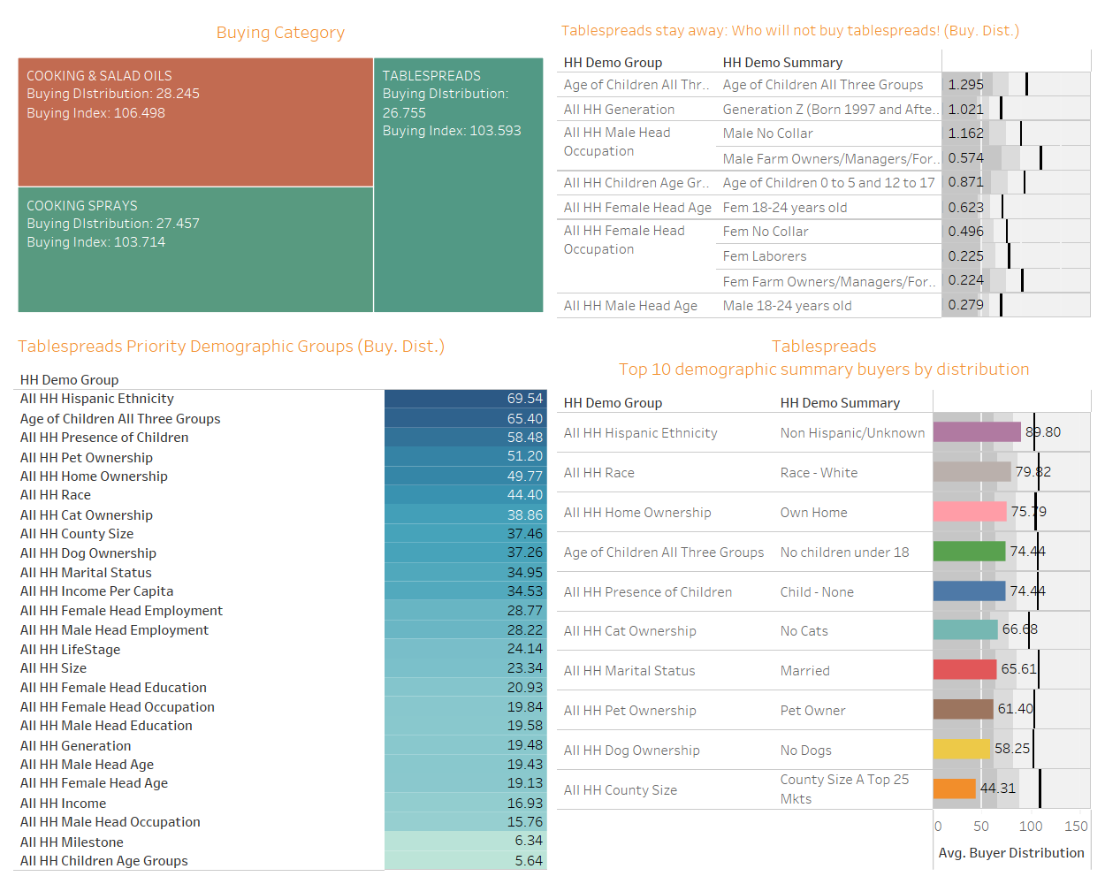
Buying Distribution and Buying Index Tablespreads: Which demographics to focus or avoid?
Buying Distribution and Buying Index
Category
On average all categories show similar buying index by population, and a slightly more buyers on Cooking & Salad Oils.
How to choose which demographics to focus for Tablespreads
Focus priority demographic groups:
On our campaigns we should focus on Hispanic ethnicity, children’s age groups (No children under 18), pet ownership, home ownership, race, cat ownership and county size.
income level does not seem a very strong attribute for buyers.
As important to know: Where not to focus?
Among age of all children group we should spend less focus on Gen Z, Male 18-24 years old, Female 18-24 years old, Female Head occupation.
Subgroups to focus:
Non-Hispanic, white, married, home owner, no children or grownup childrens, per owner but neither cats nor dogs and who lives in County Size A Top 25 Markets.

Slide 36
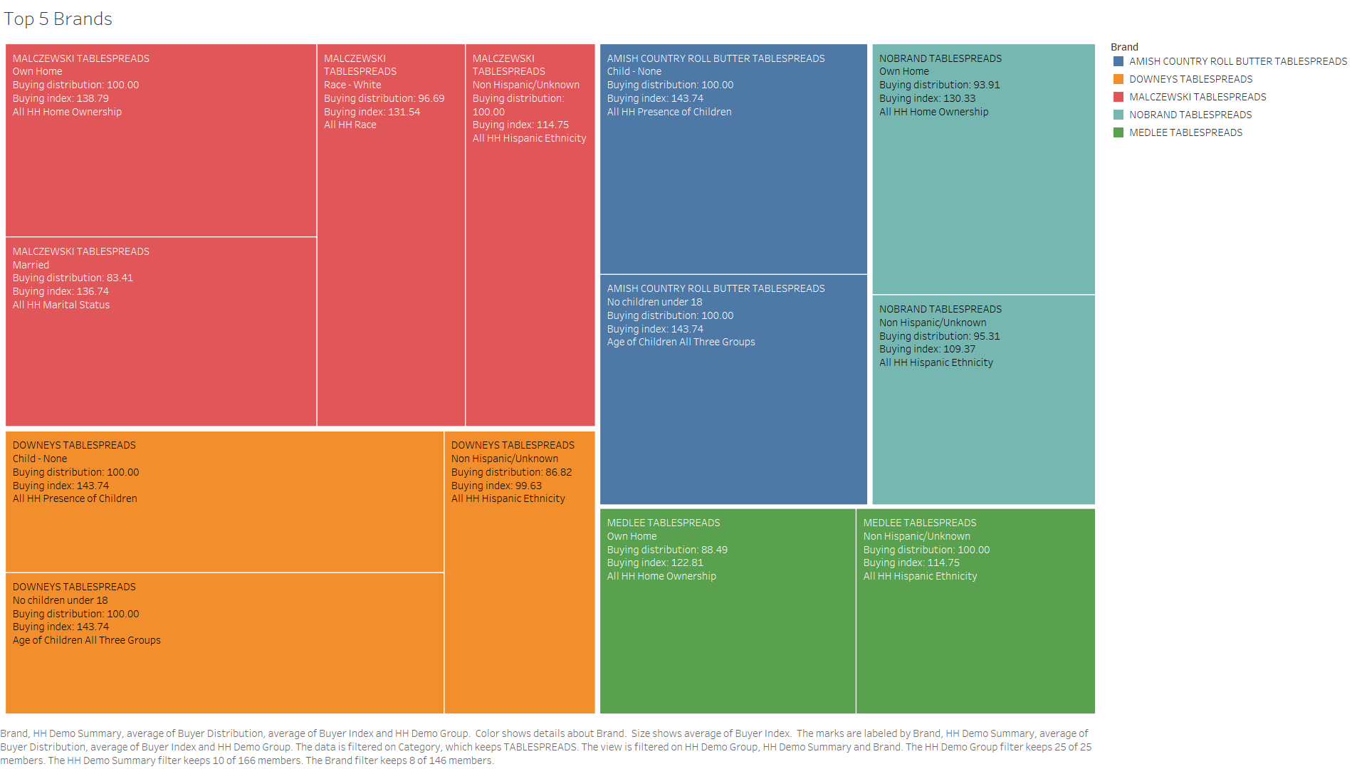
Tablespreads: Strongest Competitors (by Buying Distribution)
Where do top 5 competitors focus for Tablespreads market?
Malczewski Tablespreads: Malczewski seems focusing on exactly where we recommend to focus: White or Non-Hispanic, home owner and married.
Amish Country: Amish is popular among population especially with no children or with grown-up children.
Downeys Tablespreads: Non-Hispanic with either no children or grown-up children.
Medlee Tablespreads: Non-Hispanic home owners.
One interesting fact that in this category of Tablespreads having Nobrand among top 5 brands indicate that in this category brand loyalty can be fragile.

Slide 37
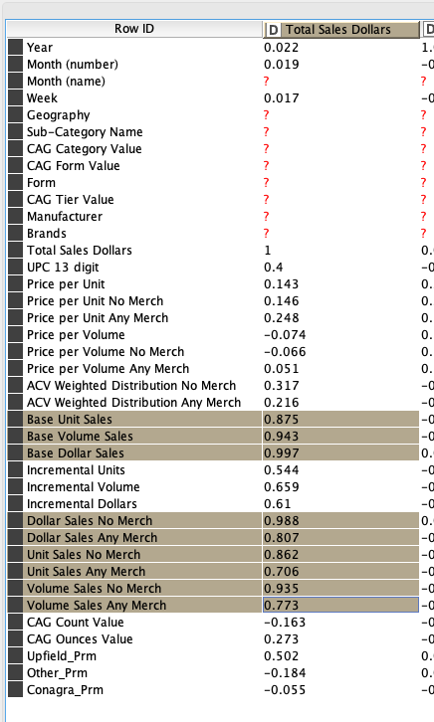
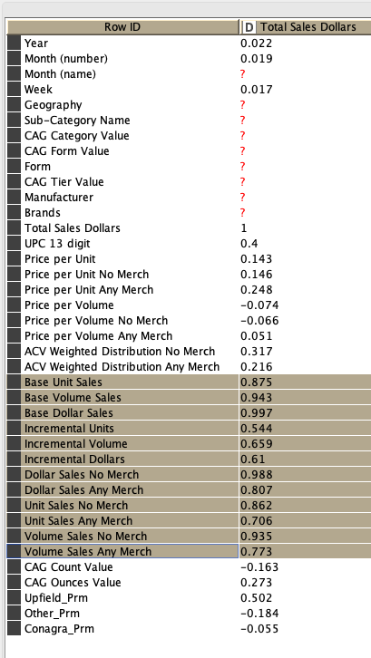
How does correlation help in feature selection?
Features with high correlation are more linearly dependent and hence have almost the same effect on the dependent variable. So, when two features have high correlation, we can drop one of the two features.

