Slide 1
GAME THEORY PROJECT · SECTION C
Game-Theoretic Analysis of EV Charging Station Competition
A two-player pricing game: payoff matrix, best responses, Nash equilibrium
Aditya Raj Jain · 2427030117
Arnav Khandelwal · 242703019
Pranav Chauhan · 2427030220
Khushi Yadav · 2427030186
Notes:
Introduce the team and the topic: we model how two EV charging stations choose prices when each one's profit depends on the other's choice.

Slide 2
PROBLEM STATEMENT
Why EV charging stations face a pricing trade-off
• Two charging stations serve the same drivers and each sets a price per kWh.
• A higher price earns more on every kWh sold…
• …but drivers move to the cheaper station, so it sells fewer kWh.
• Each station's best price therefore depends on the rival's price.
• That interdependence is what game theory analyses.
Margin per kWh
Low: ₹10 − ₹6 = ₹4
High: ₹12 − ₹6 = ₹6
Market share
Equal prices: 50% each
Cheaper: 80% · dearer: 20%
2 / 10
Notes:
Explain the trade-off with the margins: High earns ₹6 per kWh instead of ₹4, but if the rival is cheaper you keep only 20% of the market.

Slide 3
OBJECTIVES AND SCOPE
What the model sets out to establish
Research question: which prices will competing stations choose, and how does that compare with the prices that maximise their combined profit?
• Formulate the competition as a 2-player, 2-strategy simultaneous game.
• Derive every payoff from a demand-allocation and profit model, in code.
• Compute best responses and all pure-strategy Nash equilibria algorithmically.
• Compare the equilibrium with joint-profit maximisation; test the Prisoner's Dilemma conditions.
• Re-solve the game across parameter ranges and present it in an interactive website.
• Scope: an illustrative model with assumed prices and costs, not an empirical forecast.
3 / 10
Notes:
State the research question clearly. Emphasise that the numbers are illustrative assumptions.

Slide 4
GAME-THEORY FORMULATION
Players, strategies and game type
Players | Station A, Station B
Strategies | Low (₹10/kWh) or High (₹12/kWh)
Payoff | Profit = (price − cost) × energy sold
Timing | Simultaneous: each chooses without seeing the other
Type | Non-cooperative, finite, normal-form, complete information
4 / 10
Notes:
Walk through each row. Non-cooperative means no binding agreements; simultaneous means neither station observes the other's price before choosing.

Slide 5
MATHEMATICAL MODEL
Demand allocation and profit equations
s_A = 0.5 if p_A = p_B
s_A = q if p_A < p_B
s_A = 1 − q if p_A > p_B
E_A = D · s_A E_B = D · (1 − s_A)
π_A = (p_A − c_A) · E_A
π_B = (p_B − c_B) · E_B
• D = 1,000 kWh (fixed)
• p_L = ₹10, p_H = ₹12
• c_A = c_B = ₹6/kWh
• q = 80% to the cheaper station
• No fixed costs, capacity or queues
5 / 10
Notes:
Worked example, Low/High: A gets 80% of 1,000 = 800 kWh and earns (10−6)×800 = ₹3,200; B gets 200 kWh and earns ₹1,200.

Slide 6
PAYOFF MATRIX
Four outcomes, computed from the formulas
A \ B | B: Low (₹10) | B: High (₹12)
A: Low (₹10) | (₹2,000, ₹2,000) Nash equilibrium | (₹3,200, ₹1,200)
A: High (₹12) | (₹1,200, ₹3,200) | (₹3,000, ₹3,000) ★ max joint profit
• If B plays Low, A's best reply is Low (₹2,000 vs ₹1,200).
• If B plays High, A's best reply is Low (₹3,200 vs ₹3,000).
• The game is symmetric, so B's best replies mirror A's.
Cells show (Profit A, Profit B).
6 / 10
Notes:
Read one cell aloud. Then show that whatever B does, Low gives A more profit: a dominant strategy.

Slide 7
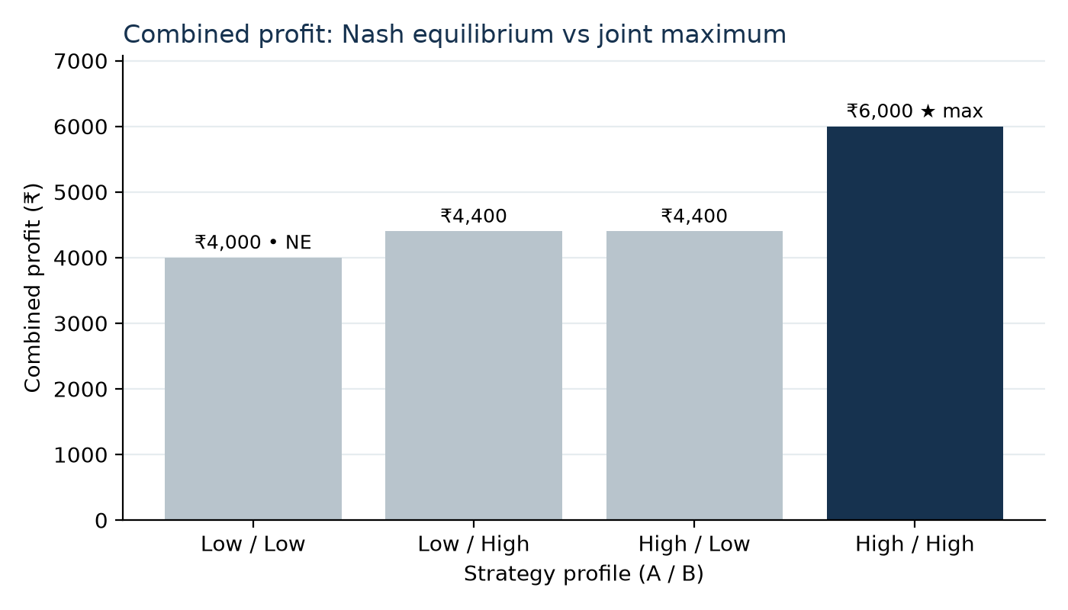
NASH EQUILIBRIUM
Why (Low, Low) is the unique equilibrium
• Low is strictly dominant for both stations, so (Low, Low) is the unique pure Nash equilibrium.
• At equilibrium each earns ₹2,000; switching alone to High drops profit to ₹1,200.
• High/High would give ₹3,000 each (₹6,000 combined) but is unstable: undercutting earns ₹3,200.
• T > R > P > S: ₹3,200 > ₹3,000 > ₹2,000 > ₹1,200, a Prisoner's Dilemma.
• No interior mixed equilibrium: the indifference formula gives q* = -0.33, outside [0, 1].
7 / 10
Notes:
Key viva point: the Nash equilibrium is stable against one-player deviations; the joint maximum High/High is not. The firms forgo ₹2,000 of combined profit, while drivers pay less.

Slide 8
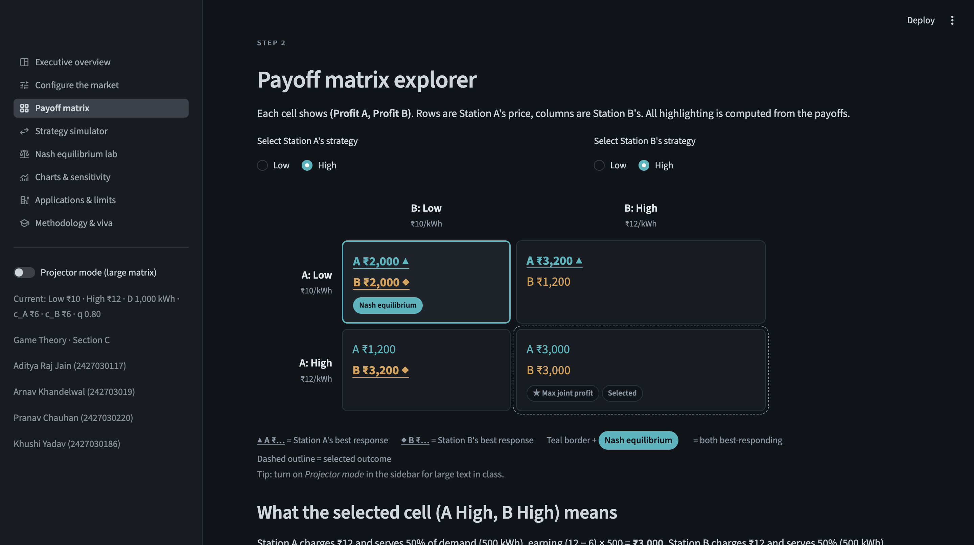
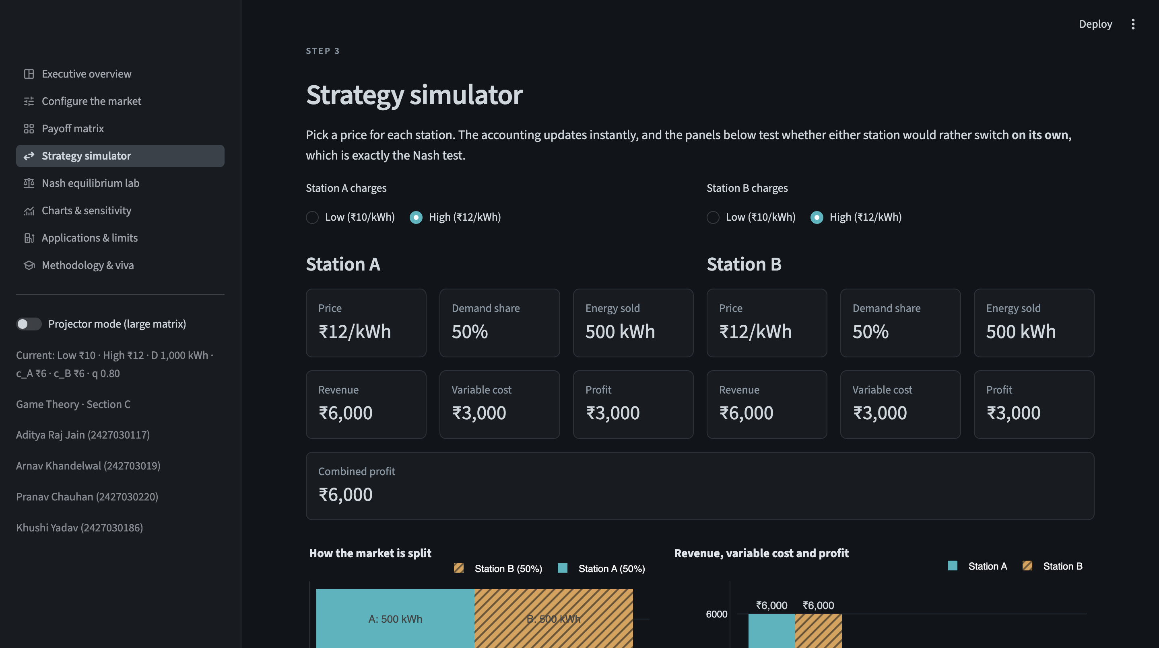
WEBSITE AND IMPLEMENTATION
Interactive Streamlit dashboard
game_theory.py: model, best responses, Nash search, PD check, mixed strategies, sensitivity
app.py + visualizations.py: 8 pages in Streamlit and Plotly · pytest suite on the model
Run locally: streamlit run app.py
8 / 10
Notes:
Live demo: on Configure, set q to 0.70 and show two equilibria appear; then show the simulator's unilateral-deviation panels.

Slide 9
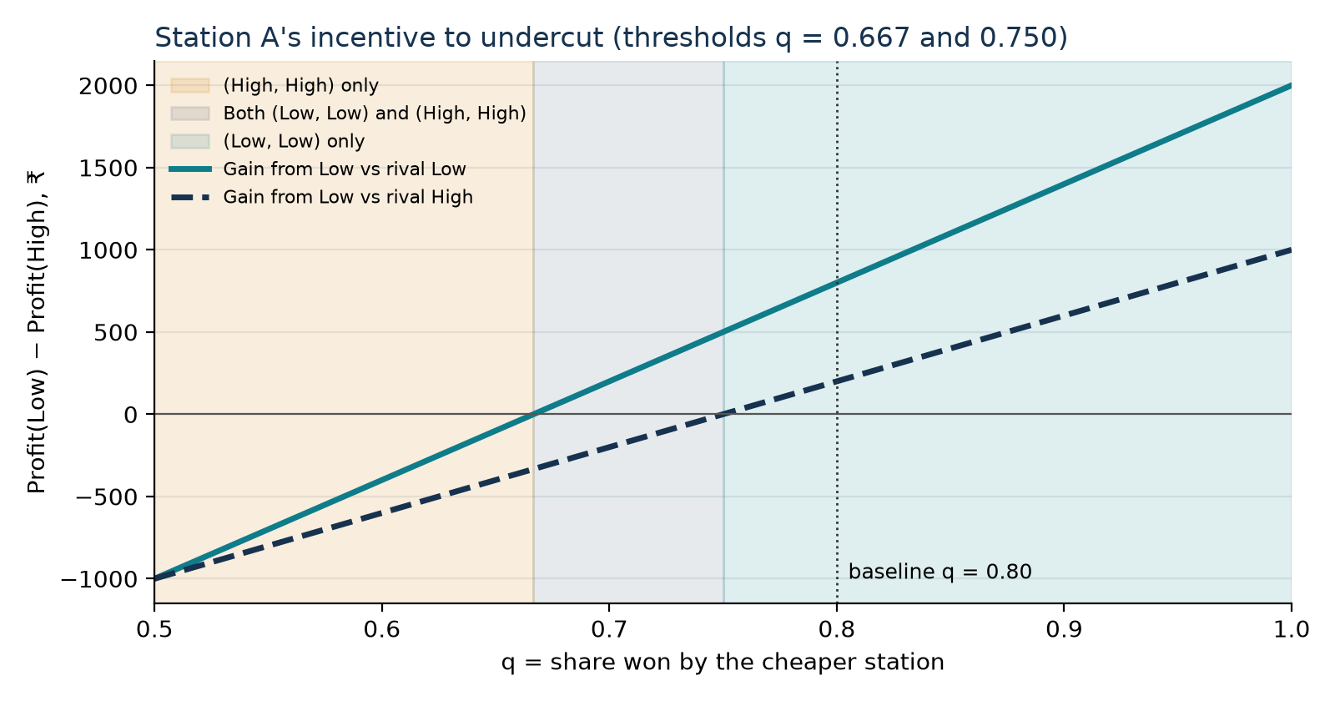
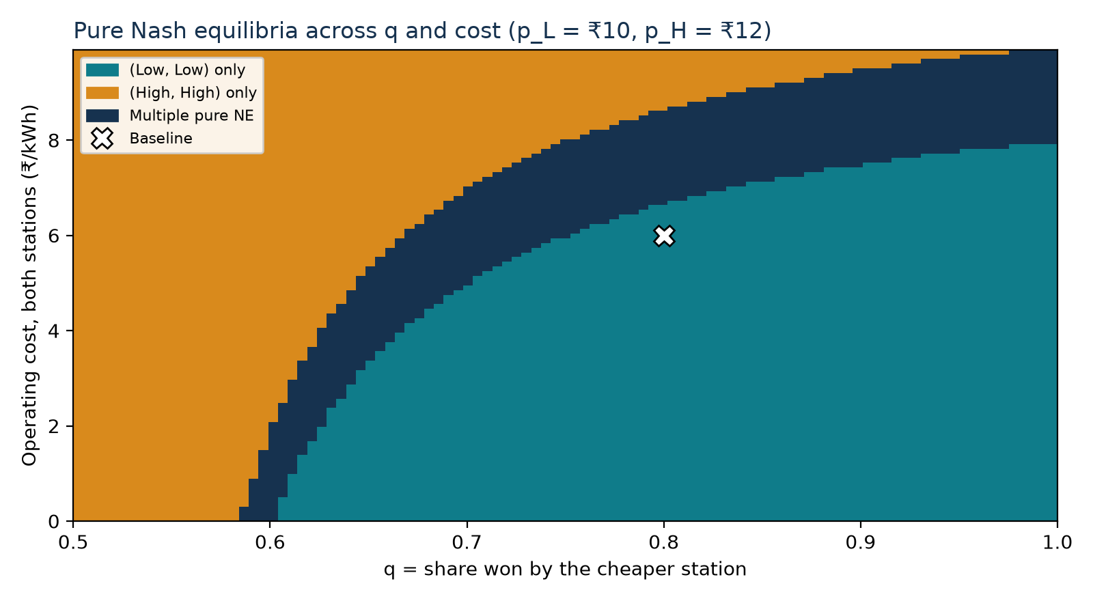
RESULTS AND SENSITIVITY
How the outcome changes with q and cost
q > 0.75: Low dominant, (Low, Low) unique, Prisoner's Dilemma. 0.667 < q < 0.75: two pure equilibria. q < 0.667: (High, High).
Applications: pricing strategy for charging operators, understanding price wars, individual vs joint profit.
Limitation: illustrative parameters, fixed demand, two price levels; not an empirical prediction.
9 / 10
Notes:
Undercutting only pays when it wins enough extra customers. The heatmap shows the same idea when costs change: lower costs make the low price's margin relatively larger.

Slide 10
CONCLUSION AND FUTURE SCOPE
What the model shows
• Under the baseline, competition drives both stations to the low price.
• The equilibrium is stable, yet not the joint-profit maximum: a Prisoner's Dilemma.
• Whether undercutting pays depends on driver price sensitivity (q) and on margins.
• All results are computed, tested and explorable in the dashboard.
Future scope
• Continuous prices and elastic demand
• Charging capacity and queues
• Location-based (Hotelling) competition
• Repeated game: can High/High be sustained?
• More stations and real tariff data
Answer to the research question: the stations choose (Low, Low) and earn ₹4,000 together, while (High, High) would earn ₹6,000. Individual incentives and joint profit point in different directions.
10 / 10
Notes:
Restate the research question and the answer, then invite questions.

