Slide 1
OE5450- Term Project
Panel method to find Added Mass and Radiation Damping of Heaving Buoy
Submitted by- Aditya Narayanan
Roll No- OE13S013

Slide 2
Problem Statement

Slide 3
Problem Statement

Slide 5
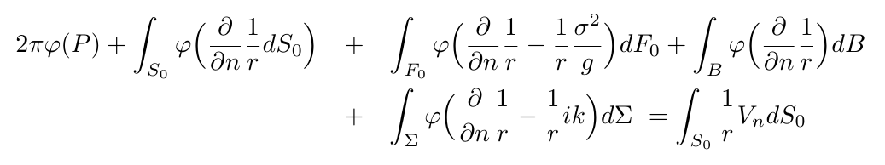
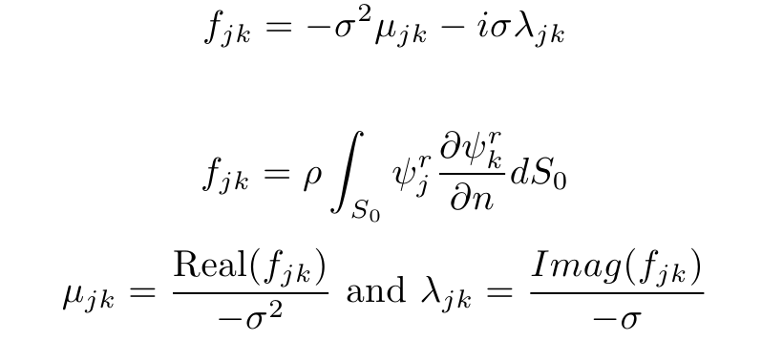
Governing Equations

Slide 6
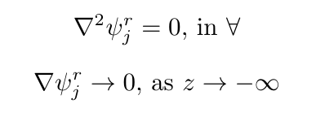


Boundary Conditions

Slide 7
n_total | n_body | sigma | mu | damping
20 | 8 | 0.628318 | 136.588 | 0.0109
500 | 200 | 0.628318 | 255.537 | -0.019652
1125 | 450 | 0.628318 | 259.343 | 0.123192
1475 | 800 | 0.628318 | 261.899 | 0.121553
3125 | 1250 | 0.628318 | 261.469 | -0.315908
3675 | 1800 | 0.628318 | 262.183 | -0.313927
4152 | 1800 | 0.628318 | 263.062 | -0.019075
10043 | 5000 | 0.628318 | 263.985 | 0.000283
14075 | 5000 | 0.628318 | 263.359 | 0.000553
9800 | 5000 | 5.026 | 257.71 | -0.008731

