Slide 1
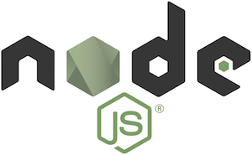
Node.Js modules and html form handling

Slide 2
What is a Module
The module is a small self-contained piece of code. You can include module using the “require” statement.
A module encapsulates related code into a single unit of code. When creating a module, this can be interpreted as moving all related functions into a file.
There are three types of modules:
1) Core Modules
2) Local Modules
3) Third-party Modules
You can use file and folder both as the module.

Slide 3


Types of Modules in Nodejs
Core modules Built-in modules of node.js that are part of nodejs and come with the Node.js installation process. To load/include this module in our program, we use he require function.
    let module = require('module_name')
Local modules are created by us locally in our Node.js application. These modules are included in our program in the same way as we include the built in module. Exports keyword is used to make properties and methods available outside the file.
Third party modules are available online and are installed using the npm. Example: express, mongoose, etc.
You can load the modules from the “node_modules” folder.
Creating local modules and exporting (sum.js)
Importing local modules
(calsum.js)
You can run the module using the node calsum.js

Slide 4
exports vs module.exports
exports and module.exports reference the same object.
But methods will be available as public when we use module.exports.
If a developer unintentionally or intentionally re-assigns module.exports to a different object or different data structure, then any properties added to the original module.exports object will be unaccessible.

Slide 5


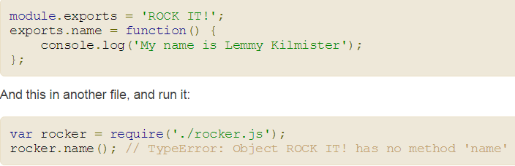
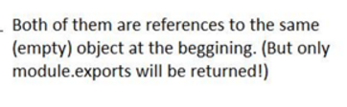
Example
Your module returns module.exports to the caller ultimately, not exports. All exports does is collect properties and attach them to module.exports if module.exports doesn't have something on it already. If there's something attached to module.exports already, everything on exports is ignored. Put the following in rocker.js
rocker.js
main.js

Slide 6
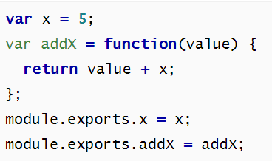

Example-1
misc.js
misc_main.js

Slide 7




Example-2
Create a folder testnodejs
Create three files module1.js,module2.js and index.js
module1.js
index.js
module2.js
Output is

Slide 8
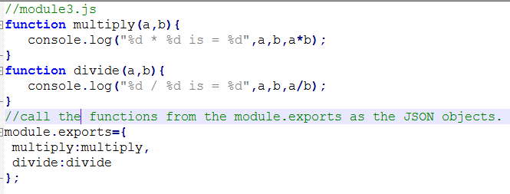


Another module to export
Example-3
module3.js
index.js
Output

Slide 9
Creating web application using Node.js
Creating a web application (to be more precise, a web server) in Node.js, you write a single JavaScript function for your entire application. This function listens to a web browser’s requests, or the requests from a mobile application consuming your API, or any other client talking to your server. When a request comes in, this function will look at the request and determine how to respond. If you visit the homepage in a web browser, for example, this function could determine that you want the homepage and it will send back some HTML. If you send a message to an API endpoint, this function could determine what you want and respond with JSON.

Slide 10
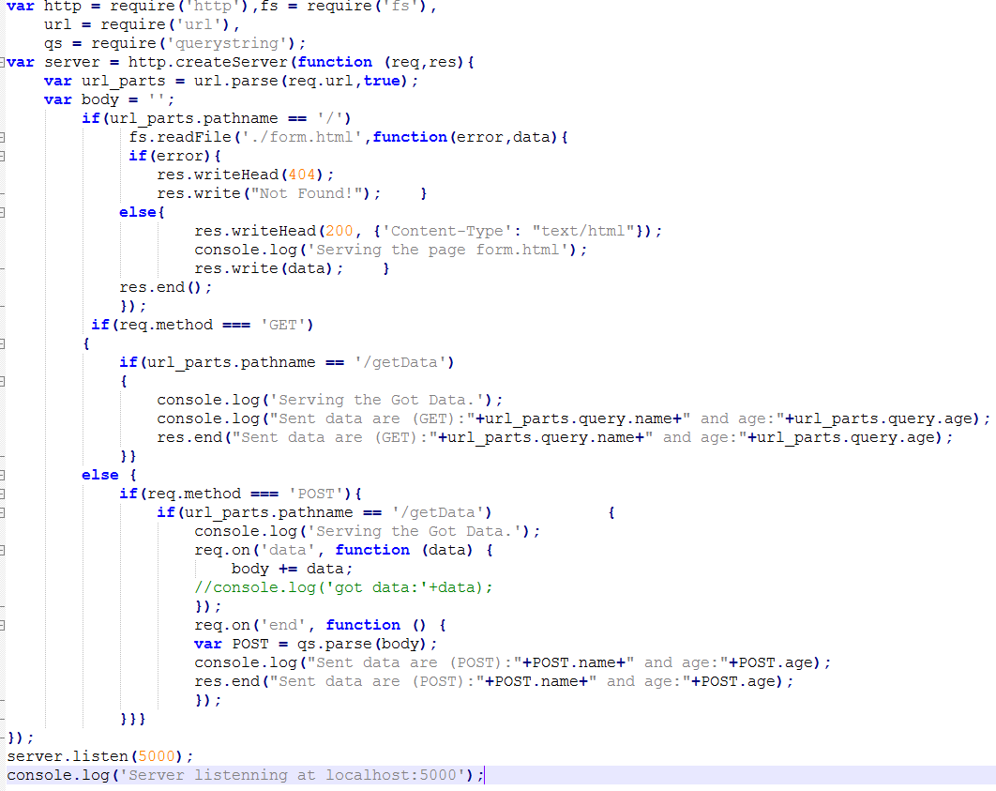
Creating an HTTP Server With a Form in Node.js
Server1.js

Slide 11
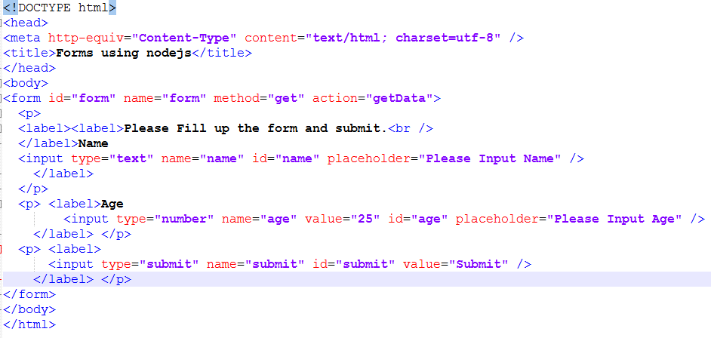
form.html
We’ll also need to create a form.html file which will contain the HTML code to render the form as shown below:

Slide 12
Anatomy of an HTTP Transaction
Any node web server application will at some point have to create a web server object. This is done by using createServer. The function that's passed in to createServer is called once for every HTTP request that's made against that server, so it's called the request handler.
When an HTTP request hits the server, node calls the request handler function with a few handy objects for dealing with the transaction, request and response.
In order to actually serve requests, the listen method needs to be called on the serverobject. In most cases, all you'll need to pass to listen is the port number you want the server to listen on.
Method, URL and Headers
  The method here will always be a normal HTTP method/verb. The url is the full URL without the server, protocol or port. For a typical URL, this means everything after and including the third forward slash. All headers are represented in lower-case only, regardless of how the client actually sent them. This simplifies the task of parsing headers for whatever purpose.

Slide 13
Request Body
When receiving a POST or PUT request, the request body might be important to your application. Getting at the body data is a little more involved than accessing request headers. The request object that's passed in to a handler implements the ReadableStream interface. This stream can be listened to or piped elsewhere just like any other stream. We can grab the data right out of the stream by listening to the stream's 'data' and 'end‘ events.
The chunk emitted in each 'data' event is a Buffer. If you know it's going to be string data, the best thing to do is collect the data in an array, then at the 'end', concatenate and stringify it.

Slide 14
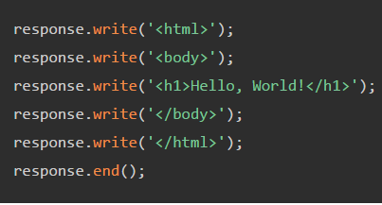
Setting Response Headers: you can explicitly write the headers to the response stream. To do this, there's a method called writeHead, which writes the status code and the headers to the stream. Once you've set the headers, you're ready to start sending response data.
Sending Response Body: Since the response object is a WritableStream, writing a response body out to the client is just a matter of using the usual stream methods.
The end function on streams can also take in some optional data to send as the last bit of data on the stream
It's important to set the status
and headers before you start
writing chunks of data to the
body, since headers come before
the body in HTTP responses.

Slide 15
About Errors
An error in the request stream presents itself by emitting an 'error' event on the stream. If you don't have a listener for that event, the error will be thrown, which could crash your Node.js program. You should therefore add an 'error' listener on your request streams, even if you just log it and continue on your way.
The response stream can also emit 'error' events.
The HTTP status code on a response will always be 200.
response.statusCode = 404; // Tell the client that the resource wasn't found.

Slide 16
fs is a built-in module in the platform for accessing file system. Using fs, we can perform CRUD operations over files and directories. It contains both synchronous and asynchronous APIs for talking to the file system. Use of asynchronous API is preferred as it will not block the event loop till the operation is completed.
In the above code we’ve created a HTTP server. readFile() is used to read the form.html file. The form.html file contains the HTML code to build the fields of a form which is meant to be displayed to the user. If we click on the “Submit” button, it’ll do a get/post request with the submitted form information to the same URL.
Here we first grab the requested url parts and then check the pathname for '/' and the page with form will be sent to client side. Now user can see the page with the form. When user fills up and submits the form then server will get the request 'http://localhost:8080/getData' and the grabbed data will be sent back to client side with a confirmation message.

Slide 17
We know Node.js is a event driven IO platform. So here we implemented the data event handler, the body variable taking all the data and finally the qs.parse() method pasres the data into different parts as the form fields. To use the qs.parse() we need to require the module named 'querystring'. Finally the data found from the POST request is sent back to the client as a confirmation.
We used the module 'querystring' to parse the data into the POST. In the POST processing code see the req.on is waiting for the data event and when the data event happens we grab the data and finally at the data event 'end' we parse the data and send back to the client side.
We can test the system for GET and POST by changing the form method to get and post.

Slide 18
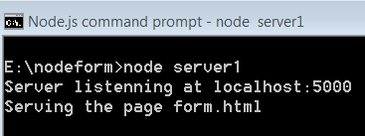
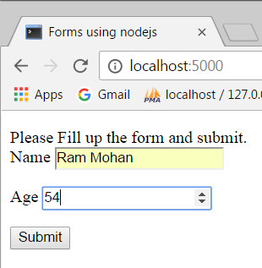
So this form will be sent to client side on client request. After filling up and successfully submission the form, the form data is grabbed and processed. The form will submitted to the getData function. Finally this will process the data and send a message.
Then, we’re starting the server at port 5000. After starting the server, if we go to localhost:5000 we should see the HTML form displayed as shown below.

Slide 19
