Slide 1

Node.js - Express Framework

Slide 2
Introduction
Express is a relatively small framework that sits on top of Node.js’s web server functionality to simplify its APIs and add helpful new features. It makes it easier to organize your application’s functionality with middleware and routing; it adds helpful utilities to Node.js’s HTTP objects; it facilitates the rendering of dynamic HTML views; it defines an easily implemented extensibility standard.
It is a fast, robust and asynchronous in nature.
It can be used to design single-page, multi-page and hybrid web applications.
It allows to setup middlewares to respond to HTTP Requests.
It defines a routing table which is used to perform different actions based on HTTP method and URL.
It allows to dynamically render HTML Pages based on passing arguments to templates.

Slide 3
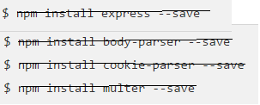

Installing Express
The above commands saves the installation locally in the node_modules directory and creates a directory express inside node_modules. You should install the following important modules along with express −
body-parser − This is a node.js middleware for handling JSON, Raw, Text and URL encoded form data.
cookie-parser − Parse Cookie header and populate req.cookies with an object keyed by the cookie names.
multer − This is a node.js middleware for handling multipart/form-data.
Note: No need to install npm packages, already available in node_modules
Notes:
No need to install npm packages, already available in node_modules

Slide 4
Writing middleware for use in Express apps
Middleware functions are functions that have access to the request object (req), the response object (res), and the next() function in the application’s request-response cycle. The next() function is a function in the Express router which, when invoked, executes the middleware succeeding the current middleware.
Middleware functions can perform the following tasks:
  Execute any code.
  Make changes to the request and the response objects.
  End the request-response cycle.
  Call the next middleware in the stack.
If the current middleware function does not end the request-response cycle, it must call next() to pass control to the next middleware function. Otherwise, the request will be left hanging.

Slide 5
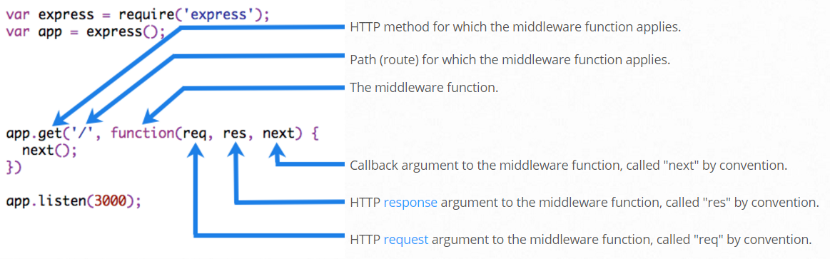
The basic syntax for the middleware functions are as follows –
app.get(path, (req, res, next) => {}, (req, res) => {})
The middle part (req,res,next)=>{} is the middleware function. Here we generally perform the actions required before the user is allowed to view the webpage or call the data and many other functions.
The following figure shows the elements of a middleware function call:
So let us create our own middleware and see its uses

Slide 6
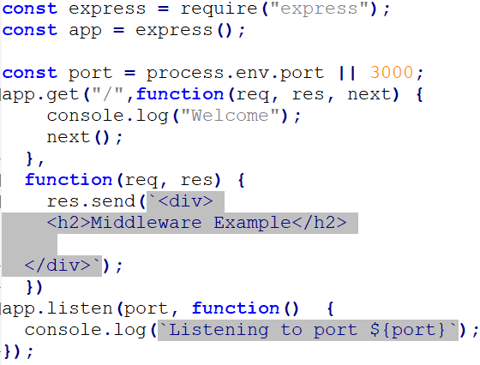
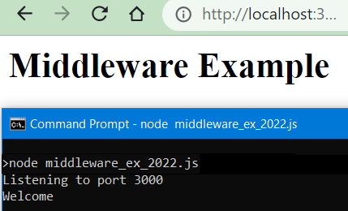
Example : Middleware
When you type http://localhost:3000
prints message “Welcome” on console from middleware function before the web page displays “Middleware Example”

Slide 7
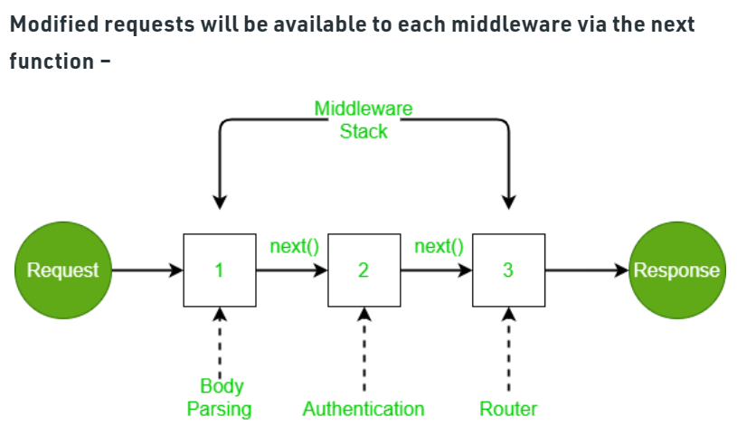
Middleware Chaining

Slide 8
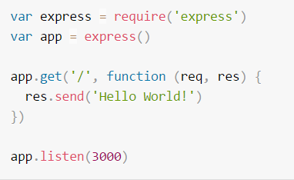
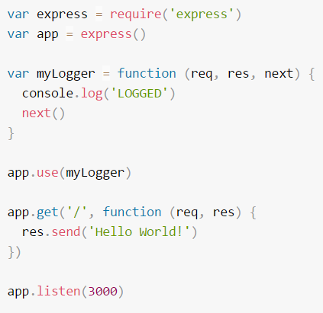
Another example with middleware
Here is an example of a simple “Hello World” Express application.
Here is a simple example of a middleware function called “myLogger”. This function just prints “LOGGED” when a request to the app passes through it. The middleware function is assigned to a variable named myLogger.
Notice the call above to next(). Calling this function invokes the next middleware function in the app.
To load the middleware function, call app.use().

Slide 9
The order of middleware loading is important: middleware functions that are loaded first are also executed first.
If myLogger is loaded after the route to the root path, the request never reaches it and the app doesn’t print “LOGGED”, because the route handler of the root path terminates the request-response cycle.
The middleware function myLogger simply prints a message, then passes on the request to the next middleware function in the stack by calling the next() function.
Next, we’ll create a middleware function called “requestTime” and add it as a property called requestTime to the request object.

Slide 10
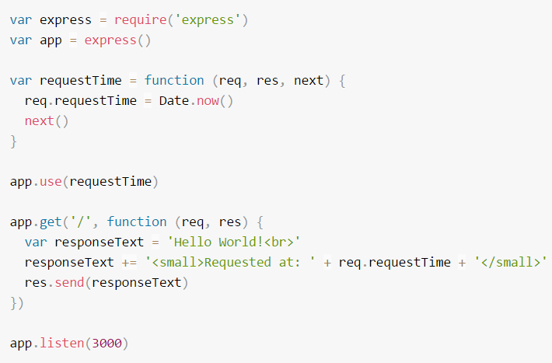
When you make a request to the root of the app, the app now displays the timestamp of your request in the browser.
Because you have access to the request object, the response object, the next middleware function in the stack, and the whole Node.js API, the possibilities with middleware functions are endless.
In the above middleware example a new function is used to invoke with every request via app.use().

Slide 11
Advantages of using middleware
Middleware is a function, just like route handlers. You can add more middleware’s above or below using the same API.
Middleware can process request objects multiple times before the server works for that request.
Middleware can be used to add logging and authentication functionality.
Middleware improves client-side rendering performance.
Middleware is used for setting some specific HTTP headers.
Middleware helps for Optimization and better performance.

Slide 12
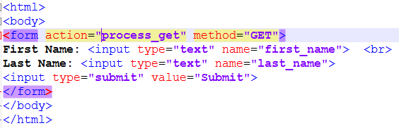
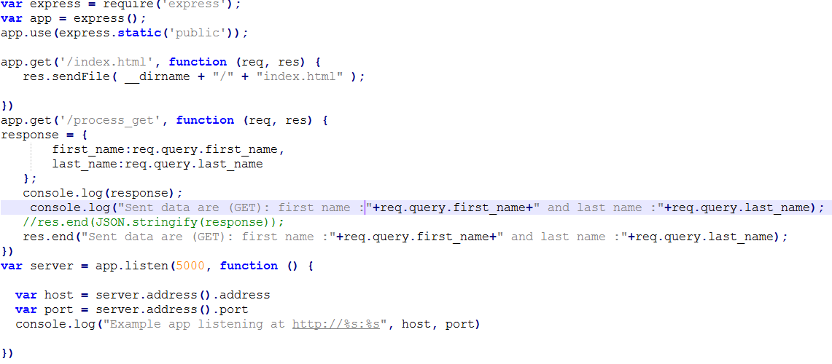
Express.js GET Method Example 1
index.html
get_ex1.js
Open the page index.html and fill the entries:

Slide 13
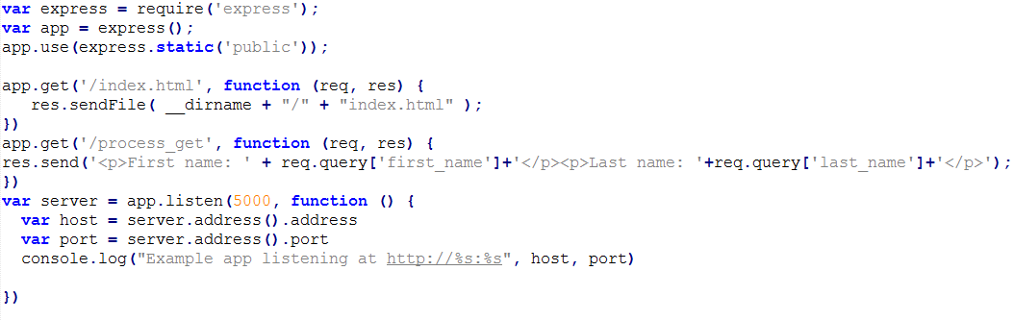
Fetch data in paragraph format
get_ex2.js

Slide 14
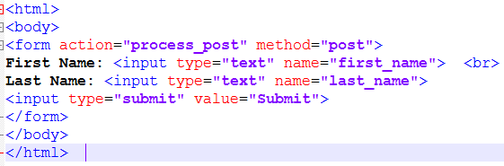
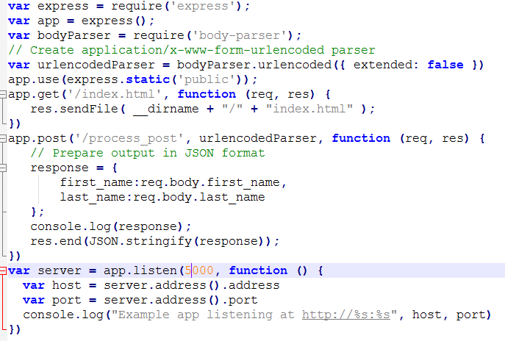
Express.js POST Method
index.html
post_ex1.js

