Slide 1
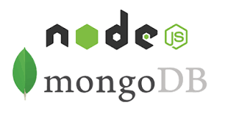
Access MongoDB in Node.js

Slide 2
Introduction to MongoDB
MongoDB is a No SQL database. It is an open-source, cross-platform, document-oriented database written in C++.
Mongo DB is developed and supported by a company named 10gen.
Main purpose to build MongoDB:
  Scalability
  Performance
  High Availability
  Scaling from single server deployments to large, complex multi-site architectures.

Slide 3
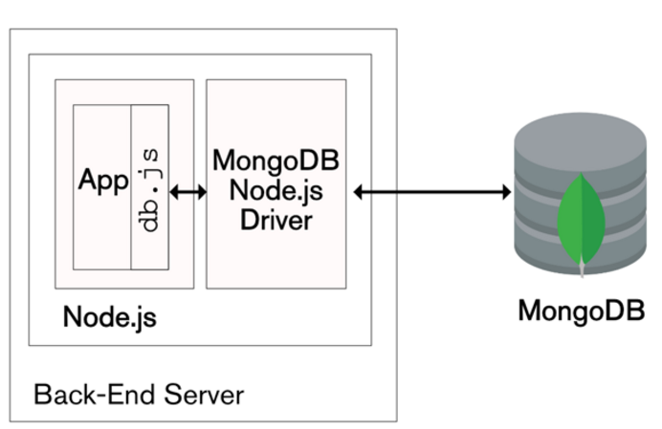

Architecture

Slide 4
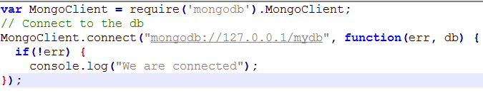
Mongodb connection
The prototype has a single property – db which stores the database connection; it's initialised to null in the constructor.
The connect() method returns the database reference if the specified database is already exists, otherwise it creates a new database.
The MongoDB driver is asynchronous (the function returns without waiting for the requested operation to complete)
The basic interaction model from the application should be:
  Connect to the database
  Perform all of the required database actions for the current request
  Disconnect from the database

Slide 5

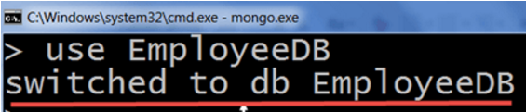

Create database
There is no create database command in MongoDB. Actually, MongoDB do not provide any command to create database.
Don't need to mention what you want to create, it will be automatically created at the time you save the value into the defined collection.
If there is no existing database, the following command is used to create a new database.
To check the database list, use the command

Slide 6
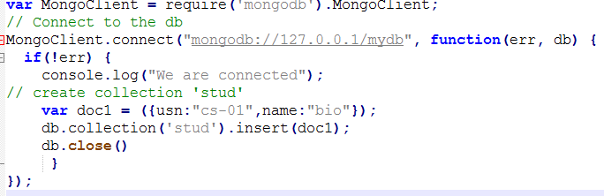

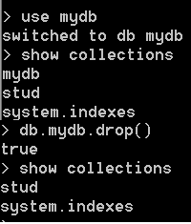
MongoDB Collections
In MongoDB, db.createCollection(name, options) is used to create collection. But usually you no need to create collection. MongoDB creates collection automatically when you insert some documents.
To check the created collection
To drop collection

Slide 7
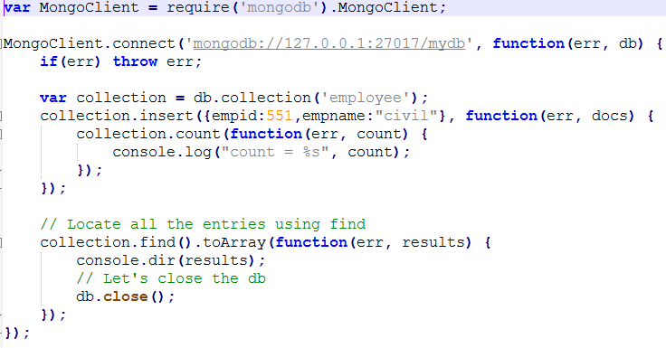
Node.js script to Insert and Display monogDB documents

Slide 8
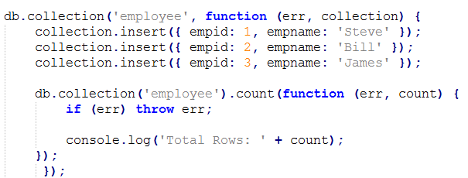
Node.js script to Insert and Count monogDB documents
In the above example, db.collection() method creates or gets the reference of the specified collection. Collection is similar to table in relational database. We created a collection called employee in the above example and insert three documents (rows) in it. After that, we display the count of total documents stored in the collection.

Slide 9
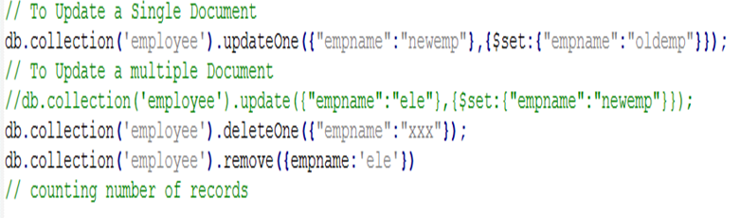
Node.js script to Update/Delete monogDB documents

Slide 10
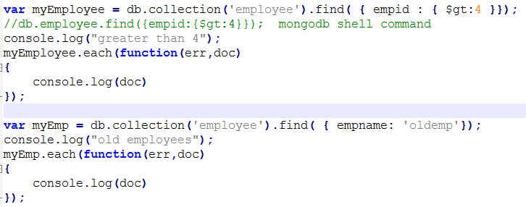
Node.js script to Search monogDB documents

Slide 11
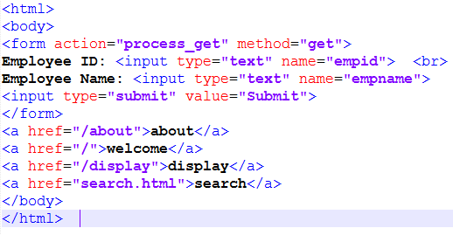
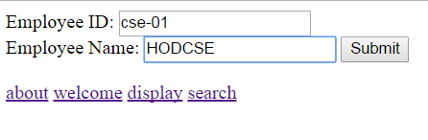

Building a Simple CRUD web Application with Express and MongoDB
index.html

Slide 12
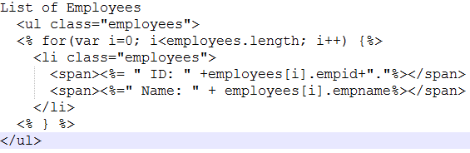
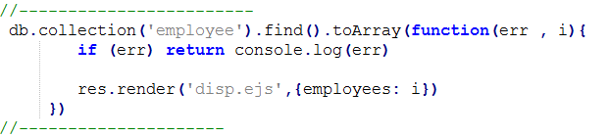
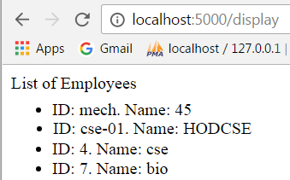
Display using Embedded js
Create ‘disp.ejs’ in ‘views ‘ folder
disp.ejs

Slide 13
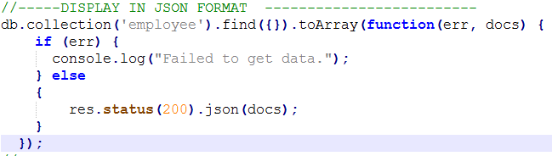
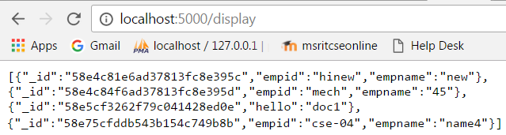
Display in JSON format

Slide 14
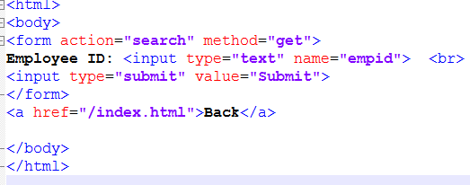
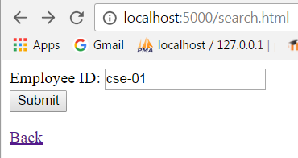
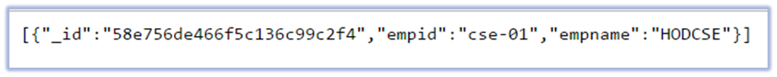
Search module
search.html
Search and display the result in JSON format

