Slide 1

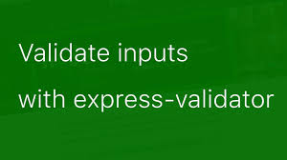
Node.js - Express Framework

Slide 2


Data Validation
Express itself doesn't provide any specific support for form handling operations, but it can use middleware to process POST and GET parameters from the form, and to validate their values.
import the express-validator module after the other modules.
checkBody(parameter, message): Specifies a body (POST) parameter to validate along with a message to be displayed if it fails the tests. The validation criteria are daisy chained to the checkBody() method. For example, the first check below will test that the "name" parameter is alphanumeric and set an error message "Invalid name" if it is not. The second test checks that the age parameter has an integer value.

Slide 3
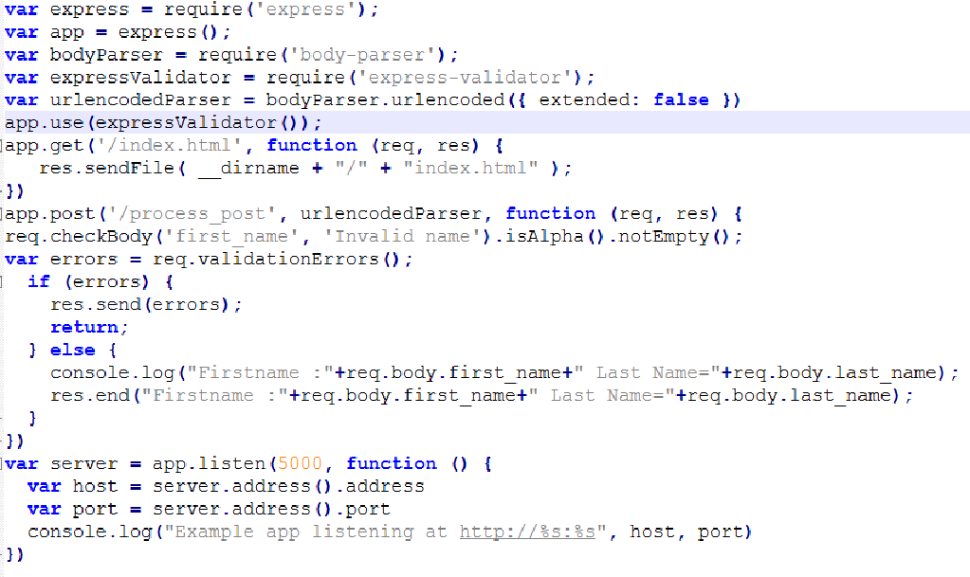
validation_ex.js

Slide 4
Express.js Routing
Routers are simply an endpoint of a server.
It is used to determine the specific behavior of an application. It specifies how an application responds to a client request to a particular route, URI or path and a specific HTTP request method (GET, POST, etc.). It can handle different types of HTTP requests.
  http://localhost:3000/Books
  http://localhost:3000/Students
In the above example, Books and Students are routes. If a GET request is made for the first URL, then the response should ideally be a list of books. If the GET request is made for the second URL, then the response should ideally be a list of Students.
So based on the URL which is accessed, a different functionality on the web server will be invoked and accordingly the response will be sent to the client. This is the concept of routing.
Each route can have one or more handler functions, which are executed when the route is matched.

Slide 5
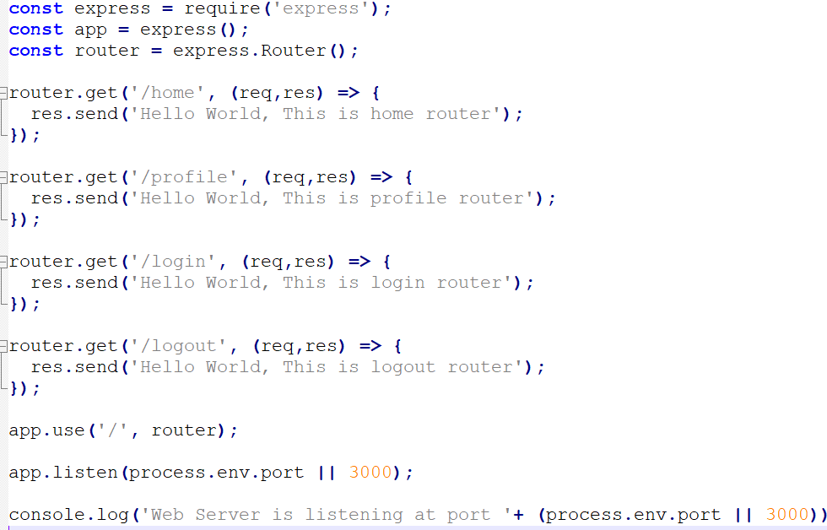
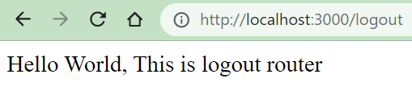
Configure Routes:
Open your browser and visit the routes

Slide 6
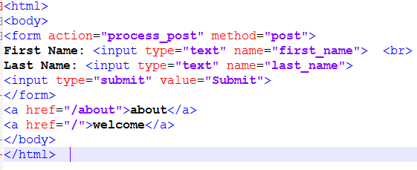
You can also handle other HTTP methods such as GET and POST
index.html

Slide 7
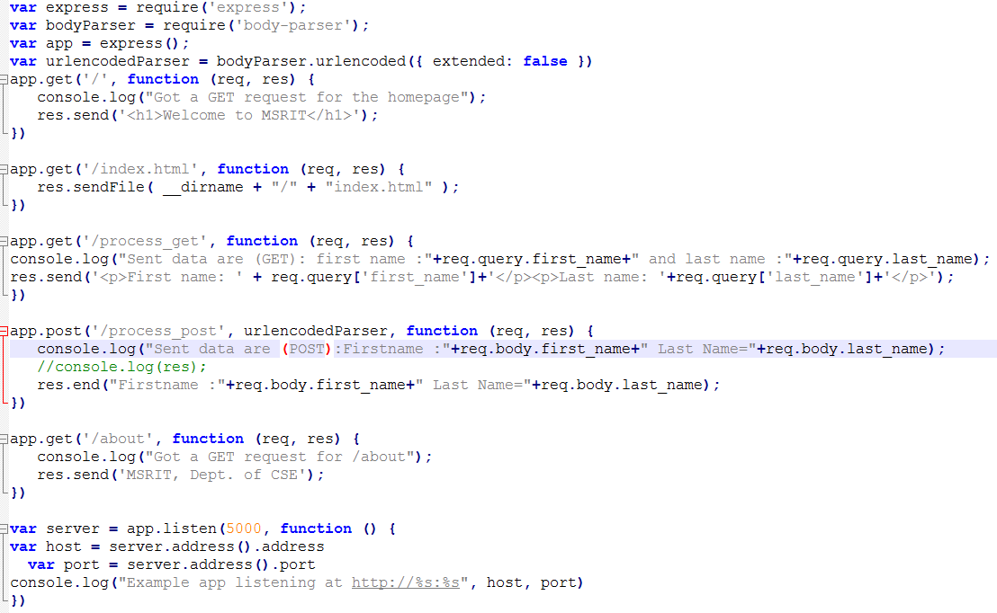
route_ex.js

