Slide 1
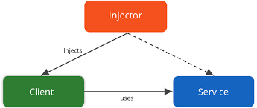
Dependency Injection Using Spring Boot

Slide 2
Inversion of Control
Inversion of Control is a principle based on which, Dependency Injection is made. Also, as the name suggests, Inversion of Control is basically used to invert different kinds of additional responsibilities of a class rather than the main responsibility.
Inversion of Control is a principle in software engineering which transfers the control of objects or portions of a program to a container or framework. We most often use it in the context of object-oriented programming.
Consider an example, wherein you have the ability to cook. According to the IoC principle, you can invert the control, so instead of you cooking food, you can just directly order from outside, wherein you receive food at your doorstep. Thus the process of food delivered to you at your doorstep is called the Inversion of Control.
You do not have to cook yourself, instead, you can order the food and let a delivery executive, deliver the food for you. In this way, you do not have to take care of the additional responsibilities and just focus on the main work.

Slide 3
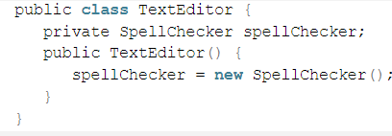
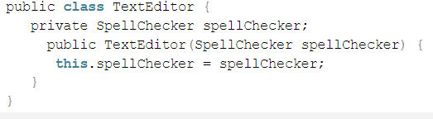
IoC : an Example
Consider an application having text editor component in which you want to add a spell checker. This is a creation of a dependency between a TextEditor and the SpellCheker.
This is the code using IoC container. The TextEditor here shouldn’t worry about the implementation of the SpellChecker. Instead, the SpellChecker should be implemented separately and should be provided to the TextEditor while doing the instantiation of the TextEditor. This process is entirely controlled by the Spring Framework.
Now after removing the entire control from the TextEditor and then keeping it somewhere else and the Dependency that is SpellChecker is injected into the TextEditor class via a Class Constructor. Therefore, the flow of control is being inverted by the Spring Dependency Injection as you have delegated the dependencies to some external system.
Another method of injecting the dependency is via Setter methods of the class TextEditor where the SpellChecker instantiation is created. This will be used for calling the setter methods to initialize the TextEditor properties.

Slide 4
What is Dependency Injection (DI)
Dependency Injection is the ability of an object to supply dependencies of another object.
It is a technique which aims to help the developer code easily by providing dependencies of another object.
The Dependency Injection Principle (DIP) is a simple – yet powerful – programming paradigm that we can use to implement well-structured, highly-decoupled, and reusable software components.
Dependency in programming is an approach where a class uses specific functionalities of another class. So, for example, If you consider two classes A and B, and say that class A uses functionalities of class B, then its implied that class A has a dependency of class B. Now, if you are coding in Java then you must know that, you have to create an instance of class B before the objects are being used by class A.

Slide 5
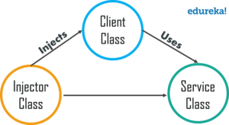
The process of creating an object for some other class and let the class directly using the dependency is called Dependency Injection.
If there is any change in objects, then DI looks into it and it should not concern the class using those objects. This way if the objects change in the future, then its DI’s responsibility to provide the appropriate objects to the class. It mainly has three classes
Client Class: This is the dependent class and is dependent on the Service class.
Service Class: This class provides a service to the client class.
Injector Class: This class is responsible for injecting the service class object into the client class
A Java class creates an instance of another class via the new operator, it cannot be used (and tested) independently from this class and this is called a hard dependency.
A framework class, usually called the dependency container, could analyze the dependencies of this class. With this analysis it is able to create an instance of the class and inject the objects into the defined dependencies, via Java reflection.
It does not rely on an instance of a certain class. This allows you to test your class in isolation, for example by using mock objects.
Mock objects (mocks/imitates) are objects which behave similar as the real object. But these mocks are not programmed; they are configured to behave in a certain predefined way. If dependency injection is used, a Java class can be tested in isolation.

Slide 6
Advantages and Disadvantages of Dependency Injection
Advantages
Loosely coupled architecture.
Separation of responsibility.
Configuration and code are separate.
A different implementation can be supplied using configuration without changing the code dependent.
Improves testability.
DI allows you to replace actual objects with mock objects. This improves testability by writing simple JUnit tests that use mock objects.
Disadvantages
It’s a bit complex to learn, and if overused can lead to management issues and other problems.
Many compile time errors are pushed to run-time.

Slide 7
Types of Dependency Injection
Dependency Injection in Spring can be done through constructors, setters or fields.
Spring recommends constructor based dependency in most cases
It is a good rule of thumb to use constructors for mandatory dependencies and setter methods or configuration methods for optional dependencies.”
Spring introduced the @Autowired annotation for dependency injection. Any of the Spring components can be autowired. These include, components, configurations, services and beans.
It’s a common pattern for controllers to be responsible for managing requests and responses while services perform business logic.
we can put the @Autowired annotation before the constructor and give Spring hints as to what the values of the constructor parameters should be

Slide 8
Libraries and Frameworks that implement DI
Spring (Java)
Google Guice (Java)
Dagger (Java and Android)
Castle Windsor (.NET)
Unity(.NET)
popular dependency injection frameworks

Slide 9
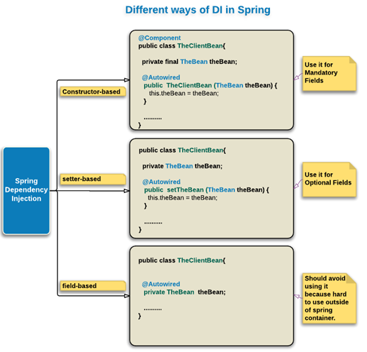
Spring Dependency Injection
There are three possible ways of DI in Spring
Constructor-based: should be used for mandatory dependencies. In constructor, we should assign constructor args to final member fields.
Setter-based: Should be used for optional dependencies.
Field-based: Spring discourages the use of this because it would possibly hide mandatory fields from outside which would otherwise be assigned in the constructor. This would take away the advantage of properly initialized POJO (Plain Old Java Object), specially if intended to use outside of Spring container. Even though, we are mostly using field based injection, we suggest the developers to always avoid using field-based DI in real project scenarios.

Slide 10
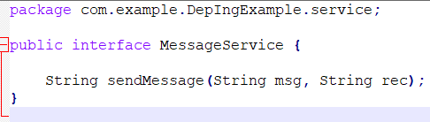
Demonstration of DI with an example
There are many ways to send a message like an email, twitter, SMS etc.
Let’s say we want to send email message and twitter message to the users. For dependency injection, we need to have a base class for the services. Implement the MessageService interface with single method declaration for sending message.
We will have actual implementation classes to send email and twitter message.

Slide 11
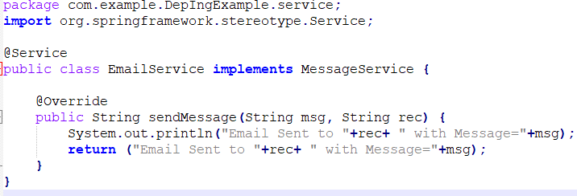
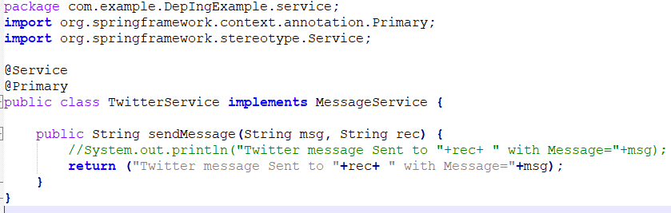
Email Service
Now that our services are ready, we can move on to Controller classes that will consume the service.
Twitter Service
Note that there are multiple implementations for the MessageService interface. So to avoid ambiguity, let's use @Primary annotation.

Slide 12
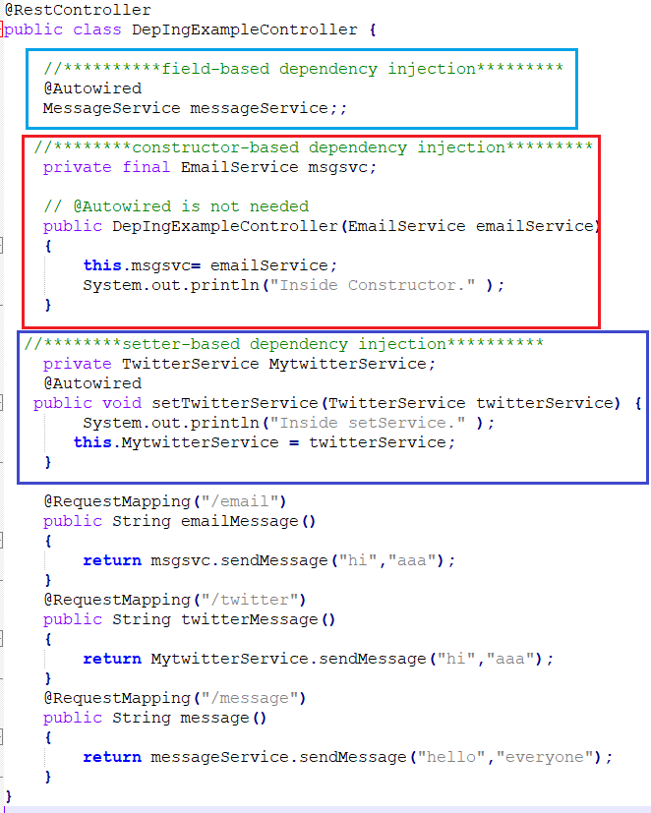
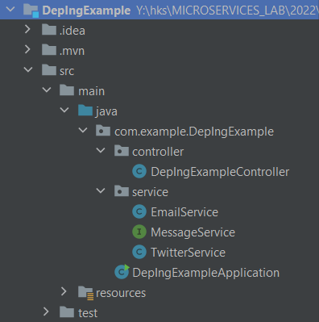
We will have a controller class with Spring annotations for autowiring
@Autowired is used to inject the dependency.
The @Service annotation makes it autowireable. Spring injects the dependency into our controller.

Slide 13
Exercise
Add SMS service for the above application and demonstrate the same.

