Slide 1

GSE 580: Seminar in Economics Presentation
“The Effect of EU-ETS Carbon-Price Shocks on Green-Energy Equity Performance and Volatility”
Aditya Rohatgi, Marco Montenegro, Jesse Mason, and Vicente Puga

Slide 2
Research Question & Motivation
Motivation:
Governments increasingly adopt carbon pricing to address climate change.
Investors increasingly integrate climate policies into asset valuations.
Crucial to understand how these policy shocks translate into market reactions, particularly for environmentally aligned (green) vs. traditional (brown) investments.
Research Question:
How do significant carbon pricing events impact returns of green (e.g., ICLN) vs. brown (e.g., XLE) ETFs?
Hypotheses:
Null: Carbon pricing events have no significant impact on ETF returns.
Alternative: Green and brown ETFs respond differently to carbon pricing shocks.

Slide 3
Data Sources & Methodologies
Data Sources:
ETF price data (daily): Yahoo Finance (2018–2024)
Green ETF: iShares Global Clean Energy ETF (ICLN)
Brown ETF: Energy Select Sector SPDR Fund (XLE)
Benchmark ETF: SPDR S&P 500 ETF (SPY)
Carbon policy events data, curated from official announcements (IMF, EU ETS, World Bank)
Gathered over 1,700 daily observations per variable, blending carbon prices, ETF returns, and the pulse of global markets (VIX, oil, stocks, T-Bill rates).
This makes the results fully reproducible and robust to bias.
Methodologies:
Event Study: Analyze returns and volatility around carbon shocks.
OLS Regression: Measure average impact of carbon shocks controlling for macro factors.
Causal Forest Analysis: Estimate heterogeneous (context-dependent) treatment effects.
Forecasting: Compare volatility forecasts (LSTM vs. GARCH).

Slide 4
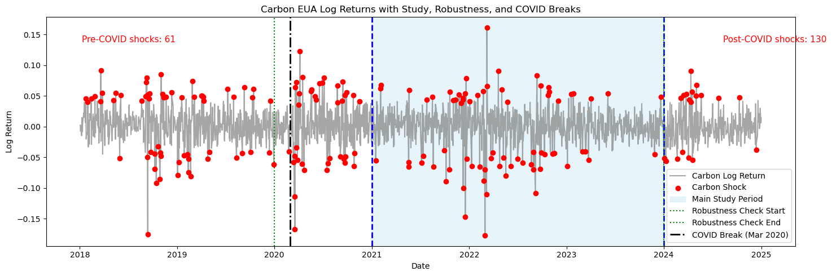
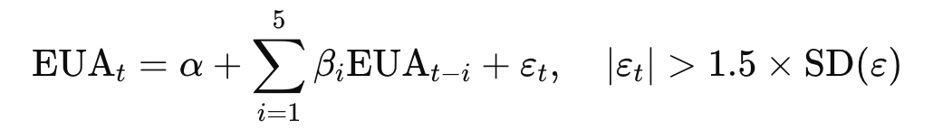
Carbon Shock Identification
Autoregressive AR(5) model to detect statistically significant carbon price shocks.
Once the model estimates daily prices, the residual tells us how "surprising" today's price is.
We define a "shock day" as any day when the residual (surprise) is larger than 1.5 times the standard deviation of all residuals.
Shock days represent significant deviations from the typical price behavior.

Slide 5
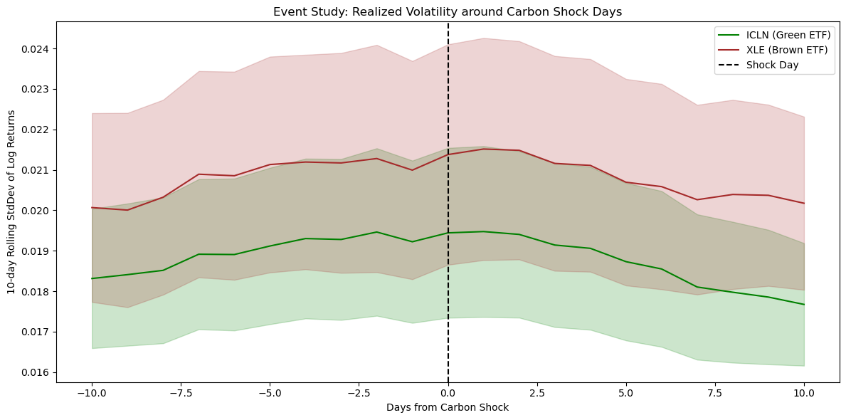
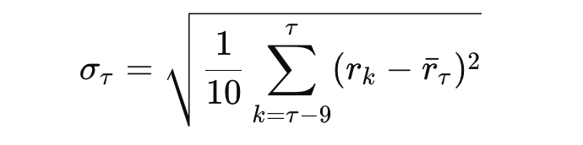
Volatility Response (Model and Event Based)
We examined volatility response around carbon shock events.
Taking the 10-day rolling standard deviation of ETF log returns centered on shock day (t=0).
Both ETFs experience volatility spikes post-shock. But XLE (Brown) volatility remains consistent, but ICLN (Green) exhibits clearer post-event response dynamics.

Slide 6
OLS Regression Analysis
To understand and quantify how much carbon shocks affect ETF returns, after adjusting for broader market conditions, we use OLS lets us isolate and measure this impact.
ETF | Coefficient (Carbon Shock) | Statistical Significance | Interpretation
ICLN (Green) | +0.20% | P<0.05 | Positive & Statistically Robust
XLE (Brown) | ~0.00% | P>0.1 | No meaningful impact detected
ICLN (Green ETF): The Coefficient +0.20 means, on average, the returns of the green ETF increase by about 0.20% on days when there is a carbon shock. And the since p < 0.05, the effect is statistically significant.
XLE (Brown ETF): The Coefficient ~0.00, indicates no measurable effect. And since p > 0.1, implying the carbon shocks have no reliable impact on brown ETF returns.
These results clearly indicate that carbon shocks systematically and significantly boost returns for green ETFs, while leaving brown ETFs unaffected.

Slide 7
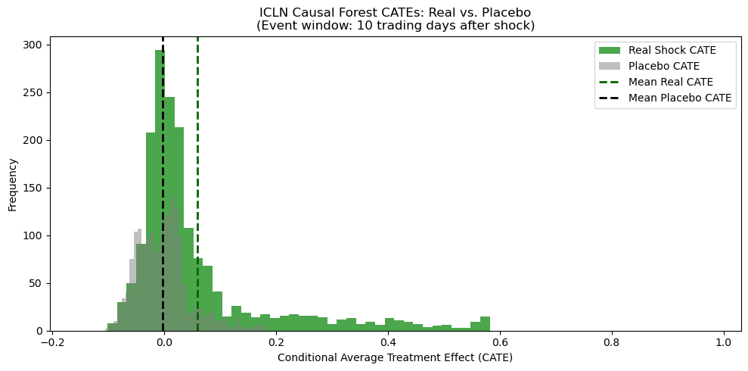
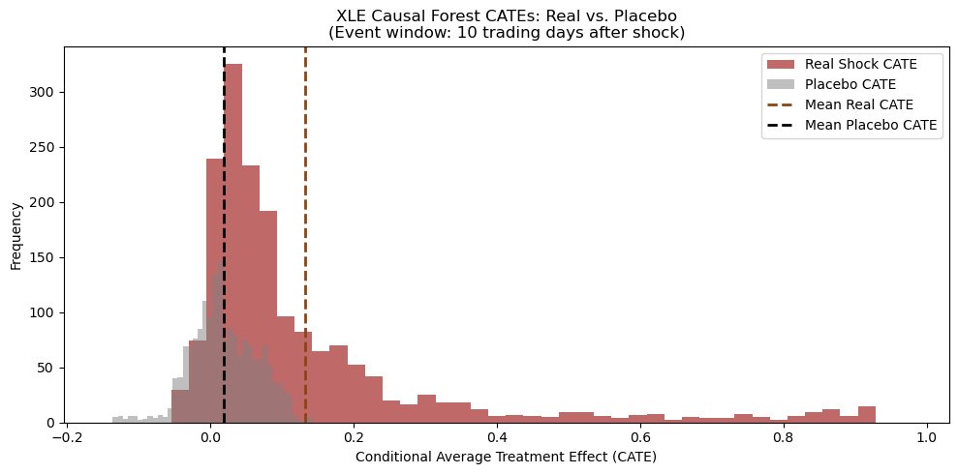
Robustness & Placebo Testing
Robustness Analysis:
Placebo Test - Randomized shocks remove the measured effect entirely—proving causal effect validity.
Bootstrap Confidence Interval:
ICLN effect robust within 95% confidence intervals.
No significant effect for XLE confirmed via bootstrapping.
Robust causal effect for ICLN; negligible for XLE across all contexts.

Slide 8

Causal Forest – Heterogeneous Treatment Effects
Traditional methods (like OLS) give us average effects but might miss important differences across different conditions.
The Causal Forest estimates what's called a Conditional Average Treatment Effect (CATE).
ICLN (Green ETF):
Positive effect observed broadly across different market conditions.
Effects especially strong in high-volatility periods.
XLE (Brown ETF):
No significant effects across any market conditions.
Causal Forest confirms no hidden or situational benefits from carbon shocks for brown ETFs.

Slide 9
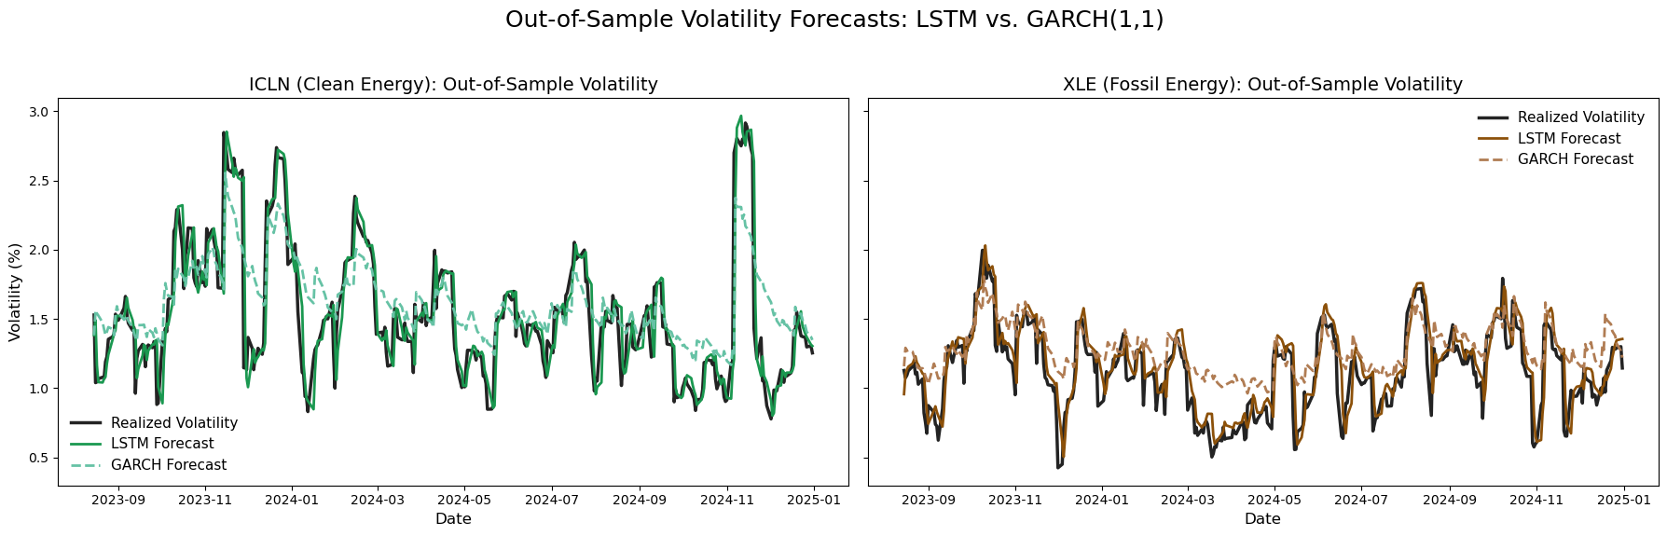

Volatility Forecasting – LSTM vs. GARCH
GARCH: A widely-used method to forecast volatility, relying primarily on past price volatility.
LSTM: A modern neural-network-based model designed to capture complex time dependencies and patterns that traditional methods may miss.
LSTM forecasts volatility by learning from historical sequences of volatility data, automatically capturing subtle relationships.
LSTM model improved volatility forecasting accuracy compared to the traditional GARCH model by approximately 13.2% (in RMSE terms) and about 14.0% (in MAE terms).

Slide 10
The Story, Implications, & Recommendations
Overall Story:
Investors are sensitive to carbon pricing policy signals and actively reallocate capital accordingly.
Positive signals strengthen valuations of climate-aligned assets while raising concerns for traditional fossil-fuel investments.
Policy and Market Implications:
Investors: Recognize policy events as critical trading signals for ESG-focused investment strategies.
Policymakers: Credible carbon policies have immediate and meaningful effects on capital markets.
Asset Managers: Can exploit policy announcement windows for strategic portfolio management.
Recommendations:
Investors: Leverage climate policy announcements for tactical ESG portfolio adjustments.
Policymakers: Communicate policy intentions clearly and credibly to facilitate efficient market transitions.

Slide 11
Limitations, Next Steps & Conclusions
Limitations:
Limited carbon event frequency restricts broader inference.
Potential confounding from macroeconomic or unrelated financial events.
ETF price movements may partially reflect broader ESG market sentiments not explicitly controlled in analysis.
Next Steps:
Expand the dataset with additional historical carbon pricing events.
Incorporate macroeconomic controls and perform longer-term market impact analyses.
Refine visualizations and comprehensive research.
Conclusions:
Financial markets are increasingly integrating climate policy risk into asset prices, suggesting growing climate-policy credibility and investor sophistication.

Slide 12
THANK YOU!

