Slide 1




SUMMER INTERNSHIP PRESENTATION
IILM UNIVERSITY GREATER NOIDA
AI-Powered B2B Sales Automation
Bonhoeffer Machines Pvt. Ltd. (Gurugram )
B.Tech CSE( AI/ML) | 2026–27 | 4CSE1 | CS-2341727
Aditya Sahani · AI & ML Intern
Notes:
1

Slide 2
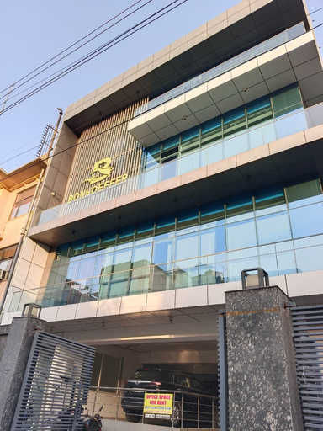
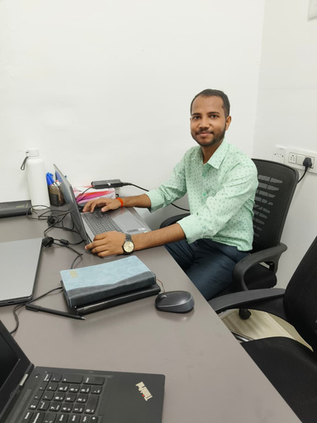

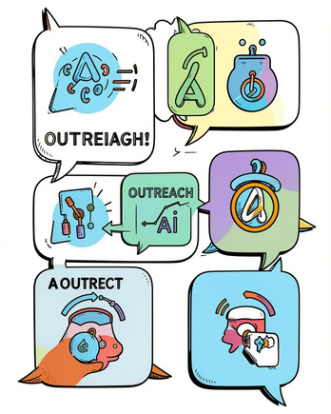

Internship Snapshot
Organization
Role
Duration
Focus
Bonhoeffer Machines Pvt. Ltd., Gurugram — industrial & agricultural power equipment
AI & ML Intern — Sales AI department (product design, engineering, deployment)
21 May 2026 — 21 Aug 2026 (3 months)
End-to-end AI sales automation: intelligence, outreach, multilingual conversational agent
Hands-on work: design, build, and deploy a production-ready international sales platform.
Notes:
2

Slide 3

Organization Profile
Bonhoeffer Machines (est. 1978) produces power equipment for farming, gardens, forestry and industry. Two operating divisions — Garden & Forestry and Hardware — manufacture products in ISO-certified facilities across Asia.
International Reach
Strategic Goal
Serves 23+ countries via 5,743+ distributors and 5.7M+ customers worldwide.
Modernize B2B sales with AI to scale international outreach and improve conversion visibility.
Notes:
3

Slide 4






The Problem — Before the Project
Manual Lead Research
Manual Outreach
Hours spent finding right contacts per company across geographies.
Each WhatsApp or email was composed and sent individually — no scale.
Scheduling Overhead
Language Barriers
Time-zone coordination and meeting setup required heavy manual effort.
Prospects spoke Spanish, Portuguese, English and Bengali — limiting reach.
No Visibility
No Follow-Up System
No unified dashboard to track conversations, campaigns, and engagement.
Non-responsive leads were frequently forgotten — no automated sequence.
Notes:
4

Slide 5




Project Objectives
1
2
3
4
Automate Prospect Discovery
Scale Multi-Channel Outreach
Multilingual Conversational Agent
Automated Follow-Ups
Enrich international leads with company and contact data automatically.
Enable WhatsApp + Email campaigns with template and language controls.
Structured, multi-stage sequences with exit-phrase detection and deduplication.
Build an AI to qualify leads, book meetings, and converse in EN/ES/PT/Bengali.
5
6
Unified CRM Visibility
Production Readiness
Central dashboard for conversations, delivery badges, campaigns and status.
Lean infrastructure and resource-optimised cron jobs for reliable operation.
Notes:
5

Slide 6
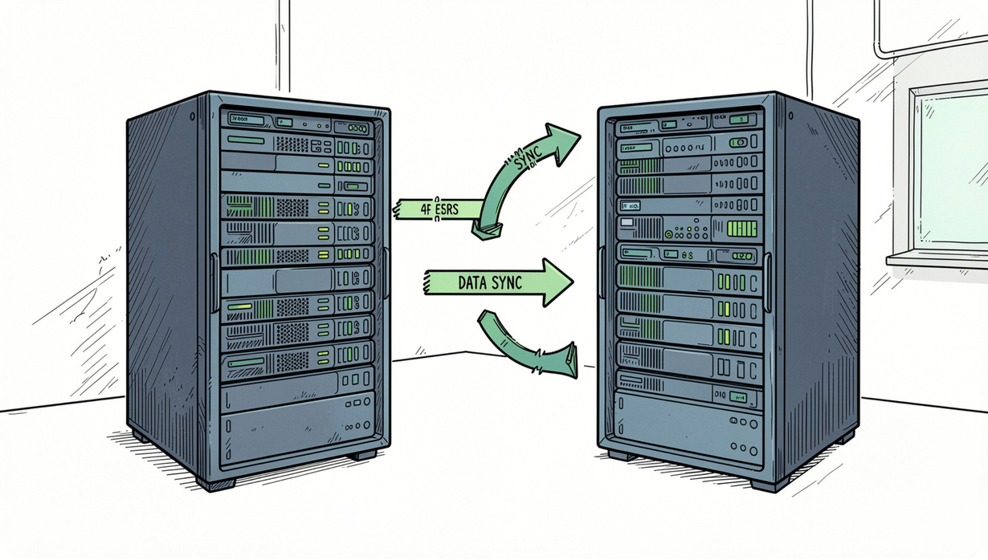
Solution Overview — Two-Server Architecture
Server 1 — Company Intelligence Platform
Features: Apollo.io enrichment, Hunter.io email verification, Serper.dev research, deduplicated store for contact data.
Server 2 — Global AI Agent Platform
Features: Dual-channel WhatsApp + Email campaigns, Valentina AI agent (conversational qualification), automated multi-stage follow-ups and unified CRM dashboard.
Data flows via enrichment-sync webhooks — asynchronous processing enables parallel lead handling at scale.
Notes:
6

Slide 7
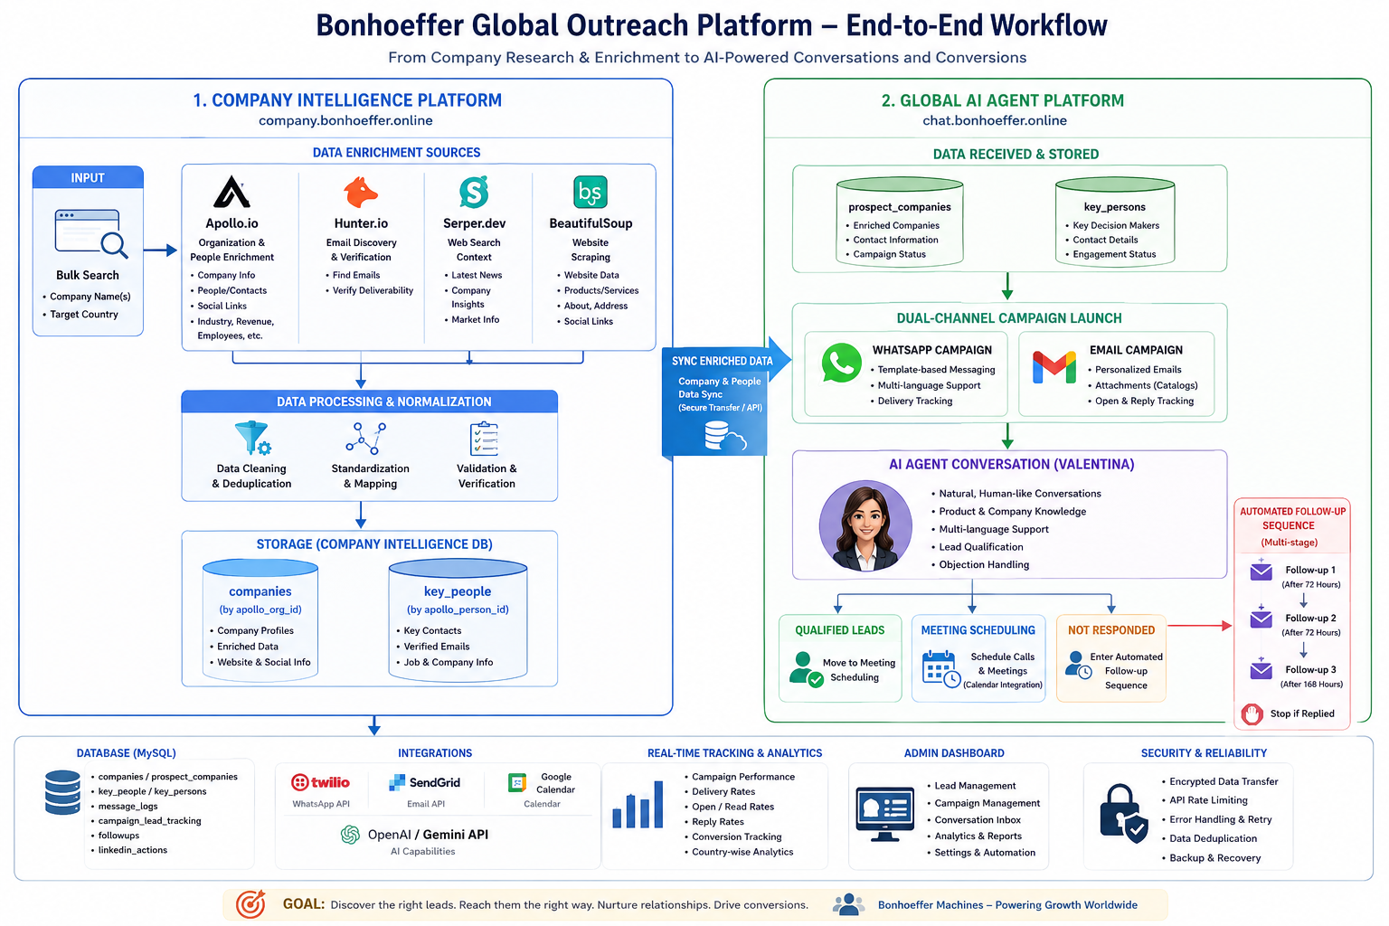

Slide 8






Technology Stack
Backend
AI Orchestration
Data & Memory
Messaging
Python 3.12, Flask, Gunicorn, VPS
Twilio WhatsApp API, Gmail SMTP/OAuth
CrewAI multi-agent orchestration, OpenAI GPT-4o / GPT-4o-mini
OpenAI embeddings, FAISS, MySQL 8.0, SQLAlchemy
Frontend
Infra
React, TypeScript, Vite, Tailwind
Ubuntu 24, Nginx, systemd - lightweight, production-focused, VPS ,ClaudPanel
Notes:
7

Slide 9

Company Intelligence Platform — Flow
Input
Apollo Enrich
Hunter Verify
Context & Store
Key innovation: webhook-driven phone verification from Apollo — enables asynchronous, parallel enrichment and large-batch processing without blocking workers.
Notes:
8

Slide 10


Global AI Agent Platform — Flow
Sync Data
Route Replies
Follow-up
Import prospects, dedupe by Apollo ID
Automated sequence if no reply
Direct responses to Valentina AI agent
Launch Campaign
Qualify & Schedule
Send WA + Email with delivery badges
AI qualifies leads and books meetings
The platform handles delivery-status badges (WA/Email combinations), deduplicates by Apollo IDs, and skips previously mess_sent leads to avoid duplicate outreach.
Notes:
9

Slide 11
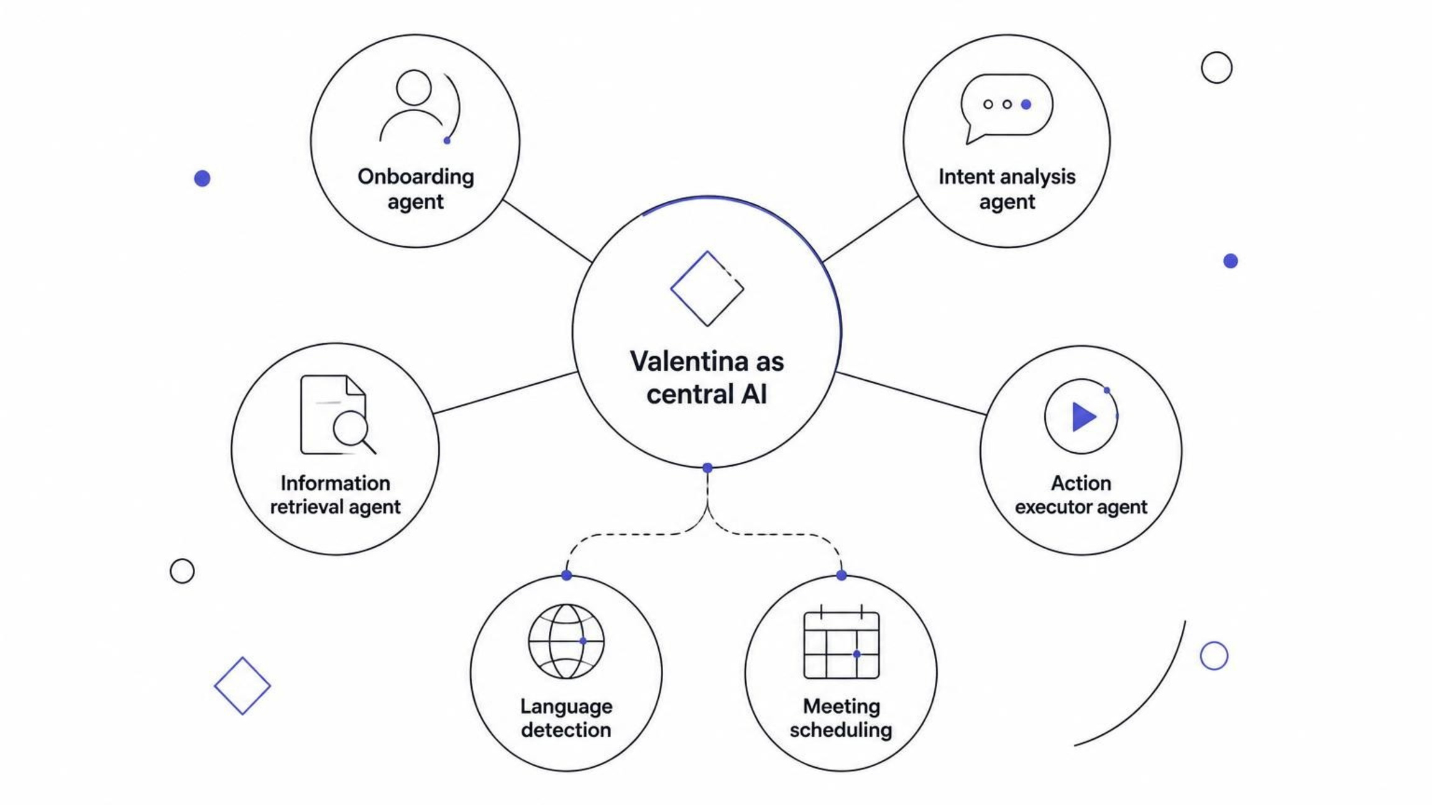
Valentina — Multi-Agent Pipeline & Impact
24/7
3
Always-on Qualification
Multilingual
AI handles leads around the clock across time zones.
English, Spanish, Portuguese supported in campaign templates and agent responses.
23+
0
Geographic Reach
Leads Forgotten
Automated outreach across 23+ target countries.
Automated sequences and exit-phrase detection ensure no lead is lost.
Operational wins: reduced per-run memory from ~500MB to ~15MB via lightweight cron jobs; webhook architecture increased parallelism for enrichment and campaign processing.
Next steps: add analytics dashboards for conversion by language & country; iterate on agent retrieval latency and fallbacks.
Notes:
10

Slide 12


THANK YOU

