Slide 1
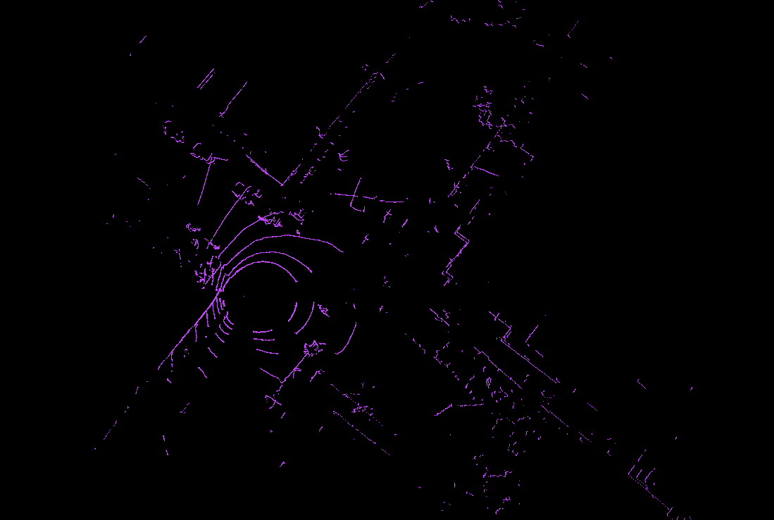
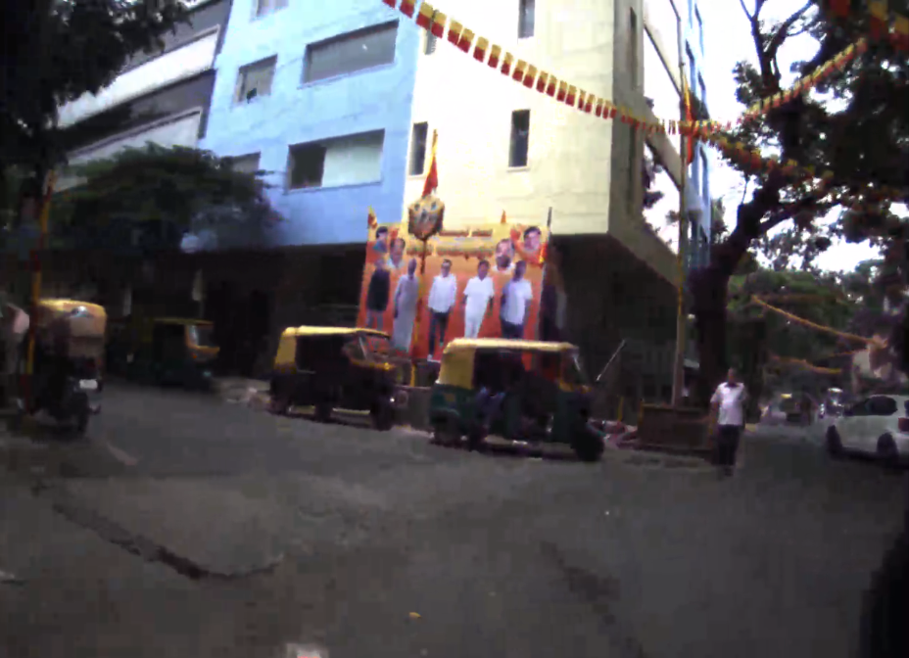
How to view point m8 clouds pcl_viewer (intersection view, start of left turn)

Slide 2
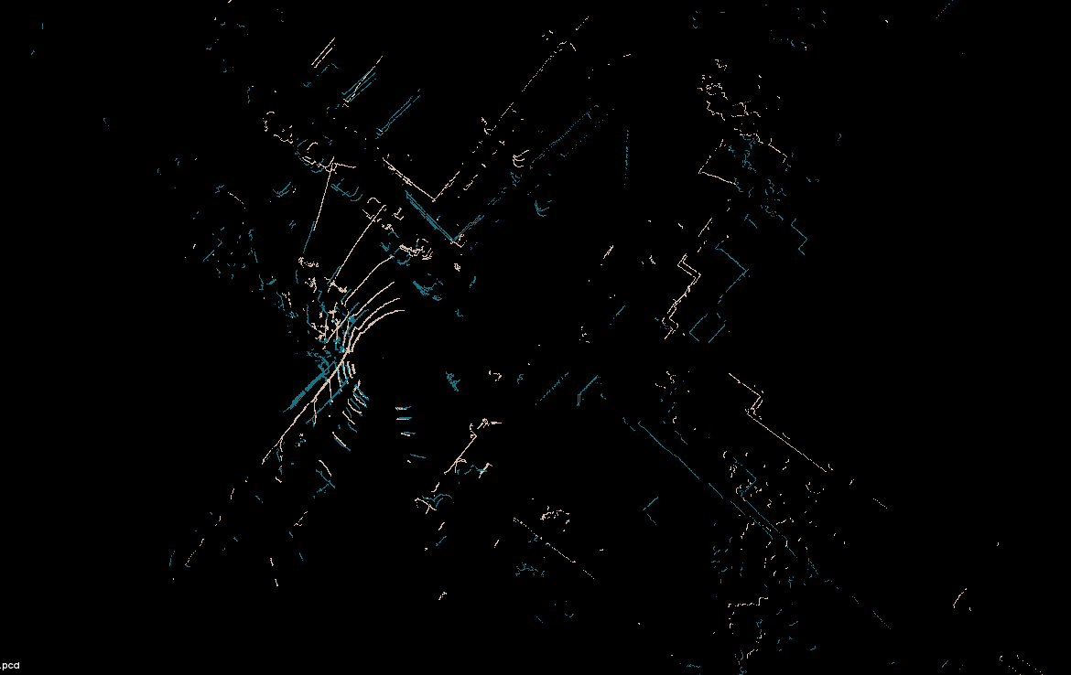
Overlay clouds (intersection 1 second apart left turn

Slide 3
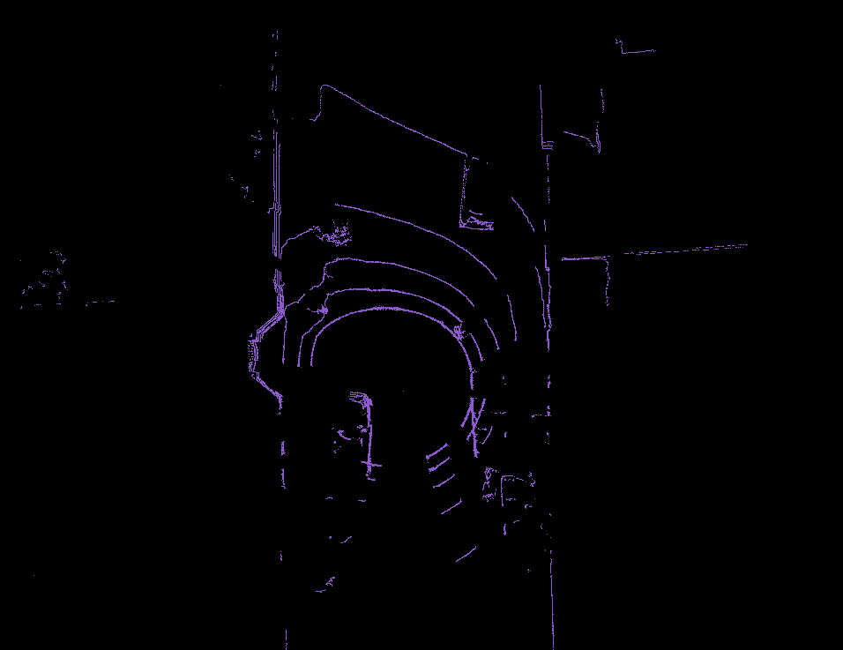
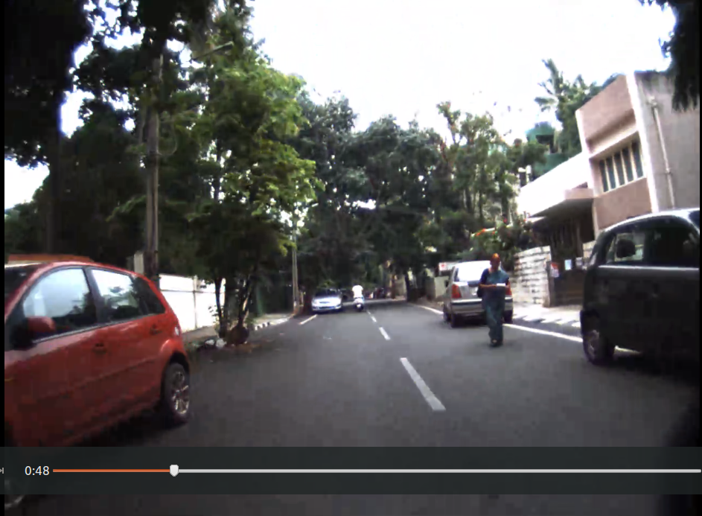
Examples of obstruction and clear road – bounding box 2.5 X 7 X 3 mts

