Slide 1
CS 215: Data Interpretation and Analysis
Sunita Sarawagi
Autumn 2024

Slide 2
What is the course about?
Suppose you want to find reliable answers to questions:
Which minor should I opt for?
What are the types of future careers that IITB graduates favor lately?
How many students seats should IITB allocate to each department?
Which products are likely to be in high demand next month?
Is rainfall in Mumbai becoming more erratic lately?
Is inflation increasing at a faster pace in recent times?
How is supply of drinking water keeping pace with increasing population?
Is a flu vaccine useful to prevent frequent cold&fever?

Slide 3
How do you find the answers?
Go by your existing vague impressions
Ask your peer group, Ask older experienced people
Do a websearch
Ask ChatGPT
…

Slide 4
The data scientists approach
Go to an authentic source that has recorded correctly the observed values over time → This is your data
Public data: World bank datasets, Datacommons, National Data Analytics platform, Stock prices
Enterprise data: Student data in universities, sales and customer interaction data in enterprises
Scientific data: experiments, simulations and observations in lab
Try to find answers from the data →How?
This course will teach you how to get answers to top-level questions from data in a scientific way.

Slide 5
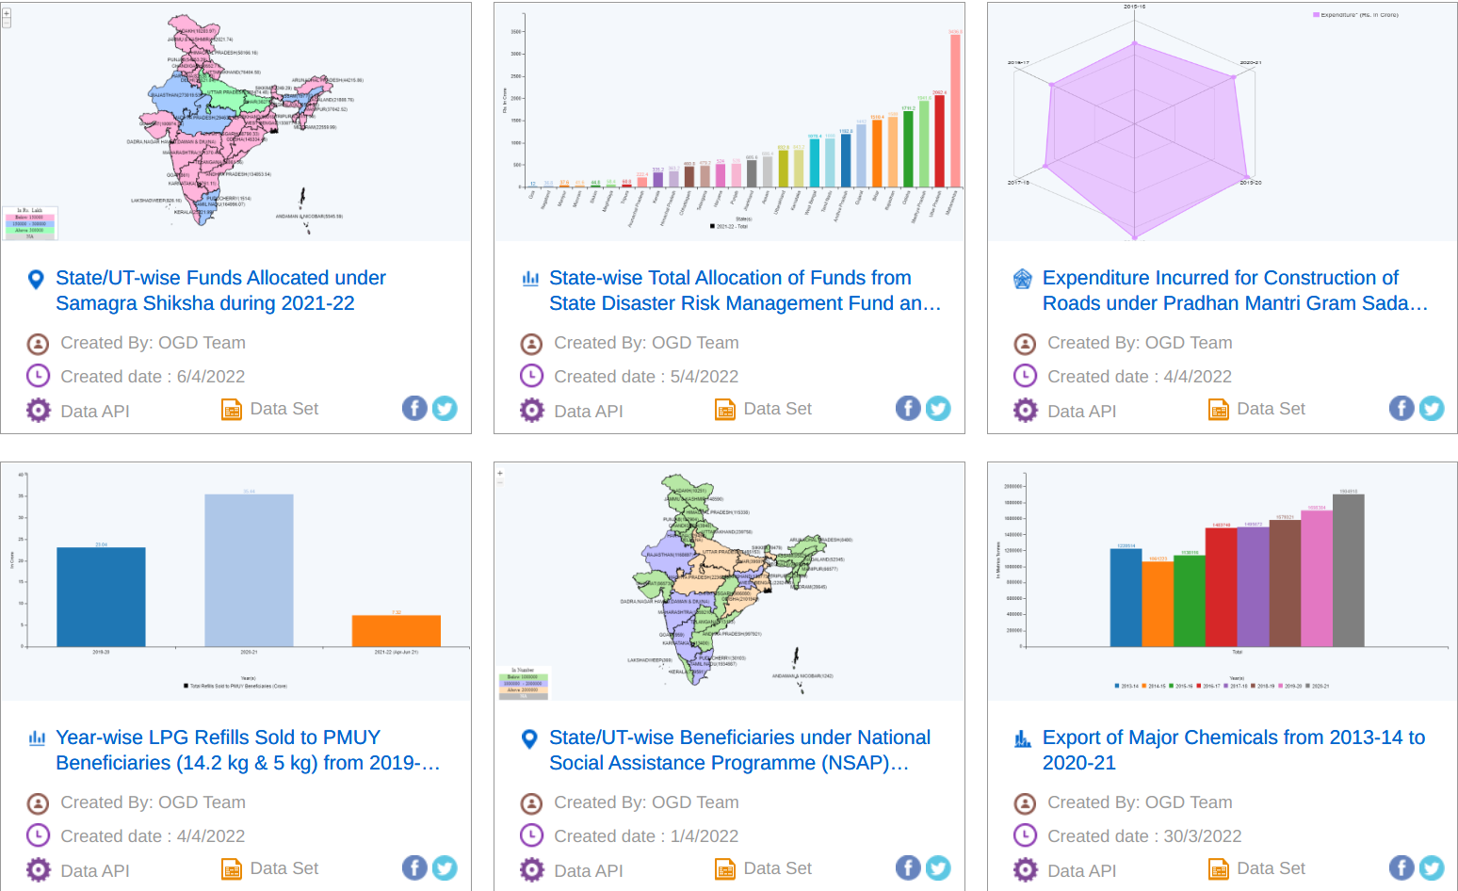
Several sources of public data in India
Image from data.gov.in
Notes:
For example, in India data.gov.in has 12K catalogs which provide citizens all kinds of data such as:
While these are laudable initiatives, we have a long way to go in improving the quality, quantity, accessibility, and usability of public data in India.

Slide 6
Some example studies on Indian Data
Power consumption in India
Health of Indian population
Housing in India

Slide 7
Course contents
Data analysis: gathering, summarizing, and visualizing data in intuitive ways
Probability: Mathematical tool to represent uncertainty
Statistical inference: Drawing probabilistic conclusions from limited data
Important pre-requisite for future courses in machine learning, image processing, computer vision, deep learning, AI, finance, etc..

Slide 8
Mode of running the course
Three 55 minute slots per week:
SAFE/Moodle/paper quizzes on the material covered in prior weeks
20 minute duration at a pre-announced time or 55 minute quiz.
Grading will be done on top n-2 out of n quizzes for 20 minute quizzes.
No compensation for missed quizzes.
All materials will be uploaded on Moodle, announcements via Moodle, questions on Moodle or cs215-ta@googlegroups.com
Course webpage

Slide 9
Evaluation
Approximate credit structure
15% In-class Quizzes
25% Mid-semester exam
35% End semester exam
25% Programming and written homeworks: in teams (about 5 assignments)
Attendance mandatory. Students with less than 80% may get a DX.
We will all adhere to principles of academic honesty. Penalties for violation will be severe and will be reported to DADAC. Givers and takers are equally responsible.

