Slide 1
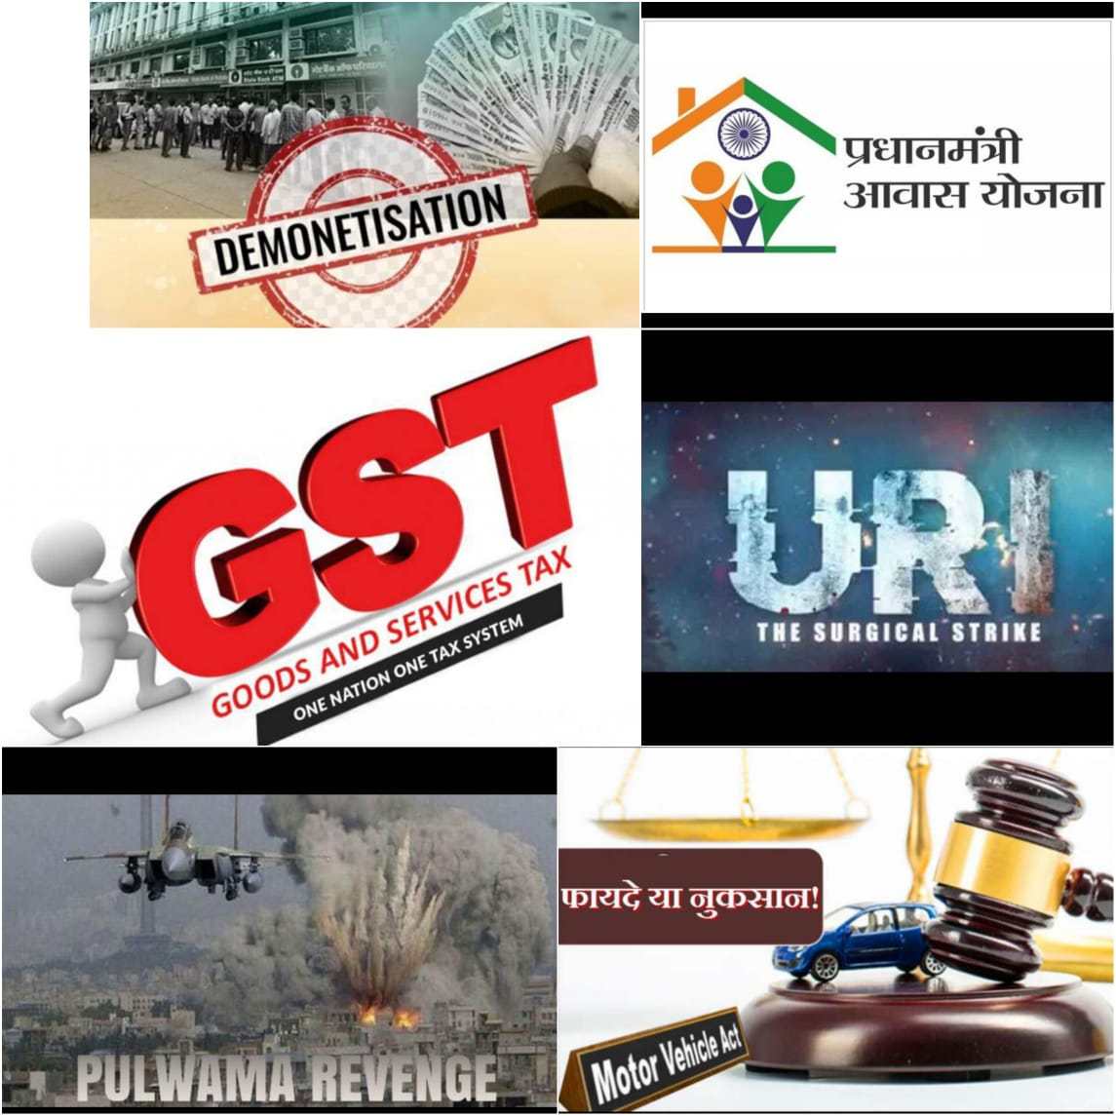

Slide 2

OPINIONS OF VADODARA ON major central GOVERNMENT DECISIONS
Guided by :
Jayshree Madam

Slide 3
What is an Opinion ?

Slide 4
MAJOR CENTRAL GOVERNMENT DECISIONS
Pradhan Mantri Awas Yojana - June 2015 (Scheme)
Demonetization - 8th November 2016 (Economic)
Surgical Strike (Uri) - 29th September 2016 (Security)
Goods and Services Tax (GST) - 1st July 2017 (Economic)
Air Strike (Pulwama) - 14th February 2019 (Security)
Motor Vehicles Amendment Law - 1st September 2019 (Security)

Slide 5
OBJECTIVES
To assess whether the people’s opinions are influenced or independent.
To assess the relationship of the factors affecting the opinions.
To determine the effectiveness of central government decisions.

Slide 6
QUESTIONNAIRE

Slide 7
Sampling Techniques
Simple Random Sampling
Cluster Sampling

Slide 8
Sample Size Determination
Chi-squared Test
Proportion Test

Slide 9
1. For Chi-Squared Test
Age
Gender Helpful
Occupation v/s
Education Awareness
Income

Slide 10
[Python3 Code]
>>>chipower=power.GofChisquarePower()
>>>import statsmodels.stats.power as power
>>>A=chipower.solve_power(0.216,nobs=None,alpha=0.05,power=0.8,n_bins=4)
>>>print("Gender*Awareness:-“,A)
Max Sample Size : 491

Slide 11
2. For Proportion Test
n= N z² _{α/2} p(1-p)
d²(N-1)+ z² _{α/2} p(1-p)
Max Sample Size : 200

Slide 12
Sample Size
Collected Sample : 107
Required Sample : 491

Slide 13
Graphical Representation

Slide 14
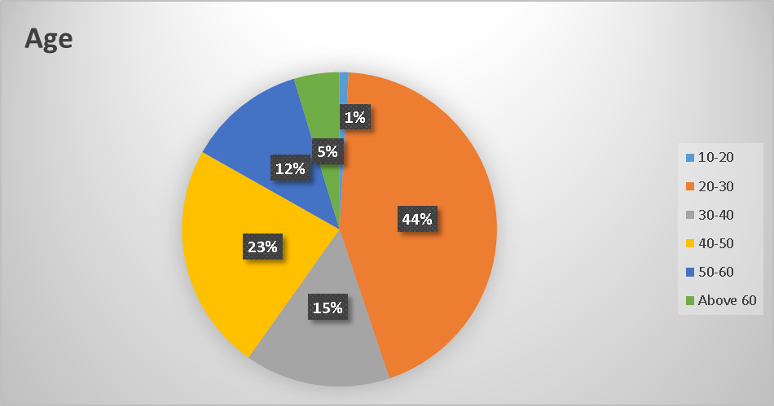
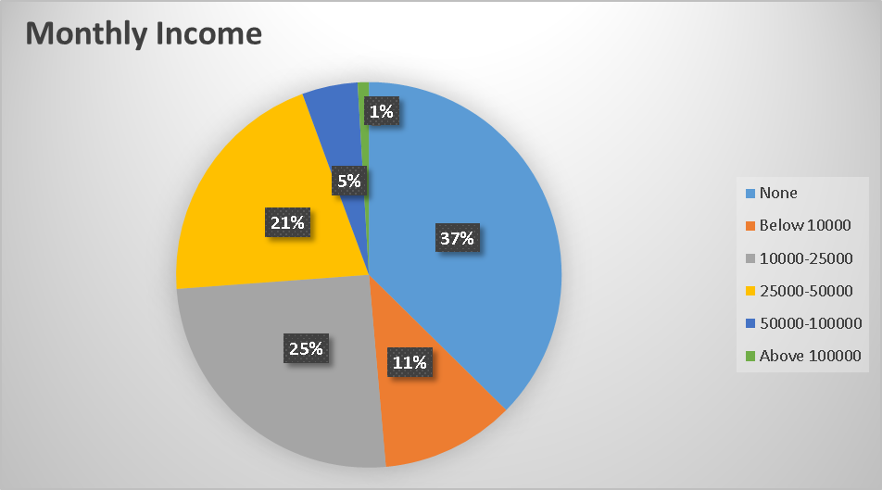

Slide 15
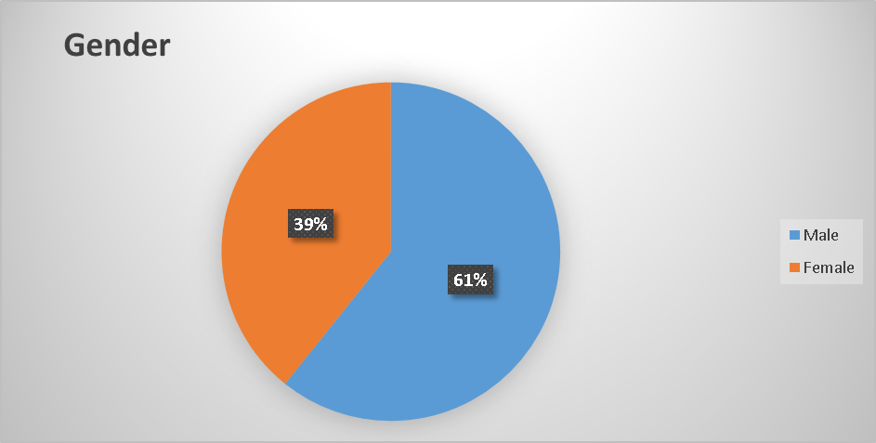
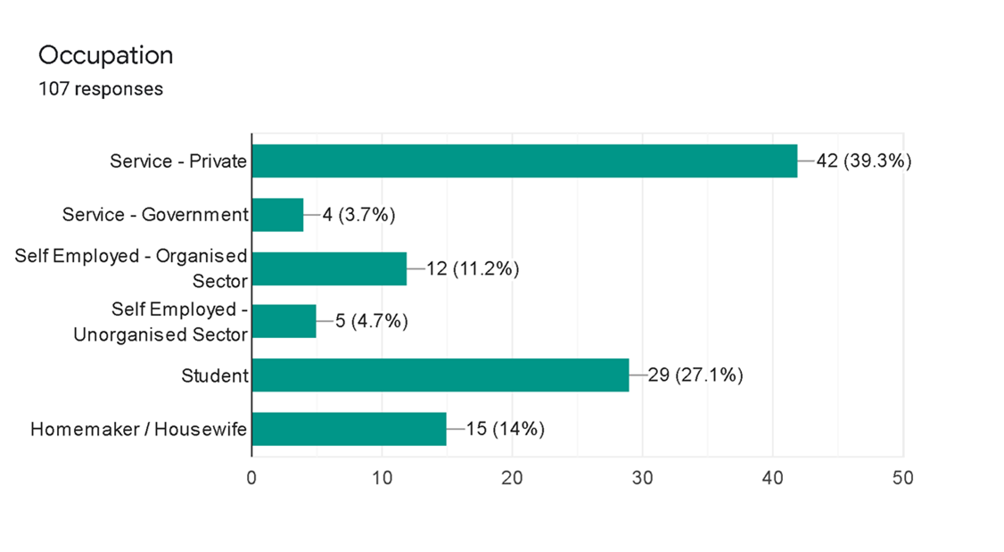

Slide 16
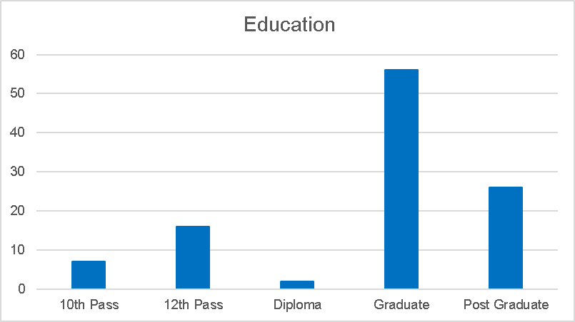

Slide 17
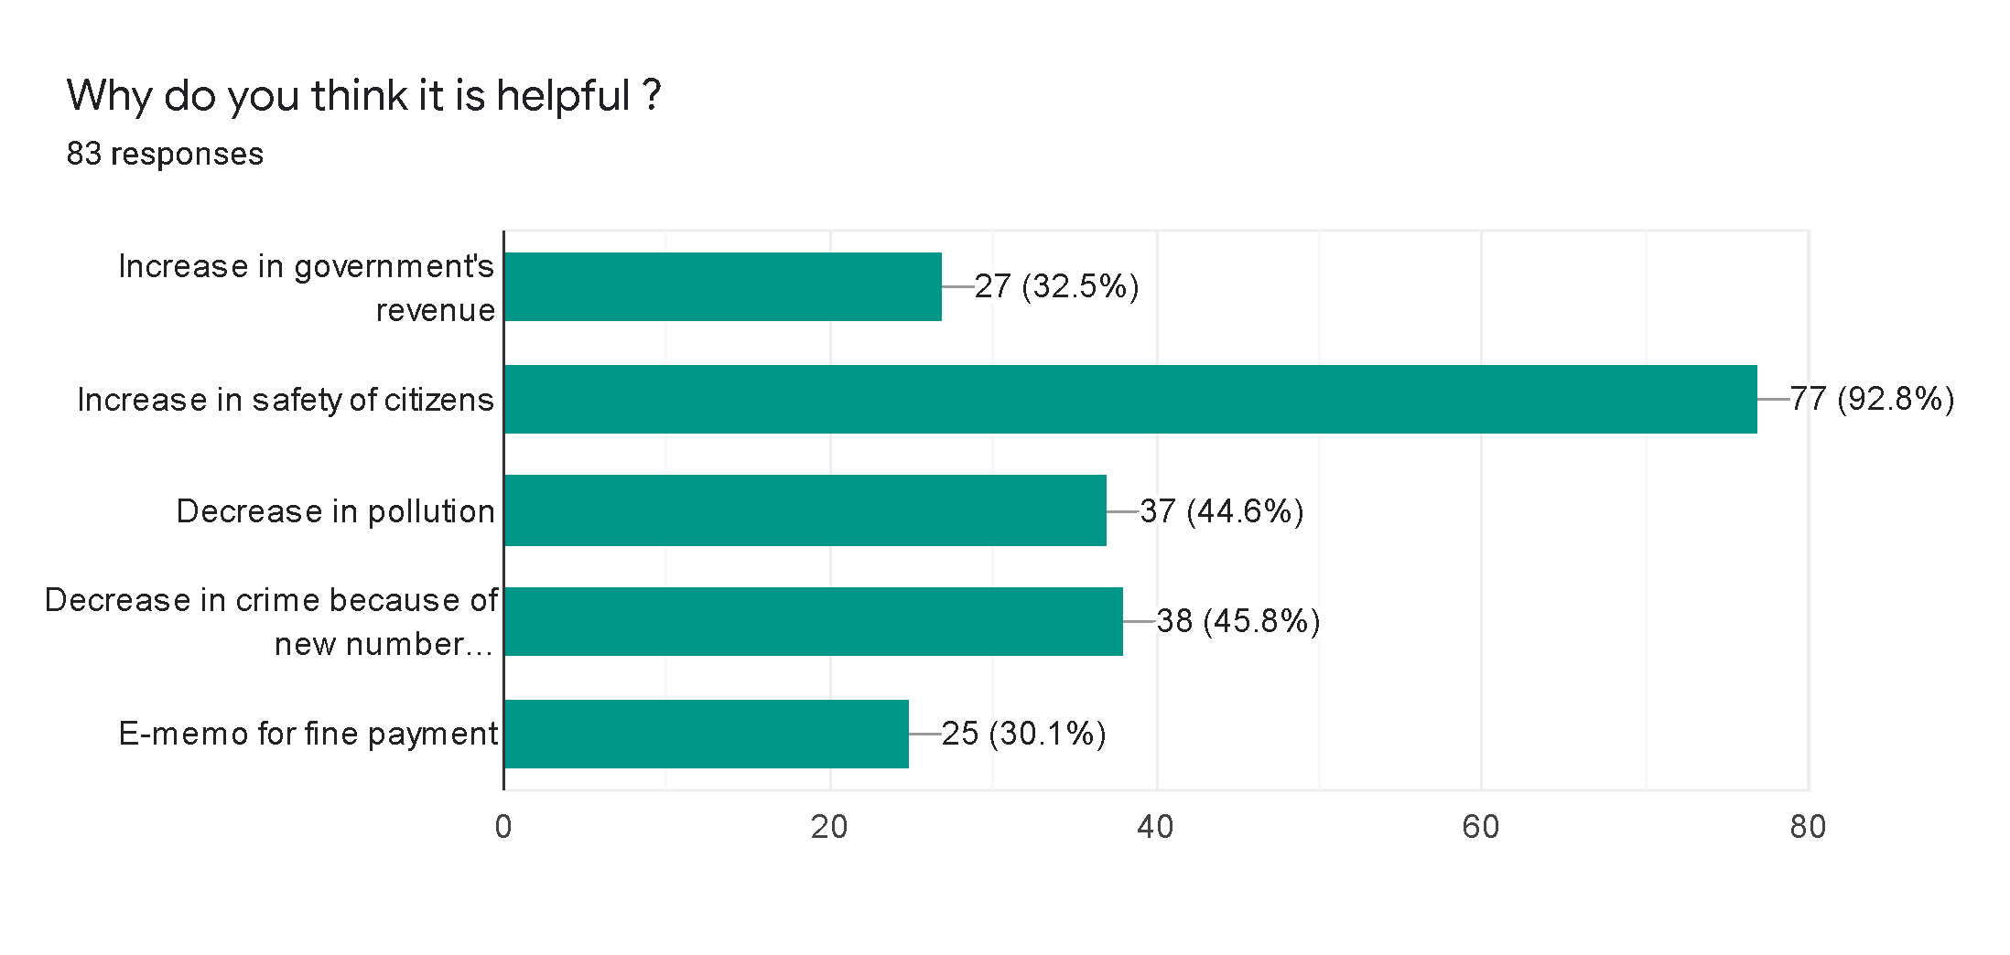
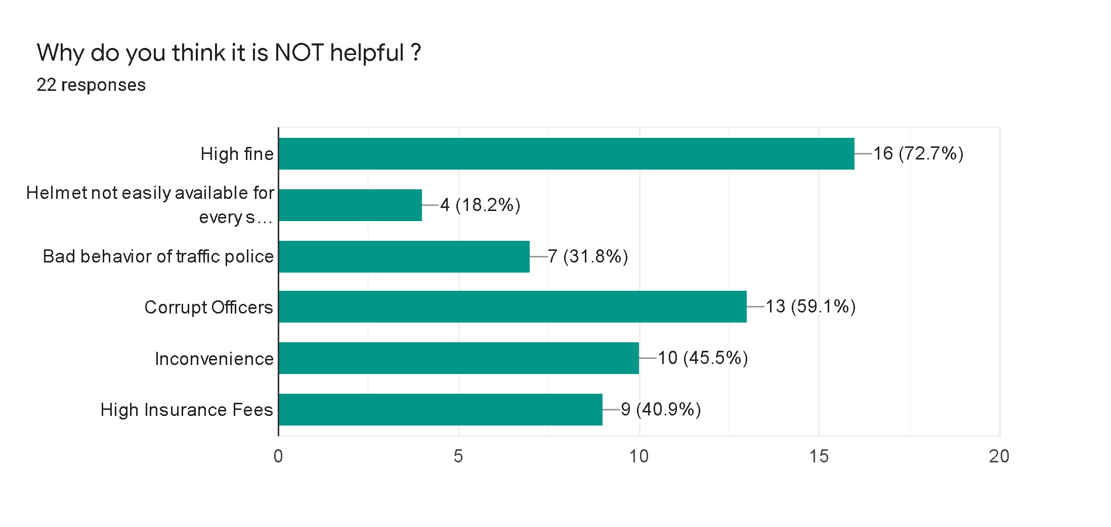
Motor Vehicle Act

Slide 18
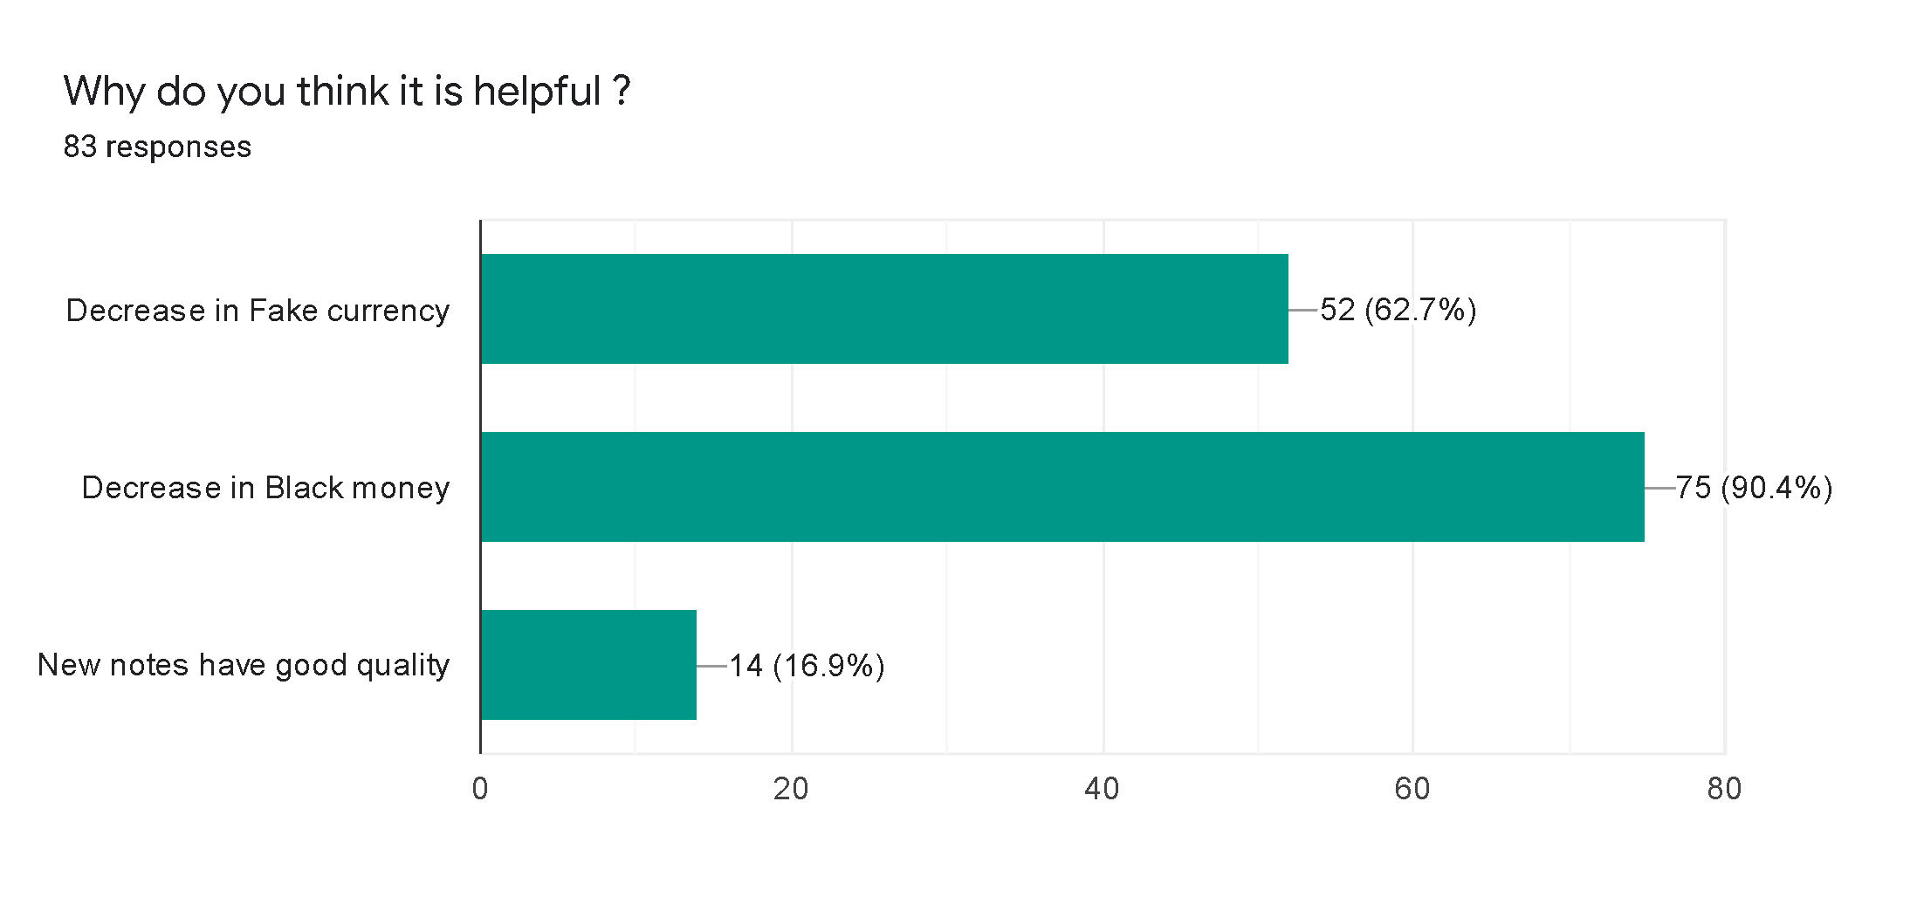
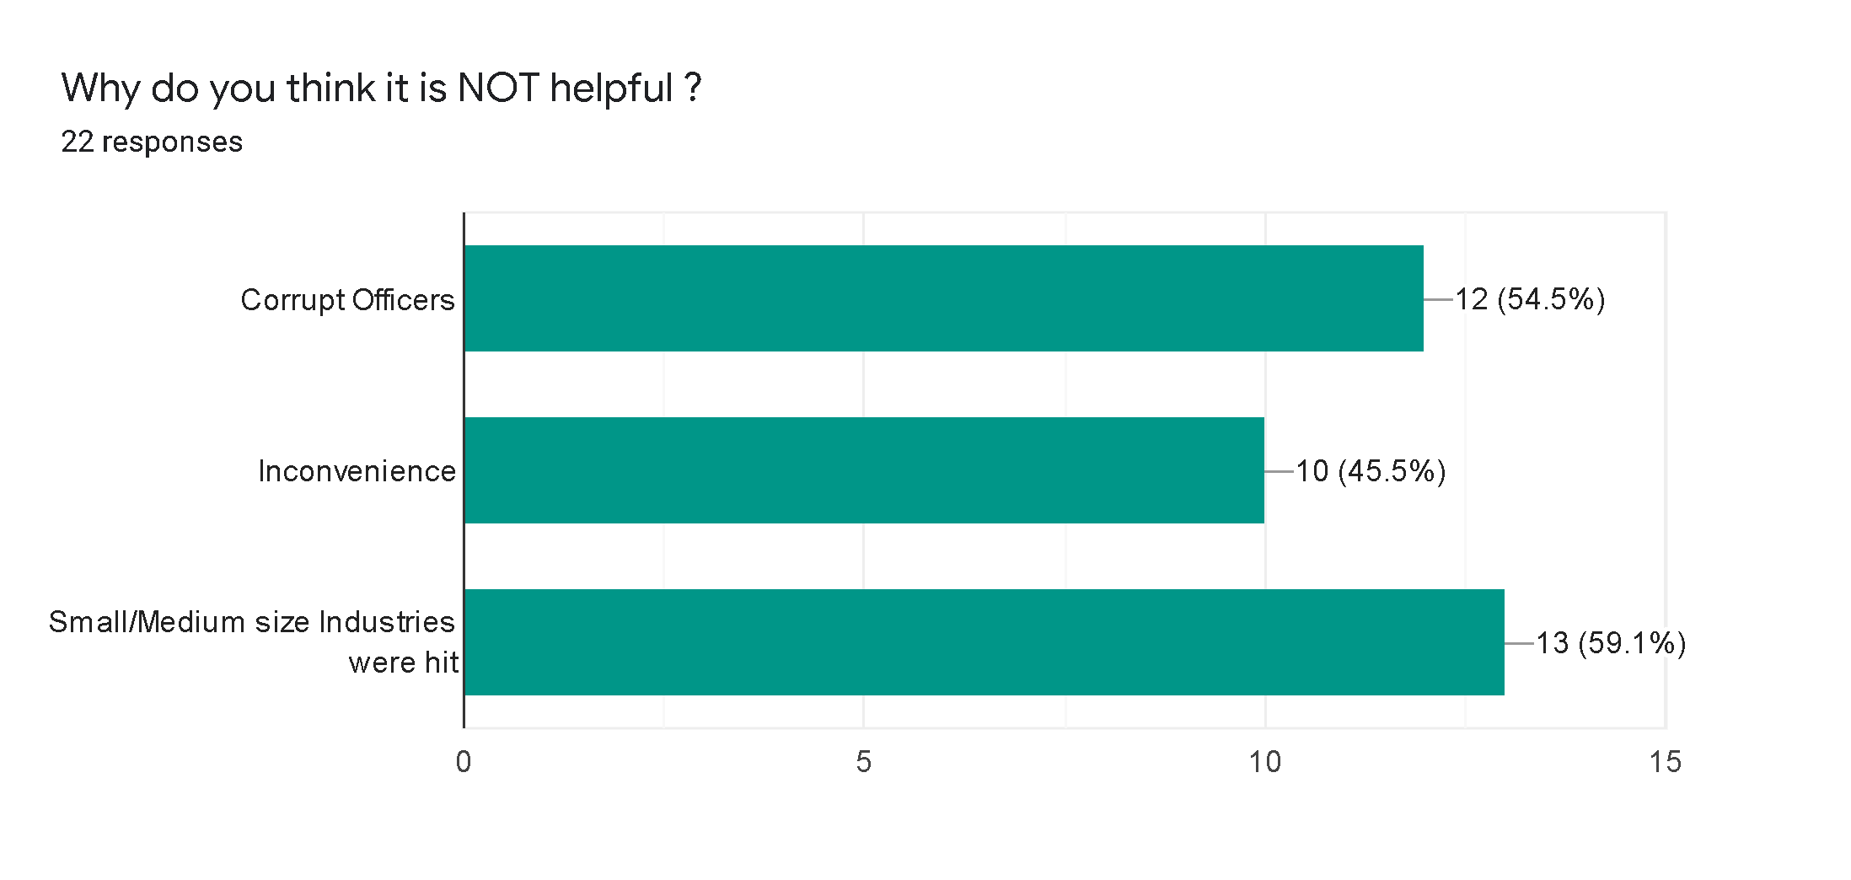
Demonetization

Slide 19
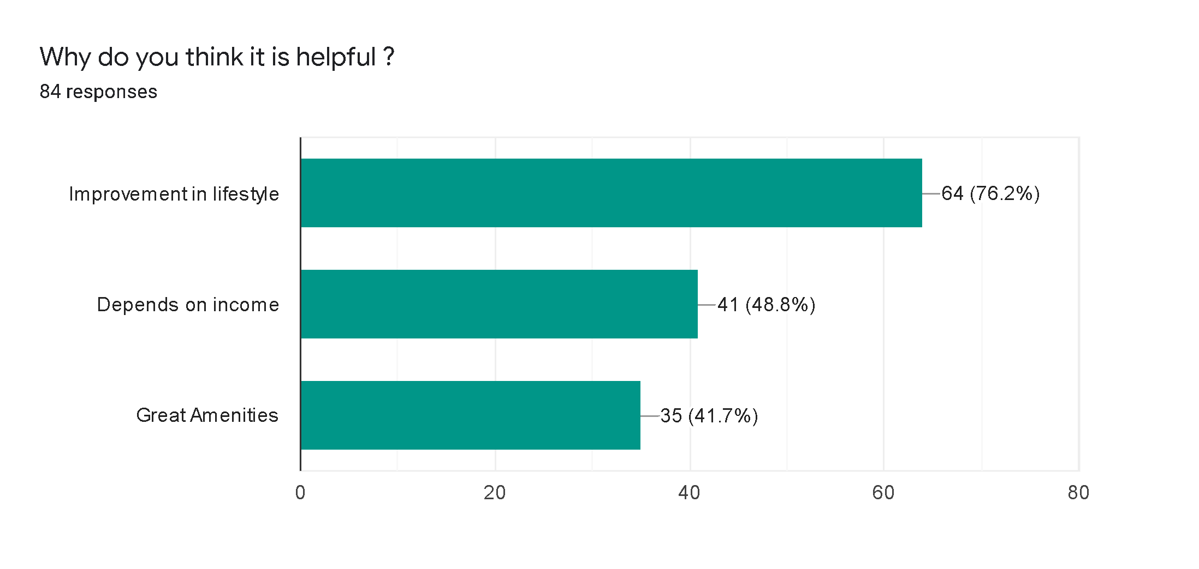
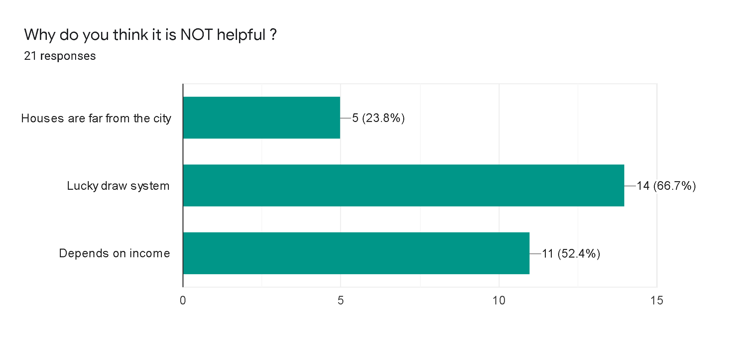
Pradhan Mantri Awas Yojna

Slide 20
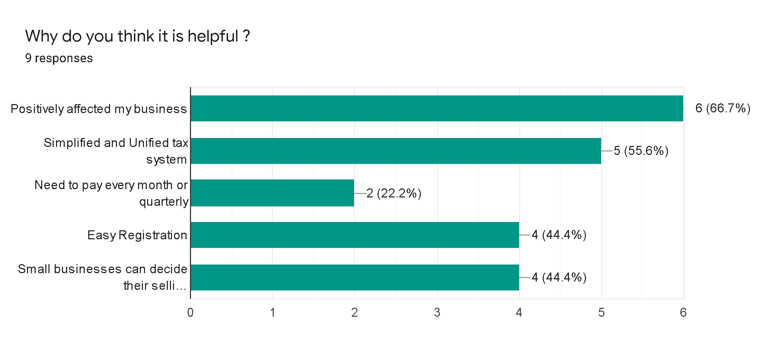
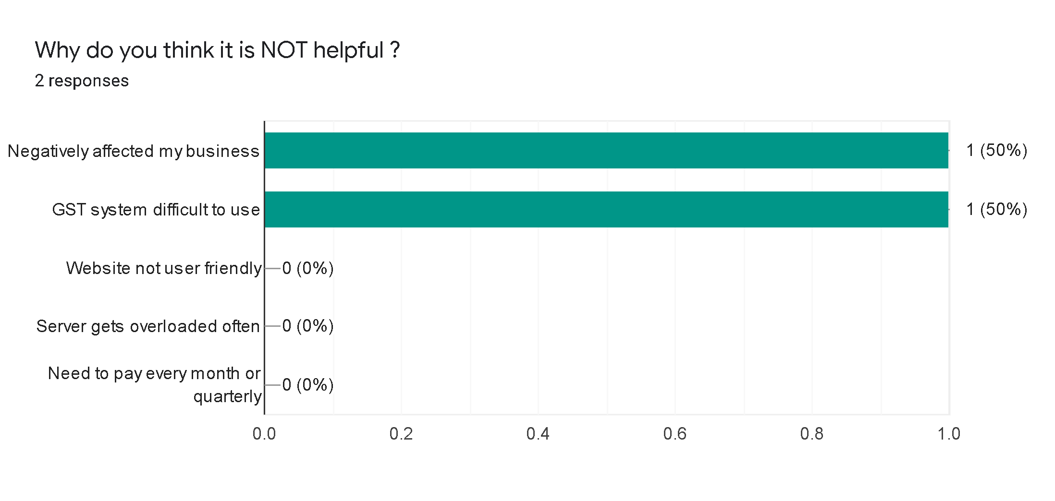
Goods And Service Tax (GST)

Slide 21
Statistical Analysis

Slide 22
1. Multiple Response Crosstabulation

Slide 23
GENDER | CODE
Male | 0
Female | 1
INCOME | CODE
Below 10,000 | 1
10k-25k | 2
25k-50k | 3
50k-1lakh | 4
1lakh Above | 5
PMAY
Gender*Income*$ReasonsForOpinion Crosstabulation
ReasonsForOpinionª |  |  |  | Income
 |  |  |  | 1.00 | 2.00 | 3.00 | 4.00
Great_Amenities | Gender | .00 | Count | 4 | 4 | 10 | 7
 |  | 1.00 | Count | 6 | 0 | 4 | 0
 | Total |  | Count | 10 | 4 | 14 | 7
Lifestyle_Improvement | Gender | .00 | Count | 9 | 5 | 8 | 13
 |  | 1.00 | Count | 11 | 3 | 7 | 2
 | Total |  | Count | 20 | 8 | 15 | 15
Income_Dependent | Gender | .00 | Count | 5 | 3 | 7 | 6
 |  | 1.00 | Count | 11 | 0 | 5 | 0
 | Total |  | Count | 16 | 3 | 12 | 6
Lucky_Draw | Gender | .00 | Count | 2 |  | 2
 |  | 1.00 | Count | 1 |  | 2
 | Total |  | Count | 3 |  | 4
Houses_Faraway | Gender | .00 | Count | 1 |  | 2
 |  | 1.00 | Count | 1 |  | 1
 | Total |  | Count | 2 |  | 3
Income |  | Total
5.00 | 6.00
 |  | 25
 |  | 10
 |  | 35
5 | 1 | 41
0 | 0 | 23
5 | 1 | 64
1 | 1 | 23
0 | 0 | 16
1 | 1 | 39
 |  | 4
 |  | 3
 |  | 7
 |  | 3
 |  | 2
 |  | 5

Slide 24
2. Chi-Squared Test For Independence
HYPOTHESIS
H0 : Assumes that there is independence between the two variables.
H1 : Assumes that there is dependence between the two variables.
Critical Region :
Level Of Significance = 0.05
If p-value is less than or equal to 𝛂 then we reject H0
If p-value is greater than 𝛂 then we fail to reject H0
Legend :
Highlighted value signifies the p-value
Red : We reject H0
Green : We fail to reject H0

Slide 25
Gender * Do you know about this decision ? (Pradhan Mantri Awas Yojana)

Slide 26
Education * Do you know about this decision ?
(Pradhan Mantri Awas Yojana)

Slide 27
 | Dependent | Independent
1.Pradhan Mantri Awas Yojana | Education* Awareness | Gender * Awareness
 | Education* Helpful | Gender * Helpful
 | Occupation*Awareness | Occupation*Helpful
 | Age* Awareness | Monthly Income*Awareness
 |  | Monthly Income*Helpful
 |  | Age*Helpful
2.Demonetization | Age* Awareness | Gender * Awareness
 | Education* Awareness | Gender * Helpful
 | Occupation*Helpful | Age*Helpful
 |  | Monthly Income*Awareness
 |  | Monthly Income*Helpful
 |  | Occupation*Awareness
 |  | Education* Helpful
3.Surgical Strike (Uri) |  | Age* Awareness
 |  | Gender * Awareness
 |  | Occupation*Awareness
 |  | Monthly Income*Awareness
 |  | Education* Awareness

Slide 28
4.Goods and Service Tax | Education* Awareness | Gender * Awareness
 | Education* Helpful | Gender * Helpful
 | Occupation*Helpful | Occupation*Awareness
 | Monthly Income*Awareness | Monthly Income*Helpful
 |  | Age*Helpful
 |  | Age*Awareness
5.Air Strike (Pulwama) | Education* Awareness | Age*Helpful
 |  | Age*Awareness
 |  | Monthly Income*Awareness
 |  | Gender * Awareness
6. Motor Vehicle Act | Occupation*Awareness | Age*Helpful
 | Occupation*Helpful | Age*Awareness
 |  | Monthly Income* Helpful
 |  | Monthly Income* Awareness
 |  | Gender * Helpful
 |  | Gender * Awareness
 |  | Education* Helpful
 |  | Education* Awareness

Slide 29
3. Proportion Test
H0 : 70% of the people formed their opinion by themselves.
H1 : More than 70% of the people formed their opinion by themselves.
Decision | Reject H0 | Do not Reject H0
PMAY
Demonetization
Uri
GST
Airstrike
MVA

Slide 30
Conclusions

Slide 31
Pradhan Mantri Awas Yojna (PMAY)
More than 80 percent of the people were aware about PMAY.
Newspapers followed by TV were the 2 main sources of information.
Half of the respondents formed their opinion independently, for the rest family, friends and media played an important role in shaping their opinion.
About 90 percent viewed PMAY as a helpful scheme in their lives.
We found that it caused a huge improvement in lifestyle of the beneficiaries. They were happy that the houses had great amenities and the flats were distributed according to one's income.
On the other side, house site being far away from the city, a lucky draw system to select beneficiaries and inability to provide maintenance services were the main criticisms. Interestingly, flats being distributed according to one's income was perceived as a flaw to some.

Slide 32
Goods And Service Tax (GST)
95.3% of the people that we asked knew about the GST reform.
TV, Newspaper and WhatsApp were the 3 main sources of information.
More than half formed their opinion independently.
75% of the respondents thought that GST is helpful in their business. This includes both segments - those who had a GST number and those who did not.
We found that for most people GST positively affected their business. Simplified and Unified tax system, need to pay regularly, easy registration into the GST module were the main positives. Over that, small businesses could also decide their selling prices.
Though they were a minority, we also found some respondents who said that it negatively affected their business. They also found GST system to be difficult to use and, in most cases, had to hire someone to pay GST

Slide 33
Motor Vehicle Act
70% of the people formed their opinion independently.
TV, Newspaper and WhatsApp were the 3 main sources of information.
81% people are happy with this decision but the rest think that this decision should be enacted mainly on highways and not in the city areas.
About 80% said that this decision is helpful mainly because it has increased the safety of citizens.
The remaining had said that they faced the problems as helmets were not easily available and hike in fines were unreasonable.

Slide 34
Demonetization
More than 90% of the people were aware about Demonetization.
Most of the people get the information from TV, Newspaper and WhatsApp are other important sources of information.
Around 65% of the people form their opinion independently.
About 70% of the people found this decision helpful.
Most of the people found this helpful because of removal of black money and decrease in fake currency. But few people with income below 25k found it not helpful because of inconvenience.

Slide 35
Air Strike and Surgical Strike
More than 90% of the people were aware about it.
Most of the people get the information from TV, Newspaper and WhatsApp are other important sources of information.

Slide 36
Limitations
Due to time constraint and COVID-19 Lockdown, we could only collect 107 samples.
These conclusions cannot be used for practical purposes.

Slide 37
References
Sample Size Determination and Power - Book by Thomas P. Ryan
A Guide to Chi-Squared Testing (Wiley Series in Probability and Statistics)
https://www.ibm.com/support/knowledgecenter/SSEP7J_11.1.0/com.ibm.swg.ba.cognos.cbi.doc/welcome.html
Classwork Notes of Bachelors and Masters

Slide 38
Subjective Learning
Throughout the journey of this project we learnt how to form and express our opinions too.
We learned how to communicate with people of all age groups.
We learned how to form a questionnaire under the guidance of professors as well as domain experts.
How to put forward ones opinion without fighting with each other.

Slide 39
THANK YOU ☺
Presented By :
Aditya Sant
Mrinal Bankar
Mrunal Gokhale
Yuti Tailor

Slide 40
Questions / Suggestions

