Slide 1
Food Ordering & Delivery System
A Command-line Java application
Group Members
T090800307 : Aditya Sasane
T090800321 : Ankit Kadav
T090800413 : Om Kurkut
T090800445 : Sairaj Pawar
T090800517 : Shubhankar Patil

Slide 2
Project Overview
This Java application allows user to order food from different restaurants
It includes functionality for Customer, Admin and Delivery Personnel
Built using Core Java, focusing on OOP concepts such as Inheritance, Polymorphism and Collections.
Provided a console – based user interface.

Slide 3
System Modules
Admin
01
02
Customer
03
Delivery Person
Add/ Remove Restaurants
Manage food items in the restaurants
View Orders and Assign delivery personnel
Add delivery personnel
View restaurants menus and available food items
Add items to the cart and place orders.
View and track order status
View Assigned Orders
Update delivery status

Slide 4
Admin Functions
Add Restaurant:
Manage Menu:
Assign Delivery Person:
Admin can add restaurants to the system
Add/Remove food items from the restaurants menus
Assign delivery personnel to customer’s order and their status
View Orders:
See all customers order and their status

Slide 5
Customer Functions
View Menus
Add Food to Cart:
Place Order :
Admin can add restaurants to the system
Add/Remove food items from the restaurants menus
Assign delivery personnel to customer’s order and their status
View Cart:
See all customers order and their status

Slide 6
CONCEPTS USED
INHERITANCE
POLYMORPHISM
ENCAPSULATION
The Customer and Delivery Person classes inherits from base User Class
Different methods are overriden to perform specific task for various user types
Fields like userId, foodItem are private and accessed via getter and setter methods

Slide 7
CONCEPTS USED
COLLECTIONS
RELATIONSHIPS
One-to-one: A customer has exactly one cart.
One-to-many: A restaurant can have many food items, and
a customer can place multiple orders.
Many-to-many: Orders can include multiple food items, and
food items can be part of multiple carts/orders.
Maps: Used to manage food items in the cart
(e.g., Map<FoodItem, Integer> for quantity).
Lists: Restaurants manage their menus using a List<FoodItem>.

Slide 8
PROJECT WORKFLOW
Phase I
Customer searches for restaurants & views Menu
Phase II
Customer adds item to cart & places Order
Phase III
Admin receives order and assigns the delivery person

Slide 9
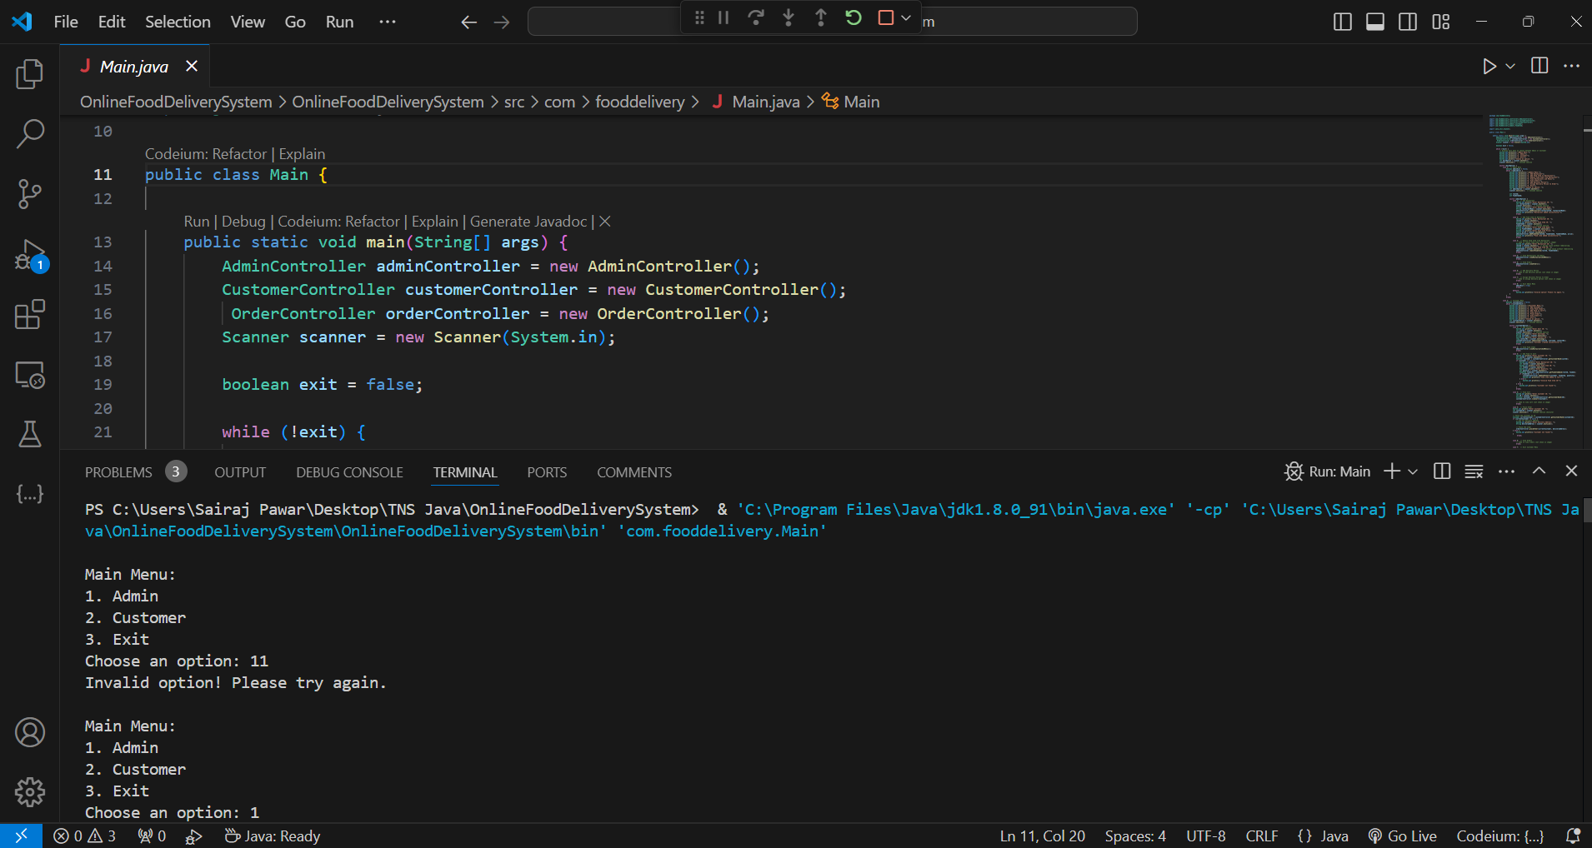
SNAPSHOTS

Slide 10
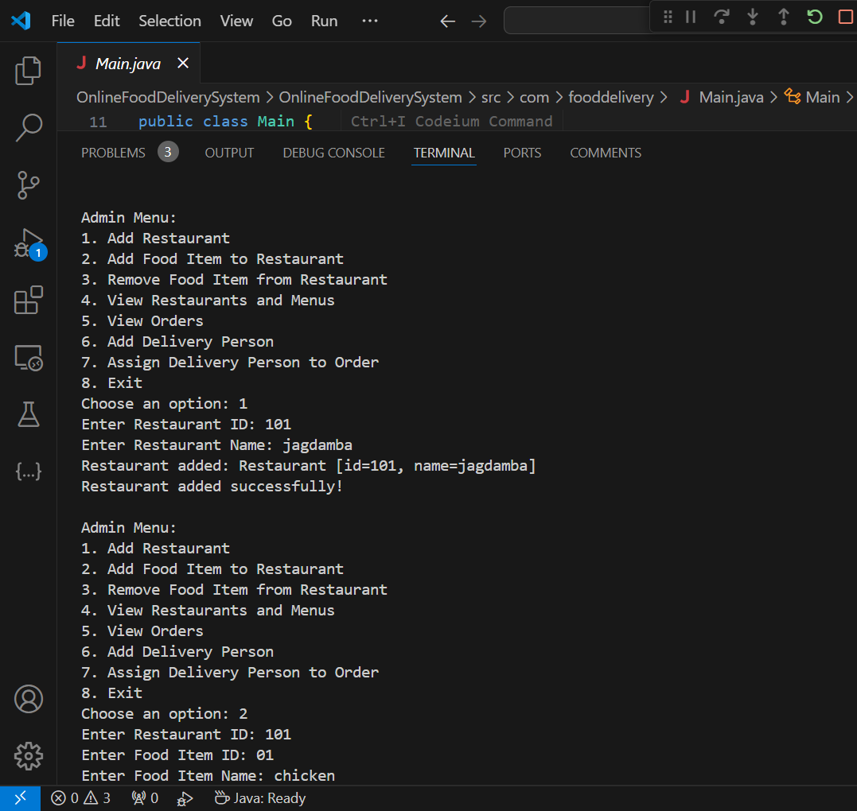
SNAPSHOTS

Slide 11
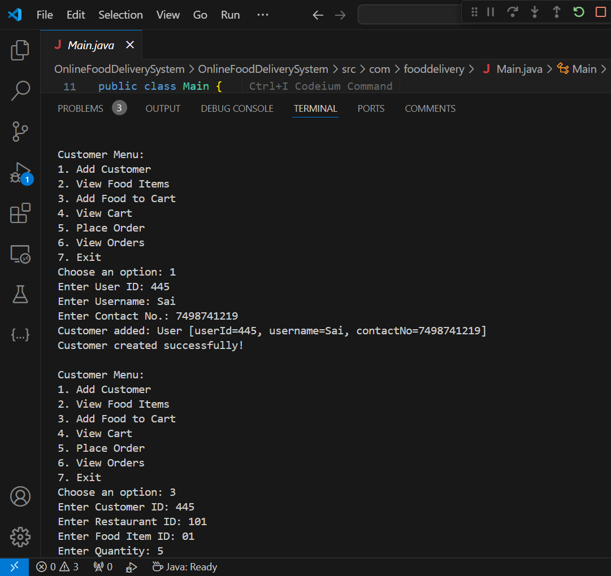
SNAPSHOTS

Slide 12
CONCLUSION
The Food Delivery System successfully demonstrates the use of OOP principles in Java
It provides an end to end solution for managing orders, restaurants, and deliveries
A future Improvements could include adding a GUI or integrating with a database for persistent data storage

Slide 13
THANK YOU

