Slide 1


COEP ERP PLATFORM
TEAM BROCODERS
Team Members:
Payal Sankpal(Team Lead)
Aditya Deshmukh
Satvik Gaikwad
Tanmay Bansode
Mehmood Deshmukh
Viraj Bakshi
Revolutionizing College Management through Unified Digital Platforms
COEP Technological University
A Unitary Public University of Govt. of Maharashtra
Formerly College of Engineering Pune

Slide 2
Problem Statement
Challenges Faced by Colleges in Management:
Fragmented systems leading to inefficiencies in operations.
Manual processes prone to errors and delays.
Inefficiencies in Traditional Systems:
Siloed information resulting in a lack of coordination.
Difficulty in tracking and managing resources effectively.
Need for a Comprehensive Solution:
Emphasizing the importance of transitioning to a modern, integrated platform for enhanced productivity and effectiveness.
COEP Technological University
A Unitary Public University of Govt. of Maharashtra
Formerly College of Engineering Pune

Slide 3
Our Solution Overview
Overview of Our ERP Platform:
Client: College Administration:
Users: Students, Teachers, HODs and Admin:
ERP platform will solve most of the current problems faced by the students as well as the administration
The universal access of all the functionalities will be available to the college administration
Our universal login will have access to the mentioned users
COEP Technological University
A Unitary Public University of Govt. of Maharashtra
Formerly College of Engineering Pune

Slide 4





Key Features
Universal Login System
Integration Capability
Venue Booking System
Lecture Lab Management
Leave Management System
COEP Technological University
A Unitary Public University of Govt. of Maharashtra
Formerly College of Engineering Pune

Slide 5




Extra Features
Email Notification:
Each action related to the user done will be conveyed via email notification using
node-mailer
Signed Permission letter:
E-signature is made available for faculties for approving Venue Booking
Result Viewing Page:
Result of student will be displayed
Chatbot integration:
An AI chatbot is integrated for better user experience
COEP Technological University
A Unitary Public University of Govt. of Maharashtra
Formerly College of Engineering Pune

Slide 6
Universal Login
Streamlined Access for All Users:
Enhanced Security Measures:
Single Sign-On Convenience:
It is time saving and
easy to access
JWT Auth
BCRYPT
With single user login details user will be able to access multiple platforms
COEP Technological University
A Unitary Public University of Govt. of Maharashtra
Formerly College of Engineering Pune

Slide 7
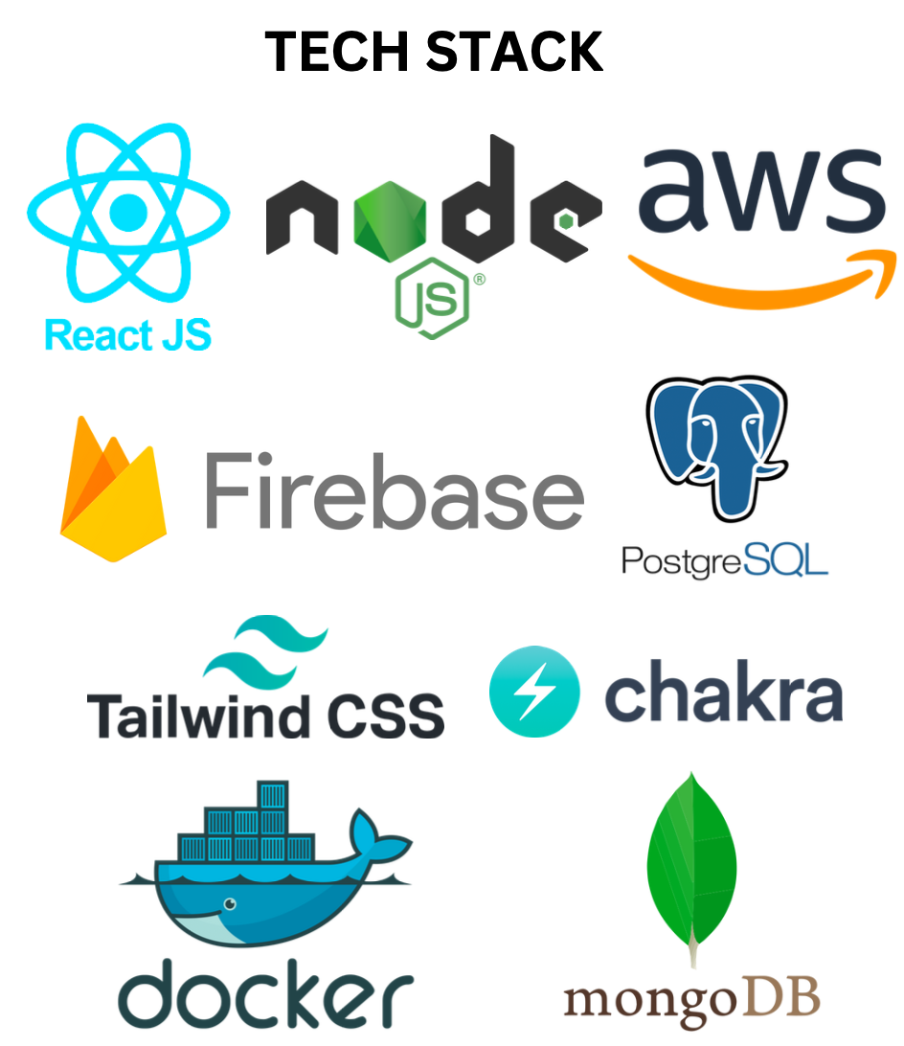



What after Hackathon?
Deployment:
After hackathon our project is readily available for deployment.It can be deployed on deployment service platforms like Vercel, Netlify, etc.
Techstack:
Integration with more projects:
We can integrate with Plagiarism, Hostel management facility and Library management facility
COEP Technological University
A Unitary Public University of Govt. of Maharashtra
Formerly College of Engineering Pune

