Slide 1
A model for predicting controls through EEG signals
Charan Sai Venkat Narayana Lolugu – AP21110011621 Aditya Sesha Sai Samineni – AP21110011627 Mani Chandrika Pachipulusu – AP21110011629

Slide 2

Introduction
This project is about training a machine learning model which can be used for the construction of a personalized game controller which has basic controls such as up, down, left, right, and rest position and can be controlled using brain signals, which has many real world applications such as hands free gaming experience and controlling heavy machinery in production.
The dataset used to train this model will be one person’s data from the BCI-2000 dataset which consists of the EEG signals. The basic idea is to collect the raw signals, preprocess the data and send it to the model which will predict the game control the user is performing through his tasks.

Slide 3
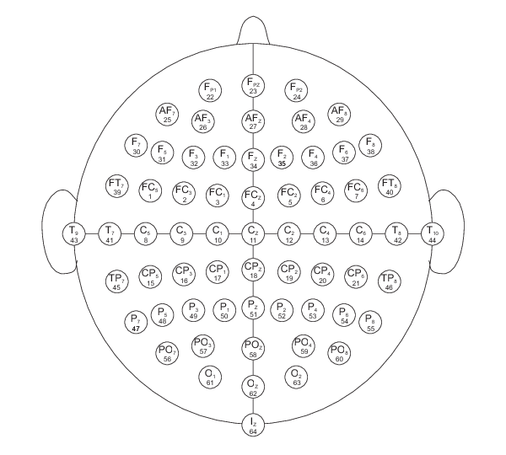
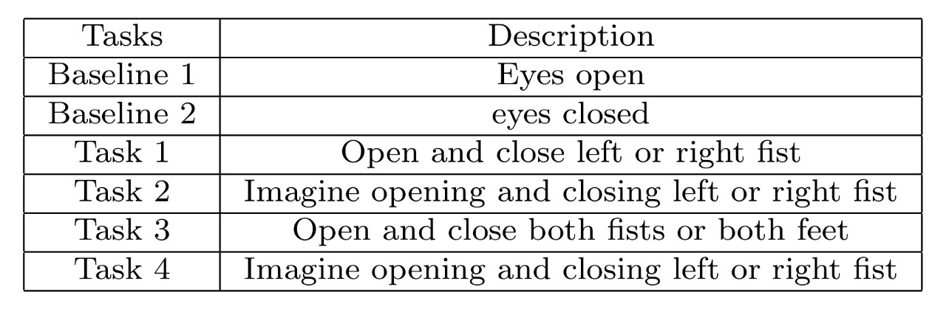
Dataset description
Each subject performed 14 experimental runs involving different motor/imagery tasks while 64-channel EEG was recorded using the BCI2000 system. The dataset includes two one-minute baseline runs with eyes open and closed, as well as three two-minute runs for each of four tasks. The tasks involve responding to visual cues by opening and closing fists or feet, both physically and through imagination. The EEG signals are recorded 160 times per second for each task and this is done approximately for 2 minutes which gives us a 19680 samples.
link to dataset

Slide 4
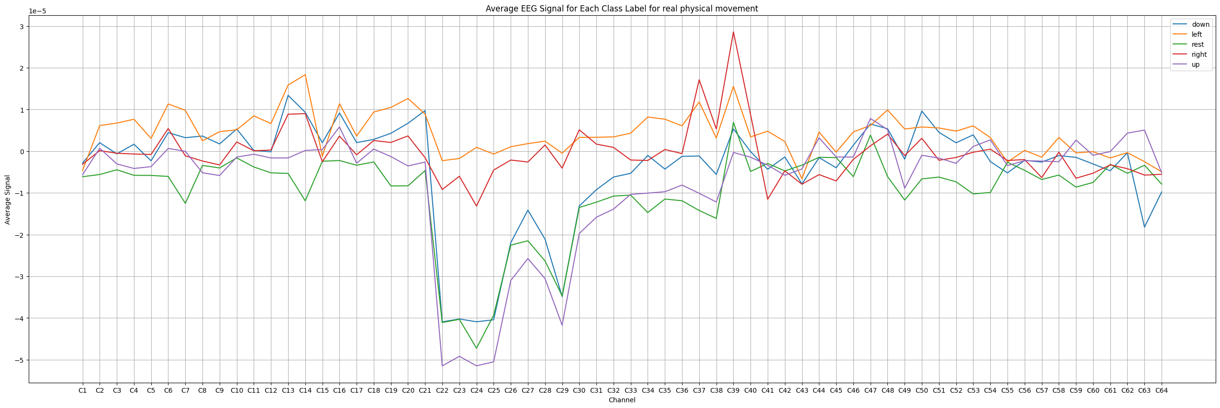
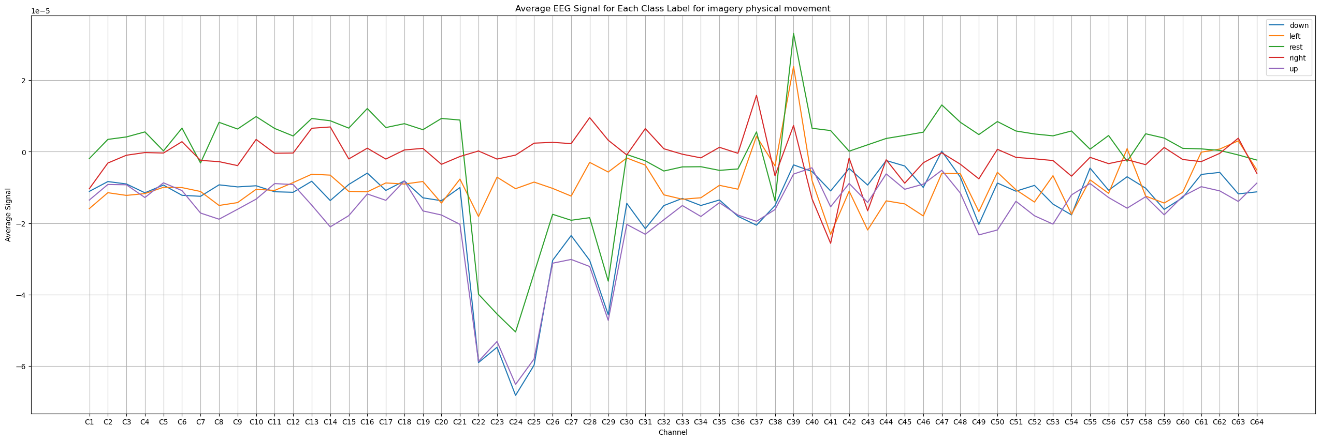
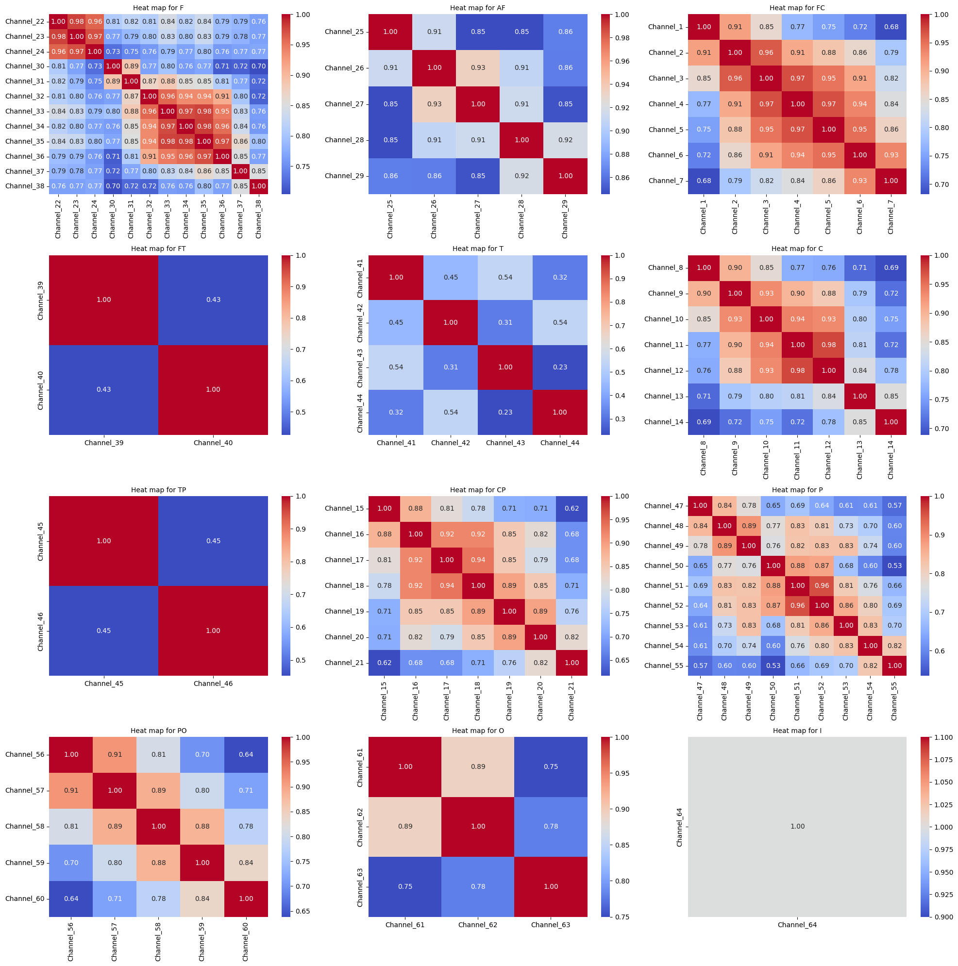
Data Analysis
Real tasks avg values plot
Imaginary tasks avg values plot
As shown above the rest, up and down have a similar average values while the left, right have a similar average values for the corresponding electrodes.
The correlation matrix for each region of the brain as mentioned in the experimental protocol of the dataset is plotted and there is no significant correlation observed between the electrodes of the same region of the brain for both real and imaginary task data.
Correlation plot between different electrode segments of the brain

Slide 5
Methodology
Read the raw EEG data
Results
Results
Results
Results
Extract the events
SVM/RF
Classification
SVM/RF
Classification
SVM/RF
Classification
SVM/RF
Classification
Label the data
Normalize
Feature selection using correlation matrix with threshold 0.9
Normalize and pca with 0.95 cumulative explained variance
Combine the data
Preprocessed DataSet

Slide 6
Results and Conclusion
 | RAW data (accuracy) | Normalized (accuracy) | Feature selection with correlation < 0.9 (accuracy) | Normalized and PCA ( 0.95 cumulative explained variance) (accuracy)
SVM(real) | 87 | 86 | 85 | 70
SVM(imaginary) | 83 | 83 | 77 | 67
RF(real) | 81 | 81 | 81 | 79
RF(imaginary) | 78 | 78 | 75 | 74
SVM seems to perform better than the random forest classifier
Real tasks have shown more predictability than the Imaginary tasks
Other forms of feature selection and data transformation performed have no significant impact in accuracy than the RAW data.

Slide 7
THANK YOU

