Slide 1

Capstone Project
Aditya sharma

Slide 2
Introduction to Problem
Delhi is one of the most densely populated capital cities in the world. Thus location-wise business opportunities differ drastically when we consider the demographic situation of a particular region.
Many new businesses’ turnover decrease or they even collapse simply because owner(s) of the business is/are not able to identify competition from already established businesses or otherwise miss the chance of being the first one to tap out a business opportunity from a particular locality.

Slide 3
Proposed Solution
With the help of already available data, we’ll break down the localities of Delhi in neighbourhoods. These will be our locations for analysis. After compiling and visualizing the locations on the map, Foursquare API will be used to identify venues at those locations. Location-wise venues will be clustered together with the help of K-Means clustering algorithm. The clusters would then be displayed on the map using folium library. Hence, business hotspots would be identified and location-wise data about top business activities would be generated. This will facilitate in opening any new business in the city of Delhi.

Slide 4
Methodology
1. Loading relevant data sets.
2. Characterizing data on the bases of neighbourhoods.
3. Updating the neighbourhood data with their geographical locations.
4. Visualizing neighbourhoods on the map with the help of suitable libraries.

Slide 5
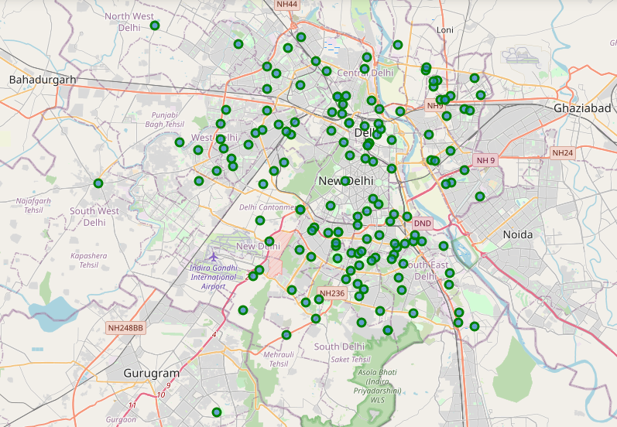
Map
Visualizing the neighbourhoods in Delhi.

Slide 6
Methodology (contd.)
5. Using API to explore the neighbourhood data.
6. Clustering the data of explored venues with respect to each location using K-means clustering algorithm.
7. Displaying the clustered hotspots on the map using suitable libraries.

Slide 7
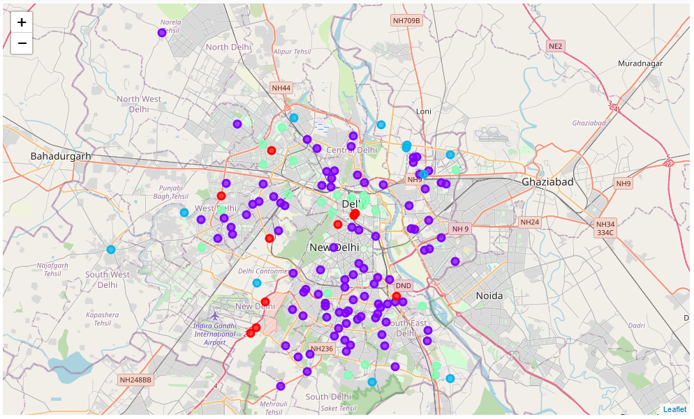
Map
Hotspots indicating the clusters formed with respect to the venue types in different localities.

Slide 8
Results obtained from Analysis
• Neighbourhoods in Delhi.
• Geographical location coordinates of neighbourhoods.
• List of venues at the locations.
• Determining the most popular venue groups in the localities.
• Grouping the localities with respect to venue type.
• Each location with most common venues nearby.
• Clustering the locations with respect to the venue grouping.
• Visualizing geographical location of hotspots.

Slide 9
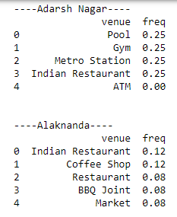
Data
Observations are drawn from the analysis regarding the top popular venues nearby a locality.

Slide 10
Conclusion
Therefore, it can be concluded that the analysis of neighbourhoods and their nearby venues provided us with results that are visually empowered and can be presented to any new businessman who is trying to start a business in the city of Delhi.
He can identify the “hot” businesses in an area as well as where he’s going to get the maximum competition for the services that he is about to offer.

Slide 11
Thank You!

