Slide 1

Pawsitively Profitable
Optimizing Product Bundling and Logistics for E commerce Growth

Slide 2

Overview
Business Context: Munchy's, a fictional online pet supply store, operates in a competitive e-commerce landscape, requiring data-driven strategies to enhance profitability and streamline operations. Understanding customer preferences, regional demands, and cost dynamics is vital to staying ahead in the market.
Motivation: The project aims to uncover actionable insights from Munchy's sales and logistics data to:
Identify key revenue drivers across regions, product categories, and seasons.
Optimize pricing strategies and cost efficiency by analyzing landed and shipping costs.
Apply the Pareto Principle to focus on high-impact products and maximize profitability.
Strategic Goal: Leverage data insights to refine Munchy's business strategy, enabling sustained growth, improved customer satisfaction, and a competitive edge in the evolving pet supply market.

Slide 3
Data Description
Source: https://app.datacamp.com/learn/courses/case-study-ecommerce-analysis-in-tableau
This dataset tracks the sales data of Munchy’s pet store in the US by state.
The dataset represents sales data tracked from Munchy’s chain of stores across various regions and states, covering the period from 2020 to 2021. It includes insights into product categories, shipping costs, quantities sold and landed costs. Through detailed analysis, we have identified trends and correlations within the data to provide actionable recommendations aimed at increasing sales and improving overall business strategy.
Source: Data camp
Format: .csv
Key variable (Columns): Transaction Date, Quantity, Sales, Unit price, Shipping Cost, Category, State, Region
Number of Records (Rows): 29,649
Number of Sheets/files: 4

Slide 4
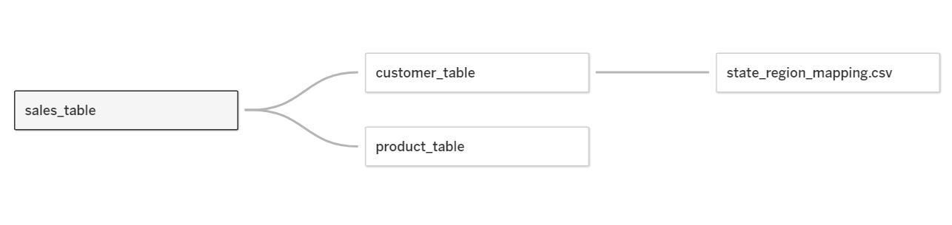
Data Preparation
We used Tableau to join four CSV datasets by identifying and leveraging a common column present across all tables, ensuring seamless integration of the data.
Unnecessary columns were removed to maintain focus on relevant data points for our analysis and visualizations.
Inconsistent entries in fields such as "Order State" (e.g., AZ and Arizona for the same state) were standardized to ensure data uniformity and prevent discrepancies.
Stringent checks were performed to ensure that numeric columns, such as revenue or order quantities, were free of errors or outliers (such as filtering out null values)
Duplicates across datasets were removed, and column names were standardized to ensure consistency in the reporting structure.

Slide 5
Research Questions
1. How does revenue generated by different product categories (e.g., Food, Disposables, Grooming) fluctuate across seasons?
2. How does revenue vary across regions and states, and are there specific product categories that perform better in certain areas?
3. What is the correlation between Product Category, Costs, and Quantities?
4. What is the average landed cost versus shipping cost per order, and how does this vary by region or product type?
5. Does the current revenue model follow the pareto-principle?
6. How do sales and profit trends, product category performance, and regional revenue distribution shape Munchy’s business strategy, and what insights can be derived to optimize growth and profitability?

Slide 6
Methodologies Used
We used a wide variety of charts to formulate answers for our research questions.
Bar Charts
Line Graphs
Scatter Plot
Maps
Sparklines
Side-by-Side Bar Chart
Pareto Chart
Dual- Axis Line Chart

Slide 7
How does revenue generated by different product categories (e.g., Food, Disposables, Grooming) fluctuate across seasons?
Q1.

Slide 8
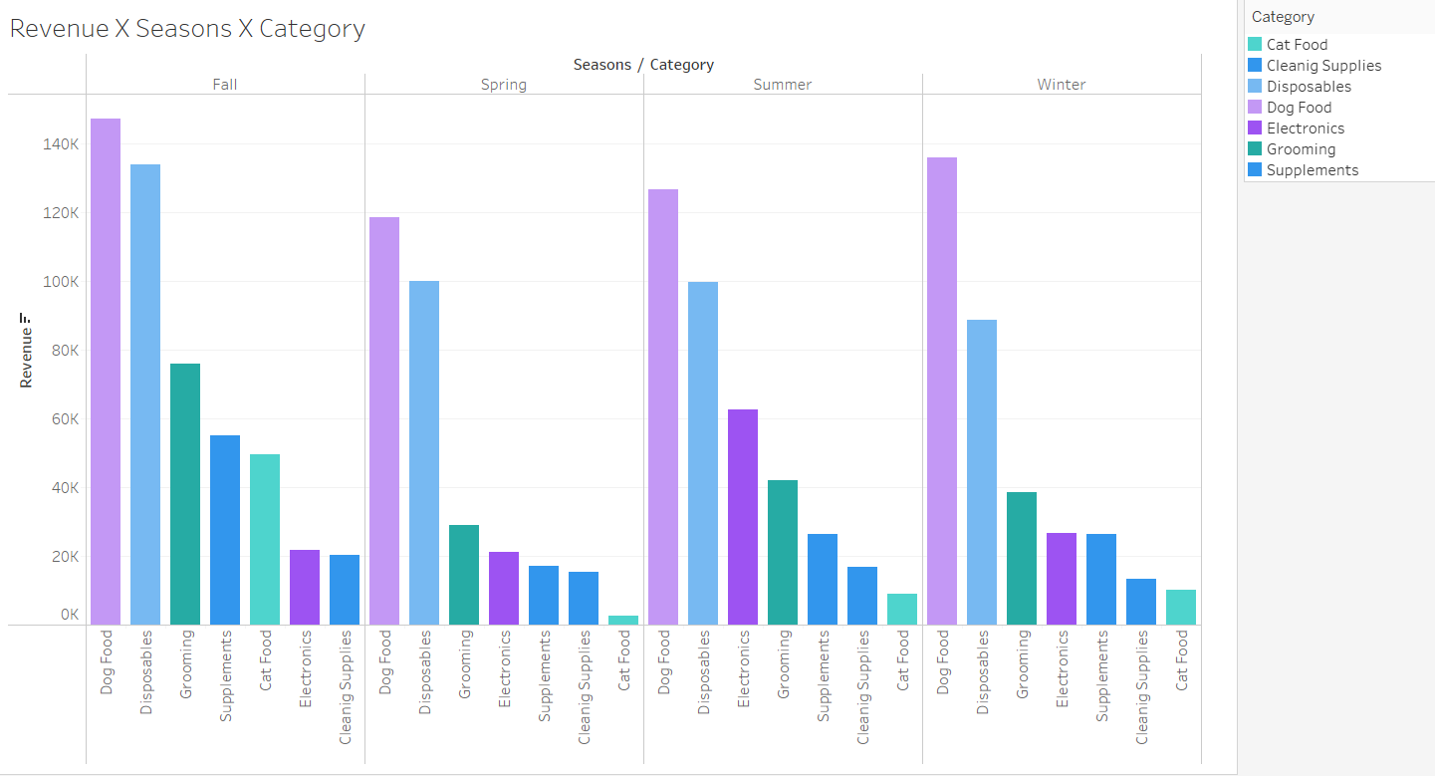
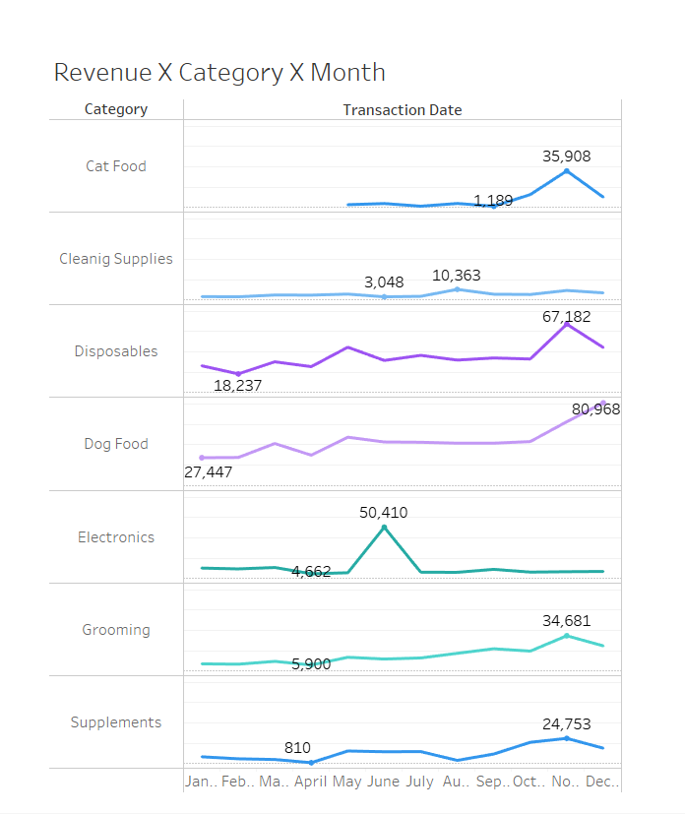
Dog Food generates the highest revenue across all seasons, peaking at 147K in Fall and remaining strong in Winter (136K). Disposables follow closely, with 134K in Fall, but drop to 88K in Winter. Grooming sees consistent but moderate demand, ranging from 76K in Fall to 38K in Winter.
Disposables and Dog Food drive consistent revenue throughout the year, with Dog Food peaking in December ($80,968) and Electronics showing a notable spike in June ($50,410). Additionally, Cat Food appears to have been introduced in May, reflected by its initial recorded revenue ($1,200) and subsequent growth into December ($10,100).

Slide 9
How does revenue vary across regions and states, and are there specific product categories that perform better in certain areas?
Q2.

Slide 10
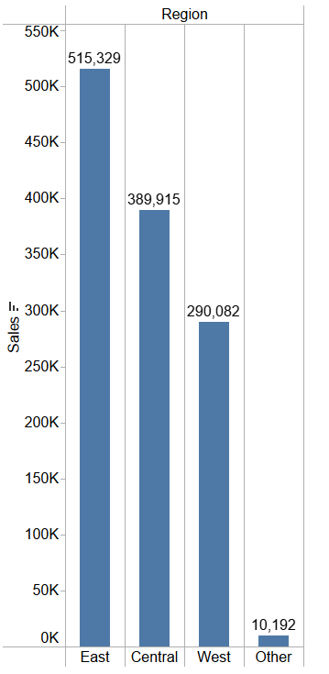
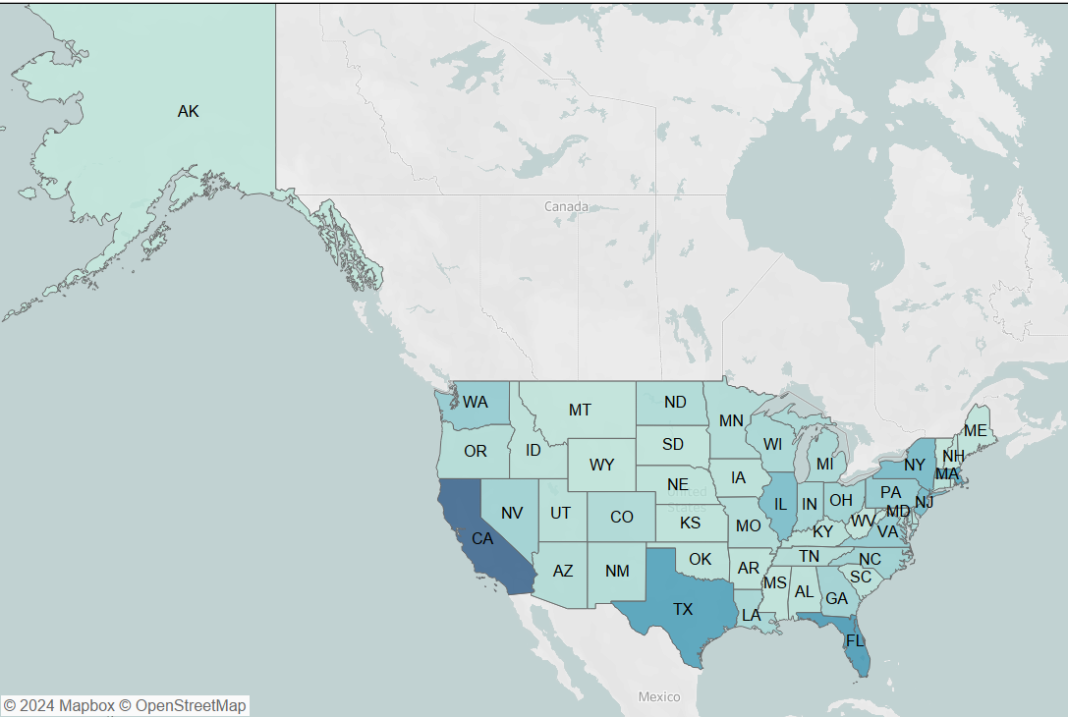
Regional Revenue Distribution
East Region: Top-performing region, surpassing 500,000 in revenue.
Central and West Regions: Strong contributors, each generating over 400,000 in sales.
State-wise Contribution
California: Leads with 154,642 in revenue, nearly double Texas.
Texas: Second-highest contributor with 88,602 in sales.
Florida & Massachusetts: Significant performers, each contributing over 75,000 in revenue..

Slide 11
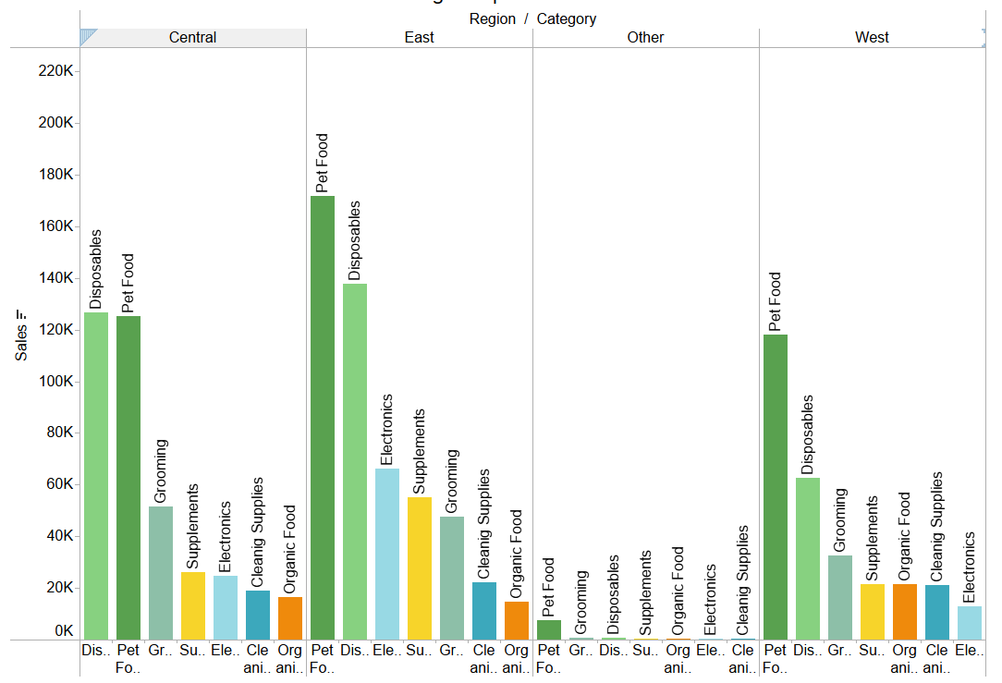
Product Categories X Areas
Category Leaders by Region
Disposables dominate sales in East and West regions, peaking at 180K in East, while Dog Food leads in Central with over 120K.
Regional Preferences
Supplements and Cleaning Supplies consistently rank high across all regions, indicating steady demand for these categories.
Minimal Sales in "Other"
The "Other" region shows negligible sales across all categories, highlighting limited market activity there.

Slide 12
What is the correlation between Product Category, Costs, and Quantities?
Q3.

Slide 13
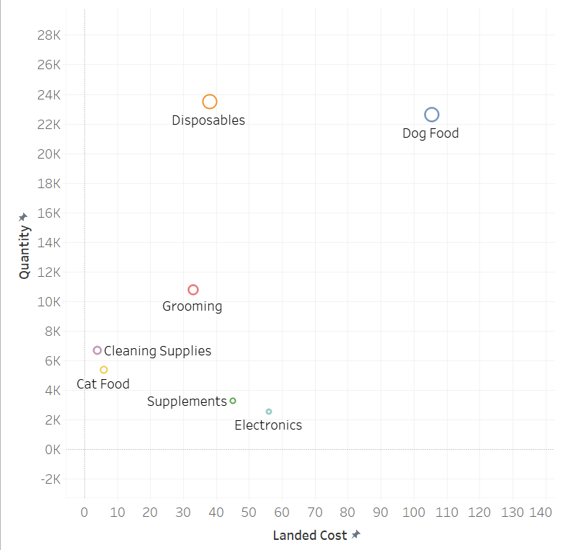
Scatter Plot for relationship between Landed Cost (X-Axis) and Quantity Sold (Y-Axis) across various Product Categories.
Key Observations:
1. Disposables:
Positioned in the upper-left quadrant, Disposables have a low landed cost but exceptionally high quantities sold (over 25K).
2. Pet Food:
Found in the upper-mid section, Pet Food demonstrates high quantities sold with a moderate landed cost (~$80).
3. Electronics and Supplements:
Both categories are located in the lower-right quadrant with high landed costs (~$100+) but minimal quantities sold.
4. Low Landed Cost, Low Quantities (Cleaning Supplies, Organic Food, Grooming):
These categories have lower landed costs (~$40 or less) but fail to achieve significant quantities sold.
The analysis reveals an inverse correlation between landed cost and quantity sold, except for categories where necessity (like Pet Food) overrides cost considerations.
Categories like Disposables demonstrate the significance of affordability in driving demand, while Electronics and Supplements showcase challenges with premium pricing.
Tailored pricing, enhanced visibility, and supply chain efficiencies could drive growth across less-performing categories.

Slide 14
Scatter Plot for relationship between Landed Cost (X-Axis) and Quantity Sold (Y-Axis) across various Product Categories.
Insights:
Disposables are likely essential, low-cost items that customers purchase frequently or in bulk.
Despite higher costs, Pet Food maintains demand due to its essential nature for pet owners.
These are premium or specialized products with limited market demand, possibly due to higher pricing or niche usage.
Products in these categories might suffer from poor visibility, competition, or lack of customer interest.
Recommendations:
1. Leverage Strong Performers:
Continue prioritizing Disposables and Pet Food, as they contribute significantly to sales volumes. Enhance promotions and ensure steady stock levels for these products.
2. Reevaluate High-Cost, Low-Quantity Products (Electronics and Supplements):
Reduce landed costs through supply chain optimization or renegotiating vendor contracts.
Develop marketing campaigns that highlight the value or unique benefits of these products.
3. Boost Visibility for Underperforming Categories:
Focus on increasing awareness and demand for Cleaning Supplies, Organic Food, and Grooming.
Explore bundling options with high-performing products (e.g., Disposables + Cleaning Supplies) to boost sales.

Slide 15
How do different product categories vary in terms of their Avg. landed costs and Avg. shipping costs, and what impact does product weight have on them?
Q4.

Slide 16
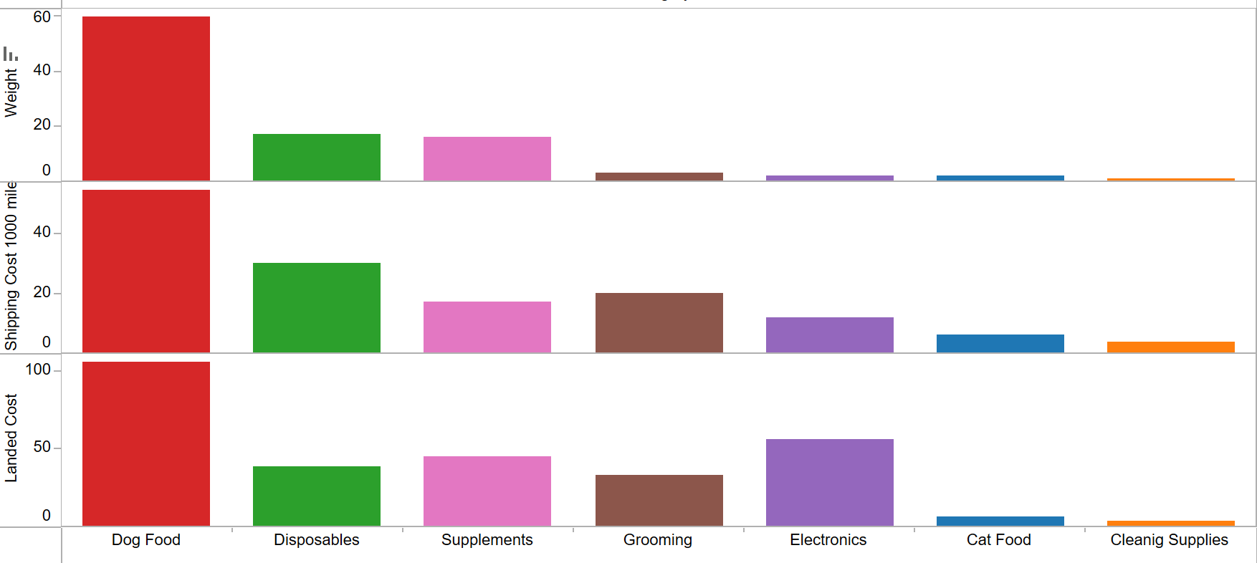
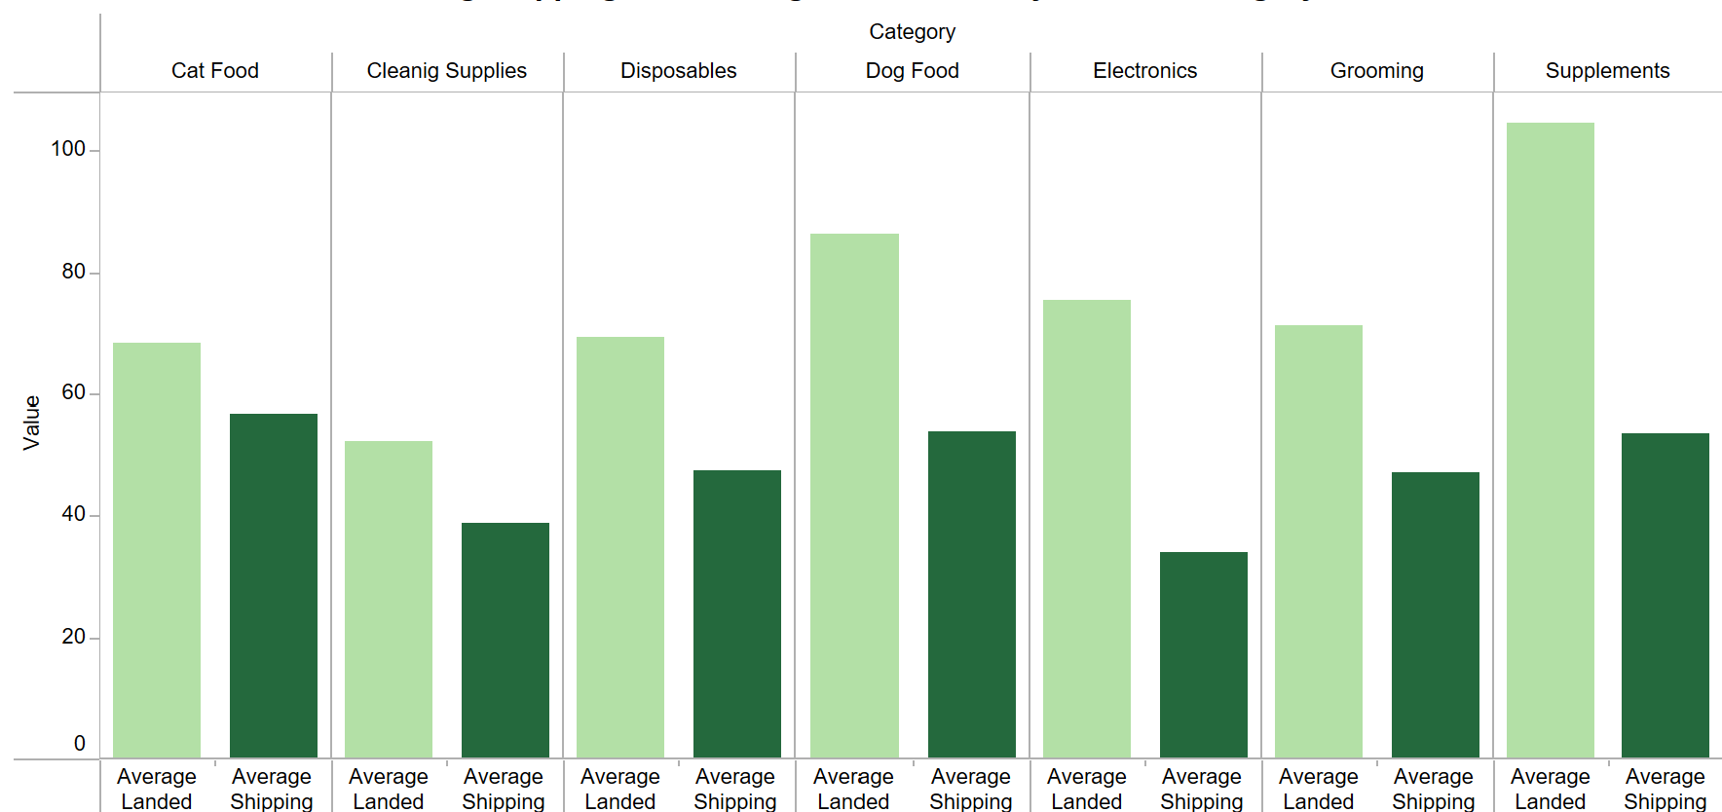
Product weight is a critical factor in determining shipping costs. Here we can clearly see that for Pet Food, despite its substantial purchase price, the weight of the large bags significantly drove up the shipping costs, thereby increasing the overall landed cost.
Despite Electronics being lightweight, their shipping and landed costs can still be higher due to factors such as specialized packaging, fragile handling requirements, and often expedited shipping needs.
By understanding the average landed cost and average shipping cost for each category, you can better analyze profit margins for each product line.
Categories with high shipping costs relative to their landed costs may have lower profit margins unless priced accordingly.
Understanding the interplay between landed costs and shipping costs is crucial for optimizing your business. By analyzing these metrics, you can make strategic decisions that enhance your profit margins and ensure long-term success.

Slide 17
Does the current revenue model follow the pareto-principle?
Does 80% of the revenue come from 20% of categories? Is it the same with products?
Q5.

Slide 18
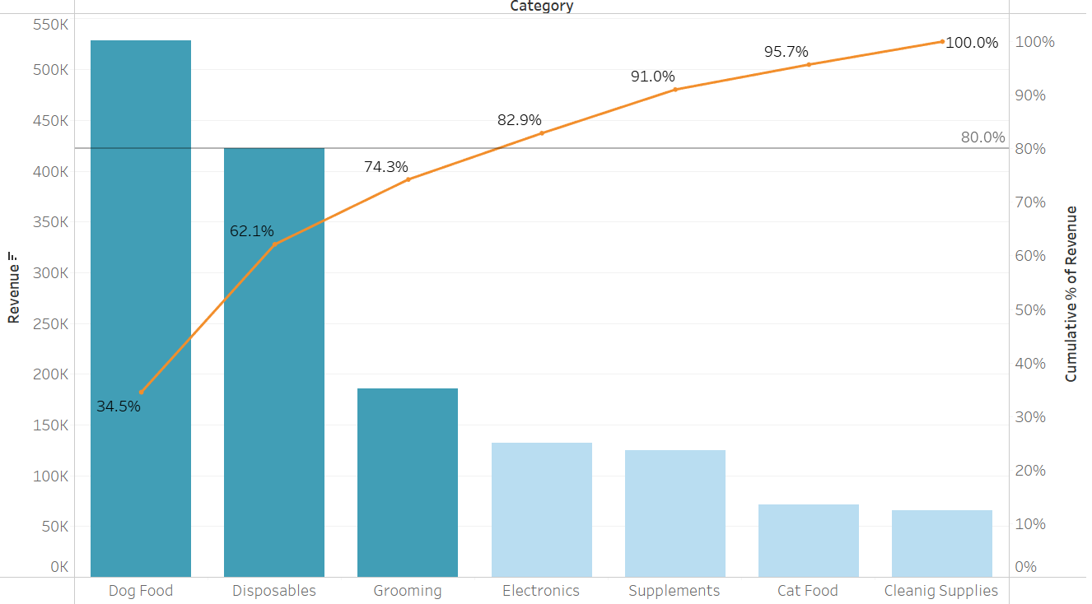
Pareto Chart of Revenue by Product Categories: Identifying Top Revenue Drivers
The Pareto chart reveals that the top three categories, Dog Food, Disposables, and Grooming, contribute 74.3% of total revenue, with Dog Food alone generating 34.5%. This indicates that a significant portion of revenue is concentrated in a few high-performing categories. In contrast, categories like Electronics, Supplements, Cat Food, and Cleaning Supplies collectively account for a smaller share, highlighting the potential for growth through targeted marketing or bundling strategies.

Slide 19
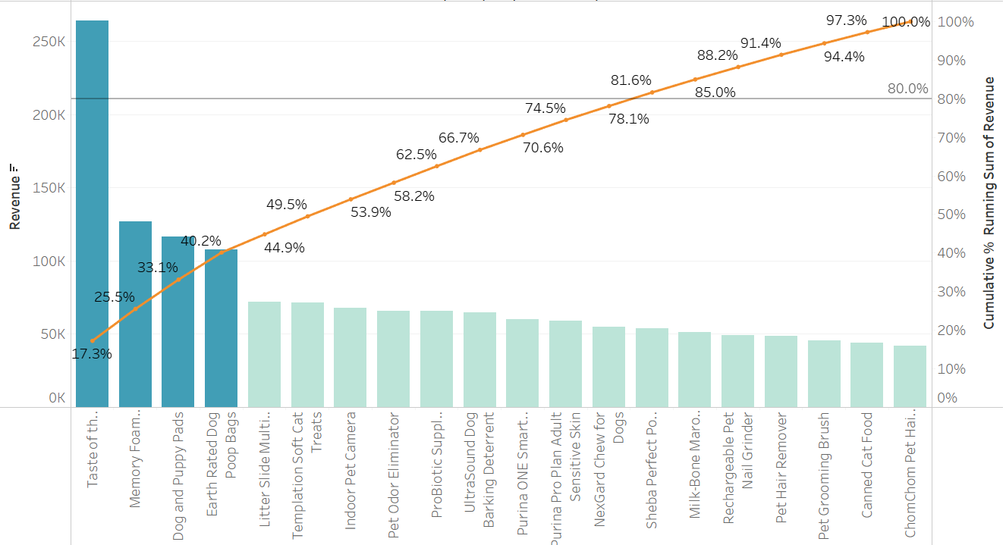
Pareto Chart of Revenue by Products: Identifying Top Revenue Drivers
The chart shows that the top four products—Taste of the Wild (17.3%), Memory Foam, Dog and Puppy Pads, and Earth Rated Dog Bags—together contribute 40.2% of total revenue. Taste of the Wild stands out as the single largest revenue driver. Lower-performing products make up the remaining 59.8%, emphasizing the opportunity to reevaluate or optimize these products to boost their contribution or redirect resources to the top performers.

Slide 20
Recommendations
Prioritize High-Performing Categories and Products
Optimize Resources
Explore Cross-Selling Opportunities
Invest in Data-Driven Insights

Slide 21
Q6.
How do sales and profit trends, product category performance, and regional revenue distribution shape Munchy’s business strategy, and what insights can be derived to optimize growth and profitability?

Slide 22
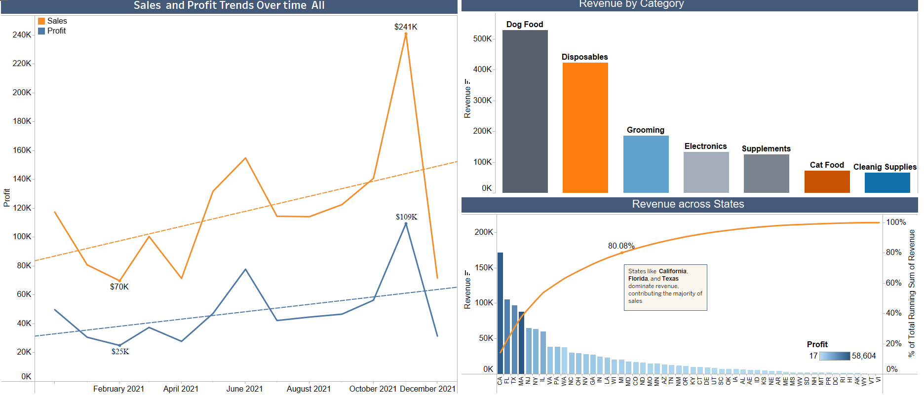
Sales and Profit Trends: Sales peaked at $241K in December, while profit hit $109K in October. The gap highlights opportunities to improve cost efficiency or focus on higher-margin products.
Revenue by category: Dog food and Disposables lead in revenue. Grooming and Electronics show growth potential, while Cat food and Cleaning Supplies require strategic adjustments.
Revenue by state: California, Texas, and Florida account for 80% of total revenue. Untapped opportunities exist in lower-performing states with targeted strategies.

Slide 23
Learning Outcomes
Data Quality Matters:
Ensuring uniformity and accuracy in data is critical. Standardizing inconsistent entries (e.g., state names) and removing duplicates was essential for deriving reliable insights.
Visualization Drives Insights: Using tools like Tableau highlighted trends across regions, product categories, and seasonal variations, making complex data more accessible and actionable.
Key Patterns Emerged:
Regional dominance in sales (e.g., East region and California).
Product category performance and pricing strategies' impact on sales volumes.
Shipping and landed costs significantly influence profit margins.
Strategic Applications:
Leveraging strong performers like disposables and pet food to maximize profitability.
Addressing challenges in high-cost, low-demand products through better marketing and supply chain optimization.
Pareto Principle Confirmed: A minority of products (top 20%) generated a significant portion of revenue, affirming its application in business strategy.
Iterative Approach is Key: Reassessing methodology and aligning with business goals helped refine insights, ensuring recommendations were actionable and data-driven.
Practical Takeaway: Optimizing data preparation and visualization processes results in actionable business strategies, supporting profitability and efficiency goals.

Slide 24
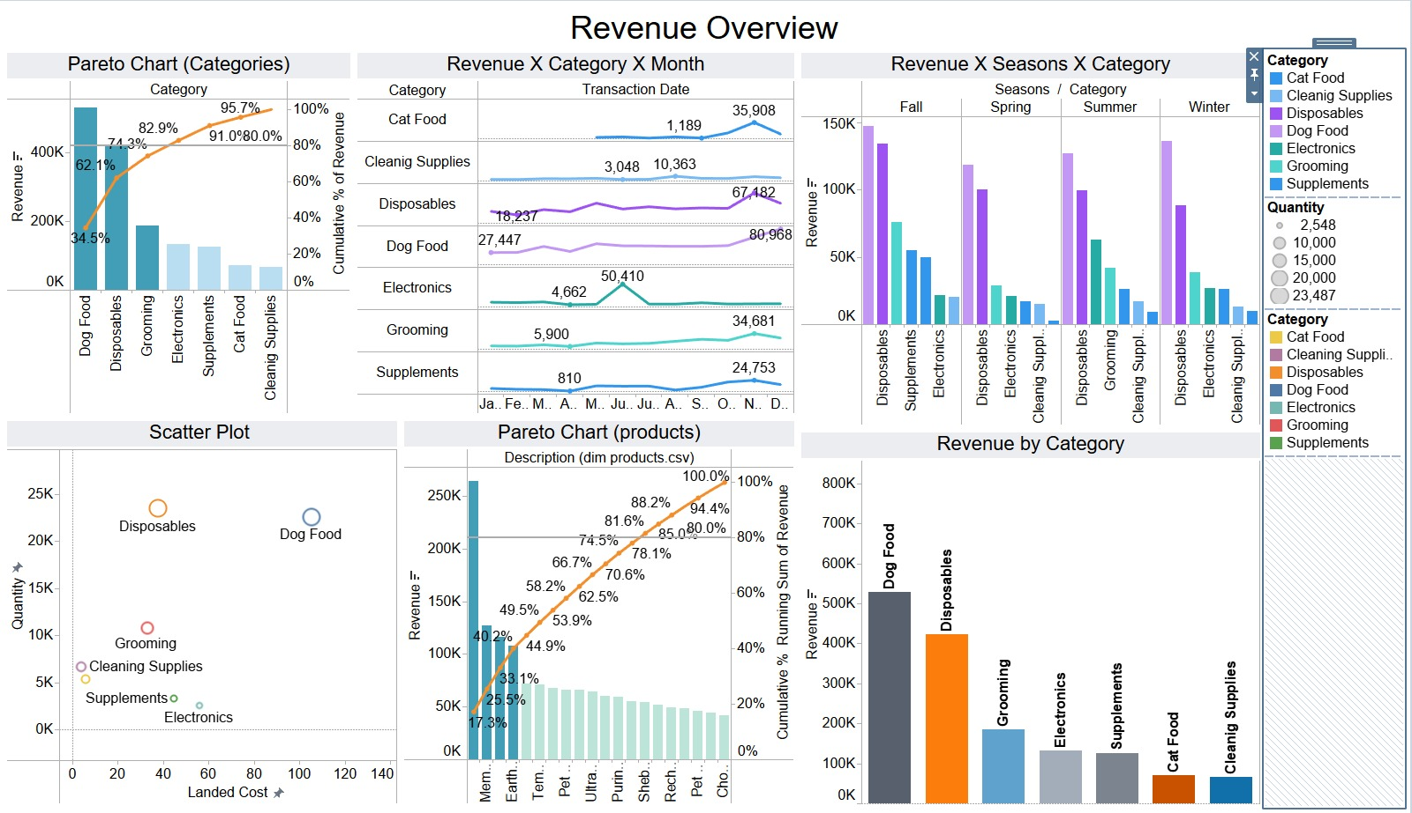
Dashboard 1

Slide 25
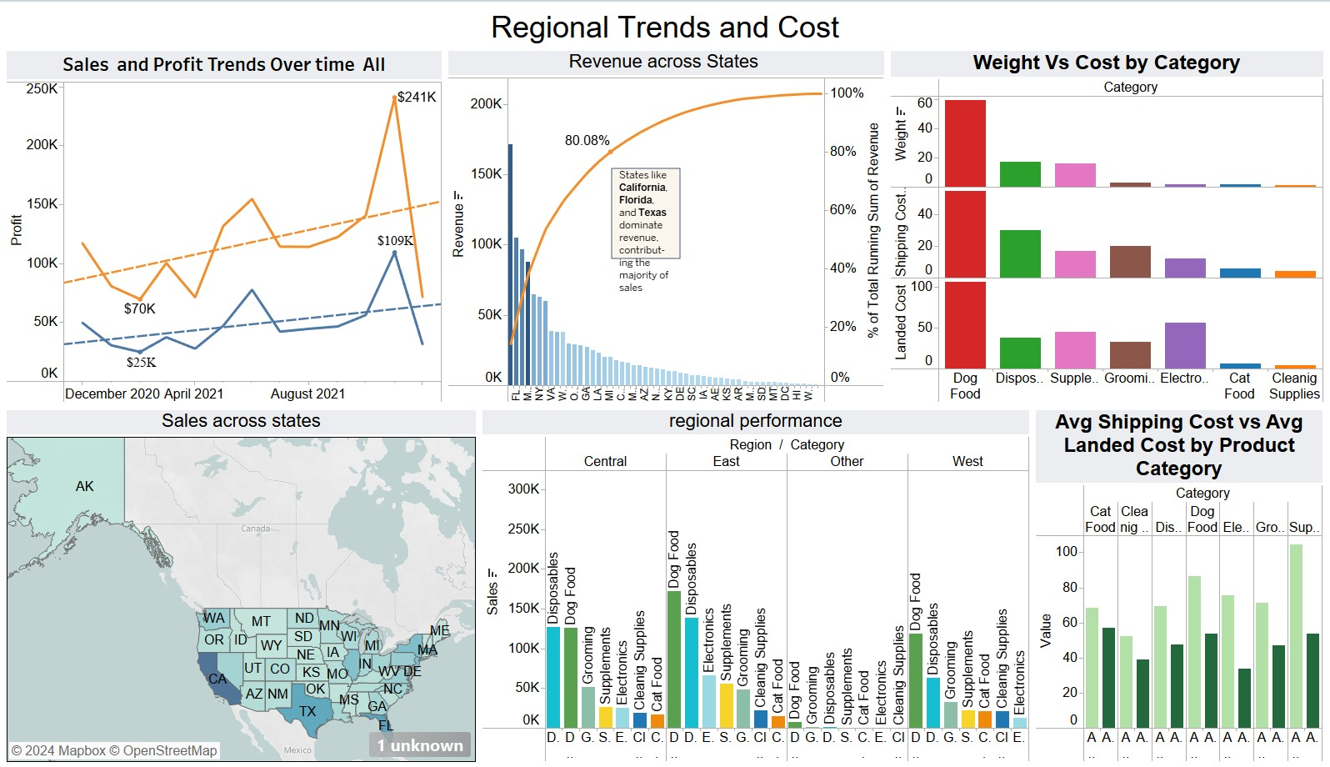
Dashboard 2

Slide 26
THANK YOU

