Slide 1
OS WAR ROOM
An Interactive Multiprogramming Operating System Simulator for Workload Management, Failure Injection and Kernel Recovery
Create. Run. Break. Diagnose. Recover.
C++17 kernel · React / TypeScript control room · 87 tests · 11 scenarios
Notes:
One-minute pitch: OS War Room integrates the major concepts of our Operating Systems syllabus in one virtual OS. You can create processes, watch scheduling and context switching, inspect PCBs, generate page faults, manage I/O, demonstrate synchronisation and IPC, and create deadlocks. The differentiator is the Failure Lab: deliberately break the system and watch the kernel detect and recover. The Experiment Lab runs identical workloads under different algorithms and compares measurable metrics.

Slide 2
Not a collection of algorithms — a living system
CONVENTIONAL PROJECT
OS WAR ROOM
Implement FCFS
Implement paging
Implement a semaphore
Implement deadlock detection
Print the output
CREATE
processes, programs, scenarios
RUN
scheduler, memory, I/O, sync — together
BREAK
inject faults into the simulated kernel
DIAGNOSE
logs, health monitor, OS Detective
Each concept shown in isolation.
RECOVER
load control, victim kill, EIO, cleanup
Notes:
A conventional project implements FCFS, paging, a semaphore and a deadlock detector and prints output. We instead built one kernel in which those mechanisms interact: a page fault blocks a process, which changes the ready queue, which changes utilisation, which can look like thrashing.

Slide 3
Architecture: a kernel model behind a live dashboard
DASHBOARD
DESIGN CHOICES
React 18 + TypeScript — Control Room · Memory Lab · Sync & IPC · Experiment Lab · OS Detective
Tick-driven, deterministic (seeded) — reproducible to the millisecond
Programs, not scripts: races and deadlocks emerge
Strategy interfaces: swap algorithms live
Labs run on private kernels
Zero external dependencies
▼
API SERVER
C++ HTTP/1.1 + JSON · background tick thread · one lock on the live simulation
▼
SIMULATION
Failure Lab · scenario loader · workload generator · Experiment Lab · OS Detective
▼
KERNEL
Scheduler · Memory (paging) · Interrupts · System calls · Sync · IPC · I/O · Error handler
Notes:
Layers: a React/TypeScript dashboard polls a JSON API served by a dependency-free C++ HTTP server. The server drives a Simulation that owns the kernel plus the Failure Lab, Experiment Lab and OS Detective. The kernel contains the scheduler, memory manager, interrupt controller, synchronisation, IPC, I/O and error handling behind a system-call trap boundary. Everything is deterministic and seeded.

Slide 4
One tick = one millisecond = seven phases
1
2
3
4
5
6
7
ADMIT
HARDWARE
INTERRUPTS
RECOVERY
DISPATCH
EXECUTE
ACCOUNT
NEW → READY
devices, timers, page-ins
by priority
deadlock victim
preempt · switch
one instruction
waits · aging
WORKED EXAMPLE — ONE PAGE FAULT
t
P3 references page 12 — not in its page table → PAGE_FAULT exception
t
handler picks a victim (LRU), updates both page tables, pins the new frame
t
P3 → WAITING; page-in scheduled; CPU switches to another process
t+4
swap read done → IO_COMPLETE interrupt → P3 READY
t+5
P3 re-executes the same reference: hit, PC advances
Notes:
Every Kernel::tick() runs the same seven phases. Synchronous events (traps, page faults, errors) are dispatched immediately like CPU exceptions; asynchronous events (device completion, timers) are queued and served by priority: ERROR, PAGE_FAULT, IO_COMPLETE, TIMER. Walk through the page-fault example on the bottom row.

Slide 5
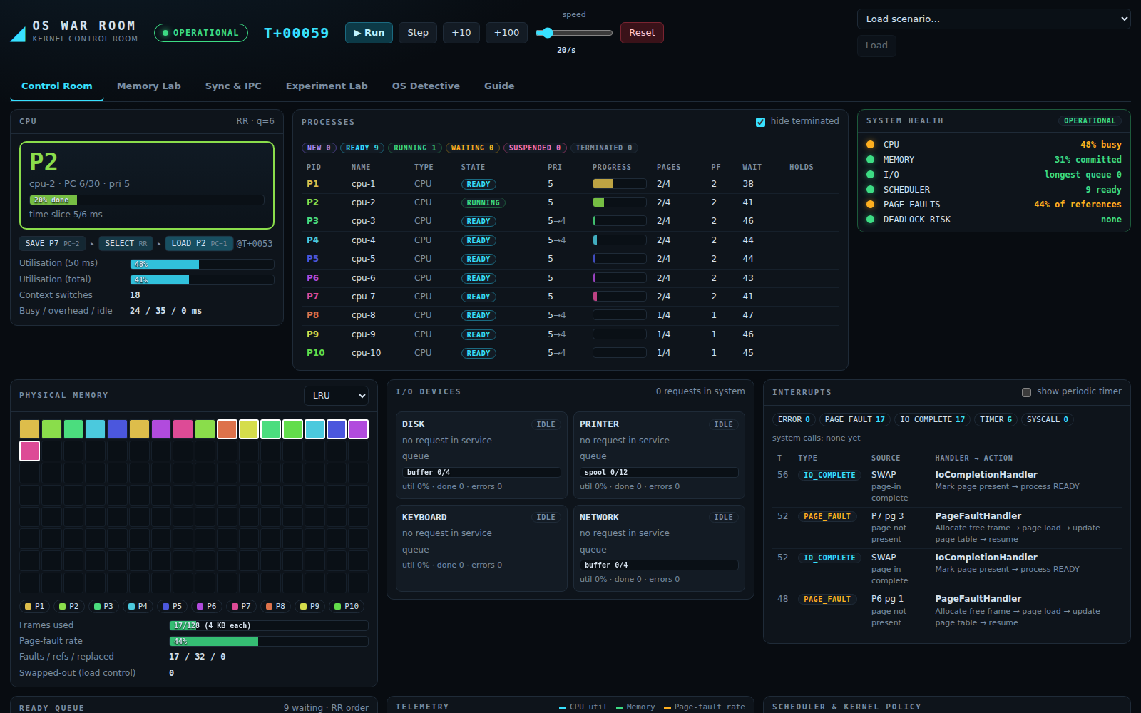
The control room: watch every mechanism at once
CPU + context-switch chain
Process table → PCB inspector
Frame map, page-fault rate
Device queues, buffers, spool
Interrupt viewer: handler → action
Six-LED health monitor
Live scheduler / policy switching
Scenario 1 — CPU Battle, Round Robin q=6
Notes:
Point out: CPU panel with the SAVE-SELECT-LOAD context switch chain, process table with states and wait reasons, PCB inspector on click, frame map coloured per process, I/O devices with queues and buffers, interrupt viewer with handler and action, system health LEDs, and the filterable kernel event log.

Slide 6
Seven schedulers, validated against textbook numbers
FCFS · SJF · SRTF
classic baselines
Round Robin
timer-interrupt quantum
Priority + aging
preemptive, starvation-proof
MLFQ
3 levels, demote / boost
Adaptive
burst prediction τ
Validated: FCFS 17 · RR(4) 5.67 · SJF 7.75 · SRTF 6.5 · Priority 8.2 ms avg wait
Notes:
FCFS, SJF, SRTF, Round Robin, preemptive Priority with aging, a three-level MLFQ, and an Adaptive scheduler using exponentially averaged burst prediction. They are checked against published examples: FCFS 17 ms, RR 5.67 ms, SJF 7.75 ms, SRTF 6.5 ms, Priority 8.2 ms. The chart shows measured average waiting time for the same 25-process seeded workload.

Slide 7
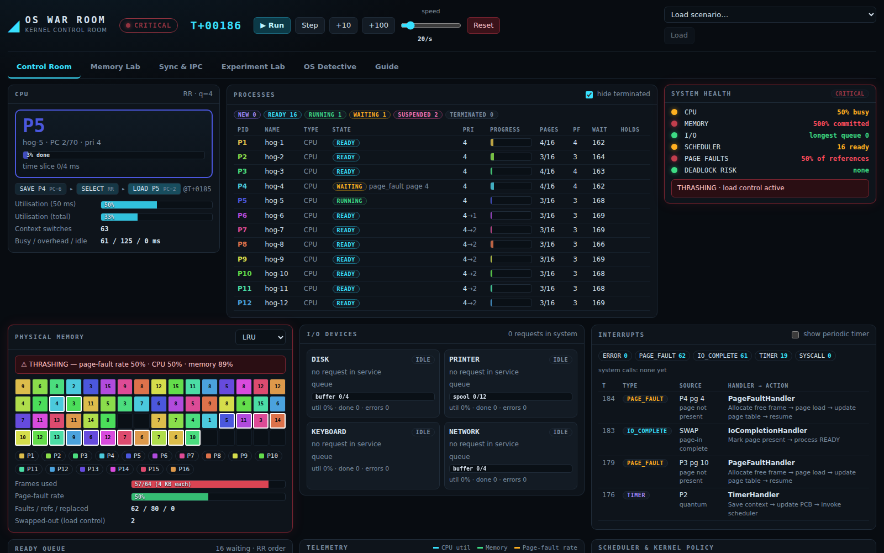
Virtual memory: paging, replacement and thrashing
129
148
LRU faults
FIFO faults
127
106
Clock faults
Optimal*
Textbook: FIFO 15 · LRU 12 · OPT 9
Thrash rule: faults ≥55% · CPU <50% · mem >85%
Load control: swap out, swap back in
* owner-local look-ahead inside the kernel; exact in the standalone lab
Notes:
Demand paging with per-process page tables and four replacement policies: FIFO, LRU, Clock and Optimal. Frames being paged in are pinned so a loaded page cannot be stolen before its owner uses it. Thrashing is detected from fault rate, CPU utilisation and memory occupancy; load control swaps out low-priority processes and swaps them back in when pressure eases. On the textbook string the lab gives FIFO 15, LRU 12, Optimal 9 faults and reproduces Belady's anomaly.

Slide 8
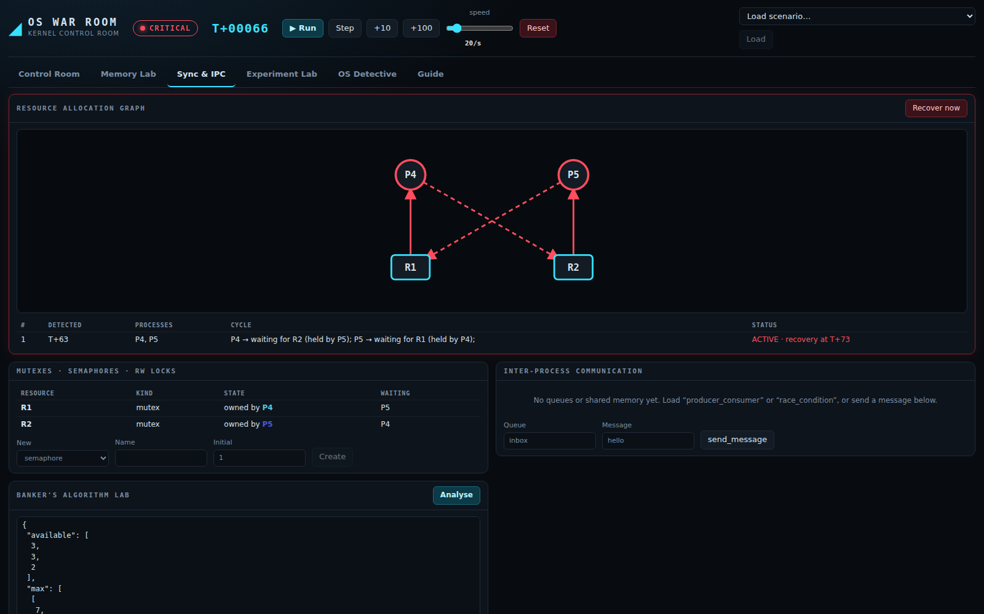
Synchronisation and deadlock: detect, then recover
Live Resource Allocation Graph
Wait-for graph + Tarjan SCC
Victim: lowest priority → least CPU
TERMINATE or ROLLBACK recovery
Race condition: 10+10 increments → <20 unlocked, =20 locked
Producer–consumer, readers–writers, dining philosophers
Banker's algorithm lab
Notes:
Mutexes, counting semaphores and fair reader-writer locks hand ownership directly to waiters. Deadlock detection builds the wait-for graph and finds cycles with Tarjan's algorithm. The victim is the least important process; recovery either terminates it or rolls it back. The race-condition scenario shows lost updates without a lock and a correct count with one; dining philosophers deadlocks naively and not with resource ordering.

Slide 9
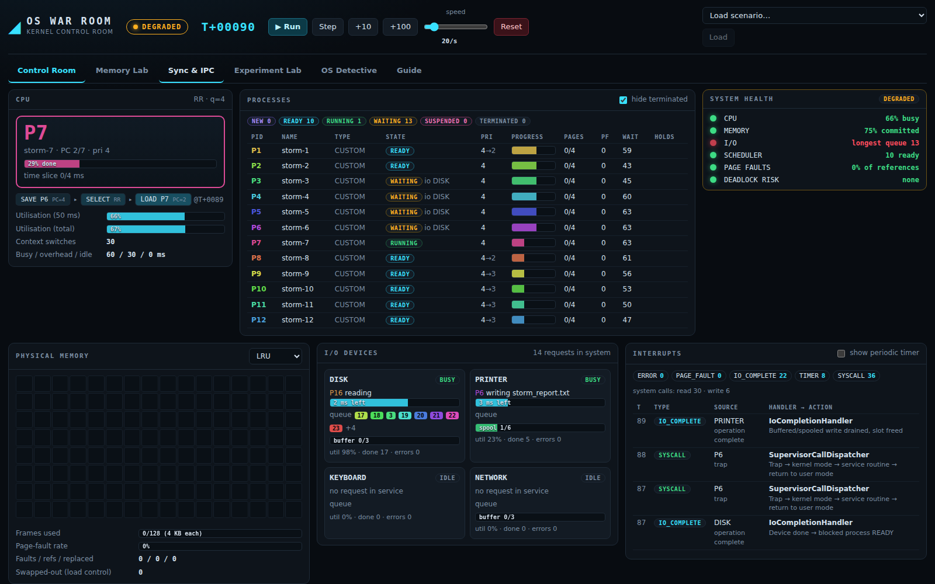
I/O: blocking, buffering and spooling
BLOCKING
BUFFERING
SPOOLING
READ DISK 5
WRITE DISK / NETWORK
WRITE PRINTER doc
process → WAITING
completion interrupt → READY
CPU runs others meanwhile
bounded write-behind buffer
full buffer ⇒ producer blocks
stats: full events, idle consumer
spool queue of named jobs
process continues at once
spool full ⇒ producer blocks
Scenario 3 — I/O Storm
Device failure → queued requests aborted with EIO, blocked processes woken with an error code, new requests rejected until repair; buffered writes in flight are counted as lost. Health: I/O LED turns RED.
Notes:
Four devices with FIFO queues. Blocking I/O moves the process to WAITING until the completion interrupt. DISK and NETWORK writes go through bounded write-behind buffers: the process continues until the buffer fills, then the producer blocks. The printer uses a spool queue so processes never wait for the slow device. A device failure aborts requests with EIO and later recovers.

Slide 10
Failure Lab: break it, watch the kernel respond
FAILURE | KERNEL DETECTS | KERNEL RECOVERS
Force page fault | PAGE_FAULT interrupt | victim selection → page load → resume
Exhaust memory | thrashing rule (faults, CPU, memory) | swap out low-priority, swap back in
Create deadlock | wait-for graph cycle | victim terminated / rolled back
Crash process | ERROR interrupt | crash dump; frames, locks, I/O released
Flood I/O | device queue length | buffers/spool absorb; producers block
Fail a device | device state OFFLINE | EIO to waiters; repair after N ms
Buffer stress | buffer full events | producer blocking, drain
Starvation | READY ≥ 120 ms | turn on aging / change policy
Notes:
Eight injectable failures. All faults are injected into the simulated kernel only. For each, the dashboard shows the detection (health LED, banner, log, interrupt viewer) and the recovery action. This is the live demonstration: inject, watch, recover.

Slide 11
Experiment Lab: same workload, different decisions
78%
4 KB
faults @ 64 KB RAM
best page size
44→77%
48%
CPU util, q=1→32
less waiting: SJF vs FCFS
Process count · quantum · memory · page size · I/O intensity
Metrics: wait, turnaround, response, CPU, throughput, faults, switches
Deterministic: same seed → same numbers
Notes:
The same seeded workload runs on fresh kernels under any set of algorithms and what-if variables. Sweeping the process count from 10 to 50, CPU utilisation falls from 63 to 47 percent and the page-fault rate rises from 16.6 to 54 percent. Memory 64 KB gives a 78 percent fault rate; page size shows a U-shaped optimum at 4 KB. Honest negative results are in the report: FCFS shows no convoy effect in a blocking-heavy mix, and preemptive priority with aging churns.

Slide 12
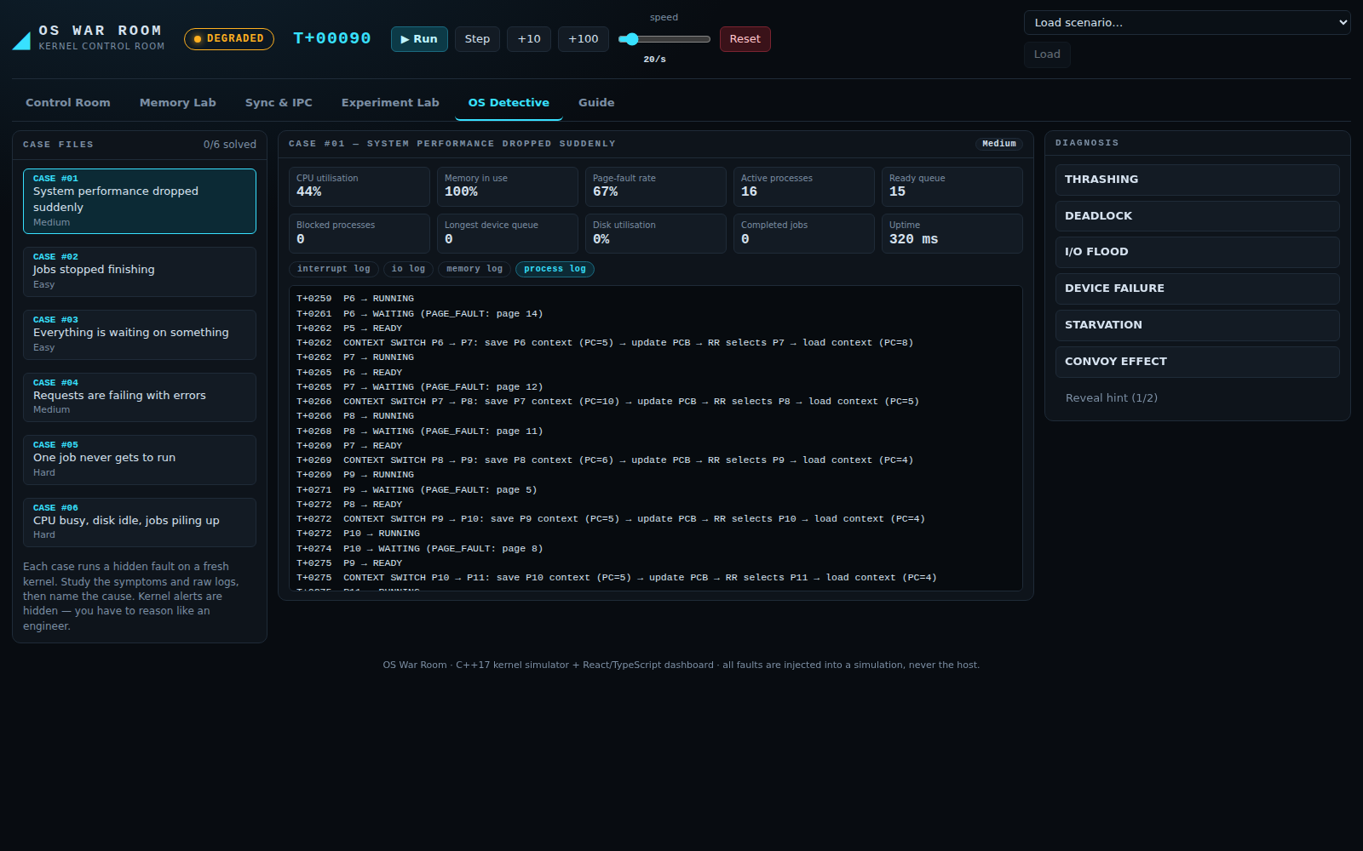
OS Detective and the evaluator walk-through
1
Start: OPERATIONAL, CPU 0%, I/O idle
2
Create four process types (presets)
3
Run: states, ready queue, CPU, memory
4
Force a page fault → handler chain
5
Create deadlock → detect → recover
6
Flood I/O → queue, buffer, spool
7
Crash a process → cleanup
8
Experiment: FCFS vs RR vs MLFQ
Six cases: thrashing · deadlock · I/O flood · device failure · starvation · convoy effect
9
OS Detective: diagnose from logs
Notes:
OS Detective generates six case files. Each runs a hidden fault on a fresh kernel and shows symptoms plus raw logs with kernel alerts removed. The evaluator names the cause; wrong guesses never leak the answer. The right-hand list is the nine-step faculty demonstration flow from the case study; each step maps to a button in the dashboard.

Slide 13
Verified, not just demonstrated
87
2,036
0
clean
automated tests
assertions
compiler warnings (-Wpedantic)
ASan + UBSan + stress
GROUND TRUTH USED
INTEGRATION BEHAVIOURS
Scheduling: 17 · 5.67 · 7.75 · 6.5 · 8.2 ms
Replacement 15/12/9 faults, Bélády's anomaly
Banker's safe sequence P1,P3,P4,P0,P2
Exact timing: READ 5 ms ⇒ completes at T+7
Crash releases a lock to its waiter
Thrashing detected, then resolved
Race loses updates; mutex fixes it
Detective never leaks answers
Same seed ⇒ identical metrics
Notes:
Every algorithm is checked against published results, and cross-module behaviour is tested end to end. The suite is clean under AddressSanitizer and UBSan and the API server survived concurrent-client stress under the same sanitizers. Writing the tests found real defects - for example a thrashing detector that could never fire because it demanded too many references.

Slide 14
Scope, limits and what is next
DELIVERED
LIMITS & NEXT
All must-have and recommended features
All four signature features
Optional: shared memory, Banker's, thrashing control, adaptive scheduler
11 scenarios, 12 deliverables
Single simulated CPU (multi-core: future)
Idealised devices, no file system
Optimal replacement approximated in-kernel
Next: disk scheduling, real-time classes
Create. Run. Break. Diagnose. Recover.
Notes:
It is an educational simulation: single simulated CPU, discrete time, idealised devices, constant page-fault latency, no file system. All failures are inside the simulation. Future scope from the case study: multi-core, disk scheduling, file system, real-time scheduling. Close with the tagline.

