Slide 1


ERange
Renewable power management system in an integrated power generation set-up
Team: Akhil Kailasam, Jibin John Jackson, Aditya Shinde
Project Link: https://app.moqups.com/jibinjohn100/dPUiaSghUr/view

Slide 2


We cover this presentation in two sections today:
What is POWERange ?
The Gist
The Problem Addressed
The Solution
Solution Highlights
UX Design Process
Need Finding / Brain Storming
Personas
Story-Boarding
Information Architecture
Paper Prototyping
Wire-framing
Work Division
Prototyping (future scope)

Slide 3
We cover this presentation in two sections today:
What is POWERange ?
The Gist
The Problem Addressed
The Solution
Solution Highlights
UX Design Process
Need Finding / Brain Storming
Personas
Story-Boarding
Information Architecture
Paper Prototyping
Wire-framing
Work Division
Prototyping (future scope)

Slide 4
What is POWERange?
”
The Gist:
Powerange is a highly customizable, fully integrated end-to-end Energy Management Solution providing functional solutions for Monitoring integrated power production, Power Quality, Control and Automation and Cost Allocation.
The system will also involve the data from the National weather Services which combined with sensors will help switch between various energy sources.
Overall it aims at our social community migrating towards renewable energy as their primary power source and non-renewable power source acting as their secondary backup source.
”

Slide 5
What is the problem addressed?
It is hard to determine how much electrical energy a solar or wind energy can produce in a day and both of these energy system is dependent on the external weather factor.
The integration of hybrid energy storage system (ESS) with renewable energy has been considered an effective solution to counteract its variant and unpredictable power generation.
It is necessary to determine the amount of electricity which will be consumed by a consumer and system has to be designed such that a consumer can best utilize the benefits of Renewable source of Energy which will help to decrease the carbon emission.

Slide 6
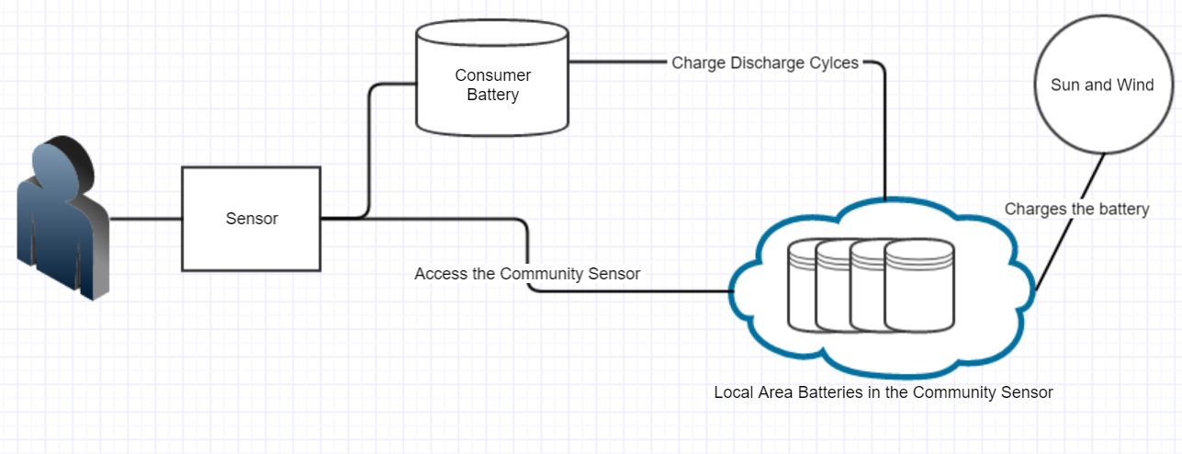
The Solution

Slide 7
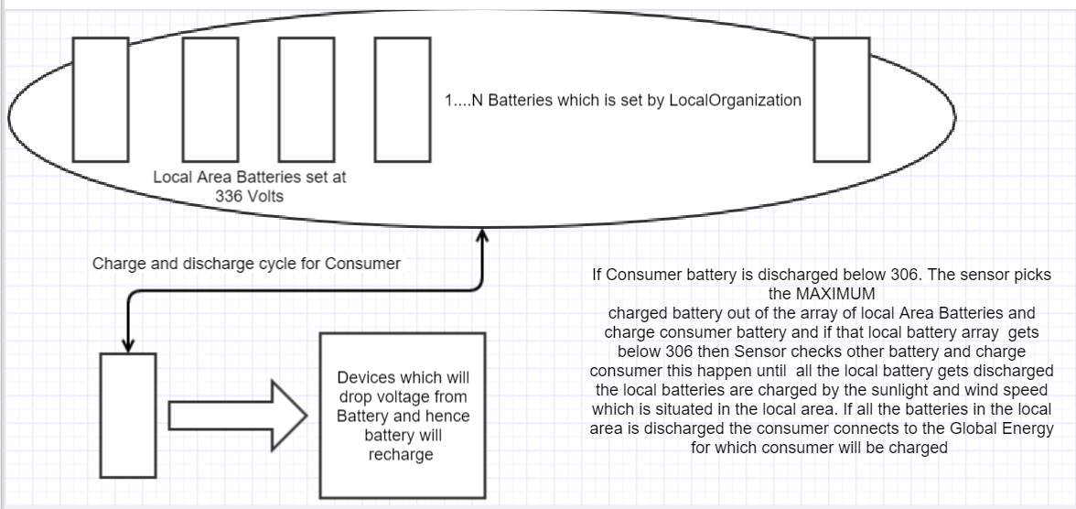
The Solution

Slide 8
The Solution: Strategy Plane:
Product Objectives:
A design methodology for hybrid energy systems.
Use of multiple renewable power sources alongside conventional power grid.
An optimal sizing methodology integrated with the energy management strategy.
Optimization based on sensors, analytics and weather prediction.
Design and validation using historical climate data and load demands.
Business Goals:
Short term goal: Convert the entire city population into the consumer base
Long term goal: expand the model to other cities and make the primary energy source of the country to Renewable energy source and main power grid line as a backup source
Success Metrics:
Consumer base
Add more renewable sources into renewable energy production list
User Needs:
User Segmentation:
House holds
Enterprise
Usability and User Research:
Market research methods and Contextual Inquiry
Personas & Storyboarding:

Slide 9
Solution highlights:
Improved predictive maintenance for less downtime
Identify maintenance tasks and make scheduled corrections to asset damage and downtime. Redundant configurations are also available to ensure maximum uptime and reduce outage risks.
Faster problem determination
Quickly pinpoint the root cause of problems using tools such as time-tagged alarms, sequence of events logs and triggered waveform capture.
Improved power quality
Identify sources of "dirty" power and take corrective action to save wear and possible damage to critical production equipment and other loads.
Higher productivity
Free up maintenance and repair personnel to perform other needed duties.
Increased safety
Provide a centralized source of information, reducing the need for physical contact with equipment and reduce shop-floor or substation.
Increased scalability
Open, comprehensive protocol and device support to easily integrate and expand existing systems and/or include a multitude of third-party devices in the system solution.

Slide 10
We cover this presentation in two sections today:
What is POWERange ?
The Gist
The Problem Addressed
The Solution
Solution Highlights
UX Design Process
Brain Storming / Need Finding
Personas
Story-Boarding
Information Architecture
Paper Prototyping
Wire-framing
Work Division
Prototyping (future scope)

Slide 11
Brain Storming/Need Finding

Slide 12
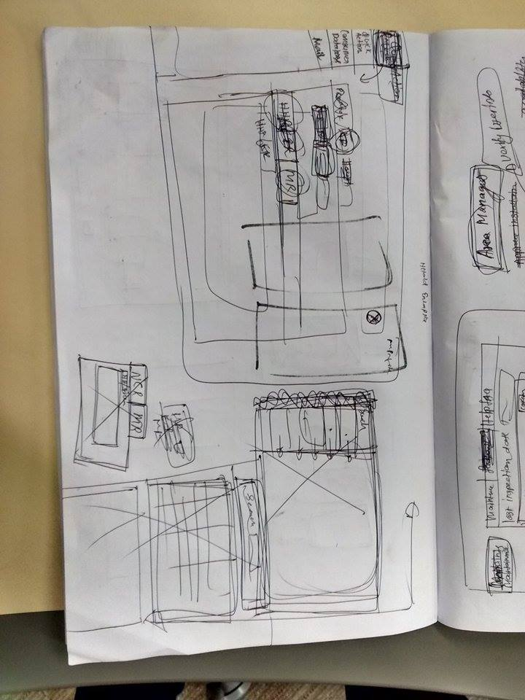
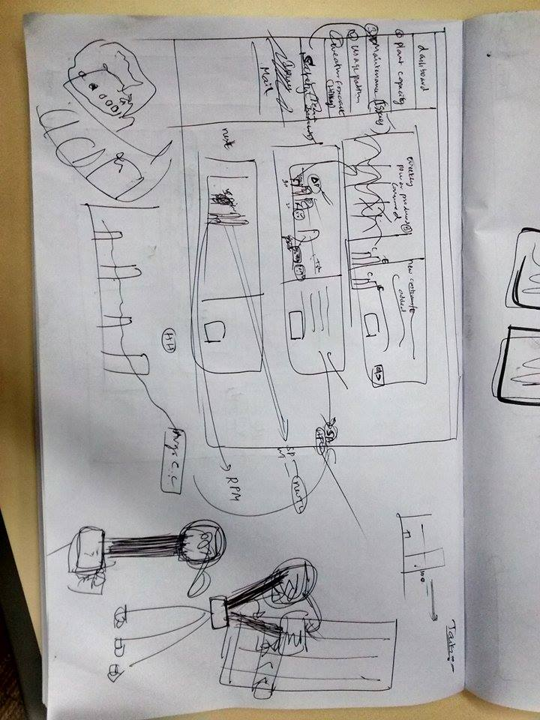

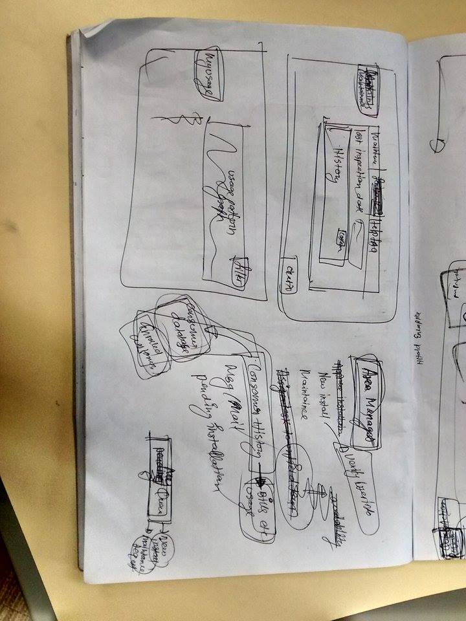
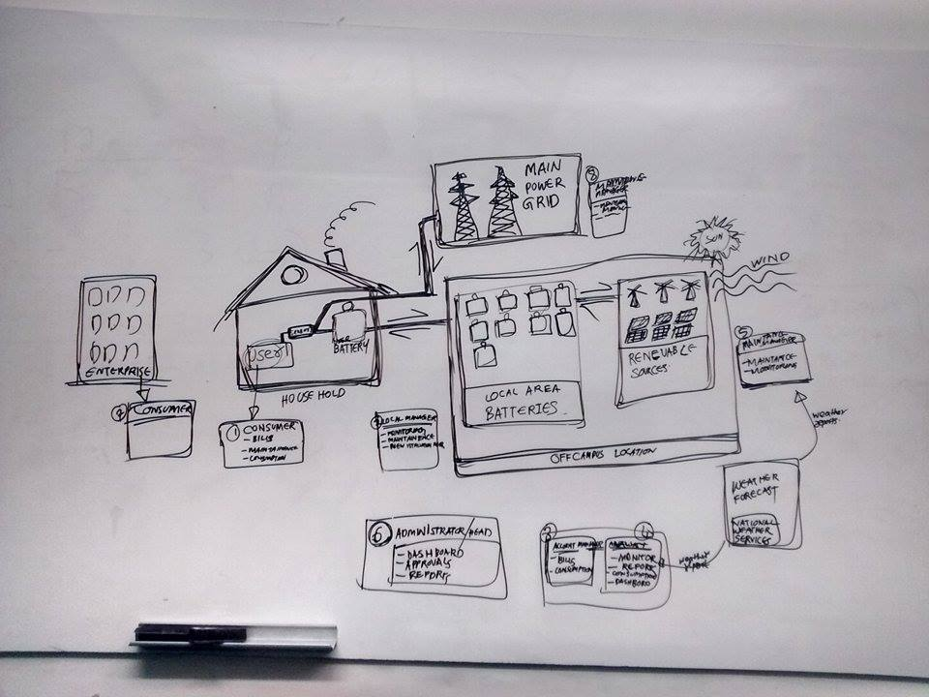
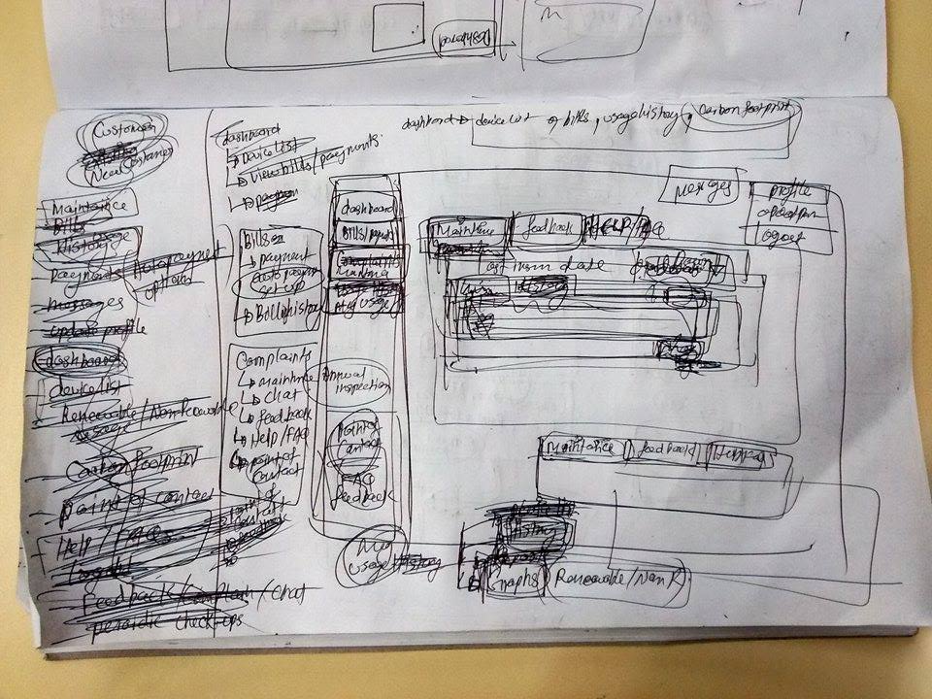
Need finding / Brain Storming

Slide 13
Personas

Slide 14

Personas: The Budget Conscious Consumer :
Scenario:
I am disappointed with the fluctuation in my power bills. Having an option, I could opt for an alternative power source which is reliable with long term benefits.
User Needs:
Can contribute a few extra bucks initially, if its an end to end managed system. Lower charges with transparency in bills.
The system safety is a concern. The service provider should be Authorized/Certified.
Easy hassle free request, approval and installation.
Easy maintenance with a single point of contact.
Uninterrupted power supply and automated switching from renewable to main power grid and vice versa
Usage history/patterns is easily accessible to better manage usage.
The setup including battery should take up less ‘home space’.
Demographics
Name
:
Jake
Age
:
30
Occupation
:
Clerk
Status
:
Married
Location
:
California
I need to reduce my power bills and better support my other family needs.
Frustrations:
Difficult to manage my budget with the fluctuation in power bills.
Less transparency in usage history/patterns .
Interruptions/Down-time in power supply leading to stagnant life situations.

Slide 15
Personas: The Environment Friendly Consumer :
Scenario:
I understand the impact of climate change and there is immediate need to step-up and opt for alternate sources. We should not take earth for granted.
User Needs:
The alternate energy source should be globally viable to solve the global warming issue.
The alternative should be based on renewable sources so that the solution is environment friendly and sustainable.
The system safety is a concern. The service provider should be Authorized/Certified.
Easy hassle free request, approval and installation.
Easy maintenance with a single point of contact.
Uninterrupted power supply and automated switching from renewable to main power grid and vice versa.
Demographics
Name
:
Leonardo
Age
:
41
Occupation
:
Actor
Status
:
Single
Location
:
California
I'm deeply concerned that climate change is a brewing crisis. If we don’t act now we will be forced to act later.
Frustrations:
Not many people are concerned about using alternate energy source to combat climate change.
Interruptions/Down-time in power supply leading to stagnant life situations.

Slide 16

Personas: Area Manager:
Scenario:
As I am the front facing to the customer I need to have easy access to all the information and tools required for serving customers.
User Needs:
There should be an efficient online system which will list all the tasks and action items and have tools to track their status online dynamically.
Monitor each enrolled house hold and address their requirements/concerns. Conduct periodic home equipment check-ups.
Process new installation and maintenance requests. Assign these requests to local on-filed team.
Report to the administrator about any problems she faces.
Get user feedback regarding customer satisfaction, improvement scope, utilization, etc.
Need to plan on-field team capacity planning to ensure uninterrupted customer services.
Demographics
Name
:
Iris
Age
:
26
Occupation
:
Area Mngr.
Status
:
Single
Frustrations:
Location
:
California
There is too much work to handle and require assistance to complete tasks.
It is difficult to keep track of requests and ensure they are serviced on time.
It is difficult to plan the capacity of the on-filed team and recruiting skilled workers accordingly.
It is demanding to make the on-filed team accountable for tasks assigned.
I need to address consumer problems and requests.

Slide 17
Personas: Project Accounts/Audit Manager:
Scenario:
I need to maintain and audit all financial transactions and history across the business. Report these and get approvals form the regularity authorities.
User Needs:
Maintain each consumer’s financial record.
Collate the consumer consumption from renewable and non-renewable plant mangers and generate a single bill for each customer.
Requires a way to monitor generated bills and keep a track of user payments and account history.
Collaborate with data-analyst and decide on the charging criteria per unit for the billing cycle. Get the approval for the same from project manager.
Monthly track defaulted (bill-payment) consumers and report the same to area manager.
Should conduct periodic audits to generate the overall profit-loss balance sheet for the business.
Need to manage employee pay-rolls.
Manage bills for new device orders and their maintenance. Decide on such approvals and forward them to the project manager for final approval.
Demographics
Name
:
Williams
Age
:
48
Occupation
:
Account Mgr.
Status
:
Married
Location
:
California
I maintain and audit all financial records across the business.
Frustrations:
Each financial record of the system should be up-to-date to ensure authentic bill generation.
For every billing cycle data is required form multiple stakeholders on time. Needs to process the data and send to the concerned stake-holders for approval. This data needs to be available and also processed within particular deadlines.

Slide 18
Personas: Plant Manager (Renewable):
Scenario:
Each day I need to ensure efficient productivity depending on availability of renewable sources and maintain the plant up and running with less down-time.
To keep a track of new connection requests and accordingly plan the power generation capacity of the plant.
Increased safety by providing a centralized source of information, reducing the need for physical contact with equipment.
Need an automated system to estimate power generation each day depending on the weather forecast.
Improve power quality by Identifying sources of "dirty" power and take corrective action to save wear and possible damage to critical production equipment and other loads.
Identify maintenance tasks and make scheduled corrections to asset damage and downtime. Report to account manager for approvals on new device orders and maintenance.
Ensure plant supports scalability- Open, comprehensive protocol and device support to easily integrate and expand existing systems and/or include a multitude of third-party devices in the system solution.
Quickly pinpoint the root cause of problems using tools such as time-tagged alarms, sequence of events logs and triggered waveform capture.
Higher Productivity - Free up maintenance and repair personnel to perform other needed duties. Need to plan on-field team capacity planning to ensure uninterrupted customer services.
Need to ensure the on-field team has undergone all necessary training and drills to handle the equipment in emergency/breakdown situations.
User Needs:
Demographics
Name
:
Jude
Age
:
28
Occupation
:
Plant Mngr.
Status
:
Single
Location
:
California
I need to maintain and monitor plant requirements, problems and requests.

Slide 19
Personas: Plant Manager (Renewable):
User needs (cont.)
Send the consumer consumption details to the account manager for bill generation.
Frustration:
There might occur unpredictable weather changes which will impact the power generation.
The on-field team may not be well trained to handle breakdown or emergency situations. They also may not be adequately trained in safety procedures.
It is tiresome to keep a track of any damage in the power equipment and schedule timely maintenance drills.
In case of demand for increase in power generation capacity, keeping a track of new equipment requests/approvals and its installation by the on-filed team is tedious.
Sometimes the number of On-filed staff may be inadequate to handle the smooth operation of the plant. Request/approval for new staff consumes a lot of time and effort.
Third party services may be needed to install/repair some equipment. These process may lack coordination and take longer than expected leading to operational down-times.
Demographics
Name
:
Jude
Age
:
28
Occupation
:
Plant Mngr.
Status
:
Single
Location
:
California
I need to maintain and monitor plant requirements, problems and requests.

Slide 20
Personas: Plant Manager (Non-Renewable):
Scenario:
Each day I need to ensure efficient productivity and maintain the plant up and running with less down-time.
User Needs:
Increased safety by providing a centralized source of information, reducing the need for physical contact with equipment.
Improve power quality by Identifying sources of "dirty" power and take corrective action to save wear and possible damage to critical production equipment and other loads.
Identify maintenance tasks and make scheduled corrections to asset damage and downtime. Report to account manager for approvals on new device orders and maintenance.
Ensure plant supports scalability- Open, comprehensive protocol and device support to easily integrate and expand existing systems and/or include a multitude of third-party devices in the system solution.
Quickly pinpoint the root cause of problems using tools such as time-tagged alarms, sequence of events logs and triggered waveform capture.
Higher Productivity - Free up maintenance and repair personnel to perform other needed duties. Need to plan on-field team capacity planning to ensure uninterrupted customer services.
Need to ensure the on-field team has undergone all necessary training and drills to handle the equipment in emergency/breakdown situations.
Send the consumer consumption details to the account manager for bill generation.
Demographics
Name
:
Jayden
Age
:
38
Occupation
:
Plant Mngr.
Status
:
Married
Location
:
California
I need to maintain and monitor plant requirements, problems and requests.

Slide 21
Personas: Plant Manager (Non-Renewable):
Frustration:
The on-field team may not be well trained to handle breakdown or emergency situations. They also may not be adequately trained in safety procedures.
It is tiresome to keep a track of any damage in the power equipment and schedule timely maintenance drills.
In case of demand for increase in power generation capacity, keeping a track of new equipment requests/approvals and its installation by the on-filed team is tedious.
Sometimes the number of On-filed staff may be inadequate to handle the smooth operation of the plant. Request/approval for new staff consumes a lot of time and effort.
Third party services may be needed to install/repair some equipment. These process may lack coordination and take longer than expected leading to operational down-times.
Demographics
Name
:
Jayden
Age
:
38
Occupation
:
Plant Mngr.
Status
:
Married
Location
:
California
I need to maintain and monitor plant requirements, problems and requests.

Slide 22
Personas: Project Manager:
Scenario:
I need to make this model a success by expanding it across all households and large enterprises in the city. Ensure reliable and quality service.
User Needs:
Analyze Dashboard and reports generated by data analyst and draft critical business plans based on them.
Manage all local managers and ensure smooth operation of all business processes.
Approve new plant equipment installation request from Plant Manager.
Monitor all consumer and Plant installations/maintenance bills.
Ensure the integrated power solution is cost-effective in a way that maximize power reliability, while optimizing equipment and energy costs.
Annually/Biannually check that the company policies support maintaining the infrastructure and system resources in parallel with the market trends.
Plan adequate marketing strategy to expand the service across the city.
Demographics
Name
:
Jasper
Age
:
41
Occupation
:
PM
Status
:
Married
Location
:
California
I need to make critical business decisions to successfully achieve the short and long term goals of the project.
Frustrations:
I need end to end and dynamic data in order to make critical business decisions effectively.
There is a need for an effective application which can be used to align business processes with the the business needs generated.

Slide 23
Personas: Data Analyst:
Scenario:
I need to make sure that the business data generated is converted to meaningful inferences using top notch analytical tools and also automate few analytics. Also my role is to find new business expansion areas/scope.
User Needs:
Extract data from the system, perform analytics, observe the patterns and report to the management.
Prepare dashboard for project manager with all the analytics relevant to the business.
Generate inferences from data related to consumer like their consumption patterns, bills, number of new installation requests, etc.
Extract weather forecast history, and generate inferences on weather patterns to better manage power production and estimate the power demand and supply.
Extract power generation data, perform analytics and report to the management.
Need the business data in a structured format for easier analytics.
Responsible for deciding the charging criteria based on the data collected from plant manager like operational cost, generation cost etc.
Demographics
Name
:
Mark
Age
:
31
Occupation
:
Analyst
Status
:
Single
Location
:
California
I need to analyze the business data generated and make valuable inferences.
Frustrations:
It is difficult to perform analytics if the business data generated is in unstructured format.
The application should capture data at every step of the process/work-request which will help in generating better inferences.

Slide 24
Information Architecture

Slide 25
Structure Plane:
Structuring Content: Top – down approach (Adoptable)
Architecture: Hierarchical structure
Categories organizing principles: Roles / Functionality
Sub categories organizing principles: Activities / Duties performed by selected role
Language and Metadata: Researched relevant power generation websites and followed similar nomenclature and metadata.
Information Architecture

Slide 26
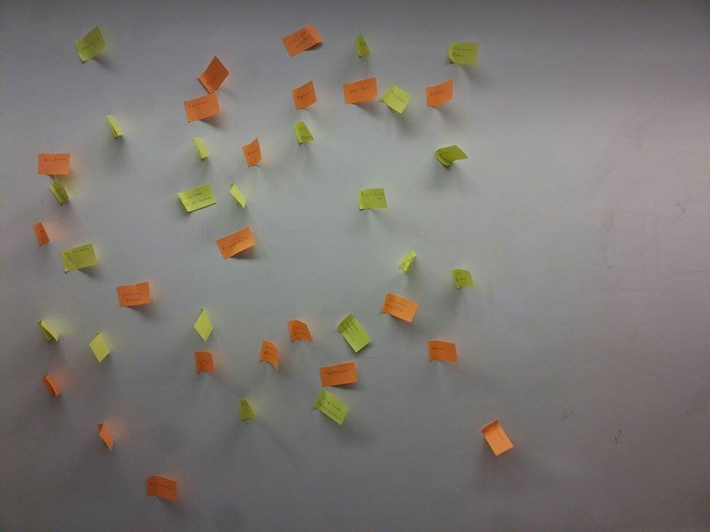
Information Architecture : Card Sorting

Slide 27
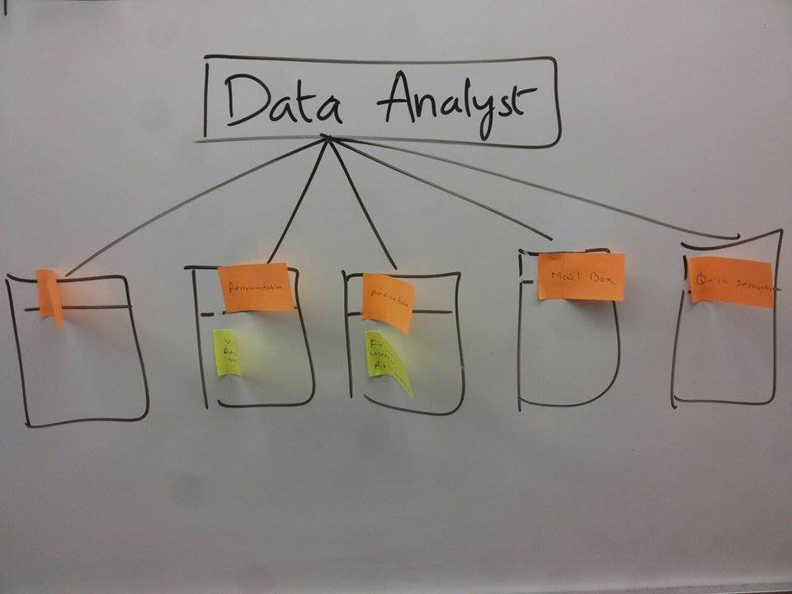
Information Architecture: Card Sorting

Slide 28
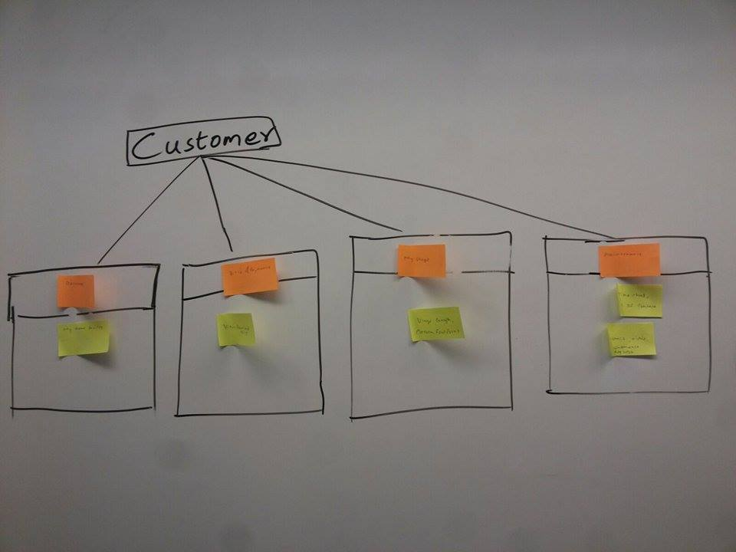
Information Architecture: Card Sorting

Slide 29
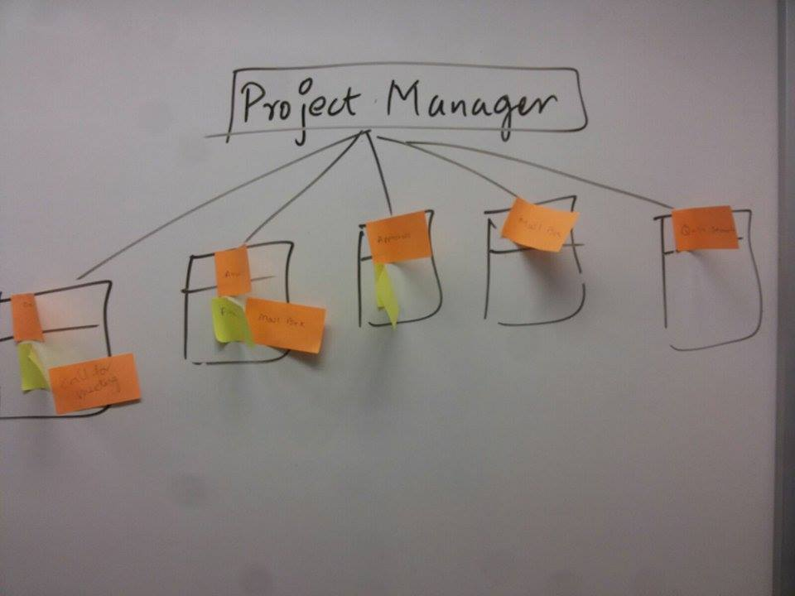
Information Architecture: Card Sorting

Slide 30
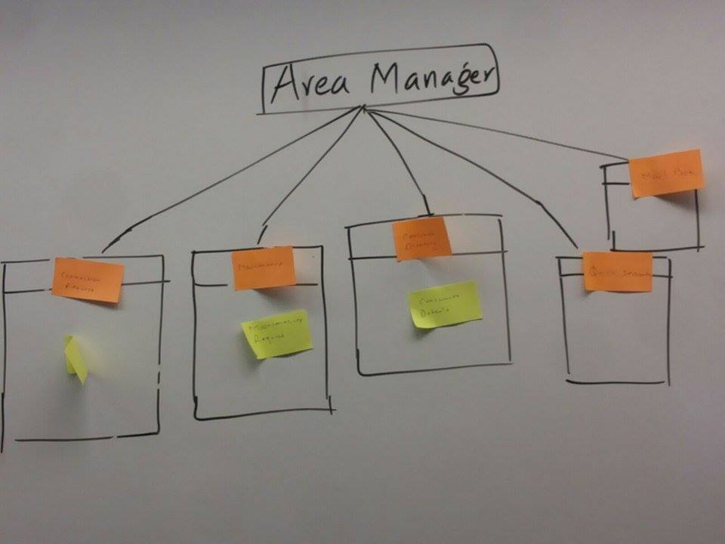
Information Architecture: Card Sorting

Slide 31
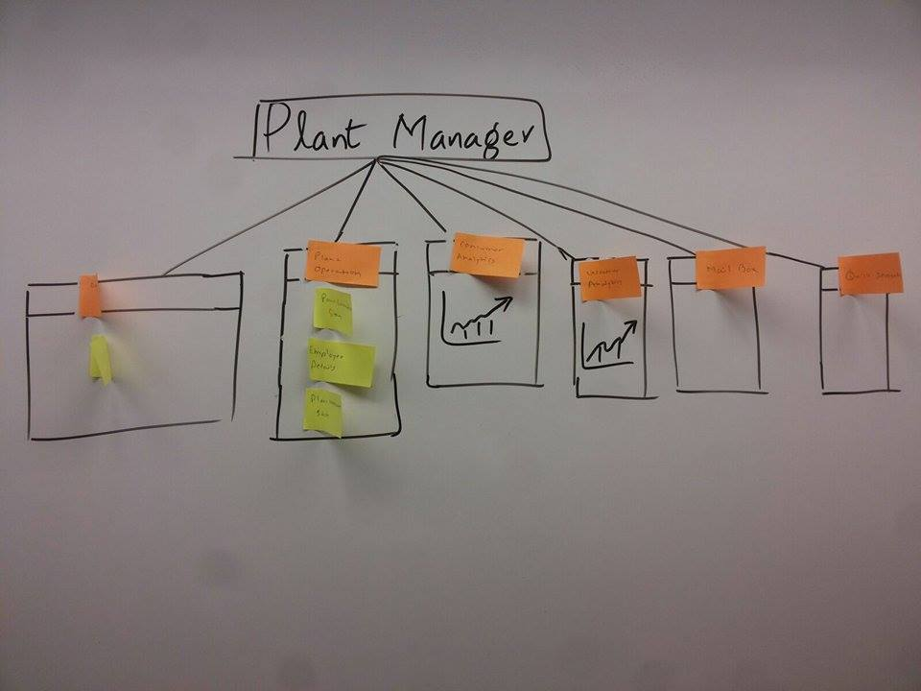
Information Architecture: Card Sorting

Slide 32
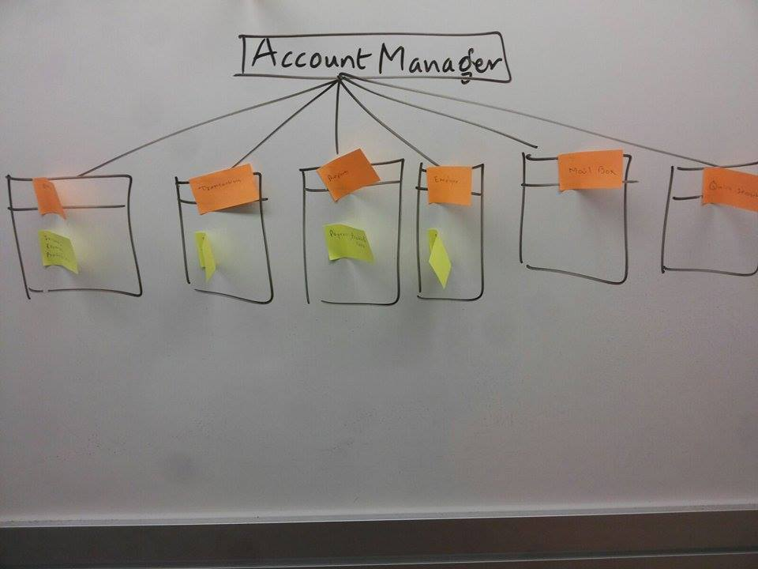
Information Architecture: Card Sorting

Slide 33
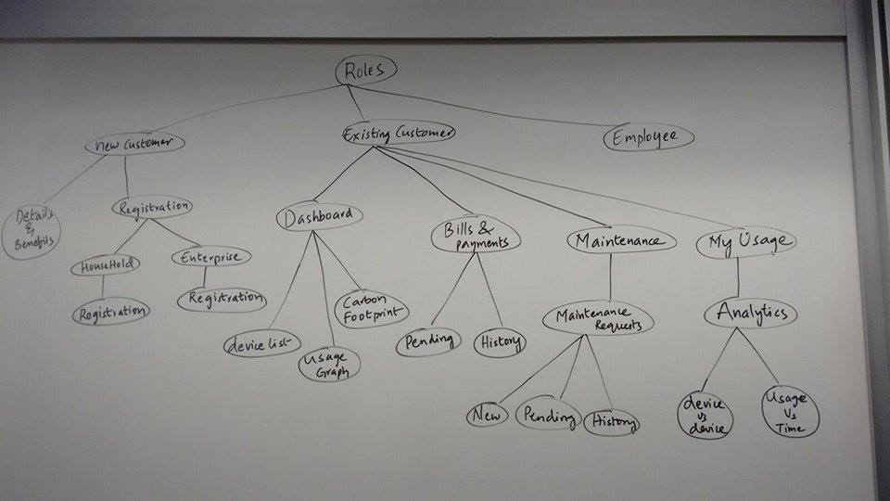
Information Architecture:

Slide 34
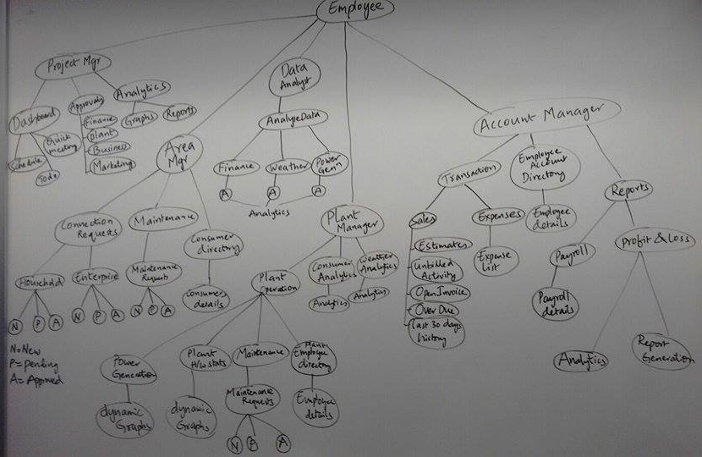
Information Architecture:

Slide 35
Information Architecture:
Roles
New Customer
Existing Customer
Employee
Details and Benefits
Dashboard
Registration
Bills and Pay
Maintenance
My Usage

Slide 36
Information Architecture:
Employee
Project Manager
Area Manager
Data Analyst
Plant Manager
Account Manager
Dashboard
Connection Requests
Finance
Plant Operations
Transactions
Approvals
Maintenance
Weather
Consumer Analytics
Employee Account Dir.
Analytics
Consumer directory
Power Generation
Weather Analytics
Reports
Mail Box
Mail Box
Mail Box
Mail Box
Mail Box
Quick Search
Quick Search
Quick Search
Quick Search
Quick Search

Slide 37
Information Architecture:
Project Manager
Dashboard
Approvals
Consumer directory
Mail Box
Quick Search
Schedule
Financial
Schedule
Quick Meetings
Plant Operations
Quick Meetings
To Do List
Marketing
To Do List
Graphs/
Reports
Graphs/
Reports

Slide 38
Information Architecture:
Project Manager
Dashboard
Approvals
Consumer directory
Mail Box
Quick Search
Global Navigation
Schedule
Financial
Schedule
Quick Meetings
Plant Operations
Quick Meetings
To Do List
Marketing
To Do List
Graphs/
Reports
Graphs/
Reports
Local Navigation

Slide 39
Information Architecture:
Area Manager
Connection Requests
Maintenance
Consumer Dir.
Mail Box
Quick Search
House Hold
Requests
Consumer Details
Enterprise

Slide 40
Information Architecture:
Data Analyst
Finance
Weather
Power Generation.
Mail Box
Quick Search
Analytics
Analytics
Analytics
Create New
Create New
Create New

Slide 41
Information Architecture:
Plant Manager
Plant Operations
Consumer Analytics
Weather analytics
Mail Box
Quick Search
Power generation
Analytics
Analytics
Plant Hardware
Maintenance
Employee Details

Slide 42
Information Architecture:
Account Manager
Transactions
Employee Account Dir.
Reports.
Mail Box
Quick Search
Sales
Employee Details
Report List
Expenses

Slide 43
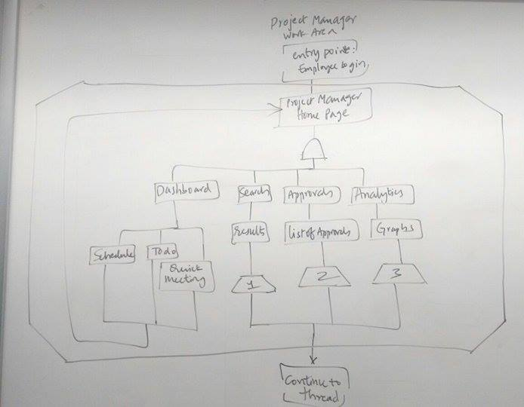
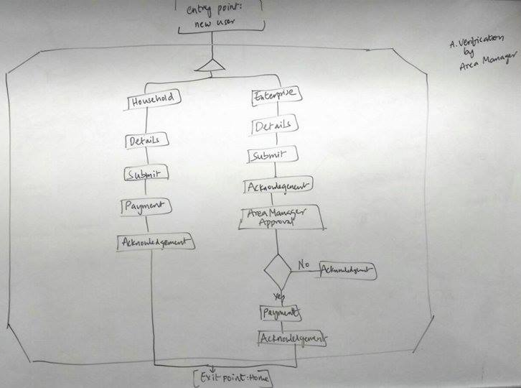
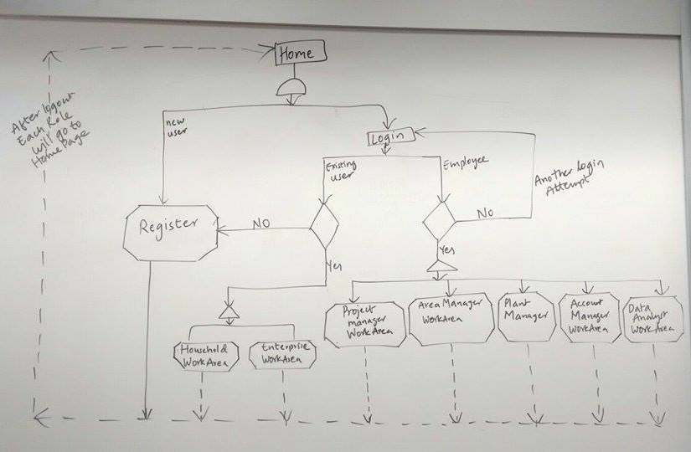
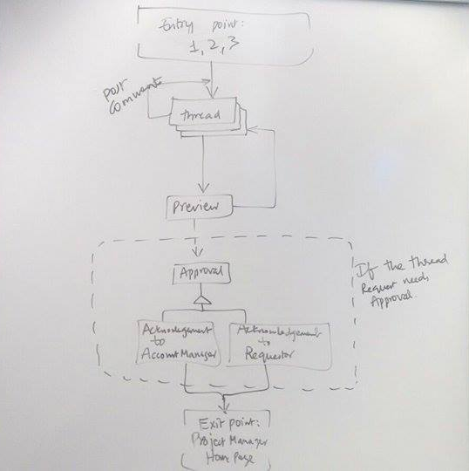
Information Architecture (Conditional Flow):

Slide 44
Information Architecture:
Home
Logout
New User
Login
Existing
User
Another login attempt
Employee
Register
No
Yes
Yes
Project Manager Work Area
Area Manager Work Area
Plant Manager Work Area
Account Manager Work Area
Data Analyst Work Area
Household workplace
Enterprise Workplace

Slide 45
Information Architecture:
Entry Point:
1, 2, 3
Post
Comments
thread
Preview
If the thread
Request needs approval
Approved
Acknowledgement to Account Manager
Acknowledgement to Account Requestor
Entry Point:
Project Mgr.
Home page

Slide 46
Information Architecture:
Entry Point:
Project Manager Login
Project Manager
Home Page
Dashboard
Sales
Approvals
Analytics
Results
List Of Approvals
Graphs
Quick monitoring
1
2
3
Schedule
To do
Continue to Thread

Slide 47
Information Architecture:
Entry Point:
New User
A verification by area manager
Household
Expertise
Details
Details
Submit
Submit
Payment
Acknowledgement
Acknowledgement
Area Mgr. approval
No
Acknowledgement
Yes
Payment
Acknowledgement
Entry Point:
Home

Slide 48
Paper Prototyping

Slide 49
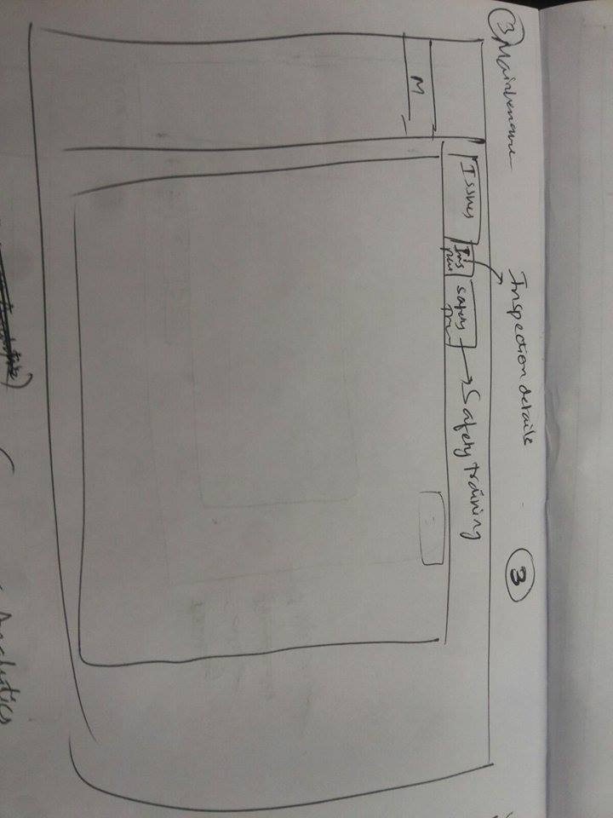
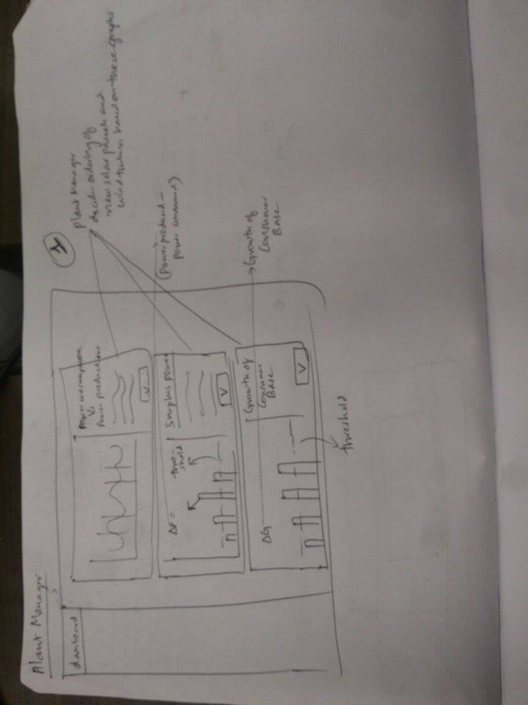
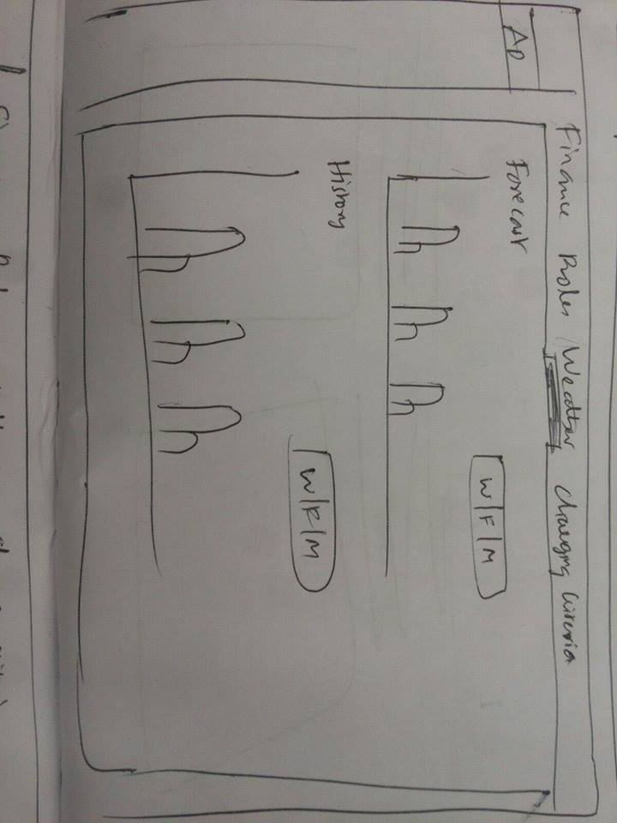
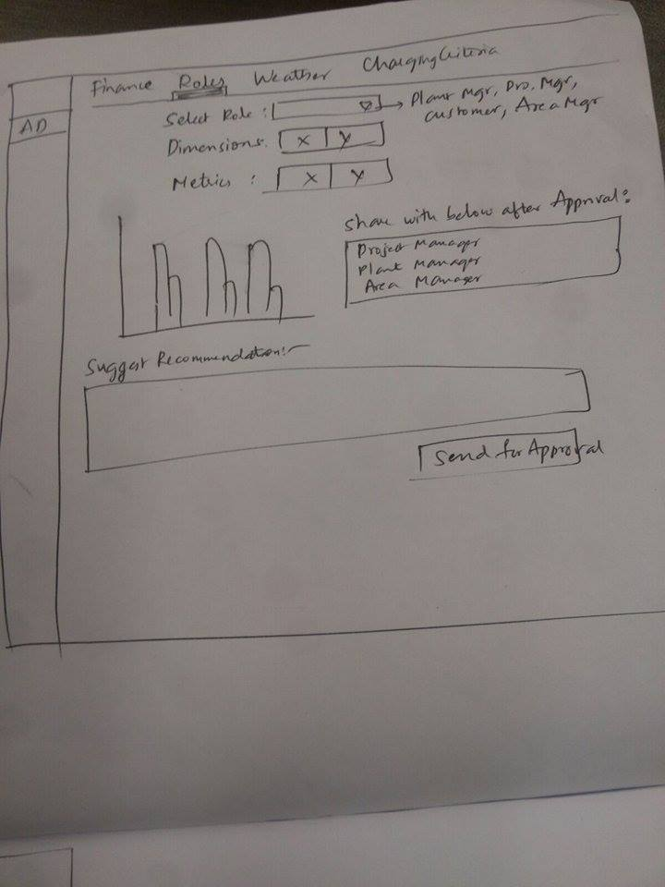
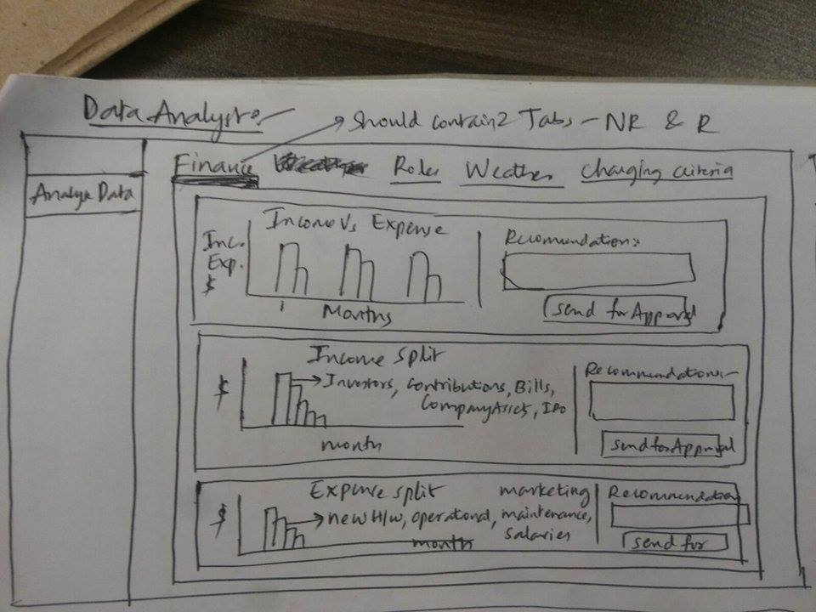
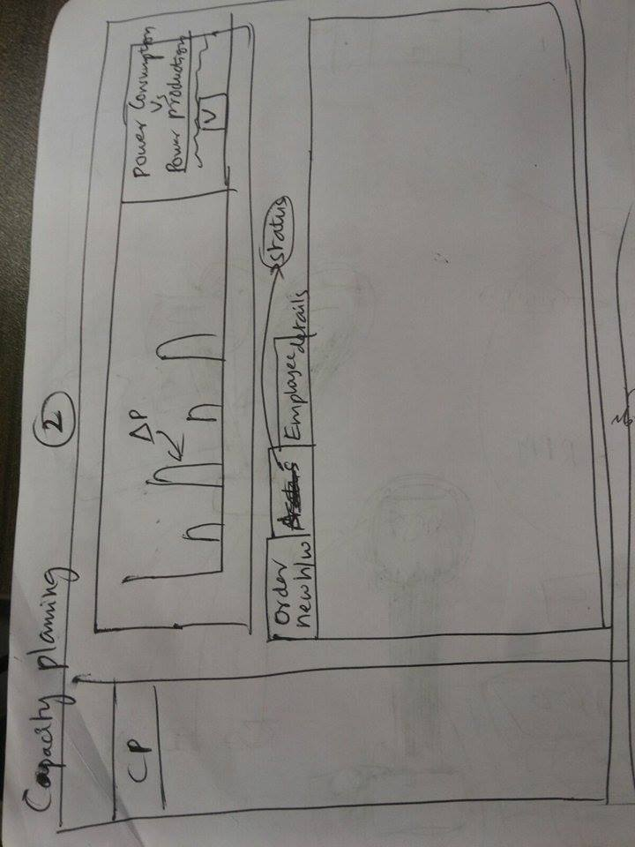
Paper Prototyping:

Slide 50
Wireframes
: https://app.moqups.com/jibinjohn100/dPUiaSghUr/view

Slide 51
Thanks!

