Slide 1


ERange
Renewable power management system in an integrated power generation set-up
Post Midterm
Team: Akhil Kailasam, Jibin John Jackson, Aditya Shinde
To open project: Go to folder “html” and click on “index.html”
NOTE:
Use one of the following user names to login:
AM(for area manager),
ACM(for account manager),
DA(for data analyst),
PM(for plant manager)
Customer.
Password can be anything.

Slide 2

We cover this presentation in following sections:
User research methods
Storyboarding
Usability testing
Automation Testing
Prototype
Feedback

Slide 3

User Research methods:

Slide 4
User Research Methods:
Dimension prioritized:
Behavioral > Attitudinal
Qualitative > Quantitative
Context of use: non-product user
Methods used:
Phone Interviews
Card sorting
Customer Feedback
Surveys

Slide 5
User Research Methods:
Phases of product development team:
Strategize - Inspire and explore
Methods used – Surveys, Reference sites
Execute – Optimize design
Methods used – Card Sorting, Paper prototype
Assess – Surveys, online assessments
Methods used – Online assessments, Surveys

Slide 6
Story Boarding

Slide 7

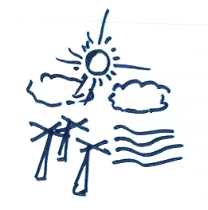


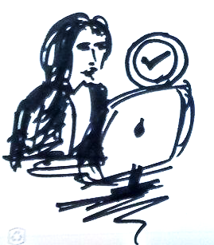
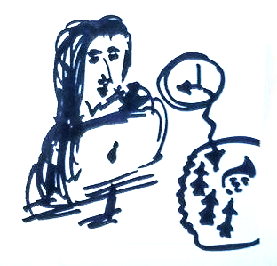
Story Boarding: Consumer and the Area Manager (New System Installation):
Decides to take up an alternative power source and looks out for options.
Learns about integrated power service, visits the online portal and reads about the monitory and environmental benefits of opting for the service.
Gets clarity on all doubts regarding safety among other things through FAQs and online chat support. Then submits an online application for a new connection.
The system auto-checks the availability of home-equipment and plant capacity
(a)redirects user to payment.
(b)sends for approval to the Area Manager.
The Area manager then checks the application details and verifies user information. She then grants the final approval for the service provision.
She also updates the system so that the plant manager is notified regarding new installations.

Slide 8
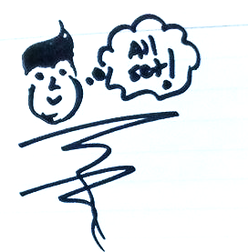
Story Boarding: Consumer and the Area Manager (New System Installation):
Once the home equipment is deployed and the connection is established the on-field team updates the system status and the customer is moved to the permanent consumer database.

Slide 9
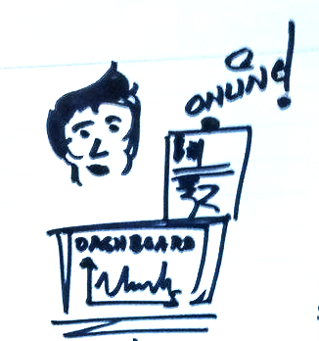

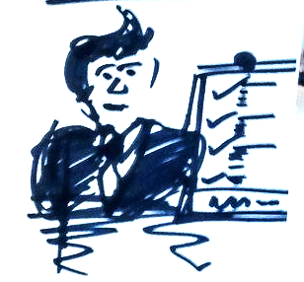
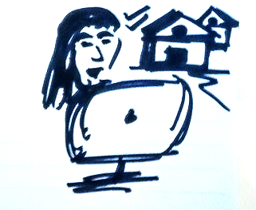
Story Boarding: Consumer and the Area Manager (Maintenance/Billing Installation):
The consumer can view and pay their bills online. They can also set up auto-payment options for hassle free payments. They can view their usage history/patterns and billing details on their dashboard.
In case of any maintenance or other issues, the consumer logs in to the portal and logs a complaint.
The Area manger attends to those issues either with the help of the on-field team for equipment related issues or collaborates with the accountant in case there is a billing issue.
She also keeps a track of billing defaulters and notifies them of the consequences.
She also keeps track of the periodic home-equipment check-ups by the on-field team.

Slide 10
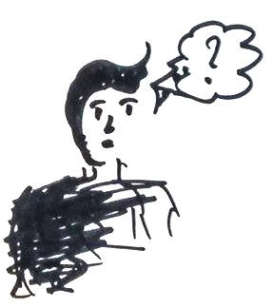
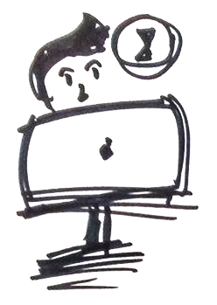
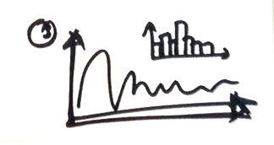
Story Boarding: Consumer (Power Usage):
The consumer is conscious of usage and needs to reduce on his energy bills.
He logs in to the system and accesses his usage history.
The usage history shows him floor-wise, room-wise and device-wise usage patterns.
Depending on these usage patterns he decides on how to better manage future energy bills.

Slide 11
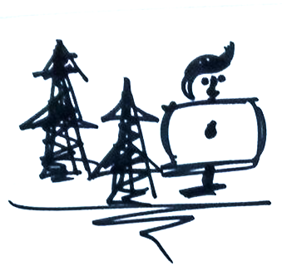
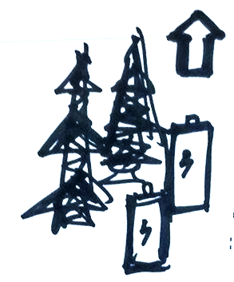
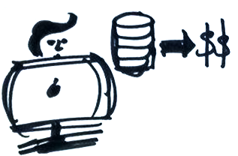
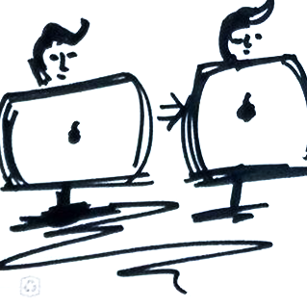

Story Boarding: Plant Manager and Project Manager(Scalability):
The plant manager keeps a track of the new connection requests i.e. the demand and accordingly plans the scalability of the plant.
If there is a surge in demand and he decides to scale up the power equipment in the plant.
He aggregates the related data, prepares a report and sends for approval to the Accounting manger for Budget Allocation.
On approval from the Accounting manager, he then forwards the request to the Project manager for final approval.
The Project Manager Approves the Request.
The Plant manager then places the order for the equipment required. The order details are also visible to the Accounting manager.

Slide 12
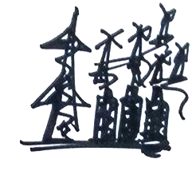
Story Boarding: Plant Manager and Project Manager(Scalability):
He then deploys the on-field team to install the equipment and ensures that the installation is complete.

Slide 13
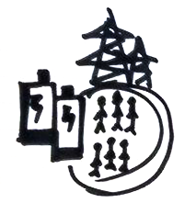
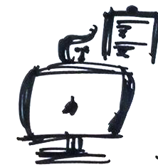
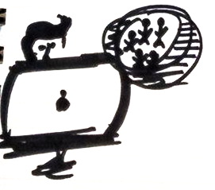
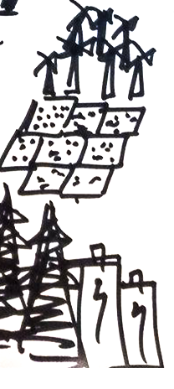
Story Boarding: Plant Manager (Safety and Maintenance):
The plant manager needs to ensure the safety of on-field staff and equipment.
He plans, executes and keeps a track of regular safety training procedures and drills for the staff.
He also makes sure that periodic maintenance check-ups of the on field equipment is carried out and keeps a track of the same.
He also keeps a track of how much electricity the solar panels and/or turbines produces on the basis of the incident solar radiation/wind speed and other environmental factors, such as temperature, and humidity. Thus keeping track of any faults in equipment.
Deploys team in case any discrepancies or unusual events are observed.

Slide 14
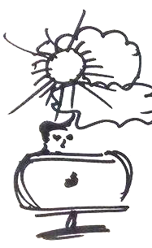
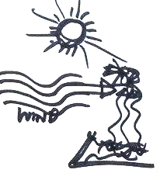
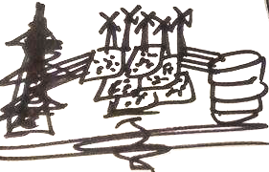
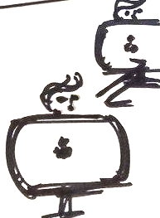
Story Boarding: Plant Manager (Weather Forecast):
The plant manager monitors weather patterns since planning power depends on renewable energy resources like wind, solar radiation and precipitation.
The model uses forecasts for wind speed, temperature, and humidity to predict the farm’s electricity output within xyz percent.
He then decides on the number of transmission lines to be employed to counterbalance transmission losses.
He sends a report of this to the main-power grid manager. He there-by decides on the approximate back-up generation they need to keep online, and thus reduce costs.

Slide 15
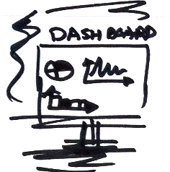
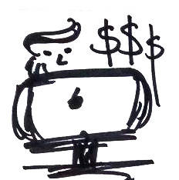
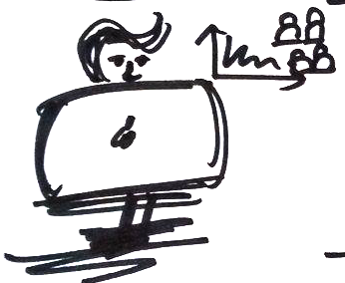
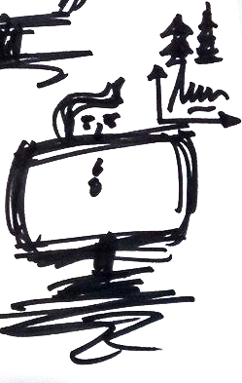
Story Boarding: Project Manager:
The project manager has a dashboard giving him overall analytical reports of all the business processes.
He looks at the financial plots and decides on the budget allocation of the project.
He looks at plots related to demographics of the consumers and decides on the target market group.
He will keep a check of the power generation capacity and demand statistics and decide on the pace of business expansion.

Slide 16
Usability Testing:

Slide 17
Usability Testing
Procedure followed:
Prepared usability tasks prior performing test
Consent form
Welcome and purpose
Questions to know the subject profile and make him feel comfortable
The home page tour
Tasks
Identify top 5 usability problems
Assess impact and solution for each usability problem

Slide 18
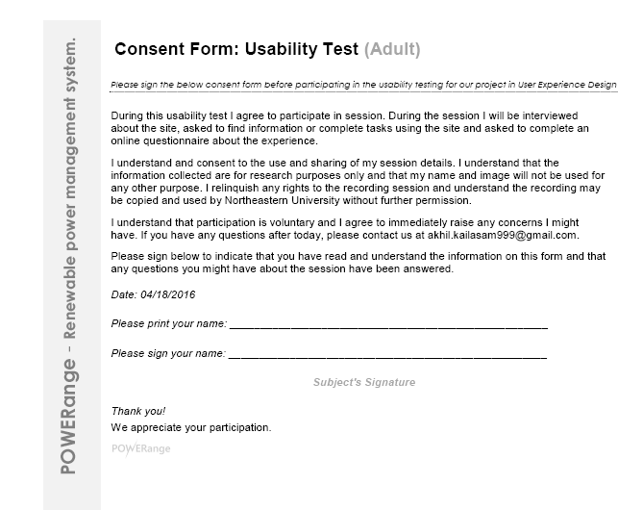
Usability Testing

Slide 19
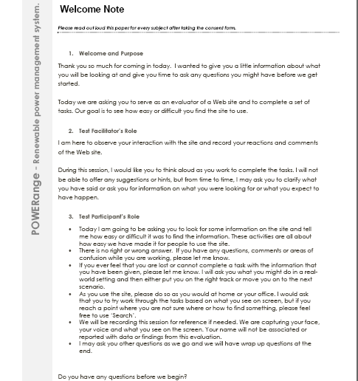
Usability Testing

Slide 20
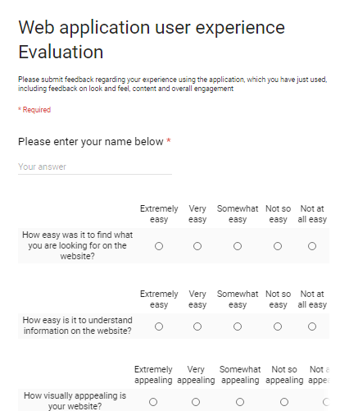
Usability Testing

Slide 21
Automation Testing :

Slide 22
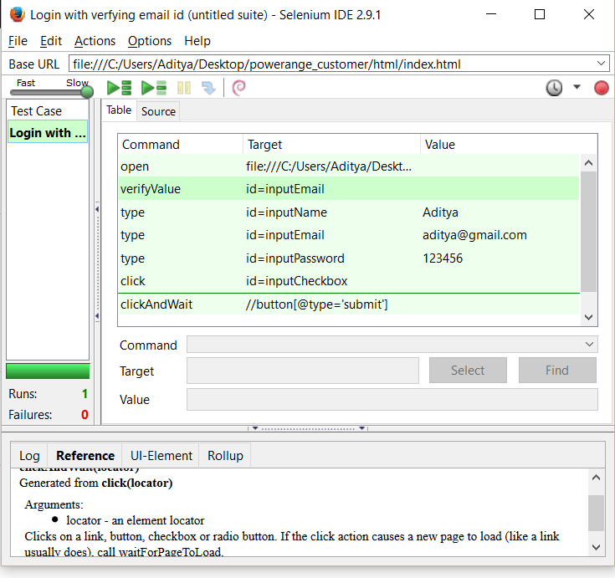
Automation test cases:
Check Login page functionality: Here we verify functionality of login button, text box

Slide 23
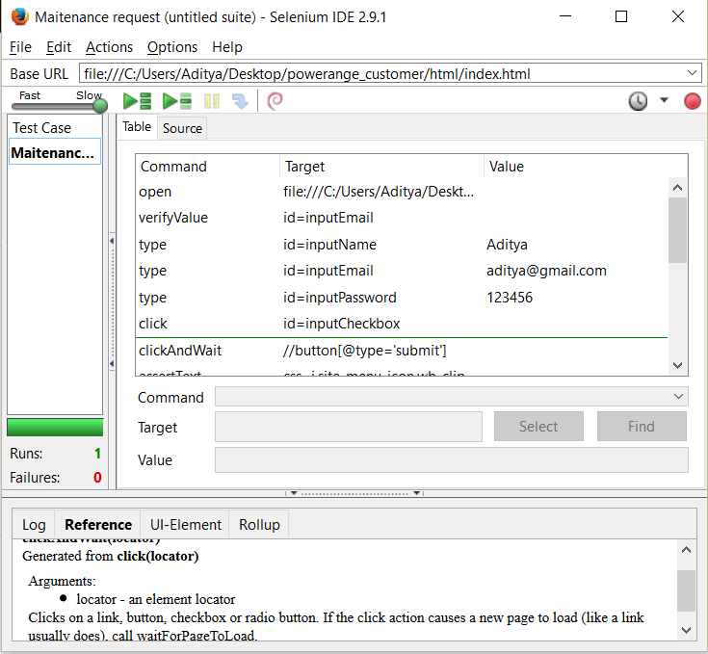
Automation test cases:
Check functionality Maintenance Request: Here we test whether user
able to raise maintenance request

Slide 24
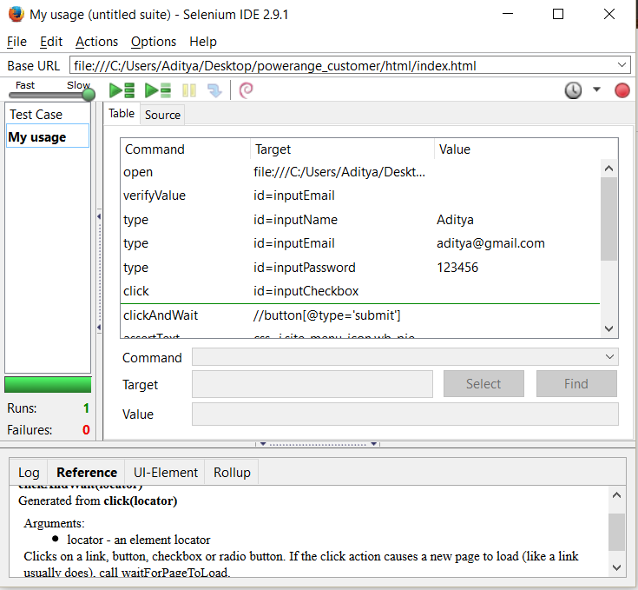
Automation test cases:
Check functionality of customer usage pattern

Slide 25
Automation test cases:
NOTE:
Since we have changed the home page and certain parameters towards the end, so all test cases may not work. If needed you can contact us and arrange to show the test case demo on the old code.

Slide 26
Project Prototype

Slide 27
Prototype:
To open project: Go to folder “html” and click on “index.html”
NOTE:
Use one of the following user names to login:
AM(for area manager),
ACM(for account manager),
DA(for data analyst),
PM(for plant manager)
Customer.
Password can be anything.

Slide 28
User Experience
Ease of use
interacting / user engagement
look and feel of application (UI)
3 click rule
user satisfaction
persona (beginner, advance, new/returning, on-boarding)
control / User control
fun interacting with website
less time / effort
stability / operation / fault tolerance / traffic management
consistency / standardization
what next for users action
color choices
features
accessibility
Graphs - lazy loading
screen resolution / responsive design - Bootstrap
font sizes
right balance
Maintain trust of the user – Consistent info
visual analytics

Slide 29
Work Distribution

Slide 30
Work Distribution - Midterm
Akhil Kailasam
Jibin Jackson
Aditya Shinde
-The Gist
-The Problem Addressed
-The Solution
-Solution Highlights
-The Gist
-The Problem Addressed
-The Solution
-Solution Highlights
-The Gist
-The Problem Addressed
-The Solution
-Solution Highlights
-Need Finding
-Brain Storming
-Paper Prototyping
-Need Finding
-Brain Storming
-Paper Prototyping
-Need Finding
-Brain Storming
-Paper Prototyping
-Personas
-Story-Boarding
-Information Architecture
-Wire-framing(Data Analyst,
Project Manager)
-Personas
-Story-Boarding
-Information Architecture
-Wire-framing(Area Manager,
Plant Manager)
-Personas
-Information Architecture
-Wire-framing(Home Page,
Consumer, Account Manager)

Slide 31
Work Distribution -Final
Akhil Kailasam
Jibin Jackson
Aditya Shinde
Prototype coding
User research methods
Usability Testing
Prototype coding
User research methods
Usability Testing
Prototype coding
User research methods
Automation testing

Slide 32
Thanks!

